Slide 1

International Trade and Trade Policy
Chapter 9
Principles of Micro
Trade creates national gains and real local losses
Mark Wilson
Notes:
Reconnect the chapter to comparative advantage. Chapter 2 explained why specialization creates gains; this chapter shows those gains and losses inside a domestic market.
[Sources]
- Principles of Micro, Chapter 9: International Trade and Trade Policy (current project draft).
- Cover artwork: design/book-cover/principles-of-micro-cover.png (project-generated asset).
[/Sources]

Slide 2
CHAPTER 9
Comparative advantage now enters a domestic market
Trade lets domestic buyers and sellers compare their price with a world price.
•
A lower world price leads to imports.
•
A higher world price leads to exports.
•
In both cases, total surplus rises in the small-country benchmark.
PRINCIPLES OF MICRO
2
Notes:
Make the bridge to Chapter 2 explicit. The production logic becomes a supply-and-demand welfare analysis.
[Sources]
- Principles of Micro, Chapter 9: International Trade and Trade Policy (current project draft).
[/Sources]

Slide 3
CHAPTER 9
The world price tells a small country whether to import or export
WORLD PRICE BELOW NO-TRADE PRICE
WORLD PRICE ABOVE NO-TRADE PRICE
Import
Export
Domestic buyers want more than domestic sellers produce at the world price.
Domestic sellers produce more than domestic buyers purchase at the world price.
The gap between domestic demand and domestic supply is trade.
PRINCIPLES OF MICRO
3
Notes:
Define the small-country benchmark: domestic buying and selling do not move the world price. This is a simplifying benchmark, not a claim about every country and product.
[Sources]
- Principles of Micro, Chapter 9: International Trade and Trade Policy (current project draft).
[/Sources]

Slide 4
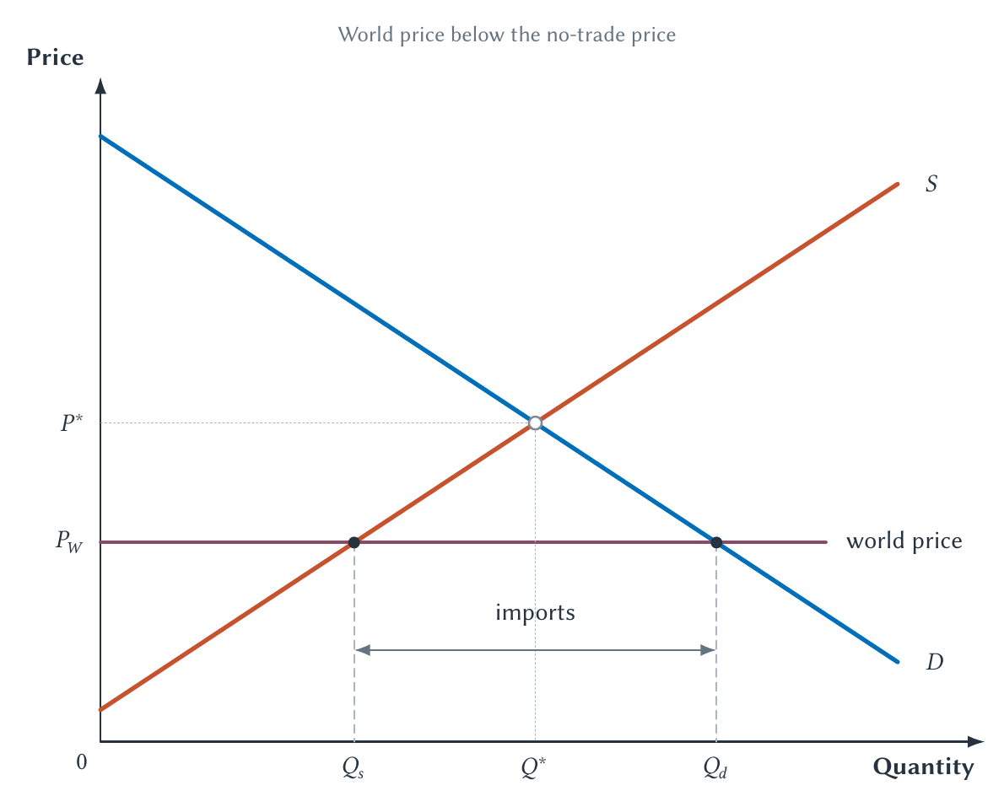
CHAPTER 9
A lower world price creates imports
Buyers purchase more, domestic producers sell less, and imports fill the gap.
PRINCIPLES OF MICRO
4
Notes:
Have students identify the two domestic quantities before measuring imports. The world supply is represented by a horizontal price line in the small-country benchmark.
[Sources]
- Principles of Micro, Chapter 9: International Trade and Trade Policy (current project draft).
- Project-reviewed Chapter 9 figures from figures/ch09_international_trade_and_trade_policy/.
[/Sources]

Slide 5
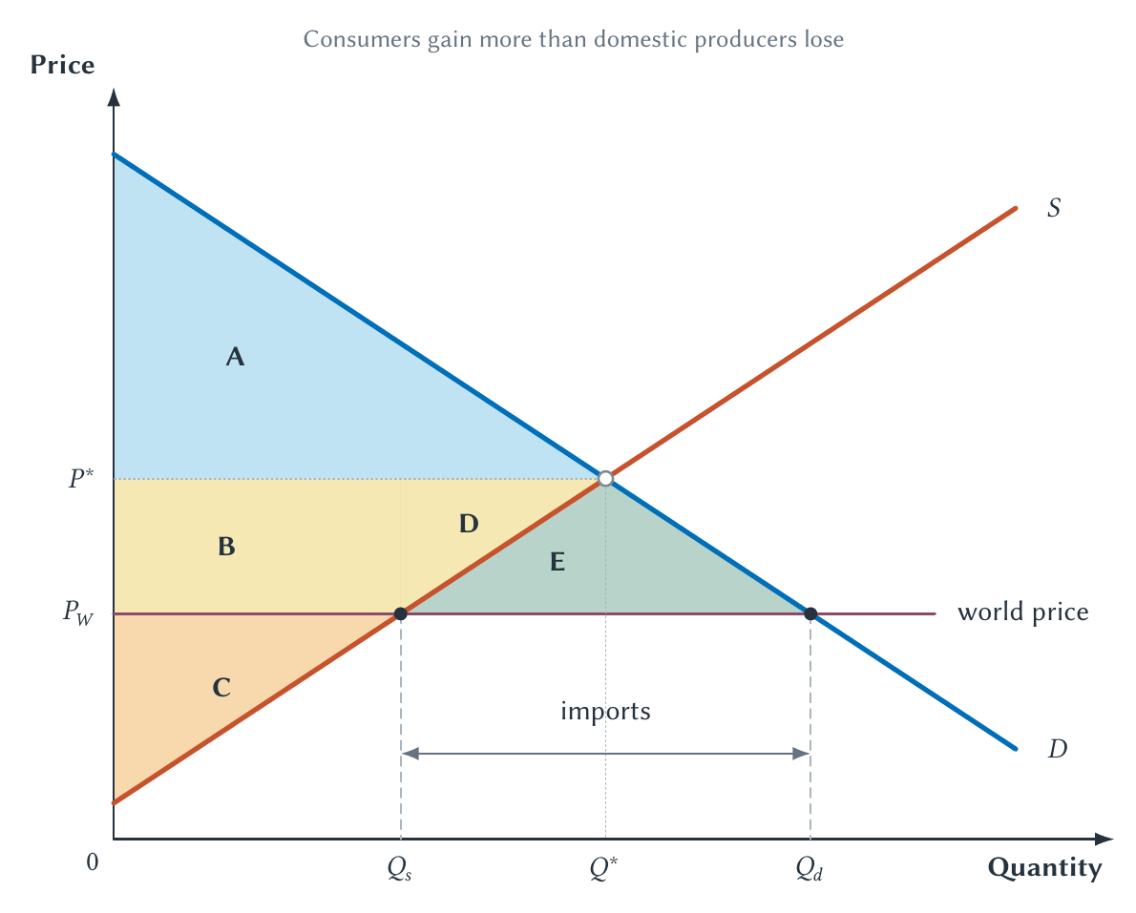
CHAPTER 9
Imports create gains larger than the producer loss
Consumers gain, producers lose, and the consumer gain is larger.
PRINCIPLES OF MICRO
5
Notes:
Use the letters to show the transfer from producers to consumers separately from the two net-gain triangles.
[Sources]
- Principles of Micro, Chapter 9: International Trade and Trade Policy (current project draft).
- Project-reviewed Chapter 9 figures from figures/ch09_international_trade_and_trade_policy/.
[/Sources]

Slide 6
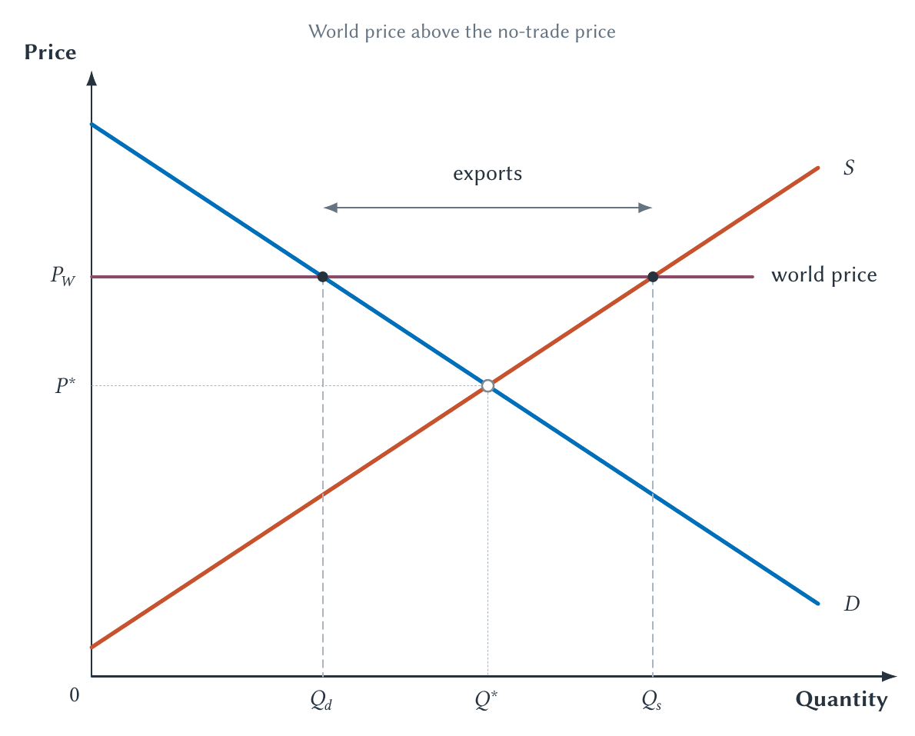
CHAPTER 9
A higher world price creates exports
Domestic producers sell more, domestic consumers buy less, and the rest is exported.
PRINCIPLES OF MICRO
6
Notes:
Again identify the two domestic quantities first. Exports are not a separate curve; they are the horizontal gap at the world price.
[Sources]
- Principles of Micro, Chapter 9: International Trade and Trade Policy (current project draft).
- Project-reviewed Chapter 9 figures from figures/ch09_international_trade_and_trade_policy/.
[/Sources]

Slide 7
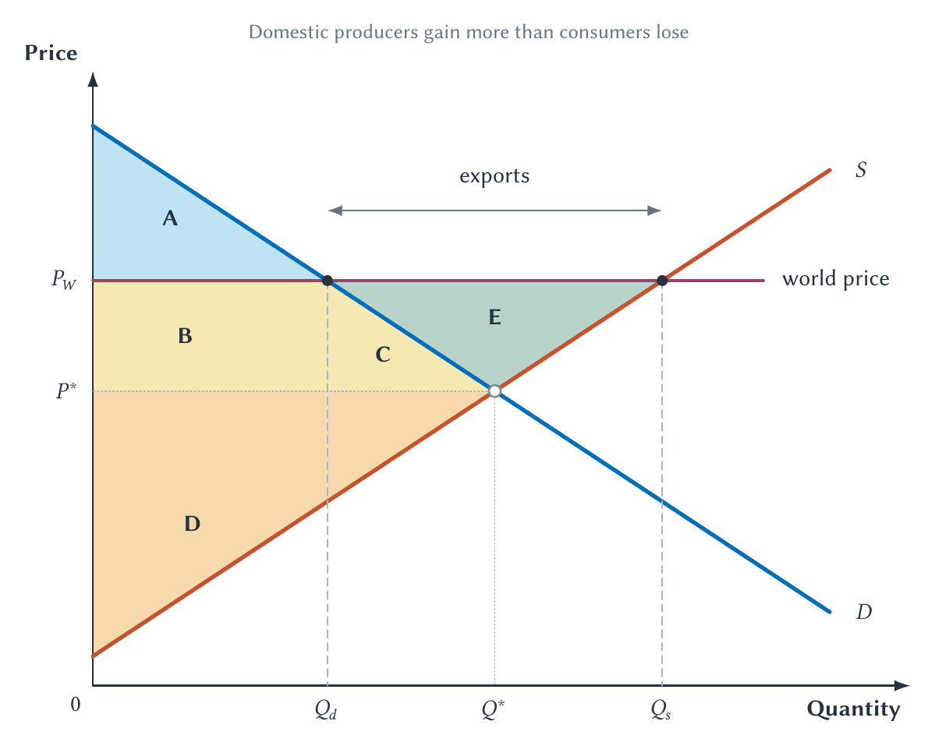
CHAPTER 9
Exports create gains larger than the consumer loss
Producers gain, consumers lose, and the producer gain is larger.
PRINCIPLES OF MICRO
7
Notes:
Keep the symmetry with imports. Trade changes who gains inside the country, but total surplus rises in the benchmark.
[Sources]
- Principles of Micro, Chapter 9: International Trade and Trade Policy (current project draft).
- Project-reviewed Chapter 9 figures from figures/ch09_international_trade_and_trade_policy/.
[/Sources]

Slide 8
CHAPTER 9
Trade can be good for the country and painful for a community
A national net gain does not mean every worker, firm, or town gains.
•
Losses may be concentrated in one industry or place.
•
Workers may have skills tied to declining employers.
•
Moving, retraining, and rebuilding local networks take time.
PRINCIPLES OF MICRO
8
Notes:
This distinction is essential in a Rust Belt classroom. Acknowledge concentrated loss without confusing it with the national total-surplus result.
[Sources]
- Principles of Micro, Chapter 9: International Trade and Trade Policy (current project draft).
- David H. Autor, David Dorn, and Gordon H. Hanson, The China Syndrome, American Economic Review 103(6), 2013.
[/Sources]

Slide 9
CHAPTER 9
Trade creates gains through more than one channel
LOWER COST
GREATER VARIETY
Buy at a better price
Choose among more products
Imports let buyers obtain some goods below the domestic no-trade price.
Consumers also gain from access to imported varieties not captured by a one-good diagram.
The standard graph may understate some consumer gains from trade.
PRINCIPLES OF MICRO
9
Notes:
Keep the variety result qualitative. It adds to the mechanism rather than replacing the supply-and-demand analysis.
[Sources]
- Principles of Micro, Chapter 9: International Trade and Trade Policy (current project draft).
- Christian Broda and David E. Weinstein, Globalization and the Gains from Variety, Quarterly Journal of Economics 121(2), 2006.
[/Sources]

Slide 10
CHAPTER 9
A tariff is a tax on imports
A tariff raises the domestic price above the world price.
•
Consumers buy less.
•
Domestic producers sell more.
•
Imports fall.
•
Government collects tariff revenue.
PRINCIPLES OF MICRO
10
Notes:
Link directly to Chapter 7. The tariff creates a wedge between the world opportunity cost and the domestic price.
[Sources]
- Principles of Micro, Chapter 9: International Trade and Trade Policy (current project draft).
[/Sources]

Slide 11
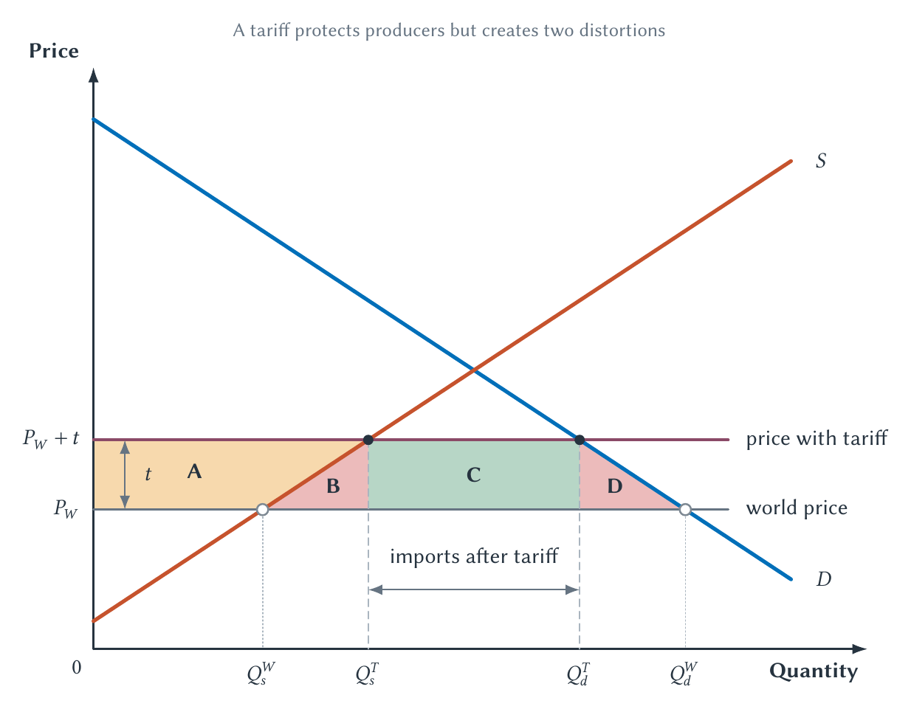
CHAPTER 9
A tariff protects producers by taxing domestic consumers
Part of the consumer loss becomes producer surplus and revenue; two triangles are lost.
PRINCIPLES OF MICRO
11
Notes:
Identify the production-distortion triangle and consumption-distortion triangle. Do not describe the producer transfer as a national loss.
[Sources]
- Principles of Micro, Chapter 9: International Trade and Trade Policy (current project draft).
- Project-reviewed Chapter 9 figures from figures/ch09_international_trade_and_trade_policy/.
[/Sources]

Slide 12
CHAPTER 9
Washing-machine tariffs changed more than imports
•
Prices of protected washing machines rose.
•
Dryer prices also rose even though dryers were not covered by the same tariff.
•
Foreign producers changed production locations.
•
The cost per job created was high relative to typical earnings.
Firms and consumers adjust around the written rule.
PRINCIPLES OF MICRO
12
Notes:
Use this as an unintended-consequences application, not a universal estimate for every tariff.
[Sources]
- Principles of Micro, Chapter 9: International Trade and Trade Policy (current project draft).
- Aaron Flaaen, Ali Hortacsu, and Felix Tintelnot, The Production Relocation and Price Effects of US Trade Policy: The Case of Washing Machines, American Economic Review 110(7), 2020.
[/Sources]

Slide 13
CHAPTER 9
A quota limits quantity instead of taxing each import
A binding quota raises the domestic price and reduces imports much like a tariff.
The key difference is who receives the quota rent.
PRINCIPLES OF MICRO
13
Notes:
Explain quota rent as the value of the right to import at the world price and sell at the higher domestic price.
[Sources]
- Principles of Micro, Chapter 9: International Trade and Trade Policy (current project draft).
[/Sources]

Slide 14
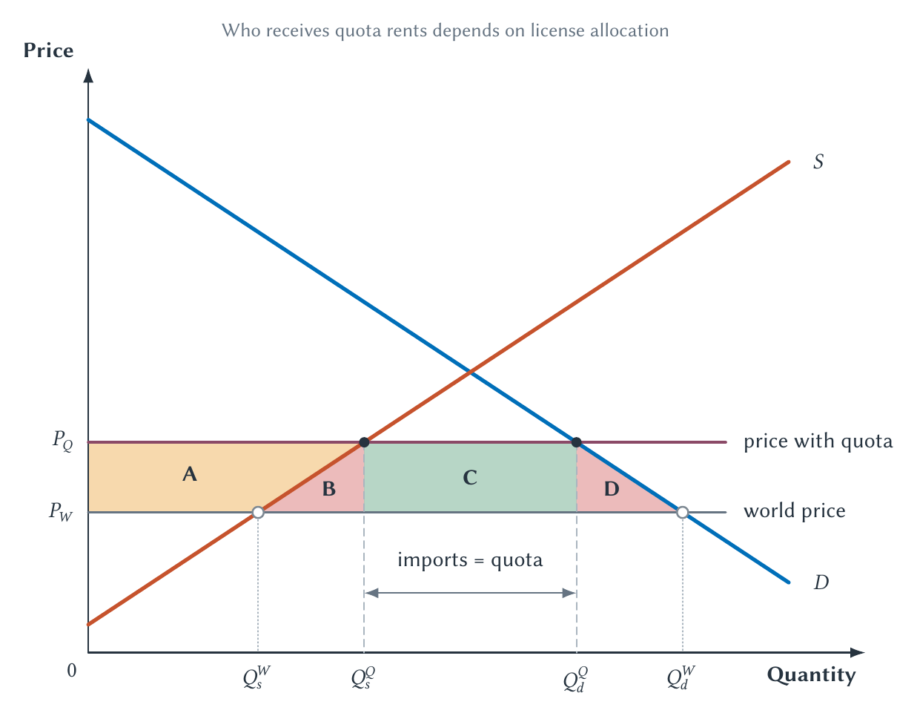
CHAPTER 9
Quota rents replace tariff revenue
A quota can copy a tariff's quantity effect while sending the revenue somewhere else.
PRINCIPLES OF MICRO
14
Notes:
Ask who owns the import licenses. If foreign exporters capture the rents, the domestic national loss is larger than when the government auctions them.
[Sources]
- Principles of Micro, Chapter 9: International Trade and Trade Policy (current project draft).
- Project-reviewed Chapter 9 figures from figures/ch09_international_trade_and_trade_policy/.
[/Sources]

Slide 15
CHAPTER 9
Arguments for trade restrictions ask different questions
Argument
Economic question
Jobs and communities
Are losses concentrated, persistent, and cheaper to address directly?
Infant industry
What prevents private investors from financing a promising new industry?
National security
Is the product truly essential, and is the policy narrowly targeted?
Unfair trade
Does retaliation improve bargaining or mainly tax domestic buyers?
Revenue
Is a tariff the least costly way to raise government funds?
A serious argument names the problem and compares remedies.
PRINCIPLES OF MICRO
15
Notes:
Treat national security as potentially legitimate when the claim is true. Do not let a broad label substitute for evidence or policy design.
[Sources]
- Principles of Micro, Chapter 9: International Trade and Trade Policy (current project draft).
[/Sources]

Slide 16
CHAPTER 9
National security can justify resilience, but not every tariff
REAL SECURITY CONCERN
LOOSE INVOCATION
A disruption threatens essential capacity
Security becomes a slogan
Stockpiles, diversified sourcing, domestic capacity, or allied production may be warranted.
A broad tariff can protect ordinary producers while imposing larger costs on users and downstream firms.
Match the policy to the vulnerability.
PRINCIPLES OF MICRO
16
Notes:
Use a specific hypothetical product and ask which remedy addresses the exact risk at least cost.
[Sources]
- Principles of Micro, Chapter 9: International Trade and Trade Policy (current project draft).
[/Sources]

Slide 17
CHAPTER 9
Protection is politically durable because gains and losses are organized differently
PROTECTED INDUSTRY
CONSUMERS
Large gain per firm or worker
Small cost per purchase
The group has a strong reason to organize, lobby, and remain attentive.
The total cost may be large, but each buyer has little reason to organize around one product.
Concentrated benefits often receive more political attention than dispersed costs.
PRINCIPLES OF MICRO
17
Notes:
This is the public-choice link from Chapter 8. It explains political durability, not whether every restriction is unjustified.
[Sources]
- Principles of Micro, Chapter 9: International Trade and Trade Policy (current project draft).
[/Sources]

Slide 18
CHAPTER 9
Trade rules grew from retaliation toward negotiated limits
1930
1947
1995
Smoot-Hawley
GATT
WTO
→
→
The United States raised many tariffs and trading partners retaliated.
Countries negotiated reciprocal tariff reductions and shared rules.
The system expanded into a standing institution for trade rules and disputes.
Rules can make mutually beneficial restraint more credible.
PRINCIPLES OF MICRO
18
Notes:
Do not claim Smoot-Hawley single-handedly caused the Great Depression. The durable point is that protection invites retaliation and negotiated rules can reduce that risk.
[Sources]
- Principles of Micro, Chapter 9: International Trade and Trade Policy (current project draft).
- U.S. Senate Historical Office, The Senate Passes the Smoot-Hawley Tariff; World Trade Organization, The GATT Years: From Havana to Marrakesh.
[/Sources]

Slide 19
CHAPTER 9
The honest conclusion is stronger than a slogan
Trade raises total surplus, but it does not compensate every person who loses.
•
Protecting an industry transfers income and creates deadweight loss.
•
Some security or transition problems can be real.
•
The best response usually targets the problem more directly than a broad tariff.
PRINCIPLES OF MICRO
19
Notes:
The chapter should be clearly pro-trade without pretending adjustment costs are imaginary.
[Sources]
- Principles of Micro, Chapter 9: International Trade and Trade Policy (current project draft).
[/Sources]

Slide 20
CHAPTER 9
Trade changes prices, production, and who gains
•
A lower world price creates imports and consumer gains larger than producer losses.
•
A higher world price creates exports and producer gains larger than consumer losses.
•
Tariffs and quotas protect domestic producers by raising domestic prices.
•
National gains can coexist with severe local adjustment costs.
Next: externalities arise when market prices leave out costs or benefits.
PRINCIPLES OF MICRO
20
Notes:
Close by asking students to identify the winners, losers, and net effect of one import or export example without calculating areas.
[Sources]
- Principles of Micro, Chapter 9: International Trade and Trade Policy (current project draft).
[/Sources]

