Slide 1

Externalities and Property Rights
Chapter 10
Principles of Micro
When prices leave out costs or benefits, institutions must bring them back in
Mark Wilson
Notes:
Begin with a familiar activity whose market price omits a cost imposed on someone outside the trade. The chapter's task is to restore that missing cost or benefit to decision making.
[Sources]
- Principles of Micro, Chapter 10: Externalities and Property Rights (current project draft).
- Cover artwork: design/book-cover/principles-of-micro-cover.png (project-generated asset).
[/Sources]

Slide 2
CHAPTER 10
An externality reaches someone outside the trade
NEGATIVE EXTERNALITY
POSITIVE EXTERNALITY
An outside cost
An outside benefit
A buyer or seller acts without bearing every cost created by the action.
A buyer or seller acts without receiving every benefit created by the action.
The market price leaves out part of the social consequence.
PRINCIPLES OF MICRO
2
Notes:
Keep the definition plain. Outside means outside the buyer-seller decision, not necessarily outside the industry or geographic area.
[Sources]
- Principles of Micro, Chapter 10: Externalities and Property Rights (current project draft).
[/Sources]

Slide 3
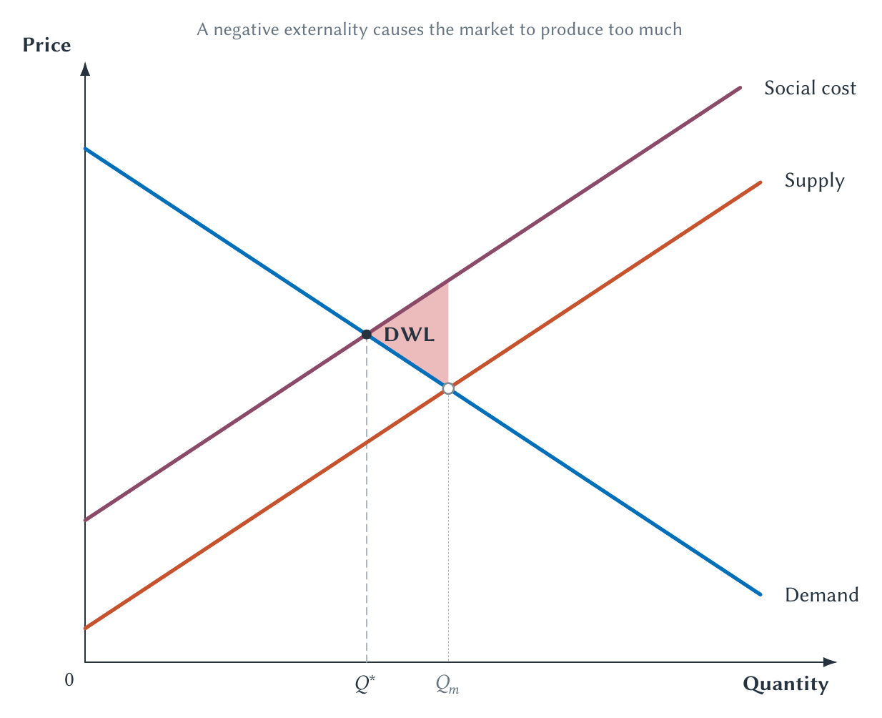
CHAPTER 10
A negative externality causes the market to overproduce
The supply curve records private cost; social cost is higher when production harms others.
PRINCIPLES OF MICRO
3
Notes:
Use the heights of the curves. Continue producing only while value is at least social cost. The market goes too far because private decisions omit the external cost.
[Sources]
- Principles of Micro, Chapter 10: Externalities and Property Rights (current project draft).
- Project-reviewed Chapter 10 figures from figures/ch10_externalities_and_property_rights/.
[/Sources]

Slide 4
CHAPTER 10
The efficient amount of pollution is not usually zero
Reducing pollution creates benefits, but it also uses scarce resources.
•
The first reductions may be cheap and valuable.
•
Further reductions become more costly.
•
Efficiency compares the added benefit of cleanup with its added cost.
PRINCIPLES OF MICRO
4
Notes:
Avoid treating pollution reduction as free. The regulator faces the same marginal question as any other decision maker.
[Sources]
- Principles of Micro, Chapter 10: Externalities and Property Rights (current project draft).
[/Sources]

Slide 5
CHAPTER 10
An externality is a market failure
The unregulated market quantity is inefficient because a relevant cost or benefit is missing from the price.
The policy question is how to make decision makers face the missing consequence.
PRINCIPLES OF MICRO
5
Notes:
Use market failure precisely. It identifies a reason the Chapter 6 competitive benchmark does not apply; it does not identify one automatic remedy.
[Sources]
- Principles of Micro, Chapter 10: Externalities and Property Rights (current project draft).
[/Sources]

Slide 6
CHAPTER 10
Command-and-control regulation tells firms what they must do
TECHNOLOGY RULE
PERFORMANCE RULE
Use this equipment
Meet this standard
The regulator specifies a method, filter, fuel, or production process.
The regulator limits emissions or requires a result while leaving some choice over method.
The rule can reduce pollution without directly pricing the external cost.
PRINCIPLES OF MICRO
6
Notes:
Do not say command and control literally internalizes the externality. It can reduce the harmful activity by legal requirement even though no explicit price is placed on the external cost.
[Sources]
- Principles of Micro, Chapter 10: Externalities and Property Rights (current project draft).
- U.S. Environmental Protection Agency, Economic Incentives; Acid Rain Program; What Is Emissions Trading?
[/Sources]

Slide 7
CHAPTER 10
A regulator must still compare benefits and costs
How much cleanup is worth doing, and which source can reduce pollution most cheaply?
•
The regulator may not know each firm's cleanup cost.
•
A uniform rule can be cheap for one source and extremely costly for another.
•
Reducing pollution beyond the point where added cost exceeds added benefit lowers welfare.
PRINCIPLES OF MICRO
7
Notes:
This is the informational problem in command and control. Market-based policies do not magically reveal the best total target, but they make the cost of achieving a chosen target more visible and flexible.
[Sources]
- Principles of Micro, Chapter 10: Externalities and Property Rights (current project draft).
[/Sources]

Slide 8
CHAPTER 10
Market-based policies let firms search for the cheapest reductions
CORRECTIVE TAX
CAP AND TRADE
Set a price on pollution
Set total emissions
Each source reduces emissions when doing so costs less than paying the tax.
Allowances move toward sources that value them most, while low-cost reducers sell permits.
Different firms can make different choices while pursuing the same policy goal.
PRINCIPLES OF MICRO
8
Notes:
This flexibility is why economists often prefer market-based tools. The government still must choose a tax rate or cap.
[Sources]
- Principles of Micro, Chapter 10: Externalities and Property Rights (current project draft).
- U.S. Environmental Protection Agency, Economic Incentives; Acid Rain Program; What Is Emissions Trading?
[/Sources]

Slide 9
CHAPTER 10
A corrective tax fills the gap in the earlier graph
Tax the activity by the external cost it creates, and the private supply curve moves toward social cost.
The market quantity moves toward the efficient quantity.
PRINCIPLES OF MICRO
9
Notes:
Explicitly tie the tax to the negative-externality figure. This is not a new diagram or a new theory; the tax makes the missing cost part of the decision.
[Sources]
- Principles of Micro, Chapter 10: Externalities and Property Rights (current project draft).
[/Sources]

Slide 10
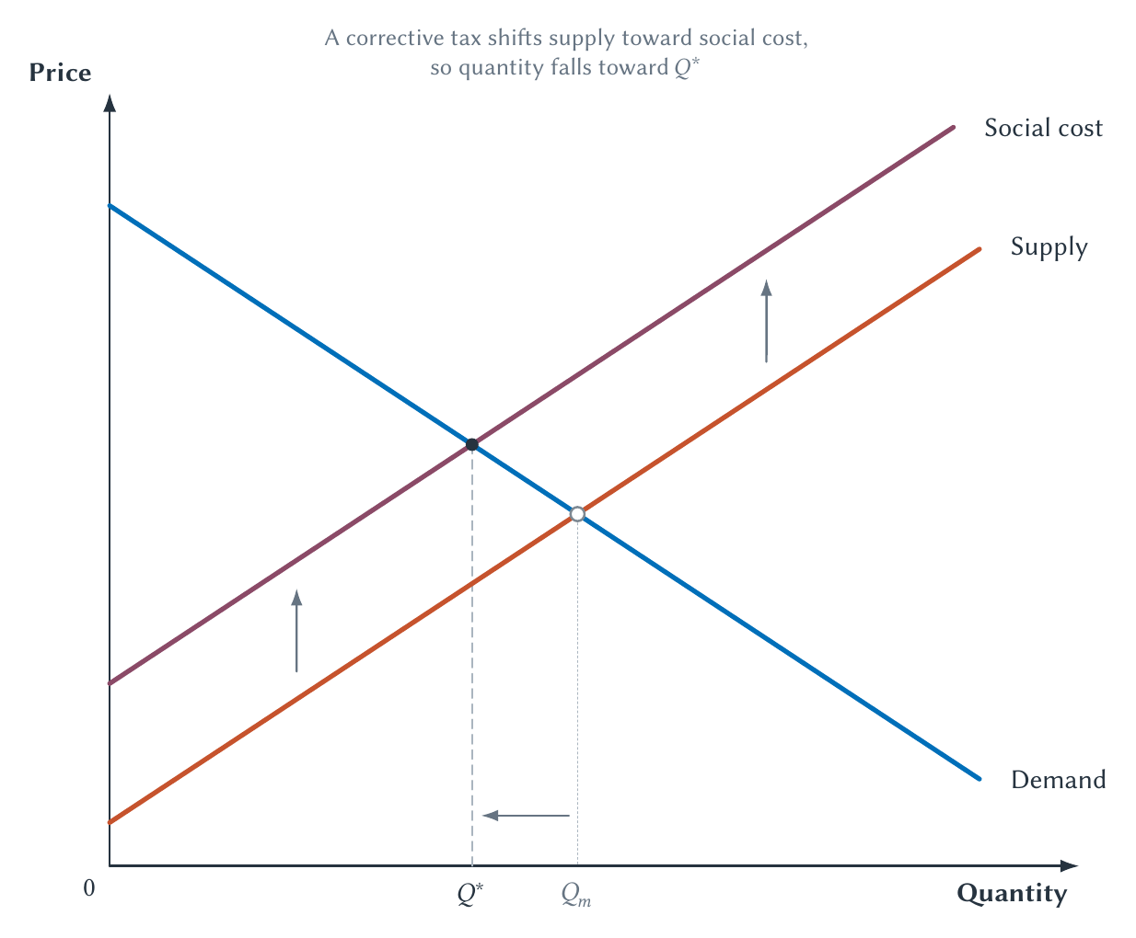
CHAPTER 10
A corrective tax moves output toward the efficient quantity
Unlike an ordinary revenue tax, a well-designed corrective tax can remove a deadweight loss.
PRINCIPLES OF MICRO
10
Notes:
Connect this reversal to Chapter 7. The tax discourages transactions whose private value does not cover their full social cost.
[Sources]
- Principles of Micro, Chapter 10: Externalities and Property Rights (current project draft).
- Project-reviewed Chapter 10 figures from figures/ch10_externalities_and_property_rights/.
[/Sources]

Slide 11
CHAPTER 10
People often want less pollution but resist paying for it
Pricing gasoline emissions works partly by making driving more expensive.
•
Oil companies supply fuel, but drivers burn it.
•
A pollution price reaches consumers through fuel prices and other channels.
•
Facing the cost is what gives people a reason to drive less or choose cleaner options.
PRINCIPLES OF MICRO
11
Notes:
Make incidence honest. Firms are not abstract villains who can absorb the full cost without changing prices, output, investment, or wages.
[Sources]
- Principles of Micro, Chapter 10: Externalities and Property Rights (current project draft).
[/Sources]

Slide 12
CHAPTER 10
Cap and trade makes the quantity limit explicit
Government creates a fixed number of emission allowances and lets firms trade them.
•
A firm must surrender an allowance for each unit emitted.
•
Low-cost reducers can sell allowances.
•
High-cost reducers can buy allowances.
•
The cap fixes total permitted emissions.
PRINCIPLES OF MICRO
12
Notes:
Use the sulfur-dioxide program as the historical application. Keep the institution simple: cap, allowances, trading, compliance.
[Sources]
- Principles of Micro, Chapter 10: Externalities and Property Rights (current project draft).
- U.S. Environmental Protection Agency, Economic Incentives; Acid Rain Program; What Is Emissions Trading?
[/Sources]

Slide 13
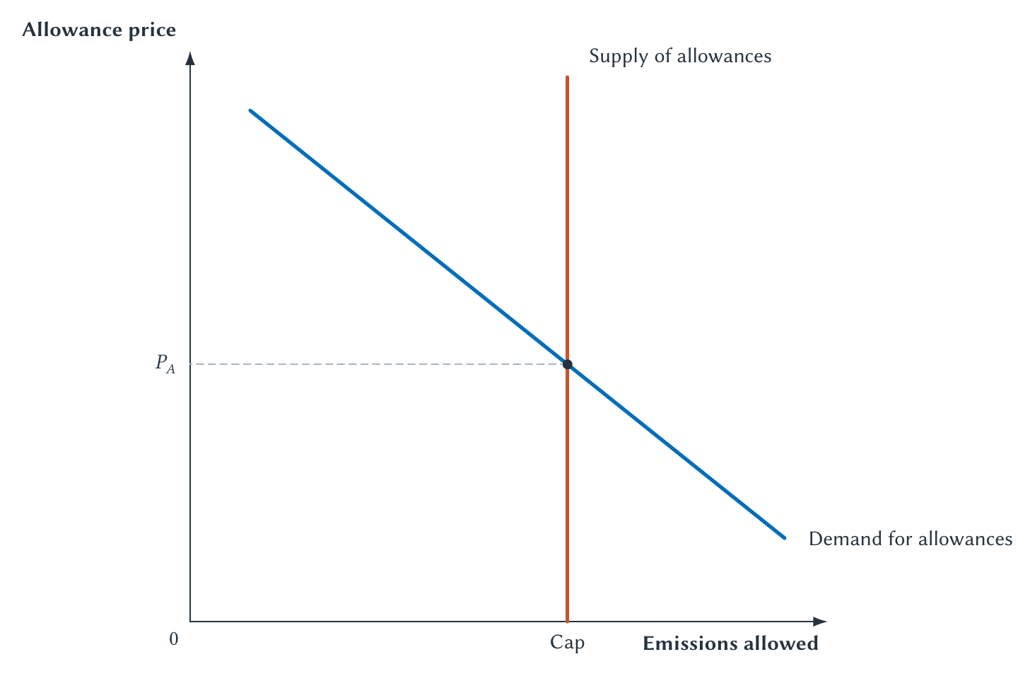
CHAPTER 10
Trading directs cleanup toward lower-cost sources
The allowance price gives every source a reason to compare emitting with reducing pollution.
PRINCIPLES OF MICRO
13
Notes:
The diagram is an allowance market, not the product market. Explain that the cap fixes quantity while trading determines the permit price.
[Sources]
- Principles of Micro, Chapter 10: Externalities and Property Rights (current project draft).
- U.S. Environmental Protection Agency, Economic Incentives; Acid Rain Program; What Is Emissions Trading?
- Project-reviewed Chapter 10 figures from figures/ch10_externalities_and_property_rights/.
[/Sources]

Slide 14
CHAPTER 10
A tax fixes price; a cap fixes quantity
CORRECTIVE TAX
CAP AND TRADE
Known price, uncertain emissions
Known emissions, uncertain price
Policymakers choose the tax; firms' responses determine the total reduction.
Policymakers choose the cap; trading determines the allowance price.
With full information they can be designed to reach the same outcome.
PRINCIPLES OF MICRO
14
Notes:
Under uncertainty, the choice depends on whether mistakes about emissions or abatement cost are more damaging. Keep that insight qualitative. Auctioned allowances can raise revenue; freely allocated permits create valuable assets for recipients.
[Sources]
- Principles of Micro, Chapter 10: Externalities and Property Rights (current project draft).
[/Sources]

Slide 15
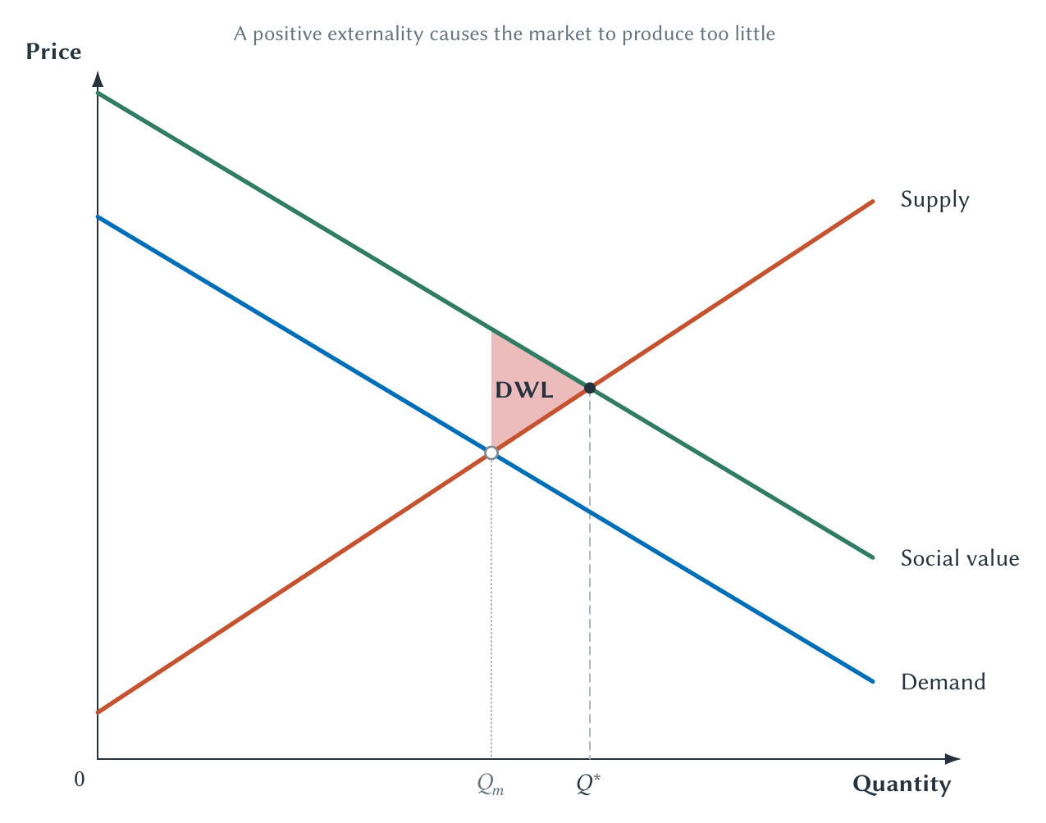
CHAPTER 10
A positive externality causes the market to underproduce
Demand records private value; social value is higher when others also benefit.
PRINCIPLES OF MICRO
15
Notes:
Use vaccination, education, or research only as examples where the outside benefit can be explained clearly. The market stops too early because the buyer does not receive every benefit.
[Sources]
- Principles of Micro, Chapter 10: Externalities and Property Rights (current project draft).
- Project-reviewed Chapter 10 figures from figures/ch10_externalities_and_property_rights/.
[/Sources]

Slide 16
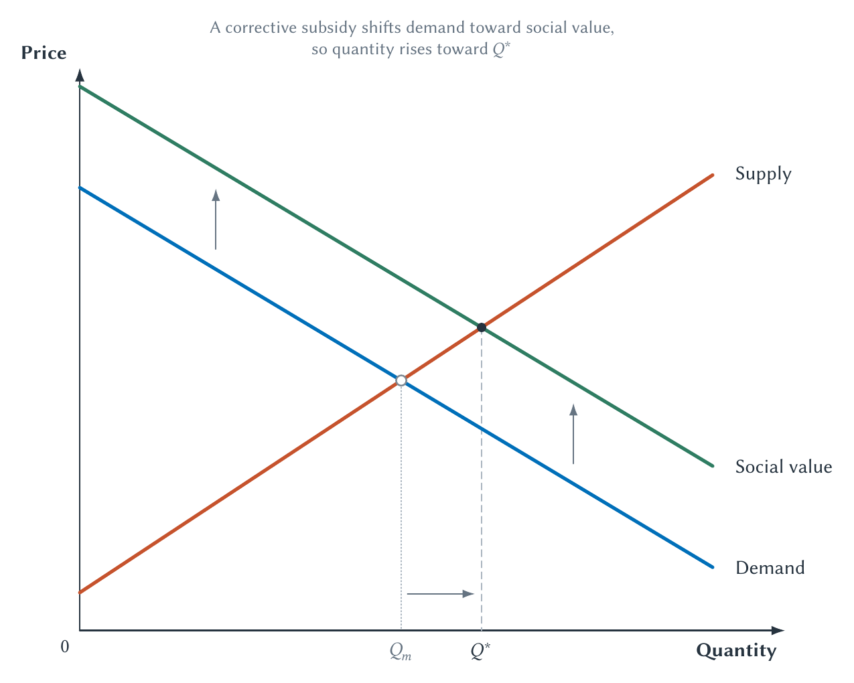
CHAPTER 10
A corrective subsidy moves output toward the efficient quantity
The subsidy rewards an action that creates benefits beyond the buyer.
PRINCIPLES OF MICRO
16
Notes:
Tie the subsidy back to the vertical gap between social value and private demand. The prose should explain the movement toward the optimal quantity.
[Sources]
- Principles of Micro, Chapter 10: Externalities and Property Rights (current project draft).
- Project-reviewed Chapter 10 figures from figures/ch10_externalities_and_property_rights/.
[/Sources]

Slide 17
CHAPTER 10
Public policy is not the only possible response
GOVERNMENT RESPONSE
PRIVATE RESPONSE
Rules, taxes, subsidies, or permits
Contracts, ownership, norms, or organizations
Collective action may be necessary when many affected parties cannot bargain.
People sometimes find ways to bring outside effects into their own decisions.
The right question is which institution works best in the actual setting.
PRINCIPLES OF MICRO
17
Notes:
Use this as the transition to Coase. Government action may be necessary, but it is not logically the first or only possible institution.
[Sources]
- Principles of Micro, Chapter 10: Externalities and Property Rights (current project draft).
[/Sources]

Slide 18
CHAPTER 10
The Coase theorem in one sentence
“When property rights are clear and transaction costs are low, bargaining can lead to an efficient outcome regardless of who initially holds the right.”
The theorem named by George Stigler from Ronald Coase's argument
The hard work begins when bargaining is costly.
PRINCIPLES OF MICRO
18
Notes:
Do not intimidate students with the lake example before stating the theorem plainly. Coase used the zero-transaction-cost result as a stepping stone toward the real world.
[Sources]
- Principles of Micro, Chapter 10: Externalities and Property Rights (current project draft).
- R. H. Coase, The Problem of Social Cost, Journal of Law and Economics 3, 1960.
[/Sources]

Slide 19
CHAPTER 10
A factory and a developer want incompatible uses of one lake
The factory uses the lake for waste disposal; the developer needs clean water for valuable housing.
The problem is competing uses, not simply a villain and a victim.
PRINCIPLES OF MICRO
19
Notes:
Assume the factory initially holds the legal right to pollute. The developer discovers the pollution after buying nearby land.
[Sources]
- Principles of Micro, Chapter 10: Externalities and Property Rights (current project draft).
- R. H. Coase, The Problem of Social Cost, Journal of Law and Economics 3, 1960.
[/Sources]

Slide 20
CHAPTER 10
One owner would compare the joint gains and costs
KEEP POLLUTING
REDUCE POLLUTION
Factory value is larger
Development gain is larger
Continue production if cleanup would destroy more value than clean water creates.
Install controls or change production if cleaner water creates more value than it costs.
Unified ownership makes the external effect internal to one decision.
PRINCIPLES OF MICRO
20
Notes:
This is a thought experiment. It reveals the efficient comparison before bargaining, legal rules, or moral language distract from the joint-value question.
[Sources]
- Principles of Micro, Chapter 10: Externalities and Property Rights (current project draft).
[/Sources]

Slide 21
CHAPTER 10
Coase says separate firms can sometimes copy that result
If bargaining is easy, the developer can pay the factory to reduce pollution whenever the joint gain exceeds the cleanup cost.
•
Clear rights tell the parties what must be negotiated.
•
Low transaction costs make agreement possible.
•
Enforceable contracts make promises credible.
PRINCIPLES OF MICRO
21
Notes:
The initial right changes who pays, but under the theorem's strict conditions bargaining reaches the value-maximizing use.
[Sources]
- Principles of Micro, Chapter 10: Externalities and Property Rights (current project draft).
- R. H. Coase, The Problem of Social Cost, Journal of Law and Economics 3, 1960.
[/Sources]

Slide 22
CHAPTER 10
External harm is reciprocal
Stopping the factory harms production; allowing pollution harms development.
The economic task is to avoid the more costly harm.
PRINCIPLES OF MICRO
22
Notes:
This is the deeper Coasean framing. Externalities often involve incompatible uses of a resource whose rights or rules are incomplete.
[Sources]
- Principles of Micro, Chapter 10: Externalities and Property Rights (current project draft).
- R. H. Coase, The Problem of Social Cost, Journal of Law and Economics 3, 1960.
[/Sources]

Slide 23
CHAPTER 10
Assign responsibility to the party that can prevent harm most cheaply
RAILROAD CAN FIX SPARKS CHEAPLY
SPARKS ARE COSTLY TO PREVENT
Require the railroad to act
Require nearby farmers to adapt
Lubrication, spark arrestors, or another low-cost precaution prevents widespread fires.
If fires are local and crops can be moved cheaply, the farmer may be the lower-cost avoider.
Liability should encourage the least-cost way to prevent the expected harm.
PRINCIPLES OF MICRO
23
Notes:
Keep this principles-level. The point is not a universal legal rule; it is to compare prevention costs on both sides.
[Sources]
- Principles of Micro, Chapter 10: Externalities and Property Rights (current project draft).
- R. H. Coase, The Problem of Social Cost, Journal of Law and Economics 3, 1960.
- Guido Calabresi, The Cost of Accidents: A Legal and Economic Analysis, 1970.
[/Sources]

Slide 24
CHAPTER 10
Bargaining fails when agreement is costly
•
Many people must be found and organized.
•
Information about harm and cleanup costs is disputed.
•
Some parties hold out for a larger payment or free ride on others.
•
Agreements are difficult to write, monitor, or enforce.
Transaction costs explain why valuable bargains may never occur.
PRINCIPLES OF MICRO
24
Notes:
Use plain examples. Transaction costs include finding information, negotiating, writing an agreement, and enforcing it.
[Sources]
- Principles of Micro, Chapter 10: Externalities and Property Rights (current project draft).
- Carl J. Dahlman, The Problem of Externality, Journal of Law and Economics 22(1), 1979.
[/Sources]

Slide 25
CHAPTER 10
Norms and organizations can also reduce outside effects
NORMS
ORGANIZATIONS
People restrain behavior
Bring decisions together
Reputation, repeated interaction, and shared expectations can discourage harmful actions.
Firms, homeowner groups, clubs, or associations can coordinate uses that were previously separate.
Institutions can change who decides and what consequences enter the decision.
PRINCIPLES OF MICRO
25
Notes:
Do not imply informal solutions always work. They are more plausible in close-knit groups with repeated interaction and observable behavior.
[Sources]
- Principles of Micro, Chapter 10: Externalities and Property Rights (current project draft).
[/Sources]

Slide 26
CHAPTER 10
No one solution fits every externality
STEP 1
STEP 2
STEP 3
STEP 4
Identify the missing effect
Find the obstacle
Compare institutions
Trace new incentives
→
→
→
What cost or benefit is left outside the price?
Why do private decisions fail to include it?
Rules, prices, rights, contracts, norms, or organizations.
Who adjusts, what information is needed, and what can go wrong?
Externality policy is institutional design, not merely drawing a second curve.
PRINCIPLES OF MICRO
26
Notes:
This is the chapter's transfer checklist. Ask students to apply it to a new environmental or neighborhood conflict.
[Sources]
- Principles of Micro, Chapter 10: Externalities and Property Rights (current project draft).
[/Sources]

Slide 27
CHAPTER 10
Bring missing costs and benefits into the decision
•
Negative externalities cause overproduction; positive externalities cause underproduction.
•
Command and control reduces activity by rule; taxes and permits change incentives.
•
Bargaining can work when rights are clear and transaction costs are low.
•
The best institution depends on information, enforcement, and the cost of agreement.
Next: public goods and common resources are special externality problems.
PRINCIPLES OF MICRO
27
Notes:
Close by returning to the lake. Ask students to name one government solution and one possible private solution, then identify the information each requires.
[Sources]
- Principles of Micro, Chapter 10: Externalities and Property Rights (current project draft).
[/Sources]

