Slide 1
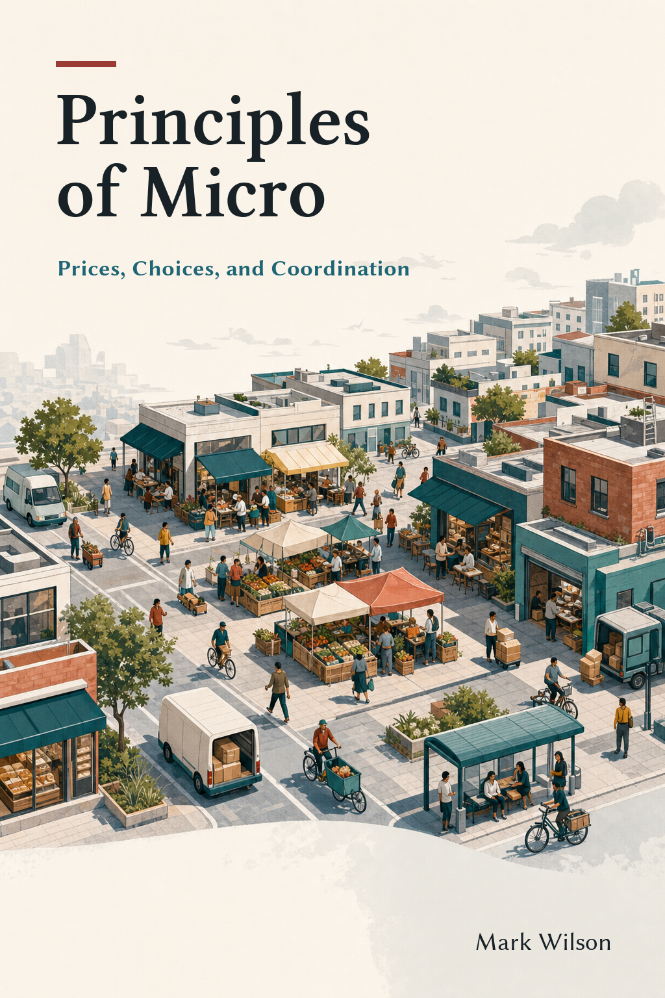
Public Goods and Common Resources
Chapter 11
Principles of Micro
The hard question is whether users can be excluded and whether one person's use leaves less for others
Mark Wilson
Notes:
Begin with two questions rather than four labels: can nonpayers be excluded, and does one person's use leave less for someone else?
[Sources]
- Principles of Micro, Chapter 11: Public Goods and Common Resources (current project draft).
- Cover artwork: design/book-cover/principles-of-micro-cover.png (project-generated asset).
[/Sources]

Slide 2
CHAPTER 11
Classify a good with two questions
EXCLUDABLE?
RIVAL?
Can nonpayers be kept out?
Does one person's use leave less?
Ownership, access controls, law, technology, or location may make exclusion possible.
A rival good is depleted, occupied, crowded, or otherwise less available after use.
These properties create different incentive problems.
PRINCIPLES OF MICRO
2
Notes:
Use ordinary examples before introducing the four-way matrix. Excludability concerns control over access; rivalry concerns the effect of one person's use on others.
[Sources]
- Principles of Micro, Chapter 11: Public Goods and Common Resources (current project draft).
[/Sources]

Slide 3
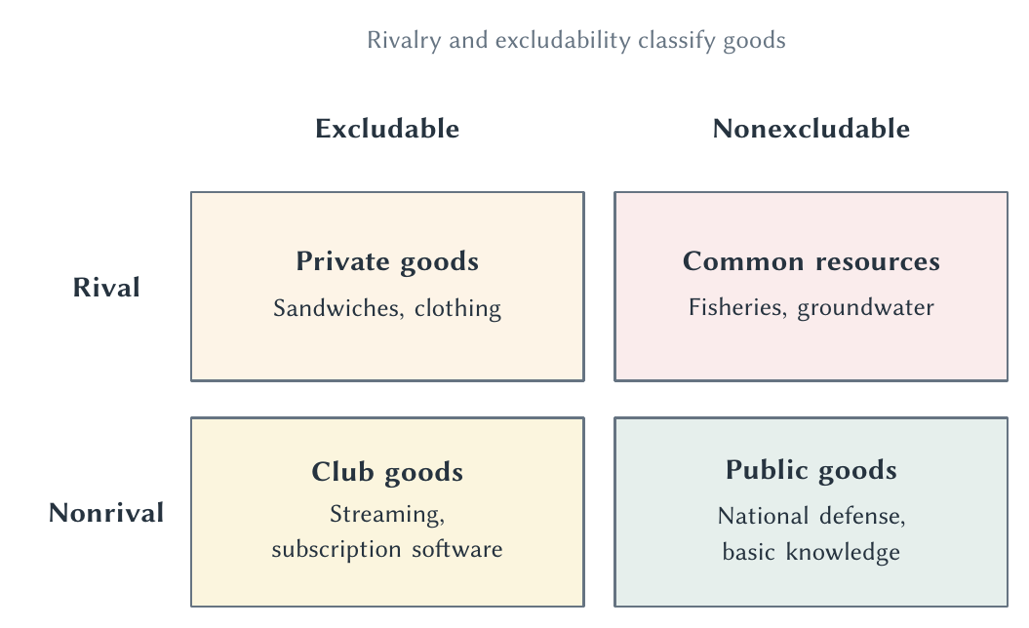
CHAPTER 11
Two properties create four kinds of goods
The labels are shorthand for the incentive problem created by each combination.
PRINCIPLES OF MICRO
3
Notes:
Do not ask students to memorize examples mechanically. Ask why each example is placed in a cell and whether the classification could change in a different setting.
[Sources]
- Principles of Micro, Chapter 11: Public Goods and Common Resources (current project draft).
- Project-reviewed Chapter 11 figure from figures/ch11_public_goods_and_common_resources/.
[/Sources]

Slide 4
CHAPTER 11
Private goods and club goods can charge users
PRIVATE GOOD
CLUB GOOD
Rival and excludable
Nonrival until congestion
A sandwich can be sold to one buyer, and eating it leaves none for someone else.
A streaming service or toll road can exclude nonpayers while serving additional users cheaply for a time.
Excludability lets providers connect payment with access.
PRINCIPLES OF MICRO
4
Notes:
Keep the club-good point brief. Congestion can make use rival, but the chapter does not need a separate congestion model.
[Sources]
- Principles of Micro, Chapter 11: Public Goods and Common Resources (current project draft).
[/Sources]

Slide 5
CHAPTER 11
A public good creates a positive externality
Once the good exists, another user can often benefit at nearly zero additional cost.
•
National defense protects many people at once.
•
A warning siren can alert another listener without weakening the warning.
•
Knowledge can often be used by another person without being used up.
PRINCIPLES OF MICRO
5
Notes:
Connect nonrivalry to Chapter 10: the marginal cost of serving one more user is often zero or very low, so excluding a willing user can waste a gain.
[Sources]
- Principles of Micro, Chapter 11: Public Goods and Common Resources (current project draft).
[/Sources]

Slide 6
CHAPTER 11
Zero marginal cost has a welfare implication
If another person values the public good and can use it at no added cost, letting that person benefit raises total surplus.
The hard problem is paying for the fixed cost of creating the good.
PRINCIPLES OF MICRO
6
Notes:
Separate efficient use after creation from financing before creation. Nonrival use can be efficient even when producing the good is expensive.
[Sources]
- Principles of Micro, Chapter 11: Public Goods and Common Resources (current project draft).
[/Sources]

Slide 7
CHAPTER 11
Free riding threatens provision
A person can enjoy a nonexcludable benefit without paying for it.
•
Each person hopes someone else will finance the good.
•
Voluntary payment can fall short even when total willingness to pay exceeds cost.
•
The market may provide too little or nothing at all.
PRINCIPLES OF MICRO
7
Notes:
Stress that free riding is an incentive problem, not necessarily a character flaw. Even people who value the good may prefer that someone else pay.
[Sources]
- Principles of Micro, Chapter 11: Public Goods and Common Resources (current project draft).
[/Sources]

Slide 8
CHAPTER 11
Add willingness to pay across users
Person
Willingness to pay for a neighborhood siren
Ava
$35
Ben
$30
Maya
$25
Riley
$20
Total benefit
$110
Provide the siren if its cost is below $110, even though no one person will pay the full cost.
PRINCIPLES OF MICRO
8
Notes:
For a public good, users consume the same quantity, so add their willingness to pay vertically. Keep the arithmetic simple and verbal.
[Sources]
- Principles of Micro, Chapter 11: Public Goods and Common Resources (current project draft).
[/Sources]

Slide 9
CHAPTER 11
Taxes solve the payment problem by making contribution compulsory
People accept some coercion because otherwise free riding can leave them without defense, courts, or other shared services.
•
The state can collect from beneficiaries who would not pay voluntarily.
•
Compulsory finance can support a good almost everyone wants to exist.
•
The remaining question is how much to provide and how well government performs.
PRINCIPLES OF MICRO
9
Notes:
Give the point philosophical force without theatrical language. One reason people form states is that voluntary payment may not supply basic public goods.
[Sources]
- Principles of Micro, Chapter 11: Public Goods and Common Resources (current project draft).
[/Sources]

Slide 10
CHAPTER 11
Without a market price, value is harder to observe
People have a reason to overstate benefits when others pay and understate them when payment depends on their answer.
•
Surveys can help, but answers are not ordinary purchases.
•
Voting combines many issues and does not reveal exact willingness to pay.
•
Economists often infer value from costly choices people actually make.
PRINCIPLES OF MICRO
10
Notes:
Briefly mention the value of statistical life only as an application of willingness to pay for small risk reductions, not as a price placed on an identifiable life.
[Sources]
- Principles of Micro, Chapter 11: Public Goods and Common Resources (current project draft).
[/Sources]

Slide 11
CHAPTER 11
Entrepreneurs sometimes find a way around free riding
British lighthouses could be financed through port fees collected from ships using nearby harbors.
The light remained nonrival, but payment became connected to port access.
PRINCIPLES OF MICRO
11
Notes:
Use Coase's lighthouse as evidence that institutional arrangements can make exclusion or bundled payment possible. Also note that public authority and legal privileges remained part of the system.
[Sources]
- Principles of Micro, Chapter 11: Public Goods and Common Resources (current project draft).
- R. H. Coase, The Lighthouse in Economics, Journal of Law and Economics 17(2), 1974.
[/Sources]

Slide 12
CHAPTER 11
A common resource creates a negative externality
Each user receives the private benefit of taking more while spreading part of the depletion cost across everyone.
•
Fish taken today are unavailable to other fishers.
•
Groundwater pumped from a shared aquifer lowers what remains.
•
Open grazing lets one owner's animal reduce forage available to others.
PRINCIPLES OF MICRO
12
Notes:
Use the exact phrase negative externality. Common resources are rival but difficult to exclude people from using.
[Sources]
- Principles of Micro, Chapter 11: Public Goods and Common Resources (current project draft).
[/Sources]

Slide 13
CHAPTER 11
Garrett Hardin named the tragedy of the commons
“Each user receives the gain from using more of the resource while sharing the resulting cost with everyone else.”
The open-access incentive behind the tragedy of the commons
Individually sensible actions can destroy the shared resource.
PRINCIPLES OF MICRO
13
Notes:
Credit Hardin for naming the problem, then distinguish unmanaged open access from commons governed through enforceable rules.
[Sources]
- Principles of Micro, Chapter 11: Public Goods and Common Resources (current project draft).
- Garrett Hardin, The Tragedy of the Commons, Science 162, 1968.
[/Sources]

Slide 14
CHAPTER 11
Every commons solution must reduce overuse
STEP 1
STEP 2
STEP 3
STEP 4
Define rights
Limit use
Monitor behavior
Enforce the rule
→
→
→
Give an owner a claim to the future value of the resource.
Set quotas, seasons, access rules, or extraction charges.
Observe use and make violations detectable.
Use sanctions strong enough to change incentives.
The mechanism matters more than the label placed on it.
PRINCIPLES OF MICRO
14
Notes:
Property rights are the obvious solution when feasible. When exclusion is too costly, communities or governments must find another way to limit use.
[Sources]
- Principles of Micro, Chapter 11: Public Goods and Common Resources (current project draft).
[/Sources]

Slide 15
CHAPTER 11
Ostrom showed that communities can govern shared resources
Markets and central government are not the only choices.
•
Users can develop boundaries and locally understood rules.
•
Monitoring may be easier when users know the resource and one another.
•
Graduated sanctions and conflict-resolution procedures can support cooperation.
PRINCIPLES OF MICRO
15
Notes:
Present these as recurring design features, not a guaranteed checklist. Social trust helps, but successful governance still requires rules and enforcement.
[Sources]
- Principles of Micro, Chapter 11: Public Goods and Common Resources (current project draft).
- Elinor Ostrom, Beyond Markets and States: Polycentric Governance of Complex Economic Systems, Nobel lecture, 2009.
[/Sources]

Slide 16
CHAPTER 11
Why were cattle domesticated while bison nearly vanished?
Demand was not the decisive difference: valuable cattle had owners with reason to protect and reproduce them.
•
Open-access bison were worth more dead to the hunter than alive for the future.
•
Owned cattle carried a future value for the owner.
•
Domestication made control, breeding, and capture of future benefits easier.
PRINCIPLES OF MICRO
16
Notes:
Do not reduce bison history to one cause. Use the comparison to isolate the property-rights mechanism.
[Sources]
- Principles of Micro, Chapter 11: Public Goods and Common Resources (current project draft).
- Dean Lueck, The Extermination and Conservation of the American Bison, Journal of Legal Studies 31(S2), 2002; Dean Lueck and Gustavo Torrens, Property Rights and Domestication, Journal of Institutional Economics 16(2), 2020.
[/Sources]

Slide 17
CHAPTER 11
Property rights can evolve when open access becomes costly
People invest in defining and enforcing rights when the gains from doing so grow larger than the cost.
Scarcity can create demand for better rules.
PRINCIPLES OF MICRO
17
Notes:
This is Demsetz's central insight. Property rights are not merely handed down once; they can change as resource values, technology, and enforcement costs change.
[Sources]
- Principles of Micro, Chapter 11: Public Goods and Common Resources (current project draft).
- Harold Demsetz, Toward a Theory of Property Rights, American Economic Review 57(2), 1967.
[/Sources]

Slide 18
CHAPTER 11
Wildlife survives when local people gain from its future
OPEN ACCESS
COMMUNITY RIGHTS
Take the animal before someone else does
Protect an asset that pays locally
The future value of the herd is spread broadly, while the current kill benefits one user.
Tourism or controlled harvest can give communities a claim to future wildlife value.
Conservation incentives improve when benefits reach the people who bear the costs.
PRINCIPLES OF MICRO
18
Notes:
Use southern African conservation as a qualified application. Rights can improve populations while local wildlife damage and incomplete tenure remain real problems.
[Sources]
- Principles of Micro, Chapter 11: Public Goods and Common Resources (current project draft).
- Karol Boudreaux and Fred Nelson, Community Conservation in Namibia: Empowering the Poor with Property Rights, Economic Affairs 31(2), 2011.
[/Sources]

Slide 19
CHAPTER 11
Match the remedy to the incentive problem
PUBLIC GOOD
COMMON RESOURCE
Too little provision
Too much use
Connect payment to beneficiaries, finance collectively, or find a way to make access excludable.
Define rights or create rules that limit extraction and reward preservation.
Nonexcludability creates both problems; rivalry determines their direction.
PRINCIPLES OF MICRO
19
Notes:
This is the compact synthesis. Public goods are underprovided; common resources are overused.
[Sources]
- Principles of Micro, Chapter 11: Public Goods and Common Resources (current project draft).
[/Sources]

Slide 20
CHAPTER 11
Institutions determine whether shared value survives
•
Public goods are nonrival and nonexcludable, creating free riding and underprovision.
•
Common resources are rival and nonexcludable, creating overuse.
•
Taxes, bundled payment, property rights, community rules, and enforcement can change incentives.
•
The right institution depends on exclusion, information, trust, monitoring, and enforcement costs.
Next: markets and organizations also struggle when information is incomplete.
PRINCIPLES OF MICRO
20
Notes:
Close by asking students to classify one unfamiliar good and then identify the likely incentive problem.
[Sources]
- Principles of Micro, Chapter 11: Public Goods and Common Resources (current project draft).
[/Sources]

