Slide 1

Information, Uncertainty, and Market Design
Chapter 12
Principles of Micro
Prices, signals, contracts, and markets help people act on knowledge no one person possesses
Mark Wilson
Notes:
Open with Challenger. The stock market rapidly identified Morton Thiokol as the likely source of the failure long before the formal investigation finished.
[Sources]
- Principles of Micro, Chapter 12: Information, Uncertainty, and Market Design (current project draft).
- Cover artwork: design/book-cover/principles-of-micro-cover.png (project-generated asset).
[/Sources]

Slide 2
CHAPTER 12
Minutes after Challenger, the market began sorting blame
Investors sharply reduced Morton Thiokol's value while the official investigation was only beginning.
•
No central investigator ordered the trades.
•
Different people acted on scattered clues, experience, and suspicion.
•
The price change combined that information into one public signal.
PRINCIPLES OF MICRO
2
Notes:
Be precise: the market response pointed toward Morton Thiokol, whose rocket-booster joint was later identified as the physical source of the failure. This was not a legal finding of guilt. Some Thiokol engineers had warned about the launch conditions before the disaster.
[Sources]
- Principles of Micro, Chapter 12: Information, Uncertainty, and Market Design (current project draft).
- Michael T. Maloney and J. Harold Mulherin, The Complexity of Price Discovery in an Efficient Market: The Stock Market Reaction to the Challenger Crash, Journal of Corporate Finance 9(4), 2003; Rogers Commission report.
[/Sources]

Slide 3
CHAPTER 12
Hayek asked how society uses scattered knowledge
“The economic problem is how to use knowledge that is never given to anyone in its totality.”
F. A. Hayek, The Use of Knowledge in Society
A price system coordinates people who know different things.
PRINCIPLES OF MICRO
3
Notes:
Use a short paraphrase rather than dwelling on the essay's vocabulary. Knowledge of local conditions, opportunities, shortages, and alternatives is dispersed.
[Sources]
- Principles of Micro, Chapter 12: Information, Uncertainty, and Market Design (current project draft).
- F. A. Hayek, The Use of Knowledge in Society, American Economic Review 35(4), 1945.
[/Sources]

Slide 4
CHAPTER 12
Central planning faces two separate problems
INCENTIVE PROBLEM
INFORMATION PROBLEM
Will people act with care?
Who knows what should be done?
Weak rewards and diffuse responsibility can reduce effort, investment, and experimentation.
Local needs, costs, substitutes, and changing conditions cannot be fully assembled at the center.
Communism struggled not only because incentives were weak, but because knowledge was dispersed.
PRINCIPLES OF MICRO
4
Notes:
Keep the comparison institutional rather than ideological. The planner may be well intentioned and still lack information held by millions of people.
[Sources]
- Principles of Micro, Chapter 12: Information, Uncertainty, and Market Design (current project draft).
- F. A. Hayek, The Use of Knowledge in Society, American Economic Review 35(4), 1945.
[/Sources]

Slide 5
CHAPTER 12
A price change condenses scattered information
STEP 1
STEP 2
STEP 3
STEP 4
A resource becomes scarcer
Its price rises
Users conserve and search
Suppliers respond
→
→
→
Some users discover the change before others.
No buyer needs to know the full cause.
Higher cost rewards substitutes and economizing.
Higher returns attract new effort and investment.
The price communicates what people need to do, not everything they need to know.
PRINCIPLES OF MICRO
5
Notes:
This is Hayek's coordinating mechanism. A price can be useful even when no trader knows the entire story behind it.
[Sources]
- Principles of Micro, Chapter 12: Information, Uncertainty, and Market Design (current project draft).
- F. A. Hayek, The Use of Knowledge in Society, American Economic Review 35(4), 1945.
[/Sources]

Slide 6
CHAPTER 12
Risk and uncertainty are not identical
RISK
UNCERTAINTY
Probabilities can be estimated
The probability itself is unclear
Past frequencies, data, or a known process support numerical chances.
A new technology, event, or market may not have a reliable history.
Expected value is most useful when outcomes and probabilities can be stated.
PRINCIPLES OF MICRO
6
Notes:
Use Frank Knight's distinction as a practical framework. Modern economists sometimes use uncertainty more broadly.
[Sources]
- Principles of Micro, Chapter 12: Information, Uncertainty, and Market Design (current project draft).
[/Sources]

Slide 7
CHAPTER 12
Expected value is a probability-weighted average
Expected value = Σ (probability × outcome)
Multiply each possible outcome by its chance, then add the results.
50% chance of $100 and 50% chance of $0 → expected value of $50
PRINCIPLES OF MICRO
7
Notes:
The equation is shorthand for an ordinary weighted average. Work the two-outcome example aloud before adding more cases.
[Sources]
- Principles of Micro, Chapter 12: Information, Uncertainty, and Market Design (current project draft).
[/Sources]

Slide 8
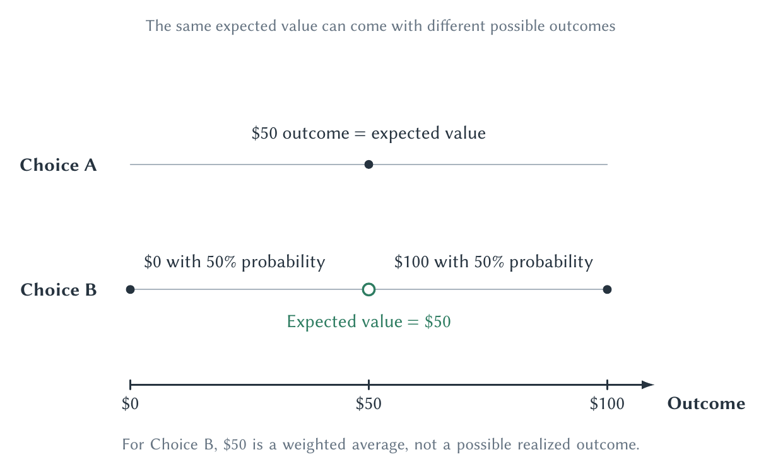
CHAPTER 12
The same expected value can carry very different risk
Expected value describes the center, not how widely outcomes can vary.
PRINCIPLES OF MICRO
8
Notes:
Use the figure to explain why people may prefer a sure or tightly clustered outcome to a gamble with the same expected value.
[Sources]
- Principles of Micro, Chapter 12: Information, Uncertainty, and Market Design (current project draft).
- Project-reviewed Chapter 12 figures from figures/ch12_information_uncertainty_and_market_design/.
[/Sources]

Slide 9
CHAPTER 12
Risk preferences affect choices with the same expected value
RISK AVERSE
RISK NEUTRAL
RISK SEEKING
Prefers less spread
Focuses on expected value
Prefers the gamble
A person may pay to avoid a large loss even when the insurance premium exceeds expected payout.
A person is indifferent between equally valued averages despite different spreads.
A person may accept a lower expected value in exchange for a chance at a large gain.
Choosing the highest expected value is not the definition of rational behavior.
PRINCIPLES OF MICRO
9
Notes:
Rational choice depends on preferences over outcomes and risk, not simply on selecting the largest average dollar amount.
[Sources]
- Principles of Micro, Chapter 12: Information, Uncertainty, and Market Design (current project draft).
[/Sources]

Slide 10
CHAPTER 12
Insurance trades a small certain cost for protection from a large loss
Risk pooling makes individual losses more predictable across a large group.
•
Most members pay premiums without suffering the covered loss.
•
The pool pays the smaller number who do suffer it.
•
The arrangement works best when risks are not perfectly linked.
PRINCIPLES OF MICRO
10
Notes:
This introduces the logic without moving into health insurance, which Chapter 19 develops in detail.
[Sources]
- Principles of Micro, Chapter 12: Information, Uncertainty, and Market Design (current project draft).
[/Sources]

Slide 11
CHAPTER 12
Adverse selection begins with hidden characteristics
One side knows more about quality or risk before the agreement is made.
•
Sellers may know more about a used car than buyers.
•
Insurance applicants may know more about their risk than insurers.
•
A price based on average quality can drive the best risks or products out.
PRINCIPLES OF MICRO
11
Notes:
Keep adverse selection before-contract and moral hazard after-contract. Students often reverse them.
[Sources]
- Principles of Micro, Chapter 12: Information, Uncertainty, and Market Design (current project draft).
- George A. Akerlof, The Market for Lemons, Quarterly Journal of Economics 84(3), 1970.
[/Sources]

Slide 12
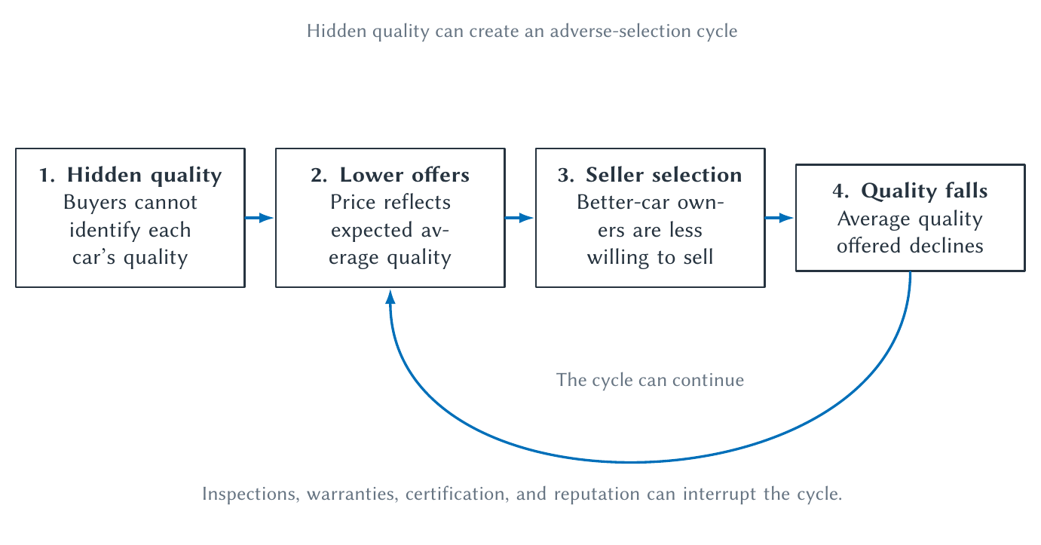
CHAPTER 12
Adverse selection can make a market unravel
A falling average price can push good products out and make the information problem worse.
PRINCIPLES OF MICRO
12
Notes:
Walk through the arrows slowly. Akerlof's lemons model identifies a mechanism, not a claim that every used-car market completely collapses.
[Sources]
- Principles of Micro, Chapter 12: Information, Uncertainty, and Market Design (current project draft).
- George A. Akerlof, The Market for Lemons, Quarterly Journal of Economics 84(3), 1970.
- Project-reviewed Chapter 12 figures from figures/ch12_information_uncertainty_and_market_design/.
[/Sources]

Slide 13
CHAPTER 12
Markets create institutions that make quality more believable
REPUTATION
GUARANTEE OR INSPECTION
Future sales are at risk
Shift the cost of hidden defects
A seller who expects repeat business has something valuable to lose by cheating today.
A warranty, return policy, certification, or independent inspection makes quality claims more credible.
The lemons problem predicts demand for trust-producing institutions.
PRINCIPLES OF MICRO
13
Notes:
Do not imply a car's price must fall discretely the instant it leaves the lot. Real markets respond with histories, inspections, warranties, and reputation.
[Sources]
- Principles of Micro, Chapter 12: Information, Uncertainty, and Market Design (current project draft).
[/Sources]

Slide 14
CHAPTER 12
Moral hazard begins after protection changes behavior
A contract can reduce the cost a person bears from taking an action.
•
Insurance can reduce the price of risky behavior or additional care.
•
A worker may exert less effort when the owner cannot observe it.
•
A lender may face more risk after a borrower receives the funds.
PRINCIPLES OF MICRO
14
Notes:
Moral hazard is not a moral accusation. It is the change in incentives created by hidden action after an agreement.
[Sources]
- Principles of Micro, Chapter 12: Information, Uncertainty, and Market Design (current project draft).
[/Sources]

Slide 15
CHAPTER 12
A restaurant owner cannot watch every managerial decision
OWNER'S GOAL
MANAGER'S PRIVATE INCENTIVE
Long-run restaurant value
Effort and rewards today
Maintain quality, control waste, train workers, and protect the brand.
Some valuable actions are hard to observe and may not directly raise the manager's pay.
A principal-agent problem appears when goals differ and action is hard to monitor.
PRINCIPLES OF MICRO
15
Notes:
Use monitoring, performance pay, promotion, reputation, and ownership as possible responses. No contract measures everything perfectly.
[Sources]
- Principles of Micro, Chapter 12: Information, Uncertainty, and Market Design (current project draft).
- Armen A. Alchian and Harold Demsetz, Production, Information Costs, and Economic Organization, American Economic Review 62(5), 1972.
[/Sources]

Slide 16
CHAPTER 12
Who monitors the monitor?
Monitoring creates another agency problem unless the monitor has a reason to care about the result.
Giving a decision maker a claim on the residual can substitute for constant supervision.
PRINCIPLES OF MICRO
16
Notes:
Preview Chapter 20. A franchise owner who keeps the remaining profit has a stronger reason to monitor the restaurant carefully than a salaried manager may have.
[Sources]
- Principles of Micro, Chapter 12: Information, Uncertainty, and Market Design (current project draft).
- Armen A. Alchian and Harold Demsetz, Production, Information Costs, and Economic Organization, American Economic Review 62(5), 1972.
[/Sources]

Slide 17
CHAPTER 12
A signal is credible when it is costly to fake
A peacock's tail is useful as a signal precisely because a weak bird cannot display and survive with it as easily.
•
Cheap claims can be copied by high- and low-quality sellers.
•
A costly signal separates types when the cost differs by type.
•
Signals existed long before modern markets.
PRINCIPLES OF MICRO
17
Notes:
Use the biological example briefly, then move to education and brands. A reliable signal need not be wasteful in every setting.
[Sources]
- Principles of Micro, Chapter 12: Information, Uncertainty, and Market Design (current project draft).
[/Sources]

Slide 18
CHAPTER 12
College can create value in three different ways
HUMAN CAPITAL
SIGNALING
CONSUMPTION
Learn productive skills
Reveal traits to employers
Enjoy the experience
Classes, practice, and experience raise what the student can produce.
Completing college may signal ability, persistence, or conformity with workplace expectations.
Friendships, activities, independence, and campus life can be valuable even apart from future earnings.
The same tuition payment can buy more than one thing.
PRINCIPLES OF MICRO
18
Notes:
Do not claim the literature finds college is mainly signaling. Evidence supports meaningful roles for both skill formation and signaling, and consumption value also exists.
[Sources]
- Principles of Micro, Chapter 12: Information, Uncertainty, and Market Design (current project draft).
- Michael Spence, Job Market Signaling, Quarterly Journal of Economics 87(3), 1973.
- Andrew Weiss, Human Capital vs. Signalling Explanations of Wages, Journal of Economic Perspectives 9(4), 1995; Yifan Gong and coauthors, The Consumption Value of College, NBER Working Paper 26335.
[/Sources]

Slide 19
CHAPTER 12
Signals come from sellers; screens come from buyers
SIGNAL
SCREEN
The informed side acts
The uninformed side tests
A worker earns a credential or a seller offers a warranty to reveal hidden quality.
An employer gives an exam or an insurer offers contracts designed to separate risk types.
Both devices try to separate people or products that look similar at first.
PRINCIPLES OF MICRO
19
Notes:
The direction of action is the easiest way to distinguish the two terms.
[Sources]
- Principles of Micro, Chapter 12: Information, Uncertainty, and Market Design (current project draft).
[/Sources]

Slide 20
CHAPTER 12
Prediction markets turn beliefs into prices
A contract pays when an event occurs, so traders profit by moving its price toward their best estimate.
•
Different traders bring different information.
•
A price near 0.70 can be read roughly as a 70 percent market probability under suitable conditions.
•
The market updates as new information arrives.
PRINCIPLES OF MICRO
20
Notes:
Frame prediction markets as a direct Hayek application. Prices aggregate dispersed beliefs when participation and contract design are adequate.
[Sources]
- Principles of Micro, Chapter 12: Information, Uncertainty, and Market Design (current project draft).
- Justin Wolfers and Eric Zitzewitz, Prediction Markets, Journal of Economic Perspectives 18(2), 2004; Robin Hanson and Ryan Oprea, A Manipulator Can Aid Prediction Market Accuracy, Economica 76(302), 2009.
[/Sources]

Slide 21
CHAPTER 12
Can someone rig a prediction market?
Manipulation may move a price temporarily, but it can also create a profit opportunity for better-informed traders.
•
Thin markets can still be noisy or vulnerable.
•
Ambiguous settlement rules can create disputes.
•
A trader might even try to change the measured event itself.
PRINCIPLES OF MICRO
21
Notes:
Do not claim every market is manipulation-proof. Accuracy depends on liquidity, incentives, contract wording, and the cost of influencing the outcome.
[Sources]
- Principles of Micro, Chapter 12: Information, Uncertainty, and Market Design (current project draft).
- Justin Wolfers and Eric Zitzewitz, Prediction Markets, Journal of Economic Perspectives 18(2), 2004; Robin Hanson and Ryan Oprea, A Manipulator Can Aid Prediction Market Accuracy, Economica 76(302), 2009.
[/Sources]

Slide 22
CHAPTER 12
A hairdryer at a Paris airport reveals a design problem
Police investigated whether someone tried to heat a weather sensor tied to a prediction-market contract.
A market can predict the event and also create an incentive to influence how the event is measured.
PRINCIPLES OF MICRO
22
Notes:
Describe this as a suspected manipulation under investigation, not an established fact about the exact method. The funny story makes the serious contract-design point memorable.
[Sources]
- Principles of Micro, Chapter 12: Information, Uncertainty, and Market Design (current project draft).
- Bobby Allyn, French Police Probe Suspected Weather Device Tampering After Odd Polymarket Bet, NPR, April 23, 2026; Le Monde, April 24, 2026.
[/Sources]

Slide 23
CHAPTER 12
Information problems create demand for institutions
STEP 1
STEP 2
STEP 3
STEP 4
What is hidden?
Who knows it?
What incentive follows?
What can reveal or align it?
→
→
→
Quality, risk, action, local knowledge, or future events.
Buyer, seller, worker, manager, trader, or nobody with certainty.
Exit, cheating, low effort, false claims, or costly search.
Prices, reputation, guarantees, signals, screens, contracts, or markets.
Market design means changing rules so useful information affects decisions.
PRINCIPLES OF MICRO
23
Notes:
Use this as the transfer framework for a new information problem.
[Sources]
- Principles of Micro, Chapter 12: Information, Uncertainty, and Market Design (current project draft).
[/Sources]

Slide 24
CHAPTER 12
Information is scarce, dispersed, and costly to verify
•
Prices coordinate knowledge no one person possesses.
•
Expected value summarizes outcomes but does not describe their spread.
•
Adverse selection concerns hidden characteristics; moral hazard concerns hidden actions.
•
Signals, screens, contracts, reputation, and prediction markets can improve decisions.
Next: production and cost curves compress information about real constraints inside firms.
PRINCIPLES OF MICRO
24
Notes:
Close by returning to Challenger: no trader needed the full investigation to act on a piece of relevant knowledge.
[Sources]
- Principles of Micro, Chapter 12: Information, Uncertainty, and Market Design (current project draft).
[/Sources]

