Slide 1

Costs and Production
Chapter 13
Principles of Micro
Cost curves are stories about forgone alternatives, fixed capacity, and organization
Mark Wilson
Notes:
Begin with the rich-uncle example. It makes the opportunity cost of financial capital concrete before students encounter any cost curve.
[Sources]
- Principles of Micro, Chapter 13: Costs and Production (current project draft).
- Cover artwork: design/book-cover/principles-of-micro-cover.png (project-generated asset).
[/Sources]

Slide 2
CHAPTER 13
Your business earned $50,000. Did it create value?
A rich uncle gives you $1 million. The business earns $50,000 after paying every bill.
•
The accountant reports a $50,000 profit.
•
A comparable investment would also have earned 5 percent, or $50,000.
•
The business did no better than the next-best use of the money.
PRINCIPLES OF MICRO
2
Notes:
Ask for a show of hands before revealing the alternative return. The accountant is not wrong; the economist is asking an additional question.
[Sources]
- Principles of Micro, Chapter 13: Costs and Production (current project draft).
[/Sources]

Slide 3
CHAPTER 13
Accounting and economic profit answer different questions
ACCOUNTING PROFIT
ECONOMIC PROFIT
Revenue minus explicit costs
Revenue minus every opportunity cost
Did sales revenue exceed the payments recorded by the business?
Did the business outperform the next-best use of the owner's money, time, and property?
Implicit costs are real even when no check is written.
PRINCIPLES OF MICRO
3
Notes:
Define explicit and implicit cost through the owner's money, unpaid labor, and owned building.
[Sources]
- Principles of Micro, Chapter 13: Costs and Production (current project draft).
- Armen A. Alchian, Cost, International Encyclopedia of the Social Sciences, 1968.
[/Sources]

Slide 4
CHAPTER 13
Positive accounting profit can hide an economic loss
Accounting profit
Implicit capital cost
Economic profit
Meaning
$80,000
$50,000
$30,000
Beats the alternative
$50,000
$50,000
$0
Matches the alternative
$30,000
$50,000
-$20,000
Falls short
A firm can pay every bill and still be a poor use of the owner's resources.
PRINCIPLES OF MICRO
4
Notes:
Read the third row aloud. Students often assume positive accounting profit proves the investment was worthwhile.
[Sources]
- Principles of Micro, Chapter 13: Costs and Production (current project draft).
[/Sources]

Slide 5
CHAPTER 13
Zero economic profit includes a normal return
The owner covers every explicit cost and earns enough to keep money and effort in the business.
Zero economic profit does not mean the owner earns nothing.
PRINCIPLES OF MICRO
5
Notes:
This point becomes central in Chapter 14. Entry can eliminate economic profit while owners continue receiving a normal accounting return.
[Sources]
- Principles of Micro, Chapter 13: Costs and Production (current project draft).
[/Sources]

Slide 6
CHAPTER 13
The short run is defined by a constraint, not a clock
SHORT RUN
LONG RUN
At least one input is fixed
Every input can adjust
Main Street Cafe can change workers during lunch but cannot enlarge its kitchen.
The cafe can expand, relocate, redesign the kitchen, or choose a different scale.
A month can be long run for one firm and short run for another.
PRINCIPLES OF MICRO
6
Notes:
Ask students to name the fixed input before discussing diminishing marginal product.
[Sources]
- Principles of Micro, Chapter 13: Costs and Production (current project draft).
[/Sources]

Slide 7
CHAPTER 13
Main Street Cafe: total and marginal product
Workers
Meals per shift
Marginal product
0
0
--
1
20
20
2
50
30
3
90
40
4
120
30
5
140
20
6
150
10
Marginal product is the addition to total output made by the next worker.
PRINCIPLES OF MICRO
7
Notes:
Read consecutive rows. Subtract the earlier total from the new total to find marginal product.
[Sources]
- Principles of Micro, Chapter 13: Costs and Production (current project draft).
[/Sources]

Slide 8
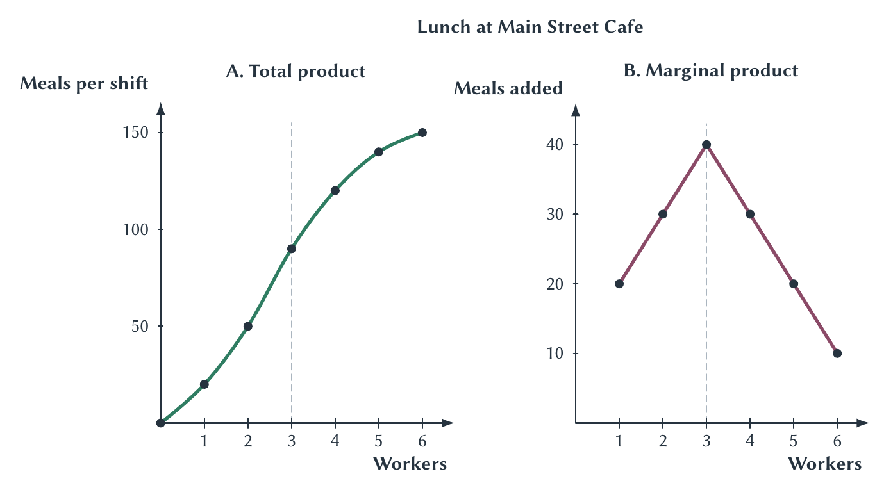
CHAPTER 13
Specialization raises marginal product before crowding reduces it
Later workers are not worse workers; they have less fixed kitchen capacity available per worker.
PRINCIPLES OF MICRO
8
Notes:
Total product keeps rising because marginal product remains positive. Diminishing marginal product means the additions get smaller, not that total output must fall.
[Sources]
- Principles of Micro, Chapter 13: Costs and Production (current project draft).
- Project-reviewed Chapter 13 figures from figures/ch13_costs_and_production/.
[/Sources]

Slide 9
CHAPTER 13
Practice: work from totals to margins and back
Mechanics
Bikes repaired
Marginal product
0
0
--
1
8
?
2
?
12
3
29
?
4
?
6
5
38
?
Subtract totals to find a margin; add the margin to recover the next total.
PRINCIPLES OF MICRO
9
Notes:
Pause before revealing answers orally: 8, 20, 9, 35, and 3. The equations simply shorten addition and subtraction.
[Sources]
- Principles of Micro, Chapter 13: Costs and Production (current project draft).
[/Sources]

Slide 10
CHAPTER 13
Production becomes cost when inputs receive prices
FIXED COST
VARIABLE COST
$300 kitchen cost
$120 per worker
The cost is unchanged whether the cafe serves zero meals or 150 during the lunch shift.
Hiring more labor raises cost as the cafe expands current output.
Total cost = fixed cost + variable cost.
PRINCIPLES OF MICRO
10
Notes:
Real restaurants also have ingredients and packaging. The simplified example isolates labor productivity.
[Sources]
- Principles of Micro, Chapter 13: Costs and Production (current project draft).
[/Sources]

Slide 11
CHAPTER 13
Marginal product and marginal cost move in opposite directions
Additional worker
Meals added
Labor cost
Cost per added meal
2nd
30
$120
$4
3rd
40
$120
$3
5th
20
$120
$6
6th
10
$120
$12
When the same wage produces fewer additional meals, each additional meal costs more.
PRINCIPLES OF MICRO
11
Notes:
The wage does not change. Marginal cost changes because marginal product changes.
[Sources]
- Principles of Micro, Chapter 13: Costs and Production (current project draft).
[/Sources]

Slide 12
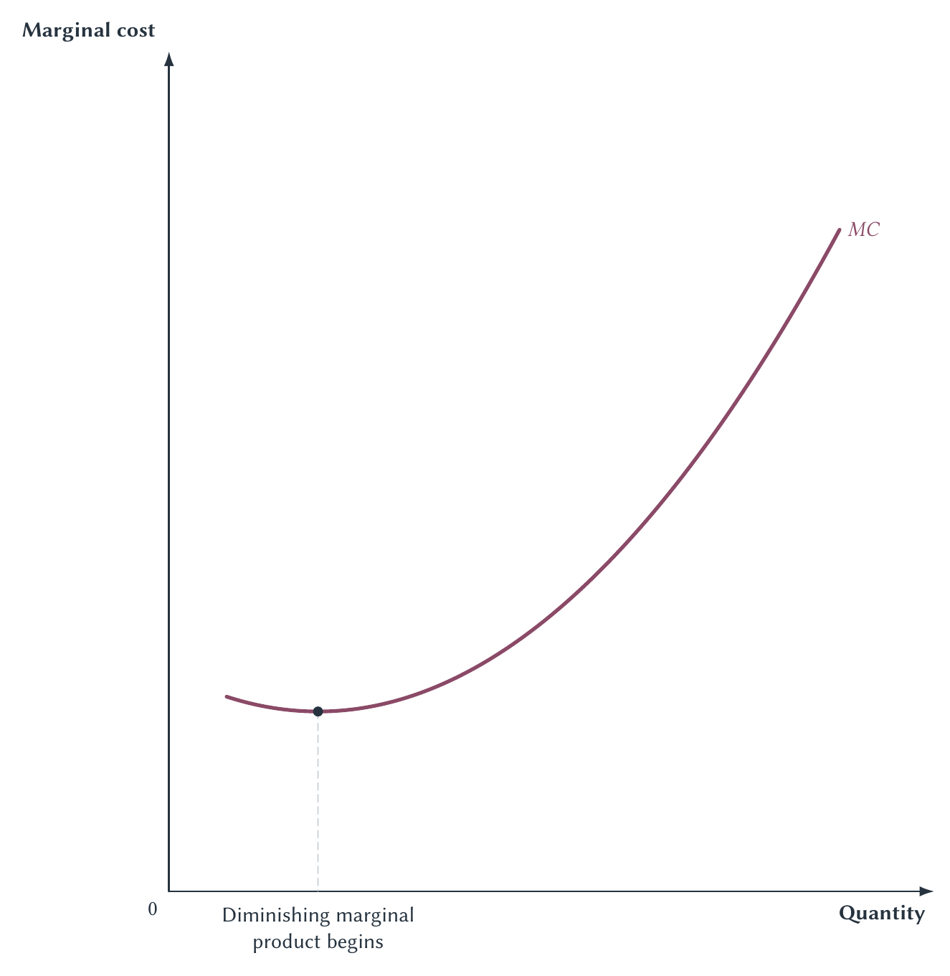
CHAPTER 13
The marginal-cost curve comes from production
Marginal cost reaches its minimum when marginal product reaches its maximum.
PRINCIPLES OF MICRO
12
Notes:
Tie every part of the curve back to the kitchen. The curve is a compressed production story, not an arbitrary shape.
[Sources]
- Principles of Micro, Chapter 13: Costs and Production (current project draft).
- Project-reviewed Chapter 13 figures from figures/ch13_costs_and_production/.
[/Sources]

Slide 13
CHAPTER 13
Average costs divide total costs by output
AVERAGE FIXED COST
AVERAGE VARIABLE COST
AVERAGE TOTAL COST
AFC = FC ÷ Q
AVC = VC ÷ Q
ATC = TC ÷ Q
Spreading a fixed cost over more output always pushes average fixed cost down.
Variable cost per unit reflects how much variable input the firm needs.
Average total cost equals average fixed cost plus average variable cost.
Marginal cost asks about the next unit; average cost looks backward across all units produced.
PRINCIPLES OF MICRO
13
Notes:
Do not display the full nine-column cost schedule on one slide. Build the definitions before combining the curves.
[Sources]
- Principles of Micro, Chapter 13: Costs and Production (current project draft).
[/Sources]

Slide 14
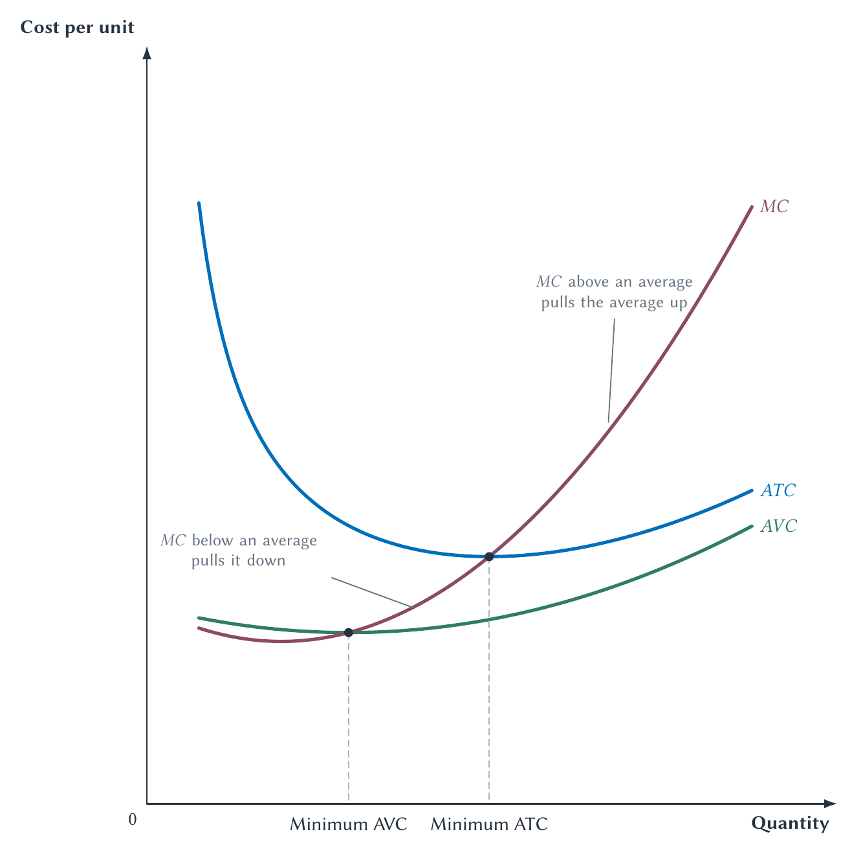
CHAPTER 13
The marginal pulls the average
MC below an average pulls it down; MC above an average pulls it up.
PRINCIPLES OF MICRO
14
Notes:
Avoid saying the curves are generally equal. They are equal only at the minimum of the relevant average curve.
[Sources]
- Principles of Micro, Chapter 13: Costs and Production (current project draft).
- Project-reviewed Chapter 13 figures from figures/ch13_costs_and_production/.
[/Sources]

Slide 15
CHAPTER 13
Your semester GPA follows the same marginal-average rule
A semester GPA above your cumulative GPA pulls the cumulative average up; one below it pulls the average down.
That is why MC crosses AVC and ATC at their minimum points.
PRINCIPLES OF MICRO
15
Notes:
Use the familiar GPA analogy before returning to the cost graph. The current semester is the marginal addition.
[Sources]
- Principles of Micro, Chapter 13: Costs and Production (current project draft).
[/Sources]

Slide 16
CHAPTER 13
Fixed cost and sunk cost answer different questions
FIXED FOR CURRENT OUTPUT
SUNK
Does not change with Q today
Cannot be recovered
A payment may be fixed during the current decision but still avoidable later.
A past expenditure that no current choice can change should not affect the current decision.
Every sunk cost is fixed for the current decision, but not every fixed cost is permanently sunk.
PRINCIPLES OF MICRO
16
Notes:
Use a nonrefundable renovation as sunk and a month-to-month lease as fixed during the month but avoidable later.
[Sources]
- Principles of Micro, Chapter 13: Costs and Production (current project draft).
[/Sources]

Slide 17
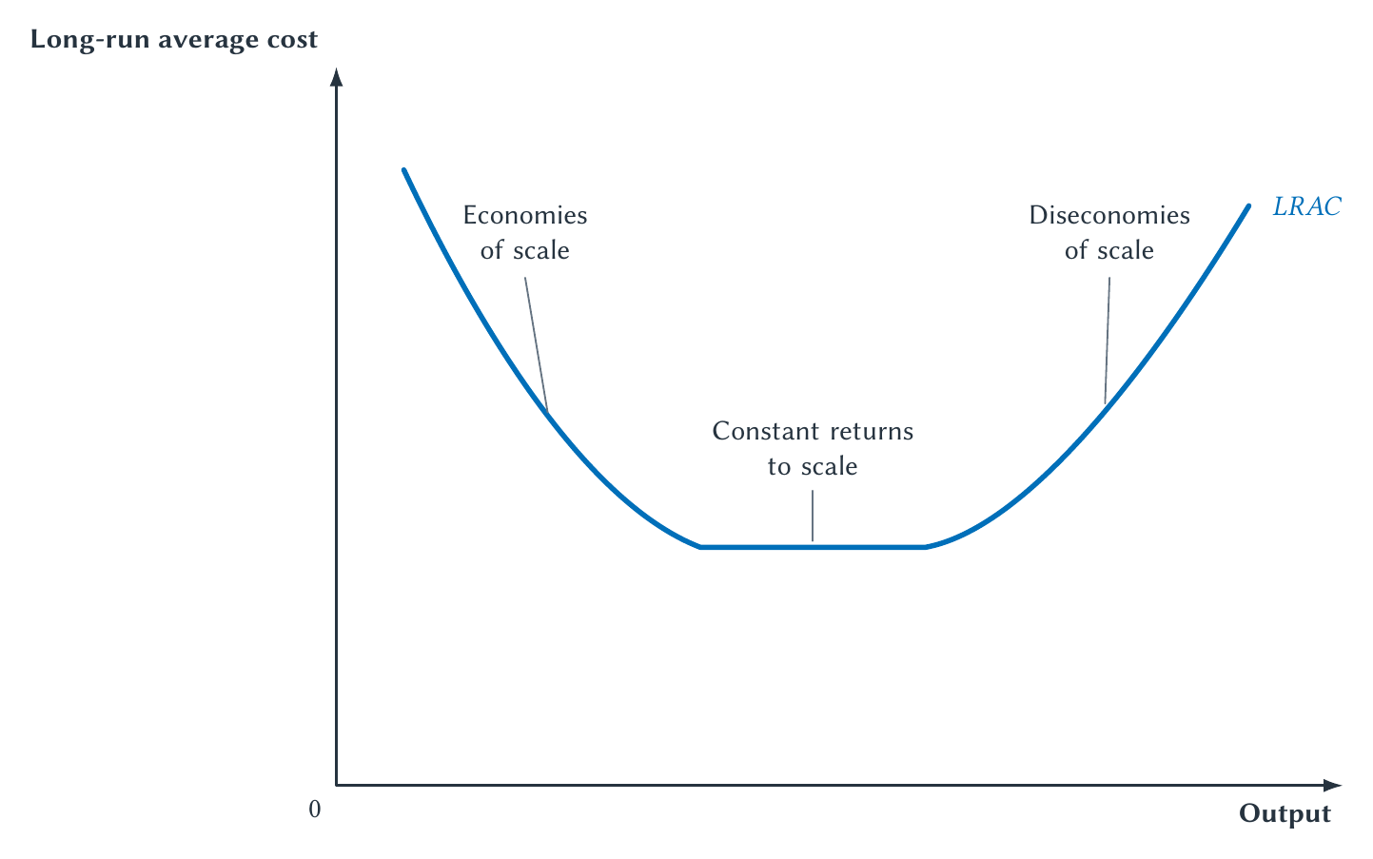
CHAPTER 13
Long-run average cost asks how scale changes unit cost
In the long run every input can change; the question is whether average cost falls, stays flat, or rises with scale.
PRINCIPLES OF MICRO
17
Notes:
Distinguish long-run scale from short-run diminishing marginal product. They answer different questions.
[Sources]
- Principles of Micro, Chapter 13: Costs and Production (current project draft).
- Project-reviewed Chapter 13 figures from figures/ch13_costs_and_production/.
[/Sources]

Slide 18
CHAPTER 13
Minimum efficient scale is a cost concept
MES is the smallest output at which long-run average cost reaches its minimum.
•
It is not automatically the profit-maximizing quantity.
•
A small MES relative to market demand allows many efficient-sized firms.
•
A large MES relative to market demand can support only a few efficient-sized firms.
PRINCIPLES OF MICRO
18
Notes:
Keep MES in prose rather than adding it to the figure. This prepares students for market structure.
[Sources]
- Principles of Micro, Chapter 13: Costs and Production (current project draft).
[/Sources]

Slide 19
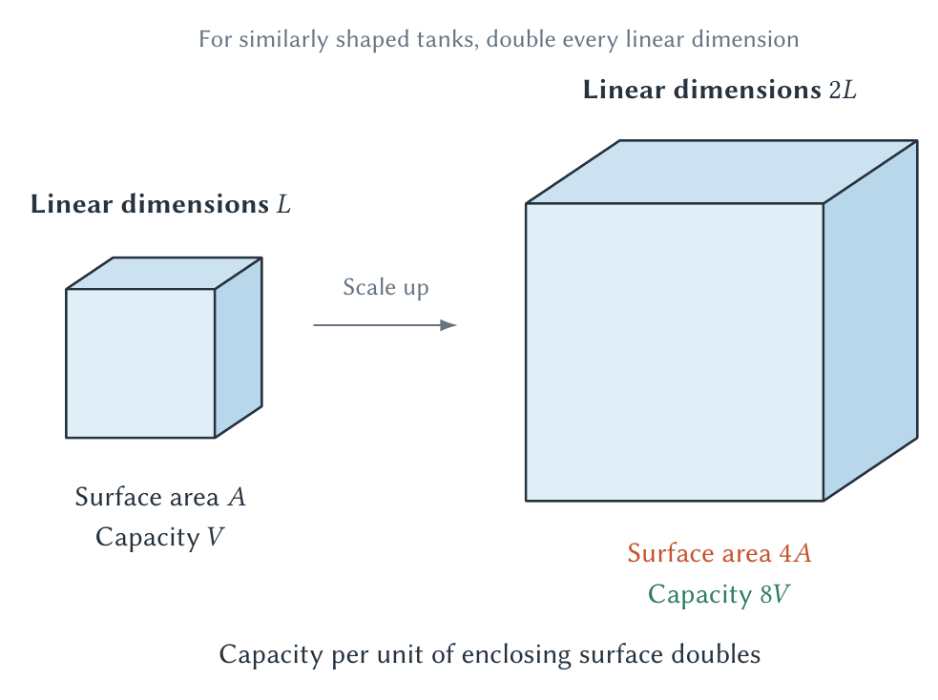
CHAPTER 13
Physical law can create economies of scale
Capacity can grow faster than the material needed merely to enclose it.
PRINCIPLES OF MICRO
19
Notes:
Use tankers as the memorable application. Geometry contributes to scale economies but does not settle propulsion, port, risk, or engineering costs.
[Sources]
- Principles of Micro, Chapter 13: Costs and Production (current project draft).
- Project-reviewed Chapter 13 figures from figures/ch13_costs_and_production/.
[/Sources]

Slide 20
CHAPTER 13
Average cost can fall for several reasons
•
Spread a large design, plant, or compliance cost over more units.
•
Use specialized workers, machines, or production stages.
•
Buy or ship inputs in larger, more efficient quantities.
•
Exploit physical relationships such as capacity growing faster than surface area.
Name the source of an economy of scale instead of merely asserting one.
PRINCIPLES OF MICRO
20
Notes:
Semiconductor fabrication illustrates large fixed commitments and specialized production stages.
[Sources]
- Principles of Micro, Chapter 13: Costs and Production (current project draft).
- OECD, Measuring Distortions in International Markets: The Semiconductor Value Chain, OECD Trade Policy Paper 234, 2019.
[/Sources]

Slide 21
CHAPTER 13
Diseconomies of scale usually come from organization
There is no physical law that requires every large firm to become inefficient.
•
Communication passes through more people and layers.
•
Effort and quality become harder to observe.
•
Managers may pursue goals that differ from owners' goals.
•
Monitoring creates its own costs and incentive problems.
PRINCIPLES OF MICRO
21
Notes:
Link back to Chapter 12. Better ownership, contracts, technology, and internal rules can reduce these costs.
[Sources]
- Principles of Micro, Chapter 13: Costs and Production (current project draft).
[/Sources]

Slide 22
CHAPTER 13
Collective farming promised scale and weakened incentives
Larger fields and shared machinery could create technical gains, but diffuse claims on output reduced the reward from effort and local knowledge.
•
Households received little of the extra value from careful work.
•
Monitoring every action was costly.
•
China's household responsibility reforms strengthened claims on output and productivity rose sharply.
PRINCIPLES OF MICRO
22
Notes:
The lesson is not that every farm should be small. Scale and incentives must be evaluated together.
[Sources]
- Principles of Micro, Chapter 13: Costs and Production (current project draft).
- Justin Yifu Lin, Rural Reforms and Agricultural Growth in China, American Economic Review 82(1), 1992; John McMillan, John Whalley, and Zhu Lijing, The Impact of China's Economic Reforms on Agricultural Productivity Growth, Journal of Political Economy 97(4), 1989.
[/Sources]

Slide 23
CHAPTER 13
Different products create different cost structures
RESTAURANT
HOTEL OR SOFTWARE
Variable cost rises with service
High capacity cost, low cost of one more user
More meals require more labor, ingredients, and use of crowded capacity.
An empty room or digital copy may be cheap to serve after the capacity already exists.
A low marginal cost does not mean creating the capacity was cheap.
PRINCIPLES OF MICRO
23
Notes:
Preview monopoly and price discrimination. Large fixed costs with low marginal cost complicate pricing, entry, and recovery of total cost.
[Sources]
- Principles of Micro, Chapter 13: Costs and Production (current project draft).
[/Sources]

Slide 24
CHAPTER 13
Cost curves compress real production choices
•
Economic cost includes explicit payments and implicit opportunities given up.
•
Diminishing marginal product comes from adding a variable input to fixed capacity.
•
Falling marginal product causes rising marginal cost when the input price is unchanged.
•
The marginal pulls the average; long-run scale depends on technology and organization.
Next: a competitive firm combines these costs with a market-given price.
PRINCIPLES OF MICRO
24
Notes:
Close by asking students to explain one cost curve without using the graph: what is happening in the restaurant?
[Sources]
- Principles of Micro, Chapter 13: Costs and Production (current project draft).
[/Sources]

