Slide 1

Perfect Competition
Chapter 14
Principles of Micro
When entry is easy, economic profit attracts the competition that erodes it
Mark Wilson
Notes:
Define market structure before introducing perfect competition. This is the benchmark from which monopoly, monopolistic competition, and oligopoly will depart.
[Sources]
- Principles of Micro, Chapter 14: Perfect Competition (current project draft).
- Cover artwork: design/book-cover/principles-of-micro-cover.png (project-generated asset).
[/Sources]

Slide 2
CHAPTER 14
Market structure describes the competitive setting
How many sellers compete, how similar are their products, and how difficult is entry?
•
Perfect competition begins with many small firms and easy entry.
•
Monopoly begins with one seller protected by an entry barrier.
•
Other structures lie between those benchmarks.
PRINCIPLES OF MICRO
2
Notes:
Use organization of industry and market structure as synonyms at this level. The chapter begins with the clean competitive benchmark.
[Sources]
- Principles of Micro, Chapter 14: Perfect Competition (current project draft).
[/Sources]

Slide 3
CHAPTER 14
Perfect competition rests on four conditions
Condition
Meaning
Many buyers and sellers
No single participant is large relative to the market.
Identical or very similar product
Buyers readily switch among sellers.
Good information
Prices and relevant product features are observable.
Free entry and exit
Resources can enter when economic profit appears and leave after losses.
These conditions make each firm a price taker.
PRINCIPLES OF MICRO
3
Notes:
Treat the assumptions as a benchmark, not a claim that every actual market fits perfectly.
[Sources]
- Principles of Micro, Chapter 14: Perfect Competition (current project draft).
[/Sources]

Slide 4
CHAPTER 14
The market sets the price; the firm chooses quantity
MARKET
INDIVIDUAL FIRM
Demand and supply determine P
Can sell at P
Thousands of buyers and sellers jointly determine the market price.
The firm is too small to change the price and can choose how much to produce at that price.
A competitive firm has no reason to charge less and cannot charge more.
PRINCIPLES OF MICRO
4
Notes:
Price taking does not mean passivity. The firm still chooses output, technology, entry, exit, and other decisions.
[Sources]
- Principles of Micro, Chapter 14: Perfect Competition (current project draft).
[/Sources]

Slide 5
CHAPTER 14
For a price taker, each additional unit adds the market price
Marginal revenue = Price
Selling one more unit does not force the competitive firm to lower the price on earlier units.
If P = $12, every additional unit adds $12 to total revenue.
PRINCIPLES OF MICRO
5
Notes:
This simple result is what changes under monopoly in Chapter 15.
[Sources]
- Principles of Micro, Chapter 14: Perfect Competition (current project draft).
[/Sources]

Slide 6
CHAPTER 14
Choose output by comparing price with marginal cost
Produce more when P > MC; produce less when P < MC; stop adjusting when P = MC.
•
If price exceeds marginal cost, the next unit adds more revenue than cost.
•
If marginal cost exceeds price, the last unit costs more than it adds to revenue.
•
The rule finds the quantity that maximizes economic profit or minimizes loss.
PRINCIPLES OF MICRO
6
Notes:
Emphasize the directional reasoning before the equality. P equals MC is the stopping point because neither expanding nor contracting can improve profit.
[Sources]
- Principles of Micro, Chapter 14: Perfect Competition (current project draft).
[/Sources]

Slide 7
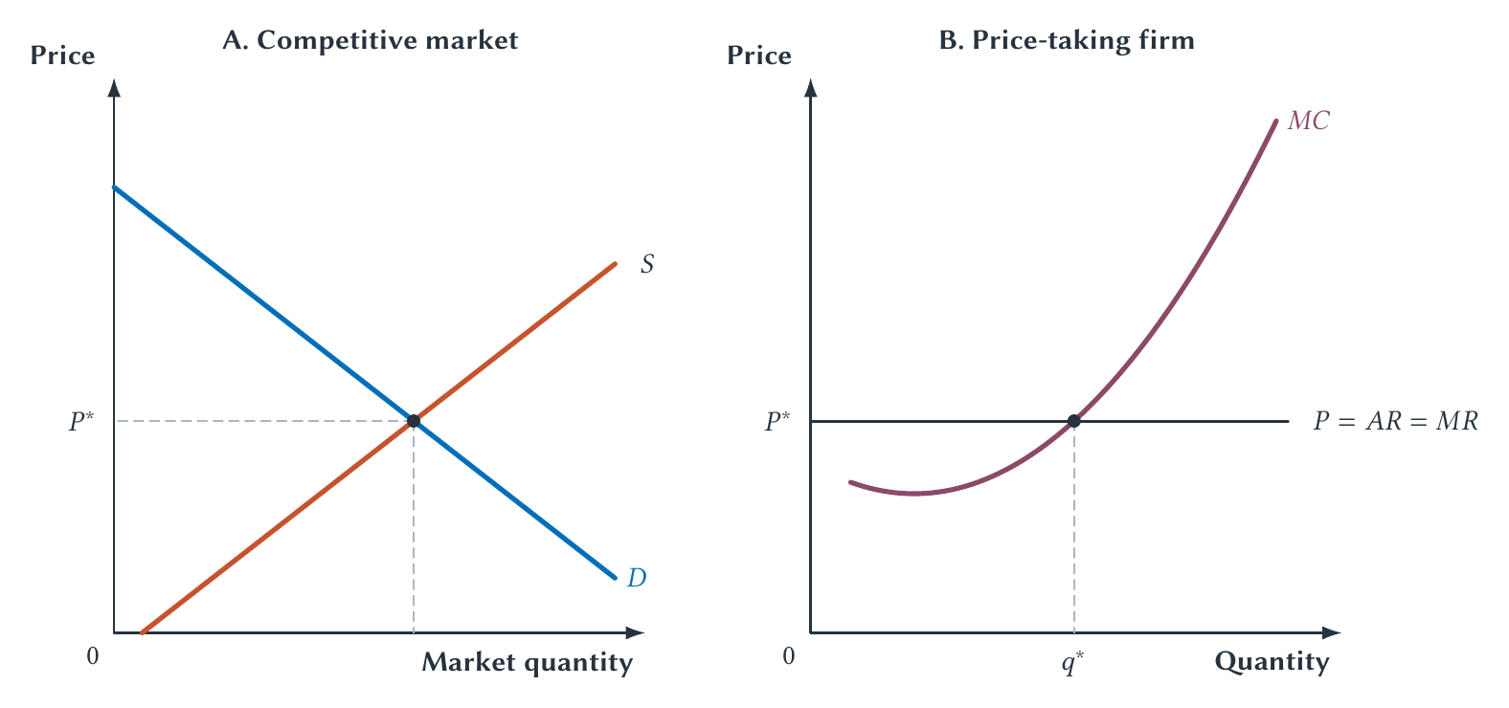
CHAPTER 14
The competitive firm produces where price meets marginal cost
The market sends the price signal; the firm's cost curve determines its output response.
PRINCIPLES OF MICRO
7
Notes:
Trace price from the market panel to the firm panel. Then move left and right of the chosen output to apply P greater than or less than MC.
[Sources]
- Principles of Micro, Chapter 14: Perfect Competition (current project draft).
- Project-reviewed Chapter 14 figures from figures/ch14_perfect_competition/.
[/Sources]

Slide 8
CHAPTER 14
Output choice and economic profit are separate questions
OUTPUT DECISION
PROFIT TEST
P compared with MC
P compared with ATC
This identifies the best quantity given the current price.
At that quantity, price above average total cost creates positive economic profit.
A firm can choose the best quantity and still earn an economic loss.
PRINCIPLES OF MICRO
8
Notes:
Students often confuse the marginal output rule with the average profit test. Keep them on separate slides before combining them.
[Sources]
- Principles of Micro, Chapter 14: Perfect Competition (current project draft).
[/Sources]

Slide 9
CHAPTER 14
Economic profit is revenue minus every economic cost
Economic profit = (P − ATC) × Q
The height P minus ATC is profit per unit; multiplying by quantity gives total economic profit.
Opportunity cost of the owner's money and time is already inside ATC.
PRINCIPLES OF MICRO
9
Notes:
Use economic profit consistently when discussing entry and exit. Positive economic profit means more than a normal accounting return.
[Sources]
- Principles of Micro, Chapter 14: Perfect Competition (current project draft).
[/Sources]

Slide 10
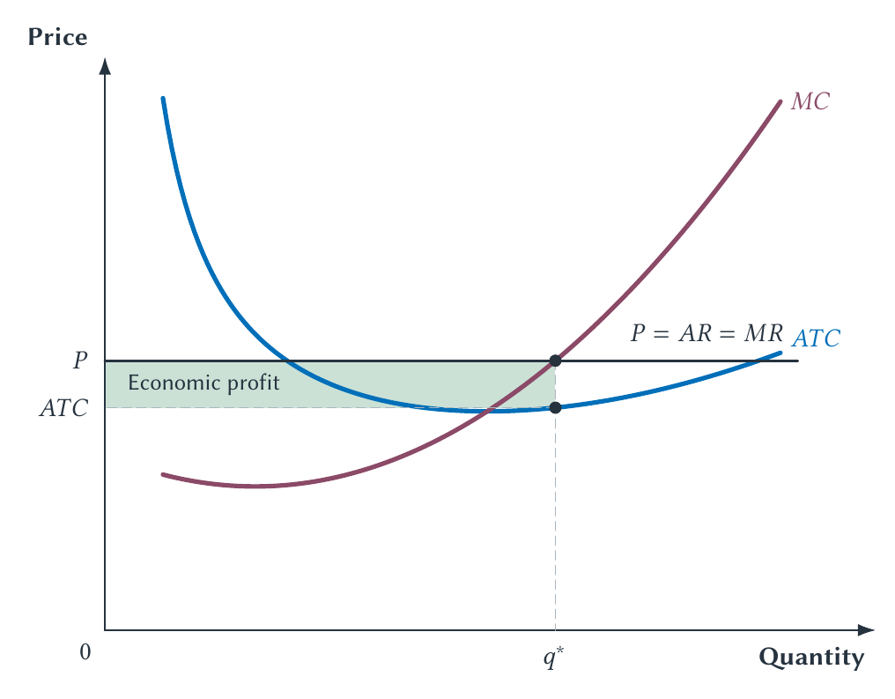
CHAPTER 14
Price above average total cost creates short-run economic profit
The firm chooses quantity using MC, then measures profit using ATC.
PRINCIPLES OF MICRO
10
Notes:
Read the rectangle as height times width. Do not imply that the profit label is another curve.
[Sources]
- Principles of Micro, Chapter 14: Perfect Competition (current project draft).
- Project-reviewed Chapter 14 figures from figures/ch14_perfect_competition/.
[/Sources]

Slide 11
CHAPTER 14
Producing at a loss can reduce the loss
A hotel can rent a room below average total cost when the room revenue still covers cleaning and other avoidable costs.
•
The building cost exists for the night whether the room is empty or occupied.
•
Renting the room helps pay part of that fixed cost.
•
The same logic can keep a laundromat open during a slow period.
PRINCIPLES OF MICRO
11
Notes:
Use the hotel and laundromat as alternatives to the familiar restaurant-lunch examples. The short-run question is whether operating covers variable cost.
[Sources]
- Principles of Micro, Chapter 14: Perfect Competition (current project draft).
[/Sources]

Slide 12
CHAPTER 14
Lead with total revenue and variable cost
Operate in the short run when TR ≥ VC
Revenue covers the wage bill and other variable costs, so operating contributes something toward fixed cost.
Divide both sides by Q to place the same test on the graph: P ≥ AVC.
PRINCIPLES OF MICRO
12
Notes:
Walk through the division only after the intuitive wage-bill example. Students should see P greater than AVC as the graphical form of the total-revenue test.
[Sources]
- Principles of Micro, Chapter 14: Perfect Competition (current project draft).
[/Sources]

Slide 13
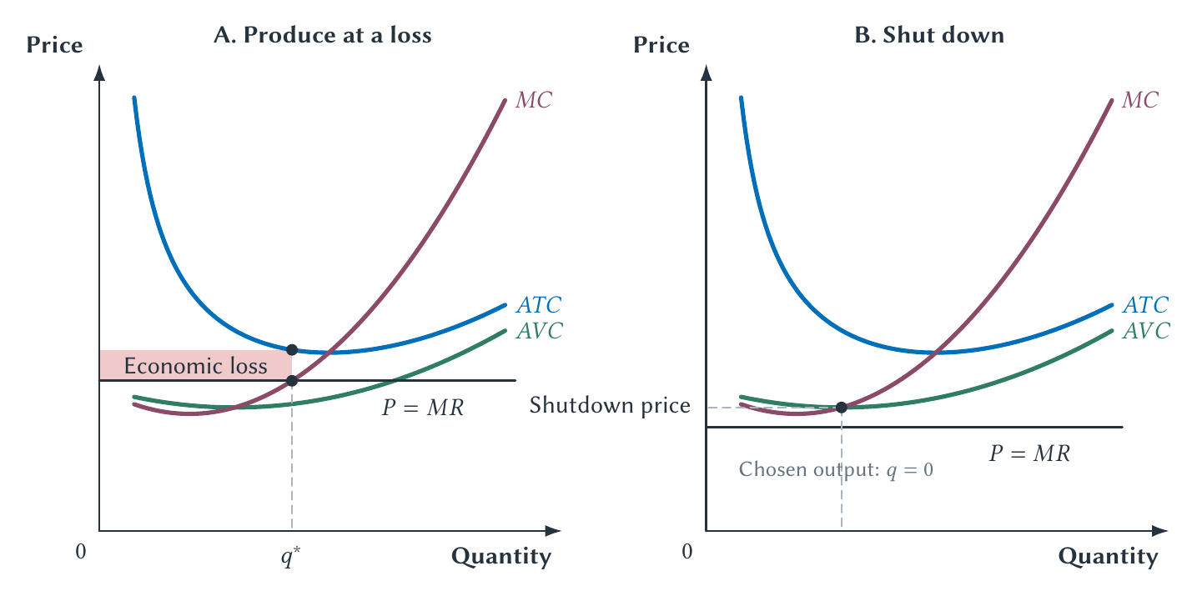
CHAPTER 14
A firm can operate with a loss or shut down
Below AVC, producing adds more variable cost than revenue and makes the loss larger.
PRINCIPLES OF MICRO
13
Notes:
Explain both panels in total terms first. Fixed cost remains in the short run whether the firm operates or shuts down.
[Sources]
- Principles of Micro, Chapter 14: Perfect Competition (current project draft).
- Project-reviewed Chapter 14 figures from figures/ch14_perfect_competition/.
[/Sources]

Slide 14
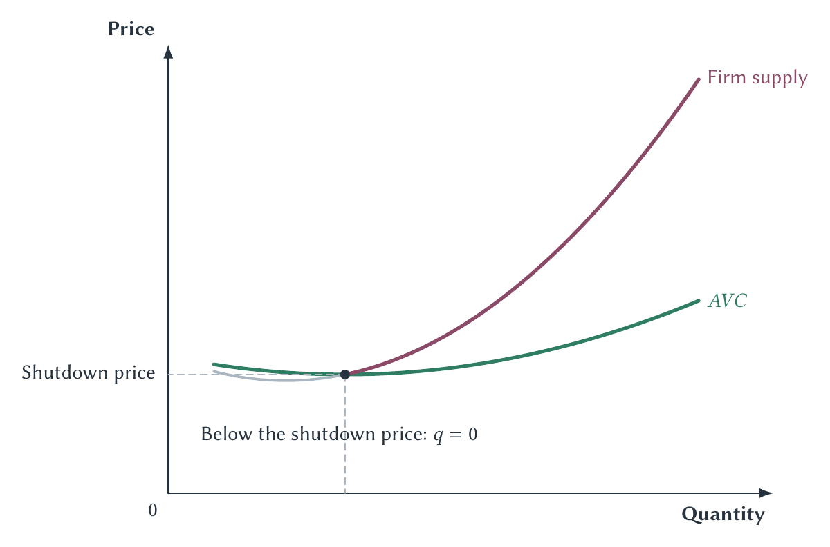
CHAPTER 14
The firm's short-run supply curve is MC above AVC
A higher price moves the firm to a higher quantity on MC, unless price falls below the shutdown point.
PRINCIPLES OF MICRO
14
Notes:
Reconnect to Chapter 3: a supply curve records how quantity supplied changes when the good's own price changes. P equals MC generates that response.
[Sources]
- Principles of Micro, Chapter 14: Perfect Competition (current project draft).
- Project-reviewed Chapter 14 figures from figures/ch14_perfect_competition/.
[/Sources]

Slide 15
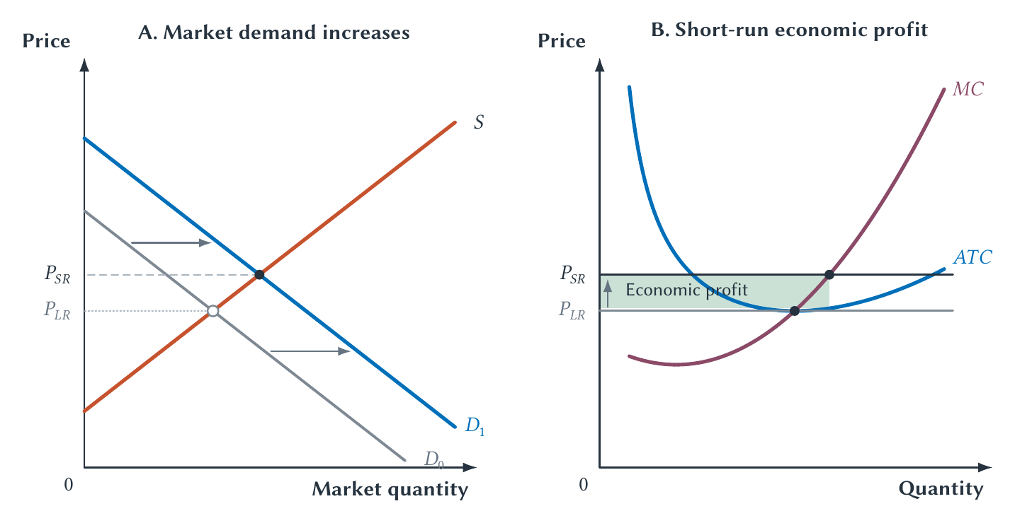
CHAPTER 14
A demand increase can create short-run economic profit
Economic profit can arise from a change in market conditions, not only from special talent or wrongdoing.
PRINCIPLES OF MICRO
15
Notes:
This figure supplies the missing starting point for entry. Trace the market demand shift, higher price, firm's higher output, and positive profit.
[Sources]
- Principles of Micro, Chapter 14: Perfect Competition (current project draft).
- Project-reviewed Chapter 14 figures from figures/ch14_perfect_competition/.
[/Sources]

Slide 16
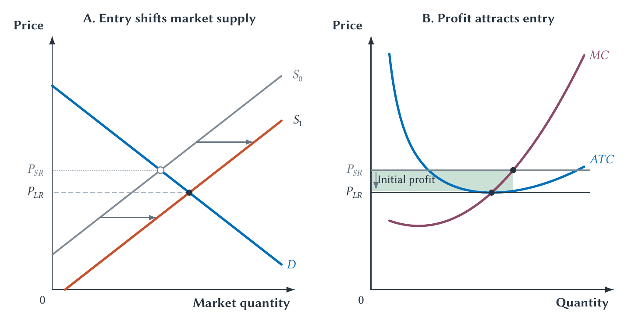
CHAPTER 14
Economic profit attracts entry and expands market supply
Entry competes away economic profit by raising market output and lowering price.
PRINCIPLES OF MICRO
16
Notes:
Entry does not shift one existing firm's MC or ATC. It adds firms to the market and shifts market supply.
[Sources]
- Principles of Micro, Chapter 14: Perfect Competition (current project draft).
- Project-reviewed Chapter 14 figures from figures/ch14_perfect_competition/.
[/Sources]

Slide 17
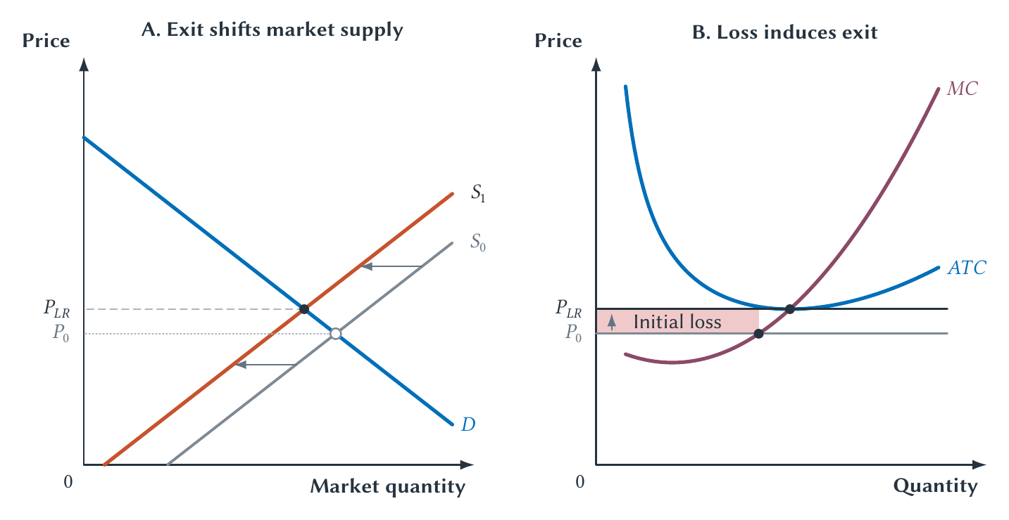
CHAPTER 14
Economic loss encourages exit and contracts market supply
Exit reduces market output until the remaining firms cover every economic cost.
PRINCIPLES OF MICRO
17
Notes:
Use the entry story in reverse. The firm exits in the long run because all costs are avoidable then.
[Sources]
- Principles of Micro, Chapter 14: Perfect Competition (current project draft).
- Project-reviewed Chapter 14 figures from figures/ch14_perfect_competition/.
[/Sources]

Slide 18
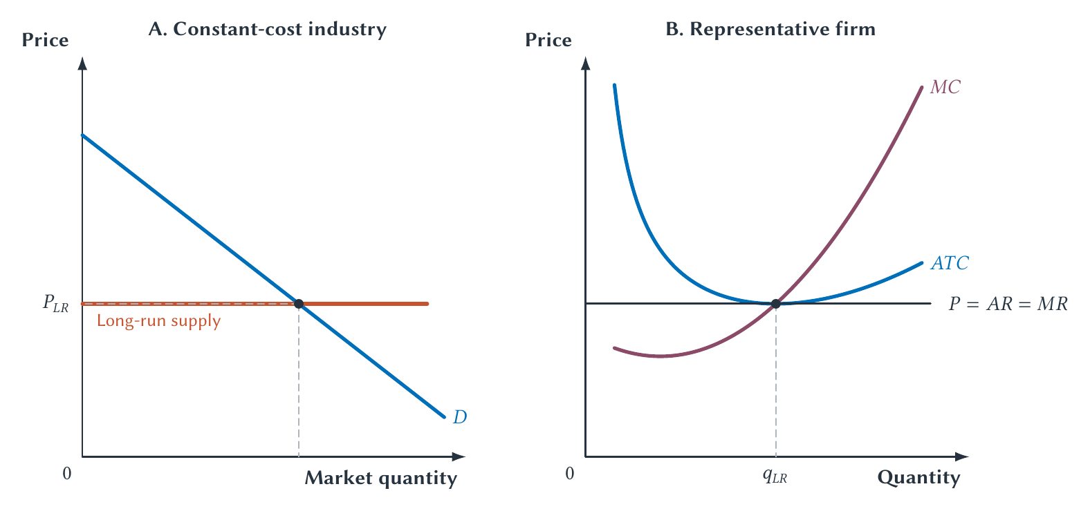
CHAPTER 14
Long-run competitive equilibrium leaves zero economic profit
Zero economic profit means the firm covers explicit costs and earns a normal return on owner-supplied resources.
PRINCIPLES OF MICRO
18
Notes:
Tie back to Chapter 13. Owners are not working for nothing; economic profit is zero because opportunity cost is included in total cost.
[Sources]
- Principles of Micro, Chapter 14: Perfect Competition (current project draft).
- Project-reviewed Chapter 14 figures from figures/ch14_perfect_competition/.
[/Sources]

Slide 19
CHAPTER 14
Long-run market supply need not always be horizontal
INCREASING-COST INDUSTRY
DECREASING-COST INDUSTRY
Expansion raises input costs
Expansion improves the environment
New firms bid up specialized labor, land, or materials, so long-run price rises with industry output.
A larger industry can support specialized suppliers, infrastructure, or knowledge that lowers cost.
The constant-cost case is a benchmark, not a law.
PRINCIPLES OF MICRO
19
Notes:
Keep these cases brief and intuitive. Long-run supply depends on how industry expansion changes the costs facing individual firms.
[Sources]
- Principles of Micro, Chapter 14: Perfect Competition (current project draft).
[/Sources]

Slide 20
CHAPTER 14
Free entry does not mean costless entry
It means no artificial barrier prevents a new firm from entering on the same basic terms as incumbents.
•
A restaurant still needs capital, workers, licenses, and a location.
•
A new firm may make mistakes and bear real risk.
•
Entry eliminates persistent economic profit only when those costs are available to competitors too.
PRINCIPLES OF MICRO
20
Notes:
Distinguish real production cost from an entry barrier that protects incumbents from competition.
[Sources]
- Principles of Micro, Chapter 14: Perfect Competition (current project draft).
[/Sources]

Slide 21
CHAPTER 14
Large fixed cost and low marginal cost complicate the benchmark
Price equal to marginal cost may not cover the cost of creating capacity.
Cost structure helps determine whether many firms can survive.
PRINCIPLES OF MICRO
21
Notes:
Preview natural monopoly and price discrimination. Do not jump from high fixed cost directly to monopoly without considering market demand and entry conditions.
[Sources]
- Principles of Micro, Chapter 14: Perfect Competition (current project draft).
[/Sources]

Slide 22
CHAPTER 14
Rent-to-own: diagnose the high price before declaring exploitation
With few entry barriers, unusually high economic profit should attract competitors and push price toward economic cost.
•
Is the total price high because default, collection, delivery, and repossession are costly?
•
Do customers value flexibility or immediate access without credit?
•
Is information poor or is an entry barrier protecting persistent profit?
PRINCIPLES OF MICRO
22
Notes:
Lead students to the implication. A harsh description of an industry is not a substitute for evidence of persistent economic profit or an entry barrier.
[Sources]
- Principles of Micro, Chapter 14: Perfect Competition (current project draft).
- Alix M. Freedman, Peddling Dreams, Wall Street Journal, September 22, 1993; Federal Trade Commission, Survey of Rent-to-Own Customers, 2000.
[/Sources]

Slide 23
CHAPTER 14
Competitive markets can converge without one person knowing the whole market
In Vernon Smith's experiments, repeated trading moved prices toward the competitive prediction even though participants knew only their own values or costs.
Use as an optional evidence question, not a required theory section.
PRINCIPLES OF MICRO
23
Notes:
Ask what the experiment suggests about decentralized coordination and what limits keep it from proving every real market converges automatically.
[Sources]
- Principles of Micro, Chapter 14: Perfect Competition (current project draft).
- Vernon L. Smith, An Experimental Study of Competitive Market Behavior, Journal of Political Economy 70(2), 1962.
[/Sources]

Slide 24
CHAPTER 14
Entry turns short-run profit into long-run discipline
•
A competitive firm takes price as given and chooses output where P equals MC.
•
Price above ATC creates economic profit; price below ATC creates loss.
•
The firm operates in the short run when revenue covers variable cost.
•
Entry expands supply after profit; exit contracts supply after loss.
•
Long-run zero economic profit includes a normal return.
Next: a monopolist faces the market demand curve and searches for the most profitable price.
PRINCIPLES OF MICRO
24
Notes:
End with the full dynamic story: demand changes, profit appears, entry occurs, supply shifts, and profit is competed away.
[Sources]
- Principles of Micro, Chapter 14: Perfect Competition (current project draft).
[/Sources]

