Slide 1

Monopoly
Chapter 15
Principles of Micro
A monopoly is a price searcher protected from close substitutes and entry
Mark Wilson
Notes:
Begin with the puzzle: how many monopolies are there? The answer depends on the relevant market and the availability of close substitutes.
[Sources]
- Principles of Micro, Chapter 15: Monopoly (current project draft).
- Cover artwork: design/book-cover/principles-of-micro-cover.png (project-generated asset).
[/Sources]

Slide 2
CHAPTER 15
A monopoly is more than one seller
A monopolist is the only seller of a product with no close substitutes.
•
One seller of a narrowly named brand may still face close alternatives.
•
One local electricity-delivery network may have no practical substitute.
•
The relevant market determines whether the word monopoly fits.
PRINCIPLES OF MICRO
2
Notes:
Stress no close substitutes as strongly as one seller. A firm can have market power without being a literal monopoly.
[Sources]
- Principles of Micro, Chapter 15: Monopoly (current project draft).
[/Sources]

Slide 3
CHAPTER 15
Cross-price elasticity helps define the relevant market
STRONG SUBSTITUTES
WEAK SUBSTITUTES
Buyers switch when price rises
Buyers have few alternatives
A positive and sizable cross-price response suggests the products constrain one another.
A small response suggests the seller may have substantial market power within the relevant market.
Counting firms is less informative than asking what buyers can switch to.
PRINCIPLES OF MICRO
3
Notes:
This reconnects monopoly to Chapter 5. Do not turn market definition into a technical antitrust exercise.
[Sources]
- Principles of Micro, Chapter 15: Monopoly (current project draft).
[/Sources]

Slide 4
CHAPTER 15
Entry barriers protect monopoly power
Barrier
How it blocks entry
Control of a key input
Rivals cannot obtain an essential resource or facility.
Legal protection
A patent, license, or exclusive franchise limits who may sell.
Economies of scale
One firm can serve the market at lower average cost than several firms.
Network effects
A service becomes more useful when many users join the same network.
Without an entry barrier, economic profit attracts competitors.
PRINCIPLES OF MICRO
4
Notes:
Patents deserve separate treatment because the barrier is deliberately created to reward innovation for a limited time.
[Sources]
- Principles of Micro, Chapter 15: Monopoly (current project draft).
[/Sources]

Slide 5
CHAPTER 15
National Grid contains a monopoly and a competitive choice
Western New York customers may choose an energy supplier, but National Grid still owns the local delivery network.
•
Generating electricity can be separated from delivering it.
•
Duplicating poles, wires, and local distribution can be extremely costly.
•
The delivery service is the clearer natural-monopoly component.
PRINCIPLES OF MICRO
5
Notes:
Use the bill to separate supply charges from delivery and outage responsibility. Program details can change, so keep the visible claim general.
[Sources]
- Principles of Micro, Chapter 15: Monopoly (current project draft).
- National Grid, Energy Choice; New York State Department of Public Service, Retail Access Application.
[/Sources]

Slide 6
CHAPTER 15
A monopolist is a price searcher
The firm can choose any point on its demand curve, but not price and quantity independently.
•
A higher price means fewer units sold.
•
A lower price means more units sold.
•
The firm searches along demand for the combination that maximizes economic profit.
PRINCIPLES OF MICRO
6
Notes:
Price searcher is intuitive and worth using. The firm has discretion, but the demand curve constrains every choice.
[Sources]
- Principles of Micro, Chapter 15: Monopoly (current project draft).
[/Sources]

Slide 7
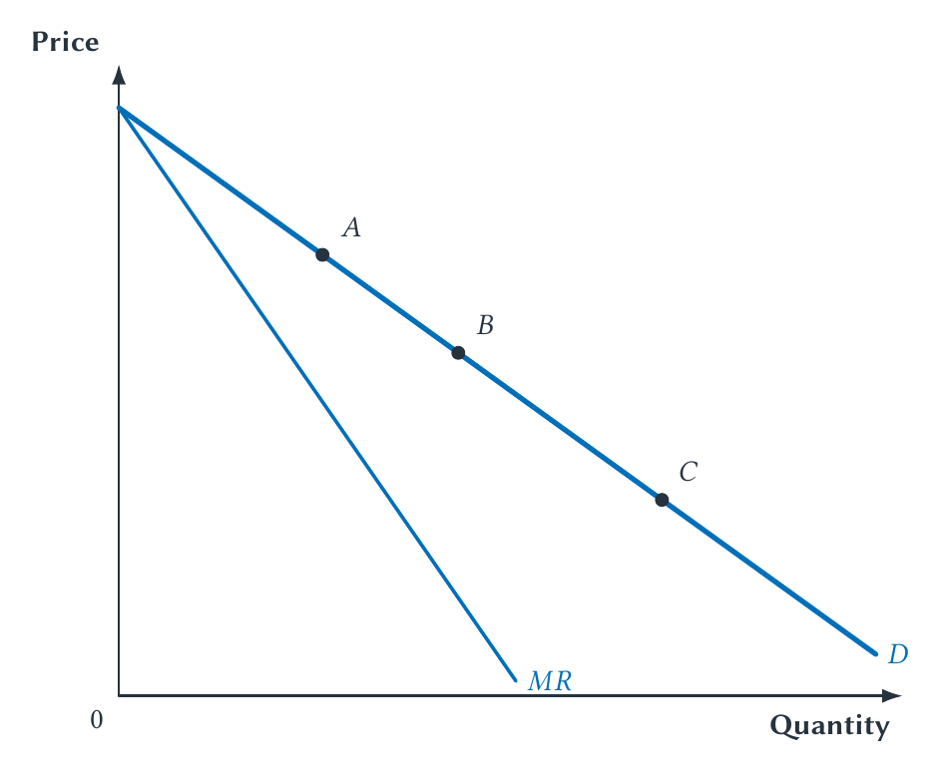
CHAPTER 15
Marginal revenue lies below demand
Selling another unit adds its price but lowers the price received on earlier units.
PRINCIPLES OF MICRO
7
Notes:
Use points A, B, and C to separate the quantity effect from the price effect. The loss on earlier units is why MR is below price.
[Sources]
- Principles of Micro, Chapter 15: Monopoly (current project draft).
- Project-reviewed Chapter 15 figures from figures/ch15_monopoly/.
[/Sources]

Slide 8
CHAPTER 15
One more sale creates two revenue effects
QUANTITY EFFECT
PRICE EFFECT
Sell one more unit
Lower price on earlier units
Revenue rises by the price received from the additional buyer.
When one posted price applies to everyone, expanding sales reduces revenue from units already sold.
Marginal revenue is the quantity gain minus the price loss.
PRINCIPLES OF MICRO
8
Notes:
Keep the explanation verbal. The chapter deliberately avoids the linear-demand algebra.
[Sources]
- Principles of Micro, Chapter 15: Monopoly (current project draft).
[/Sources]

Slide 9
CHAPTER 15
Choose monopoly output first, then price
STEP 1
STEP 2
STEP 3
Find the output
Stop at MR = MC
Move to demand
→
→
Expand while marginal revenue exceeds marginal cost.
The next unit would no longer add more revenue than cost.
Demand shows the highest price buyers will pay for that quantity.
Do not use the demand-MC intersection to choose monopoly output.
PRINCIPLES OF MICRO
9
Notes:
This two-step graphical rule is the center of the chapter.
[Sources]
- Principles of Micro, Chapter 15: Monopoly (current project draft).
[/Sources]

Slide 10
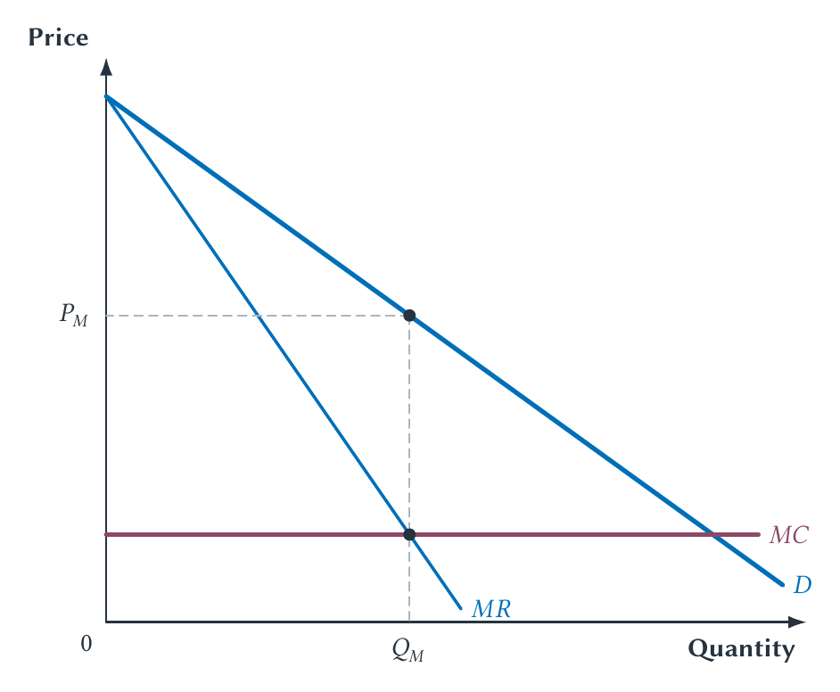
CHAPTER 15
The monopolist chooses quantity with MR and price with demand
The price exceeds marginal cost because the demand curve lies above MR at the chosen output.
PRINCIPLES OF MICRO
10
Notes:
Do not leave MR equals MC as a floating label. Demonstrate the two movements with the pointer or board.
[Sources]
- Principles of Micro, Chapter 15: Monopoly (current project draft).
- Project-reviewed Chapter 15 figures from figures/ch15_monopoly/.
[/Sources]

Slide 11
CHAPTER 15
A monopolist does not automatically earn economic profit
Demand may still be too weak to cover average total cost at the best output.
•
Market power changes the firm's demand and marginal revenue.
•
Economic profit still depends on price relative to average total cost.
•
A protected firm can make mistakes or face declining demand.
PRINCIPLES OF MICRO
11
Notes:
Separate market power from guaranteed success. Entry barriers prevent rivals from entering; they do not force buyers to cover cost.
[Sources]
- Principles of Micro, Chapter 15: Monopoly (current project draft).
[/Sources]

Slide 12
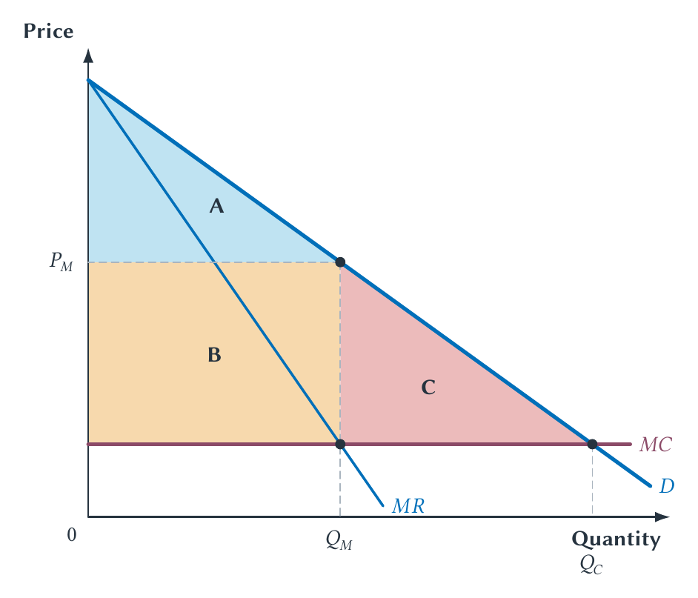
CHAPTER 15
Monopoly reduces output below the competitive benchmark
The deadweight loss comes from units not produced even though buyer value exceeds marginal cost.
PRINCIPLES OF MICRO
12
Notes:
Distinguish the transfer from consumers to the monopolist from the deadweight-loss triangle.
[Sources]
- Principles of Micro, Chapter 15: Monopoly (current project draft).
- Project-reviewed Chapter 15 figures from figures/ch15_monopoly/.
[/Sources]

Slide 13
CHAPTER 15
The high monopoly price is not itself the deadweight loss
The welfare loss comes from too little production.
•
A higher price transfers surplus from buyers to the seller on units still sold.
•
Units between monopoly output and competitive output would create gains from trade.
•
Those unrealized gains form the deadweight loss.
PRINCIPLES OF MICRO
13
Notes:
Perfect price discrimination later makes this point vivid: a monopolist can charge very high individual prices yet eliminate the lost-trade triangle by expanding output.
[Sources]
- Principles of Micro, Chapter 15: Monopoly (current project draft).
[/Sources]

Slide 14
CHAPTER 15
Market power alone does not identify the best remedy
POSSIBLE CONCERN
POSSIBLE CAUTION
Protected restriction of output
Innovation or scale created the position
An artificial barrier may preserve economic profit and prevent mutually beneficial trades.
A patent, lower cost, superior product, or network may create benefits that intervention could weaken.
Ask where the power came from and what a feasible remedy would improve.
PRINCIPLES OF MICRO
14
Notes:
The chapter should hint at policy without turning into a full antitrust course. Chapter 17 returns to competition policy.
[Sources]
- Principles of Micro, Chapter 15: Monopoly (current project draft).
[/Sources]

Slide 15
CHAPTER 15
Patent expiration can reveal the power of an entry barrier
When generic entry becomes possible, a drug's price can collapse toward manufacturing and distribution cost.
•
The patent rewards costly research by delaying imitation.
•
After expiration, multiple approved producers compete for the same molecule.
•
Greater generic competition is associated with much lower acquisition prices.
PRINCIPLES OF MICRO
15
Notes:
Use the dramatic brand-to-generic price change without promising a discrete $300-to-$3 fall for every drug or every patient.
[Sources]
- Principles of Micro, Chapter 15: Monopoly (current project draft).
- U.S. Food and Drug Administration, Generic Competition and Drug Prices, 2019.
[/Sources]

Slide 16
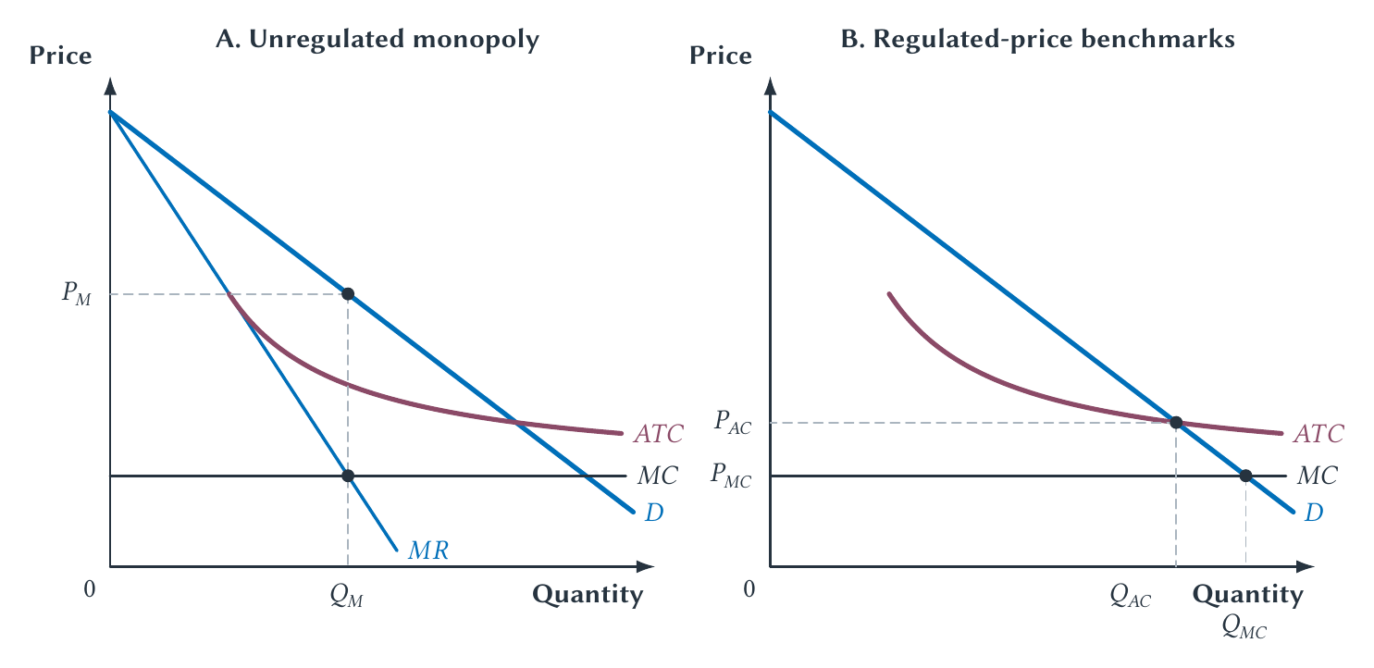
CHAPTER 15
A natural monopoly has falling average cost over market demand
Price equal to marginal cost may be efficient but too low to cover the network's total cost.
PRINCIPLES OF MICRO
16
Notes:
Compare three choices: monopoly pricing, marginal-cost pricing with a subsidy or loss, and average-cost pricing with zero economic profit.
[Sources]
- Principles of Micro, Chapter 15: Monopoly (current project draft).
- Project-reviewed Chapter 15 figures from figures/ch15_monopoly/.
[/Sources]

Slide 17
CHAPTER 15
Demsetz asked whether firms can compete for the market
Even if one network serves customers, firms might bid for the right to operate it under a specified contract.
•
Competition before the award can discipline price.
•
The contract must specify quality, investment, and adaptation.
•
Long-lived assets and changing conditions make renegotiation difficult.
PRINCIPLES OF MICRO
17
Notes:
Present the argument as a strong alternative to automatic rate regulation, then state why contracting is not costless.
[Sources]
- Principles of Micro, Chapter 15: Monopoly (current project draft).
- Harold Demsetz, Why Regulate Utilities?, Journal of Law and Economics 11(1), 1968.
[/Sources]

Slide 18
CHAPTER 15
Price discrimination charges different buyers different markups
The price difference must come from demand, not merely from a difference in cost.
•
The seller needs market power.
•
The seller must separate buyers or purchases by willingness to pay.
•
Resale must be limited, or low-price buyers will resell to high-price buyers.
PRINCIPLES OF MICRO
18
Notes:
Define price discrimination broadly before naming degrees. Lower lunch prices may reflect demand, lower cost, or the opportunity cost of a table; diagnosis matters.
[Sources]
- Principles of Micro, Chapter 15: Monopoly (current project draft).
[/Sources]

Slide 19
CHAPTER 15
Movie theaters separate high- and low-demand groups
Senior discounts can raise profit when seniors are more price sensitive than other adult customers.
•
Without a discount, some seniors stay home.
•
A lower senior price adds sales with little extra screening cost.
•
Keeping the regular adult price avoids giving the discount to a less price-sensitive group.
PRINCIPLES OF MICRO
19
Notes:
Use this as the main third-degree price-discrimination example. Removing the discount would not necessarily increase profit.
[Sources]
- Principles of Micro, Chapter 15: Monopoly (current project draft).
[/Sources]

Slide 20
CHAPTER 15
Three degrees describe three ways to sort willingness to pay
THIRD DEGREE
SECOND DEGREE
FIRST DEGREE
Different groups
Different packages or quantities
Each buyer's maximum
Seniors, students, business travelers, or residents receive different prices.
Buyers sort themselves through volume discounts, versions, or pricing plans.
Perfect discrimination charges each buyer exactly the willingness to pay.
Third-degree group pricing is the most familiar everyday form.
PRINCIPLES OF MICRO
20
Notes:
Keep second degree to a brief definition. The chapter does not need two-part tariffs.
[Sources]
- Principles of Micro, Chapter 15: Monopoly (current project draft).
[/Sources]

Slide 21
CHAPTER 15
A price difference is not always price discrimination
Example
First question
Lunch versus dinner
Do demand conditions differ, or is scarce table capacity more costly at dinner?
Airline seats
Do restrictions separate willingness to pay, or do timing and flexibility change cost?
Bulk discount
Does serving a larger order lower cost, or does the menu sort buyers by demand?
College aid
Does the net price respond to willingness and ability to pay, merit, or institutional goals?
Ask whether the cost of serving the transactions differs.
PRINCIPLES OF MICRO
21
Notes:
Use this as a discussion slide, not a table to memorize. Reveal one example at a time if teaching software permits.
[Sources]
- Principles of Micro, Chapter 15: Monopoly (current project draft).
[/Sources]

Slide 22
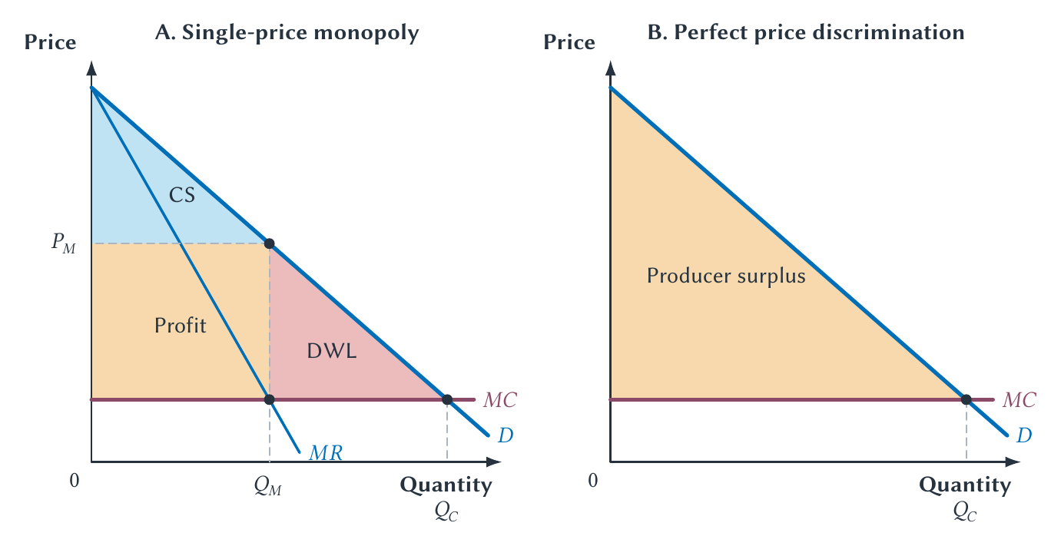
CHAPTER 15
Perfect price discrimination expands output and captures surplus
The monopoly deadweight loss disappears because production expands, not because prices become low.
PRINCIPLES OF MICRO
22
Notes:
This is the clearest proof that high price is not the source of deadweight loss. Distribution changes sharply even as total surplus rises.
[Sources]
- Principles of Micro, Chapter 15: Monopoly (current project draft).
- Project-reviewed Chapter 15 figures from figures/ch15_monopoly/.
[/Sources]

Slide 23
CHAPTER 15
Real price discrimination usually raises output, but welfare is not automatic
Opening a lower-price market can create new trades, while raising prices to another group can remove trades.
•
Total surplus tends to rise when discrimination expands total output.
•
It can fall when pricing mainly reallocates sales or restricts a group.
•
Buyer surplus and seller profit can move very differently from total surplus.
PRINCIPLES OF MICRO
23
Notes:
Keep the welfare rule qualitative. Do not promise that every form of price discrimination improves welfare.
[Sources]
- Principles of Micro, Chapter 15: Monopoly (current project draft).
[/Sources]

Slide 24
CHAPTER 15
College tuition is a sticker price, not one price paid by everyone
Grant aid and institutional discounts create different net tuition for students with different characteristics.
•
A higher sticker price creates more room for discounts.
•
Aid can pursue access, enrollment, merit, or revenue goals at the same time.
•
Published tuition growth can overstate growth in average net tuition, though real costs still rise.
PRINCIPLES OF MICRO
24
Notes:
Keep the discussion compact. Not every scholarship has one motive, and net tuition is not the full cost of attendance.
[Sources]
- Principles of Micro, Chapter 15: Monopoly (current project draft).
- College Board, Trends in College Pricing and Student Aid 2025; Ian Fillmore, Price Discrimination and Public Policy in the U.S. College Market, Review of Economic Studies 90(3), 2023.
[/Sources]

Slide 25
CHAPTER 15
Monopoly power changes the output decision
•
A monopoly has no close substitute and is protected by an entry barrier.
•
The price searcher faces market demand, so marginal revenue lies below price.
•
Choose quantity where MR equals MC, then read price from demand.
•
Deadweight loss comes from underproduction, not from the transfer created by a high price.
•
Price discrimination changes output, surplus, and who pays.
Next: many firms can retain small amounts of market power by differentiating their products.
PRINCIPLES OF MICRO
25
Notes:
Close with one two-step monopoly problem and one price-discrimination diagnosis.
[Sources]
- Principles of Micro, Chapter 15: Monopoly (current project draft).
[/Sources]

