Slide 1

Monopolistic Competition, Product Differentiation, and Advertising
Chapter 16
Principles of Micro
Product differences create small market power, variety, and a reason to communicate with buyers
Mark Wilson
Notes:
Frame monopolistic competition honestly: it describes many real markets, but small product differences often create only modest pricing power.
[Sources]
- Principles of Micro, Chapter 16: Monopolistic Competition, Product Differentiation, and Advertising (current project draft).
- Cover artwork: design/book-cover/principles-of-micro-cover.png (project-generated asset).
[/Sources]

Slide 2
CHAPTER 16
Many firms sell products that are similar but not identical
Restaurants, salons, coffee shops, clothing brands, and local services compete while offering something different.
•
Each firm faces a slightly downward-sloping demand curve.
•
Close substitutes limit how far price can rise.
•
Entry pushes long-run economic profit toward zero.
PRINCIPLES OF MICRO
2
Notes:
The category is descriptive of reality, but do not exaggerate the practical difference from competition when cross-price elasticity is high.
[Sources]
- Principles of Micro, Chapter 16: Monopolistic Competition, Product Differentiation, and Advertising (current project draft).
[/Sources]

Slide 3
CHAPTER 16
Product differentiation creates a continuum of market power
VERY CLOSE SUBSTITUTES
DISTINCT PRODUCT OR LOCATION
Demand is highly elastic
Demand is less elastic
A small price increase sends many buyers to nearly identical rivals.
A stronger brand, unique feature, or convenient location gives the firm more pricing room.
Cross-price response matters more than the category name.
PRINCIPLES OF MICRO
3
Notes:
Avoid treating market structures as boxes with sharp real-world borders.
[Sources]
- Principles of Micro, Chapter 16: Monopolistic Competition, Product Differentiation, and Advertising (current project draft).
[/Sources]

Slide 4
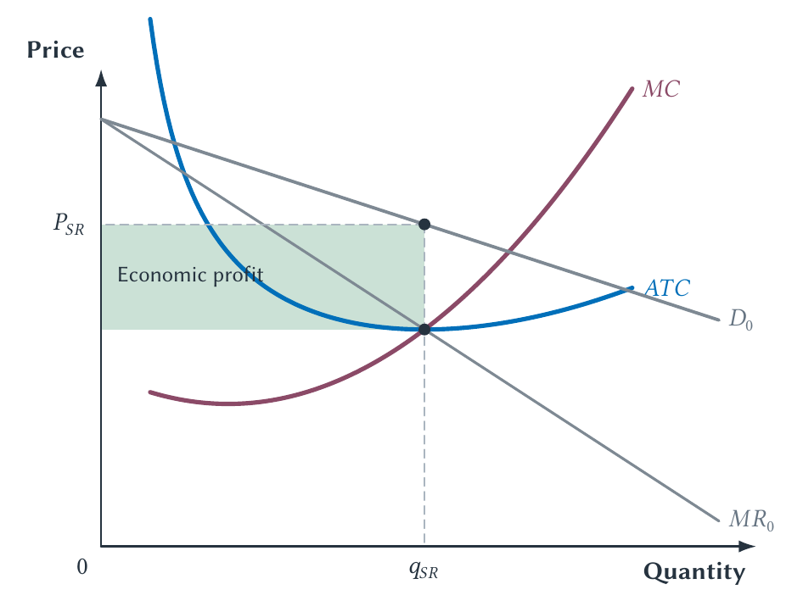
CHAPTER 16
A differentiated firm can earn short-run economic profit
The firm uses the monopoly output rule, but close substitutes constrain demand.
PRINCIPLES OF MICRO
4
Notes:
The graph looks like monopoly because the firm faces downward-sloping demand. The difference appears through entry.
[Sources]
- Principles of Micro, Chapter 16: Monopolistic Competition, Product Differentiation, and Advertising (current project draft).
- Project-reviewed Chapter 16 figures from figures/ch16_monopolistic_competition_product_differentiation_and_advertising/.
[/Sources]

Slide 5
CHAPTER 16
Entry erodes profit by taking customers from each firm
STEP 1
STEP 2
STEP 3
STEP 4
Economic profit appears
New varieties enter
Each firm's demand shifts left
Economic profit reaches zero
→
→
→
Existing firms earn more than every economic cost.
Entrants offer substitutes and divide market demand.
The representative firm sells less at any given price.
Entry stops when price just covers average total cost.
Free entry disciplines profit even though products are different.
PRINCIPLES OF MICRO
5
Notes:
No separate entry-shift figure is needed. The long-run diagram shows the destination.
[Sources]
- Principles of Micro, Chapter 16: Monopolistic Competition, Product Differentiation, and Advertising (current project draft).
[/Sources]

Slide 6
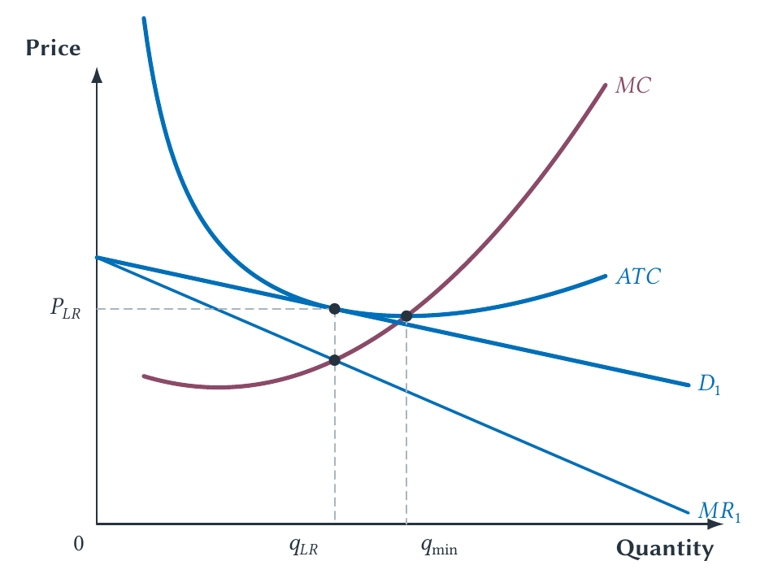
CHAPTER 16
Long-run equilibrium has zero economic profit but P > MC
The firm covers every cost but retains a markup and unused scale capacity.
PRINCIPLES OF MICRO
6
Notes:
Explain two textbook labels: markup means price exceeds MC; excess capacity means output lies below the minimum point of ATC.
[Sources]
- Principles of Micro, Chapter 16: Monopolistic Competition, Product Differentiation, and Advertising (current project draft).
- Project-reviewed Chapter 16 figures from figures/ch16_monopolistic_competition_product_differentiation_and_advertising/.
[/Sources]

Slide 7
CHAPTER 16
The textbook inefficiency comes with a benefit the graph omits
COST OF DIFFERENTIATION
BENEFIT OF DIFFERENTIATION
Markup and unused scale
Variety and better matches
Price exceeds marginal cost and firms do not operate at minimum average total cost.
Buyers may prefer many products to one forced standard, even if variety duplicates some fixed cost.
A feasible alternative must preserve the benefits buyers value.
PRINCIPLES OF MICRO
7
Notes:
Do not present the small textbook triangle as proof that product variety is a meaningful social loss. Compare actual institutions with feasible alternatives.
[Sources]
- Principles of Micro, Chapter 16: Monopolistic Competition, Product Differentiation, and Advertising (current project draft).
- Avinash Dixit and Joseph Stiglitz, Monopolistic Competition and Optimum Product Diversity, American Economic Review 67(3), 1977; Harold Demsetz, Information and Efficiency: Another Viewpoint, Journal of Law and Economics 12(1), 1969.
[/Sources]

Slide 8
CHAPTER 16
Old magazines are full of famous ads for vanished brands
Advertising can attract attention, but it cannot permanently rescue a product buyers do not value.
•
Large campaigns do not guarantee survival.
•
Repeat purchases test the claim made by the advertisement.
•
A brand gives the seller something valuable to lose after disappointing buyers.
PRINCIPLES OF MICRO
8
Notes:
Use the grandparents' magazine prompt. Advertising and brand capital work inside a competitive process rather than replacing it.
[Sources]
- Principles of Micro, Chapter 16: Monopolistic Competition, Product Differentiation, and Advertising (current project draft).
[/Sources]

Slide 9
CHAPTER 16
Advertising has two competing interpretations
MARKET-POWER VIEW
INFORMATION VIEW
Create artificial loyalty
Lower the cost of comparison
Persuasion may make demand less elastic and weaken comparison across brands.
Prices, locations, features, and new products become easier to find, making demand more elastic.
Do not assume the first story without looking at evidence.
PRINCIPLES OF MICRO
9
Notes:
Narrate the hypotheses rather than presenting a table. The same advertisement can contain persuasion and useful information.
[Sources]
- Principles of Micro, Chapter 16: Monopolistic Competition, Product Differentiation, and Advertising (current project draft).
- George Stigler, The Economics of Information, Journal of Political Economy 69(3), 1961; Phillip Nelson, Advertising as Information, Journal of Political Economy 82(4), 1974.
[/Sources]

Slide 10
CHAPTER 16
Eyeglass advertising was associated with lower prices
Lee Benham found higher eyeglass prices in states that restricted advertising.
•
Advertising helped buyers discover and compare providers.
•
Easier comparison increased competitive pressure.
•
The historical study supports the information view but does not prove every ad lowers price.
PRINCIPLES OF MICRO
10
Notes:
Keep the result qualitative and historical. The value lies in overturning the automatic presumption that advertising only creates market power.
[Sources]
- Principles of Micro, Chapter 16: Monopolistic Competition, Product Differentiation, and Advertising (current project draft).
- Lee Benham, The Effect of Advertising on the Price of Eyeglasses, Journal of Law and Economics 15(2), 1972.
[/Sources]

Slide 11
CHAPTER 16
A brand can act like a performance bond
A firm that spent years building repeat business loses future profit if it cheats customers today.
•
The brand itself becomes a valuable asset.
•
A bad product threatens future sales across many buyers.
•
That threatened loss can make an otherwise hard-to-check promise more credible.
PRINCIPLES OF MICRO
11
Notes:
This is the principles-level bond idea. The firm need not place cash in escrow; valuable future business is what it stands to forfeit.
[Sources]
- Principles of Micro, Chapter 16: Monopolistic Competition, Product Differentiation, and Advertising (current project draft).
- Benjamin Klein and Keith Leffler, The Role of Market Forces in Assuring Contractual Performance, Journal of Political Economy 89(4), 1981.
[/Sources]

Slide 12
CHAPTER 16
Brand value depends on how easily quality can be verified
GENERIC MEDICINE
DIETARY SUPPLEMENT
A regulator verifies equivalence
Quality is harder to guarantee before sale
FDA standards reduce the information role of the original brand for the approved drug.
Sourcing, ingredients, and performance may make brand reputation more valuable.
A brand matters most when buyers cannot cheaply verify what they are getting.
PRINCIPLES OF MICRO
12
Notes:
Use the contrast carefully. FDA approval standards differ between generic drugs and dietary supplements.
[Sources]
- Principles of Micro, Chapter 16: Monopolistic Competition, Product Differentiation, and Advertising (current project draft).
[/Sources]

Slide 13
CHAPTER 16
Certification can replace part of a brand
An independent test can make quality visible without requiring buyers to trust the seller's name alone.
•
Safety inspection can verify a restaurant or building standard.
•
Professional licensing can confirm minimum training.
•
Product certification can test a feature buyers cannot inspect before purchase.
PRINCIPLES OF MICRO
13
Notes:
Keep this compact. Certification works only when the certifier is credible and the tested standard matches what buyers care about.
[Sources]
- Principles of Micro, Chapter 16: Monopolistic Competition, Product Differentiation, and Advertising (current project draft).
[/Sources]

Slide 14
CHAPTER 16
A sale after an ad does not prove the ad caused the sale
People who search for a familiar brand may have intended to buy before clicking the sponsored result.
•
Observed buyers differ from people who never saw or clicked the ad.
•
A randomized experiment can separate new sales from redirected sales.
•
eBay experiments found much branded-search advertising had little short-run causal effect for experienced users.
PRINCIPLES OF MICRO
14
Notes:
Use the case as a simple causal-inference lesson, not a universal claim about all advertising channels.
[Sources]
- Principles of Micro, Chapter 16: Monopolistic Competition, Product Differentiation, and Advertising (current project draft).
- Thomas Blake, Chris Nosko, and Steven Tadelis, Consumer Heterogeneity and Paid Search Effectiveness, Econometrica 83(1), 2015.
[/Sources]

Slide 15
CHAPTER 16
Chamberlin made product differences central to competition
Competition is often a struggle over price, quality, location, service, design, and reputation at the same time.
Real markets can be competitive without selling identical products.
PRINCIPLES OF MICRO
15
Notes:
Use Chamberlin as the chapter's economist profile. Keep the historical note short and tied to the core concept.
[Sources]
- Principles of Micro, Chapter 16: Monopolistic Competition, Product Differentiation, and Advertising (current project draft).
[/Sources]

Slide 16
CHAPTER 16
Product differences change competition without eliminating it
•
Differentiation gives each firm a downward-sloping demand curve and some pricing power.
•
Entry pushes long-run economic profit toward zero.
•
Markup and unused scale must be weighed against the value of product variety.
•
Advertising can create loyalty, provide information, and place brand value at risk.
Next: when only a few major rivals remain, every firm must anticipate how the others will respond.
PRINCIPLES OF MICRO
16
Notes:
Close by asking whether one familiar ad mainly informs, persuades, signals quality, or does several things at once.
[Sources]
- Principles of Micro, Chapter 16: Monopolistic Competition, Product Differentiation, and Advertising (current project draft).
[/Sources]

