Slide 1

Oligopoly and Strategic Behavior
Chapter 17
Principles of Micro
When a few rivals matter, the best choice depends on what each expects the others to do
Mark Wilson
Notes:
Open with an industry in which one firm's price, output, or product decision clearly provokes a response from a few recognizable rivals.
[Sources]
- Principles of Micro, Chapter 17: Oligopoly and Strategic Behavior (current project draft).
- Cover artwork: design/book-cover/principles-of-micro-cover.png (project-generated asset).
[/Sources]

Slide 2
CHAPTER 17
An oligopolist cannot ignore its rivals
Each major firm's best choice depends on how other major firms respond.
•
A price cut may be matched.
•
An output increase can depress the market price.
•
A new feature, route, or chip can provoke investment by rivals.
PRINCIPLES OF MICRO
2
Notes:
Strategic interdependence is the defining idea. Few sellers alone does not produce one universal pricing result.
[Sources]
- Principles of Micro, Chapter 17: Oligopoly and Strategic Behavior (current project draft).
[/Sources]

Slide 3
CHAPTER 17
The familiar price and quantity effects still exist
QUANTITY EFFECT
PRICE EFFECT
Sell more units
Market price may fall
Expanding output creates revenue from additional sales.
A larger total quantity can reduce price on units the firm was already selling.
Unlike monopoly, the strength of each effect depends partly on rival reactions.
PRINCIPLES OF MICRO
3
Notes:
State the intuition without implying a determinate formula. Rivals may match, accommodate, collude, innovate, or enter.
[Sources]
- Principles of Micro, Chapter 17: Oligopoly and Strategic Behavior (current project draft).
[/Sources]

Slide 4
CHAPTER 17
Few sellers does not produce one answer
Oligopoly outcomes range from intense competition to coordinated restriction of output.
•
Products may be identical or differentiated.
•
Entry may be easy or difficult.
•
Firms may interact once or repeatedly.
•
Prices, capacity, innovation, and contracts may all be strategic choices.
PRINCIPLES OF MICRO
4
Notes:
This is why the chapter does not teach Cournot and Bertrand models by name. Game theory supplies a general language without pretending one model fits every oligopoly.
[Sources]
- Principles of Micro, Chapter 17: Oligopoly and Strategic Behavior (current project draft).
[/Sources]

Slide 5
CHAPTER 17
Define the market before counting firms
Apple and NVIDIA have substantial power in some products without being economy-wide monopolies.
•
A company can face different rivals across hardware, software, services, and platforms.
•
Cross-price response reveals which alternatives actually constrain buyers.
•
Market boundaries can change as technology creates new substitutes.
PRINCIPLES OF MICRO
5
Notes:
Avoid forcing technology firms into one textbook category. The relevant market is a question, not a company label.
[Sources]
- Principles of Micro, Chapter 17: Oligopoly and Strategic Behavior (current project draft).
[/Sources]

Slide 6
CHAPTER 17
Game theory gives strategic choices a simple language
Term
Plain meaning
Players
The people or firms making choices.
Strategies
The actions available to each player.
Payoffs
What each player receives from the combined choices.
Dominant strategy
A best choice no matter what the other player does.
Nash equilibrium
A set of choices where no player wants to switch alone.
A payoff matrix organizes incentives; it does not replace the economic story.
PRINCIPLES OF MICRO
6
Notes:
Use each term immediately in the prisoners' dilemma rather than assigning the list for memorization.
[Sources]
- Principles of Micro, Chapter 17: Oligopoly and Strategic Behavior (current project draft).
[/Sources]

Slide 7
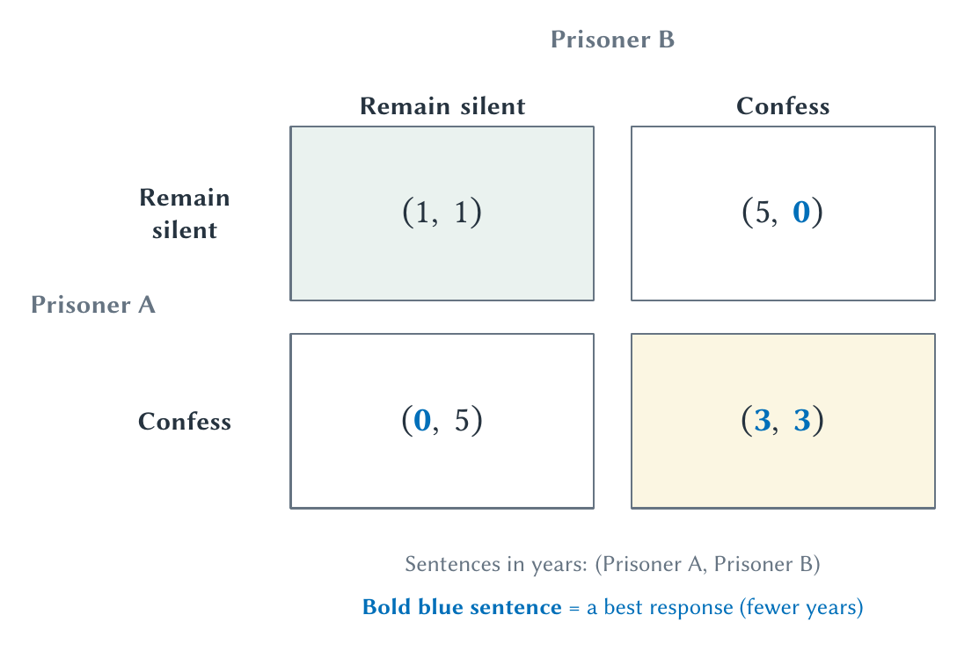
CHAPTER 17
Two prisoners can make individually sensible choices that hurt both
Confessing is individually attractive, yet mutual confession leaves both worse than mutual silence.
PRINCIPLES OF MICRO
7
Notes:
Use confess and stay silent directly. Do not add moral labels to cooperate and defect; the matrix describes incentives.
[Sources]
- Principles of Micro, Chapter 17: Oligopoly and Strategic Behavior (current project draft).
- Project-reviewed Chapter 17 figures from figures/ch17_oligopoly_and_strategic_behavior/.
[/Sources]

Slide 8
CHAPTER 17
A Nash equilibrium need not maximize joint payoff
Each prisoner is choosing a best response, but the combined result is worse for both.
Individual rationality does not guarantee the best group outcome.
PRINCIPLES OF MICRO
8
Notes:
Ask whether either prisoner would switch alone after both confess. That no-deviation test identifies the Nash equilibrium.
[Sources]
- Principles of Micro, Chapter 17: Oligopoly and Strategic Behavior (current project draft).
[/Sources]

Slide 9
CHAPTER 17
Cartel members want everyone else to restrain output
A cartel tries to copy a monopolist by limiting total quantity and raising price.
•
Jointly, members gain from restriction.
•
Individually, each member wants to sell extra units at the high cartel price.
•
The incentive to cheat makes cartels fragile.
PRINCIPLES OF MICRO
9
Notes:
This is one unusual setting where cooperation among sellers harms consumers and defection can improve welfare.
[Sources]
- Principles of Micro, Chapter 17: Oligopoly and Strategic Behavior (current project draft).
[/Sources]

Slide 10
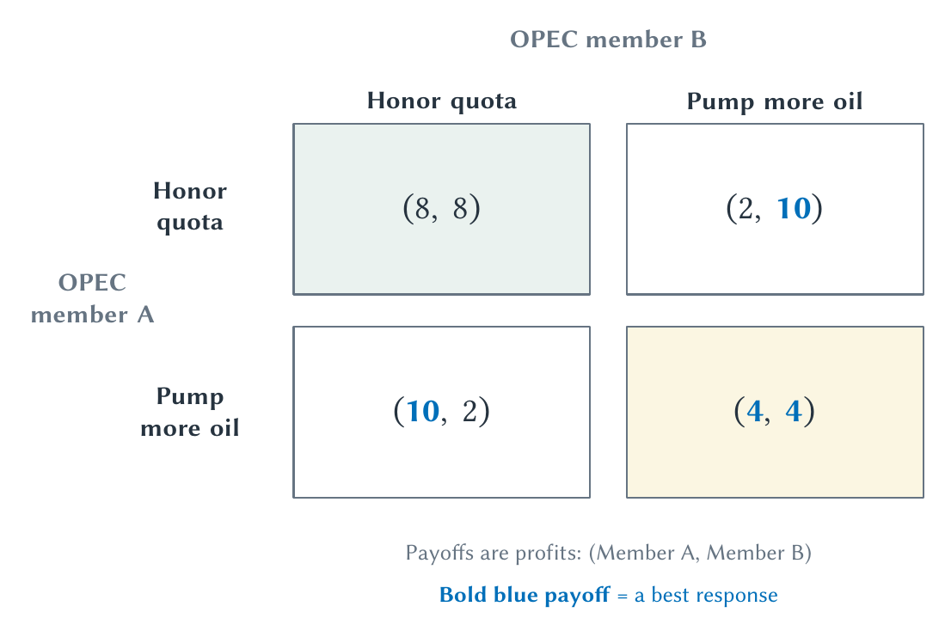
CHAPTER 17
OPEC members face the cartel prisoner's dilemma
Each producer wants the other to restrict output while it quietly expands sales.
PRINCIPLES OF MICRO
10
Notes:
Connect the payoffs to price and quantity. If both pump more, the world price falls and cartel profit erodes.
[Sources]
- Principles of Micro, Chapter 17: Oligopoly and Strategic Behavior (current project draft).
- Project-reviewed Chapter 17 figures from figures/ch17_oligopoly_and_strategic_behavior/.
[/Sources]

Slide 11
CHAPTER 17
Repeated interaction changes what can be sustained
A short-run gain from cheating can trigger future punishment.
•
Firms can observe patterns and respond later.
•
A credible punishment makes cooperation more valuable.
•
Uncertain end dates can make future consequences matter more.
PRINCIPLES OF MICRO
11
Notes:
Do not imply repetition guarantees cooperation. Monitoring errors, changing membership, impatience, and weak punishment can still break it.
[Sources]
- Principles of Micro, Chapter 17: Oligopoly and Strategic Behavior (current project draft).
[/Sources]

Slide 12
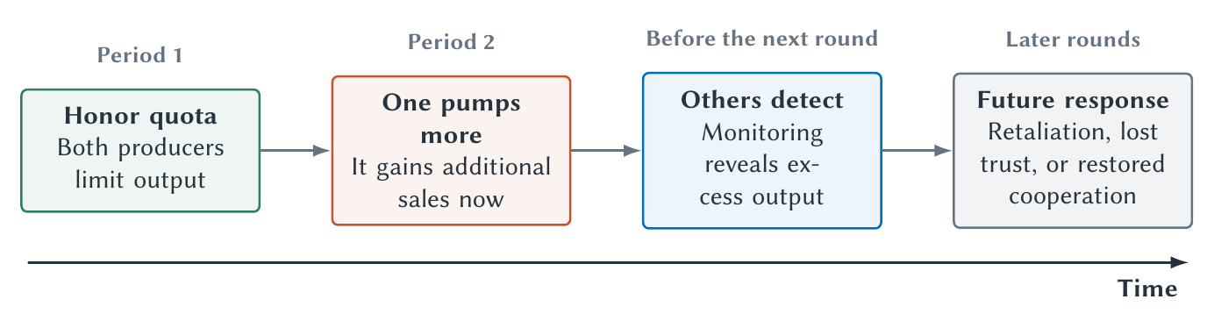
CHAPTER 17
Today’s choice changes tomorrow’s response
Reputation links current behavior to future payoffs.
PRINCIPLES OF MICRO
12
Notes:
Use the timeline for both cartels and ordinary cooperation. The welfare meaning of cooperation depends on the setting.
[Sources]
- Principles of Micro, Chapter 17: Oligopoly and Strategic Behavior (current project draft).
- Project-reviewed Chapter 17 figures from figures/ch17_oligopoly_and_strategic_behavior/.
[/Sources]

Slide 13
CHAPTER 17
Axelrod's tournament found strength in a simple strategy
Tit for Tat began by cooperating, then copied the other player's previous move.
•
It was nice: it did not defect first.
•
It was retaliatory: defection received a quick response.
•
It was forgiving: renewed cooperation was immediately accepted.
•
It was clear: other players could understand its pattern.
PRINCIPLES OF MICRO
13
Notes:
Present the tournament as an important demonstration, not a universal theorem. Performance depends on opponents, noise, payoffs, and how long interaction lasts.
[Sources]
- Principles of Micro, Chapter 17: Oligopoly and Strategic Behavior (current project draft).
- Robert Axelrod, Effective Choice in the Prisoner's Dilemma, Journal of Conflict Resolution 24(1), 1980; Robert Axelrod and William D. Hamilton, The Evolution of Cooperation, Science 211, 1981.
[/Sources]

Slide 14
CHAPTER 17
Cooperation can emerge without a central commander
Reciprocal strategies can make cooperation self-enforcing when people expect to meet again.
•
Markets and property rights scale cooperation among strangers.
•
Repeated interaction supplies an even deeper layer of trust and reciprocity.
•
Institutions work partly by making good behavior observable and future response possible.
PRINCIPLES OF MICRO
14
Notes:
Tie this back to the book's coordination theme. For cartels, seller cooperation is bad for consumers; in most other settings, cooperation creates value.
[Sources]
- Principles of Micro, Chapter 17: Oligopoly and Strategic Behavior (current project draft).
- Robert Axelrod, Effective Choice in the Prisoner's Dilemma, Journal of Conflict Resolution 24(1), 1980; Robert Axelrod and William D. Hamilton, The Evolution of Cooperation, Science 211, 1981.
[/Sources]

Slide 15
CHAPTER 17
Schelling showed that expectations can coordinate choices
A focal point, credible commitment, or visible rule can help people choose the same action without direct communication.
•
People meeting in an unfamiliar city may converge on a famous landmark.
•
A commitment changes strategy only when others believe it will be carried out.
•
Shared expectations can support coordination or conflict.
PRINCIPLES OF MICRO
15
Notes:
Keep the examples intuitive. Schelling extends strategic thinking beyond price competition.
[Sources]
- Principles of Micro, Chapter 17: Oligopoly and Strategic Behavior (current project draft).
- Thomas C. Schelling, The Strategy of Conflict, 1960; Nobel Prize, Popular Information, 2005.
[/Sources]

Slide 16
CHAPTER 17
Antitrust should protect competition, not a particular competitor
Aggressive rivalry can injure a firm while benefiting consumers.
•
Price cuts, better products, and innovation can eliminate weaker rivals.
•
Agreements to restrict output or exclude efficient competition can harm the process.
•
The difficult cases require a counterfactual: what would happen without the challenged conduct?
PRINCIPLES OF MICRO
16
Notes:
Use consumer welfare and the competitive process as the principles-level frame. Avoid making firm size itself the offense.
[Sources]
- Principles of Micro, Chapter 17: Oligopoly and Strategic Behavior (current project draft).
[/Sources]

Slide 17
CHAPTER 17
JetBlue and Spirit posed a real trade-off
MERGER CONCERN
CLAIMED EFFICIENCY
Remove a low-fare rival
Create a stronger challenger
The government argued Spirit disciplined fares and its disappearance would reduce competition.
The airlines argued a larger JetBlue could compete more effectively against major carriers.
A merger case asks which future is more plausible.
PRINCIPLES OF MICRO
17
Notes:
The district court blocked the merger. Use the case to show why antitrust is a comparative prediction, not simply counting firms.
[Sources]
- Principles of Micro, Chapter 17: Oligopoly and Strategic Behavior (current project draft).
- U.S. District Court for the District of Massachusetts, United States v. JetBlue Airways Corp., Findings of Fact and Conclusions of Law, January 16, 2024.
[/Sources]

Slide 18
CHAPTER 17
Microsoft and Netscape blurred exclusion and competition
Microsoft used favorable Windows licensing terms to keep Internet Explorer prominent on computer desktops while Netscape paid for placement too.
•
The government viewed restrictions on computer makers as protection of the Windows monopoly.
•
Microsoft argued browser integration and low price benefited users and defended its platform.
•
A breakup order was later vacated; the final remedy imposed conduct restrictions.
PRINCIPLES OF MICRO
18
Notes:
Keep the case compact but preserve the strange path from browser placement to a proposed company breakup. It is a good example of how difficult remedy design can be.
[Sources]
- Principles of Micro, Chapter 17: Oligopoly and Strategic Behavior (current project draft).
- U.S. District Court for the District of Columbia, United States v. Microsoft Corp., Findings of Fact, 1999; Benjamin Klein, The Microsoft Case, Journal of Economic Perspectives 15(2), 2001; U.S. Department of Justice case archive.
[/Sources]

Slide 19
CHAPTER 17
Strategic analysis asks what happens after the first move
STEP 1
STEP 2
STEP 3
STEP 4
Define the players
List their choices
Anticipate responses
Compare outcomes
→
→
→
Which firms or decision makers matter?
Price, output, capacity, entry, agreement, or innovation.
What will each rival do after observing the move?
Which result is stable, profitable, and beneficial to consumers?
The first-order effect is rarely the whole oligopoly story.
PRINCIPLES OF MICRO
19
Notes:
Use this as the transfer checklist for an unfamiliar oligopoly.
[Sources]
- Principles of Micro, Chapter 17: Oligopoly and Strategic Behavior (current project draft).
[/Sources]

Slide 20
CHAPTER 17
Oligopoly is the economics of mutual response
•
Few important rivals create strategic interdependence, not one automatic price.
•
A prisoner's dilemma can make individually sensible choices jointly costly.
•
Repetition, reputation, retaliation, and forgiveness can support cooperation.
•
Antitrust must distinguish harm to competition from harm to one competitor.
Next: firms demand workers and other inputs because those inputs help produce valuable output.
PRINCIPLES OF MICRO
20
Notes:
Close by asking students how the cartel game and an ordinary cooperation game differ in their effect on outsiders.
[Sources]
- Principles of Micro, Chapter 17: Oligopoly and Strategic Behavior (current project draft).
[/Sources]

