Slide 1

Factor Markets, Labor, and Income Distribution
Chapter 18
Principles of Micro
Workers and other inputs are valuable because they help produce output buyers value
Mark Wilson
Notes:
Begin with derived demand. A restaurant does not hire labor for its own sake; it hires workers because customers value the meals those workers help produce.
[Sources]
- Principles of Micro, Chapter 18: Factor Markets, Labor, and Income Distribution (current project draft).
- Cover artwork: design/book-cover/principles-of-micro-cover.png (project-generated asset).
[/Sources]

Slide 2
CHAPTER 18
Demand for an input is derived from demand for output
A worker is valuable to a firm because the worker helps produce something customers will buy.
•
More valuable output raises the value created by an additional worker.
•
Higher worker productivity raises the value created by an additional worker.
•
Changes in product demand therefore shift labor demand.
PRINCIPLES OF MICRO
2
Notes:
Use Main Street Cafe. If customers stop buying lunches, the demand for lunch-shift workers falls even when worker skill has not changed.
[Sources]
- Principles of Micro, Chapter 18: Factor Markets, Labor, and Income Distribution (current project draft).
[/Sources]

Slide 3
CHAPTER 18
Value of marginal product turns output into dollars
VMP = marginal product × product price
VMP is the added revenue created by hiring one more unit of an input in a competitive product market.
A worker adds 10 lunches worth $15 each → VMP = $150 per shift
PRINCIPLES OF MICRO
3
Notes:
Use VMP rather than both VMP and MRP. The one term is enough for principles.
[Sources]
- Principles of Micro, Chapter 18: Factor Markets, Labor, and Income Distribution (current project draft).
[/Sources]

Slide 4
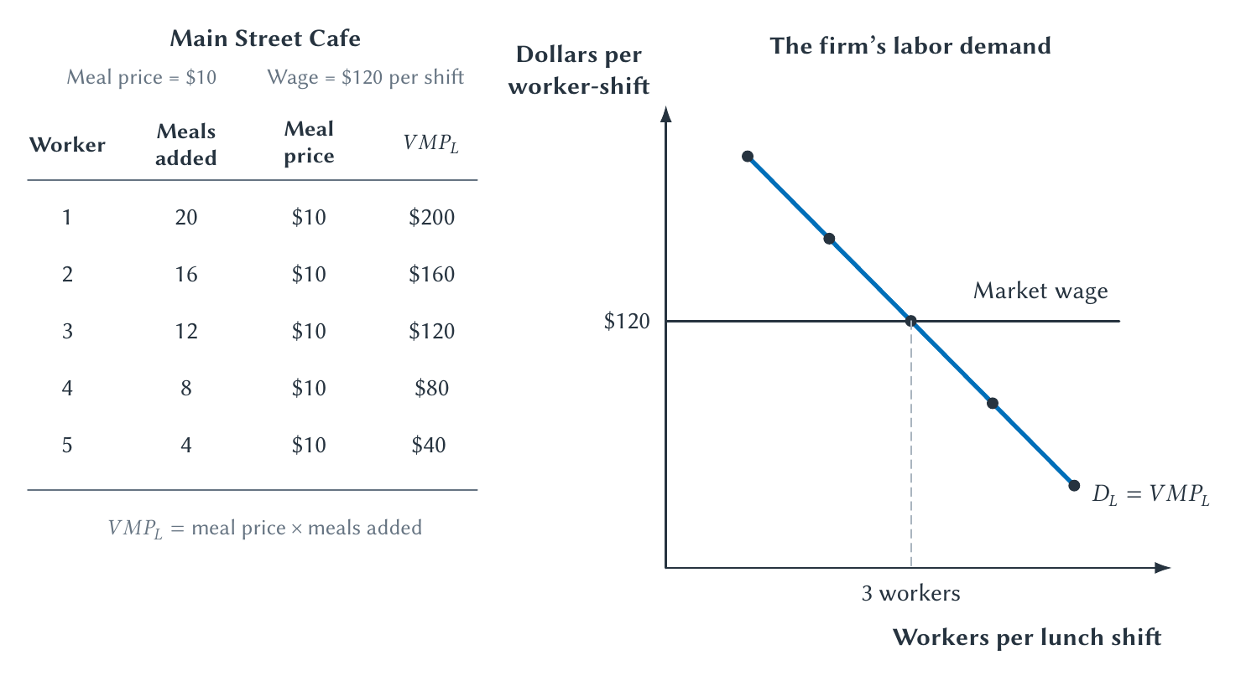
CHAPTER 18
Hire workers while their value exceeds their wage
The labor-demand curve slopes down because marginal product eventually falls.
PRINCIPLES OF MICRO
4
Notes:
Read the table before the curve. Hiring continues while the next worker's VMP is at least the wage.
[Sources]
- Principles of Micro, Chapter 18: Factor Markets, Labor, and Income Distribution (current project draft).
- Project-reviewed Chapter 18 figures from figures/ch18_factor_markets_labor_and_income_distribution/.
[/Sources]

Slide 5
CHAPTER 18
Labor demand shifts when output value or productivity changes
•
A higher product price raises VMP and labor demand.
•
Better tools, training, or organization can raise marginal product.
•
A complementary input can make workers more productive.
•
A substitute such as automation can reduce demand for a task.
Ask how the event changes what the next worker adds or what that output is worth.
PRINCIPLES OF MICRO
5
Notes:
Keep movement along labor demand separate from shifts. A change in the wage causes movement along the curve.
[Sources]
- Principles of Micro, Chapter 18: Factor Markets, Labor, and Income Distribution (current project draft).
[/Sources]

Slide 6
CHAPTER 18
The market wage coordinates labor demand and labor supply
LABOR DEMAND
LABOR SUPPLY
Firms compare wage with VMP
Workers compare jobs and time
A lower wage makes more workers profitable to hire along the demand curve.
A higher wage attracts more hours, workers, training, or migration over time.
Equilibrium wage balances the quantity of labor offered and hired.
PRINCIPLES OF MICRO
6
Notes:
This is Chapter 4 applied to an input market. The price of labor is the wage.
[Sources]
- Principles of Micro, Chapter 18: Factor Markets, Labor, and Income Distribution (current project draft).
[/Sources]

Slide 7
CHAPTER 18
The Black Death made labor drastically scarcer
The plague killed a large share of Europe's population in the fourteenth century.
•
Fewer workers remained relative to land and other resources.
•
Employers competed more intensely for surviving labor.
•
Wages rose in many parts of western Europe despite attempts to restrain them.
PRINCIPLES OF MICRO
7
Notes:
Explain the Black Death briefly because many students will not know the history. Regional wage and institutional responses differed.
[Sources]
- Principles of Micro, Chapter 18: Factor Markets, Labor, and Income Distribution (current project draft).
- Jane Humphries and Jacob Weisdorf, The Wages of Women in England, 1260-1850, Journal of Economic History 75(2), 2015; Sevket Pamuk, The Black Death and the Origins of the Great Divergence, European Review of Economic History 11(3), 2007.
[/Sources]

Slide 8
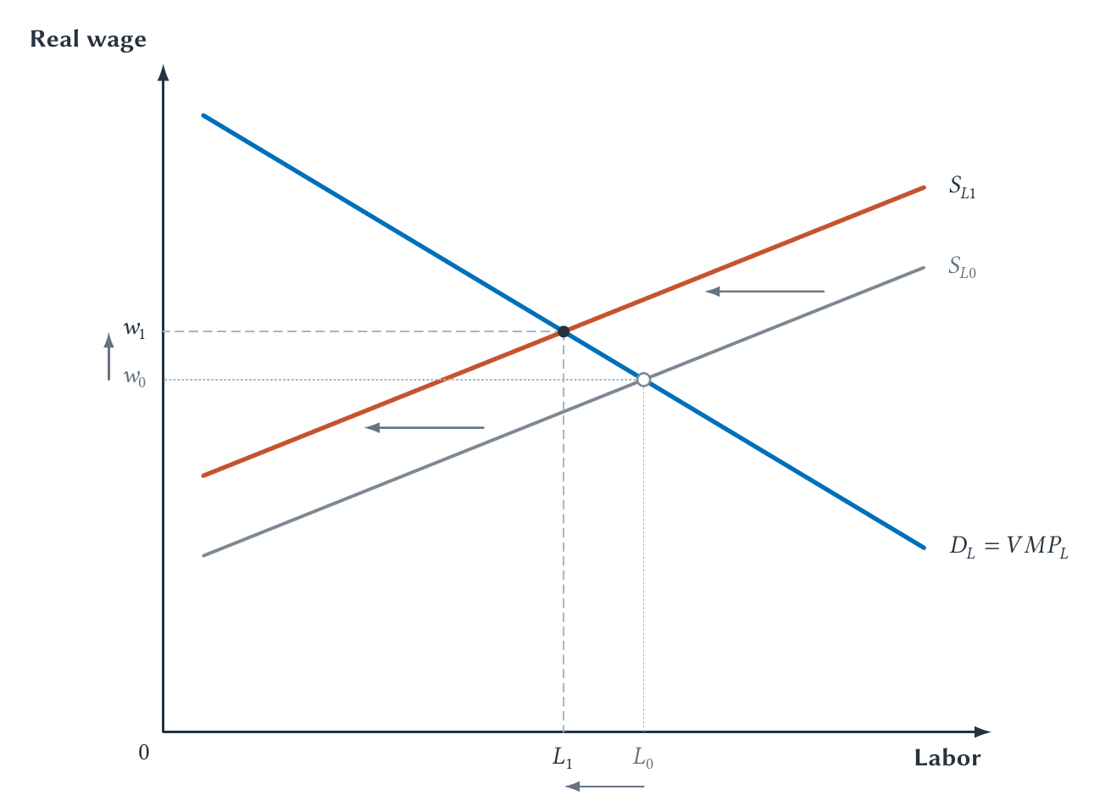
CHAPTER 18
A labor-supply collapse raises the wage
Scarcity raises the price of labor just as it raises the price of other scarce resources.
PRINCIPLES OF MICRO
8
Notes:
Use the figure as a clean mechanism, not a complete history of post-plague Europe.
[Sources]
- Principles of Micro, Chapter 18: Factor Markets, Labor, and Income Distribution (current project draft).
- Jane Humphries and Jacob Weisdorf, The Wages of Women in England, 1260-1850, Journal of Economic History 75(2), 2015; Sevket Pamuk, The Black Death and the Origins of the Great Divergence, European Review of Economic History 11(3), 2007.
- Project-reviewed Chapter 18 figures from figures/ch18_factor_markets_labor_and_income_distribution/.
[/Sources]

Slide 9
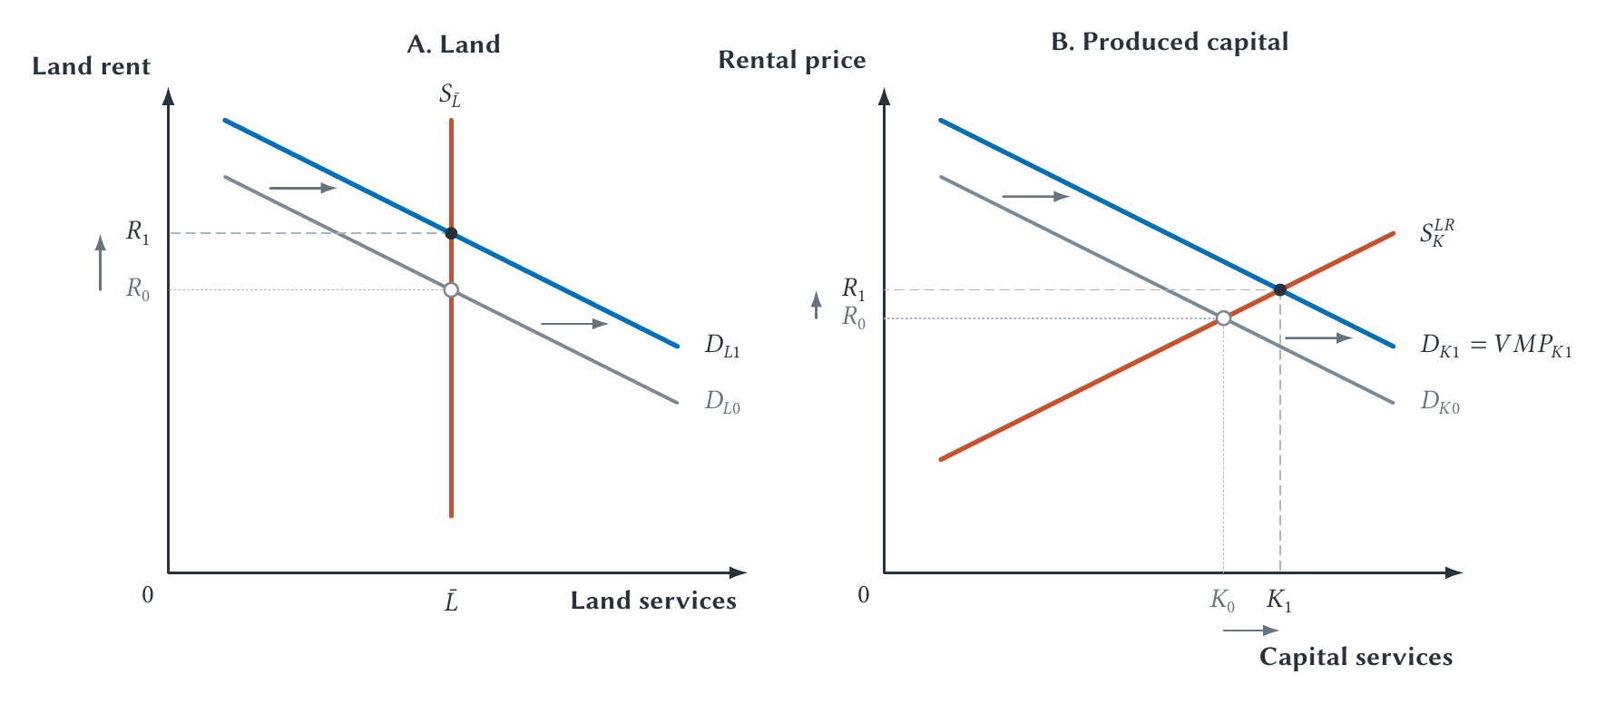
CHAPTER 18
The same logic applies to land and capital
An input's payment reflects demand for what it helps produce and the availability of the input.
PRINCIPLES OF MICRO
9
Notes:
Keep capital to a principles-level treatment: tools, machines, structures, and equipment that raise future production.
[Sources]
- Principles of Micro, Chapter 18: Factor Markets, Labor, and Income Distribution (current project draft).
- Project-reviewed Chapter 18 figures from figures/ch18_factor_markets_labor_and_income_distribution/.
[/Sources]

Slide 10
CHAPTER 18
Land and physical capital adjust differently
LAND
PHYSICAL CAPITAL
Total location is fixed
Supply can grow over time
Demand changes mainly affect rent because the physical supply of a particular location cannot expand.
Investment can create more machines and structures when expected returns rise.
The time horizon shapes factor supply and who receives the gain.
PRINCIPLES OF MICRO
10
Notes:
Do not drift into finance. The point is simply that produced capital can accumulate while land is location-specific.
[Sources]
- Principles of Micro, Chapter 18: Factor Markets, Labor, and Income Distribution (current project draft).
[/Sources]

Slide 11
CHAPTER 18
Earnings differ for several economic reasons
•
Education, training, experience, health, and skill can raise productivity.
•
Danger, unpleasant conditions, or irregular hours may require compensating pay.
•
Talent, luck, location, and demand for a product or occupation differ.
•
Employer power, bargaining institutions, and discrimination can also affect pay.
A wage gap is a description; explaining it requires evidence about causes.
PRINCIPLES OF MICRO
11
Notes:
Keep the list compact. The chapter is not a complete theory of every earnings difference.
[Sources]
- Principles of Micro, Chapter 18: Factor Markets, Labor, and Income Distribution (current project draft).
[/Sources]

Slide 12
CHAPTER 18
Technology replaces tasks and creates new tasks
DISPLACEMENT
PRODUCTIVITY AND NEW TASKS
Automate work people performed
Make workers more valuable
Machines or software can reduce demand for workers assigned to the substituted task.
Technology can complement labor, lower prices, expand output, and create work that did not exist before.
The effect on jobs and wages can cut either way.
PRINCIPLES OF MICRO
12
Notes:
Avoid saying technology generally destroys or creates jobs. Trace tasks, product demand, productivity, and adjustment time.
[Sources]
- Principles of Micro, Chapter 18: Factor Markets, Labor, and Income Distribution (current project draft).
- Daron Acemoglu and Pascual Restrepo, Automation and New Tasks, Journal of Economic Perspectives 33(2), 2019; Erik Brynjolfsson, Danielle Li, and Lindsey Raymond, Generative AI at Work, Quarterly Journal of Economics 140(2), 2025.
[/Sources]

Slide 13
CHAPTER 18
Generative AI can raise productivity without settling the employment question
In one customer-support setting, an AI assistant raised productivity especially for less-experienced workers.
•
The tool complemented workers in that task and firm.
•
Higher productivity can increase output demand and worker value.
•
Other tasks or industries may experience substitution instead.
PRINCIPLES OF MICRO
13
Notes:
Do not treat one field study as an economy-wide employment estimate. Use it to illustrate a complementarity mechanism.
[Sources]
- Principles of Micro, Chapter 18: Factor Markets, Labor, and Income Distribution (current project draft).
- Daron Acemoglu and Pascual Restrepo, Automation and New Tasks, Journal of Economic Perspectives 33(2), 2019; Erik Brynjolfsson, Danielle Li, and Lindsey Raymond, Generative AI at Work, Quarterly Journal of Economics 140(2), 2025.
[/Sources]

Slide 14
CHAPTER 18
Employer market power can weaken the competitive wage benchmark
A worker may have few realistic employers because of location, occupation, search cost, contracts, or family constraints.
Unions, minimum wages, noncompete rules, and search institutions can matter when alternatives are limited.
PRINCIPLES OF MICRO
14
Notes:
Keep this section short. The competitive model remains the baseline; employer power explains why a firm may face an upward-sloping labor supply.
[Sources]
- Principles of Micro, Chapter 18: Factor Markets, Labor, and Income Distribution (current project draft).
[/Sources]

Slide 15
CHAPTER 18
Begin discrimination analysis with the evidence
A raw earnings gap does not by itself measure unequal treatment.
•
Hours, occupation, experience, location, job conditions, and career interruptions can differ.
•
Statistical controls can narrow a comparison but cannot guarantee every cause is measured.
•
Direct experiments and institutional details can provide different evidence.
PRINCIPLES OF MICRO
15
Notes:
Do not begin from an implied assumption that discrimination always favors one group. State the question neutrally and examine the relevant market evidence.
[Sources]
- Principles of Micro, Chapter 18: Factor Markets, Labor, and Income Distribution (current project draft).
- Francine D. Blau and Lawrence M. Kahn, The Gender Wage Gap: Extent, Trends, and Explanations, Journal of Economic Literature 55(3), 2017.
[/Sources]

Slide 16
CHAPTER 18
Becker: prejudice can be costly to the employer
A firm that refuses equally productive workers from a disliked group gives competitors access to talent at lower cost.
•
Competitive pressure punishes profit-reducing prejudice.
•
The force is weaker when customers discriminate or employers have market power.
•
Competition is a mechanism against discrimination, not a guarantee that it disappears.
PRINCIPLES OF MICRO
16
Notes:
This point matters because discrimination is not an activity the economic system must naturally reward.
[Sources]
- Principles of Micro, Chapter 18: Factor Markets, Labor, and Income Distribution (current project draft).
- Gary S. Becker, The Economics of Discrimination, 1957; Kerwin Charles and Jonathan Guryan, Prejudice and Wages, Journal of Political Economy 116(5), 2008.
[/Sources]

Slide 17
CHAPTER 18
Experiments can point in different directions
NAMES ON APPLICATIONS
STEM FACULTY CANDIDATES
Some employers respond differently
Female names received more interest
Large correspondence studies find differences in contact rates associated with racial cues in names.
A national experiment found a roughly two-to-one preference for highly qualified female hypothetical candidates.
There is no substitute for specifying the market, stage, group, and outcome being measured.
PRINCIPLES OF MICRO
17
Notes:
The STEM experiment studied evaluations of hypothetical assistant-professor candidates, not completed hiring across every STEM market. The correspondence study measured employer contact, not every stage of employment.
[Sources]
- Principles of Micro, Chapter 18: Factor Markets, Labor, and Income Distribution (current project draft).
- Patrick Kline, Evan Rose, and Christopher Walters, Systemic Discrimination Among Large U.S. Employers, Quarterly Journal of Economics 137(4), 2022; Wendy Williams and Stephen Ceci, National Hiring Experiments Reveal 2:1 Faculty Preference for Women on STEM Tenure Track, PNAS 112(17), 2015.
[/Sources]

Slide 18
CHAPTER 18
Factor payments become household income
STEP 1
STEP 2
STEP 3
STEP 4
Labor income
Capital income
Land and resource income
Taxes and transfers
→
→
→
Wages and benefits reward work supplied to firms.
Returns reward saving and ownership of productive assets.
Rents reflect demand for scarce locations and resources.
Government changes disposable income and insurance against hardship.
Distribution reflects factor ownership, market prices, institutions, and public policy.
PRINCIPLES OF MICRO
18
Notes:
Keep transfers and incentives balanced. Social insurance changes risk and resources while taxes and eligibility rules can change behavior.
[Sources]
- Principles of Micro, Chapter 18: Factor Markets, Labor, and Income Distribution (current project draft).
[/Sources]

Slide 19
CHAPTER 18
Factor prices connect productivity, scarcity, and income
•
Input demand is derived from the value of the output an input helps produce.
•
Hire labor while VMP covers the wage.
•
Technology can substitute for tasks, complement workers, and create new tasks.
•
Earnings differences require causal evidence, not a raw gap alone.
•
Income distribution also reflects ownership, institutions, taxes, and transfers.
Next: health insurance applies risk, information, incentives, and market power in one important sector.
PRINCIPLES OF MICRO
19
Notes:
Close with a VMP calculation and one AI example. Ask which part of VMP changes.
[Sources]
- Principles of Micro, Chapter 18: Factor Markets, Labor, and Income Distribution (current project draft).
[/Sources]

