Slide 1

Health, Medical Care, and Insurance
Chapter 19
Principles of Micro
Health depends on far more than medical care, while insurance changes risk, prices, and incentives
Mark Wilson
Notes:
Begin by separating health outcomes from the health-care system. Medical care matters, but behavior, environment, income, genetics, and chance also matter.
[Sources]
- Principles of Micro, Chapter 19: Health, Medical Care, and Insurance (current project draft).
- Cover artwork: design/book-cover/principles-of-micro-cover.png (project-generated asset).
[/Sources]

Slide 2
CHAPTER 19
Health is not the same thing as medical care
Medical care is one input into health, not the sole producer of it.
•
Behavior affects diet, exercise, smoking, sleep, and exposure to risk.
•
Income, education, environment, and social conditions shape opportunities and stress.
•
Genetics, aging, and chance also influence outcomes.
PRINCIPLES OF MICRO
2
Notes:
This distinction prevents the chapter from treating every health difference as evidence about access to doctors or insurance.
[Sources]
- Principles of Micro, Chapter 19: Health, Medical Care, and Insurance (current project draft).
- Michael Grossman, On the Concept of Health Capital and the Demand for Health, Journal of Political Economy 80(2), 1972.
[/Sources]

Slide 3
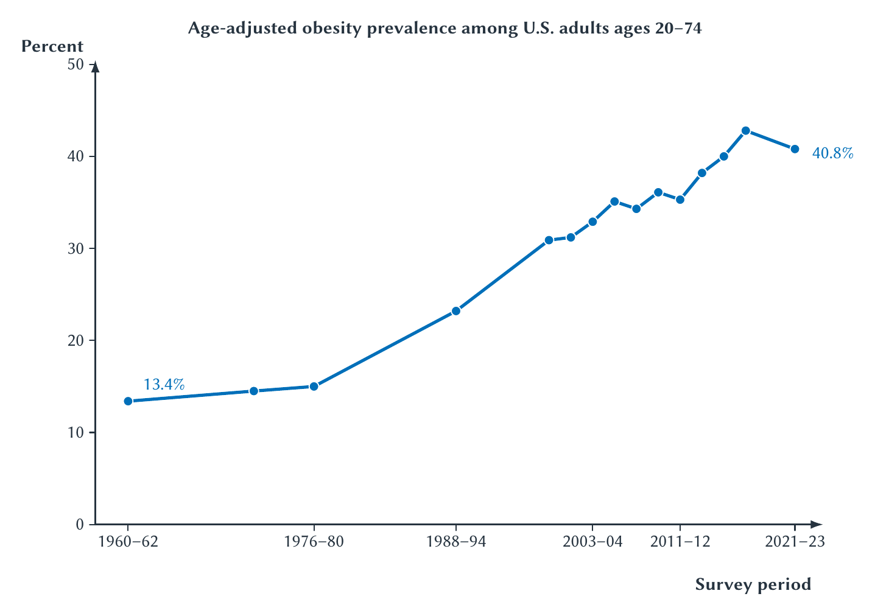
CHAPTER 19
Adult obesity rose greatly over the long run
The trend establishes a large health change; it does not identify one cause.
PRINCIPLES OF MICRO
3
Notes:
These are periodic survey estimates for ages 20 to 74, not annual observations. BMI is useful for population measurement but is not a complete measure of individual metabolic health.
[Sources]
- Principles of Micro, Chapter 19: Health, Medical Care, and Insurance (current project draft).
- Cheryl Fryar, Joseph Afful, and Nadia Saif, Prevalence of Overweight, Obesity, and Severe Obesity Among Adults Age 20 and Older, NCHS Health E-Stat 111, 2026.
- Project-reviewed Chapter 19 figures from figures/ch19_health_medical_care_and_insurance/.
[/Sources]

Slide 4
CHAPTER 19
A growing health problem need not produce a fixed future
Obesity and related metabolic risk can place enormous pressure on households, insurers, and public budgets, but technology can change that path.
•
New GLP-1 medicines have produced large average weight loss in major trials.
•
Additional treatments and uses are being studied rapidly.
•
Prevention, behavior, prices, access, and long-run adherence still matter.
PRINCIPLES OF MICRO
4
Notes:
Keep the discussion hopeful but bounded. Trial averages apply to selected populations, doses, and durations and are not guarantees for an individual.
[Sources]
- Principles of Micro, Chapter 19: Health, Medical Care, and Insurance (current project draft).
- John Wilding and coauthors, Once-Weekly Semaglutide in Adults with Overweight or Obesity, New England Journal of Medicine 384, 2021; Ania Jastreboff and coauthors, Tirzepatide Once Weekly for the Treatment of Obesity, New England Journal of Medicine 387, 2022.
[/Sources]

Slide 5
CHAPTER 19
Medical innovation can create value far beyond drug-company revenue
A treatment can improve life, reduce other care, raise productivity, and ease pressure on private and public insurance.
•
Large social gains can justify large rewards for successful research.
•
Patents create incentives but leave imperfections and high prices during protection.
•
Nonpatentable compounds and new uses for old drugs may receive too little study.
PRINCIPLES OF MICRO
5
Notes:
Do not imply every medicine creates savings or every patent is well designed. The point is that the social return to valuable medical R&D can be very large.
[Sources]
- Principles of Micro, Chapter 19: Health, Medical Care, and Insurance (current project draft).
- Kevin Murphy and Robert Topel, The Value of Health and Longevity, Journal of Political Economy 114(5), 2006; Eric Budish and coauthors, Missing Markets for Innovation, NBER Working Paper 34222, 2025, revised 2026.
[/Sources]

Slide 6
CHAPTER 19
Medicare and Medicaid are major public insurance programs
MEDICARE
MEDICAID
Mainly older Americans and some disabled people
Eligible low-income households and other groups
A federal program financed through payroll taxes, premiums, and general revenue.
A federal-state program whose rules and financing are shared.
Federal outlays for the two programs are measured in trillions of dollars over short spans of time.
PRINCIPLES OF MICRO
6
Notes:
CBO projected roughly $1.1 trillion in net federal Medicare outlays and $708 billion in federal Medicaid outlays for 2026. Medicaid excludes state spending. Treat current projections as update-sensitive.
[Sources]
- Principles of Micro, Chapter 19: Health, Medical Care, and Insurance (current project draft).
- Congressional Budget Office, The Budget and Economic Outlook: 2026 to 2036, Chapter 3.
[/Sources]

Slide 7
CHAPTER 19
Medical care is unusually difficult to organize
Need is uncertain, quality is hard to judge, decisions can be urgent, and a third party often pays most of the bill.
•
Patients know symptoms but providers know more medicine.
•
Providers may recommend care and also receive payment for it.
•
Insurance protects against risk while weakening the direct price signal.
PRINCIPLES OF MICRO
7
Notes:
These features make the sector a concentrated application of Chapters 5, 10, 12, 15, and 18.
[Sources]
- Principles of Micro, Chapter 19: Health, Medical Care, and Insurance (current project draft).
[/Sources]

Slide 8
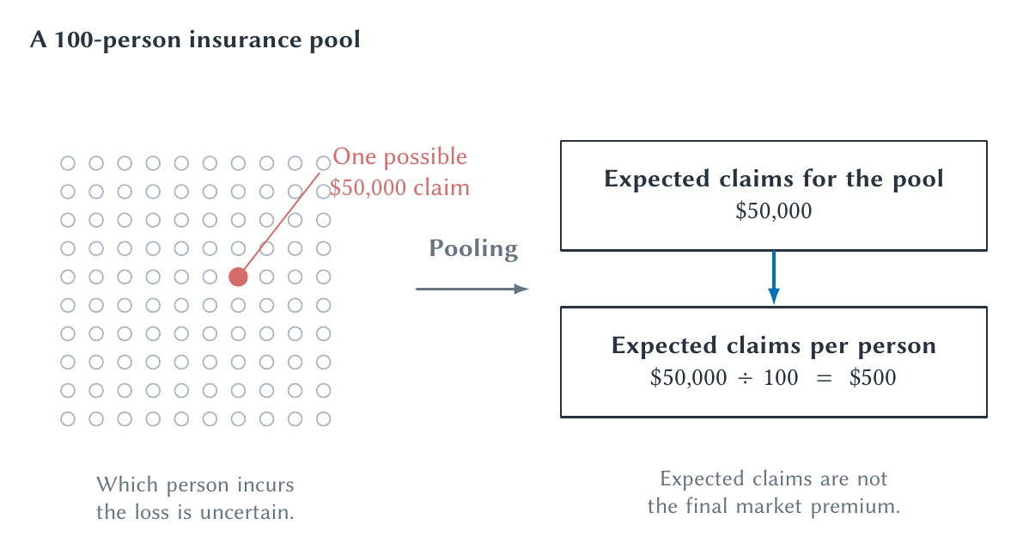
CHAPTER 19
Insurance pools an uncertain loss across many people
Pooling makes financial exposure more predictable; it does not make medical resources free.
PRINCIPLES OF MICRO
8
Notes:
The identity of the person with the loss is uncertain, and the loss may not occur exactly as pictured. The $500 is expected claims per person, not necessarily the final market premium.
[Sources]
- Principles of Micro, Chapter 19: Health, Medical Care, and Insurance (current project draft).
- Project-reviewed Chapter 19 figures from figures/ch19_health_medical_care_and_insurance/.
[/Sources]

Slide 9
CHAPTER 19
Adverse selection changes who enters the insurance pool
People who expect high medical spending have a stronger reason to buy generous coverage.
•
Insurers raise premiums when the covered group is costlier than expected.
•
Higher premiums can drive lower-risk people out.
•
The remaining pool becomes still more expensive.
PRINCIPLES OF MICRO
9
Notes:
Recall Chapter 12: adverse selection concerns information and selection before or when coverage is chosen.
[Sources]
- Principles of Micro, Chapter 19: Health, Medical Care, and Insurance (current project draft).
[/Sources]

Slide 10
CHAPTER 19
Moral hazard changes behavior after coverage begins
Insurance lowers the price paid when care is used, so people may use more care.
•
Some additional care is valuable and would otherwise be unaffordable.
•
Some has value below the full resource cost.
•
Providers and patients may both respond to the payment rules.
PRINCIPLES OF MICRO
10
Notes:
Moral hazard is not proof of fraud or bad character. It is the ordinary response to a lower out-of-pocket price.
[Sources]
- Principles of Micro, Chapter 19: Health, Medical Care, and Insurance (current project draft).
[/Sources]

Slide 11
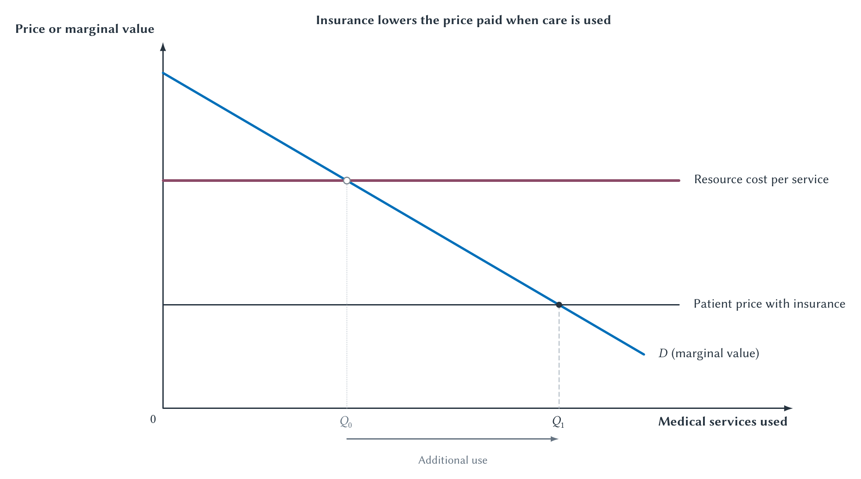
CHAPTER 19
Insurance lowers the patient price and increases use
Coverage changes utilization because the patient no longer faces the full cost at the point of care.
PRINCIPLES OF MICRO
11
Notes:
Do not shade all additional use as waste. Welfare depends on the value and resource cost of the marginal services.
[Sources]
- Principles of Micro, Chapter 19: Health, Medical Care, and Insurance (current project draft).
- Project-reviewed Chapter 19 figures from figures/ch19_health_medical_care_and_insurance/.
[/Sources]

Slide 12
CHAPTER 19
Cost sharing balances risk protection and price signals
MORE GENEROUS COVERAGE
HIGHER COST SHARING
Better protection
Stronger price signal
Households face less financial risk when serious care is needed.
Deductibles and copayments discourage some use but also expose patients to more risk.
There is no insurance design that provides full protection and leaves every incentive unchanged.
PRINCIPLES OF MICRO
12
Notes:
Use RAND as the main evidence that use responds to out-of-pocket price. Keep numerical estimates out of the main slide.
[Sources]
- Principles of Micro, Chapter 19: Health, Medical Care, and Insurance (current project draft).
- RAND Corporation, The Health Insurance Experiment; Aviva Aron-Dine, Liran Einav, and Amy Finkelstein, The RAND Health Insurance Experiment, Three Decades Later, Journal of Economic Perspectives 27(1), 2013.
[/Sources]

Slide 13
CHAPTER 19
Patients, providers, and payers face different prices
The patient can pay a copay while the insurer pays a negotiated amount and the provider receives payment under a separate rule.
•
The sticker price may be paid by almost nobody.
•
Network contracts determine which providers are covered and at what rate.
•
The payment rule affects which services providers are rewarded for supplying.
PRINCIPLES OF MICRO
13
Notes:
Explain third-party payment in prose; the removed flowchart added more complexity than the principles-level point required.
[Sources]
- Principles of Micro, Chapter 19: Health, Medical Care, and Insurance (current project draft).
[/Sources]

Slide 14
CHAPTER 19
Provider payment changes what is rewarded
FEE FOR SERVICE
CAPITATION
Pay for each visit or procedure
Pay a fixed amount per enrolled patient
Rewards additional billable activity but may encourage more services than needed.
Rewards cost control and prevention but may encourage too little care or avoiding costly patients.
Every payment system solves one incentive problem by creating another.
PRINCIPLES OF MICRO
14
Notes:
Mention salary and bundled payment briefly in discussion. No model removes the need for information, quality measurement, and monitoring.
[Sources]
- Principles of Micro, Chapter 19: Health, Medical Care, and Insurance (current project draft).
[/Sources]

Slide 15
CHAPTER 19
Competition in medical care can be weak on several sides
Hospital systems, insurers, physician groups, and drug firms can each possess market power in different markets.
•
Emergency need and travel limits reduce patient alternatives.
•
Insurance networks affect which providers compete for a patient.
•
Patents and specialized treatments can limit substitutes.
PRINCIPLES OF MICRO
15
Notes:
Avoid treating health care as one national market. Market power depends on service, geography, network, and available substitutes.
[Sources]
- Principles of Micro, Chapter 19: Health, Medical Care, and Insurance (current project draft).
[/Sources]

Slide 16
CHAPTER 19
Public health adds externalities to private medical decisions
Vaccination, infection control, sanitation, and information can protect people beyond the direct patient.
The Chapter 10 case for intervention returns when private choices omit outside benefits or costs.
PRINCIPLES OF MICRO
16
Notes:
Keep public health distinct from insurance. The externality concerns effects on others; insurance concerns risk pooling and point-of-care prices.
[Sources]
- Principles of Micro, Chapter 19: Health, Medical Care, and Insurance (current project draft).
[/Sources]

Slide 17
CHAPTER 19
Every health system rations scarce care
No institution can supply every service to every patient immediately at zero price.
•
Money prices and cost sharing ration some care.
•
Insurance networks and approval rules ration access.
•
Waiting time, queues, and budgets ration care in other settings.
PRINCIPLES OF MICRO
17
Notes:
The serious comparison is among rationing mechanisms, their incentives, and their consequences, not between rationing and no rationing.
[Sources]
- Principles of Micro, Chapter 19: Health, Medical Care, and Insurance (current project draft).
[/Sources]

Slide 18
CHAPTER 19
Research question: should blood or plasma donors be compensated?
Compensation may increase supply, but the effect depends on the product, reward, population, and institution.
•
Does payment attract more donors or crowd out voluntary motives?
•
How do whole blood and source plasma differ?
•
What do countries with different rules actually experience?
PRINCIPLES OF MICRO
18
Notes:
Use as an optional research assignment linked back to Chapter 6. Students should distinguish causal experiments from simple cross-country comparisons.
[Sources]
- Principles of Micro, Chapter 19: Health, Medical Care, and Insurance (current project draft).
- Nicola Lacetera, Mario Macis, and Robert Slonim, Rewarding Volunteers, Management Science 60(5), 2014; Carl Mellstrom and Magnus Johannesson, Crowding Out in Blood Donation, Journal of the European Economic Association 6(4), 2008.
[/Sources]

Slide 19
CHAPTER 19
Health-care analysis follows the same economic habits
STEP 1
STEP 2
STEP 3
STEP 4
Separate health from care
Follow the price
Locate hidden information
Trace the incentive
→
→
→
Identify the outcome and all major inputs.
Who pays at the point of care and who bears the full cost?
Who knows risk, quality, need, or effort?
How do patients, providers, insurers, and innovators adjust?
Complicated institutions still respond to prices, information, and rules.
PRINCIPLES OF MICRO
19
Notes:
Use this as the chapter's transfer framework rather than a large institution-comparison table.
[Sources]
- Principles of Micro, Chapter 19: Health, Medical Care, and Insurance (current project draft).
[/Sources]

Slide 20
CHAPTER 19
Insurance protects people and changes behavior
•
Health depends on behavior, environment, genetics, income, chance, and medical care.
•
Insurance pools risk but creates adverse-selection and moral-hazard problems.
•
Payment rules change patient, provider, and insurer incentives.
•
Medical innovation can create enormous social value and budget consequences.
•
Every system rations scarce care through some combination of prices, rules, and waiting.
Next: firms and contracts are themselves institutions for coordinating information and incentives.
PRINCIPLES OF MICRO
20
Notes:
Close by asking students to apply adverse selection and moral hazard to one insurance design without mixing their timing.
[Sources]
- Principles of Micro, Chapter 19: Health, Medical Care, and Insurance (current project draft).
[/Sources]

