Slide 1
CHOICE
The Microeconomic
Toolkit for Law
TRADE-OFFS
Chapter 2
Rules, Rights, and Runtimes
INSTITUTIONS
Law and Economics in the Age of AI
Notes:
Frame the chapter as a compact toolkit rather than a general microeconomics survey. Every concept appears because it will be reused in later legal domains.
[Sources]
- Rules, Rights, and Runtimes, Chapter 2: The Microeconomic Toolkit for Law (canonical project draft).
- Law and Economics project evidence ledger: evidence/ch02_microeconomic_toolkit_for_law.md.
[/Sources]

Slide 2
CHAPTER 2
One safety rule can activate many margins
HOME-REPAIR REQUIREMENT
Certified parts + safety checklist + installation records
The rule may improve safety. It also changes choices.
What can contractors, customers, and inspectors change?
RULES, RIGHTS, AND RUNTIMES
2
Notes:
Pause before advancing. Ask for responses beyond simple compliance: price, job selection, training, do-it-yourself repair, informal providers, inspection frequency, and record review.
[Sources]
- Rules, Rights, and Runtimes, Chapter 2: The Microeconomic Toolkit for Law (canonical project draft).
- Law and Economics project evidence ledger: evidence/ch02_microeconomic_toolkit_for_law.md.
[/Sources]

Slide 3
CHAPTER 2
The rule changes a system, not one decision
CONTRACTORS
CUSTOMERS
INSPECTORS
Price
Job selection
Training
Entry or exit
Pay
Postpone
Do it themselves
Use informal sellers
Review records
Choose targets
Set frequency
Allocate time
Evaluation requires tracing all three sets of adjustments and the resulting safety effects.
RULES, RIGHTS, AND RUNTIMES
3
Notes:
Use the opening responses to establish the chapter's job. Observing a benefit or a compliance cost is not enough; the economic question follows all affected actors.
[Sources]
- Rules, Rights, and Runtimes, Chapter 2: The Microeconomic Toolkit for Law (canonical project draft).
- Law and Economics project evidence ledger: evidence/ch02_microeconomic_toolkit_for_law.md.
[/Sources]

Slide 4
CHAPTER 2
The toolkit moves from choice to institutions
CHOICE
MARKETS
WELFARE
DIVERGENCE
RISK
STRATEGY
Scarcity
Margin
→
Price
Quantity
→
Surplus
Distribution
→
Externality
Information
→
Probability
Insurance
→
Cooperation
Agency
Each layer adds structure without replacing the earlier one.
RULES, RIGHTS, AND RUNTIMES
4
Notes:
This is the lecture roadmap. Do not define every term yet. Stress accumulation: markets aggregate choices; welfare evaluates results; risk, strategy, and agency complicate the baseline.
[Sources]
- Rules, Rights, and Runtimes, Chapter 2: The Microeconomic Toolkit for Law (canonical project draft).
- Law and Economics project evidence ledger: evidence/ch02_microeconomic_toolkit_for_law.md.
[/Sources]

Slide 5
CHAPTER 2
Purposeful choice is a modest baseline
People try to make themselves as well off as they can, given what they value, know, and can choose.
GOALS
INFORMATION
CONSTRAINTS
May include family, fairness, duty, reputation, or money
Can be incomplete, mistaken, or costly to obtain
Limit the options that can actually be chosen
Rationality does not require selfishness, omniscience, or equation solving.
RULES, RIGHTS, AND RUNTIMES
5
Notes:
Give the baseline plainly. A driver may value time, safety, legality, and reputation at once. The model asks which options, beliefs, costs, or constraints change the choice.
[Sources]
- Rules, Rights, and Runtimes, Chapter 2: The Microeconomic Toolkit for Law (canonical project draft).
- Law and Economics project evidence ledger: evidence/ch02_microeconomic_toolkit_for_law.md.
[/Sources]

Slide 6
CHAPTER 2
Opportunity cost reveals the forgone alternative
A resource is costly even when no new check is written.
RESOURCE
CHOSEN USE
BEST ALTERNATIVE GIVEN UP
Court week
Complex commercial case
→
Other disputes delayed
Ten officers
Traffic enforcement
→
Other offenses not investigated
Employee time
Compliance records
→
Production, service, or another safety step
RULES, RIGHTS, AND RUNTIMES
6
Notes:
Ask what is displaced by an additional legal requirement. Opportunity cost prevents comparison with an imaginary world in which staff time, court time, and compliance effort are free.
[Sources]
- Rules, Rights, and Runtimes, Chapter 2: The Microeconomic Toolkit for Law (canonical project draft).
- Law and Economics project evidence ledger: evidence/ch02_microeconomic_toolkit_for_law.md.
[/Sources]

Slide 7
CHAPTER 2
The relevant question concerns the next unit
Add another safety check while its additional benefit covers its additional cost.
TAKE THE NEXT UNIT
STOP BEFORE THE NEXT UNIT
MB ≥ MC
MB < MC
MB = marginal benefit | MC = marginal cost
For discrete legal choices, the equality is a guide rather than a literal requirement.
RULES, RIGHTS, AND RUNTIMES
7
Notes:
Read every symbol in words. Use safety checks or hearings. Many choices are discrete: take a unit while its benefit covers its cost, then stop before the next unit costs more than it adds.
[Sources]
- Rules, Rights, and Runtimes, Chapter 2: The Microeconomic Toolkit for Law (canonical project draft).
- Law and Economics project evidence ledger: evidence/ch02_microeconomic_toolkit_for_law.md.
[/Sources]

Slide 8
CHAPTER 2
A legal rule can move four parts of a choice
BENEFIT
COST
CONSTRAINT
INFORMATION
Remedy
Reward
Access
Fine
Liability
Delay
Injunction
License
Prohibition
Disclosure
Proof
Reputation
Identify the lever, then identify the margin on which behavior can adjust.
RULES, RIGHTS, AND RUNTIMES
8
Notes:
Connect back to Chapter 1's implicit prices. An injunction changes the feasible set; disclosure changes information; a reputation score changes future benefits and costs.
[Sources]
- Rules, Rights, and Runtimes, Chapter 2: The Microeconomic Toolkit for Law (canonical project draft).
- Law and Economics project evidence ledger: evidence/ch02_microeconomic_toolkit_for_law.md.
[/Sources]

Slide 9
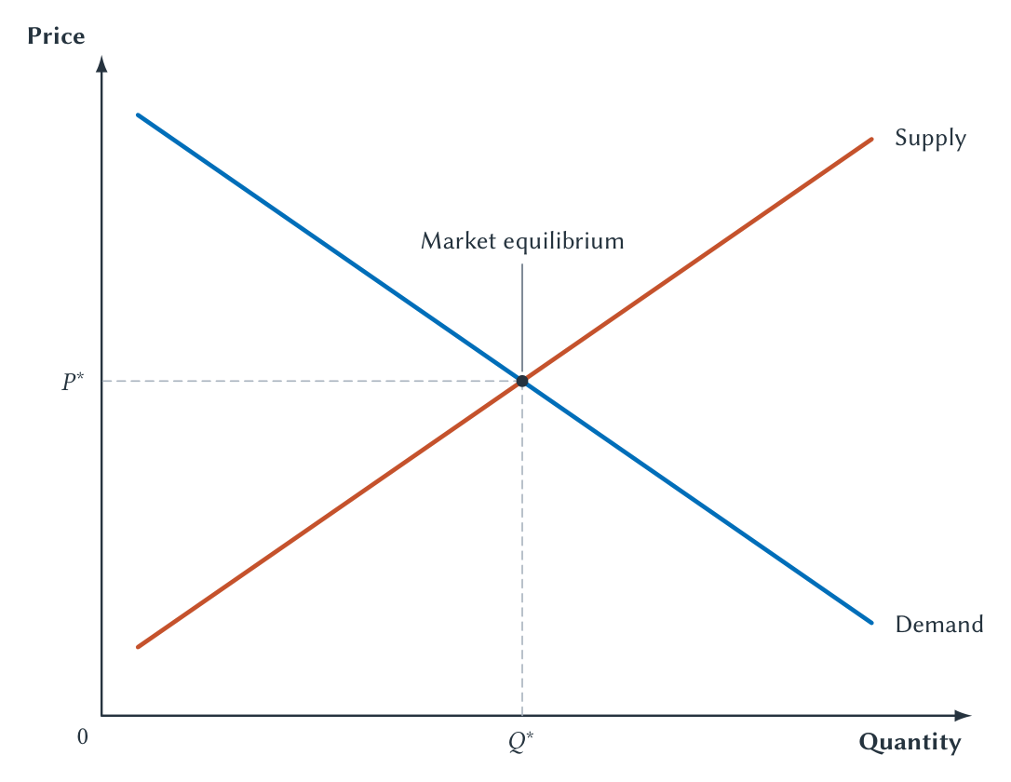
CHAPTER 2
Price and quantity emerge from interacting plans
Equilibrium coordinates buyer and seller plans; it does not imply fairness or perfection.
RULES, RIGHTS, AND RUNTIMES
9
Notes:
Define demand and supply in words before naming equilibrium. Ask students to locate the price and quantity at which planned purchases equal planned sales.
[Sources]
- Rules, Rights, and Runtimes, Chapter 2: The Microeconomic Toolkit for Law (canonical project draft).
- Law and Economics project evidence ledger: evidence/ch02_microeconomic_toolkit_for_law.md.
- Project-original Chapter 2 TikZ figures and accepted QA assets: figures/ch02_microeconomic_toolkit/.
[/Sources]

Slide 10
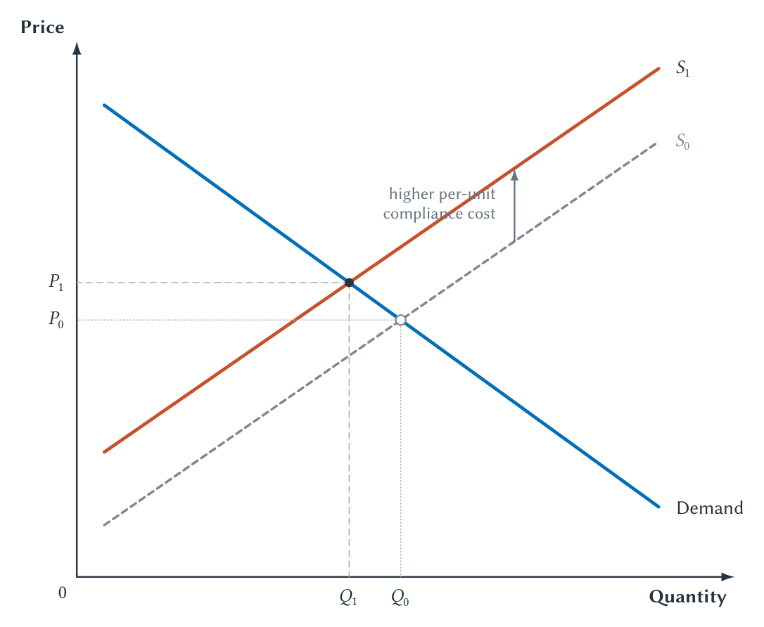
CHAPTER 2
A compliance cost shifts supply and changes both sides
The graph predicts a private-market adjustment; it does not display the rule's safety benefit.
RULES, RIGHTS, AND RUNTIMES
10
Notes:
Return to the home-repair rule. Hold demand fixed and isolate the higher per-unit private cost. Price rises and quantity falls in this benchmark, but policy evaluation still requires the safety benefit.
[Sources]
- Rules, Rights, and Runtimes, Chapter 2: The Microeconomic Toolkit for Law (canonical project draft).
- Law and Economics project evidence ledger: evidence/ch02_microeconomic_toolkit_for_law.md.
- Project-original Chapter 2 TikZ figures and accepted QA assets: figures/ch02_microeconomic_toolkit/.
[/Sources]

Slide 11
CHAPTER 2
Curve shifts and incidence answer different questions
WHAT CHANGES THE CURVE?
WHO ULTIMATELY BEARS IT?
Own price changes
Formal incidence
movement along a fixed curve
Contractor must comply
Cost, risk, information, or rules
Economic incidence
shift of the curve
Price, income, service, entry, and exit adjust
Responsiveness determines how the burden is divided.
RULES, RIGHTS, AND RUNTIMES
11
Notes:
Make two distinctions. A rule-induced cost shift is not movement caused by the service's own price. The person legally regulated also need not bear the full ultimate burden after price, entry, and quality adjust.
[Sources]
- Rules, Rights, and Runtimes, Chapter 2: The Microeconomic Toolkit for Law (canonical project draft).
- Law and Economics project evidence ledger: evidence/ch02_microeconomic_toolkit_for_law.md.
[/Sources]

Slide 12
CHAPTER 2
Elasticity asks how large the response will be
Direction
Magnitude
A higher expected punishment reduces prohibited conduct in the benchmark model.
Elasticity asks whether the change in conduct is large or small.
Alternatives
Time to adjust
Information and beliefs
Inelastic means less responsive, not unresponsive.
RULES, RIGHTS, AND RUNTIMES
12
Notes:
Separate a directional theoretical prediction from the empirical magnitude. Alternatives, time, knowledge, planning, and the available margins of adjustment affect responsiveness.
[Sources]
- Rules, Rights, and Runtimes, Chapter 2: The Microeconomic Toolkit for Law (canonical project draft).
- Law and Economics project evidence ledger: evidence/ch02_microeconomic_toolkit_for_law.md.
[/Sources]

Slide 13
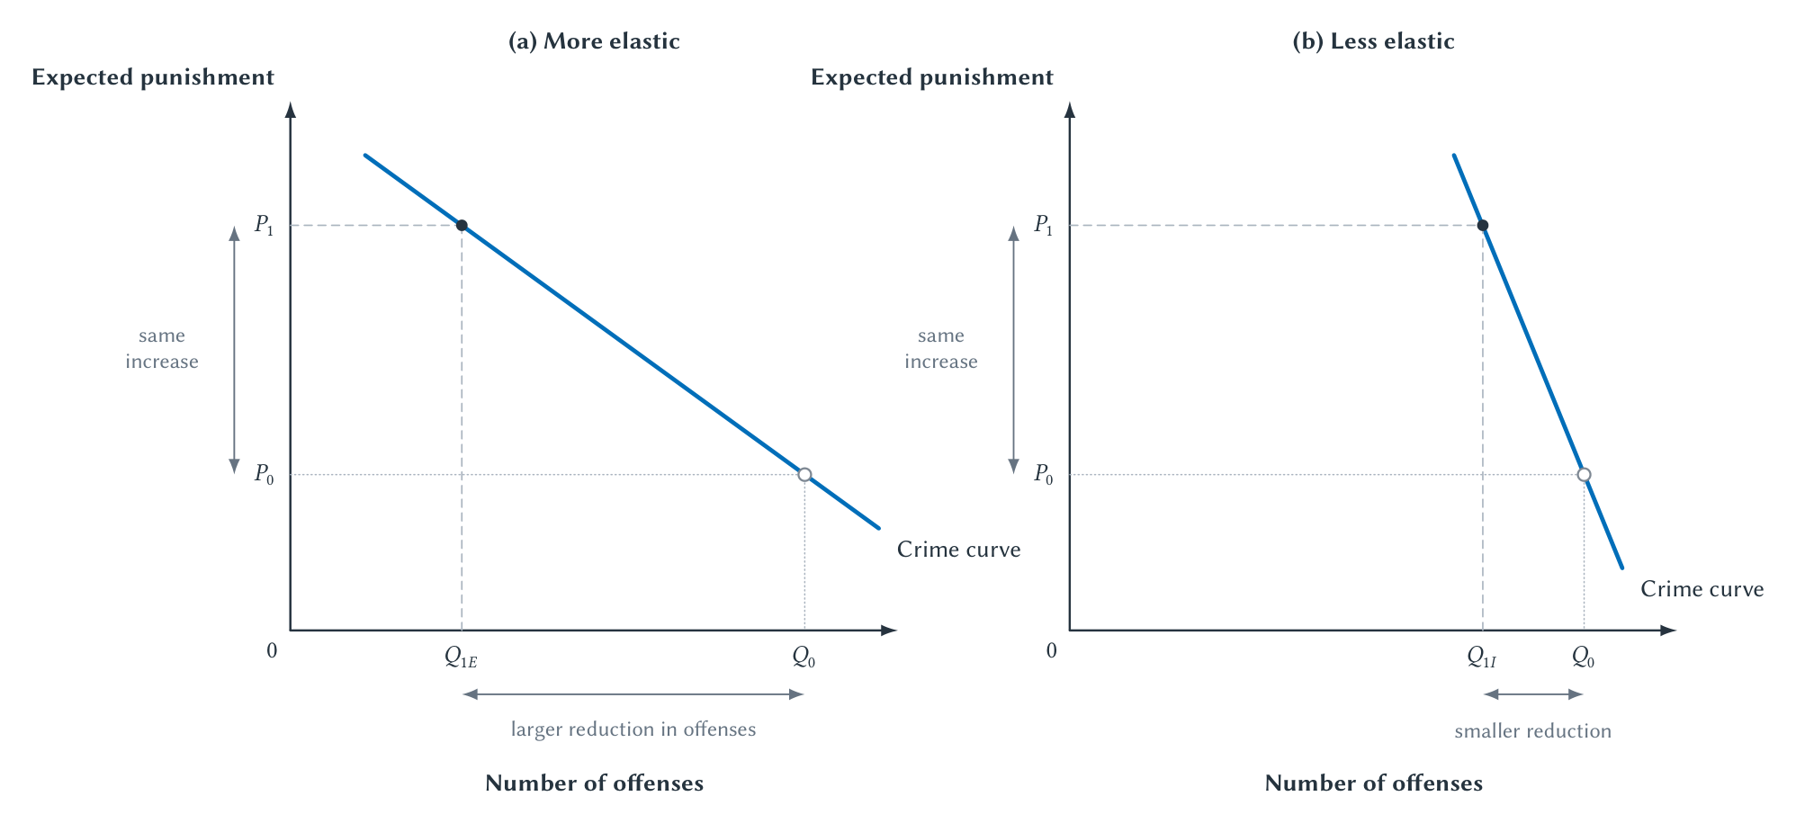
CHAPTER 2
The same punishment change can produce different responses
Both panels predict deterrence; only evidence can identify the magnitude for real conduct.
RULES, RIGHTS, AND RUNTIMES
13
Notes:
Use repeated offenses as the clean horizontal quantity. Do not classify real crimes from the schematic curves. Ask what other margins could change: timing, targets, concealment, methods, or seriousness.
[Sources]
- Rules, Rights, and Runtimes, Chapter 2: The Microeconomic Toolkit for Law (canonical project draft).
- Law and Economics project evidence ledger: evidence/ch02_microeconomic_toolkit_for_law.md.
- Project-original Chapter 2 TikZ figures and accepted QA assets: figures/ch02_microeconomic_toolkit/.
[/Sources]

Slide 14
CHAPTER 2
A voluntary trade can create cooperative surplus
Seller values apple at
Trade price
Buyer values apple at
$0.60
→
$0.90
→
$1.20
Seller surplus: $0.30
+
Buyer surplus: $0.30
= $0.60 total gain from exchange
RULES, RIGHTS, AND RUNTIMES
14
Notes:
Work the arithmetic. Cooperative surplus here means the gains from trade, not Nash bargaining. Price divides the gain; moving the apple to the higher-valued use creates the total gain.
[Sources]
- Rules, Rights, and Runtimes, Chapter 2: The Microeconomic Toolkit for Law (canonical project draft).
- Law and Economics project evidence ledger: evidence/ch02_microeconomic_toolkit_for_law.md.
[/Sources]

Slide 15
CHAPTER 2
Pie size and slice size remain different questions
EFFICIENCY
DISTRIBUTION
How much total value is created?
Who receives the gains and bears the losses?
Are avoidable losses reduced?
Are gains from cooperation realized?
Who begins with which rights?
Does the allocation satisfy other values?
Efficiency is the default economic benchmark, not a complete theory of justice or legitimacy.
RULES, RIGHTS, AND RUNTIMES
15
Notes:
Use the pie metaphor briefly. An efficient result can divide gains objectionably, and redistribution can change the size of the pie. Rights and legitimacy remain distinct considerations.
[Sources]
- Rules, Rights, and Runtimes, Chapter 2: The Microeconomic Toolkit for Law (canonical project draft).
- Law and Economics project evidence ledger: evidence/ch02_microeconomic_toolkit_for_law.md.
[/Sources]

Slide 16
CHAPTER 2
Most legal change creates winners and losers
PARETO IMPROVEMENT
REAL LEGAL CHANGE
At least one person gains
and no one loses
Pollution, procedure, patents:
gains and losses coexist
Potential compensation is not actual compensation.
Cost-benefit analysis does not erase distribution, reliance, rights, or legitimacy.
RULES, RIGHTS, AND RUNTIMES
16
Notes:
Explain why Pareto improvement is attractive but too demanding for most legal reform. Total gains exceeding losses does not mean the losers are compensated.
[Sources]
- Rules, Rights, and Runtimes, Chapter 2: The Microeconomic Toolkit for Law (canonical project draft).
- Law and Economics project evidence ledger: evidence/ch02_microeconomic_toolkit_for_law.md.
[/Sources]

Slide 17
CHAPTER 2
Market failure diagnoses where private choice can diverge
Externality
Effects fall on people outside the decision
BRING EFFECT INTO CHOICE
Public good
Beneficiaries can free ride on provision
ORGANIZE FINANCE
Market power
A participant restricts quantity or terms
RESTORE OR REGULATE COMPETITION
Information
A party cannot evaluate quality, risk, or performance
DISCLOSE, VERIFY, OR ALLOCATE RISK
Diagnosis begins the institutional comparison; it does not select the remedy.
RULES, RIGHTS, AND RUNTIMES
17
Notes:
Move quickly through the four diagnoses. Externalities receive the full treatment because they recur across property, tort, crime, regulation, platforms, and AI.
[Sources]
- Rules, Rights, and Runtimes, Chapter 2: The Microeconomic Toolkit for Law (canonical project draft).
- Law and Economics project evidence ledger: evidence/ch02_microeconomic_toolkit_for_law.md.
[/Sources]

Slide 18
CHAPTER 2
Social cost includes harm outside the transaction
MSC = MPC + MEC
MSC
MPC
MEC
marginal social cost
marginal private cost
marginal external cost
If the decision maker does not bear MEC, private output can exceed the social benchmark.
RULES, RIGHTS, AND RUNTIMES
18
Notes:
Read every symbol in words. Private cost is not fake or irrelevant; it is incomplete when outsiders bear an additional marginal cost.
[Sources]
- Rules, Rights, and Runtimes, Chapter 2: The Microeconomic Toolkit for Law (canonical project draft).
- Law and Economics project evidence ledger: evidence/ch02_microeconomic_toolkit_for_law.md.
[/Sources]

Slide 19
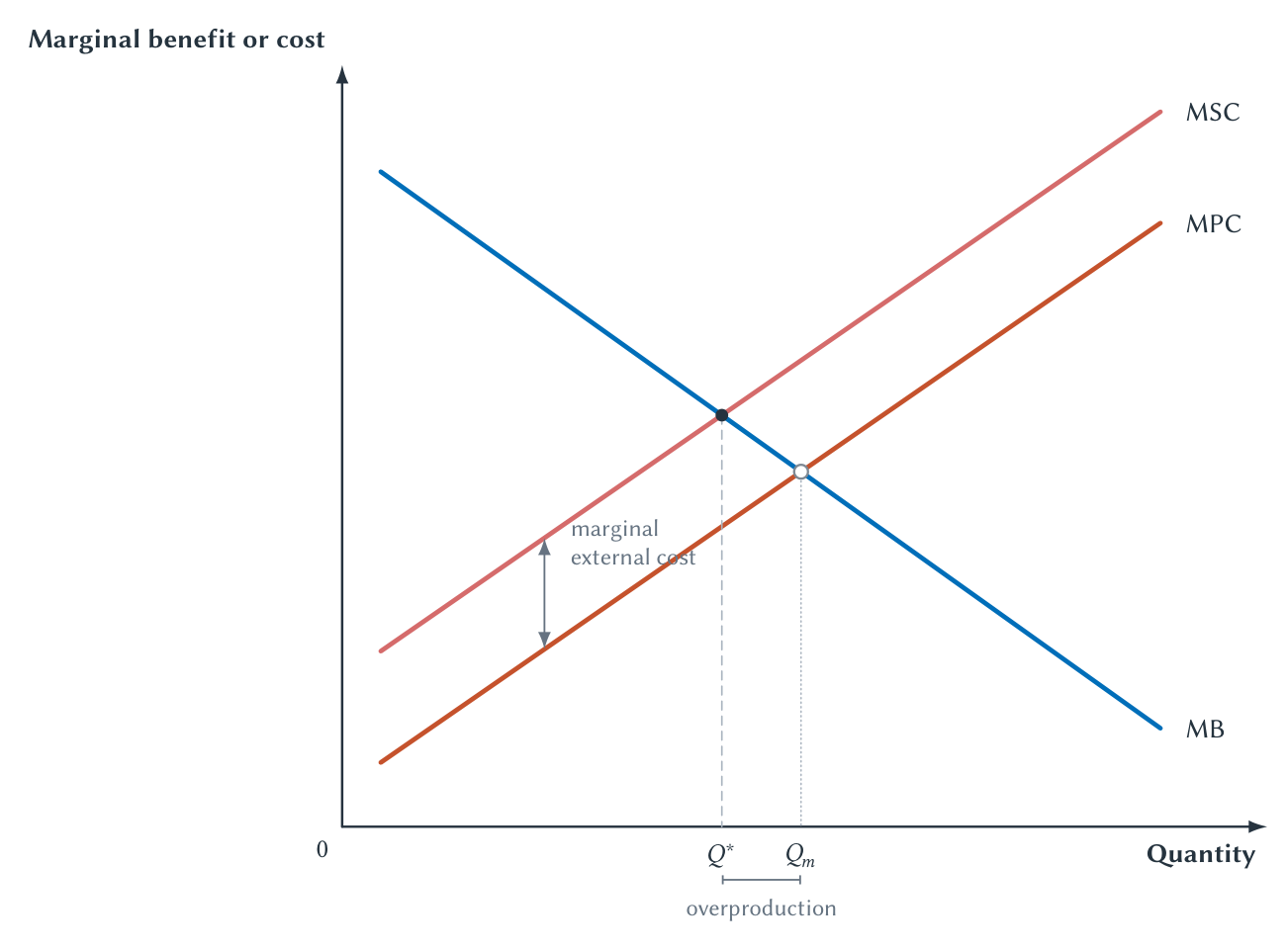
CHAPTER 2
Ignoring external cost can produce too much activity
The efficient quantity is lower than the market quantity, but it is not zero.
RULES, RIGHTS, AND RUNTIMES
19
Notes:
Walk from MB=MPC at the private quantity to MB=MSC at the efficient quantity. Stress that the useful activity continues at Q*. The graph diagnoses an incentive gap but does not prescribe a remedy.
[Sources]
- Rules, Rights, and Runtimes, Chapter 2: The Microeconomic Toolkit for Law (canonical project draft).
- Law and Economics project evidence ledger: evidence/ch02_microeconomic_toolkit_for_law.md.
- Project-original Chapter 2 TikZ figures and accepted QA assets: figures/ch02_microeconomic_toolkit/.
[/Sources]

Slide 20
CHAPTER 2
Internalization is an objective, not a single remedy
Bring more of the external effect into the actor's decision
Tax
Liability
Regulation
Rights + bargaining
Subsidy
Each requires different information, enforcement, parties, and tolerance for error.
The institutional question is comparative: which feasible response performs better here?
RULES, RIGHTS, AND RUNTIMES
20
Notes:
Define internalization as changing the choice, not automatically imposing a tax. Compare the information and enforcement requirements of liability, regulation, bargaining, and other instruments.
[Sources]
- Rules, Rights, and Runtimes, Chapter 2: The Microeconomic Toolkit for Law (canonical project draft).
- Law and Economics project evidence ledger: evidence/ch02_microeconomic_toolkit_for_law.md.
[/Sources]

Slide 21
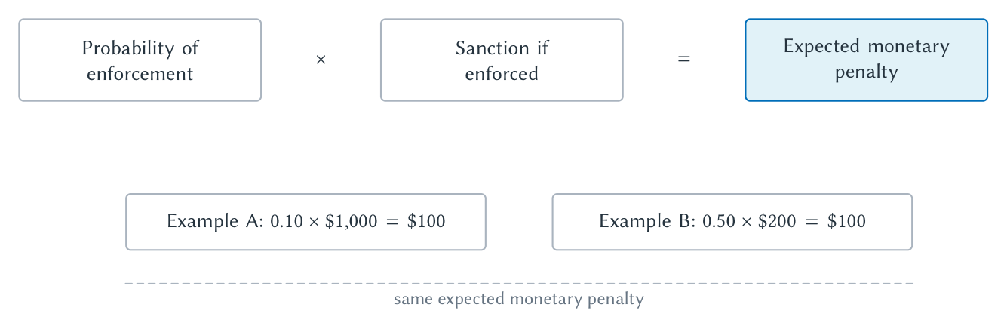
CHAPTER 2
Expected punishment has two separate policy margins
E(P) = p × F is a baseline calculation, not proof that the policies are equivalent.
RULES, RIGHTS, AND RUNTIMES
21
Notes:
Read the equation in English: expected penalty equals probability of punishment times the sanction if imposed. Work both calculations before discussing the caveats.
[Sources]
- Rules, Rights, and Runtimes, Chapter 2: The Microeconomic Toolkit for Law (canonical project draft).
- Law and Economics project evidence ledger: evidence/ch02_microeconomic_toolkit_for_law.md.
- Project-original Chapter 2 TikZ figures and accepted QA assets: figures/ch02_microeconomic_toolkit/.
[/Sources]

Slide 22
CHAPTER 2
Equal expected penalties need not be equivalent
RARE + SEVERE
FREQUENT + MODEST
10% × $1,000
= $100
50% × $200
= $100
Risk
Wealth
Delay
Salience
Error
Proportionality
Arithmetic organizes the comparison; institutional detail determines equivalence.
RULES, RIGHTS, AND RUNTIMES
22
Notes:
Ask why the two policies may differ despite equal expected monetary values. Draw out risk aversion, inability to pay, salience, evasion, enforcement cost, false positives, proportionality, and marginal deterrence.
[Sources]
- Rules, Rights, and Runtimes, Chapter 2: The Microeconomic Toolkit for Law (canonical project draft).
- Law and Economics project evidence ledger: evidence/ch02_microeconomic_toolkit_for_law.md.
[/Sources]

Slide 23
CHAPTER 2
Expected harm makes precaution comparable
E(H) = p × L
BEFORE
PRECAUTION
AFTER
NET
1% × $10,000
→
Costs $30
→
0.5% × $10,000
+$20
$100 expected harm
Risk falls to 0.5%
$50 expected harm
Expected harm falls $50 at a $30 cost.
RULES, RIGHTS, AND RUNTIMES
23
Notes:
Work the arithmetic slowly. Before: $100 expected harm. After: $50. The precaution reduces expected harm by $50 at a $30 cost, creating $20 in net expected value under the simplified assumptions.
[Sources]
- Rules, Rights, and Runtimes, Chapter 2: The Microeconomic Toolkit for Law (canonical project draft).
- Law and Economics project evidence ledger: evidence/ch02_microeconomic_toolkit_for_law.md.
[/Sources]

Slide 24
CHAPTER 2
Insurance reveals two distinct information problems
AFTER PROTECTION
BEFORE AGREEMENT
Moral hazard
Adverse selection
Protection changes behavior and may increase the probability or size of loss.
One side knows more about risk or quality, changing who enters the agreement.
Deductibles, monitoring, disclosure, warranties, screening, reputation, and liability can respond at a cost.
RULES, RIGHTS, AND RUNTIMES
24
Notes:
Keep the distinction temporal and causal. Moral hazard is an incentive change after protection; adverse selection is sorting caused by hidden information before agreement. Neither implies insurance is undesirable.
[Sources]
- Rules, Rights, and Runtimes, Chapter 2: The Microeconomic Toolkit for Law (canonical project draft).
- Law and Economics project evidence ledger: evidence/ch02_microeconomic_toolkit_for_law.md.
[/Sources]

Slide 25
CHAPTER 2
Individual incentives can produce a worse joint result
COLUMN COOPERATES
COLUMN DEFECTS
ROW COOPERATES
(3, 3)
(0, 5)
ROW DEFECTS
(5, 0)
(1, 1)
Defection is individually attractive; mutual defection leaves both at (1, 1) instead of (3, 3).
RULES, RIGHTS, AND RUNTIMES
25
Notes:
Read the table one row at a time and remind students that payoffs are ordered (Row, Column). Establish defection as dominant before naming the stable but jointly inferior outcome.
[Sources]
- Rules, Rights, and Runtimes, Chapter 2: The Microeconomic Toolkit for Law (canonical project draft).
- Law and Economics project evidence ledger: evidence/ch02_microeconomic_toolkit_for_law.md.
[/Sources]

Slide 26
CHAPTER 2
Repetition makes opportunism costly tomorrow
SHORT-RUN GAIN
FUTURE RESPONSE
LONG-RUN LOSS
→
→
Defect while the other cooperates
Refusal to trade, monitoring, retaliation
Reputation, access, and relationship value
Cooperation is easier when conduct is observable, identities persist, and future interaction matters.
RULES, RIGHTS, AND RUNTIMES
26
Notes:
Explain repeated games intuitively. Norms and reputation can substitute for some formal enforcement, but they weaken near the end of a relationship or when identities and histories are cheap to replace.
[Sources]
- Rules, Rights, and Runtimes, Chapter 2: The Microeconomic Toolkit for Law (canonical project draft).
- Law and Economics project evidence ledger: evidence/ch02_microeconomic_toolkit_for_law.md.
[/Sources]

Slide 27
CHAPTER 2
Delegation creates gains and agency costs
PRINCIPAL
AGENT
OUTCOME
→
→
Delegates authority or resources
Uses expertise and chooses action
Creates value and possible divergence
Monitoring, incentives, limits, disclosure, voting, exit
Perfect alignment is costly and can destroy useful discretion.
RULES, RIGHTS, AND RUNTIMES
27
Notes:
Use shareholders and managers or clients and lawyers. Delegation creates gains from expertise and scale, while divergent objectives or hidden action create agency cost. Controls also have costs.
[Sources]
- Rules, Rights, and Runtimes, Chapter 2: The Microeconomic Toolkit for Law (canonical project draft).
- Law and Economics project evidence ledger: evidence/ch02_microeconomic_toolkit_for_law.md.
[/Sources]

Slide 28
CHAPTER 2
Behavioral evidence tells us when to revise the baseline
Start with purposeful choice
Specify options, incentives, information, and constraints.
Limited attention
Misunderstood probabilities
Framing and defaults
Immediate rewards
Norms and fairness
Revise the model when systematic evidence shows that the baseline predicts poorly.
RULES, RIGHTS, AND RUNTIMES
28
Notes:
Do not present behavioral economics as a rejection of incentives or a claim that behavior is random. Predictable errors and social preferences create testable refinements.
[Sources]
- Rules, Rights, and Runtimes, Chapter 2: The Microeconomic Toolkit for Law (canonical project draft).
- Law and Economics project evidence ledger: evidence/ch02_microeconomic_toolkit_for_law.md.
[/Sources]

Slide 29
CHAPTER 2
Use the simplest tool that captures the legal problem
•
What is scarce, and what is the opportunity cost?
•
Which margin does the rule change?
•
How do price, quantity, entry, and incidence adjust?
•
Do private and social consequences diverge?
•
How do risk, information, strategy, or delegation matter?
•
Which feasible institution improves the result after its own costs are counted?
Next: the legal institutions that make rules authoritative and enforceable.
RULES, RIGHTS, AND RUNTIMES
29
Notes:
Return to the home-repair rule. Students should now be able to identify the margin, market adjustment, welfare comparison, possible externality or information problem, expected consequences, and institutional alternatives.
[Sources]
- Rules, Rights, and Runtimes, Chapter 2: The Microeconomic Toolkit for Law (canonical project draft).
- Law and Economics project evidence ledger: evidence/ch02_microeconomic_toolkit_for_law.md.
[/Sources]

