Slide 1
AUTHORITY
Law, Courts, and Legal Institutions
PROCEDURE
Chapter 3
Rules, Rights, and Runtimes
PRECEDENT
Law and Economics in the Age of AI
Notes:
This chapter supplies the legal map for the economic analysis that follows. Students should leave able to identify who makes a rule, who applies it, and how a claim becomes an enforceable result.
[Sources]
- Rules, Rights, and Runtimes, Chapter 3: Law, Courts, and Legal Institutions (canonical project draft).
- Law and Economics project evidence ledger: evidence/ch03_law_courts_and_legal_institutions.md.
[/Sources]

Slide 2
CHAPTER 3
One collision can activate several legal systems
A driver runs a red light and seriously injures a cyclist.
PUBLIC PROCESSES
PRIVATE CLAIMS
•
Criminal prosecution
•
Civil damages
•
License review
•
Insurance coverage
•
Court interpretation
•
Settlement
Which institution has authority to do what?
RULES, RIGHTS, AND RUNTIMES
2
Notes:
Keep the event fixed while changing the institution. The cyclist may sue, a prosecutor may charge, an agency may review a license, and an insurer may apply a policy, but none has every legal power.
[Sources]
- Rules, Rights, and Runtimes, Chapter 3: Law, Courts, and Legal Institutions (canonical project draft).
- Law and Economics project evidence ledger: evidence/ch03_law_courts_and_legal_institutions.md.
[/Sources]

Slide 3
CHAPTER 3
Rights need institutions
THE OPERATING PRINCIPLE
A legal right is only the beginning.
Fact finding, jurisdiction, procedure, remedies, and enforcement determine what the right is worth in practice.
RULES, RIGHTS, AND RUNTIMES
3
Notes:
Connect the legal map to transaction costs. Institutions make rights operational, but every step consumes resources and can produce error.
[Sources]
- Rules, Rights, and Runtimes, Chapter 3: Law, Courts, and Legal Institutions (canonical project draft).
- Law and Economics project evidence ledger: evidence/ch03_law_courts_and_legal_institutions.md.
[/Sources]

Slide 4
CHAPTER 3
Law comes from institutions
Source
Primary institution
Characteristic function
Constitution
People and courts
Creates and limits public authority
Statute
Legislature
Sets general duties, rights, and programs
Regulation
Agency
Implements delegated authority
Judicial rule
Court
Resolves cases and interprets law
Private rule
Firm or association
Governs access, membership, or agreement
Authority, information, revision, and enforcement differ across rule makers.
RULES, RIGHTS, AND RUNTIMES
4
Notes:
Treat this as a map, not a complete hierarchy. Private rules can be powerful, but their authority usually rests on contract, ownership, membership, or control of access and remains bounded by public law.
[Sources]
- Rules, Rights, and Runtimes, Chapter 3: Law, Courts, and Legal Institutions (canonical project draft).
- Law and Economics project evidence ledger: evidence/ch03_law_courts_and_legal_institutions.md.
[/Sources]

Slide 5
CHAPTER 3
Substance and procedure interact
SUBSTANTIVE LAW
PROCEDURAL LAW
•
Defines rights and duties
•
Selects the forum
•
Defines offenses
•
Produces information
•
Specifies remedies
•
Controls proof and review
Procedure helps determine what a substantive right is worth.
RULES, RIGHTS, AND RUNTIMES
5
Notes:
A strong claim may be practically worthless if filing, proof, delay, or collection is too costly. This previews the incentive effects of litigation studied in Chapter 9.
[Sources]
- Rules, Rights, and Runtimes, Chapter 3: Law, Courts, and Legal Institutions (canonical project draft).
- Law and Economics project evidence ledger: evidence/ch03_law_courts_and_legal_institutions.md.
[/Sources]

Slide 6
CHAPTER 3
Common law grew through institutions and cases
ROYAL COURTS
WRITS
PRECEDENT
EQUITY
Rules became common across regions
→
Available forms shaped available claims
→
Earlier decisions guided later disputes
→
Injunctions and specific performance supplemented damages
The tradition accumulated; it was not enacted as one complete code.
RULES, RIGHTS, AND RUNTIMES
6
Notes:
Give only the historical spine. Common law developed through concrete disputes, professional practice, judicial reasons, and remedies, then was selectively received and adapted in American jurisdictions.
[Sources]
- Rules, Rights, and Runtimes, Chapter 3: Law, Courts, and Legal Institutions (canonical project draft).
- Law and Economics project evidence ledger: evidence/ch03_law_courts_and_legal_institutions.md.
[/Sources]

Slide 7
CHAPTER 3
Common law and civil law are traditions, not pure types
COMMON-LAW EMPHASIS
CIVIL-LAW EMPHASIS
•
Decided cases and precedent
•
Comprehensive codes
•
Incremental development
•
Enacted text and scholarly organization
•
Extensive statutes still matter
•
Judicial interpretation still matters
The difference is one of institutional emphasis, not judges versus no judges.
RULES, RIGHTS, AND RUNTIMES
7
Notes:
Also resolve the vocabulary trap: the civil-law tradition is a legal family; a civil case is a noncriminal proceeding. Modern systems borrow from one another.
[Sources]
- Rules, Rights, and Runtimes, Chapter 3: Law, Courts, and Legal Institutions (canonical project draft).
- Law and Economics project evidence ledger: evidence/ch03_law_courts_and_legal_institutions.md.
[/Sources]

Slide 8
CHAPTER 3
Common law and legislation use different information
Feature
Common-law process
Legislative process
Trigger
Concrete dispute
Political agenda
Information
Case record and argument
Hearings, staff, lobbying
Scope
Case plus precedent
Broad prospective rule
Revision
Distinguish or overrule
Amend or repeal
Characteristic limit
Selected disputes
Generalization and politics
Neither process is automatically efficient or precise.
RULES, RIGHTS, AND RUNTIMES
8
Notes:
Courts see detailed facts but only in disputes that reach them. Legislatures can coordinate broad change but must generalize and respond to political incentives. Agencies add expertise and another set of constraints.
[Sources]
- Rules, Rights, and Runtimes, Chapter 3: Law, Courts, and Legal Institutions (canonical project draft).
- Law and Economics project evidence ledger: evidence/ch03_law_courts_and_legal_institutions.md.
[/Sources]

Slide 9
CHAPTER 3
Institutional choice is comparative
No institution presses a button marked ‘make good law.’
Ask which decision maker has the relevant information, incentives, authority, correction mechanisms, and acceptable error costs.
RULES, RIGHTS, AND RUNTIMES
9
Notes:
This is the chapter's economic bridge. The proper comparison is among feasible institutions, each with characteristic strengths and failure modes.
[Sources]
- Rules, Rights, and Runtimes, Chapter 3: Law, Courts, and Legal Institutions (canonical project draft).
- Law and Economics project evidence ledger: evidence/ch03_law_courts_and_legal_institutions.md.
[/Sources]

Slide 10
CHAPTER 3
Jurisdiction divides legal authority
SUBJECT MATTER
PERSONAL
GEOGRAPHIC
What kind of dispute may this court hear?
Does the court have authority over this defendant?
Which sovereign and location govern?
A correct legal theory in the wrong forum cannot produce a valid judgment.
RULES, RIGHTS, AND RUNTIMES
10
Notes:
Keep doctrine at principles level. Jurisdiction makes divided authority operational and generates costs involving forum choice, parallel systems, and uncertainty.
[Sources]
- Rules, Rights, and Runtimes, Chapter 3: Law, Courts, and Legal Institutions (canonical project draft).
- Law and Economics project evidence ledger: evidence/ch03_law_courts_and_legal_institutions.md.
[/Sources]

Slide 11
CHAPTER 3
Trial and appellate courts perform different tasks
TRIAL COURT
APPELLATE COURT
•
Develops the factual record
•
Reviews claimed legal error
•
Hears evidence
•
Works from the record
•
Applies law to the dispute
•
May create influential precedent
An appeal is not normally a new trial.
RULES, RIGHTS, AND RUNTIMES
11
Notes:
Explain why hierarchy matters economically: appellate review corrects some errors and coordinates legal expectations, but adds delay and cost.
[Sources]
- Rules, Rights, and Runtimes, Chapter 3: Law, Courts, and Legal Institutions (canonical project draft).
- Law and Economics project evidence ledger: evidence/ch03_law_courts_and_legal_institutions.md.
[/Sources]

Slide 12
CHAPTER 3
Civil and criminal cases may begin with the same act
Feature
Civil case
Criminal case
Initiator
Private claimant
Government prosecutor
Central purpose
Remedy a legal injury
Condemn and sanction an offense
Typical outcome
Damages or injunction
Fine, supervision, imprisonment
Proof
Preponderance is common
Beyond reasonable doubt
Control
Parties can settle
Public authority retains control
The processes differ in party, purpose, proof, and sanction.
RULES, RIGHTS, AND RUNTIMES
12
Notes:
Return to the cyclist. The civil plaintiff seeks a remedy; the state prosecutes the offense. Do not collapse compensation, punishment, deterrence, and public condemnation.
[Sources]
- Rules, Rights, and Runtimes, Chapter 3: Law, Courts, and Legal Institutions (canonical project draft).
- Law and Economics project evidence ledger: evidence/ch03_law_courts_and_legal_institutions.md.
[/Sources]

Slide 13
CHAPTER 3
Standards of proof allocate error risk
PREPONDERANCE
CLEAR AND CONVINCING
BEYOND REASONABLE DOUBT
More likely than not
Common civil baseline
Intermediate confidence
Selected civil matters
Highest familiar burden
Criminal conviction
Do not convert these verbal standards into exact percentages.
RULES, RIGHTS, AND RUNTIMES
13
Notes:
A proof standard changes the relative frequency of false positives and false negatives. The higher criminal burden reflects the stakes and the special costs of wrongful conviction and state punishment.
[Sources]
- Rules, Rights, and Runtimes, Chapter 3: Law, Courts, and Legal Institutions (canonical project draft).
- Law and Economics project evidence ledger: evidence/ch03_law_courts_and_legal_institutions.md.
[/Sources]

Slide 14
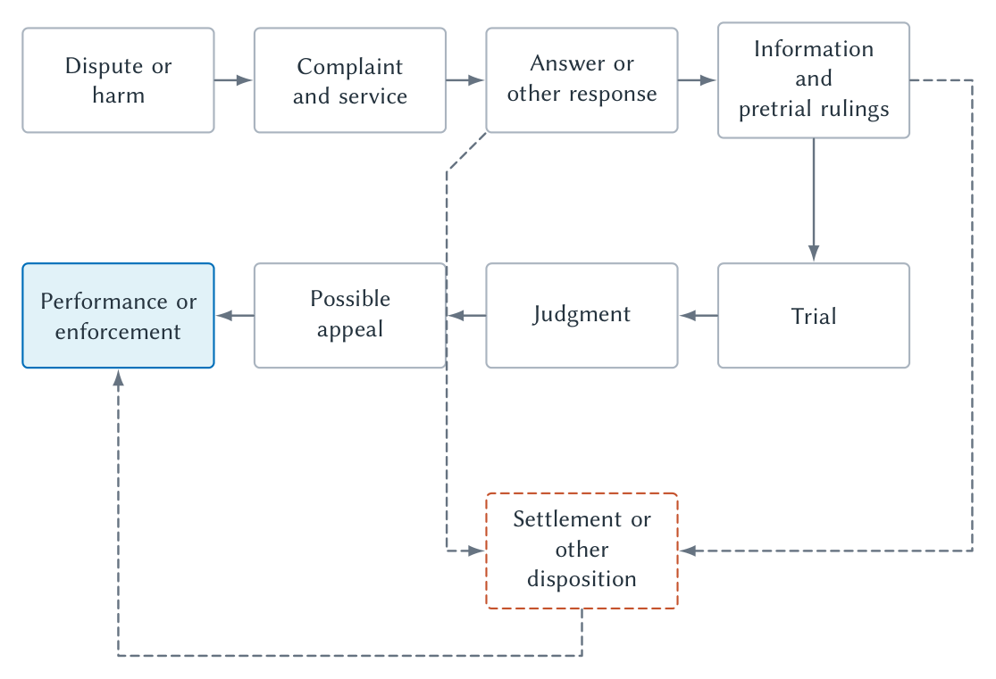
CHAPTER 3
A civil claim moves through a sequence of decisions
Most disputes exit before trial; every stage changes information and bargaining.
RULES, RIGHTS, AND RUNTIMES
14
Notes:
Trace the main path, then point out the exits. Filing, discovery, settlement, trial, appeal, and collection are not clerical details; each changes expected value and cost.
[Sources]
- Rules, Rights, and Runtimes, Chapter 3: Law, Courts, and Legal Institutions (canonical project draft).
- Law and Economics project evidence ledger: evidence/ch03_law_courts_and_legal_institutions.md.
- Project-original accepted TikZ figure and QA asset: figures/ch03_law_courts_and_legal_institutions/.
[/Sources]

Slide 15
CHAPTER 3
A complaint turns a grievance into a legal claim
COMPLAINT
NOTICE
RESPONSE
COURT CONTROL
States claims and requested relief
→
Gives the defendant an opportunity to respond
→
Admits, denies, or challenges
→
Applies procedure and schedules the case
Procedure begins by defining the dispute and who must answer it.
RULES, RIGHTS, AND RUNTIMES
15
Notes:
Distinguish having experienced harm from stating a legally cognizable claim. Notice is part of legitimate process and also enables useful information to enter.
[Sources]
- Rules, Rights, and Runtimes, Chapter 3: Law, Courts, and Legal Institutions (canonical project draft).
- Law and Economics project evidence ledger: evidence/ch03_law_courts_and_legal_institutions.md.
[/Sources]

Slide 16
CHAPTER 3
Pretrial procedure produces information and leverage
DISCOVERY
MOTIONS
SETTLEMENT
Documents, testimony, experts, and admissions
Test legal sufficiency or narrow issues
Parties bargain in the shadow of expected trial
Information can improve accuracy and also become strategically expensive.
RULES, RIGHTS, AND RUNTIMES
16
Notes:
Preview Chapter 9. Discovery can reveal facts and reduce disagreement, while also creating delay, bargaining leverage, and disproportionate cost.
[Sources]
- Rules, Rights, and Runtimes, Chapter 3: Law, Courts, and Legal Institutions (canonical project draft).
- Law and Economics project evidence ledger: evidence/ch03_law_courts_and_legal_institutions.md.
[/Sources]

Slide 17
CHAPTER 3
Decision is not the same as collection
TRIAL
JUDGMENT
APPEAL
ENFORCEMENT
Fact finder applies proof rules
→
Court states the legal result
→
Higher court reviews claimed error
→
Remedy is collected or obeyed
A paper judgment still requires assets, compliance, or coercive enforcement.
RULES, RIGHTS, AND RUNTIMES
17
Notes:
Students often stop at judgment. Explain that collection, injunction compliance, and institutional capacity determine whether the formal remedy changes the world.
[Sources]
- Rules, Rights, and Runtimes, Chapter 3: Law, Courts, and Legal Institutions (canonical project draft).
- Law and Economics project evidence ledger: evidence/ch03_law_courts_and_legal_institutions.md.
[/Sources]

Slide 18
CHAPTER 3
Precedent coordinates expectations over time
DECIDE
EXPLAIN
RELY
ADAPT
Resolve a concrete dispute
→
State reasons and legal rule
→
Later actors plan and settle
→
Follow, distinguish, limit, or overrule
Stability lowers uncertainty; stability can also preserve error.
RULES, RIGHTS, AND RUNTIMES
18
Notes:
Precedent creates a public information product beyond the immediate case. Its value depends on clarity, hierarchy, publication, and how later courts use the decision.
[Sources]
- Rules, Rights, and Runtimes, Chapter 3: Law, Courts, and Legal Institutions (canonical project draft).
- Law and Economics project evidence ledger: evidence/ch03_law_courts_and_legal_institutions.md.
[/Sources]

Slide 19
CHAPTER 3
Not every sentence in an opinion is binding
READING A PRECEDENT
•
Identify the material facts and legal question.
•
Separate the holding needed to resolve the case from broader dicta.
•
Ask whether the later case is sufficiently similar.
•
Check the court hierarchy and whether later authority changed the rule.
Precedent is structured reasoning, not quotation hunting.
RULES, RIGHTS, AND RUNTIMES
19
Notes:
Keep this practical. Students should understand why lawyers argue by analogy and distinction and why jurisdiction-specific verification matters.
[Sources]
- Rules, Rights, and Runtimes, Chapter 3: Law, Courts, and Legal Institutions (canonical project draft).
- Law and Economics project evidence ledger: evidence/ch03_law_courts_and_legal_institutions.md.
[/Sources]

Slide 20
CHAPTER 3
Public courts and private rule systems are complements
PUBLIC COURTS
PRIVATE GOVERNANCE
•
Public authority and coercive remedies
•
Specialized rules and rapid decisions
•
Procedural safeguards
•
Reputation, access, and account sanctions
•
Precedent and third-party effects
•
Limited reach and possible conflicts
The key question is which disputes private ordering can handle and which require public authority.
RULES, RIGHTS, AND RUNTIMES
20
Notes:
Use an insurer, sports league, university, or platform. Private systems may be fast and specialized, while public law defines their boundaries and supplies backstop enforcement.
[Sources]
- Rules, Rights, and Runtimes, Chapter 3: Law, Courts, and Legal Institutions (canonical project draft).
- Law and Economics project evidence ledger: evidence/ch03_law_courts_and_legal_institutions.md.
[/Sources]

Slide 21
CHAPTER 3
Map the institution before analyzing the incentive
•
What is the source of the rule?
•
Which institution has authority?
•
What facts and procedures determine the result?
•
How can the decision be reviewed or changed?
•
What remedy can actually be enforced?
•
What information, delay, error, and strategic behavior accompany the process?
Legal rules work through institutions, not in isolation.
RULES, RIGHTS, AND RUNTIMES
21
Notes:
Close by remapping the red-light collision. The legal map prevents later chapters from making institution-free efficiency claims.
[Sources]
- Rules, Rights, and Runtimes, Chapter 3: Law, Courts, and Legal Institutions (canonical project draft).
- Law and Economics project evidence ledger: evidence/ch03_law_courts_and_legal_institutions.md.
[/Sources]

