Slide 1
ENTITLEMENTS
Transaction Costs and the Coase Theorem
BARGAINING
Chapter 4
Rules, Rights, and Runtimes
INSTITUTIONS
Law and Economics in the Age of AI
Notes:
This is the first sustained encounter with Coase. Lead with the realistic lake conflict and use the theorem to discover what transaction costs require institutions to do.
[Sources]
- Rules, Rights, and Runtimes, Chapter 4: Transaction Costs and the Coase Theorem (canonical project draft).
- Law and Economics project evidence ledger: evidence/ch04_transaction_costs_and_coase_theorem.md.
[/Sources]

Slide 2
CHAPTER 4
A factory, a lake, and a developer
Discharge saves the factory $500,000 but reduces nearby development value by $800,000.
FACTORY
DEVELOPER
•
Existing productive use
•
Higher-value housing plan
•
Avoidance costs $500,000
•
Pollution loss $800,000
•
Needs legal permission to discharge
•
Needs a clean-water entitlement
Which legal arrangement preserves the larger joint value?
RULES, RIGHTS, AND RUNTIMES
2
Notes:
Freeze the numbers and avoid moral labels. The social comparison is between $500,000 in avoidance cost and $800,000 in development loss.
[Sources]
- Rules, Rights, and Runtimes, Chapter 4: Transaction Costs and the Coase Theorem (canonical project draft).
- Law and Economics project evidence ledger: evidence/ch04_transaction_costs_and_coase_theorem.md.
[/Sources]

Slide 3
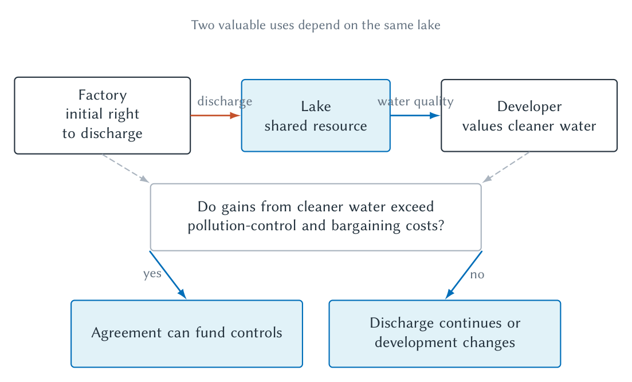
CHAPTER 4
The conflict is reciprocal
Stopping pollution harms one use; allowing pollution harms another.
RULES, RIGHTS, AND RUNTIMES
3
Notes:
Use the figure to reject the idea that one party alone causes the conflict. The institutional question is which activity yields when both cannot fully coexist.
[Sources]
- Rules, Rights, and Runtimes, Chapter 4: Transaction Costs and the Coase Theorem (canonical project draft).
- Law and Economics project evidence ledger: evidence/ch04_transaction_costs_and_coase_theorem.md.
- Project-original accepted TikZ figure and QA asset: figures/ch04_transaction_costs_and_coase_theorem/.
[/Sources]

Slide 4
CHAPTER 4
The Pigouvian first answer
EXTERNALITY LOGIC
Make the decision maker face the social cost imposed on others.
A tax, liability rule, standard, or property right may internalize harm, but each requires information and enforcement.
RULES, RIGHTS, AND RUNTIMES
4
Notes:
Connect to Chapter 2. The Pigouvian logic is valuable, but Coase asks us to specify the entitlement and examine whether parties can rearrange it.
[Sources]
- Rules, Rights, and Runtimes, Chapter 4: Transaction Costs and the Coase Theorem (canonical project draft).
- Law and Economics project evidence ledger: evidence/ch04_transaction_costs_and_coase_theorem.md.
[/Sources]

Slide 5
CHAPTER 4
An entitlement has several dimensions
HOLDER
CONTENT
PROTECTION
Who begins with the protected claim?
What conduct may occur or be stopped?
Damages, injunction, regulation, or consent?
‘The right’ is incomplete until law specifies its holder, content, and remedy.
RULES, RIGHTS, AND RUNTIMES
5
Notes:
This vocabulary prepares students for property rules and liability rules later. An entitlement is a legally protected position, broader than ordinary ownership language.
[Sources]
- Rules, Rights, and Runtimes, Chapter 4: Transaction Costs and the Coase Theorem (canonical project draft).
- Law and Economics project evidence ledger: evidence/ch04_transaction_costs_and_coase_theorem.md.
[/Sources]

Slide 6
CHAPTER 4
Reciprocal harm changes the question
The problem is not simply how to stop A from harming B.
It is how to avoid the more costly interference when incompatible activities compete for the same resource.
RULES, RIGHTS, AND RUNTIMES
6
Notes:
This is Coase's conceptual turn. It does not deny causation or rights; it insists that legal choice affects both sides and should account for joint value.
[Sources]
- Rules, Rights, and Runtimes, Chapter 4: Transaction Costs and the Coase Theorem (canonical project draft).
- Law and Economics project evidence ledger: evidence/ch04_transaction_costs_and_coase_theorem.md.
[/Sources]

Slide 7
CHAPTER 4
Cooperative surplus measures gains from rearrangement
Cooperative surplus = gain from change − cost of change
GAIN
COST
$800,000 development loss avoided
$500,000 factory avoidance
$800,000 − $500,000 = $300,000 cooperative surplus
There is room for a bargain that makes both parties better off.
RULES, RIGHTS, AND RUNTIMES
7
Notes:
This is gains from trade, not Nash bargaining. The $300,000 is the extra joint value created by choosing avoidance; the parties may divide it in many ways.
[Sources]
- Rules, Rights, and Runtimes, Chapter 4: Transaction Costs and the Coase Theorem (canonical project draft).
- Law and Economics project evidence ledger: evidence/ch04_transaction_costs_and_coase_theorem.md.
[/Sources]

Slide 8
CHAPTER 4
The bargaining range is bounded by opportunity costs
FACTORY MINIMUM
POSSIBLE TRANSFER
DEVELOPER MAXIMUM
Needs at least $500,000 to accept avoidance
Any payment between $500,000 and $800,000
Will pay no more than $800,000
The legal entitlement affects who pays and receives, even when the efficient use is unchanged.
RULES, RIGHTS, AND RUNTIMES
8
Notes:
Have students propose several transfers. All transfers in the range can support avoidance; bargaining power determines division within the range.
[Sources]
- Rules, Rights, and Runtimes, Chapter 4: Transaction Costs and the Coase Theorem (canonical project draft).
- Law and Economics project evidence ledger: evidence/ch04_transaction_costs_and_coase_theorem.md.
[/Sources]

Slide 9
CHAPTER 4
Reverse the entitlement, then redo the logic
DEVELOPER HAS CLEAN-WATER RIGHT
FACTORY HAS DISCHARGE RIGHT
•
Factory must avoid or buy permission
•
Developer may buy avoidance
•
Avoidance costs $500,000
•
Will pay up to $800,000
•
Clean development remains
•
Factory accepts at $500,000 or more
With costless bargaining, the higher-valued use survives under either initial entitlement.
RULES, RIGHTS, AND RUNTIMES
9
Notes:
Do not say rights do not matter. They matter for wealth, bargaining position, fairness, and possibly behavior through income effects; the narrow invariance result concerns resource use under strong assumptions.
[Sources]
- Rules, Rights, and Runtimes, Chapter 4: Transaction Costs and the Coase Theorem (canonical project draft).
- Law and Economics project evidence ledger: evidence/ch04_transaction_costs_and_coase_theorem.md.
[/Sources]

Slide 10
CHAPTER 4
A second case can make discharge efficient
Case
Avoidance cost
Development loss
Efficient use
A
$500,000
$800,000
Avoid discharge
B
$900,000
$300,000
Allow discharge
Internalizing an externality does not imply eliminating the activity.
RULES, RIGHTS, AND RUNTIMES
10
Notes:
The efficient outcome depends on relative costs. In Case B, forcing $900,000 of avoidance to prevent $300,000 of harm destroys $600,000 of joint value.
[Sources]
- Rules, Rights, and Runtimes, Chapter 4: Transaction Costs and the Coase Theorem (canonical project draft).
- Law and Economics project evidence ledger: evidence/ch04_transaction_costs_and_coase_theorem.md.
[/Sources]

Slide 11
CHAPTER 4
The Coase theorem is a benchmark
If rights are clear and bargaining is costless, parties bargain toward the value-maximizing use regardless of the initial entitlement.
The initial entitlement still affects the distribution of wealth and the direction of payment.
RULES, RIGHTS, AND RUNTIMES
11
Notes:
State the theorem carefully and then immediately flag its demanding assumptions. Its practical value is diagnostic: it tells us where bargaining obstacles matter.
[Sources]
- Rules, Rights, and Runtimes, Chapter 4: Transaction Costs and the Coase Theorem (canonical project draft).
- Law and Economics project evidence ledger: evidence/ch04_transaction_costs_and_coase_theorem.md.
[/Sources]

Slide 12
CHAPTER 4
Separate efficiency from distribution
ALLOCATION
TRANSFER
STARTING WEALTH
Which use of the resource survives?
Who pays whom, and how much?
Who owns the valuable entitlement initially?
Same allocation does not mean same people are equally well off.
RULES, RIGHTS, AND RUNTIMES
12
Notes:
Return to the pie-versus-slices framing. Coasean analysis can identify cooperative surplus without deciding the morally appropriate initial right or division.
[Sources]
- Rules, Rights, and Runtimes, Chapter 4: Transaction Costs and the Coase Theorem (canonical project draft).
- Law and Economics project evidence ledger: evidence/ch04_transaction_costs_and_coase_theorem.md.
[/Sources]

Slide 13
CHAPTER 4
Why bargaining fails
SEARCH AND INFORMATION
STRATEGY
ENFORCEMENT
Find parties, values, risks, and authority
Holdouts, bluffing, delay, and free riding
Verify performance and police future conduct
Transaction costs are the costs of arranging, carrying out, and enforcing cooperation.
RULES, RIGHTS, AND RUNTIMES
13
Notes:
Avoid using transaction cost as a synonym for inconvenience. Identify the specific obstacle and explain how it prevents a value-creating bargain.
[Sources]
- Rules, Rights, and Runtimes, Chapter 4: Transaction Costs and the Coase Theorem (canonical project draft).
- Law and Economics project evidence ledger: evidence/ch04_transaction_costs_and_coase_theorem.md.
[/Sources]

Slide 14
CHAPTER 4
Many parties transform the bargaining problem
COLLECTIVE ACTION
•
Each resident may hope others pay for cleanup.
•
One holdout may demand most of the cooperative surplus.
•
Parties may disagree about exposure, valuation, and future risk.
•
Organizing representation and authority becomes costly.
The number and heterogeneity of parties can matter more than the physical harm.
RULES, RIGHTS, AND RUNTIMES
14
Notes:
Contrast the two-party lake case with hundreds of residents or dispersed air pollution. This is where private bargaining may require associations, class procedures, or public action.
[Sources]
- Rules, Rights, and Runtimes, Chapter 4: Transaction Costs and the Coase Theorem (canonical project draft).
- Law and Economics project evidence ledger: evidence/ch04_transaction_costs_and_coase_theorem.md.
[/Sources]

Slide 15
CHAPTER 4
Future performance creates monitoring and enforcement costs
•
What counts as adequate pollution control?
•
Who measures emissions and with what technology?
•
Can the factory alter output or inputs after agreement?
•
What remedy applies when performance is disputed?
A signed agreement does not eliminate the need for governance.
RULES, RIGHTS, AND RUNTIMES
15
Notes:
Link to incomplete contracts. Cooperation over time requires information, verification, adaptation, and credible remedies.
[Sources]
- Rules, Rights, and Runtimes, Chapter 4: Transaction Costs and the Coase Theorem (canonical project draft).
- Law and Economics project evidence ledger: evidence/ch04_transaction_costs_and_coase_theorem.md.
[/Sources]

Slide 16
CHAPTER 4
Move from theorem to institutional design
DEFINE
DIAGNOSE
COMPARE
SELECT
Specify the entitlement
→
Locate the bargaining obstacle
→
Identify feasible institutions
→
Choose the least costly bundle
Do not invoke Coase as ‘let the parties bargain’ without checking whether they can.
RULES, RIGHTS, AND RUNTIMES
16
Notes:
Make this a reusable workflow. The theorem directs attention toward the institutional arrangements that reduce the transaction cost blocking cooperation.
[Sources]
- Rules, Rights, and Runtimes, Chapter 4: Transaction Costs and the Coase Theorem (canonical project draft).
- Law and Economics project evidence ledger: evidence/ch04_transaction_costs_and_coase_theorem.md.
[/Sources]

Slide 17
CHAPTER 4
The normative Hobbes and Coase principles complement each other
NORMATIVE HOBBES
NORMATIVE COASE
Structure law to minimize destructive disagreement and noncooperation
Structure law to remove obstacles to private agreement
Reduce the cost of failed cooperation; enable bargains when bargains can work.
RULES, RIGHTS, AND RUNTIMES
17
Notes:
Present these as Cooter and Ulen's useful design labels, not historical claims about Hobbes or Coase. They fit property and institutional design especially well.
[Sources]
- Rules, Rights, and Runtimes, Chapter 4: Transaction Costs and the Coase Theorem (canonical project draft).
- Law and Economics project evidence ledger: evidence/ch04_transaction_costs_and_coase_theorem.md.
[/Sources]

Slide 18
CHAPTER 4
Choose among imperfect responses
Institution
Uses well
Characteristic limit
Property rule
Decentralized valuation and consent
Holdout and diffuse parties
Liability rule
Court-set transfer without consent
Valuation and adjudication error
Tax or permit
Repeated measurable externalities
Administrative information and politics
Organization
Coordinated adaptation
Agency and governance costs
Norm
Repeated observable relationships
Limited reach and exclusion
The best response depends on the transaction cost that actually blocks cooperation.
RULES, RIGHTS, AND RUNTIMES
18
Notes:
No instrument is universally superior. Use the same criteria for each: information, participation, strategy, administration, error, and enforcement.
[Sources]
- Rules, Rights, and Runtimes, Chapter 4: Transaction Costs and the Coase Theorem (canonical project draft).
- Law and Economics project evidence ledger: evidence/ch04_transaction_costs_and_coase_theorem.md.
[/Sources]

Slide 19
CHAPTER 4
Railroad sparks reveal least-cost avoidance
Trains create value and also ignite crops beside the track.
RAILROAD MARGINS
FARMER MARGINS
•
Spark arresters
•
Crop location
•
Speed and scheduling
•
Firebreaks
•
Route and maintenance
•
Insurance
Which rule induces the cheapest mix of precautions and activity?
RULES, RIGHTS, AND RUNTIMES
19
Notes:
Use this as a bridge to torts. The physical cause does not by itself identify the least-cost avoider or the best allocation of residual loss.
[Sources]
- Rules, Rights, and Runtimes, Chapter 4: Transaction Costs and the Coase Theorem (canonical project draft).
- Law and Economics project evidence ledger: evidence/ch04_transaction_costs_and_coase_theorem.md.
[/Sources]

Slide 20
CHAPTER 4
Spectrum turns Coase into institutional engineering
PUBLIC DEFINITION
AUCTION
AFTERMARKET
Specify interference rights and license boundaries
Use decentralized bids to reveal relative value
Permit transfer and reconfiguration where feasible
Markets require legally designed objects of exchange.
RULES, RIGHTS, AND RUNTIMES
20
Notes:
Coase's spectrum work illustrates that pricing is not the opposite of public authority. Government defines and enforces the entitlement; an auction can then use dispersed information better than administrative assignment.
[Sources]
- Rules, Rights, and Runtimes, Chapter 4: Transaction Costs and the Coase Theorem (canonical project draft).
- Law and Economics project evidence ledger: evidence/ch04_transaction_costs_and_coase_theorem.md.
[/Sources]

Slide 21
CHAPTER 4
Platforms also design entitlements
ACCESS
PRIORITY
REMEDY
Who may participate and on what terms?
How are listings, attention, or capacity allocated?
Refund, removal, suspension, appeal, or exit?
Private code can lower bargaining costs while creating concentrated rule-making power.
RULES, RIGHTS, AND RUNTIMES
21
Notes:
Foreshadow Chapter 15 without turning this into a technology chapter. Platforms define tradable positions and procedures inside privately governed systems.
[Sources]
- Rules, Rights, and Runtimes, Chapter 4: Transaction Costs and the Coase Theorem (canonical project draft).
- Law and Economics project evidence ledger: evidence/ch04_transaction_costs_and_coase_theorem.md.
[/Sources]

Slide 22
CHAPTER 4
A Coasean audit asks concrete questions
•
What incompatible uses create the conflict?
•
Who holds which entitlement, protected by what remedy?
•
What allocation maximizes joint value?
•
What cooperative surplus is available?
•
Which search, strategy, information, or enforcement cost blocks agreement?
•
Which feasible institution reduces that obstacle at acceptable cost?
RULES, RIGHTS, AND RUNTIMES
22
Notes:
Use these questions on the lake, railroad, spectrum, or a student-generated conflict. They convert a slogan into disciplined analysis.
[Sources]
- Rules, Rights, and Runtimes, Chapter 4: Transaction Costs and the Coase Theorem (canonical project draft).
- Law and Economics project evidence ledger: evidence/ch04_transaction_costs_and_coase_theorem.md.
[/Sources]

Slide 23
CHAPTER 4
The theorem matters because bargaining is costly
•
Identify the reciprocal conflict.
•
Define the entitlement and remedy.
•
Calculate joint value and cooperative surplus.
•
Separate allocation from distribution.
•
Diagnose the specific transaction cost.
•
Compare institutions under realistic information and enforcement limits.
Coase turns externality analysis into comparative institutional design.
RULES, RIGHTS, AND RUNTIMES
23
Notes:
End with the paradox: the costless-bargaining theorem is most useful for explaining a world in which bargaining is not costless.
[Sources]
- Rules, Rights, and Runtimes, Chapter 4: Transaction Costs and the Coase Theorem (canonical project draft).
- Law and Economics project evidence ledger: evidence/ch04_transaction_costs_and_coase_theorem.md.
[/Sources]

