Slide 1
CONTROL
Property Rights and Institutional Evolution
EXCHANGE
Chapter 5
Rules, Rights, and Runtimes
GOVERNANCE
Law and Economics in the Age of AI
Notes:
Treat property as institutional design, not as a list of things people own. The shared oil reservoir reveals how legal boundaries can fit resources poorly and induce waste.
[Sources]
- Rules, Rights, and Runtimes, Chapter 5: Property Rights and Institutional Evolution (canonical project draft).
- Law and Economics project evidence ledger: evidence/ch05_property_rights_and_institutional_evolution.md.
[/Sources]

Slide 2
CHAPTER 5
Four parcels sit above one oil reservoir
Each surface owner can drill, but underground pressure and oil move across parcel lines.
PRIVATE INCENTIVE
JOINT CONSEQUENCE
•
Drill before neighbors
•
Too many wells
•
Capture migrating oil
•
Pressure loss
•
Protect one's own claim
•
Lower total recovery
How should rights be defined when the resource ignores the map?
RULES, RIGHTS, AND RUNTIMES
2
Notes:
Frame the opening as a prisoner's-dilemma-like structure. Individually sensible drilling can generate collectively excessive investment and destroy reservoir value.
[Sources]
- Rules, Rights, and Runtimes, Chapter 5: Property Rights and Institutional Evolution (canonical project draft).
- Law and Economics project evidence ledger: evidence/ch05_property_rights_and_institutional_evolution.md.
[/Sources]

Slide 3
CHAPTER 5
Property is a governance system
Property assigns decision rights over scarce resources.
It supports exclusion, use, investment, transfer, coordination, and conflict resolution, but every boundary also creates costs.
RULES, RIGHTS, AND RUNTIMES
3
Notes:
Avoid defining property as a relationship between a person and a thing. It is a set of legally recognized relations among people concerning a resource.
[Sources]
- Rules, Rights, and Runtimes, Chapter 5: Property Rights and Institutional Evolution (canonical project draft).
- Law and Economics project evidence ledger: evidence/ch05_property_rights_and_institutional_evolution.md.
[/Sources]

Slide 4
CHAPTER 5
Why property institutions emerge
SCARCITY
CONFLICT
DEFINITION
EXCHANGE
Uses become incompatible
→
Capture and defense consume resources
→
Rights identify who decides
→
Claims can move to higher-valued uses
Rights become more valuable when the gains from coordination exceed the cost of defining them.
RULES, RIGHTS, AND RUNTIMES
4
Notes:
Compress the philosophical origin story into an economic sequence. Property is one response to recurring conflict, not an inevitable or costless solution.
[Sources]
- Rules, Rights, and Runtimes, Chapter 5: Property Rights and Institutional Evolution (canonical project draft).
- Law and Economics project evidence ledger: evidence/ch05_property_rights_and_institutional_evolution.md.
[/Sources]

Slide 5
CHAPTER 5
A property right is a bundle of entitlements
USE
EXCLUDE
TRANSFER
REMEDY
Possess, consume, develop, or conserve
Control access within legal limits
Sell, lease, license, divide, or pledge
Obtain damages, injunction, or public enforcement
Different resources require different bundles and boundaries.
RULES, RIGHTS, AND RUNTIMES
5
Notes:
This is why legal entitlement is often more precise than simply saying property right. Components can be separated and assigned to different parties.
[Sources]
- Rules, Rights, and Runtimes, Chapter 5: Property Rights and Institutional Evolution (canonical project draft).
- Law and Economics project evidence ledger: evidence/ch05_property_rights_and_institutional_evolution.md.
[/Sources]

Slide 6
CHAPTER 5
Open access is not common property
OPEN ACCESS
COMMON PROPERTY
•
No effective exclusion
•
Defined group membership
•
Each user ignores depletion imposed on others
•
Rules for use and monitoring
•
Overuse and rent dissipation
•
Collective sanctions and adaptation
A commons can be governed; open access is the absence of effective governance.
RULES, RIGHTS, AND RUNTIMES
6
Notes:
Use a fishery, pasture, or data resource. Ostrom-style governance belongs conceptually on the common-property side, not as proof that exclusion is unnecessary.
[Sources]
- Rules, Rights, and Runtimes, Chapter 5: Property Rights and Institutional Evolution (canonical project draft).
- Law and Economics project evidence ledger: evidence/ch05_property_rights_and_institutional_evolution.md.
[/Sources]

Slide 7
CHAPTER 5
Governance regimes solve different problems
Regime
Main decision process
Characteristic risk
Private property
Owner choice and exchange
Fragmentation or spillovers
Common property
Group rules and monitoring
Collective-action failure
State property
Administrative allocation
Information and political failure
Open access
Capture by users
Overuse and rent dissipation
Choose a regime by matching institutions to the resource and user group.
RULES, RIGHTS, AND RUNTIMES
7
Notes:
Do not rank the rows. Compare exclusion cost, monitoring technology, group size, mobility, spillovers, and the value of local information.
[Sources]
- Rules, Rights, and Runtimes, Chapter 5: Property Rights and Institutional Evolution (canonical project draft).
- Law and Economics project evidence ledger: evidence/ch05_property_rights_and_institutional_evolution.md.
[/Sources]

Slide 8
CHAPTER 5
Demsetz offers an evolutionary hypothesis
Property rights tend to change when new benefits of internalization exceed the costs of defining and enforcing them.
A higher-value resource or cheaper measurement can make previously uneconomic boundaries worthwhile.
RULES, RIGHTS, AND RUNTIMES
8
Notes:
Present this as a conditional theory, not a deterministic law. Distribution, politics, path dependence, and existing power influence which rights emerge and whose costs count.
[Sources]
- Rules, Rights, and Runtimes, Chapter 5: Property Rights and Institutional Evolution (canonical project draft).
- Law and Economics project evidence ledger: evidence/ch05_property_rights_and_institutional_evolution.md.
[/Sources]

Slide 9
CHAPTER 5
First possession can create both clarity and waste
•
A simple race can identify an initial owner quickly.
•
The race may induce premature harvesting, drilling, or investment.
•
Capture technology can become privately valuable but socially duplicative.
•
Later transfer can help only if the asset survives and bargaining is feasible.
A clear rule can still create inefficient competition at the acquisition margin.
RULES, RIGHTS, AND RUNTIMES
9
Notes:
Connect directly to the oil reservoir. The rule of capture clarifies ownership of extracted oil while encouraging excessive wells and rapid withdrawal.
[Sources]
- Rules, Rights, and Runtimes, Chapter 5: Property Rights and Institutional Evolution (canonical project draft).
- Law and Economics project evidence ledger: evidence/ch05_property_rights_and_institutional_evolution.md.
[/Sources]

Slide 10
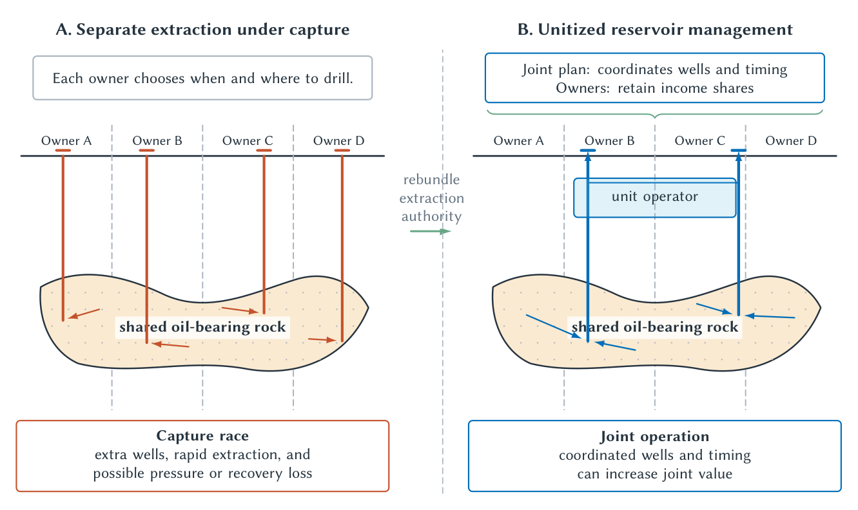
CHAPTER 5
Unitization rebundles rights around the reservoir
Governance works better when the legal decision unit fits the economic resource.
RULES, RIGHTS, AND RUNTIMES
10
Notes:
Trace the move from separate wells to coordinated reservoir management. Owners exchange unilateral drilling rights for shares in jointly optimized production.
[Sources]
- Rules, Rights, and Runtimes, Chapter 5: Property Rights and Institutional Evolution (canonical project draft).
- Law and Economics project evidence ledger: evidence/ch05_property_rights_and_institutional_evolution.md.
- Project-original accepted TikZ figure and QA asset: figures/ch05_property_rights_and_institutional_evolution/.
[/Sources]

Slide 11
CHAPTER 5
Unitization changes the game
BEFORE
REBUNDLE
AFTER
Each owner races to extract
More wells than needed
Owners pool operating control
Shares replace capture
Production follows reservoir value
Fewer wasteful wells
The solution is not weaker rights; it is a different configuration of rights.
RULES, RIGHTS, AND RUNTIMES
11
Notes:
This is a concrete Coasean institution. Agreement may still be blocked by holdouts, heterogeneous claims, measurement disputes, or distrust, which can motivate compulsory-unitization rules.
[Sources]
- Rules, Rights, and Runtimes, Chapter 5: Property Rights and Institutional Evolution (canonical project draft).
- Law and Economics project evidence ledger: evidence/ch05_property_rights_and_institutional_evolution.md.
[/Sources]

Slide 12
CHAPTER 5
Title is information infrastructure
A right is more valuable when outsiders can cheaply verify what exists, who holds it, and what limits burden it.
Recording, surveying, priority rules, and standardized forms lower search and lending costs.
RULES, RIGHTS, AND RUNTIMES
12
Notes:
Treat title systems as public information technologies. Verification supports transfer and collateral while errors, fraud, and registration costs remain governance problems.
[Sources]
- Rules, Rights, and Runtimes, Chapter 5: Property Rights and Institutional Evolution (canonical project draft).
- Law and Economics project evidence ledger: evidence/ch05_property_rights_and_institutional_evolution.md.
[/Sources]

Slide 13
CHAPTER 5
Entitlements can be protected in different ways
PROPERTY RULE
LIABILITY RULE
INALIENABILITY
Transfer requires the holder's consent
Another may take or interfere by paying a legally set amount
Some transfers are forbidden or restricted
The remedy determines bargaining power, valuation, and error risk.
RULES, RIGHTS, AND RUNTIMES
13
Notes:
Use this to connect Calabresi and Melamed to property design. Property rules use owner valuation but risk holdout; liability rules overcome holdout but require institutional valuation.
[Sources]
- Rules, Rights, and Runtimes, Chapter 5: Property Rights and Institutional Evolution (canonical project draft).
- Law and Economics project evidence ledger: evidence/ch05_property_rights_and_institutional_evolution.md.
[/Sources]

Slide 14
CHAPTER 5
Nuisance manages incompatible neighboring uses
A lawful activity on one parcel can impose smoke, noise, odor, vibration, or light on another.
POSSIBLE RESPONSES
QUESTIONS
•
Injunction
•
Who can avoid harm?
•
Damages
•
Is bargaining feasible?
•
Purchased easement
•
Which remedy uses information best?
Protect the entitlement, but choose the remedy comparatively.
RULES, RIGHTS, AND RUNTIMES
14
Notes:
Nuisance makes property boundaries relational. A landowner's use right and a neighbor's security cannot both be absolute when physical effects cross the line.
[Sources]
- Rules, Rights, and Runtimes, Chapter 5: Property Rights and Institutional Evolution (canonical project draft).
- Law and Economics project evidence ledger: evidence/ch05_property_rights_and_institutional_evolution.md.
[/Sources]

Slide 15
CHAPTER 5
Eminent domain addresses assembly and creates abuse risk
ASSEMBLY PROBLEM
PUBLIC POWER
GOVERNANCE RISK
One holdout can block a road or infrastructure corridor
Compulsory acquisition can complete the project
Officials may take for low-value or politically favored uses
Solving holdout transfers valuation and legitimacy problems to government.
RULES, RIGHTS, AND RUNTIMES
15
Notes:
Separate a genuine assembly problem from ordinary bargaining. Compensation rules, public purpose, process, and review constrain a powerful institutional response.
[Sources]
- Rules, Rights, and Runtimes, Chapter 5: Property Rights and Institutional Evolution (canonical project draft).
- Law and Economics project evidence ledger: evidence/ch05_property_rights_and_institutional_evolution.md.
[/Sources]

Slide 16
CHAPTER 5
Regulatory takings can induce excessive investment
A factory expects a future environmental restriction and rushes to expand the polluting facility before the rule arrives.
NO COMPENSATION
FULL COMPENSATION
•
Regulation may strand investment
•
Owners may overinvest before regulation
•
Owners bear policy-change risk
•
Taxpayers bear fiscal cost
•
Government may regulate more readily
•
Government faces a budget signal
How should law balance investment security and regulatory flexibility?
RULES, RIGHTS, AND RUNTIMES
16
Notes:
Use this invented EPA-style example to make excessive investment concrete. Compensation can constrain opportunistic regulation while also encouraging owners to increase the amount later compensated.
[Sources]
- Rules, Rights, and Runtimes, Chapter 5: Property Rights and Institutional Evolution (canonical project draft).
- Law and Economics project evidence ledger: evidence/ch05_property_rights_and_institutional_evolution.md.
[/Sources]

Slide 17
CHAPTER 5
Zoning coordinates space and restricts adaptation
COORDINATION
INFORMATION
POLITICAL ECONOMY
Separate incompatible uses and support infrastructure
Officials must predict local effects and future demand
Incumbents may exclude entrants or protect property values
Land-use control can internalize externalities and create artificial scarcity.
RULES, RIGHTS, AND RUNTIMES
17
Notes:
Avoid a pro- or anti-zoning verdict. Ask which externality is being addressed, whether a less restrictive instrument exists, and who gains from exclusion.
[Sources]
- Rules, Rights, and Runtimes, Chapter 5: Property Rights and Institutional Evolution (canonical project draft).
- Law and Economics project evidence ledger: evidence/ch05_property_rights_and_institutional_evolution.md.
[/Sources]

Slide 18
CHAPTER 5
Too many veto rights create an anticommons
A resource can be underused when valuable action requires consent from too many independent right holders.
Fragmented patents, divided heirs, permitting layers, or small land parcels can block assembly even when cooperation creates value.
RULES, RIGHTS, AND RUNTIMES
18
Notes:
Contrast commons overuse with anticommons underuse. Both arise from the structure of decision rights, not from a simple strong-versus-weak property scale.
[Sources]
- Rules, Rights, and Runtimes, Chapter 5: Property Rights and Institutional Evolution (canonical project draft).
- Law and Economics project evidence ledger: evidence/ch05_property_rights_and_institutional_evolution.md.
[/Sources]

Slide 19
CHAPTER 5
Property problems occur on several margins
Problem
Institutional source
Possible response
Overuse
Users ignore depletion
Exclusion or group governance
Underinvestment
Returns cannot be captured
More secure or durable claims
Holdout
Consent needed from a pivotal owner
Assembly rule or liability rule
Fragmentation
Too many complementary rights
Standardization or rebundling
Boundary spillover
Effects cross legal lines
Nuisance, covenant, zoning, tax
Diagnose the margin before prescribing stronger rights.
RULES, RIGHTS, AND RUNTIMES
19
Notes:
This table is a compact reasoning map. A reform that fixes one margin may worsen another, such as stronger exclusion increasing holdout or fragmentation.
[Sources]
- Rules, Rights, and Runtimes, Chapter 5: Property Rights and Institutional Evolution (canonical project draft).
- Law and Economics project evidence ledger: evidence/ch05_property_rights_and_institutional_evolution.md.
[/Sources]

Slide 20
CHAPTER 5
Institutional evolution is conditional
•
New scarcity can increase the gain from defining rights.
•
Measurement technology can lower boundary and monitoring costs.
•
Political power influences whose claims become protected.
•
Path dependence can preserve obsolete categories.
•
Legal change can create new transaction and enforcement costs.
Evolution can be adaptive without being automatic or efficient.
RULES, RIGHTS, AND RUNTIMES
20
Notes:
Challenge a simple efficiency story. Institutions respond to value and cost, but selection processes operate through politics, litigation, custom, organization, and unequal resources.
[Sources]
- Rules, Rights, and Runtimes, Chapter 5: Property Rights and Institutional Evolution (canonical project draft).
- Law and Economics project evidence ledger: evidence/ch05_property_rights_and_institutional_evolution.md.
[/Sources]

Slide 21
CHAPTER 5
A property-governance audit
RESOURCE
RIGHTS
MARGINS
ALTERNATIVES
What is scarce and how does it move?
→
Who may use, exclude, transfer, or veto?
→
What choices do current rights induce?
→
Which feasible regime improves the fit?
Match legal boundaries to the economically relevant resource and decision.
RULES, RIGHTS, AND RUNTIMES
21
Notes:
Apply the audit to oil, fisheries, spectrum, land, data, or a student example. Include information, monitoring, bargaining, enforcement, and political costs.
[Sources]
- Rules, Rights, and Runtimes, Chapter 5: Property Rights and Institutional Evolution (canonical project draft).
- Law and Economics project evidence ledger: evidence/ch05_property_rights_and_institutional_evolution.md.
[/Sources]

Slide 22
CHAPTER 5
Property creates coordination by assigning decision rights
•
Why is the resource scarce or conflict-prone?
•
Which entitlements exist, and how are they protected?
•
What investment, use, transfer, or capture margin changes?
•
Does the legal boundary fit the resource?
•
What commons, anticommons, holdout, or spillover remains?
•
Which governance regime performs best under realistic costs?
The objective is not maximum exclusion; it is better coordination.
RULES, RIGHTS, AND RUNTIMES
22
Notes:
Return to the oil pool. The chapter's lasting insight is that the content and scale of rights determine behavior, and rights themselves require costly institutions.
[Sources]
- Rules, Rights, and Runtimes, Chapter 5: Property Rights and Institutional Evolution (canonical project draft).
- Law and Economics project evidence ledger: evidence/ch05_property_rights_and_institutional_evolution.md.
[/Sources]

