Slide 1
CHAPTER 1 / LESSON
Introduction to Sports Economics
What changes when we turn a sports headline into an economic question?
Chapter 1 · Sports Economics
Main chapter, followed by a separately labeled optional regression appendix.
Introduction to Sports Economics
1
Notes:
Book section: Introduction to Sports Economics
Mode: Lesson
[Sources]
- draft-chapters/ch01-introduction-to-sports-economics.md
[/Sources]

Slide 2
CHAPTER 1 / OPENING CASE
Was Ohtani worth $700 million?
The Dodgers agreed to a ten-year, $700 million contract.
$680 million was deferred until after the playing term.
“Worth it” could mean wins, revenue, profit, attention, or long-run value.
Worth it to whom—and compared with which alternative?
Introduction to Sports Economics
2
Notes:
Book section: Introduction to Sports Economics
Mode: Opening case
The chapter reports contract terms, not estimated profitability. A nominal total is not a present-value calculation.
[Sources]
- draft-chapters/ch01-introduction-to-sports-economics.md
- Sarah Wexler, “$700M Stunner: Ohtani to Dodgers on Biggest Deal in Sports History,” MLB.com, December 12, 2023, <https://www.mlb.com/dodgers/news/shohei-ohtani-contract-with-dodgers>; Anthony Castrovince, “Explaining the Unprecedented Deferrals in Ohtani's Dodgers Deal,” MLB.com, December 12, 2023, <https://www.mlb.com/news/shohei-ohtani-dodgers-deal-deferrals-explained>, accessed August 12, 2026. MLB reported a ten-year, $700 million agreement and $680 million in deferred compensation beginning after the playing term. The chapter uses the contract to frame objectives, constraints, timing, and counterfactuals; it does not estimate the contract's profitability.
[/Sources]

Slide 3
CHAPTER 1 / LESSON
From a headline to an economic question
Identify the decision maker, objective, constraints, and alternatives.
Ask which players or future flexibility the choice displaces.
A counterfactual is what would likely have happened under a different choice.
A large number starts the discussion; it does not settle it.
Introduction to Sports Economics
3
Notes:
Book section: Introduction to Sports Economics
Mode: Lesson
[Sources]
- draft-chapters/ch01-introduction-to-sports-economics.md
[/Sources]

Slide 4
CHAPTER 1 / LESSON
Learning goals · The main chapter
define sports economics as applied microeconomics
identify the main economic decision makers in sports and the constraints they face
explain how incentives, models, institutions, counterfactuals, and evidence fit together
distinguish an economic question from a factual, accounting, or prediction question
explain why sports provide an unusually visible setting for economic analysis
Learning Goals
4
Notes:
Book section: Learning Goals
Mode: Lesson
[Sources]
- draft-chapters/ch01-introduction-to-sports-economics.md
[/Sources]

Slide 5
CHAPTER 1 / LESSON
Learning goals · Evidence and study
recognize the difference between association, prediction, and causation
improve an AI explanation by specifying the audience, context, task, and constraints
use an uploaded chapter as the source for AI-generated tutoring and practice
Learning Goals
5
Notes:
Book section: Learning Goals
Mode: Lesson
[Sources]
- draft-chapters/ch01-introduction-to-sports-economics.md
[/Sources]

Slide 6
CHAPTER 1 / LESSON
Learning goals · Optional appendix
if completing the optional appendix, interpret a scatterplot, regression slope, fitted value, residual, R², and confidence interval
if completing the optional appendix, reproduce a small sports-data analysis with Codex and R while checking the generated work
No retained statistics or programming knowledge is assumed.
Learning Goals
6
Notes:
Book section: Learning Goals
Mode: Lesson
[Sources]
- draft-chapters/ch01-introduction-to-sports-economics.md
[/Sources]

Slide 7
CHAPTER 1 / LESSON
Sports economics is applied microeconomics
Apply economic reasoning and evidence to decisions in sports.
Study athletes, fans, teams, leagues, media, sponsors, venues, and governments.
Use a model when it clarifies a real choice or mechanism—not to force sports into a diagram.
The setting is sports; the subject is choices, markets, and institutions.
What Is Sports Economics?
7
Notes:
Book section: What Is Sports Economics?
Mode: Lesson
[Sources]
- draft-chapters/ch01-introduction-to-sports-economics.md
[/Sources]

Slide 8
CHAPTER 1 / LESSON
Who chooses—and under what constraints?
Fans: attendance, viewing, merchandise, and other uses of time and money.
Athletes: contracts, training, risk, and career opportunities.
Teams: rosters, ticket prices, media content, and facilities.
What Is Sports Economics?
8
Notes:
Book section: What Is Sports Economics?
Mode: Lesson
[Sources]
- draft-chapters/ch01-introduction-to-sports-economics.md
[/Sources]

Slide 9
CHAPTER 1 / LESSON
Individual choices are connected
Leagues: common rules shape competition among teams that need opponents.
Media and sponsors: buy content and access to audience attention.
Governments and venues: taxes, land, services, regulation, and public funding.
A player-movement rule or media contract can affect the whole system.
What Is Sports Economics?
9
Notes:
Book section: What Is Sports Economics?
Mode: Lesson
[Sources]
- draft-chapters/ch01-introduction-to-sports-economics.md
[/Sources]

Slide 10
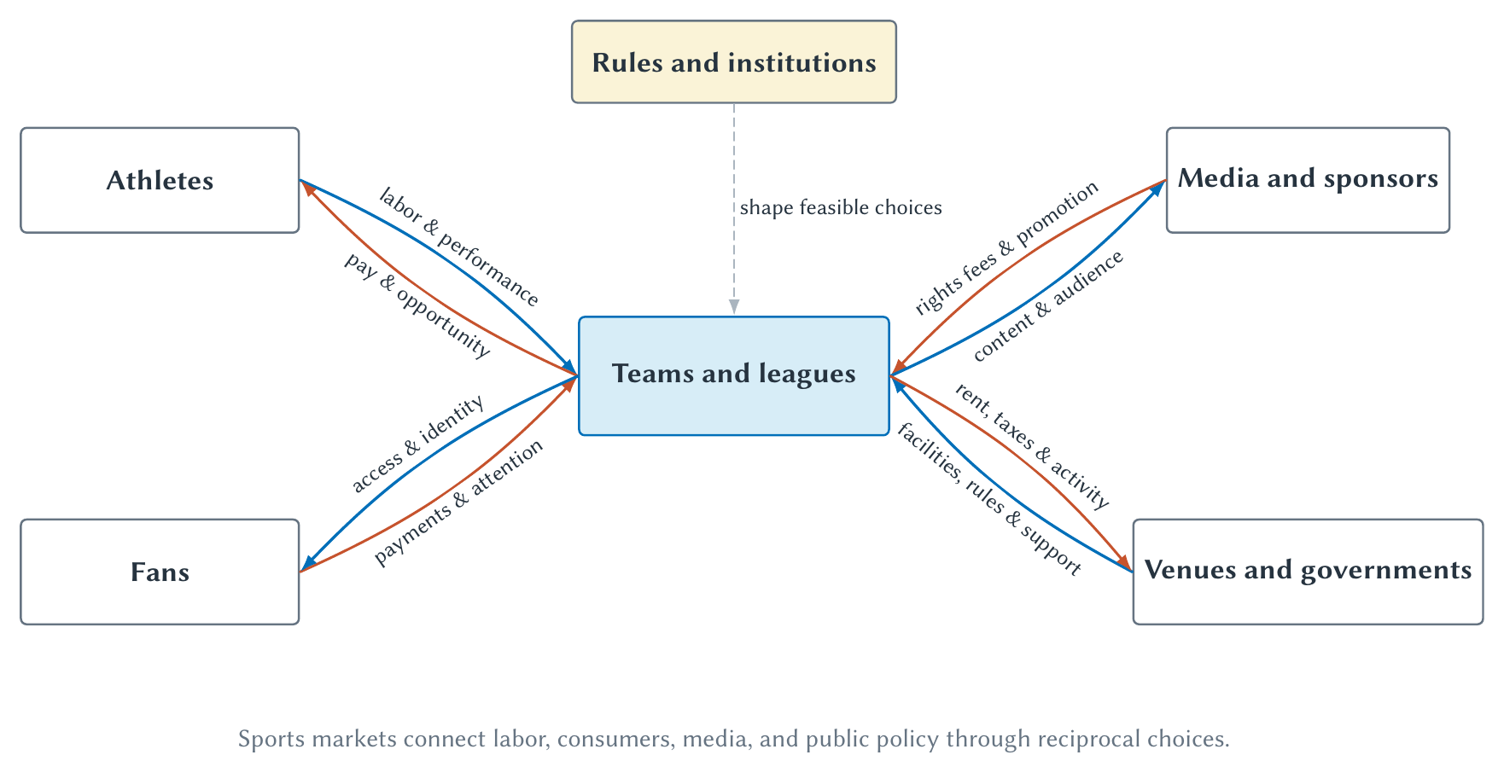
CHAPTER 1 / LESSON
Figure 1.1 · The sports-economics system
Trace the exchanges in both directions; rules shape the available choices.
What Is Sports Economics?
10
Notes:
Book section: What Is Sports Economics?
Mode: Lesson
Begin with athletes and compensation, then fans and attention. This is a conceptual map, not an accounting identity. Teams and leagues need not share objectives; public support is not automatically beneficial.
[Sources]
- draft-chapters/ch01-introduction-to-sports-economics.md
[/Sources]

Slide 11
CHAPTER 1 / LESSON
Why sports are a useful economic laboratory
Rules and institutional changes are often public.
Games produce repeated, measurable outcomes.
Contracts, performance, standings, prices, and audiences are unusually visible.
Visibility helps us connect economic reasoning to evidence.
Why Sports Are A Useful Economic Laboratory
11
Notes:
Book section: Why Sports Are A Useful Economic Laboratory
Mode: Lesson
[Sources]
- draft-chapters/ch01-introduction-to-sports-economics.md
[/Sources]

Slide 12
CHAPTER 1 / BOOK EXAMPLE
The Super Bowl sells scarce attention
Commercial time is limited even when the game is free with relevant broadcast access.
NBCUniversal reported that Super Bowl LX advertising inventory sold out early.
The broadcast averaged 125.6 million viewers across its measured platforms.
Advertisers buy access to an audience at a particular moment.
Why Sports Are A Useful Economic Laboratory
12
Notes:
Book section: Why Sports Are A Useful Economic Laboratory
Mode: Book example
These are the chapter’s dated company-reported figures, not evidence of a causal return on an individual advertisement.
[Sources]
- draft-chapters/ch01-introduction-to-sports-economics.md
- NBCUniversal, “NBCUniversal Sells Out of Milan Cortina 2026 Olympic Winter Games With One Month to Go,” January 6, 2026, <https://www.nbcsports.com/pressbox/press-releases/nbcuniversal-sells-out-of-milan-cortina-2026-olympic-winter-games-with-one-month-to-go>; NBC Sports, “Super Bowl LX Is Second Most-Watched All-Time With 125.6 Million Viewers,” updated February 19, 2026, <https://www.nbcsports.com/pressbox/press-releases/super-bowl-lx-is-second-most-watched-all-time-with-nearly-125-million-viewers-peaking-at-all-time-u-s-record-137-8-million-viewers-across-nbc-peacock-and-telemundo>, accessed August 12, 2026. These company sources support the sold-out advertising inventory and reported cross-platform audience. They do not establish any individual advertisement's causal return.
[/Sources]

Slide 13
CHAPTER 1 / BOOK EXAMPLE
Salary caps change roster choices
A roster is not simply a list of the best available players.
Teams weigh positions, contract lengths, injuries, replacement options, and future payroll.
A rule can alter bargaining and timing without changing athletic ability.
Institutions shape the available choices.
Why Sports Are A Useful Economic Laboratory
13
Notes:
Book section: Why Sports Are A Useful Economic Laboratory
Mode: Book example
[Sources]
- draft-chapters/ch01-introduction-to-sports-economics.md
[/Sources]

Slide 14
CHAPTER 1 / LESSON
A laboratory is not automatically an experiment
Popular games can have both higher prices and higher attendance.
Winning can raise revenue, while revenue can help buy talent.
A large dataset does not eliminate selection, omitted factors, or reverse causality.
Measurement makes analysis possible; research design supports causal claims.
Why Sports Are A Useful Economic Laboratory
14
Notes:
Book section: Why Sports Are A Useful Economic Laboratory
Mode: Lesson
[Sources]
- draft-chapters/ch01-introduction-to-sports-economics.md
[/Sources]

Slide 15
CHAPTER 1 / LESSON
The economist’s method
Constraints and trade-offs; incentives and behavioral response.
Models; institutions.
Counterfactuals; evidence.
Use the six ideas to analyze choices and consequences.
The Economist's Method
15
Notes:
Book section: The Economist's Method
Mode: Lesson
[Sources]
- draft-chapters/ch01-introduction-to-sports-economics.md
[/Sources]

Slide 16
CHAPTER 1 / LESSON
Constraints and trade-offs
Fans have limited income and time; teams have limited rosters and budgets.
A city cannot use the same dollar for a stadium and a school.
Opportunity cost is the value of the best forgone alternative.
Ask which alternative disappears when a choice is made.
The Economist's Method
16
Notes:
Book section: The Economist's Method
Mode: Lesson
[Sources]
- draft-chapters/ch01-introduction-to-sports-economics.md
[/Sources]

Slide 17
CHAPTER 1 / BOOK EXAMPLE
Deferral changes timing—not whether a cost exists
The Ohtani choice committed resources and future flexibility.
Alternative players and roster plans belong in the comparison.
Deferral changed payment timing and the competitive-balance-tax calculation.
A delayed commitment is not a costless commitment.
The Economist's Method
17
Notes:
Book section: The Economist's Method
Mode: Book example
[Sources]
- draft-chapters/ch01-introduction-to-sports-economics.md
- Sarah Wexler, “$700M Stunner: Ohtani to Dodgers on Biggest Deal in Sports History,” MLB.com, December 12, 2023, <https://www.mlb.com/dodgers/news/shohei-ohtani-contract-with-dodgers>; Anthony Castrovince, “Explaining the Unprecedented Deferrals in Ohtani's Dodgers Deal,” MLB.com, December 12, 2023, <https://www.mlb.com/news/shohei-ohtani-dodgers-deal-deferrals-explained>, accessed August 12, 2026. MLB reported a ten-year, $700 million agreement and $680 million in deferred compensation beginning after the playing term. The chapter uses the contract to frame objectives, constraints, timing, and counterfactuals; it does not estimate the contract's profitability.
[/Sources]

Slide 18
CHAPTER 1 / LESSON
Incentives and behavioral response
An incentive changes an action’s expected benefit or cost.
Ticket prices, bonuses, draft rules, and transfer restrictions change payoffs.
People differ in preferences, information, health, loyalty, and ability to adjust.
Predict a likely margin of adjustment, then examine the evidence.
The Economist's Method
18
Notes:
Book section: The Economist's Method
Mode: Lesson
[Sources]
- draft-chapters/ch01-introduction-to-sports-economics.md
[/Sources]

Slide 19
CHAPTER 1 / LESSON
Models deliberately simplify
A demand curve holds other relevant conditions fixed.
A competitive-market model treats buyers and sellers as price takers.
Game theory asks how one person’s best choice depends on another’s response.
State the assumptions, follow the logic, and recognize the limits.
The Economist's Method
19
Notes:
Book section: The Economist's Method
Mode: Lesson
[Sources]
- draft-chapters/ch01-introduction-to-sports-economics.md
[/Sources]

Slide 20
CHAPTER 1 / LESSON
When does a simplification stop helping?
Fixed stadium capacity can clarify scarcity for one game.
It is not a complete model of long-run seating and stadium decisions.
An omitted detail matters when it overturns the mechanism being studied.
A useful model answers a specified question—not every possible question.
The Economist's Method
20
Notes:
Book section: The Economist's Method
Mode: Lesson
[Sources]
- draft-chapters/ch01-introduction-to-sports-economics.md
[/Sources]

Slide 21
CHAPTER 1 / LESSON
Institutions organize interaction
Institutions are formal and informal rules.
Examples: drafts, free agency, salary caps, revenue sharing, and bargaining.
Eligibility, resale restrictions, and broadcasting agreements also shape choices.
The institutional detail is often the economic mechanism.
The Economist's Method
21
Notes:
Book section: The Economist's Method
Mode: Lesson
[Sources]
- draft-chapters/ch01-introduction-to-sports-economics.md
[/Sources]

Slide 22
CHAPTER 1 / LESSON
A rule’s name is not enough
A ticket-price cap: who gets the tickets, and can they resell them?
Player rights: changing ownership may affect income and allocation differently.
Trace feasible choices and bargaining positions before judging a rule.
The Economist's Method
22
Notes:
Book section: The Economist's Method
Mode: Lesson
[Sources]
- draft-chapters/ch01-introduction-to-sports-economics.md
[/Sources]

Slide 23
CHAPTER 1 / LESSON
Counterfactuals
A counterfactual is what would likely have happened under different conditions.
New restaurant spending near a stadium is not automatically new regional spending.
Some customers would have spent elsewhere without the stadium.
Compare with the relevant alternative—not with zero or a perfect world.
The Economist's Method
23
Notes:
Book section: The Economist's Method
Mode: Lesson
[Sources]
- draft-chapters/ch01-introduction-to-sports-economics.md
[/Sources]

Slide 24
CHAPTER 1 / LESSON
We observe one path—not every possible path
Comparison groups can help construct the unobserved alternative.
Rule changes, controlled variation, and explicit models can also help.
Even without a precise estimate, stating the counterfactual improves the question.
The Economist's Method
24
Notes:
Book section: The Economist's Method
Mode: Lesson
[Sources]
- draft-chapters/ch01-introduction-to-sports-economics.md
[/Sources]

Slide 25
CHAPTER 1 / LESSON
Evidence must match the claim
A contract establishes terms; an attendance series describes outcomes.
A survey measures reported preferences; a regression summarizes a relationship.
An executive’s explanation establishes a stated rationale—not proof of an effect.
A model can clarify a mechanism without proving its empirical importance.
The Economist's Method
25
Notes:
Book section: The Economist's Method
Mode: Lesson
[Sources]
- draft-chapters/ch01-introduction-to-sports-economics.md
[/Sources]

Slide 26
CHAPTER 1 / LESSON
Four kinds of economic claims
Theoretical: what follows from stated assumptions.
Descriptive: what the data show in a defined sample.
Predictive: what information helps forecast an outcome.
Causal: what changes when a factor changes relative to a counterfactual.
Classify the claim before evaluating the evidence.
The Economist's Method
26
Notes:
Book section: The Economist's Method
Mode: Lesson
[Sources]
- draft-chapters/ch01-introduction-to-sports-economics.md
[/Sources]

Slide 27
CHAPTER 1 / LESSON
Prices, products, and attention
Why do ticket prices vary across seats and games?
Why can a smaller stadium support higher prices?
Why are audiences valuable, and why bundle media rights?
Demand, scarcity, product design, and market power help explain prices.
The Economic Questions Behind Sports Headlines
27
Notes:
Book section: The Economic Questions Behind Sports Headlines
Mode: Lesson
[Sources]
- draft-chapters/ch01-introduction-to-sports-economics.md
[/Sources]

Slide 28
CHAPTER 1 / LESSON
Labor, rosters, and bargaining
Why do some athletes earn far more than others?
How do free agency, drafts, caps, and unions change bargaining power?
Does a statistic measure productivity—or teammates, role, and opportunity?
The Economic Questions Behind Sports Headlines
28
Notes:
Book section: The Economic Questions Behind Sports Headlines
Mode: Lesson
[Sources]
- draft-chapters/ch01-introduction-to-sports-economics.md
[/Sources]

Slide 29
CHAPTER 1 / LESSON
Competition and cooperation
Teams want to defeat opponents but also need them.
Rules, officials, schedules, and a credible championship create a joint product.
Revenue sharing, competitive balance, governance, and antitrust follow from this tension.
The Economic Questions Behind Sports Headlines
29
Notes:
Book section: The Economic Questions Behind Sports Headlines
Mode: Lesson
[Sources]
- draft-chapters/ch01-introduction-to-sports-economics.md
[/Sources]

Slide 30
CHAPTER 1 / LESSON
Policy and public claims
Stadium subsidies, major events, gambling, and college sports raise policy questions.
Ask how behavior changes and which alternatives are displaced.
Identify who benefits, who bears costs, and what evidence supports the claim.
Adding visible spending is not enough.
The Economic Questions Behind Sports Headlines
30
Notes:
Book section: The Economic Questions Behind Sports Headlines
Mode: Lesson
[Sources]
- draft-chapters/ch01-introduction-to-sports-economics.md
[/Sources]

Slide 31
CHAPTER 1 / LESSON
Data, prediction, and decisions
Lower analysis costs make data tools accessible to more students and organizations.
A polished chart can use the wrong variable; a regression can answer the wrong question.
The optional appendix supplies vocabulary for reading empirical evidence.
Easier analysis does not make judgment obsolete.
The Economic Questions Behind Sports Headlines
31
Notes:
Book section: The Economic Questions Behind Sports Headlines
Mode: Lesson
[Sources]
- draft-chapters/ch01-introduction-to-sports-economics.md
[/Sources]

Slide 32
CHAPTER 1 / LESSON
A vague request invites a generic answer
“Explain sports economics.”
Who is the learner? Which sport and concepts matter?
What sources, length, and level should the explanation use?
Using AI To Learn Economics
32
Notes:
Book section: Using AI To Learn Economics
Mode: Lesson
[Sources]
- draft-chapters/ch01-introduction-to-sports-economics.md
[/Sources]

Slide 33
CHAPTER 1 / LESSON
Using AI to explain a concept · A stronger prompt
Explain sports economics to a first-year student who follows baseball but has never taken economics.
Use Ohtani’s contract to explain constraints, opportunity cost, incentives, and a counterfactual.
Separate facts from interpretation, avoid unexplained jargon, and use fewer than 250 words.
A specific prompt is easier to evaluate; it does not guarantee correctness.
Using AI To Learn Economics
33
Notes:
Book section: Using AI To Learn Economics
Mode: Lesson
[Sources]
- draft-chapters/ch01-introduction-to-sports-economics.md
[/Sources]

Slide 34
CHAPTER 1 / LESSON
Specify source, audience, and task
Source: which chapter, notes, or data should the answer use?
Audience: what does the learner already know?
Task: explain, compare, quiz, diagnose, or create an example?
Using AI To Learn Economics
34
Notes:
Book section: Using AI To Learn Economics
Mode: Lesson
[Sources]
- draft-chapters/ch01-introduction-to-sports-economics.md
[/Sources]

Slide 35
CHAPTER 1 / LESSON
Specify constraints—and ask for verification
Constraints: length, difficulty, notation, and format.
Verification: facts, calculations, and assumptions to check.
Follow up: which claims are facts, models, predictions, or causal interpretations?
Using AI To Learn Economics
35
Notes:
Book section: Using AI To Learn Economics
Mode: Lesson
[Sources]
- draft-chapters/ch01-introduction-to-sports-economics.md
[/Sources]

Slide 36
CHAPTER 1 / LESSON
Use the chapter as an AI tutor
Upload the Markdown and request practice using only that chapter.
Choose conceptual, counterfactual, or optional regression practice.
Ask one question at a time; attempt it before requesting a hint or explanation.
Request outside examples separately, with links and dates.
Using AI To Learn Economics
36
Notes:
Book section: Using AI To Learn Economics
Mode: Lesson
Markdown includes hidden figure descriptions and tutor guidance. Inspect the actual figures too. A source boundary helps focus practice but does not guarantee perfect compliance.
[Sources]
- draft-chapters/ch01-introduction-to-sports-economics.md
[/Sources]

Slide 37
CHAPTER 1 / LESSON
Big picture · Frame the decision
Identify the decision maker and objective.
Identify the relevant constraints and alternatives.
Trace the incentive and likely behavioral response.
Ask more than “How much did it cost?”
Big Picture
37
Notes:
Book section: Big Picture
Mode: Lesson
[Sources]
- draft-chapters/ch01-introduction-to-sports-economics.md
[/Sources]

Slide 38
CHAPTER 1 / LESSON
Big picture · Evaluate the argument
Specify the institution and rules.
State the relevant counterfactual.
Match the evidence to the claim.
Chapter 2 turns this method into the demand-and-supply toolkit.
Big Picture
38
Notes:
Book section: Big Picture
Mode: Lesson
[Sources]
- draft-chapters/ch01-introduction-to-sports-economics.md
[/Sources]

Slide 39
CHAPTER 1 / REVIEW
Review questions 1–3
1. What makes sports economics a branch of applied microeconomics?
2. Why can sports be a useful laboratory without every sports comparison being an experiment?
3. Identify three constraints faced by a professional team and three faced by a fan.
Review Questions
39
Notes:
Book section: Review Questions
Mode: Review
1: Applied micro studies constrained choices and institutions with models and evidence. 2: Visibility does not supply a causal design. 3: Team—roster, budget, schedule; fan—income, time, access.
[Sources]
- draft-chapters/ch01-introduction-to-sports-economics.md
[/Sources]

Slide 40
CHAPTER 1 / REVIEW
Review questions 4–6
4. What is an incentive? Why does “people respond to incentives” not imply that everyone responds identically?
5. What is a model, and why can simplification be both useful and dangerous?
6. Give four examples of sports institutions.
Review Questions
40
Notes:
Book section: Review Questions
Mode: Review
4: Payoffs change, but preferences and adjustment options differ. 5: Simplification isolates a mechanism; omitted details can overturn it. 6: Drafts, free agency, caps, resale rules.
[Sources]
- draft-chapters/ch01-introduction-to-sports-economics.md
[/Sources]

Slide 41
CHAPTER 1 / REVIEW
Review questions 7–10
7. Define a counterfactual in plain language.
8. Distinguish theoretical, descriptive, predictive, and causal claims.
9. Why is “Was Ohtani worth $700 million?” incomplete as an economic question?
10. What information should a strong AI-learning prompt provide?
Review Questions
41
Notes:
Book section: Review Questions
Mode: Review
7: The relevant alternative path. 8: Theory follows assumptions; description summarizes; prediction forecasts; causation evaluates intervention. 9: Specify objective, alternatives, timing, evidence. 10: Source, audience, task, constraints, verification.
[Sources]
- draft-chapters/ch01-introduction-to-sports-economics.md
[/Sources]

Slide 42
CHAPTER 1 / APPLICATION
Application 1
A team signs a veteran player and wins five more games the following season. State the causal claim someone might make. Then identify at least three alternative explanations and the relevant counterfactual.
Applications
42
Notes:
Book section: Applications
Mode: Application
Claim: signing the veteran caused five additional wins. Alternatives include other roster changes, health, schedule, coaching, and luck. Compare with the likely same-season outcome without signing the veteran.
[Sources]
- draft-chapters/ch01-introduction-to-sports-economics.md
[/Sources]

Slide 43
CHAPTER 1 / APPLICATION
Application 2
A city reports $200 million of spending near a newly opened stadium. Explain why $200 million is not automatically the stadium's economic impact.
Applications
43
Notes:
Book section: Applications
Mode: Application
Compare with spending without the stadium. Residents may substitute from other regional activities; nearby spending is not automatically net regional impact.
[Sources]
- draft-chapters/ch01-introduction-to-sports-economics.md
[/Sources]

Slide 44
CHAPTER 1 / APPLICATION
Application 3
A league changes a draft rule. Identify the decision makers whose incentives might change and one behavioral response for each.
Applications
44
Notes:
Book section: Applications
Mode: Application
Teams may alter trades, rebuilding, or losing incentives; prospects may change entry timing; incumbent players face replacement threats. Specify the actual rule before predicting direction.
[Sources]
- draft-chapters/ch01-introduction-to-sports-economics.md
[/Sources]

Slide 45
CHAPTER 1 / APPLICATION
Application 4
A broadcaster pays a large amount for media rights. Identify the products or services flowing in both directions between the league, broadcaster, advertisers, and viewers.
Applications
45
Notes:
Book section: Applications
Mode: Application
League supplies content; broadcaster supplies rights payments, production and distribution. Advertisers pay for audience access; viewers supply attention and sometimes subscriptions.
[Sources]
- draft-chapters/ch01-introduction-to-sports-economics.md
[/Sources]

Slide 46
CHAPTER 1 / APPLICATION
Application 5
Rewrite the question “Are salary caps good?” as two answerable economic questions with specified objectives and evidence.
Applications
46
Notes:
Book section: Applications
Mode: Application
Does the cap reduce payroll dispersion? Does it improve balance in wins? Define measures and a credible no-change comparison; owner and athlete interests need not coincide.
[Sources]
- draft-chapters/ch01-introduction-to-sports-economics.md
[/Sources]

Slide 47
CHAPTER 1 / APPLICATION
Application 6
Ask an AI assistant to explain one concept from this chapter using a sport you follow. Then revise the prompt to add an audience, source boundary, format, and verification requirement. Compare the two answers.
Applications
47
Notes:
Book section: Applications
Mode: Application
Check source, audience, task, constraints, and verification. Compare correctness and clarity rather than just length.
[Sources]
- draft-chapters/ch01-introduction-to-sports-economics.md
[/Sources]

Slide 48
CHAPTER 1 / OPTIONAL APPENDIX
A practical introduction to regression
Start with rows, columns, units, and a graph.
Interpret a fitted line and the uncertainty around it.
Reproduce a small analysis and identify what it does not prove.
The main chapter stands on its own if your course omits this appendix.
Optional Appendix: A Practical Introduction To Regression With Sports Data
48
Notes:
Book section: Optional Appendix: A Practical Introduction To Regression With Sports Data
Mode: Optional appendix
[Sources]
- draft-chapters/ch01-introduction-to-sports-economics.md
[/Sources]

Slide 49
CHAPTER 1 / OPTIONAL APPENDIX
Table 1.1 · Data anatomy · 1
Term | Meaning in this dataset | Question to ask
Observation | One MLB team in the 2025 regular season | What does one row represent?
Variable | A recorded characteristic such as runs, games, batting average, or OPS | What does the column measure?
Outcome | Runs scored per game | What are we trying to describe or predict?
Define rows, columns, and units before fitting a model.
Optional Appendix: A Practical Introduction To Regression With Sports Data
49
Notes:
Book section: Optional Appendix: A Practical Introduction To Regression With Sports Data
Mode: Optional appendix
[Sources]
- draft-chapters/ch01-introduction-to-sports-economics.md
[/Sources]

Slide 50
CHAPTER 1 / OPTIONAL APPENDIX
Table 1.1 · Data anatomy · 2
Term | Meaning in this dataset | Question to ask
Predictor | Batting average or OPS | Which variable is used to explain variation in the outcome?
Unit | Runs per game or a proportion-based batting measure | What does a one-unit or 0.010 change mean?
Missing value | An observation for which a required value is unavailable | Is the value absent, or is it actually zero?
Define rows, columns, and units before fitting a model.
Optional Appendix: A Practical Introduction To Regression With Sports Data
50
Notes:
Book section: Optional Appendix: A Practical Introduction To Regression With Sports Data
Mode: Optional appendix
[Sources]
- draft-chapters/ch01-introduction-to-sports-economics.md
[/Sources]

Slide 51
CHAPTER 1 / OPTIONAL APPENDIX
Start with the data · Define the measures
One observation is one MLB team’s 2025 regular season; there are 30 teams.
Runs per game = runs ÷ games; batting average = hits ÷ at-bats.
OPS = on-base percentage + slugging percentage.
Optional Appendix: A Practical Introduction To Regression With Sports Data
51
Notes:
Book section: Optional Appendix: A Practical Introduction To Regression With Sports Data
Mode: Optional appendix
[Sources]
- draft-chapters/ch01-introduction-to-sports-economics.md
- Major League Baseball Stats API, 2025 team season hitting statistics, <https://statsapi.mlb.com/api/v1/teams/stats?stats=season&group=hitting&season=2025&sportIds=1>; Major League Baseball, “2025 MLB Team Hitting Statistics,” <https://www.mlb.com/stats/team/ops/2025>, accessed August 2, 2026. The bundled script uses official component totals, checks the 30-team structure, reconciles calculated BA and OPS with MLB's rounded measures, and reproduces every reported coefficient and figure. The regressions are descriptive team-level comparisons.
[/Sources]

Slide 52
CHAPTER 1 / OPTIONAL APPENDIX
Three rows from the 2025 dataset
Team | Runs per game | Batting average | OPS
Arizona Diamondbacks | 4.883 | 0.251 | 0.757
Boston Red Sox | 4.852 | 0.254 | 0.745
Colorado Rockies | 3.685 | 0.237 | 0.679
Rounded for display. Both models use all 30 teams.
Optional Appendix: A Practical Introduction To Regression With Sports Data
52
Notes:
Book section: Optional Appendix: A Practical Introduction To Regression With Sports Data
Mode: Optional appendix
[Sources]
- draft-chapters/ch01-introduction-to-sports-economics.md
- Major League Baseball Stats API, 2025 team season hitting statistics, <https://statsapi.mlb.com/api/v1/teams/stats?stats=season&group=hitting&season=2025&sportIds=1>; Major League Baseball, “2025 MLB Team Hitting Statistics,” <https://www.mlb.com/stats/team/ops/2025>, accessed August 2, 2026. The bundled script uses official component totals, checks the 30-team structure, reconciles calculated BA and OPS with MLB's rounded measures, and reproduces every reported coefficient and figure. The regressions are descriptive team-level comparisons.
[/Sources]

Slide 53
CHAPTER 1 / OPTIONAL APPENDIX
Inspect the dataset before modeling
Confirm 30 unique teams, the season, and 162 games per team.
Check missing values, plausible ranges, and consistent units.
Reconcile calculated batting measures with the official rounded values.
Correctly executed calculations can still use incorrectly defined data.
Optional Appendix: A Practical Introduction To Regression With Sports Data
53
Notes:
Book section: Optional Appendix: A Practical Introduction To Regression With Sports Data
Mode: Optional appendix
[Sources]
- draft-chapters/ch01-introduction-to-sports-economics.md
[/Sources]

Slide 54
CHAPTER 1 / OPTIONAL APPENDIX
Describe before you model
Mean: the sum of observations divided by their number.
Standard deviation: dispersion around the mean.
A scatterplot places the predictor horizontally and the outcome vertically.
Summary statistics do not reveal every pattern or unusual observation.
Optional Appendix: A Practical Introduction To Regression With Sports Data
54
Notes:
Book section: Optional Appendix: A Practical Introduction To Regression With Sports Data
Mode: Optional appendix
[Sources]
- draft-chapters/ch01-introduction-to-sports-economics.md
[/Sources]

Slide 55
CHAPTER 1 / OPTIONAL APPENDIX
Read the scatterplot first
Direction and strength: upward or downward; tight or widely scattered?
Shape: is a straight-line summary plausible?
Unusual observations and range: what lies far away, and where do the data stop?
Each point represents one observation.
Optional Appendix: A Practical Introduction To Regression With Sports Data
55
Notes:
Book section: Optional Appendix: A Practical Introduction To Regression With Sports Data
Mode: Optional appendix
[Sources]
- draft-chapters/ch01-introduction-to-sports-economics.md
[/Sources]

Slide 56
CHAPTER 1 / OPTIONAL APPENDIX · NOTATION
A line through the points
A simple regression summarizes an average linear relationship.
Yᵢ = β₀ + β₁Xᵢ + uᵢ
Fitted line: Ŷᵢ = b₀ + b₁Xᵢ
i identifies a team; Y is the outcome and X is the predictor.
Optional Appendix: A Practical Introduction To Regression With Sports Data
56
Notes:
Book section: Optional Appendix: A Practical Introduction To Regression With Sports Data
Mode: Optional appendix · Notation
β₀ and β₁ are intercept and slope; b₀ and b₁ are their estimates. u collects departures and omitted influences. No derivation or memorization of notation is required.
[Sources]
- draft-chapters/ch01-introduction-to-sports-economics.md
[/Sources]

Slide 57
CHAPTER 1 / OPTIONAL APPENDIX
Interpret the slope in units
The slope is the predicted change in Y associated with a one-unit increase in X.
A full 1.000 increase in batting average is outside the relevant range.
An association per 0.010 increase is easier to interpret.
State variables, predictor change, outcome units, and sample.
Optional Appendix: A Practical Introduction To Regression With Sports Data
57
Notes:
Book section: Optional Appendix: A Practical Introduction To Regression With Sports Data
Mode: Optional appendix
[Sources]
- draft-chapters/ch01-introduction-to-sports-economics.md
[/Sources]

Slide 58
CHAPTER 1 / OPTIONAL APPENDIX
The intercept positions the line
The intercept is the fitted outcome when the predictor is zero.
Zero batting average lies far outside these team data.
It can help fit the line without describing a realistic sports situation.
Optional Appendix: A Practical Introduction To Regression With Sports Data
58
Notes:
Book section: Optional Appendix: A Practical Introduction To Regression With Sports Data
Mode: Optional appendix
[Sources]
- draft-chapters/ch01-introduction-to-sports-economics.md
[/Sources]

Slide 59
CHAPTER 1 / OPTIONAL APPENDIX
Predicted values and residuals
Fitted value: the outcome predicted by the line for an observation.
Residual: observed outcome minus fitted value.
A positive residual lies above the line; a negative one lies below.
A large residual is not automatically bad data.
Optional Appendix: A Practical Introduction To Regression With Sports Data
59
Notes:
Book section: Optional Appendix: A Practical Introduction To Regression With Sports Data
Mode: Optional appendix
[Sources]
- draft-chapters/ch01-introduction-to-sports-economics.md
[/Sources]

Slide 60
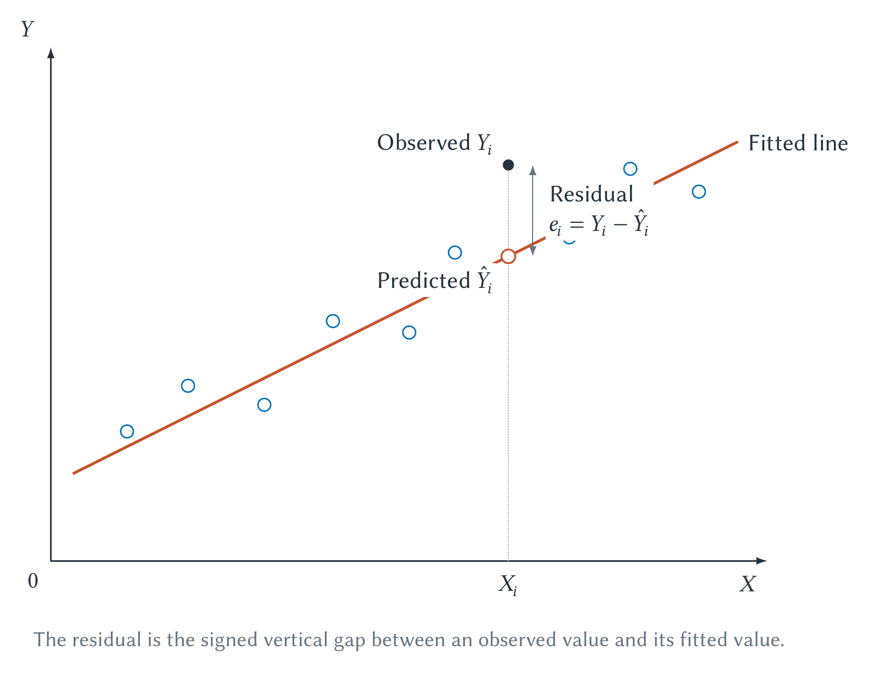
CHAPTER 1 / OPTIONAL APPENDIX
Figure 1.2 · An observed value, prediction, and residual
Compare observed and fitted outcomes at the same horizontal position.
Optional Appendix: A Practical Introduction To Regression With Sports Data
60
Notes:
Book section: Optional Appendix: A Practical Introduction To Regression With Sports Data
Mode: Optional appendix
The points are hypothetical. At X=6, fitted Y=4 and observed Y=5.2, so the residual is +1.2. Other residuals can be negative.
[Sources]
- draft-chapters/ch01-introduction-to-sports-economics.md
[/Sources]

Slide 61
CHAPTER 1 / OPTIONAL APPENDIX
The 2025 MLB comparison
Batting average records hits per at-bat; it omits walks and treats all hits alike.
OPS includes reaching base and the total-base value of hitting.
Which has the stronger linear relationship with team runs per game in 2025?
A narrow descriptive question—not the full Moneyball argument.
Optional Appendix: A Practical Introduction To Regression With Sports Data
61
Notes:
Book section: Optional Appendix: A Practical Introduction To Regression With Sports Data
Mode: Optional appendix
[Sources]
- draft-chapters/ch01-introduction-to-sports-economics.md
- Major League Baseball Stats API, 2025 team season hitting statistics, <https://statsapi.mlb.com/api/v1/teams/stats?stats=season&group=hitting&season=2025&sportIds=1>; Major League Baseball, “2025 MLB Team Hitting Statistics,” <https://www.mlb.com/stats/team/ops/2025>, accessed August 2, 2026. The bundled script uses official component totals, checks the 30-team structure, reconciles calculated BA and OPS with MLB's rounded measures, and reproduces every reported coefficient and figure. The regressions are descriptive team-level comparisons.
[/Sources]

Slide 62
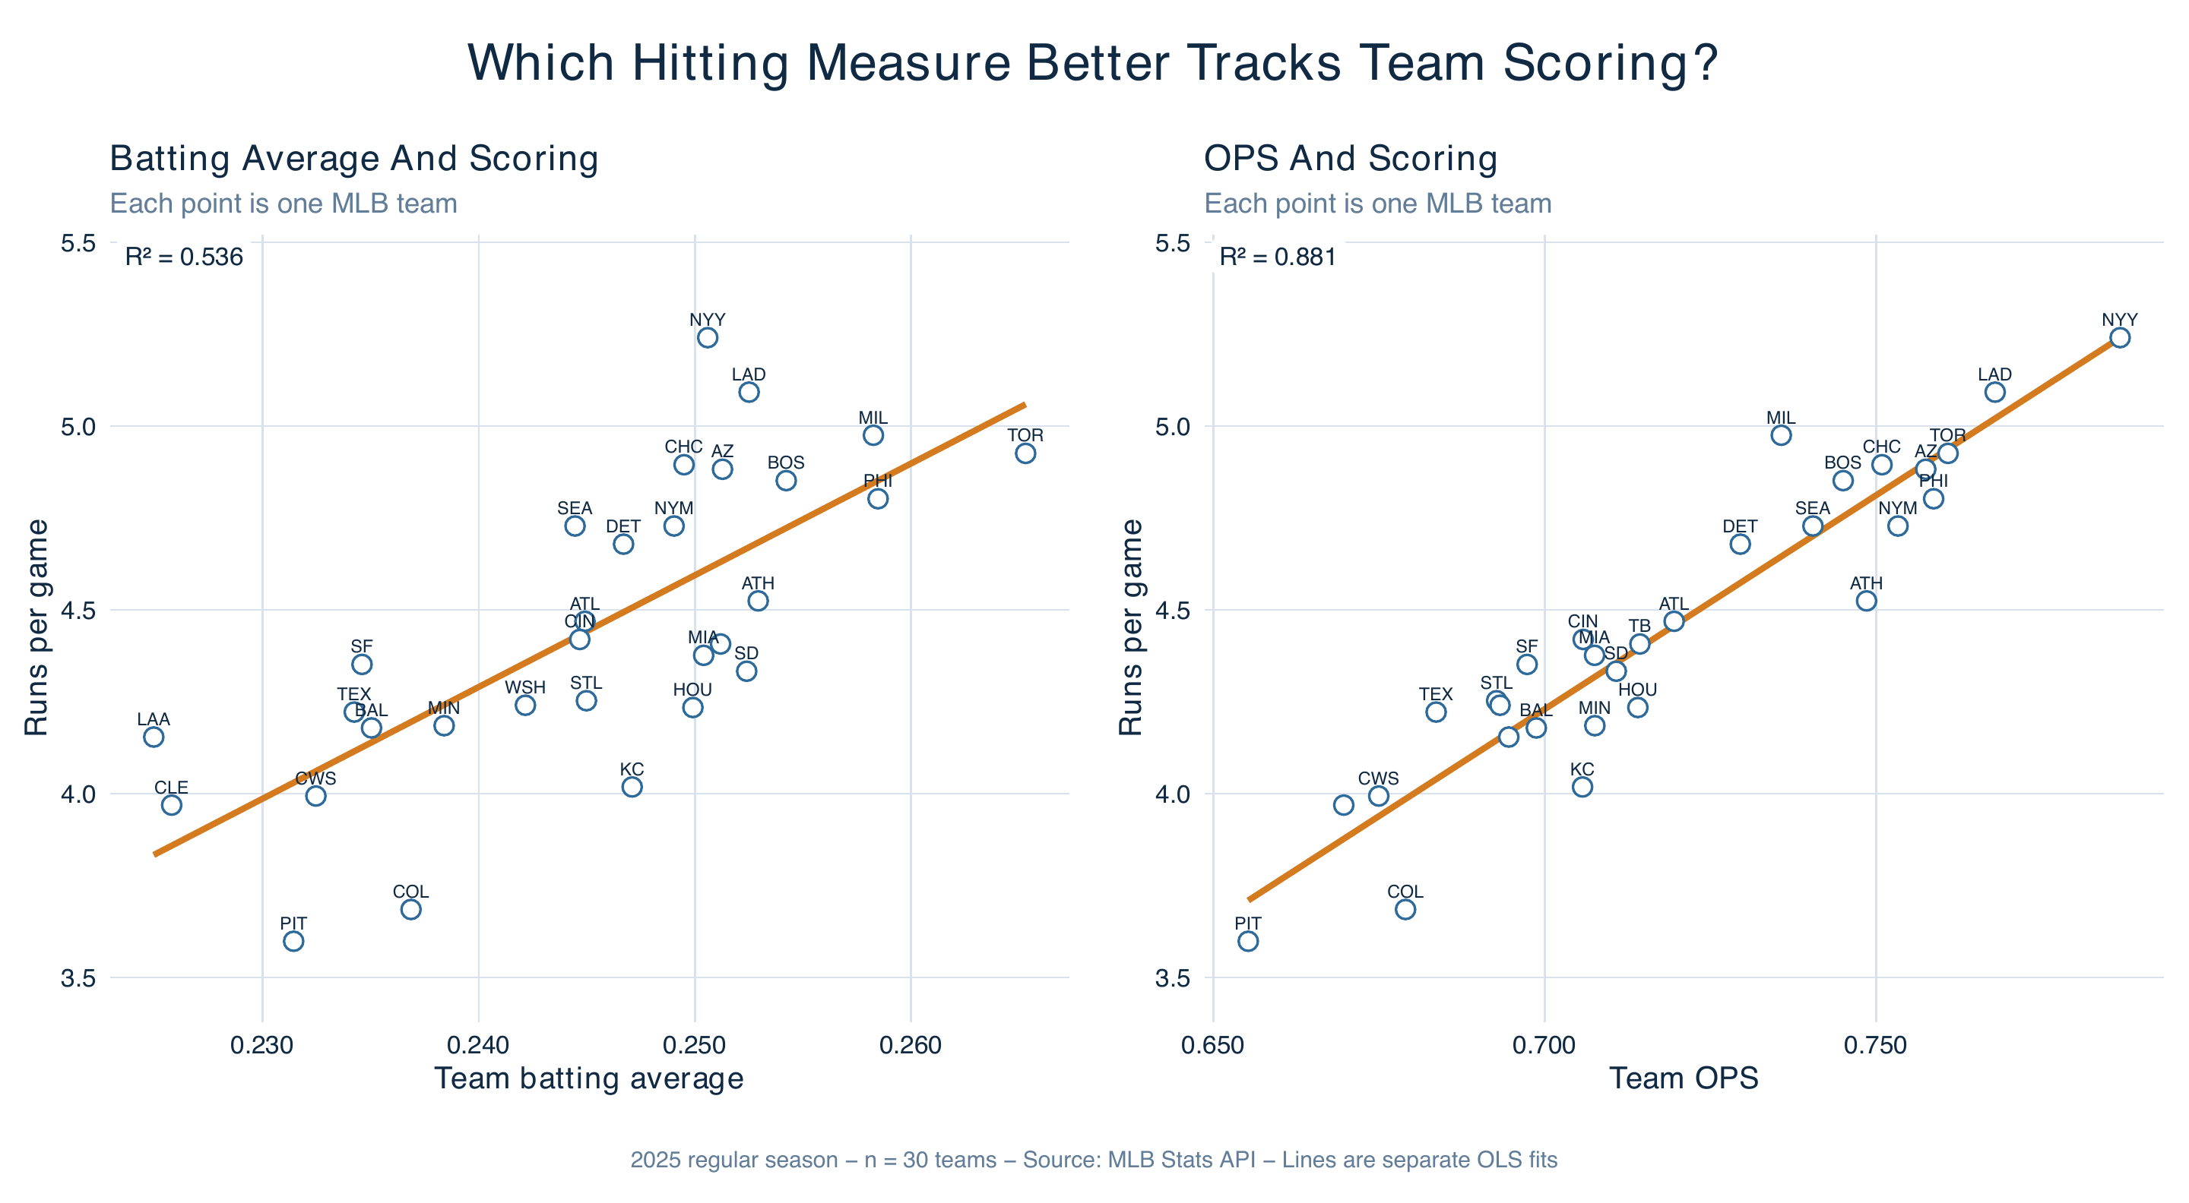
CHAPTER 1 / OPTIONAL APPENDIX
Figure 1.3 · Runs per game, batting average, and OPS
Same 30 teams and outcome: OPS points cluster more closely around the line.
Optional Appendix: A Practical Introduction To Regression With Sports Data
62
Notes:
Book section: Optional Appendix: A Practical Introduction To Regression With Sports Data
Mode: Optional appendix
Compare dispersion on the common vertical scale. These are separate OLS fits to the 2025 sample, not causal effects.
[Sources]
- draft-chapters/ch01-introduction-to-sports-economics.md
- Major League Baseball Stats API, 2025 team season hitting statistics, <https://statsapi.mlb.com/api/v1/teams/stats?stats=season&group=hitting&season=2025&sportIds=1>; Major League Baseball, “2025 MLB Team Hitting Statistics,” <https://www.mlb.com/stats/team/ops/2025>, accessed August 2, 2026. The bundled script uses official component totals, checks the 30-team structure, reconciles calculated BA and OPS with MLB's rounded measures, and reproduces every reported coefficient and figure. The regressions are descriptive team-level comparisons.
[/Sources]

Slide 63
CHAPTER 1 / OPTIONAL APPENDIX
Table 1.2 · Associated changes in scoring
Predictor | Runs per game per +0.010 | 95% confidence interval
Batting average | 0.304 | 0.195 to 0.414
OPS | 0.116 | 0.100 to 0.133
Separate regressions use the same 30 teams.
Optional Appendix: A Practical Introduction To Regression With Sports Data
63
Notes:
Book section: Optional Appendix: A Practical Introduction To Regression With Sports Data
Mode: Optional appendix
[Sources]
- draft-chapters/ch01-introduction-to-sports-economics.md
- Major League Baseball Stats API, 2025 team season hitting statistics, <https://statsapi.mlb.com/api/v1/teams/stats?stats=season&group=hitting&season=2025&sportIds=1>; Major League Baseball, “2025 MLB Team Hitting Statistics,” <https://www.mlb.com/stats/team/ops/2025>, accessed August 2, 2026. The bundled script uses official component totals, checks the 30-team structure, reconciles calculated BA and OPS with MLB's rounded measures, and reproduces every reported coefficient and figure. The regressions are descriptive team-level comparisons.
[/Sources]

Slide 64
CHAPTER 1 / OPTIONAL APPENDIX
Table 1.2 · Comparing fit
Predictor | R² | Teams
Batting average | 0.536 | 30
OPS | 0.881 | 30
OPS has the stronger linear fit with team scoring in this sample.
Optional Appendix: A Practical Introduction To Regression With Sports Data
64
Notes:
Book section: Optional Appendix: A Practical Introduction To Regression With Sports Data
Mode: Optional appendix
[Sources]
- draft-chapters/ch01-introduction-to-sports-economics.md
- Major League Baseball Stats API, 2025 team season hitting statistics, <https://statsapi.mlb.com/api/v1/teams/stats?stats=season&group=hitting&season=2025&sportIds=1>; Major League Baseball, “2025 MLB Team Hitting Statistics,” <https://www.mlb.com/stats/team/ops/2025>, accessed August 2, 2026. The bundled script uses official component totals, checks the 30-team structure, reconciles calculated BA and OPS with MLB's rounded measures, and reproduces every reported coefficient and figure. The regressions are descriptive team-level comparisons.
[/Sources]

Slide 65
CHAPTER 1 / OPTIONAL APPENDIX
Do not rank predictors by coefficient size
A +0.010 change in BA is associated with 0.304 more runs per game.
A +0.010 change in OPS is associated with 0.116 more runs per game.
Those changes represent different movements on different predictor scales.
Compare the scatterplots and fit—not 0.304 versus 0.116 alone.
Optional Appendix: A Practical Introduction To Regression With Sports Data
65
Notes:
Book section: Optional Appendix: A Practical Introduction To Regression With Sports Data
Mode: Optional appendix
[Sources]
- draft-chapters/ch01-introduction-to-sports-economics.md
[/Sources]

Slide 66
CHAPTER 1 / OPTIONAL APPENDIX
Interpreting R²
R² is the share of sample outcome variation accounted for by the fitted model.
BA: 0.536 means about 53.6% of cross-team variation in runs per game.
OPS: 0.881 means about 88.1% of that variation.
Same sample, outcome, and model form make this comparison informative.
Optional Appendix: A Practical Introduction To Regression With Sports Data
66
Notes:
Book section: Optional Appendix: A Practical Introduction To Regression With Sports Data
Mode: Optional appendix
[Sources]
- draft-chapters/ch01-introduction-to-sports-economics.md
[/Sources]

Slide 67
CHAPTER 1 / OPTIONAL APPENDIX
What R² does not establish
Good historical fit does not guarantee good prediction in a new season.
Adding variables can raise fit without improving the substantive model.
High fit does not establish causation; low fit does not rule out an important effect.
Optional Appendix: A Practical Introduction To Regression With Sports Data
67
Notes:
Book section: Optional Appendix: A Practical Introduction To Regression With Sports Data
Mode: Optional appendix
[Sources]
- draft-chapters/ch01-introduction-to-sports-economics.md
[/Sources]

Slide 68
CHAPTER 1 / OPTIONAL APPENDIX
Table 1.3 · Reading regression output · 1
Term | Plain-language interpretation | Common mistake
Intercept | Predicted outcome when every predictor equals zero | Giving it a sports meaning when zero is outside the data
Slope | Associated change in the outcome for a stated change in the predictor | Omitting units or calling association causation
Fitted value | Outcome predicted by the regression for one observation | Treating it as the observed outcome
Translate the statistic into the variables, units, sample, and limits.
Optional Appendix: A Practical Introduction To Regression With Sports Data
68
Notes:
Book section: Optional Appendix: A Practical Introduction To Regression With Sports Data
Mode: Optional appendix
[Sources]
- draft-chapters/ch01-introduction-to-sports-economics.md
[/Sources]

Slide 69
CHAPTER 1 / OPTIONAL APPENDIX
Table 1.3 · Reading regression output · 2
Term | Plain-language interpretation | Common mistake
Residual | Observed outcome minus fitted value | Treating every large residual as bad data
R² | Share of sample outcome variation accounted for by the fitted model | Treating fit as proof of causation or model correctness
Confidence interval | Range reflecting sampling uncertainty under the model's assumptions | Treating the endpoints as certain boundaries
Translate the statistic into the variables, units, sample, and limits.
Optional Appendix: A Practical Introduction To Regression With Sports Data
69
Notes:
Book section: Optional Appendix: A Practical Introduction To Regression With Sports Data
Mode: Optional appendix
[Sources]
- draft-chapters/ch01-introduction-to-sports-economics.md
[/Sources]

Slide 70
CHAPTER 1 / OPTIONAL APPENDIX
Estimates are uncertain
Another season could yield different performances and estimates.
A standard error summarizes estimated sampling uncertainty around a coefficient.
A confidence interval reports a range under the model’s assumptions.
An interval does not capture every source of uncertainty or bias.
Optional Appendix: A Practical Introduction To Regression With Sports Data
70
Notes:
Book section: Optional Appendix: A Practical Introduction To Regression With Sports Data
Mode: Optional appendix
[Sources]
- draft-chapters/ch01-introduction-to-sports-economics.md
[/Sources]

Slide 71
CHAPTER 1 / OPTIONAL APPENDIX
Read the intervals in the MLB comparison
BA: estimate 0.304; 95% interval 0.195 to 0.414 runs per game per +0.010.
OPS: estimate 0.116; 95% interval 0.100 to 0.133 runs per game per +0.010.
Neither interval resolves omitted variables, measurement error, or causal identification.
Optional Appendix: A Practical Introduction To Regression With Sports Data
71
Notes:
Book section: Optional Appendix: A Practical Introduction To Regression With Sports Data
Mode: Optional appendix
Confidence intervals reflect sampling uncertainty under model assumptions, not certain boundaries on truth. Preserve the per-0.010 units.
[Sources]
- draft-chapters/ch01-introduction-to-sports-economics.md
[/Sources]

Slide 72
CHAPTER 1 / OPTIONAL APPENDIX
Multiple regression: holding measured factors fixed
Simple regression uses one predictor; multiple regression adds others.
Interpret a coefficient while holding the included predictors fixed.
A regression cannot hold an omitted or unmeasured factor fixed by wishful thinking.
The word “included” matters.
Optional Appendix: A Practical Introduction To Regression With Sports Data
72
Notes:
Book section: Optional Appendix: A Practical Introduction To Regression With Sports Data
Mode: Optional appendix
[Sources]
- draft-chapters/ch01-introduction-to-sports-economics.md
[/Sources]

Slide 73
CHAPTER 1 / OPTIONAL APPENDIX
Why price and attendance can rise together
Teams expect some opponents, dates, and games to attract more interest.
They may choose higher prices for those already-popular games.
A raw comparison mixes demand conditions with the causal price response.
Optional Appendix: A Practical Introduction To Regression With Sports Data
73
Notes:
Book section: Optional Appendix: A Practical Introduction To Regression With Sports Data
Mode: Optional appendix
[Sources]
- draft-chapters/ch01-introduction-to-sports-economics.md
[/Sources]

Slide 74
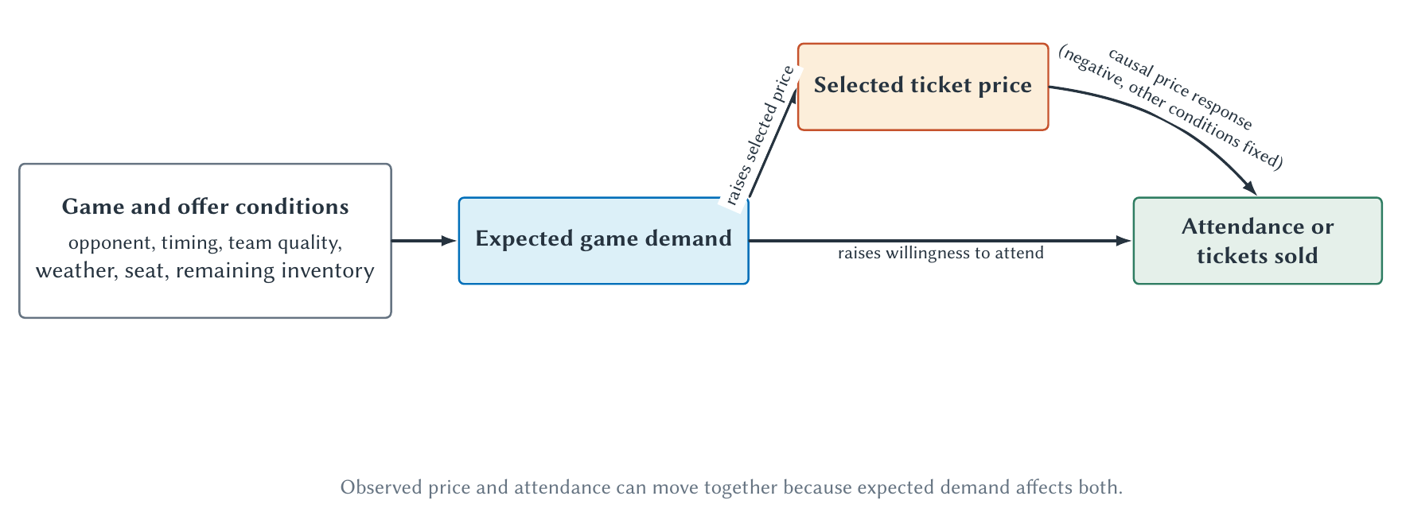
CHAPTER 1 / OPTIONAL APPENDIX
Figure 1.4 · Expected demand affects price and attendance
Separate the price response from the conditions driving both variables.
Optional Appendix: A Practical Introduction To Regression With Sports Data
74
Notes:
Book section: Optional Appendix: A Practical Introduction To Regression With Sports Data
Mode: Optional appendix
Follow expected demand to price and attendance, then the price-to-attendance arrow. Own-price response is negative holding product and other conditions fixed. Empirical work must distinguish tickets sold from turnstile attendance.
[Sources]
- draft-chapters/ch01-introduction-to-sports-economics.md
[/Sources]

Slide 75
CHAPTER 1 / OPTIONAL APPENDIX
Two problems deserve names
Omitted-variable bias: an excluded factor affects both predictor and outcome.
Reverse causality: the proposed outcome also affects the proposed predictor.
Expected attendance can influence price—not just the reverse.
Measured controls help, but do not guarantee a credible causal comparison.
Optional Appendix: A Practical Introduction To Regression With Sports Data
75
Notes:
Book section: Optional Appendix: A Practical Introduction To Regression With Sports Data
Mode: Optional appendix
[Sources]
- draft-chapters/ch01-introduction-to-sports-economics.md
[/Sources]

Slide 76
CHAPTER 1 / OPTIONAL APPENDIX
Prediction, association, and causation
Association: which variables move together in observed data?
Prediction: which information forecasts new outcomes?
Causation: what changes if we intervene relative to a relevant counterfactual?
The MLB comparison is useful because its descriptive question is clear.
Optional Appendix: A Practical Introduction To Regression With Sports Data
76
Notes:
Book section: Optional Appendix: A Practical Introduction To Regression With Sports Data
Mode: Optional appendix
[Sources]
- draft-chapters/ch01-introduction-to-sports-economics.md
[/Sources]

Slide 77
CHAPTER 1 / OPTIONAL APPENDIX
Codex plus R: from a question to an analysis
R is a free statistical programming environment.
An AI coding agent can help turn a plain-language specification into runnable code.
The student still owns the question, definitions, source, model, and interpretation.
Optional Appendix: A Practical Introduction To Regression With Sports Data
77
Notes:
Book section: Optional Appendix: A Practical Introduction To Regression With Sports Data
Mode: Optional appendix
This describes the completed workflow documented in the chapter, not a guarantee for every setup. The required R installation and project files must be available.
[Sources]
- draft-chapters/ch01-introduction-to-sports-economics.md
[/Sources]

Slide 78
CHAPTER 1 / OPTIONAL APPENDIX
What changed between editions?
Previously, the author would have treated BA versus OPS as an Excel project.
For this edition, he asked Codex to find official 2025 data, run R models, and create a figure.
He still chose the question and checked the source, measures, graph, and interpretation.
Less programming burden—not less need for statistical judgment.
Optional Appendix: A Practical Introduction To Regression With Sports Data
78
Notes:
Book section: Optional Appendix: A Practical Introduction To Regression With Sports Data
Mode: Optional appendix
[Sources]
- draft-chapters/ch01-introduction-to-sports-economics.md
[/Sources]

Slide 79
CHAPTER 1 / OPTIONAL APPENDIX
Generated analysis still requires judgment
Inspect the source, missing values, definitions, units, and plausible ranges.
Check the code, graph, numerical output, and interpretation.
Keep causal claims within what the research design supports.
Optional Appendix: A Practical Introduction To Regression With Sports Data
79
Notes:
Book section: Optional Appendix: A Practical Introduction To Regression With Sports Data
Mode: Optional appendix
[Sources]
- draft-chapters/ch01-introduction-to-sports-economics.md
[/Sources]

Slide 80
CHAPTER 1 / OPTIONAL APPENDIX
Preserve a reproducible analysis
Keep cached data, the data dictionary, and R script.
Save model results, figures, and software-version information.
Use the chapter’s test to check the sample and reported results.
Reproducibility makes errors easier to find; it does not make a design causal.
Optional Appendix: A Practical Introduction To Regression With Sports Data
80
Notes:
Book section: Optional Appendix: A Practical Introduction To Regression With Sports Data
Mode: Optional appendix
[Sources]
- draft-chapters/ch01-introduction-to-sports-economics.md
[/Sources]

Slide 81
CHAPTER 1 / OPTIONAL APPENDIX · LAB
A guided lab · Inspect before running
Inspect the bundled CSV and dictionary without changing the source.
Confirm teams, season, games, uniqueness, missing values, units, and ranges.
Explain how the R script calculates the measures and fits the two models.
Optional Appendix: A Practical Introduction To Regression With Sports Data
81
Notes:
Book section: Optional Appendix: A Practical Introduction To Regression With Sports Data
Mode: Optional appendix · Lab
Use data/ch01/mlb-team-batting-2025.csv and its dictionary, then scripts/ch01-build-regression-example.R. The full ready-to-use prompt is in the book. Keep proposed changes separate.
[Sources]
- draft-chapters/ch01-introduction-to-sports-economics.md
[/Sources]

Slide 82
CHAPTER 1 / OPTIONAL APPENDIX · LAB
A guided lab · Run, compare, and interpret
Run the offline R script and regression test.
Report effects per +0.010, confidence intervals, R², and sample sizes.
Compare table and graph; explain the descriptive result and its causal limits.
Optional Appendix: A Practical Introduction To Regression With Sports Data
82
Notes:
Book section: Optional Appendix: A Practical Introduction To Regression With Sports Data
Mode: Optional appendix · Lab
Run scripts/ch01-build-regression-example.R and tests/ch01-regression-example.R. read.csv imports data; lm fits runs_per_game on batting_average and ops separately. Memorization is not required; identifying outcome, predictor, observation, and limitations is.
[Sources]
- draft-chapters/ch01-introduction-to-sports-economics.md
[/Sources]

Slide 83
CHAPTER 1 / OPTIONAL APPENDIX · REVIEW
Appendix review 1–3
1. In the MLB dataset, what does one observation represent?
2. Distinguish an outcome from a predictor.
3. What four features should you inspect in a scatterplot before reading regression output?
Optional Appendix: A Practical Introduction To Regression With Sports Data
83
Notes:
Book section: Optional Appendix: A Practical Introduction To Regression With Sports Data
Mode: Optional appendix · Review
1: One MLB team’s 2025 regular season. 2: Outcome is described/predicted; predictor supplies information. 3: Direction, strength, shape, unusual observations; also inspect range.
[Sources]
- draft-chapters/ch01-introduction-to-sports-economics.md
[/Sources]

Slide 84
CHAPTER 1 / OPTIONAL APPENDIX · REVIEW
Appendix review 4–6
4. Interpret a regression slope in words and units.
5. Why might the intercept lack a useful sports interpretation?
6. If a team's observed runs per game is 4.8 and its fitted value is 4.5, calculate and interpret the residual.
Optional Appendix: A Practical Introduction To Regression With Sports Data
84
Notes:
Book section: Optional Appendix: A Practical Introduction To Regression With Sports Data
Mode: Optional appendix · Review
4: Associated outcome change for a stated predictor change, with units and sample. 5: Zero may be outside the data. 6: 4.8−4.5=+0.3 runs/game, above the line.
[Sources]
- draft-chapters/ch01-introduction-to-sports-economics.md
[/Sources]

Slide 85
CHAPTER 1 / OPTIONAL APPENDIX · REVIEW
Appendix review 7–9
7. What does R²=0.881 mean in the OPS regression? What does it not mean?
8. Why should the BA and OPS coefficient magnitudes not be compared directly?
9. Explain in plain language what a confidence interval adds to a point estimate.
Optional Appendix: A Practical Introduction To Regression With Sports Data
85
Notes:
Book section: Optional Appendix: A Practical Introduction To Regression With Sports Data
Mode: Optional appendix · Review
7: 88.1% of sample variation accounted for, not a causal effect or prediction accuracy. 8: Different predictor scales. 9: A range reflecting sampling uncertainty under assumptions.
[Sources]
- draft-chapters/ch01-introduction-to-sports-economics.md
[/Sources]

Slide 86
CHAPTER 1 / OPTIONAL APPENDIX · REVIEW
Appendix review 10–12
10. Why can higher ticket prices be positively associated with attendance even if the causal price response is negative?
11. Distinguish omitted-variable bias from reverse causality.
12. Give one question for which prediction is sufficient and one that requires a causal estimate.
Optional Appendix: A Practical Introduction To Regression With Sports Data
86
Notes:
Book section: Optional Appendix: A Practical Introduction To Regression With Sports Data
Mode: Optional appendix · Review
10: Expected demand raises chosen price and attendance. 11: Omitted common causes versus outcome feedback. 12: Forecasting game demand versus evaluating a price intervention.
[Sources]
- draft-chapters/ch01-introduction-to-sports-economics.md
[/Sources]

Slide 87
CHAPTER 1 / OPTIONAL APPENDIX · REVIEW
Appendix review 13–14
13. List five checks a student should perform before accepting AI-generated statistical analysis.
14. Reproduce the bundled analysis, save the output, and ask an AI assistant to identify one result that is descriptive, one step that is computational, and one claim that would require a stronger causal design.
Optional Appendix: A Practical Introduction To Regression With Sports Data
87
Notes:
Book section: Optional Appendix: A Practical Introduction To Regression With Sports Data
Mode: Optional appendix · Review
13: Verify source, observation unit, missingness, definitions/units, model, output, graph, and causal language. 14: Stronger OPS fit is descriptive; computing measures is computational; a price intervention requires a causal design.
[Sources]
- draft-chapters/ch01-introduction-to-sports-economics.md
[/Sources]

Slide 88
CHAPTER 1 / SOURCES
Source notes
MLB reporting documents Ohtani’s contract and deferrals.
NBCUniversal and NBC Sports report Super Bowl inventory and audiences.
The MLB Stats API, cached data, R script, and tests support the 2025 comparison.
Full references are in the chapter; relevant citations accompany slide notes.
Source Notes
88
Notes:
Book section: Source Notes
Mode: Sources
[Sources]
- draft-chapters/ch01-introduction-to-sports-economics.md
- Sarah Wexler, “$700M Stunner: Ohtani to Dodgers on Biggest Deal in Sports History,” MLB.com, December 12, 2023, <https://www.mlb.com/dodgers/news/shohei-ohtani-contract-with-dodgers>; Anthony Castrovince, “Explaining the Unprecedented Deferrals in Ohtani's Dodgers Deal,” MLB.com, December 12, 2023, <https://www.mlb.com/news/shohei-ohtani-dodgers-deal-deferrals-explained>, accessed August 12, 2026. MLB reported a ten-year, $700 million agreement and $680 million in deferred compensation beginning after the playing term. The chapter uses the contract to frame objectives, constraints, timing, and counterfactuals; it does not estimate the contract's profitability.
- NBCUniversal, “NBCUniversal Sells Out of Milan Cortina 2026 Olympic Winter Games With One Month to Go,” January 6, 2026, <https://www.nbcsports.com/pressbox/press-releases/nbcuniversal-sells-out-of-milan-cortina-2026-olympic-winter-games-with-one-month-to-go>; NBC Sports, “Super Bowl LX Is Second Most-Watched All-Time With 125.6 Million Viewers,” updated February 19, 2026, <https://www.nbcsports.com/pressbox/press-releases/super-bowl-lx-is-second-most-watched-all-time-with-nearly-125-million-viewers-peaking-at-all-time-u-s-record-137-8-million-viewers-across-nbc-peacock-and-telemundo>, accessed August 12, 2026. These company sources support the sold-out advertising inventory and reported cross-platform audience. They do not establish any individual advertisement's causal return.
- Major League Baseball Stats API, 2025 team season hitting statistics, <https://statsapi.mlb.com/api/v1/teams/stats?stats=season&group=hitting&season=2025&sportIds=1>; Major League Baseball, “2025 MLB Team Hitting Statistics,” <https://www.mlb.com/stats/team/ops/2025>, accessed August 2, 2026. The bundled script uses official component totals, checks the 30-team structure, reconciles calculated BA and OPS with MLB's rounded measures, and reproduces every reported coefficient and figure. The regressions are descriptive team-level comparisons.
[/Sources]

