Slide 1
CHAPTER 2 / LESSON
The Supply and Demand Playbook
How do choices become prices, quantities, and market adjustments?
Chapter 2 · Sports Economics
From economic reasoning to curves—and then to responsiveness.
The Supply and Demand Playbook
1
Notes:
Book section: The Supply and Demand Playbook
Mode: Lesson
This is a multi-session chapter companion, not a one-lecture summary. Core concepts precede worked calculations; practice is at the end. The book remains the semantic source.
[Sources]
- draft-chapters/ch02-the-supply-and-demand-playbook.md
[/Sources]

Slide 2
CHAPTER 2 / LESSON
A star arrives. Prices and attendance rise.
Fans are willing to pay more to watch the team.
Yet the law of demand says higher prices reduce quantity demanded.
How can both statements be true?
Keep the question in mind as we distinguish movements from shifts.
The Supply and Demand Playbook
2
Notes:
Book section: The Supply and Demand Playbook
Mode: Lesson
[Sources]
- draft-chapters/ch02-the-supply-and-demand-playbook.md
[/Sources]

Slide 3
CHAPTER 2 / LESSON
Learning goals · Choices and markets
explain scarcity, opportunity cost, incentives, marginal thinking, substitution, and ceteris paribus
distinguish demand from quantity demanded and supply from quantity supplied
identify the standard determinants of demand and supply
distinguish a movement along a curve from a shift of the curve
find market equilibrium and explain shortages and excess supply
use comparative statics to predict changes in equilibrium price and quantity
Learning Goals
3
Notes:
Book section: Learning Goals
Mode: Lesson
[Sources]
- draft-chapters/ch02-the-supply-and-demand-playbook.md
[/Sources]

Slide 4
CHAPTER 2 / LESSON
Learning goals · Responsiveness
define and calculate price elasticity of demand using percentage changes
connect own-price elasticity to total revenue without confusing revenue with profit
define price elasticity of supply and explain the importance of time and capacity
interpret income elasticity and cross-price elasticity
explain intuitively how a team could learn about ticket-demand responsiveness
Learning Goals
4
Notes:
Book section: Learning Goals
Mode: Lesson
[Sources]
- draft-chapters/ch02-the-supply-and-demand-playbook.md
[/Sources]

Slide 5
CHAPTER 2 / LESSON
Scarcity and constraints
Scarcity: available resources cannot satisfy every possible use.
Fans have limited income and time; teams have limited roster spots, space, staff, and capital.
Using a resource one way prevents another use.
Scarcity creates choice—even for wealthy teams.
The Economic Toolkit Before The Curves
5
Notes:
Book section: The Economic Toolkit Before The Curves
Mode: Lesson
Scarcity is not the same as absolute rarity. Ask what a wealthy team still cannot do without giving something else up.
[Sources]
- draft-chapters/ch02-the-supply-and-demand-playbook.md
[/Sources]

Slide 6
CHAPTER 2 / LESSON
Opportunity cost
Opportunity cost: the value of the best alternative forgone.
A fan gives up money, travel time, and an alternative use of the evening.
A roster spot used for one player cannot be used for the next-best alternative.
An already-incurred stadium expense is not a cost created by today’s attendance decision.
The Economic Toolkit Before The Curves
6
Notes:
Book section: The Economic Toolkit Before The Curves
Mode: Lesson
Distinguish forward-looking opportunity costs from sunk expenses. Do not add every rejected alternative together.
[Sources]
- draft-chapters/ch02-the-supply-and-demand-playbook.md
[/Sources]

Slide 7
CHAPTER 2 / LESSON
Incentives change choices
An incentive changes the benefit or cost of a choice.
A lower ticket price can attract an additional group of fans.
Higher overtime pay can encourage another hour of work.
A league rule can change the value of carrying a particular player.
The Economic Toolkit Before The Curves
7
Notes:
Book section: The Economic Toolkit Before The Curves
Mode: Lesson
[Sources]
- draft-chapters/ch02-the-supply-and-demand-playbook.md
[/Sources]

Slide 8
CHAPTER 2 / LESSON
Think at the margin
Marginal benefit (MB): the additional benefit from one more unit or adjustment.
Marginal cost (MC): its additional cost.
Continue while MB > MC; stop expanding when the next unit costs more than it is worth.
Ask “one more ticket?” or “one more hour?”—not just “sports or no sports?”
The Economic Toolkit Before The Curves
8
Notes:
Book section: The Economic Toolkit Before The Curves
Mode: Lesson
The stadium can be expensive while the added cost of filling another seat is low. This is an incremental decision, not a claim that every empty seat should be sold at any price.
[Sources]
- draft-chapters/ch02-the-supply-and-demand-playbook.md
[/Sources]

Slide 9
CHAPTER 2 / LESSON
Substitution makes adjustment possible
Fans can switch games, seats, viewing methods, purchase dates, or uses of time.
Producers can substitute machinery for labor or one material for another.
More and better alternatives generally make adjustment easier.
Elasticity will measure the size of the response.
The Economic Toolkit Before The Curves
9
Notes:
Book section: The Economic Toolkit Before The Curves
Mode: Lesson
[Sources]
- draft-chapters/ch02-the-supply-and-demand-playbook.md
[/Sources]

Slide 10
CHAPTER 2 / LESSON
Ceteris paribus
Ceteris paribus means “holding other relevant factors fixed.”
To isolate the effect of a ticket’s own price, hold other demand determinants fixed.
During a playoff race, higher price and higher attendance mix two changes.
The model isolates a relationship; it does not claim the real world stops changing.
The Economic Toolkit Before The Curves
10
Notes:
Book section: The Economic Toolkit Before The Curves
Mode: Lesson
[Sources]
- draft-chapters/ch02-the-supply-and-demand-playbook.md
[/Sources]

Slide 11
CHAPTER 2 / LESSON
Rationality without perfection
People pursue goals subject to constraints.
A devoted fan can value attendance more than an outsider does.
Choices can involve emotion, mistakes, and limited information.
Incentives and trade-offs can matter without flawless calculation.
The Economic Toolkit Before The Curves
11
Notes:
Book section: The Economic Toolkit Before The Curves
Mode: Lesson
[Sources]
- draft-chapters/ch02-the-supply-and-demand-playbook.md
[/Sources]

Slide 12
CHAPTER 2 / LESSON
Ruth and Ohtani · A specialization puzzle
Player / season | Hitting | Pitching
Babe Ruth · 1918 | 11 home runs | 13–7 record
Babe Ruth · 1919 | 29 home runs | 9–5 record
Shohei Ohtani · 2021 | 46 home runs | 23 starts · 3.18 ERA
Shohei Ohtani · 2025 | 55 home runs | 14 starts · 2.87 ERA
Both excelled at two tasks. That alone does not tell us the best allocation.
The Economic Toolkit Before The Curves
12
Notes:
Book section: The Economic Toolkit Before The Curves
Mode: Lesson
These are the same seasons and figures as the chapter, current through the completed 2025 season. Ruth led the AL in home runs in 1918; 29 was the then-record in 1919. Sources are in the chapter’s two footnotes.
[Sources]
- draft-chapters/ch02-the-supply-and-demand-playbook.md
- https://baseballhall.org/hall-of-famers/ruth-babe
- https://baseballhall.org/discover/museum/babe-ruth-his-life-and-legend
- https://www.mlb.com/press-release/shohei-ohtani-honored-with-commissioners-historic-achievement-award
- https://www.mlb.com/news/shohei-ohtani-wins-2025-nl-mvp-award
[/Sources]

Slide 13
CHAPTER 2 / LESSON
Comparative advantage is about alternatives
Absolute advantage: performing a task at a higher level than others.
Comparative advantage: a lower opportunity cost relative to the alternatives.
Compare gains relative to replacement players, not just the athlete’s raw ability.
Roster rules, recovery, injury risk, and value from combining roles also matter.
The Economic Toolkit Before The Curves
13
Notes:
Book section: The Economic Toolkit Before The Curves
Mode: Lesson
Ohtani does not disprove comparative advantage, and Ruth does not prove every talented athlete must specialize. This is an opportunity-cost application, not the foundation of a trade-theory unit.
[Sources]
- draft-chapters/ch02-the-supply-and-demand-playbook.md
- https://www.mlb.com/news/mlb-two-way-player-rules
[/Sources]

Slide 14
CHAPTER 2 / LESSON
Demand is a relationship—not one purchase
Demand relates price to the quantity buyers are willing and able to purchase.
Define the product, buyers, and time period; hold other determinants fixed.
Quantity demanded is one amount at one price.
Example: upper-level Bills tickets for one game, purchased during a specified week.
Demand: The Buyer's Side Of The Market
14
Notes:
Book section: Demand: The Buyer's Side Of The Market
Mode: Lesson
[Sources]
- draft-chapters/ch02-the-supply-and-demand-playbook.md
[/Sources]

Slide 15
CHAPTER 2 / LESSON
Table 2.1 · A demand schedule
Price per ticket | Quantity demanded
$100 | 4,000
$75 | 8,000
$50 | 12,000
$25 | 16,000
A schedule lists quantities at alternative prices. At $75, quantity demanded is 8,000; the entire schedule is demand.
Demand: The Buyer's Side Of The Market
15
Notes:
Book section: Demand: The Buyer's Side Of The Market
Mode: Lesson
Read across a row before comparing rows. These hypothetical ticket counts are not the small teaching quantities in Figure 2.1.
[Sources]
- draft-chapters/ch02-the-supply-and-demand-playbook.md
[/Sources]

Slide 16
CHAPTER 2 / LESSON
The law of demand
Holding other factors fixed, a higher price reduces quantity demanded.
A lower price brings in additional buyers or encourages larger purchases.
Substitution helps explain the response: other uses of money become relatively attractive.
Graph convention: price on the vertical axis; quantity on the horizontal axis.
Demand: The Buyer's Side Of The Market
16
Notes:
Book section: Demand: The Buyer's Side Of The Market
Mode: Lesson
Connect the downward pattern to Table 2.1. Each point represents one row; the curve summarizes the relationship, not a sequence of observed games.
[Sources]
- draft-chapters/ch02-the-supply-and-demand-playbook.md
[/Sources]

Slide 17
CHAPTER 2 / LESSON
The standard demand determinants · 1–3
Income: A change in purchasing power can change demand, although the direction depends on whether the defined product is normal or inferior for the relevant buyers.
Prices of related goods: A higher price for a substitute can increase demand; a higher price for a complement can decrease demand.
Tastes and preferences: Team loyalty, player appeal, rivalry, perceived quality, and social experience can alter willingness to buy.
Demand: The Buyer's Side Of The Market
17
Notes:
Book section: Demand: The Buyer's Side Of The Market
Mode: Lesson
Use the book’s five categories, in order. A normal good has higher demand as income rises; an inferior good has lower demand for the specified buyers/product. These are not judgments about product quality.
[Sources]
- draft-chapters/ch02-the-supply-and-demand-playbook.md
[/Sources]

Slide 18
CHAPTER 2 / LESSON
The standard demand determinants · 4–5
Expectations: Expectations about future prices, team performance, availability, or playoff importance can affect current purchases.
Number of buyers: Population, tourism, market reach, and the size of an interested fan base affect market demand.
A product’s own price is not a demand shifter.
Demand: The Buyer's Side Of The Market
18
Notes:
Book section: Demand: The Buyer's Side Of The Market
Mode: Lesson
Sports examples belong inside the general categories. A star signing affects tastes or expected team quality; visitors can change the number of buyers.
[Sources]
- draft-chapters/ch02-the-supply-and-demand-playbook.md
[/Sources]

Slide 19
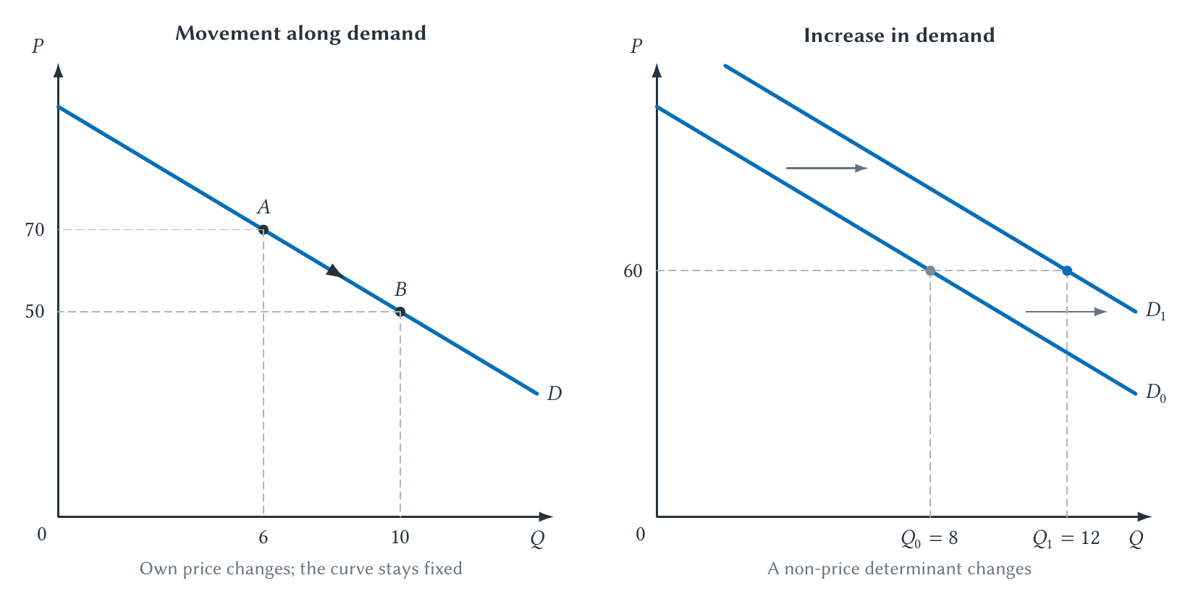
CHAPTER 2 / LESSON
Figure 2.1 · Movement along demand versus a shift
Own price changes quantity demanded. Another determinant shifts demand.
Demand: The Buyer's Side Of The Market
19
Notes:
Book section: Demand: The Buyer's Side Of The Market
Mode: Lesson
Left: P falls from 70 to 50 and Q rises from 6 to 10 on D. Right: at the same P = 60, Q rises from 8 to 12 when D shifts right. Read the shift horizontally. These are separate hypothetical teaching curves, not Table 2.1’s ticket counts.
[Sources]
- draft-chapters/ch02-the-supply-and-demand-playbook.md
[/Sources]

Slide 20
CHAPTER 2 / LESSON
Ask what changed before moving a curve
A lower ticket price: movement along an unchanged demand curve.
A popular player joins the team: demand can shift right through tastes or expected quality.
At the old price, more tickets are wanted; the new equilibrium can have higher price and quantity.
The superstar example does not violate the law of demand.
Demand: The Buyer's Side Of The Market
20
Notes:
Book section: Demand: The Buyer's Side Of The Market
Mode: Lesson
[Sources]
- draft-chapters/ch02-the-supply-and-demand-playbook.md
[/Sources]

Slide 21
CHAPTER 2 / LESSON
Supply is also a relationship
Supply relates price to the quantity sellers are willing and able to provide during a defined period.
Hold input prices and other determinants fixed.
Quantity supplied is one amount offered at one price.
The seller’s side begins with the same distinction: a curve versus a point.
Supply: The Seller's Side Of The Market
21
Notes:
Book section: Supply: The Seller's Side Of The Market
Mode: Lesson
[Sources]
- draft-chapters/ch02-the-supply-and-demand-playbook.md
[/Sources]

Slide 22
CHAPTER 2 / LESSON
The law of supply
Holding other factors fixed, a higher price generally increases quantity supplied.
Additional units can require more costly labor, materials, equipment, or uses of capacity.
A higher price can make those additional units worthwhile.
“Generally” matters: fixed event capacity is a special short-run case.
Supply: The Seller's Side Of The Market
22
Notes:
Book section: Supply: The Seller's Side Of The Market
Mode: Lesson
[Sources]
- draft-chapters/ch02-the-supply-and-demand-playbook.md
[/Sources]

Slide 23
CHAPTER 2 / LESSON
Table 2.2 · A supply schedule
Price per unit | Quantity supplied
$30 | 2,000
$40 | 4,000
$50 | 6,000
$60 | 8,000
A supply schedule lists quantities sellers offer at alternative prices. At $50, quantity supplied is 6,000.
Supply: The Seller's Side Of The Market
23
Notes:
Book section: Supply: The Seller's Side Of The Market
Mode: Lesson
The whole schedule is supply. Plot price vertically and quantity horizontally. These values differ from the small hypothetical quantities in Figure 2.2.
[Sources]
- draft-chapters/ch02-the-supply-and-demand-playbook.md
[/Sources]

Slide 24
CHAPTER 2 / LESSON
The standard supply determinants · 1–3
Input prices: Higher wages, materials prices, rent, or energy costs tend to reduce supply at any given output price.
Technology and productivity: Better production methods can increase the amount sellers can provide from available inputs.
Taxes, subsidies, and regulations: These can change the marginal benefit or cost of supplying a unit.
Supply: The Seller's Side Of The Market
24
Notes:
Book section: Supply: The Seller's Side Of The Market
Mode: Lesson
Keep the book’s six categories distinct. Policy enters through marginal benefits or costs; this slide does not yet analyze a tax wedge.
[Sources]
- draft-chapters/ch02-the-supply-and-demand-playbook.md
[/Sources]

Slide 25
CHAPTER 2 / LESSON
The standard supply determinants · 4–6
Expectations: Sellers may adjust current production or inventory when they expect future prices or costs to change.
Number of sellers: Entry expands market supply; exit contracts it.
Natural and operating conditions: Weather, transportation interruptions, injuries, or facility availability can constrain production in particular markets.
A product’s own price causes movement along supply, not a supply shift.
Supply: The Seller's Side Of The Market
25
Notes:
Book section: Supply: The Seller's Side Of The Market
Mode: Lesson
[Sources]
- draft-chapters/ch02-the-supply-and-demand-playbook.md
[/Sources]

Slide 26
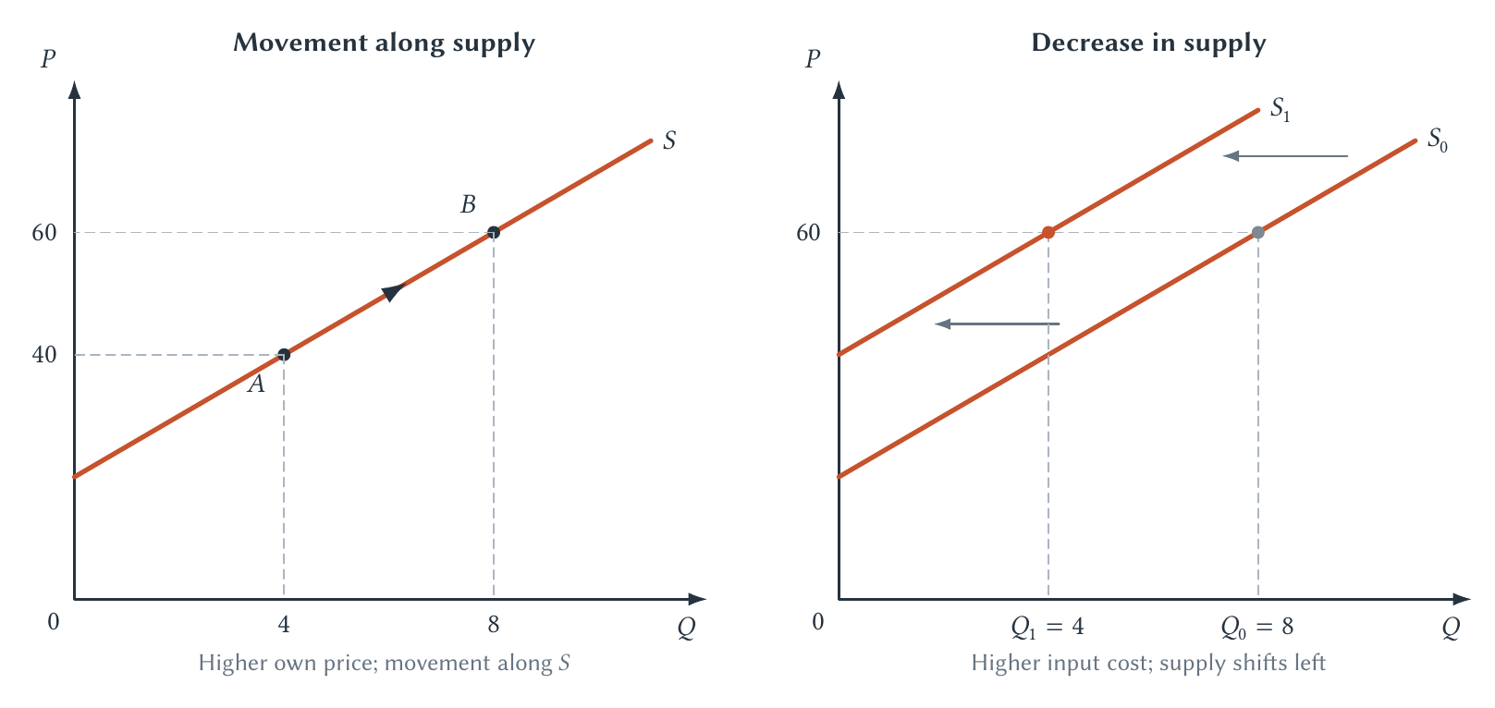
CHAPTER 2 / LESSON
Figure 2.2 · Movement along supply versus a shift
Read the shift horizontally: higher input costs mean less supplied at the same price.
Supply: The Seller's Side Of The Market
26
Notes:
Book section: Supply: The Seller's Side Of The Market
Mode: Lesson
Left: own price rises from 40 to 60 and quantity supplied rises from 4 to 8. Right: at P = 60, supply falls from 8 to 4 when input costs rise. No demand curve or equilibrium is shown here. Lower input costs reverse the shift.
[Sources]
- draft-chapters/ch02-the-supply-and-demand-playbook.md
[/Sources]

Slide 27
CHAPTER 2 / LESSON
A jersey price is not an input price
The jersey’s own price rises: quantity supplied increases along the same curve.
The material used to make jerseys becomes more expensive: supply shifts left.
After adding demand, we can ask how the supply shift changes equilibrium.
Distinguish the price of the output from the prices of its inputs.
Supply: The Seller's Side Of The Market
27
Notes:
Book section: Supply: The Seller's Side Of The Market
Mode: Lesson
[Sources]
- draft-chapters/ch02-the-supply-and-demand-playbook.md
[/Sources]

Slide 28
CHAPTER 2 / LESSON
Capacity changes the short-run response
Merchandise output can expand as producers adjust inputs and production.
Tomorrow’s stadium admissions cannot expand beyond the available seats.
A longer horizon may allow a different configuration, expansion, or a new venue.
Always specify the product and time horizon.
Supply: The Seller's Side Of The Market
28
Notes:
Book section: Supply: The Seller's Side Of The Market
Mode: Lesson
[Sources]
- draft-chapters/ch02-the-supply-and-demand-playbook.md
[/Sources]

Slide 29
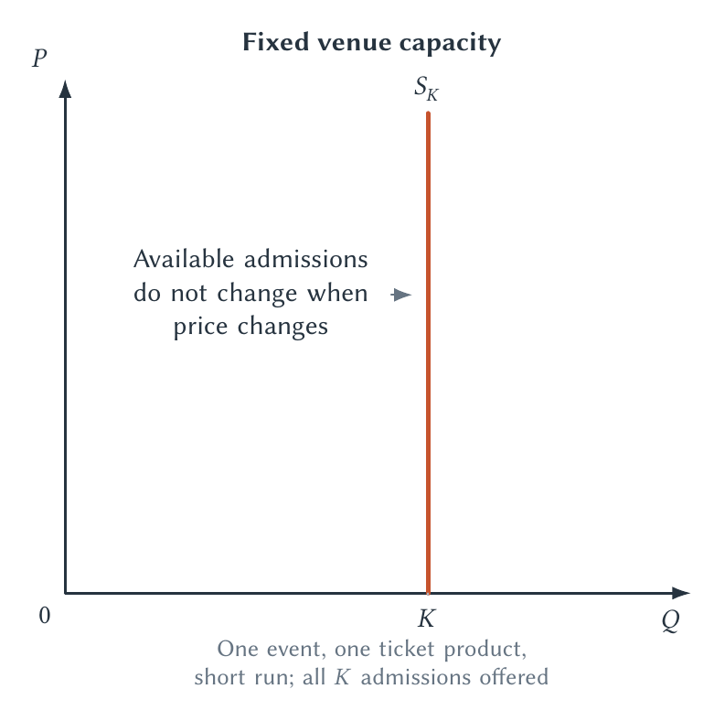
CHAPTER 2 / LESSON
Figure 2.3 · Fixed venue capacity
A vertical supply curve models fixed available admissions—not every sports market.
Supply: The Seller's Side Of The Market
29
Notes:
Book section: Supply: The Seller's Side Of The Market
Mode: Lesson
This model assumes one event, a fixed venue configuration, and all available admissions offered. It is not a claim that demand or ticket pricing is irrelevant. The team’s pricing decision returns in Chapter 4.
[Sources]
- draft-chapters/ch02-the-supply-and-demand-playbook.md
[/Sources]

Slide 30
CHAPTER 2 / LESSON
Equilibrium means the market clears
Quantity demanded equals quantity supplied at the equilibrium price.
Buyers’ and sellers’ planned quantities agree.
An intersection gives both an equilibrium price and an equilibrium quantity.
Keep this competitive market benchmark distinct from one team’s pricing decision.
Equilibrium And Market Adjustment
30
Notes:
Book section: Equilibrium And Market Adjustment
Mode: Lesson
[Sources]
- draft-chapters/ch02-the-supply-and-demand-playbook.md
[/Sources]

Slide 31
CHAPTER 2 / WORKED CALCULATION
Find equilibrium · Set the two prices equal
The book’s hypothetical curves describe price as a function of quantity.
Demand: P = 100 − 5Q
Supply: P = 20 + 5Q
100 − 5Q = 20 + 5Q
At the intersection, both curves have the same P and Q.
Equilibrium And Market Adjustment
31
Notes:
Book section: Equilibrium And Market Adjustment
Mode: Worked calculation
Because both equations give P, set their right-hand sides equal. Q is a teaching quantity without empirical units.
[Sources]
- draft-chapters/ch02-the-supply-and-demand-playbook.md
[/Sources]

Slide 32
CHAPTER 2 / WORKED CALCULATION
Find equilibrium · Solve, then check
Collect the Q terms, solve for Q, and substitute into either curve.
80 = 10Q → Q* = 8
P* = 100 − 5(8) = 60
Check: 20 + 5(8) = 60
Equilibrium: Q* = 8 and P* = 60.
Equilibrium And Market Adjustment
32
Notes:
Book section: Equilibrium And Market Adjustment
Mode: Worked calculation
Do not substitute P into an expression expecting Q. The supply calculation is a check, not a second equilibrium.
[Sources]
- draft-chapters/ch02-the-supply-and-demand-playbook.md
[/Sources]

Slide 33
CHAPTER 2 / LESSON
Prices above and below equilibrium
Price | Quantity demanded | Quantity supplied | Result
70 | 6 | 10 | Surplus of 4
60 | 8 | 8 | Market clears
50 | 10 | 6 | Shortage of 4
Surplus: sellers offer more than buyers want. Shortage: buyers want more than sellers offer.
Equilibrium And Market Adjustment
33
Notes:
Book section: Equilibrium And Market Adjustment
Mode: Lesson
At P=70, demand implies Q=6 and supply Q=10. At P=50, demand implies Q=10 and supply Q=6. Subtract quantities only after identifying the relevant side.
[Sources]
- draft-chapters/ch02-the-supply-and-demand-playbook.md
[/Sources]

Slide 34
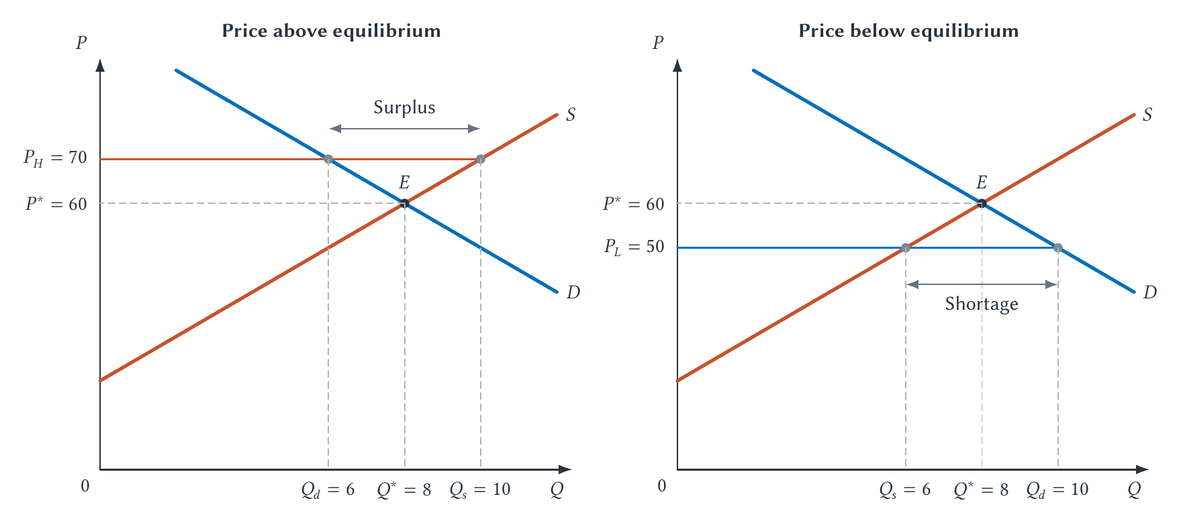
CHAPTER 2 / LESSON
Figure 2.4 · Equilibrium, surplus, and shortage
Compare quantities at the posted price—not distances measured vertically.
Equilibrium And Market Adjustment
34
Notes:
Book section: Equilibrium And Market Adjustment
Mode: Lesson
Above P*=60 there is excess supply (a surplus); below it there is a shortage. These labels describe a market imbalance, not the consumer/producer surplus introduced in Chapter 3.
[Sources]
- draft-chapters/ch02-the-supply-and-demand-playbook.md
[/Sources]

Slide 35
CHAPTER 2 / LESSON
How can an imbalance change?
Prices may adjust; sellers may also change output or the quantity they offer.
Queues, sellouts, and resale can matter when posted prices do not adjust immediately.
An asking price or a queue alone does not measure the exact shortage.
“Surplus” here means excess supply—not the gains from trade in Chapter 3.
Equilibrium And Market Adjustment
35
Notes:
Book section: Equilibrium And Market Adjustment
Mode: Lesson
[Sources]
- draft-chapters/ch02-the-supply-and-demand-playbook.md
[/Sources]

Slide 36
CHAPTER 2 / LESSON
Comparative statics · Start with the story
Comparative statics compares equilibria before and after a determinant changes.
1. Define the market and time horizon.
2. Identify the event that changed conditions.
3. Decide whether it affects demand, supply, or both.
A sports example should identify a standard determinant.
Comparative Statics: From A Story To A Prediction
36
Notes:
Book section: Comparative Statics: From A Story To A Prediction
Mode: Lesson
[Sources]
- draft-chapters/ch02-the-supply-and-demand-playbook.md
[/Sources]

Slide 37
CHAPTER 2 / LESSON
Comparative statics · Finish with two predictions
4. Shift only the affected curve in the appropriate direction.
5. Find the new intersection.
6. Compare old and new equilibrium price and quantity separately.
A demand increase: P and Q rise. A supply decrease: P rises and Q falls.
Comparative Statics: From A Story To A Prediction
37
Notes:
Book section: Comparative Statics: From A Story To A Prediction
Mode: Lesson
For a decrease in supply, use the higher jersey-material-cost example. Each prediction holds the other curve fixed.
[Sources]
- draft-chapters/ch02-the-supply-and-demand-playbook.md
[/Sources]

Slide 38
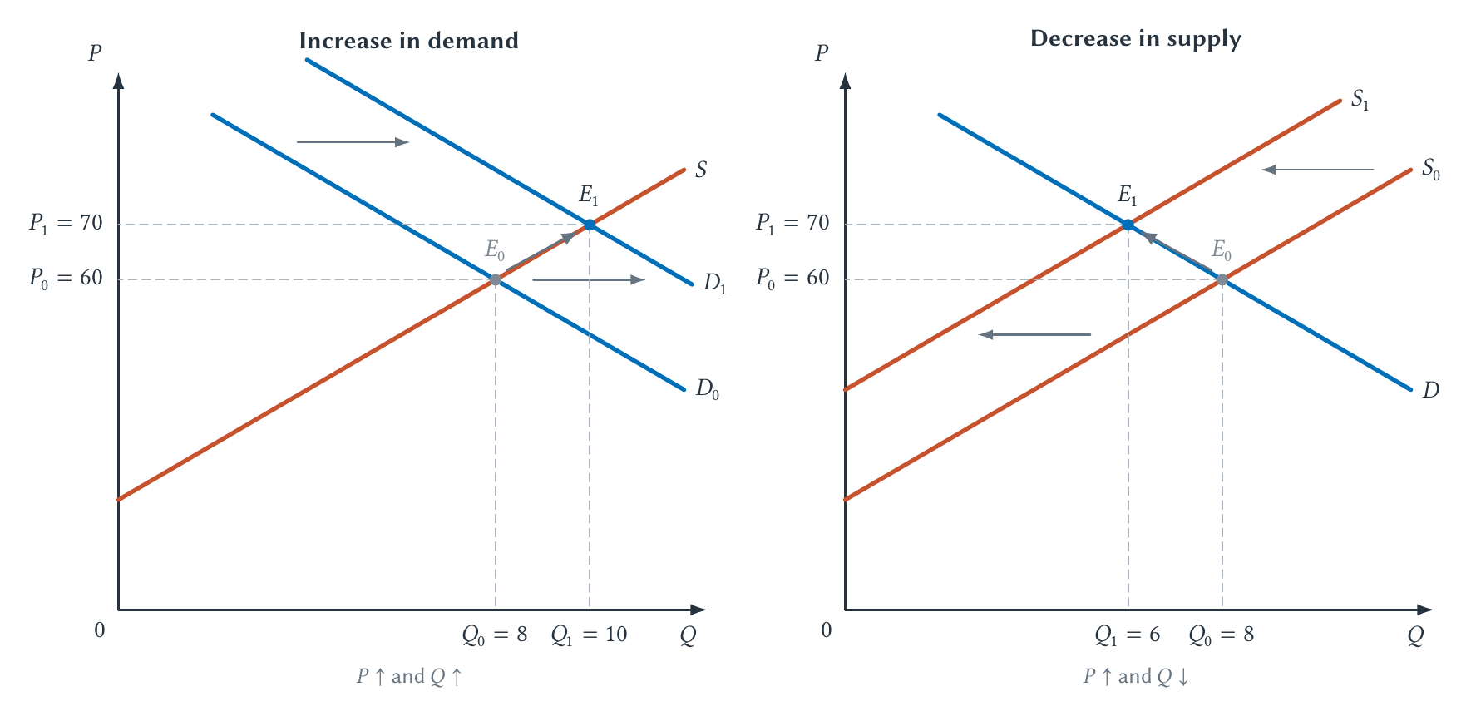
CHAPTER 2 / LESSON
Figure 2.5 · From a shift to a new equilibrium
Demand rises: P ↑, Q ↑. Supply falls: P ↑, Q ↓. Hold the other curve fixed.
Comparative Statics: From A Story To A Prediction
38
Notes:
Book section: Comparative Statics: From A Story To A Prediction
Mode: Lesson
Left: D shifts right; equilibrium moves from (8,60) to (10,70). Right: S shifts left; equilibrium moves from (8,60) to (6,70). Horizontal arrows show shifts; the equilibrium comparison then uses both curves.
[Sources]
- draft-chapters/ch02-the-supply-and-demand-playbook.md
[/Sources]

Slide 39
CHAPTER 2 / LESSON
When both curves shift
A demand increase pushes equilibrium price and quantity up.
A supply decrease pushes equilibrium price up but quantity down.
Together: price rises; the quantity change depends on the relative shifts.
An ambiguous quantity result is a valid economic prediction.
Comparative Statics: From A Story To A Prediction
39
Notes:
Book section: Comparative Statics: From A Story To A Prediction
Mode: Lesson
[Sources]
- draft-chapters/ch02-the-supply-and-demand-playbook.md
[/Sources]

Slide 40
CHAPTER 2 / DISCUSSION
Pause and predict
A playoff race attracts more fans.
Shipping becomes more expensive for licensed jerseys.
A new production technology arrives as the team wins a championship.
Rain makes attendance less attractive and raises operating costs.
More practice: the Supply and Demand Shift Practice app linked in Chapter 2.
Comparative Statics: From A Story To A Prediction
40
Notes:
Book section: Comparative Statics: From A Story To A Prediction
Mode: Discussion
Book Study and Learn prompts. Answers: 1 demand right, P/Q up; 2 supply left, P up Q down; 3 demand and supply right, Q up P ambiguous; 4 demand and supply left, Q down P ambiguous. Define the market and time period before answering; apply the standard competitive model. Shared practice app: https://sbu-econ.org/supply-demand-shift-practice/?course=sports-econ. Start with One Event, then try Two Events. No calculations are required. Substitutes and complements are cases of related-good prices; weather is an operating condition.
[Sources]
- draft-chapters/ch02-the-supply-and-demand-playbook.md
[/Sources]

Slide 41
CHAPTER 2 / CORE CONCEPT
Elasticity measures responsiveness
Price elasticity of demand measures the percentage quantity response to an own-price change.
ε
= % change in quantity demanded / % change in price
d
Hold other demand determinants fixed.
Elasticity: Measuring Responsiveness
41
Notes:
Book section: Elasticity: Measuring Responsiveness
Mode: Core concept
Read epsilon subscript d. Percentage changes make the measure unit-free. For ordinary downward-sloping demand the sign is negative.
[Sources]
- draft-chapters/ch02-the-supply-and-demand-playbook.md
[/Sources]

Slide 42
CHAPTER 2 / WORKED CALCULATION
The sign and the size tell different stories
Suppose price rises 10% and quantity demanded falls 15%.
ε
= −15% / 10% = −1.5
d
Absolute value: |−1.5| = 1.5
The negative sign gives direction. The magnitude measures responsiveness.
Elasticity: Measuring Responsiveness
42
Notes:
Book section: Elasticity: Measuring Responsiveness
Mode: Worked calculation
[Sources]
- draft-chapters/ch02-the-supply-and-demand-playbook.md
[/Sources]

Slide 43
CHAPTER 2 / LESSON
Classify demand using the absolute value
Classification | Magnitude of elasticity | Quantity response
Elastic | Greater than 1 | Larger percentage change than price
Unit elastic | Equal to 1 | Same percentage change as price
Inelastic | Less than 1 | Smaller percentage change than price
A value of −1.5 is elastic—not “less than one” in the classification sense.
Elasticity: Measuring Responsiveness
43
Notes:
Book section: Elasticity: Measuring Responsiveness
Mode: Lesson
[Sources]
- draft-chapters/ch02-the-supply-and-demand-playbook.md
[/Sources]

Slide 44
CHAPTER 2 / LESSON
What makes demand more responsive? · 1–3
Available substitutes: Demand tends to be more elastic when fans can readily switch to another game, seat, sport, broadcast, or entertainment option.
Market definition: Demand for one precisely defined game and seating section usually has more substitutes than demand for live sports entertainment as a broad category.
Budget share: Buyers generally pay closer attention when the purchase absorbs a larger share of their available income.
Elasticity: Measuring Responsiveness
44
Notes:
Book section: Elasticity: Measuring Responsiveness
Mode: Lesson
[Sources]
- draft-chapters/ch02-the-supply-and-demand-playbook.md
[/Sources]

Slide 45
CHAPTER 2 / LESSON
What makes demand more responsive? · 4–5
Time to adjust: Fans may have limited alternatives after traveling to a city on game day but many alternatives when planning months in advance.
Commitment and perceived necessity: A devoted season-ticket holder may initially respond less than a casual buyer, although loyalty does not make demand perfectly inelastic.
These are hypotheses—not substitutes for evidence.
Elasticity: Measuring Responsiveness
45
Notes:
Book section: Elasticity: Measuring Responsiveness
Mode: Lesson
Elasticity depends on the product, buyers, price range, and time horizon. The same fan can respond differently across games.
[Sources]
- draft-chapters/ch02-the-supply-and-demand-playbook.md
[/Sources]

Slide 46
CHAPTER 2 / LESSON
Why use percentages?
A $10 increase is large on a $20 ticket and small on a $500 ticket.
An extra 1,000 tickets means different things in a small arena and a much larger market.
Elasticity is unit-free; slope depends on the units used on each axis.
A flatter-looking demand curve is not automatically more elastic.
Elasticity: Measuring Responsiveness
46
Notes:
Book section: Elasticity: Measuring Responsiveness
Mode: Lesson
[Sources]
- draft-chapters/ch02-the-supply-and-demand-playbook.md
[/Sources]

Slide 47
CHAPTER 2 / LESSON
Why use the midpoint method?
Two raw observations need a common base for their percentage changes.
Use the average of the old and new quantity, and the average of the old and new price.
The midpoint method gives the same elasticity whichever direction we describe the change.
If the problem already supplies percentage changes, use them directly.
Elasticity: Measuring Responsiveness
47
Notes:
Book section: Elasticity: Measuring Responsiveness
Mode: Lesson
[Sources]
- draft-chapters/ch02-the-supply-and-demand-playbook.md
[/Sources]

Slide 48
CHAPTER 2 / WORKED CALCULATION
Midpoint example · Calculate the quantity change
Price rises from $50 to $60; quantity demanded falls from 10,000 to 9,000.
Average quantity = (10,000 + 9,000) / 2 = 9,500
% change in Q = (−1,000 / 9,500) × 100
% change in Q ≈ −10.53%
Use the average quantity—not just the original quantity.
Elasticity: Measuring Responsiveness
48
Notes:
Book section: Elasticity: Measuring Responsiveness
Mode: Worked calculation
[Sources]
- draft-chapters/ch02-the-supply-and-demand-playbook.md
[/Sources]

Slide 49
CHAPTER 2 / WORKED CALCULATION
Midpoint example · Calculate the price change
Use the same average-base convention for price.
Average price = ($50 + $60) / 2 = $55
% change in P = (10 / 55) × 100 ≈ 18.18%
ε
= −10.53% / 18.18% ≈ −0.58
d
Demand is inelastic over this comparison.
Elasticity: Measuring Responsiveness
49
Notes:
Book section: Elasticity: Measuring Responsiveness
Mode: Worked calculation
[Sources]
- draft-chapters/ch02-the-supply-and-demand-playbook.md
[/Sources]

Slide 50
CHAPTER 2 / LESSON
A transparent calculation can still mislead
The midpoint formula does not hold other demand factors fixed for us.
A rivalry game and a low-interest weekday game are not automatically comparable.
The result estimates a price response only if the comparison isolates that response.
Arithmetic cannot replace ceteris paribus.
Elasticity: Measuring Responsiveness
50
Notes:
Book section: Elasticity: Measuring Responsiveness
Mode: Lesson
[Sources]
- draft-chapters/ch02-the-supply-and-demand-playbook.md
[/Sources]

Slide 51
CHAPTER 2 / WORKED CALCULATION
Elasticity and total revenue
Total revenue is price multiplied by quantity sold: TR = P × Q.
Initial revenue: $50 × 10,000 = $500,000
New revenue: $60 × 9,000 = $540,000
Here the price increase more than offsets the quantity decrease.
Elasticity: Measuring Responsiveness
51
Notes:
Book section: Elasticity: Measuring Responsiveness
Mode: Worked calculation
[Sources]
- draft-chapters/ch02-the-supply-and-demand-playbook.md
[/Sources]

Slide 52
CHAPTER 2 / WORKED CALCULATION
What if quantity falls further?
Keep the price change from $50 to $60, but let quantity fall to 8,000.
New revenue: $60 × 8,000 = $480,000
ε
≈ −22.22% / 18.18% ≈ −1.22
d
Now demand is elastic over the comparison, and revenue falls.
Elasticity: Measuring Responsiveness
52
Notes:
Book section: Elasticity: Measuring Responsiveness
Mode: Worked calculation
The midpoint quantity base is 9,000, so −2,000/9,000≈−22.22%. Compare against the same initial $500,000 revenue.
[Sources]
- draft-chapters/ch02-the-supply-and-demand-playbook.md
[/Sources]

Slide 53
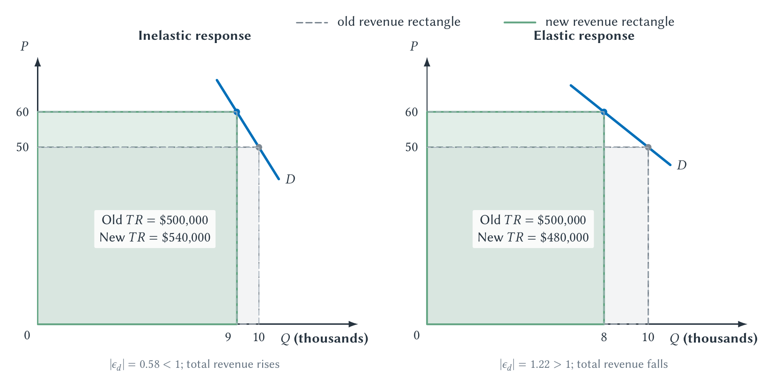
CHAPTER 2 / LESSON
Figure 2.6 · The quantity response determines revenue
The same price increase can raise or lower revenue, depending on responsiveness.
Elasticity: Measuring Responsiveness
53
Notes:
Book section: Elasticity: Measuring Responsiveness
Mode: Lesson
The rectangles represent P×Q. Left: quantity falls to 9,000 and revenue rises to $540,000 (inelastic). Right: quantity falls to 8,000 and revenue falls to $480,000 (elastic). Both start at $50 and 10,000, for $500,000.
[Sources]
- draft-chapters/ch02-the-supply-and-demand-playbook.md
[/Sources]

Slide 54
CHAPTER 2 / LESSON
The total-revenue rule
Demand | Price increases | Price decreases
Elastic | Total revenue falls | Total revenue rises
Unit elastic | Total revenue unchanged | Total revenue unchanged
Inelastic | Total revenue rises | Total revenue falls
Revenue is not profit: costs, concessions, and future fans also matter.
Elasticity: Measuring Responsiveness
54
Notes:
Book section: Elasticity: Measuring Responsiveness
Mode: Lesson
Apply the rule to the relevant price range, holding demand conditions fixed. Chapter 4 develops the team’s pricing problem; this is not yet a complete profit-maximization rule.
[Sources]
- draft-chapters/ch02-the-supply-and-demand-playbook.md
[/Sources]

Slide 55
CHAPTER 2 / CORE CONCEPT
Price elasticity of supply
How strongly does quantity supplied respond to the product’s own price?
ε
= % change in quantity supplied / % change in price
s
Generally nonnegative. More flexibility and time can mean a larger response.
Other Elasticities
55
Notes:
Book section: Other Elasticities
Mode: Core concept
Fixed available admissions to one game have zero price elasticity of supply under the chapter’s assumptions. Merchandise producers can adjust over a longer horizon.
[Sources]
- draft-chapters/ch02-the-supply-and-demand-playbook.md
[/Sources]

Slide 56
CHAPTER 2 / CORE CONCEPT
Income elasticity of demand
Hold other demand determinants fixed and change income.
ε
= % change in quantity demanded / % change in income
I
Positive: normal good. Negative: inferior good.
Other Elasticities
56
Notes:
Book section: Other Elasticities
Mode: Core concept
Do not assume that every ticket is a luxury, or that premium and value products have the same income response. Inferior is an economic response classification, not a quality judgment.
[Sources]
- draft-chapters/ch02-the-supply-and-demand-playbook.md
[/Sources]

Slide 57
CHAPTER 2 / CORE CONCEPT
Cross-price elasticity of demand
How does demand for product x respond to a change in the price of product y?
ε
= % change in quantity demanded of x / % change in price of y
xy
Positive: substitutes. Negative: complements.
Other Elasticities
57
Notes:
Book section: Other Elasticities
Mode: Core concept
The numerator is the percentage change in quantity demanded for x, with its own price and other factors held fixed. The denominator is the price of a different good. Tickets and parking may be complements; viewing and attendance are context-dependent.
[Sources]
- draft-chapters/ch02-the-supply-and-demand-playbook.md
[/Sources]

Slide 58
CHAPTER 2 / LESSON
Table 2.3 · Own-price demand and supply
Measure | Percentage-change ratio | Interpretation / sports application
Own-price demand | Quantity demanded ÷ own price | Usually negative; classify magnitude. Ticket purchases respond to ticket price.
Price elasticity of supply | Quantity supplied ÷ own price | Generally nonnegative. Merchandise can adjust; fixed admissions cannot.
Both compare percentage changes—not raw levels. Define the market and hold other factors fixed.
Other Elasticities
58
Notes:
Book section: Other Elasticities
Mode: Lesson
Classify own-price demand as elastic above 1 in magnitude, unit elastic at 1, and inelastic below 1. Larger supply elasticity means a stronger quantity response. Formulas and classifications are taught on the preceding slides.
[Sources]
- draft-chapters/ch02-the-supply-and-demand-playbook.md
[/Sources]

Slide 59
CHAPTER 2 / LESSON
Table 2.3 · Income and cross-price elasticity
Measure | Percentage-change ratio | Interpretation / sports application
Income elasticity | Quantity demanded ÷ income | Normal: positive. Inferior: negative. Premium and value tickets may differ.
Cross-price elasticity | Quantity demanded for x ÷ price of y | Substitutes: positive. Complements: negative. Consider tickets and parking.
Viewing and attendance may have a different relationship in different settings.
Other Elasticities
59
Notes:
Book section: Other Elasticities
Mode: Lesson
This is the second half of Table 2.3, split for projection rather than squeezed onto one slide. Both ratios use percentage changes. Signs require evidence for the defined products and buyers.
[Sources]
- draft-chapters/ch02-the-supply-and-demand-playbook.md
[/Sources]

Slide 60
CHAPTER 2 / LESSON
Observed prices are not random
Teams often charge more when they expect strong demand.
A rivalry game can have both higher prices and higher attendance.
That association does not identify the effect of price itself.
Ask what attendance would have been at a different price, under comparable conditions.
How Could A Team Estimate Elasticity?
60
Notes:
Book section: How Could A Team Estimate Elasticity?
Mode: Lesson
[Sources]
- draft-chapters/ch02-the-supply-and-demand-playbook.md
[/Sources]

Slide 61
CHAPTER 2 / LESSON
How could the Bills learn about elasticity?
Compare similar seats, opponents, dates, and selling periods.
Use variation from promotions or carefully designed price tests.
Use regression to account for observed demand differences.
Chapter 1 introduces the evidence problem; Chapter 4 applies it to pricing.
How Could A Team Estimate Elasticity?
61
Notes:
Book section: How Could A Team Estimate Elasticity?
Mode: Lesson
This is a plausible method, not a verified description of the Bills’ internal model. Controls do not automatically remove all confounding. Elasticity can vary across products, buyers, and price ranges.
[Sources]
- draft-chapters/ch02-the-supply-and-demand-playbook.md
[/Sources]

Slide 62
CHAPTER 2 / LESSON
Big picture · From choices to a market
Scarcity creates trade-offs; incentives affect marginal choices.
Demand and supply summarize those choices at alternative prices.
Equilibrium is the price–quantity combination where the market clears.
Comparative statics traces what changes when a determinant shifts.
Big Picture
62
Notes:
Book section: Big Picture
Mode: Lesson
[Sources]
- draft-chapters/ch02-the-supply-and-demand-playbook.md
[/Sources]

Slide 63
CHAPTER 2 / LESSON
Big picture · From direction to magnitude
Elasticity measures responsiveness using percentage changes.
Own-price elasticity helps explain changes in total revenue.
Other elasticities distinguish price, income, and related-good responses.
Next: Chapter 3 examines market outcomes; Chapter 4 develops ticket pricing.
Big Picture
63
Notes:
Book section: Big Picture
Mode: Lesson
[Sources]
- draft-chapters/ch02-the-supply-and-demand-playbook.md
[/Sources]

Slide 64
CHAPTER 2 / REVIEW
Review questions · 1–4
1. Why does scarcity create opportunity cost?
2. What does ceteris paribus mean, and why is it necessary for the law of demand?
3. Distinguish demand from quantity demanded.
4. Name the standard demand determinants and give one sports application of each.
Review Questions
64
Notes:
Book section: Review Questions
Mode: Review
Use these exact chapter questions for retrieval practice. Ask students to explain mechanisms before drawing or calculating. Detailed applications and calculation answers follow.
[Sources]
- draft-chapters/ch02-the-supply-and-demand-playbook.md
[/Sources]

Slide 65
CHAPTER 2 / REVIEW
Review questions · 5–8
5. Distinguish supply from quantity supplied.
6. Why is fixed venue capacity a short-run model rather than a universal supply curve?
7. What creates a shortage? What creates excess supply?
8. How does a demand increase affect equilibrium price and quantity when supply is unchanged?
Review Questions
65
Notes:
Book section: Review Questions
Mode: Review
Use these exact chapter questions for retrieval practice. Ask students to explain mechanisms before drawing or calculating. Detailed applications and calculation answers follow.
[Sources]
- draft-chapters/ch02-the-supply-and-demand-playbook.md
[/Sources]

Slide 66
CHAPTER 2 / REVIEW
Review questions · 9–12
9. How does a supply decrease affect equilibrium price and quantity when demand is unchanged?
10. Why is elasticity different from slope?
11. Explain the total-revenue rule for elastic and inelastic demand.
12. Distinguish own-price, supply, income, and cross-price elasticity.
Review Questions
66
Notes:
Book section: Review Questions
Mode: Review
Use these exact chapter questions for retrieval practice. Ask students to explain mechanisms before drawing or calculating. Detailed applications and calculation answers follow.
[Sources]
- draft-chapters/ch02-the-supply-and-demand-playbook.md
[/Sources]

Slide 67
CHAPTER 2 / REVIEW
Review questions · 13
13. Why can a simple comparison of ticket price and attendance fail to estimate demand elasticity?
Review Questions
67
Notes:
Book section: Review Questions
Mode: Review
Use these exact chapter questions for retrieval practice. Ask students to explain mechanisms before drawing or calculating. Detailed applications and calculation answers follow.
[Sources]
- draft-chapters/ch02-the-supply-and-demand-playbook.md
[/Sources]

Slide 68
CHAPTER 2 / PRACTICE
Practice 1 · A ticket-price reduction
A team cuts an upper-level ticket from $80 to $70; quantity rises from 6,000 to 7,500.
Movement or shift?
Calculate midpoint elasticity and classify demand.
What happens to ticket revenue?
Start by stating what is held fixed.
Problems And Applications
68
Notes:
Book section: Problems And Applications
Mode: Practice
Answer: movement along unchanged demand, assuming other determinants fixed. Midpoint %Q = 1,500/6,750=22.22%; %P=−10/75=−13.33%; epsilon_d≈−1.67, elastic. Revenue rises from $480,000 to $525,000.
[Sources]
- draft-chapters/ch02-the-supply-and-demand-playbook.md
[/Sources]

Slide 69
CHAPTER 2 / PRACTICE
Practice 2–3 · Which curve changes?
2. A popular player joins a team. Ticket price and attendance both rise. Explain and draw the curve change.
3. A jersey producer’s material cost rises 15%. Identify the affected curve and predict equilibrium price and quantity.
Problems And Applications
69
Notes:
Book section: Problems And Applications
Mode: Practice
2: Demand shifts right, so P and Q can rise without violating the law of demand. 3: Supply shifts left; P rises and Q falls with demand unchanged. A 15% input-price change does not imply a 15% output-price or quantity change.
[Sources]
- draft-chapters/ch02-the-supply-and-demand-playbook.md
[/Sources]

Slide 70
CHAPTER 2 / PRACTICE
Practice 4 · Two equilibria
Quantity Q is measured in thousands.
Initial: demand P = 140 − 4Q; supply P = 20 + 2Q
New demand: P = 164 − 4Q; supply is unchanged.
Find both equilibria. What changed?
Equate prices, solve for Q, then substitute to find P.
Problems And Applications
70
Notes:
Book section: Problems And Applications
Mode: Practice
Initial: 120=6Q, Q=20 thousand and P=60. New: 144=6Q, Q=24 thousand and P=68. A rightward demand shift raises price by 8 and quantity by 4 thousand.
[Sources]
- draft-chapters/ch02-the-supply-and-demand-playbook.md
[/Sources]

Slide 71
CHAPTER 2 / PRACTICE
Practice 5–6 · Imbalances and revenue
5. At $75, quantity demanded is 8,000 and quantity supplied is 11,000. Identify the imbalance and its size. Give two adjustments other than an immediate posted-price change.
6. Ticket price rises 8% and quantity demanded falls 4%. Calculate elasticity, classify demand, and predict revenue.
Problems And Applications
71
Notes:
Book section: Problems And Applications
Mode: Practice
5: Surplus of 3,000. Sellers may reduce output/future offerings or accumulate unsold inventory until sales adjust; for perishable tickets, some may remain unsold. Appropriate non-price changes in terms/product can alter purchases. 6: epsilon_d=−4/8=−0.5, inelastic; revenue rises. Exact revenue factor 1.08×0.96=1.036, or +3.6%; the exact percentage is not required.
[Sources]
- draft-chapters/ch02-the-supply-and-demand-playbook.md
[/Sources]

Slide 72
CHAPTER 2 / PRACTICE
Practice 7–8 · Two other elasticities
7. Parking price rises 20% and ticket demand falls 5%. Calculate cross-price elasticity. Classify the relationship and state a caution.
8. Income rises 10% and demand for one premium ticket product rises 15%. Calculate income elasticity. Does it apply to all tickets?
Problems And Applications
72
Notes:
Book section: Problems And Applications
Mode: Practice
7: epsilon_xy=−5/20=−0.25; complements in this comparison if other determinants are fixed. Association alone is not causation. 8: epsilon_I=15/10=1.5, normal for this product and population; not a universal elasticity for the team’s other ticket products.
[Sources]
- draft-chapters/ch02-the-supply-and-demand-playbook.md
[/Sources]

Slide 73
CHAPTER 2 / PRACTICE
Practice 9–10 · Time and simultaneous shifts
9. Tomorrow’s admissions are fixed at 50,000, but jersey output can expand over several months. Compare price elasticity of supply.
10. Demand increases while supply decreases. What happens unambiguously to price? Why is quantity ambiguous?
Problems And Applications
73
Notes:
Book section: Problems And Applications
Mode: Practice
9: Under fixed-admissions assumptions, epsilon_s=0; merchandise supply can respond positively as inputs adjust. 10: P rises. Demand growth raises Q, while the supply decrease lowers Q, so relative shift sizes determine net Q.
[Sources]
- draft-chapters/ch02-the-supply-and-demand-playbook.md
[/Sources]

Slide 74
CHAPTER 2 / APPLICATION
Evidence activity · Bring a claim to class
Find an article claiming a signing, winning streak, promotion, or stadium change raised ticket demand or attendance.
Record the link and access date.
Use the next five questions to assess what the evidence can support.
Evidence Activity
74
Notes:
Book section: Evidence Activity
Mode: Application
[Sources]
- draft-chapters/ch02-the-supply-and-demand-playbook.md
[/Sources]

Slide 75
CHAPTER 2 / APPLICATION
Evidence activity · Evaluate the claim
What market and time period does the claim concern?
Is the article describing quantity demanded, attendance, price, revenue, or demand itself?
Which demand or supply determinant supposedly changed?
Evidence Activity
75
Notes:
Book section: Evidence Activity
Mode: Application
[Sources]
- draft-chapters/ch02-the-supply-and-demand-playbook.md
[/Sources]

Slide 76
CHAPTER 2 / APPLICATION
Evidence activity · State the limits
What is the relevant counterfactual—what would have happened without the event?
Does the evidence establish a causal shift, show only an association, or merely offer a plausible story?
Rewrite the claim so it says no more than the evidence supports.
Evidence Activity
76
Notes:
Book section: Evidence Activity
Mode: Application
[Sources]
- draft-chapters/ch02-the-supply-and-demand-playbook.md
[/Sources]

Slide 77
CHAPTER 2 / REFERENCE
Sources and reading
The chapter’s Source Notes document the Ruth and Ohtani examples.
The schedules, curves, and calculation exercises are hypothetical teaching examples.
The Markdown chapter contains the complete explanations, figures, questions, and citations.
Book and slides should tell the same economic story.
Source Notes
77
Notes:
Book section: Source Notes
Mode: Reference
Source text: draft-chapters/ch02-the-supply-and-demand-playbook.md. Ruth and Ohtani data are carried over from the chapter’s documented sources, not newly researched for this deck. Chapter citations appear in the relevant slide notes. Do not treat the proposed Bills estimation approach as verified internal practice.
[Sources]
- draft-chapters/ch02-the-supply-and-demand-playbook.md
[/Sources]

