Slide 1
CHAPTER 4 / LESSON
Ticket Pricing and Attendance
Why can an expensive stadium have empty seats and expensive tickets?
Chapter 4
Sports Economics
Ticket Pricing and Attendance
1
Notes:
Book section: Ticket Pricing and Attendance
Mode: Lesson
Opening puzzle from the chapter. Ask students for initial explanations before introducing costs, demand, capacity, and the ticket menu.
[Sources]
- draft-chapters/ch04-ticket-pricing-and-attendance.md
[/Sources]

Slide 2
CHAPTER 4 / LESSON
The ticket-pricing decision
Explain how demand, marginal cost, and capacity affect ticket prices.
Analyze ticket menus, seat licenses, and prices that change over time.
Trace resale payments and evaluate attendance evidence.
Learning Goals
2
Notes:
Book section: Learning Goals
Mode: Lesson
The chapter contains the full learning goals. Optional calculation slides can be omitted without interrupting the conceptual sequence. Elasticity formulas and the midpoint method belong to Chapter 2.
[Sources]
- draft-chapters/ch04-ticket-pricing-and-attendance.md
[/Sources]

Slide 3
CHAPTER 4 / LESSON
Fixed cost and the next spectator
Fixed cost: stadium and event commitments that do not change with one more spectator.
Marginal cost: extra cleaning, processing, security, or other service for that spectator.
Fixed costs matter for long-run viability. Demand limits what fans will pay for the next ticket.
The Cost Puzzle
3
Notes:
Book section: The Cost Puzzle
Mode: Lesson
Marginal cost can be low without being zero. Do not divide construction cost or payroll by seats to obtain a pricing rule. A larger bill can change the desire for revenue without changing willingness to pay. The later Bills and Lakers cases apply this distinction.
[Sources]
- draft-chapters/ch04-ticket-pricing-and-attendance.md
[/Sources]

Slide 4
CHAPTER 4 / LESSON
What exactly is the ticket product?
Seat quality and event quality: view, services, opponent, stars, and game importance.
Timing and purchase terms: advance purchase, season plan, single game, or refund rights.
Buyer eligibility: student, youth, military, local resident, or another identifiable group.
What Exactly Is The Product?
4
Notes:
Book section: What Exactly Is The Product?
Mode: Lesson
These preserve the book’s five dimensions: seat quality, event quality, timing, purchase terms, buyer eligibility. Define demand for one product and event, holding the rest of the menu fixed.
[Sources]
- draft-chapters/ch04-ticket-pricing-and-attendance.md
[/Sources]

Slide 5
CHAPTER 4 / LESSON
Product differences, buyer groups, and markups
Concept | Meaning | Example
Product differentiation | The product itself differs. | Club access and a better view
Market segmentation | The seller separates buyers or buying situations. | Verified student eligibility
Price discrimination | Different markups that cost differences do not fully explain. | A discount on a similar seat
Price discrimination requires market power and some ability to limit resale between buyers.
What Exactly Is The Product?
5
Notes:
Book section: What Exactly Is The Product?
Mode: Lesson
Price discrimination requires some market power and limits on arbitrage. Different club-seat and upper-level prices alone do not establish it. Differentiation and screening can operate together.
[Sources]
- draft-chapters/ch04-ticket-pricing-and-attendance.md
[/Sources]

Slide 6
CHAPTER 4 / LESSON
Market power and marginal revenue
For one ticket product, the team faces downward-sloping demand.
Marginal revenue is the extra revenue from another sale. A lower common price also reduces receipts on earlier units.
Expand sales while MR exceeds MC. At the unconstrained optimum, MR = MC, then read price from demand.
Market Power And The Capacity Constraint
6
Notes:
Book section: Market Power And The Capacity Constraint
Mode: Lesson
This is a single-price model holding product quality and the rest of the menu fixed. Capacity adds Q ≤ K. Marginal revenue lies below demand for positive quantities in the linear model. Later sections relax the one-price assumption.
[Sources]
- draft-chapters/ch04-ticket-pricing-and-attendance.md
[/Sources]

Slide 7
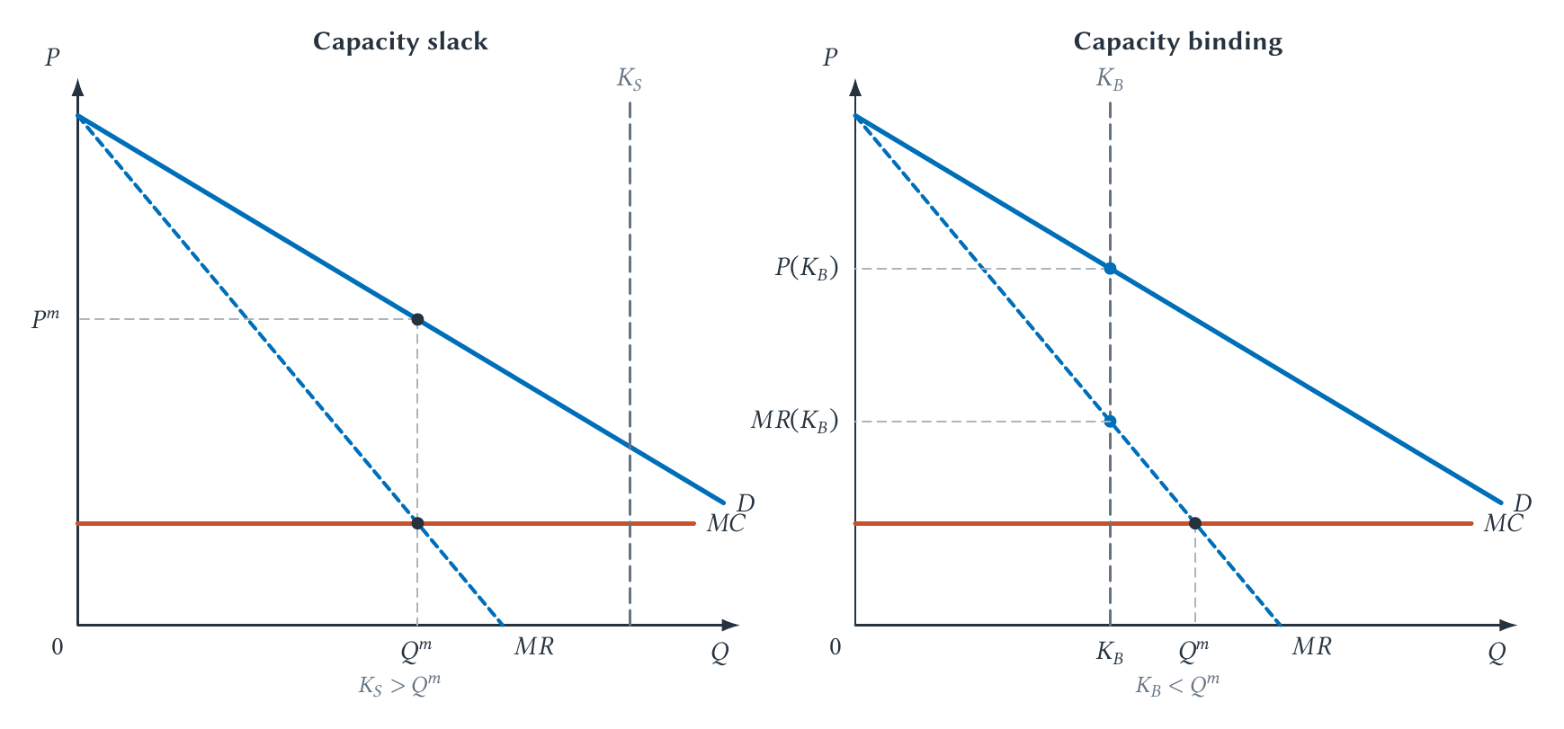
CHAPTER 4 / LESSON
Figure 4.1: Slack and binding capacity
Which panel leaves empty seats? Where do we read the ticket price?
Market Power And The Capacity Constraint
7
Notes:
Book section: Market Power And The Capacity Constraint
Mode: Lesson
Left: MR=MC at Qm, below capacity Ks. Read Pm from demand. Empty seats can be optimal because a price cut affects revenue on other tickets too. Right: Kb<Qm and MR(Kb)>MC. Quantity stops at Kb, and price comes from demand at Kb. Demand and MC are the same across panels. A small stadium does not guarantee a sellout.
[Sources]
- draft-chapters/ch04-ticket-pricing-and-attendance.md
[/Sources]

Slide 8
CHAPTER 4 / OPTIONAL CALCULATION
The chapter’s pricing example
P = 120 − Q, MR = 120 − 2Q, MC = $20. Q is thousands of tickets.
60,000 seats: 120 − 2Q = 20, so Q = 50
Price = 120 − 50 = $70
40,000 seats: Q = 40, so price = $80
At 40,000 seats, MR = $40 exceeds MC, but capacity prevents another sale.
Market Power And The Capacity Constraint
8
Notes:
Book section: Market Power And The Capacity Constraint
Mode: Optional calculation
Hypothetical curves, not an estimated Bills demand function. At 60,000 capacity, 10,000 seats remain empty. At 40,000, the constraint binds. Students can interpret Figure 4.1 without doing this algebra.
[Sources]
- draft-chapters/ch04-ticket-pricing-and-attendance.md
[/Sources]

Slide 9
CHAPTER 4 / OPTIONAL CALCULATION
A sellout can raise revenue but lower profit
Hypothetical outcome | 50,000 sold | 60,000 sold
Ticket price | $70 | $60
Ticket revenue | $3.5 million | $3.6 million
Variable cost at $20 each | $1.0 million | $1.2 million
Contribution after variable cost | $2.5 million | $2.4 million
The additional $100,000 in revenue costs $200,000 to serve.
Market Power And The Capacity Constraint
9
Notes:
Book section: Market Power And The Capacity Constraint
Mode: Optional calculation
Contribution is revenue minus variable cost, before the same fixed cost in both alternatives. It is not the final accounting profit. Do not call revenue maximization profit maximization.
[Sources]
- draft-chapters/ch04-ticket-pricing-and-attendance.md
[/Sources]

Slide 10
CHAPTER 4 / CASE STUDY
Why build a smaller Bills stadium?
Capacity: 71,621 in the former stadium versus 60,108 in the new design, about 16% fewer seats.
Bigger seats, concourses, clubs, and other amenities compete with ordinary seating for space.
Better amenities and novelty can shift demand. Fewer seats can tighten capacity. The construction bill alone does neither.
Market Power And The Capacity Constraint
10
Notes:
Book section: Market Power And The Capacity Constraint
Mode: Case study
Figures and design statements are from the chapter’s sources checked August 11, 2026. The team’s stated rationale includes comfort and the experience, not just scarcity. Early resale listings above $600 were asking prices, not completed sales or face prices. Consider ticket and premium revenue, complementary spending, costs, and fan access. Public financing belongs in Chapter 10. Avoid assigning a single motive from capacity alone.
[Sources]
- draft-chapters/ch04-ticket-pricing-and-attendance.md
- The NFL's *2024 Record and Fact Book* lists the former Highmark Stadium at 71,621 seats: <https://operations.nfl.com/media/hfjn4oid/2024-record-fact-book-incl-supplemental.pdf>. The Bills report a final capacity of 60,108 and a first regular-season game on September 17, 2026: <https://www.buffalobills.com/news/impressed-by-every-aspect-of-it-bills-officially-open-highmark-stadium-with-ribbon-cutting-ceremony>. For the team's explanation of the reduced capacity and subsequent design details, see <https://www.buffalobills.com/news/what-bills-fans-need-to-know-about-the-new-bills-stadium-project> and <https://www.buffalobills.com/news/updates-on-bills-2024-season-ticket-member-renewals-and-opening-of-bills-stadium-experience>. Current details rechecked August 11, 2026.
- Brian Mazurowski, “Many Unknowns as Fans Prepare for Bills Tickets to Go On Sale,” *WBEN*, May 12, 2026, <https://www.audacy.com/wben/news/local/bills-tickets>. For the stadium cost and capacity, see John Wawrow, “Bills' New Stadium Costs Balloon to \$2.1 Billion,” Associated Press, November 22, 2024, <https://apnews.com/article/bills-stadium-cost-pegula-8c56fad9d970f2b17429d3ae779f70ba>.
[/Sources]

Slide 11
CHAPTER 4 / CASE DISCUSSION
Shaq, the Lakers, and ticket prices
The Lakers announced 1996 ticket-price increases before completing the Shaquille O’Neal signing.
After the signing, reports described about 2,000 season-ticket sales in three hours.
What would the demand explanation predict if payroll rose but fans valued the team no more than before?
Market Power And The Capacity Constraint
11
Notes:
Book section: Market Power And The Capacity Constraint
Mode: Case discussion
The cheapest seat was scheduled to rise from $9.50 to $21 and courtside from $500 to $600. O’Neal’s reported contract was seven years and $121 million. The sequence is consistent with anticipated demand rather than mechanically recovering salary. It does not isolate a causal price effect of signing Shaq. If demand, MC, and capacity were unchanged, a higher fixed payroll would not change the short-run model’s optimum.
[Sources]
- draft-chapters/ch04-ticket-pricing-and-attendance.md
- Scott Howard-Cooper, “Most Laker Ticket Prices Will Increase,” *Los Angeles Times*, July 19, 1996, <https://www.latimes.com/archives/la-xpm-1996-07-19-sp-25835-story.html>; George Solomon, “O'Neal Receives a Record Deal from the Lakers,” *Washington Post*, July 18, 1996, <https://www.washingtonpost.com/archive/sports/1996/07/19/oneal-receives-a-record-deal-from-the-lakers/d451b845-63c3-4511-bb17-5b2f72492703/>.
[/Sources]

Slide 12
CHAPTER 4 / LESSON
Elasticity as a pricing tool
For this product and price range | If price rises | Ticket revenue
Inelastic demand | Quantity falls proportionately less | Rises
Elastic demand | Quantity falls proportionately more | Falls
Unit-elastic demand | Equal proportional response | Locally unchanged
Elasticity In The Pricing Decision
12
Notes:
Book section: Elasticity In The Pricing Decision
Mode: Lesson
This is a brief Chapter 2 recall, not a new derivation. Use a local/small change for unit elasticity, or consistent midpoint percentage changes. A finite move from a unit-elastic point need not leave revenue exactly unchanged. Estimates vary across seats, buyer groups, games, and purchase times. Revenue is not total profit.
[Sources]
- draft-chapters/ch04-ticket-pricing-and-attendance.md
[/Sources]

Slide 13
CHAPTER 4 / LESSON
How could the Bills estimate responsiveness?
Define a seat product, buyer group, and price change.
Use sales history, resale signals, surveys, or experiments while accounting for game quality and timing.
A sellout only shows that demand reached available capacity. It conceals additional buyers and willingness to pay.
Elasticity In The Pricing Decision
13
Notes:
Book section: Elasticity In The Pricing Decision
Mode: Lesson
This is a proposed approach, not a documented account of the Bills’ methods. Comparisons must separate price changes from opponent, team performance, weather, and other demand shifts. Seat-level experiments also face spillovers, fairness concerns, and substitution across products.
[Sources]
- draft-chapters/ch04-ticket-pricing-and-attendance.md
[/Sources]

Slide 14
CHAPTER 4 / LESSON
Income, related products, and event profit
Income elasticity can differ across club seats, ordinary tickets, and promotions.
Cross-price elasticity captures related products: higher parking prices may reduce ticket demand.
An extra fan may add concession sales, future purchases, and atmosphere as well as ticket revenue.
Elasticity In The Pricing Decision
14
Notes:
Book section: Elasticity In The Pricing Decision
Mode: Lesson
Own-price elasticity is a movement along demand. Income and related prices shift it. Do not assume every expensive seat is an income-elastic luxury. TV can substitute for attending today and deepen interest in later attendance. Ticket products can substitute for each other. These signs and magnitudes require evidence. Additional receipts are not all profit: account for their additional costs and the team’s share.
[Sources]
- draft-chapters/ch04-ticket-pricing-and-attendance.md
[/Sources]

Slide 15
CHAPTER 4 / LESSON
Three forms of price discrimination
Form | How the seller separates buyers | Ticketing interpretation
First-degree | Each buyer’s maximum willingness to pay | A benchmark of fully personalized prices
Second-degree | Buyers select from a menu | Season plans, bundles, and refund terms
Third-degree | Observable group eligibility | Student or youth discounts
Other things equal, more price-responsive groups tend to face lower markups.
From One Price To A Ticket Menu
15
Notes:
Book section: From One Price To A Ticket Menu
Mode: Lesson
Perfect first-degree discrimination requires information the team usually lacks. Second-degree screening can involve genuine product differences. Third-degree discrimination needs verification and restrictions on resale. Holding other factors constant, the more elastic group tends to face a lower markup. Privacy, fairness, and transaction costs constrain implementation.
[Sources]
- draft-chapters/ch04-ticket-pricing-and-attendance.md
[/Sources]

Slide 16
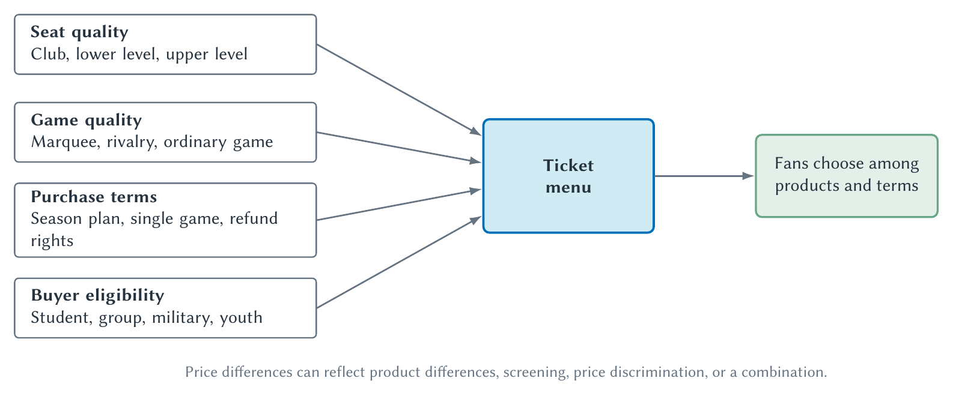
CHAPTER 4 / LESSON
Figure 4.2: Constructing a ticket menu
Which options change the product? Which let fans sort themselves or verify eligibility?
From One Price To A Ticket Menu
16
Notes:
Book section: From One Price To A Ticket Menu
Mode: Lesson
Use the book’s four branches for classification practice rather than repeat the definitions. Club access changes the product; choosing a season plan can screen willingness to commit; a verified student discount separates a group. Game quality changes the event. Several mechanisms can operate together. The diagram does not establish that all price differences are discrimination.
[Sources]
- draft-chapters/ch04-ticket-pricing-and-attendance.md
[/Sources]

Slide 17
CHAPTER 4 / LESSON
Two-part tariffs and seat licenses (PSLs)
Access charge: an upfront seat license. Usage charge: the season tickets purchased each year.
Charlotte pioneered the first large-scale NFL PSL program, demonstrating demand and raising upfront capital.
Buffalo’s stated terms give the holder a right and obligation to buy season tickets. The license does not include those tickets.
Two-Part Tariffs And Seat Licenses
17
Notes:
Book section: Two-Part Tariffs And Seat Licenses
Mode: Lesson
Carolina calls PSL a Permanent Seat License; Buffalo uses Personal Seat License. Earlier related licensing arrangements existed outside this NFL program. Max Muhleman developed the Panthers’ program. Analyze contract rights rather than assuming the expanded acronym determines the terms. Buffalo terms here are the chapter’s August 2026 snapshot.
[Sources]
- draft-chapters/ch04-ticket-pricing-and-attendance.md
- The Carolina Panthers describe their PSL plan as brand-new to the NFL and central to the franchise's early ticketing strategy: <https://www.panthers.com/news/ticketing-leader-phil-youtsey-calls-it-a-career>. The Associated Press credits Charlotte marketer Max Muhleman with developing the professional-sports PSL concept used to help finance the Panthers' stadium: <https://apnews.com/article/8fe7baf40fbf346676a42bf47a470772>. For an early industry analysis, see Larry M. McCarthy and Richard Irwin, “Permanent Seat Licenses (PSLs) as an Emerging Source of Revenue Production,” *Sport Marketing Quarterly* 7, no. 3 (1998): 41–46, <https://doi.org/10.1177/106169349800700305>.
- Buffalo Bills, “Highmark Stadium,” accessed August 11, 2026, <https://www.buffalobills.com/stadium/>. The team's December 26, 2025 inventory update reported that available new-stadium PSL inventory had sold out: <https://www.buffalobills.com/news/bills-announce-seating-availability-update-for-new-highmark-stadium>.
[/Sources]

Slide 18
CHAPTER 4 / LESSON
PSLs: benefits and risks
Perspective | Potential benefit | Potential cost or risk
Team | Upfront capital and committed demand | Sales risk and fan backlash
Fan | Seat continuity, priority, possible resale | Upfront cost, annual obligations, resale risk
Public | A source for the private stadium share | No automatic reduction in public subsidy
Two-Part Tariffs And Seat Licenses
18
Notes:
Book section: Two-Part Tariffs And Seat Licenses
Mode: Lesson
The book’s fuller table also includes demand information, administrative and transfer costs, financing costs, forfeiture risks, and unequal access. PSLs bring future fan payments forward. Compare against annual season tickets, single-game buying, team borrowing, or a different public contribution. The chosen counterfactual changes the judgment. Sold-out PSL inventory does not establish appreciation or improved welfare for every fan.
[Sources]
- draft-chapters/ch04-ticket-pricing-and-attendance.md
- Buffalo Bills, “Highmark Stadium,” accessed August 11, 2026, <https://www.buffalobills.com/stadium/>. The team's December 26, 2025 inventory update reported that available new-stadium PSL inventory had sold out: <https://www.buffalobills.com/news/bills-announce-seating-availability-update-for-new-highmark-stadium>.
- Carolina Panthers, “Permanent Seat Licenses,” accessed August 11, 2026, <https://www.panthers.com/tickets/psls-ab>; Carolina Panthers Official PSL Marketplace, accessed August 11, 2026, <https://panthers.strmarketplace.com/>.
[/Sources]

Slide 19
CHAPTER 4 / LESSON
Alienability and the value of an exit option
Alienable means transferable to another holder, subject to the contract’s rules.
Original Carolina terms allowed team repurchase at the original price for outside-family transfers through June 1997.
A resale option can raise initial willingness to pay, much as a used-car market supports demand for new cars.
Two-Part Tariffs And Seat Licenses
19
Notes:
Book section: Two-Part Tariffs And Seat Licenses
Mode: Lesson
Original Carolina licenses were not freely alienable, rather than absolutely nontransferable. The Panthers’ marketplace in the chapter’s August 2026 snapshot permits sales and transfers subject to rules. Fees, approval, and transfer windows can limit alienability. The option to sell does not guarantee a buyer or a resale gain.
[Sources]
- draft-chapters/ch04-ticket-pricing-and-attendance.md
- Mark Asher, “New Technique Saves a Seat, Collects a Fortune,” *Washington Post*, May 3, 1995, <https://www.washingtonpost.com/archive/sports/1995/05/04/new-technique-saves-a-seat-collects-a-fortune/4c643233-ea12-45bc-91a7-8c144f241686/>. The restriction was a team repurchase right rather than an absolute prohibition on every transfer.
- Carolina Panthers, “Permanent Seat Licenses,” accessed August 11, 2026, <https://www.panthers.com/tickets/psls-ab>; Carolina Panthers Official PSL Marketplace, accessed August 11, 2026, <https://panthers.strmarketplace.com/>.
[/Sources]

Slide 20
CHAPTER 4 / CASE DISCUSSION
What could make a PSL lose value?
A fan holds a transferable license but still must purchase annual season tickets.
The team sharply raises future ticket prices while expected game quality stays unchanged.
Would a new buyer pay more or less for the license? Why might a team prefer an access fee to a higher ticket price?
Two-Part Tariffs And Seat Licenses
20
Notes:
Book section: Two-Part Tariffs And Seat Licenses
Mode: Case discussion
Holding other terms fixed, higher future ticket payments reduce the surplus attached to the right and tend to lower its resale value. An access fee can capture expected surplus upfront while preserving a different marginal ticket price. A PSL is not equity in the team or a risk-free investment. Team quality, contract duration, alternatives, and financing terms also matter.
[Sources]
- draft-chapters/ch04-ticket-pricing-and-attendance.md
[/Sources]

Slide 21
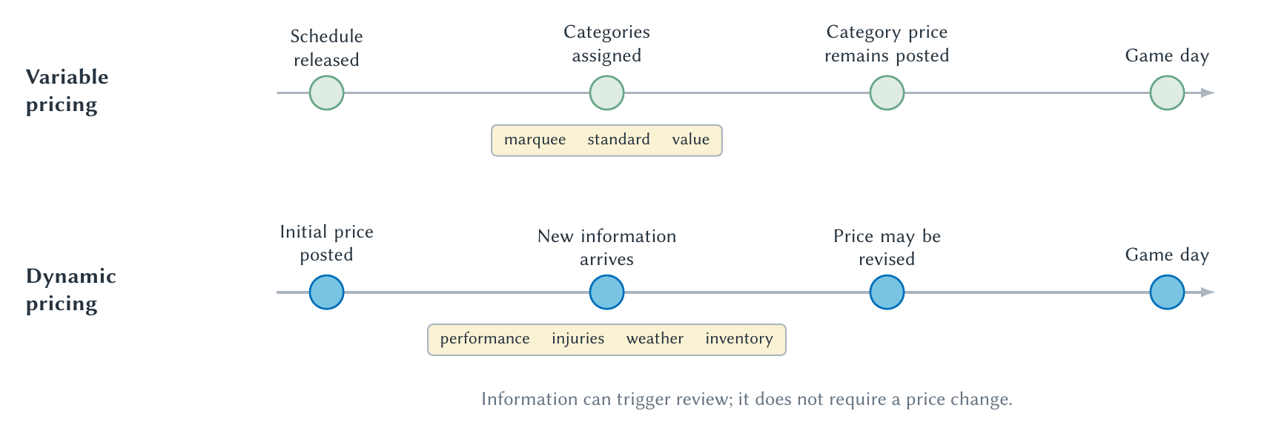
CHAPTER 4 / LESSON
Figure 4.3: Variable and dynamic pricing
Can the price change after the initial schedule? What information could trigger a revision?
Variable And Dynamic Pricing
21
Notes:
Book section: Variable And Dynamic Pricing
Mode: Lesson
Variable pricing assigns prices across categories in advance. Dynamic pricing permits revisions over time as demand, inventory, or other information changes. Read the two timelines directly. Revision need not be automatic or occur after every new signal. Dynamic pricing can improve adjustment but creates buyer uncertainty and may affect trust or the incentive to purchase early.
[Sources]
- draft-chapters/ch04-ticket-pricing-and-attendance.md
[/Sources]

Slide 22
CHAPTER 4 / LESSON
The pricing rule behind the label
Chapter’s documented examples | Stated pricing rule
FIFA World Cup 2026 guidance | Revisions across sales phases after reviewing demand and availability
St. Louis Cardinals guidance | Daily upward or downward revisions using matchup, weather, and demand
FIFA rejected the dynamic label because revisions were not automatic. The chapter’s definition is broader.
Variable And Dynamic Pricing
22
Notes:
Book section: Variable And Dynamic Pricing
Mode: Lesson
These are the chapter’s cited policies checked August 11, 2026, not a claim about every current ticket offer. FIFA’s phase-to-phase adaptation has a dynamic element under the chapter’s definition. Paul and Weinbach (2015), using eleven MLB teams, found different correlates for the highest- and lowest-priced dynamic tickets. That does not establish a universal pricing algorithm or causal effect.
[Sources]
- draft-chapters/ch04-ticket-pricing-and-attendance.md
- FIFA, “How does FIFA determine ticket prices for the FIFA World Cup 26?”, accessed August 11, 2026, <https://gpcustomersupportfwc2026.tickets.fifa.com/hc/en-gb/articles/30201776314397-9-How-does-FIFA-determine-ticket-prices-for-the-FIFA-World-Cup-26>.
- St. Louis Cardinals, “Dynamic Pricing,” accessed August 11, 2026, <https://www.mlb.com/cardinals/tickets/dynamic-pricing>.
- Rodney J. Paul and Andrew P. Weinbach, “Using Prediction Market Prices to Differentiate Factors that Influence the Highest and Lowest Priced Tickets in Dynamic Pricing for Major League Baseball,” *Journal of Prediction Markets* 9, no. 2 (2015): 43–63, <https://doi.org/10.5750/jpm.v9i2.1081>.
[/Sources]

Slide 23
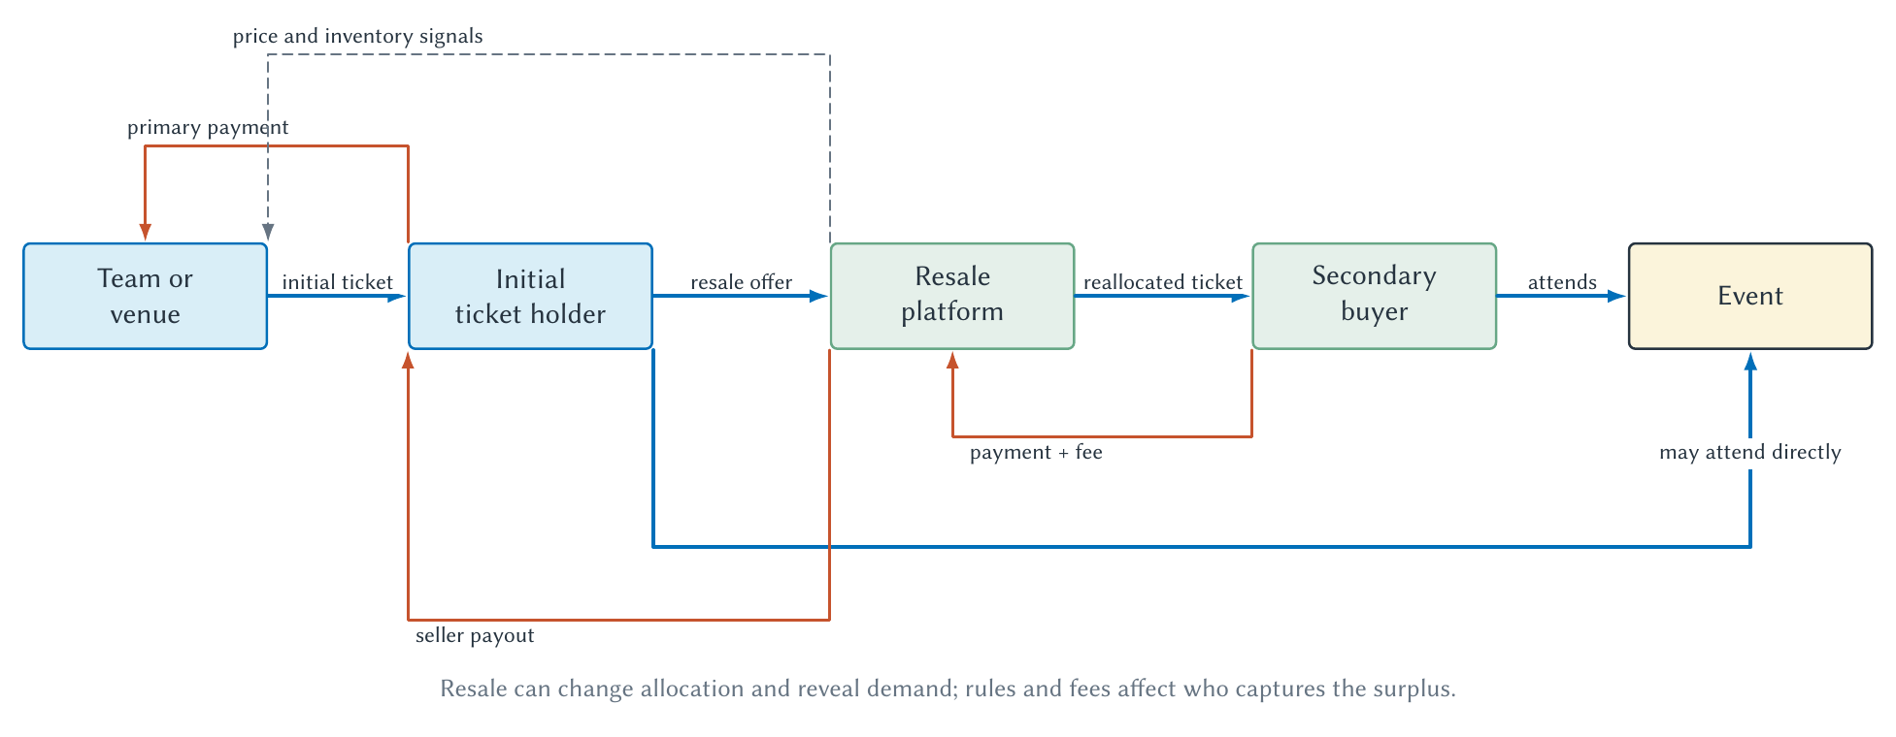
CHAPTER 4 / LESSON
Figure 4.4: Primary and secondary markets
Trace the ticket separately from the payments. Who receives the resale price?
Primary And Secondary Ticket Markets
23
Notes:
Book section: Primary And Secondary Ticket Markets
Mode: Lesson
Primary market: initial allocation by the team or authorized seller. Secondary market: reallocation after that sale. Blue arrows track tickets and attendance; orange arrows track payments. The holder can attend or resell. The platform remits a payout, and the dashed arrow shows price/inventory information returning to the team. Rules determine who captures revenue. The diagram does not imply that every team receives nothing from resale.
[Sources]
- draft-chapters/ch04-ticket-pricing-and-attendance.md
[/Sources]

Slide 24
CHAPTER 4 / OPTIONAL CALCULATION
Who captures the resale dollars?
Book example | Calculation | Amount
Final buyer: value $140, pays $110 | $140 − $110 | $30 surplus
Reseller: receives $100, paid $60 | $100 − $60 | $40 net gain
Platform: retains part of $110 | $110 − $100 | $10 revenue
Team: original ticket payment | No resale share in this example | $60 revenue
Primary And Secondary Ticket Markets
24
Notes:
Book section: Primary And Secondary Ticket Markets
Mode: Optional calculation
The $110 is the final buyer’s total payment in this example. The platform retains $10 and remits $100. Do not add another fee. Team revenue is $60, not necessarily $60 profit. Reseller gain excludes other costs. Platform revenue is not profit. Do not add the original ticket payment to surplus as if it were a net social gain.
[Sources]
- draft-chapters/ch04-ticket-pricing-and-attendance.md
[/Sources]

Slide 25
CHAPTER 4 / LESSON
Resale: allocation, costs, and disclosure
A change of plans creates gains when a ticket reaches someone who values attending more.
Search, fraud risk, fees, and transfer restrictions can reduce those gains. Refunds or authorized exchanges offer alternatives.
The FTC’s May 2025 rule introduced upfront total-price requirements for live-event tickets, including resale.
Primary And Secondary Ticket Markets
25
Notes:
Book section: Primary And Secondary Ticket Markets
Mode: Lesson
The FTC rule concerns disclosure of mandatory fees, not a government-selected optimal fee or a ban on all fees. Use the chapter’s dated source for scope, permitted exclusions, and qualifications. Courty explains resale economics; Vollmer compares resale with partial refunds in college football. Their findings do not imply all resale systems improve welfare.
[Sources]
- draft-chapters/ch04-ticket-pricing-and-attendance.md
- Pascal Courty, “Some Economics of Ticket Resale,” *Journal of Economic Perspectives* 17, no. 2 (2003): 85–97, <https://pubs.aeaweb.org/doi/10.1257/089533003765888449>.
- Drew Vollmer, “Is Resale Needed in Markets with Refunds? Evidence from College Football Ticket Sales,” *RAND Journal of Economics* 56, no. 3 (2025): 251–268, <https://doi.org/10.1111/1756-2171.12501>.
- Federal Trade Commission, “The Rule on Unfair or Deceptive Fees: Frequently Asked Questions,” accessed August 11, 2026, <https://www.ftc.gov/business-guidance/resources/rule-unfair-or-deceptive-fees-frequently-asked-questions>.
[/Sources]

Slide 26
CHAPTER 4 / LESSON
What does attendance measure?
Tickets sold or distributed count allocations. Turnstile attendance counts people entering.
A paid no-show leaves ticket revenue unchanged but affects concessions, staffing, and atmosphere.
Attendance combines demand with price, capacity, and ticketing rules.
What Determines Attendance?
26
Notes:
Book section: What Determines Attendance?
Mode: Lesson
The same word can identify different dependent variables. Check the dataset’s definition. Do not infer low underlying demand from a capped sales count or infer physical attendance from tickets distributed.
[Sources]
- draft-chapters/ch04-ticket-pricing-and-attendance.md
- Dominik Schreyer and Payam Ansari, “Stadium Attendance Demand Research: A Scoping Review,” *Journal of Sports Economics* 23, no. 6 (2022): 749–788, <https://doi.org/10.1177/15270025211000404>.
[/Sources]

Slide 27
CHAPTER 4 / LESSON
Attendance: prices and purchasing power
Table 4.1 factor | Mechanism | Interpretive caution
Ticket price | A higher price reduces quantity demanded, other things equal. | High-demand games often also have high prices.
Related-product prices and full trip cost | Parking, travel, time, and entertainment alternatives affect attending. | Substitute and complement effects require evidence.
Consumer income | Purchasing power changes demand across ticket products. | Local averages may not describe actual buyers.
What Determines Attendance?
27
Notes:
Book section: What Determines Attendance?
Mode: Lesson
Condensed from Table 4.1, preserving all nine factors in book order. The book contains fuller evidence descriptions. These are mechanisms and research cautions, not universal estimated effect sizes. The literature has gaps in women’s and niche sports and emerging markets.
[Sources]
- draft-chapters/ch04-ticket-pricing-and-attendance.md
- Jeffery Borland and Robert Macdonald, “Demand for Sport,” *Oxford Review of Economic Policy* 19, no. 4 (2003): 478–502, <https://doi.org/10.1093/oxrep/19.4.478>.
- Dominik Schreyer and Payam Ansari, “Stadium Attendance Demand Research: A Scoping Review,” *Journal of Sports Economics* 23, no. 6 (2022): 749–788, <https://doi.org/10.1177/15270025211000404>.
[/Sources]

Slide 28
CHAPTER 4 / LESSON
Attendance: the sporting contest
Table 4.1 factor | Mechanism | Interpretive caution
Home-team and contest quality | Better expected play can raise willingness to attend. | Quality also affects prices and media attention.
Opponent and star players | Attractive matchups can raise entertainment value. | Injuries and selection complicate comparisons.
Uncertainty of outcome | A closer contest may offer more suspense. | Fans may prefer a likely home win or elite play.
What Determines Attendance?
28
Notes:
Book section: What Determines Attendance?
Mode: Lesson
Condensed from Table 4.1, preserving all nine factors in book order. The book contains fuller evidence descriptions. These are mechanisms and research cautions, not universal estimated effect sizes. The literature has gaps in women’s and niche sports and emerging markets.
[Sources]
- draft-chapters/ch04-ticket-pricing-and-attendance.md
- Jeffery Borland and Robert Macdonald, “Demand for Sport,” *Oxford Review of Economic Policy* 19, no. 4 (2003): 478–502, <https://doi.org/10.1093/oxrep/19.4.478>.
- Dominik Schreyer and Payam Ansari, “Stadium Attendance Demand Research: A Scoping Review,” *Journal of Sports Economics* 23, no. 6 (2022): 749–788, <https://doi.org/10.1177/15270025211000404>.
[/Sources]

Slide 29
CHAPTER 4 / LESSON
Attendance: timing, alternatives, and loyalty
Table 4.1 factor | Mechanism | Interpretive caution
Day, time, and weather | Scheduling and comfort change the cost of attending. | Effects differ across sports and venues.
Viewing alternatives | Media can replace attendance or build later interest. | Media coverage and demand can affect each other.
Loyalty and brand attachment | Identity and habit can sustain attendance. | Past attendance also reflects other persistent factors.
What Determines Attendance?
29
Notes:
Book section: What Determines Attendance?
Mode: Lesson
Condensed from Table 4.1, preserving all nine factors in book order. The book contains fuller evidence descriptions. These are mechanisms and research cautions, not universal estimated effect sizes. The literature has gaps in women’s and niche sports and emerging markets.
[Sources]
- draft-chapters/ch04-ticket-pricing-and-attendance.md
- Jeffery Borland and Robert Macdonald, “Demand for Sport,” *Oxford Review of Economic Policy* 19, no. 4 (2003): 478–502, <https://doi.org/10.1093/oxrep/19.4.478>.
- Dominik Schreyer and Payam Ansari, “Stadium Attendance Demand Research: A Scoping Review,” *Journal of Sports Economics* 23, no. 6 (2022): 749–788, <https://doi.org/10.1177/15270025211000404>.
[/Sources]

Slide 30
CHAPTER 4 / LESSON
High prices and large crowds
Association: rivalry games may have both higher prices and higher attendance.
Prediction: price and opponent information may help forecast an unfamiliar game.
Causation: what would changing price do for the same game, holding other demand conditions fixed?
What Determines Attendance?
30
Notes:
Book section: What Determines Attendance?
Mode: Lesson
Rivalry appeal shifts demand and can raise both chosen price and attendance. That does not reverse the law of demand. Prediction requires performance on held-out observations. Causal evidence needs price variation separated from demand conditions, such as a credible experiment or defensible quasi-experiment. Sellouts censor demand, so quantity can stay fixed when demand rises.
[Sources]
- draft-chapters/ch04-ticket-pricing-and-attendance.md
[/Sources]

Slide 31
CHAPTER 4 / LESSON
A ticket policy combines several decisions
Choose a product and buyer group, assess responsiveness, and check capacity.
Set the menu, access terms, and rules for revising prices.
Account for other spending, resale, future demand, and what the attendance data can establish.
The Connected Pricing Decision
31
Notes:
Book section: The Connected Pricing Decision
Mode: Lesson
This consolidates the book’s seven connected decisions rather than creating a slide for each. Use it to organize the source-audit assignment. Profit depends on revenues and costs, not revenue per customer alone.
[Sources]
- draft-chapters/ch04-ticket-pricing-and-attendance.md
[/Sources]

Slide 32
CHAPTER 4 / LESSON
Beyond one game
Today’s ticket choice can affect tomorrow’s relationship with the fan.
Chapter 5 develops loyalty, identity, brand value, and sponsorship.
Chapter 6 follows attention beyond stadium capacity into media markets.
Big Picture
32
Notes:
Book section: Big Picture
Mode: Lesson
The preceding decision checklist supplies the chapter synthesis. The new point here is the longer-lived fan relationship and the transition to the following chapters.
[Sources]
- draft-chapters/ch04-ticket-pricing-and-attendance.md
[/Sources]

Slide 33
CHAPTER 4 / OPTIONAL REVIEW
Discussion: empty seats and changing prices
Why can an unsold seat be consistent with profit maximization under single-price monopoly pricing?
What feature of the pricing rule distinguishes variable pricing from dynamic pricing?
Review Questions
33
Notes:
Book section: Review Questions
Mode: Optional review
Selected book Review Questions 3 and 8. Q3: under a common-price model, filling an empty seat may require price reductions on other seats; compare marginal revenue with marginal cost. Q8: dynamic pricing permits later revision in response to information or inventory, whereas variable pricing assigns categories in advance. Other review answers: fixed costs do not change with another spectator; capacity binds below the unconstrained optimum; elasticity gives the revenue direction; income and related prices shift demand; distinguish products, groups, and markups; PSL separates access and usage and alienability adds transfer rights; resale gains face frictions; common demand shifts confound price-attendance correlations.
[Sources]
- draft-chapters/ch04-ticket-pricing-and-attendance.md
[/Sources]

Slide 34
CHAPTER 4 / OPTIONAL ALGEBRA PRACTICE
Practice: a new capacity problem
Book Problem 1: P = 150 − 2Q. Q is thousands of tickets. MC = $30. Capacity is 40,000.
Find marginal revenue, the unconstrained quantity and price, and whether capacity binds.
Explain your answer in words.
Problems And Applications
34
Notes:
Book section: Problems And Applications
Mode: Optional algebra practice
MR=150−4Q. Set 150−4Q=30, giving Qm=30 thousand and P=150−2(30)=$90. Capacity is slack by 10,000 seats. Do not mistake the capacity of 40,000 for the chosen quantity. This is a different hypothetical demand curve from the chapter’s worked example.
[Sources]
- draft-chapters/ch04-ticket-pricing-and-attendance.md
[/Sources]

Slide 35
CHAPTER 4 / OPTIONAL APPLICATION
Practice: buying a seat license
Book Problem 4: a PSL costs $4,000 and requires $1,200 of season tickets each year.
Resale requires team approval. Identify the access and usage charges.
Explain how transfer rights, future ticket prices, and team quality could change its value.
Problems And Applications
35
Notes:
Book section: Problems And Applications
Mode: Optional application
Problem 4: $4,000 access charge and $1,200 annual usage charge. Transfer rights add an exit option; higher future ticket prices reduce the right’s surplus, holding quality fixed; better expected quality may raise it. Additional book problems for assignment: P2, εd=−1.4 and price +5% imply quantity about −7%, so ticket revenue falls approximately 2% (0.9775 of initial revenue if those changes are applied exactly); total profit also depends on cost, concessions, and future demand. P3, εxy=−0.25 indicates complements, so dearer parking can reduce ticket and related profits. P5, final-buyer CS=190−160=$30; reseller payout=160−15=$145 and net gain=145−75=$70; platform revenue=$15; team retains $75 with no resale share in the example. P6, opponent quality can shift demand; a credible design must isolate price variation and account for capacity.
[Sources]
- draft-chapters/ch04-ticket-pricing-and-attendance.md
[/Sources]

Slide 36
CHAPTER 4 / OPTIONAL EVIDENCE ACTIVITY
Activity: audit a ticket-pricing claim
Record a seller, ticket product, source link, and access date.
Identify what can change in the price, when, and what triggers the change. Check the advertised total and fees.
Separate the seller’s label from the rule, and description from a causal claim.
Problems And Applications
36
Notes:
Book section: Problems And Applications
Mode: Optional evidence activity
Condenses the chapter’s Study and Learn activity. Ask which conclusions the evidence supports and which tempting conclusions go beyond it. Compare like products, dates, seats, packages, eligibility, and purchase terms. Record optional charges and permitted exclusions rather than assuming all later charges violate a rule.
[Sources]
- draft-chapters/ch04-ticket-pricing-and-attendance.md
[/Sources]

Slide 37
CHAPTER 4 / OPTIONAL ASSIGNMENT
Assignment: primary and resale prices
Compare the same ticket product for one future home game in the primary market and an authorized resale market.
In 500–750 words, explain demand, allocation, fees, and how the comparison could change before game day.
Include dated links or screenshots. Separate observed prices from economic interpretation.
Suggested Assignment
37
Notes:
Book section: Suggested Assignment
Mode: Optional assignment
Ensure the seat, refund rights, eligibility, package, and timing are comparable. A listed price is not proof of a completed sale. The price gap alone cannot identify a team’s demand curve or establish a welfare effect.
[Sources]
- draft-chapters/ch04-ticket-pricing-and-attendance.md
[/Sources]

Slide 38
CHAPTER 4 / REFERENCE
Sources and further reading
Bills, Panthers, and contemporary Lakers reporting: capacity, contracts, and case history.
FIFA, Cardinals, and FTC guidance: pricing rules and disclosure.
Courty; Vollmer; Borland and Macdonald; Schreyer and Ansari: resale and attendance research.
Source Notes
38
Notes:
Book section: Source Notes
Mode: Reference
Full references accompany the relevant slides in [Sources] notes. Institutional examples retain the chapter’s August 11, 2026 source snapshot. Consult the chapter’s source notes for links, dates, and scope. Paul and Weinbach (2015) provide the ticket-specific dynamic-pricing evidence.
[Sources]
- draft-chapters/ch04-ticket-pricing-and-attendance.md
- The NFL's *2024 Record and Fact Book* lists the former Highmark Stadium at 71,621 seats: <https://operations.nfl.com/media/hfjn4oid/2024-record-fact-book-incl-supplemental.pdf>. The Bills report a final capacity of 60,108 and a first regular-season game on September 17, 2026: <https://www.buffalobills.com/news/impressed-by-every-aspect-of-it-bills-officially-open-highmark-stadium-with-ribbon-cutting-ceremony>. For the team's explanation of the reduced capacity and subsequent design details, see <https://www.buffalobills.com/news/what-bills-fans-need-to-know-about-the-new-bills-stadium-project> and <https://www.buffalobills.com/news/updates-on-bills-2024-season-ticket-member-renewals-and-opening-of-bills-stadium-experience>. Current details rechecked August 11, 2026.
- Buffalo Bills, “Highmark Stadium,” accessed August 11, 2026, <https://www.buffalobills.com/stadium/>. The team's December 26, 2025 inventory update reported that available new-stadium PSL inventory had sold out: <https://www.buffalobills.com/news/bills-announce-seating-availability-update-for-new-highmark-stadium>.
- The Carolina Panthers describe their PSL plan as brand-new to the NFL and central to the franchise's early ticketing strategy: <https://www.panthers.com/news/ticketing-leader-phil-youtsey-calls-it-a-career>. The Associated Press credits Charlotte marketer Max Muhleman with developing the professional-sports PSL concept used to help finance the Panthers' stadium: <https://apnews.com/article/8fe7baf40fbf346676a42bf47a470772>. For an early industry analysis, see Larry M. McCarthy and Richard Irwin, “Permanent Seat Licenses (PSLs) as an Emerging Source of Revenue Production,” *Sport Marketing Quarterly* 7, no. 3 (1998): 41–46, <https://doi.org/10.1177/106169349800700305>.
- Carolina Panthers, “Permanent Seat Licenses,” accessed August 11, 2026, <https://www.panthers.com/tickets/psls-ab>; Carolina Panthers Official PSL Marketplace, accessed August 11, 2026, <https://panthers.strmarketplace.com/>.
- Mark Asher, “New Technique Saves a Seat, Collects a Fortune,” *Washington Post*, May 3, 1995, <https://www.washingtonpost.com/archive/sports/1995/05/04/new-technique-saves-a-seat-collects-a-fortune/4c643233-ea12-45bc-91a7-8c144f241686/>. The restriction was a team repurchase right rather than an absolute prohibition on every transfer.
- Scott Howard-Cooper, “Most Laker Ticket Prices Will Increase,” *Los Angeles Times*, July 19, 1996, <https://www.latimes.com/archives/la-xpm-1996-07-19-sp-25835-story.html>; George Solomon, “O'Neal Receives a Record Deal from the Lakers,” *Washington Post*, July 18, 1996, <https://www.washingtonpost.com/archive/sports/1996/07/19/oneal-receives-a-record-deal-from-the-lakers/d451b845-63c3-4511-bb17-5b2f72492703/>.
- FIFA, “How does FIFA determine ticket prices for the FIFA World Cup 26?”, accessed August 11, 2026, <https://gpcustomersupportfwc2026.tickets.fifa.com/hc/en-gb/articles/30201776314397-9-How-does-FIFA-determine-ticket-prices-for-the-FIFA-World-Cup-26>.
- St. Louis Cardinals, “Dynamic Pricing,” accessed August 11, 2026, <https://www.mlb.com/cardinals/tickets/dynamic-pricing>.
- Federal Trade Commission, “The Rule on Unfair or Deceptive Fees: Frequently Asked Questions,” accessed August 11, 2026, <https://www.ftc.gov/business-guidance/resources/rule-unfair-or-deceptive-fees-frequently-asked-questions>.
- Rodney J. Paul and Andrew P. Weinbach, “Using Prediction Market Prices to Differentiate Factors that Influence the Highest and Lowest Priced Tickets in Dynamic Pricing for Major League Baseball,” *Journal of Prediction Markets* 9, no. 2 (2015): 43–63, <https://doi.org/10.5750/jpm.v9i2.1081>.
- Pascal Courty, “Some Economics of Ticket Resale,” *Journal of Economic Perspectives* 17, no. 2 (2003): 85–97, <https://pubs.aeaweb.org/doi/10.1257/089533003765888449>.
- Drew Vollmer, “Is Resale Needed in Markets with Refunds? Evidence from College Football Ticket Sales,” *RAND Journal of Economics* 56, no. 3 (2025): 251–268, <https://doi.org/10.1111/1756-2171.12501>.
- Jeffery Borland and Robert Macdonald, “Demand for Sport,” *Oxford Review of Economic Policy* 19, no. 4 (2003): 478–502, <https://doi.org/10.1093/oxrep/19.4.478>.
- Dominik Schreyer and Payam Ansari, “Stadium Attendance Demand Research: A Scoping Review,” *Journal of Sports Economics* 23, no. 6 (2022): 749–788, <https://doi.org/10.1177/15270025211000404>.
[/Sources]

