Slide 1
SPORTS ECONOMICS
Introduction to Sports Economics
Chapter 1 · Turn sports headlines into economic questions
01
Notes:
Open with the Ohtani contract. Ask what 'worth it' would have to mean before accepting answers about the size of the number.
[Sources]
- Sports Economics V2, Chapter 1: Introduction to Sports Economics (canonical project draft).
[/Sources]

Slide 2
CHAPTER 1
A large number is not yet an economic question
Was Shohei Ohtani worth $700 million?
•
Worth it to whom—and relative to what alternative?
•
Measured by wins, attention, revenue, profit, or long-run value?
•
How did deferral change timing without making the commitment free?
Notes:
Use the headline to establish the method: identify the decision maker, objective, constraints, timing, alternatives, and evidence.
[Sources]
- Sports Economics V2, Chapter 1: Introduction to Sports Economics (canonical project draft).
[/Sources]

Slide 3
CHAPTER 1
Sports economics is applied microeconomics
THE SUBJECT
•
Fans choose among attendance, viewing, merchandise, and other uses of time and money.
•
Athletes choose among contracts, training, risk, and career opportunities.
•
Teams price products, assemble rosters, sell attention, and invest in facilities.
•
Leagues write rules that organize cooperation among competitors.
•
Governments influence facilities, gambling, labor, education, and health.
The setting is sports; the tools are economics.
SPORTS ECONOMICS
3
Notes:
Keep the definition broad enough to cover the whole course. Sports business facts matter when they reveal a choice, constraint, institution, or consequence.
[Sources]
- Sports Economics V2, Chapter 1: Introduction to Sports Economics (canonical project draft).
[/Sources]

Slide 4
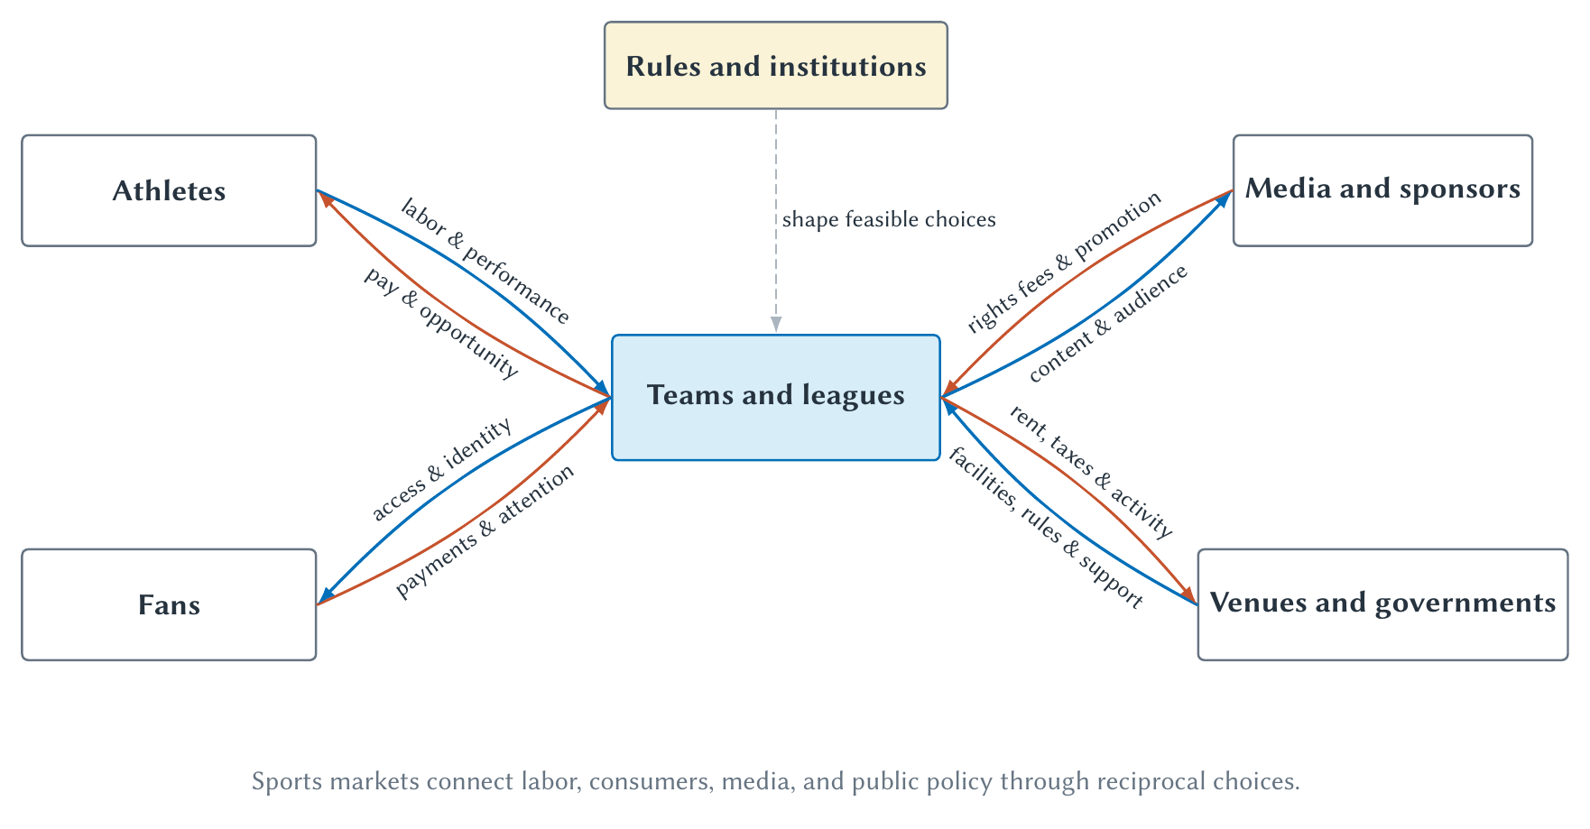
CHAPTER 1
The sports economy is an interconnected system
A change in one relationship can alter incentives throughout the system.
SPORTS ECONOMICS
4
Notes:
Trace one loop at a time. Ask students how a media agreement could affect payroll, scheduling, fan access, and franchise value.
[Sources]
- Sports Economics V2, Chapter 1: Introduction to Sports Economics (canonical project draft).
- Project-reviewed Chapter 1 figures from figures/ch01-introduction/.
[/Sources]

Slide 5
CHAPTER 1
Sports provide rich data—not automatic experiments
WHAT HELPS
WHAT REMAINS HARD
Visible rules and repeated outcomes
Cause and selection still mix
Contracts, schedules, standings, prices, audiences, and performance measures create unusually observable settings.
Popular games get higher prices; winning raises revenue; revenue can also help teams acquire talent.
A large sports dataset is evidence, but research design determines the claim.
SPORTS ECONOMICS
5
Notes:
Students often hear that sports are a laboratory and assume that every comparison is causal. Separate abundant measurement from credible counterfactual variation.
[Sources]
- Sports Economics V2, Chapter 1: Introduction to Sports Economics (canonical project draft).
[/Sources]

Slide 6
CHAPTER 1
The economist's method follows six questions
01
02
03
04
05
06
Constraints
Incentives
Models
Institutions
Alternative
Evidence
What limits the choice?
Which benefit or cost changes?
Which details can we simplify?
Which rules organize the choice?
What would likely happen otherwise?
What can the source establish?
The method turns a plausible story into a disciplined argument.
SPORTS ECONOMICS
6
Notes:
Treat this as the reusable checklist for the book. Return to it when later chapters evaluate prices, league rules, labor restrictions, and public subsidies.
[Sources]
- Sports Economics V2, Chapter 1: Introduction to Sports Economics (canonical project draft).
[/Sources]

Slide 7
CHAPTER 1
Constraints create trade-offs and opportunity costs
CONSTRAINT
OPPORTUNITY COST
Not every option is feasible
Choosing one option gives up another
A roster, schedule, stadium, budget, and hour of attention all have limits.
The relevant cost is the value of the best forgone alternative—not only the money paid.
Always ask what disappears when a choice is made.
SPORTS ECONOMICS
7
Notes:
Use roster construction or stadium spending. The opportunity cost is the best alternative use, not every imaginable alternative added together.
[Sources]
- Sports Economics V2, Chapter 1: Introduction to Sports Economics (canonical project draft).
[/Sources]

Slide 8
CHAPTER 1
A counterfactual is a disciplined comparison
What would likely have happened under a different choice or policy?
•
Compare a stadium outcome with the likely no-stadium path—not with zero.
•
Compare a pricing change with otherwise similar demand conditions.
•
State the alternative even when a precise causal estimate is unavailable.
Notes:
Define counterfactual explicitly. The word will recur throughout the book, and students are unlikely to know it at the beginning.
[Sources]
- Sports Economics V2, Chapter 1: Introduction to Sports Economics (canonical project draft).
[/Sources]

Slide 9
CHAPTER 1
Evidence must match the claim being made
DESCRIBE AND PREDICT
EXPLAIN CAUSE
What happened—and what forecasts?
What would change if X changed?
Contracts, attendance series, surveys, and regressions can establish terms, patterns, reported preferences, and predictive relationships.
Causal claims require a credible comparison, experiment, policy change, or research design that supports the counterfactual.
Correlation can be useful without answering a causal question.
SPORTS ECONOMICS
9
Notes:
Ask students to classify a claim as theoretical, descriptive, predictive, or causal before evaluating its evidence.
[Sources]
- Sports Economics V2, Chapter 1: Introduction to Sports Economics (canonical project draft).
[/Sources]

Slide 10
CHAPTER 1
Most sports headlines hide one of five questions
•
Prices, products, and the value of audience attention
•
Labor, rosters, productivity, and bargaining power
•
Competition, cooperation, league rules, and antitrust
•
Public claims about stadiums, gambling, health, and major events
•
Data, prediction, causal inference, and decision making
The course develops a small set of tools and applies them repeatedly.
SPORTS ECONOMICS
10
Notes:
Use current headlines and have students place each one in a family. Some stories span several families; that is a feature of the course.
[Sources]
- Sports Economics V2, Chapter 1: Introduction to Sports Economics (canonical project draft).
[/Sources]

Slide 11
CHAPTER 1
AI works best when the chapter anchors the session
STUDY WORKFLOW
•
Upload the chapter Markdown and ask the tutor to rely on that file.
•
Specify the audience, topic, task, and constraints.
•
Request one question at a time and require an explanation after each answer.
•
Ask for new applications, not copied review questions.
•
Challenge unclear assumptions, units, and causal language.
AI lowers the cost of practice; it does not remove the need for judgment.
SPORTS ECONOMICS
11
Notes:
Demonstrate a short tutoring exchange. Have the tutor adapt after a wrong answer instead of immediately revealing a solution.
[Sources]
- Sports Economics V2, Chapter 1: Introduction to Sports Economics (canonical project draft).
[/Sources]

Slide 12
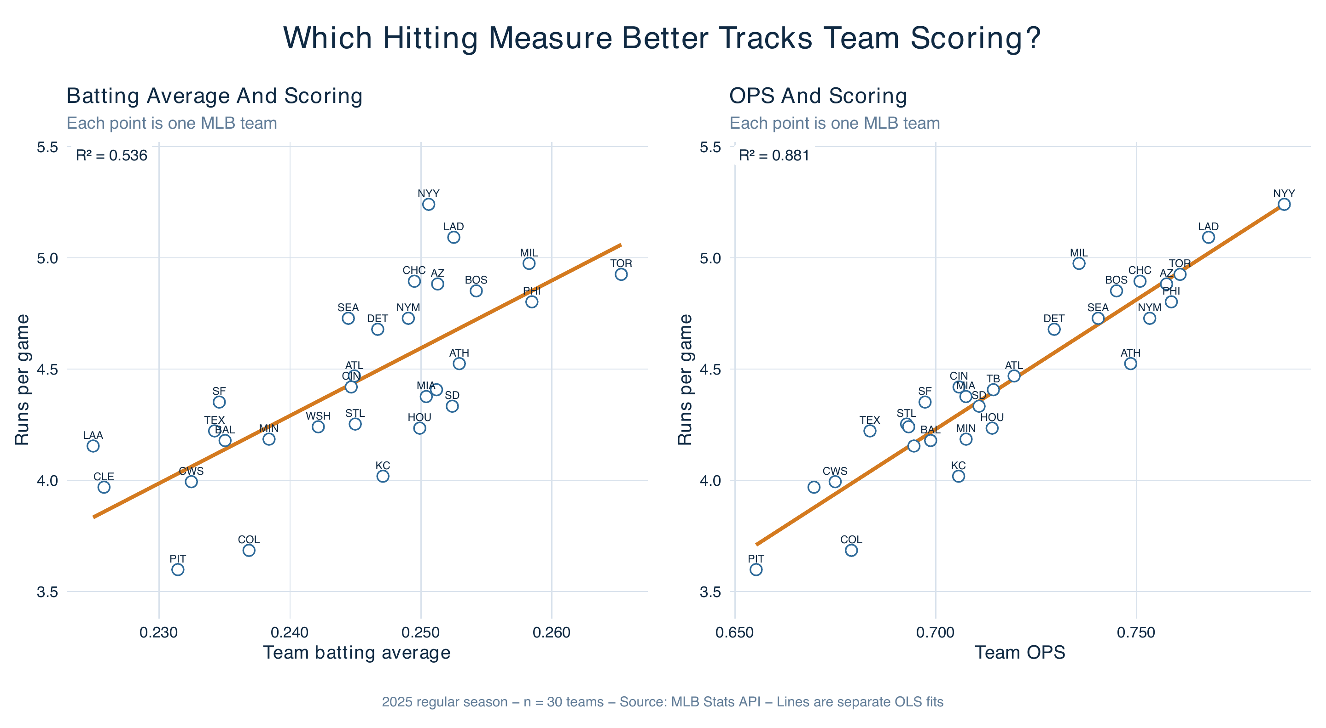
CHAPTER 1
OPS fit team scoring better than batting average
In the 2025 team sample, OPS had the stronger linear relationship with runs per game.
SPORTS ECONOMICS
12
Notes:
Start with the visual pattern before coefficients. One point represents one MLB team, and the conclusion is descriptive rather than causal.
[Sources]
- Sports Economics V2, Chapter 1: Introduction to Sports Economics (canonical project draft).
- Project-reviewed Chapter 1 figures from figures/ch01-introduction/.
[/Sources]

Slide 13
CHAPTER 1
Regression translates a pattern into a fitted line
SLOPE
R²
How the fitted outcome changes
How tightly the line fits this sample
Interpret the direction, size, variables, and units. Do not call an association causal without a design.
A higher value means more observed outcome variation is accounted for—not that the model is true or causal.
Translate every statistic back into the variables and sample.
SPORTS ECONOMICS
13
Notes:
Emphasize why BA and OPS coefficients cannot be compared by magnitude alone: a 0.010 change represents different movement on different scales.
[Sources]
- Sports Economics V2, Chapter 1: Introduction to Sports Economics (canonical project draft).
[/Sources]

Slide 14
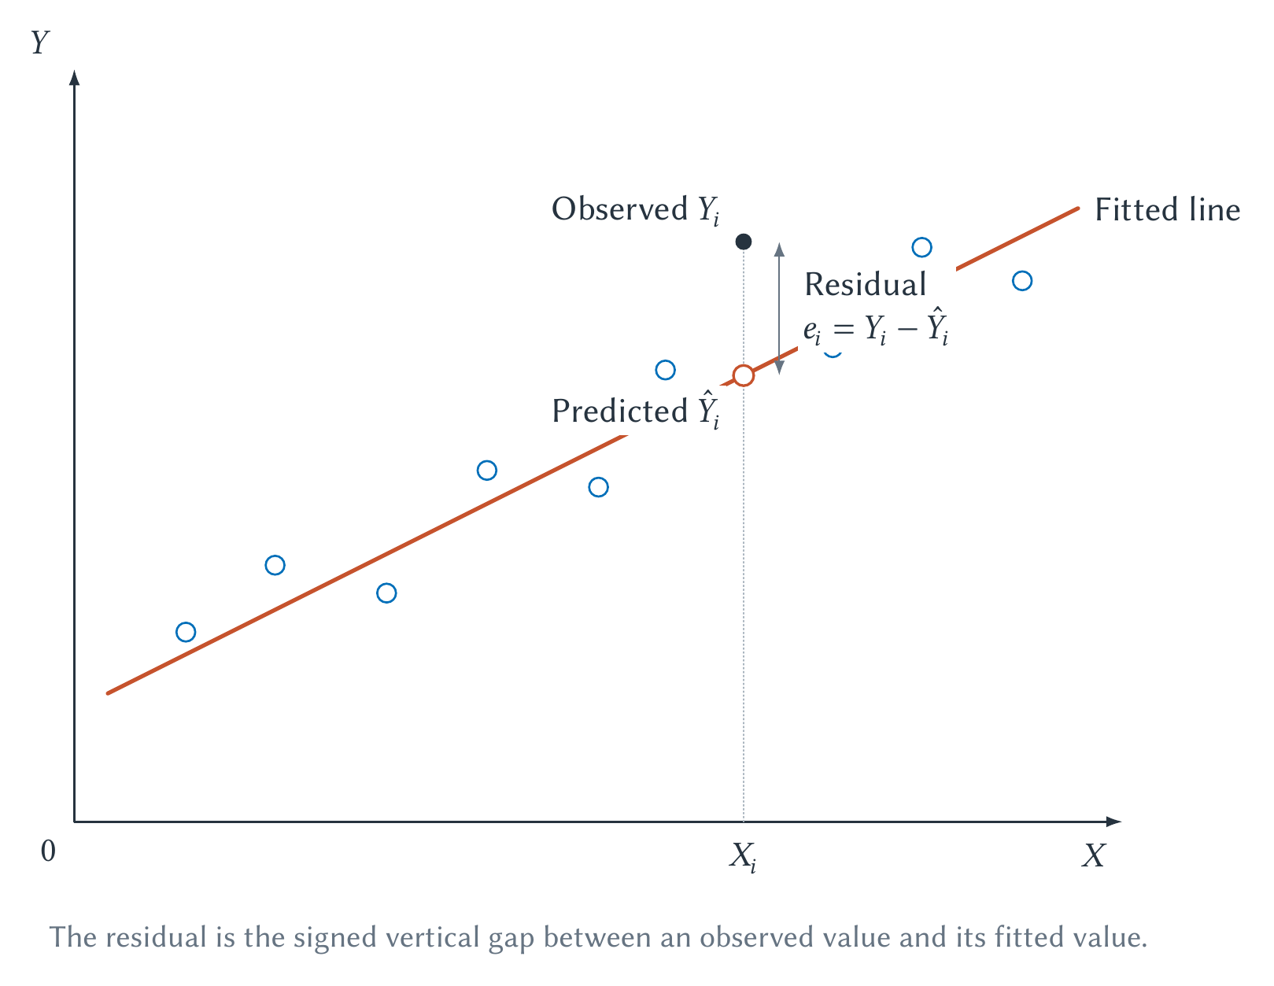
CHAPTER 1
A residual is observed minus predicted
A positive residual means the observed outcome lies above the fitted prediction.
SPORTS ECONOMICS
14
Notes:
Have students calculate one residual verbally. A residual is not automatically an error or bad observation; it is what the fitted model did not predict for that case.
[Sources]
- Sports Economics V2, Chapter 1: Introduction to Sports Economics (canonical project draft).
- Project-reviewed Chapter 1 figures from figures/ch01-introduction/.
[/Sources]

Slide 15
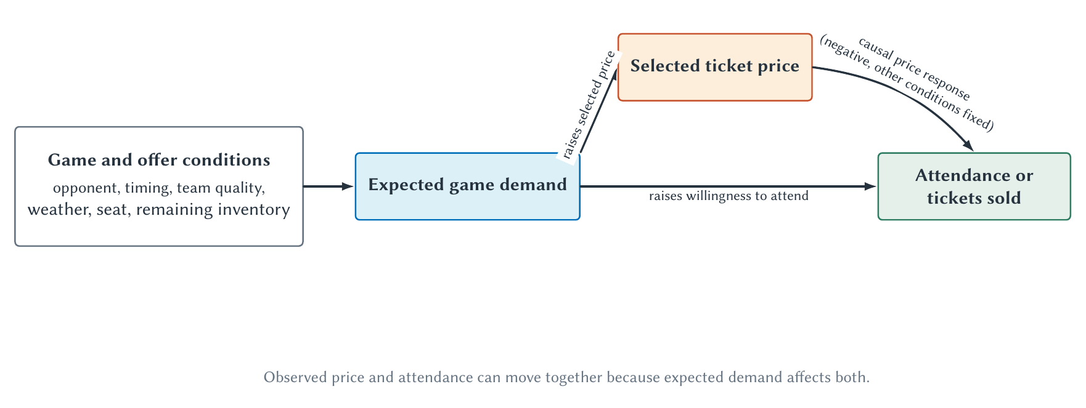
CHAPTER 1
Price and attendance can rise together
The raw association mixes the price response with underlying game demand.
SPORTS ECONOMICS
15
Notes:
Use rivalry, opponent strength, timing, and seat location as examples of demand conditions. Multiple regression can control measured factors but cannot guarantee that every relevant factor was included.
[Sources]
- Sports Economics V2, Chapter 1: Introduction to Sports Economics (canonical project draft).
- Project-reviewed Chapter 1 figures from figures/ch01-introduction/.
[/Sources]

Slide 16
Think like an economist before choosing a model
•
Identify the decision maker, objective, and constraint.
•
Name the incentive and likely margin of response.
•
Describe the institution and the relevant counterfactual.
•
Match the evidence to a theoretical, descriptive, predictive, or causal claim.
Next: incentives, opportunity cost, demand, supply, equilibrium, and elasticity.
Notes:
Close by returning to the opening headline. Students should now be able to improve the question even before knowing the later models.
[Sources]
- Sports Economics V2, Chapter 1: Introduction to Sports Economics (canonical project draft).
[/Sources]

