Slide 1
SPORTS ECONOMICS
The Supply and Demand Playbook
Chapter 2 · From incentives to disciplined market predictions
02
Notes:
Begin with a familiar sports-market change and resist drawing a curve immediately. First ask which decision maker changed, which incentive changed, and what is being held fixed.
[Sources]
- Sports Economics V2, Chapter 2: The Supply and Demand Playbook (canonical project draft).
[/Sources]

Slide 2
CHAPTER 2
The curves come after the economic reasoning
Scarcity, opportunity cost, incentives, substitution, and ceteris paribus come first.
Notes:
The chapter deliberately begins with the standard economic toolkit. Sports examples apply the concepts; they do not replace the general definitions.
[Sources]
- Sports Economics V2, Chapter 2: The Supply and Demand Playbook (canonical project draft).
[/Sources]

Slide 3
CHAPTER 2
Five ideas prepare the market model
•
Scarcity: wants exceed the resources available to satisfy them.
•
Opportunity cost: a choice gives up the best alternative.
•
Incentives: people adjust when expected benefits or costs change.
•
Substitution: buyers and sellers look for alternatives when conditions change.
•
Ceteris paribus: isolate one relationship by holding other relevant conditions fixed.
Demand and supply summarize choices made under constraints.
SPORTS ECONOMICS
3
Notes:
Use tickets, viewing, roster spots, venue time, and sponsorship inventory to illustrate scarcity without redefining it as a sports-only idea.
[Sources]
- Sports Economics V2, Chapter 2: The Supply and Demand Playbook (canonical project draft).
[/Sources]

Slide 4
CHAPTER 2
Marginal reasoning focuses on the next unit
BUYER
SELLER
Is the next unit worth its price?
Is the next unit worth providing?
A fan compares the additional benefit of one more ticket, subscription, or hour of viewing with its additional cost.
A team or venue compares the additional revenue from another unit with the additional cost and relevant capacity constraint.
Economic choices respond at the margin, not necessarily all at once.
SPORTS ECONOMICS
4
Notes:
Connect marginal thinking to later ticket-pricing analysis, but do not introduce monopoly pricing here.
[Sources]
- Sports Economics V2, Chapter 2: The Supply and Demand Playbook (canonical project draft).
[/Sources]

Slide 5
CHAPTER 2
Demand has standard determinants
A DEMAND SHIFT CHANGES WILLINGNESS TO BUY AT EVERY PRICE
•
Income and purchasing power
•
Prices of substitutes and complements
•
Tastes, expectations, and information
•
Number and composition of buyers
•
Quality, convenience, timing, and other product characteristics
The product's own price does not shift its demand curve.
SPORTS ECONOMICS
5
Notes:
Define the general determinants first. Then apply them to team quality, rivalry, weather, streaming access, and alternative entertainment.
[Sources]
- Sports Economics V2, Chapter 2: The Supply and Demand Playbook (canonical project draft).
[/Sources]

Slide 6
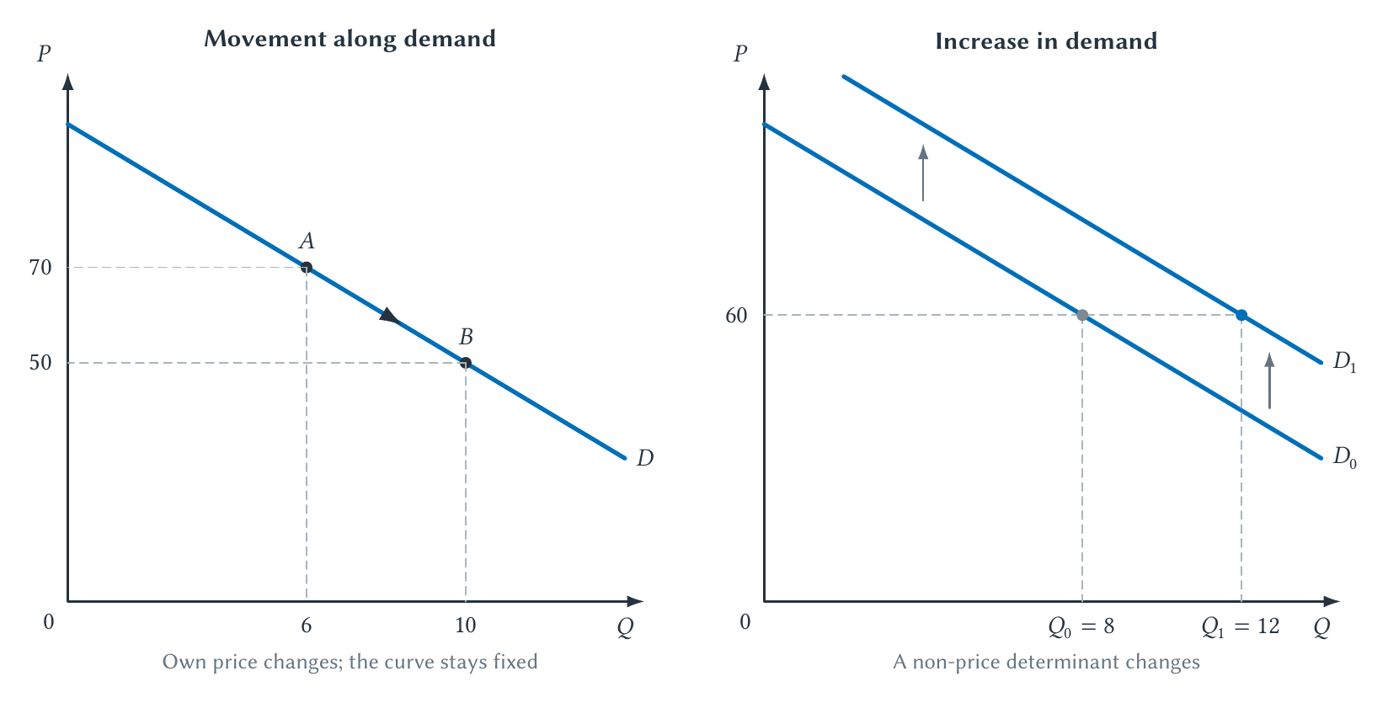
CHAPTER 2
Own price moves quantity demanded along the curve
A change in another demand determinant shifts the entire curve.
SPORTS ECONOMICS
6
Notes:
Have students identify the cause before reading the result. Point A and Point B belong to the same curve only in the movement panel.
[Sources]
- Sports Economics V2, Chapter 2: The Supply and Demand Playbook (canonical project draft).
- Project-reviewed Chapter 2 figures from figures/ch02-supply-demand/.
[/Sources]

Slide 7
CHAPTER 2
Supply also has standard determinants
A SUPPLY SHIFT CHANGES WILLINGNESS TO SELL AT EVERY PRICE
•
Input prices and production costs
•
Technology and productivity
•
Taxes, subsidies, and regulation
•
Expectations and the number of sellers
•
Capacity and the time available to adjust
The product's own price changes quantity supplied, not supply itself.
SPORTS ECONOMICS
7
Notes:
Use broadcast inventory, merchandise, concessions, and venue dates. Remind students that a team may have substantial long-run options even when one event has fixed capacity.
[Sources]
- Sports Economics V2, Chapter 2: The Supply and Demand Playbook (canonical project draft).
[/Sources]

Slide 8
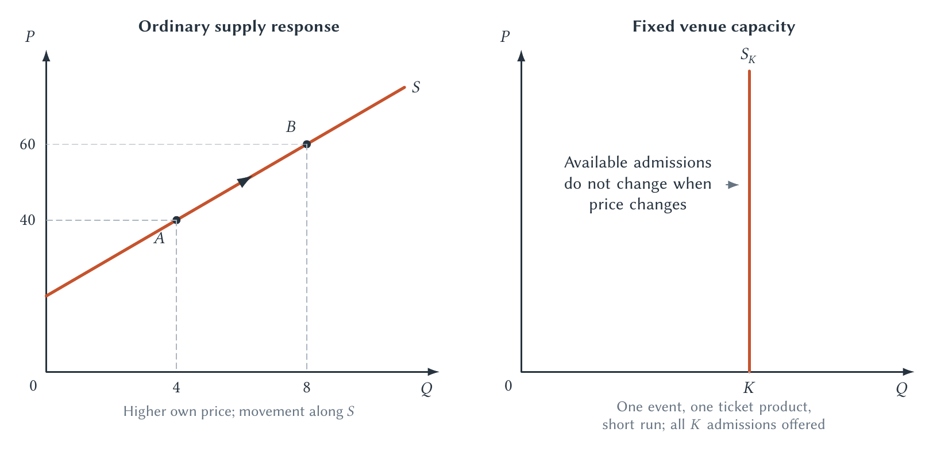
CHAPTER 2
Capacity can make short-run supply vertical
For one defined event, no price can create more seats than the venue contains.
SPORTS ECONOMICS
8
Notes:
Distinguish fixed event capacity from long-run venue capacity. Teams can later redesign sections, expand venues, or change the number and type of events.
[Sources]
- Sports Economics V2, Chapter 2: The Supply and Demand Playbook (canonical project draft).
- Project-reviewed Chapter 2 figures from figures/ch02-supply-demand/.
[/Sources]

Slide 9
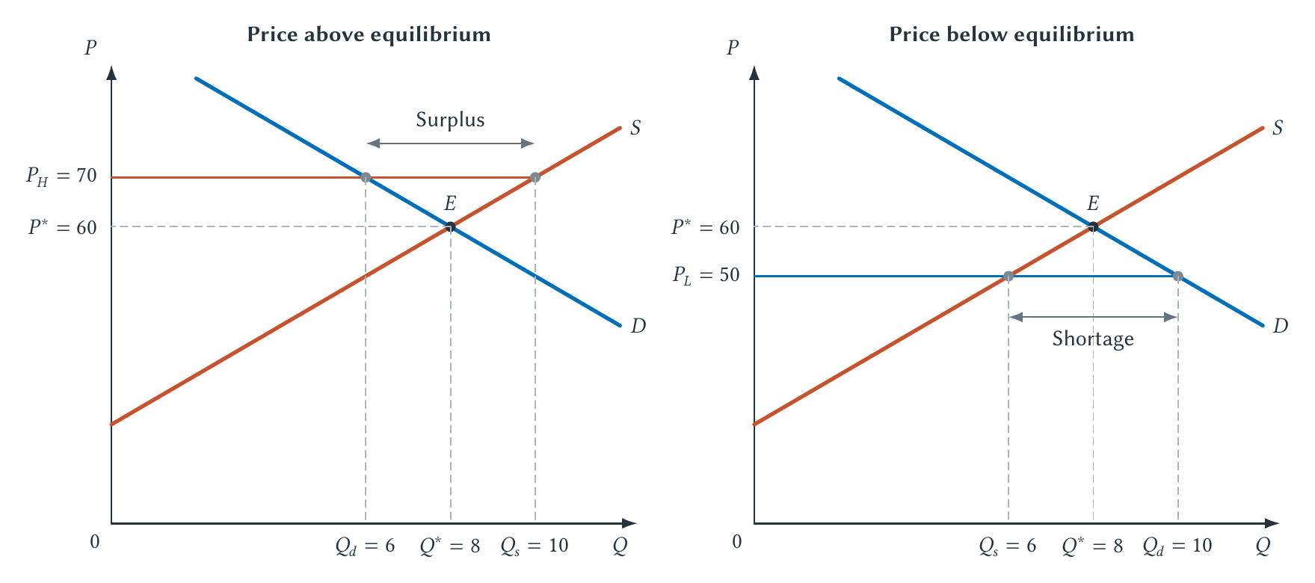
CHAPTER 2
Equilibrium is the market-clearing outcome
At equilibrium, planned quantity demanded equals planned quantity supplied.
SPORTS ECONOMICS
9
Notes:
Stress market clearing. A price above equilibrium creates surplus; a price below equilibrium creates shortage. Describe likely adjustment without implying that adjustment is instant or costless.
[Sources]
- Sports Economics V2, Chapter 2: The Supply and Demand Playbook (canonical project draft).
- Project-reviewed Chapter 2 figures from figures/ch02-supply-demand/.
[/Sources]

Slide 10
CHAPTER 2
Comparative statics uses a repeatable process
01
02
03
04
05
Name the market
Identify the cause
Choose the curve
Choose direction
Compare equilibria
Define the product, place, and time period.
Which determinant changed?
Demand, supply, or both?
Increase or decrease?
What happens to price and quantity?
Do not jump from a story directly to a memorized arrow.
SPORTS ECONOMICS
10
Notes:
Make students narrate the chain. Simultaneous shifts require separate analysis of the price and quantity effects.
[Sources]
- Sports Economics V2, Chapter 2: The Supply and Demand Playbook (canonical project draft).
[/Sources]

Slide 11
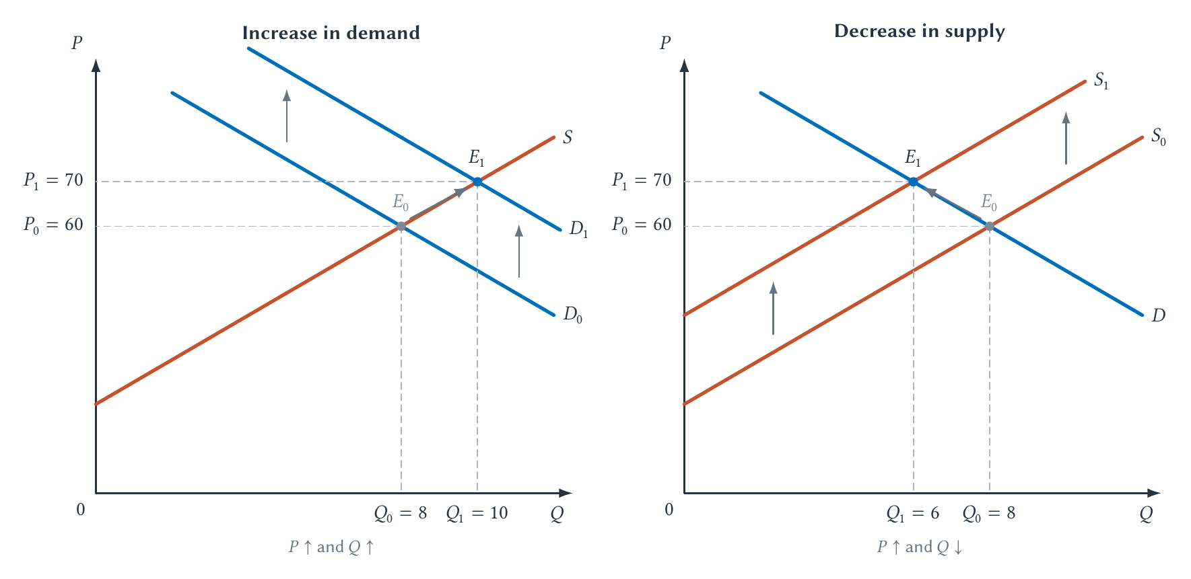
CHAPTER 2
Different shifts create different equilibrium changes
Demand up raises price and quantity; supply down raises price but lowers quantity.
SPORTS ECONOMICS
11
Notes:
Read each panel using the comparative-statics process. Then ask what is ambiguous if demand rises while supply falls at the same time.
[Sources]
- Sports Economics V2, Chapter 2: The Supply and Demand Playbook (canonical project draft).
- Project-reviewed Chapter 2 figures from figures/ch02-supply-demand/.
[/Sources]

Slide 12
CHAPTER 2
Elasticity measures responsiveness in percentages
εd = percentage change in quantity demanded ÷ percentage change in price
•
The negative sign records the usual inverse price–quantity relationship.
•
Use |εd| to classify demand as elastic, unit elastic, or inelastic.
•
Elasticity is not the same thing as the slope of a demand curve.
Notes:
Use the Greek letter epsilon consistently. The signed value records direction; the absolute value determines the conventional classification.
[Sources]
- Sports Economics V2, Chapter 2: The Supply and Demand Playbook (canonical project draft).
[/Sources]

Slide 13
CHAPTER 2
Elasticity depends on available adjustment
LESS RESPONSIVE
MORE RESPONSIVE
Few substitutes and little time
More substitutes and more time
Strong loyalty, small budget share, urgency, and short adjustment periods tend to reduce price responsiveness.
Alternative games, platforms, entertainment, and longer adjustment periods tend to increase responsiveness.
Elasticity belongs to a defined comparison—not permanently to a product label.
SPORTS ECONOMICS
13
Notes:
A fan can be inelastic for one rivalry game and much more elastic across a season or across entertainment alternatives.
[Sources]
- Sports Economics V2, Chapter 2: The Supply and Demand Playbook (canonical project draft).
[/Sources]

Slide 14
CHAPTER 2
The midpoint formula treats both directions symmetrically
%ΔQ = (Q₂ − Q₁) ÷ [(Q₁ + Q₂)/2] × 100
•
Apply the same midpoint convention to price.
•
Use supplied percentage changes directly when a problem already gives them.
•
The formula is a measurement convention—not an additional economic theory.
Notes:
Work one numerical example slowly. For undergraduates, the main learning goal is interpreting responsiveness; algebra can be assigned selectively.
[Sources]
- Sports Economics V2, Chapter 2: The Supply and Demand Playbook (canonical project draft).
[/Sources]

Slide 15
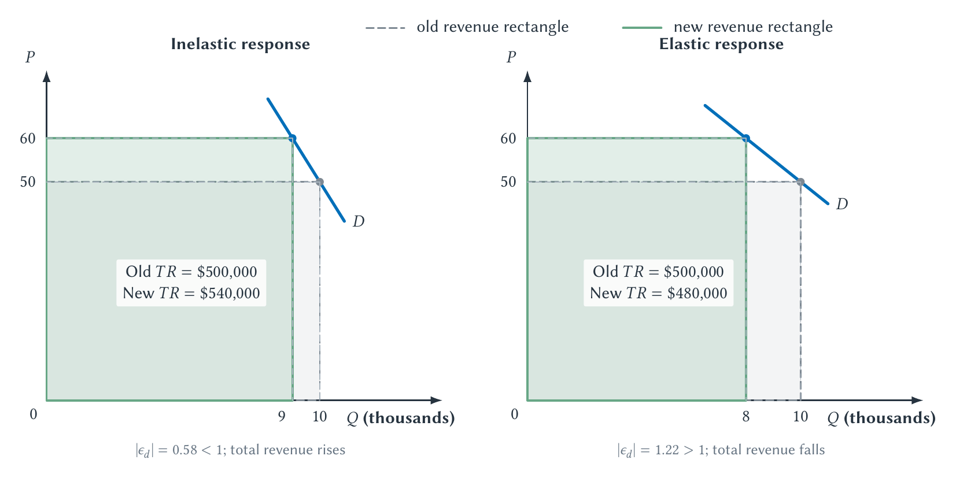
CHAPTER 2
Elasticity predicts the total-revenue response
Price and total revenue move together under inelastic demand and oppositely under elastic demand.
SPORTS ECONOMICS
15
Notes:
Revenue is price times quantity, not profit. The result assumes the comparison isolates a movement along a demand curve rather than a demand shift.
[Sources]
- Sports Economics V2, Chapter 2: The Supply and Demand Playbook (canonical project draft).
- Project-reviewed Chapter 2 figures from figures/ch02-supply-demand/.
[/Sources]

Slide 16
CHAPTER 2
Three elasticities answer different questions
OWN PRICE
INCOME
CROSS PRICE
How does quantity respond to its price?
How does demand respond to income?
How does another price affect demand?
Price elasticity of demand connects price changes to quantity demanded and total revenue.
Income elasticity distinguishes normal and inferior goods and helps anticipate market changes.
Cross-price elasticity helps identify substitutes, complements, and competitive boundaries.
Price elasticity of supply separately measures sellers' quantity response.
SPORTS ECONOMICS
16
Notes:
Use streaming services and attending versus watching as potential substitute relationships. Complementarity can arise between tickets and transportation or between viewing and related subscriptions.
[Sources]
- Sports Economics V2, Chapter 2: The Supply and Demand Playbook (canonical project draft).
[/Sources]

Slide 17
CHAPTER 2
Teams estimate elasticity rather than merely calculate it
•
Compare similar seats, games, and customer groups over time.
•
Use controlled promotions or price experiments when feasible.
•
Account for opponent, timing, team quality, weather, inventory, and resale conditions.
•
Recognize that the team chooses prices partly because it anticipates demand.
•
Use historical estimates as uncertain inputs into future pricing decisions.
The Bills implicitly need a demand model, not one isolated midpoint calculation.
SPORTS ECONOMICS
17
Notes:
This is the bridge to Chapter 4. A team faces confounding, changing products, heterogeneous buyers, and strategic price selection.
[Sources]
- Sports Economics V2, Chapter 2: The Supply and Demand Playbook (canonical project draft).
[/Sources]

Slide 18
CHAPTER 2
Specialization depends on opportunity cost
BABE RUTH
SHOHEI OHTANI
Great at two roles—more valuable in one
Technology and talent can change the trade-off
The relevant question is not whether Ruth could pitch, but whether pitching displaced an even more valuable use of his time and talent.
Ohtani's two-way success shows that specialization is a prediction based on opportunity cost, not a universal rule that forbids dual production.
Comparative advantage is useful here as an application—not a trade-theory detour.
SPORTS ECONOMICS
18
Notes:
This is the chapter's signature classroom discussion. Emphasize that absolute ability and comparative advantage answer different questions.
[Sources]
- Sports Economics V2, Chapter 2: The Supply and Demand Playbook (canonical project draft).
[/Sources]

Slide 19
Use the playbook before drawing a conclusion
•
Start with incentives, alternatives, and ceteris paribus.
•
Separate movements along curves from shifts of curves.
•
Use equilibrium to identify the market-clearing outcome.
•
Use elasticity to measure—not merely label—responsiveness.
Next: surplus, price controls, taxes, externalities, and policy analysis.
Notes:
Close by asking students to narrate one current sports-market change from cause to predicted equilibrium outcome.
[Sources]
- Sports Economics V2, Chapter 2: The Supply and Demand Playbook (canonical project draft).
[/Sources]

