Slide 1
How To: bi-Cube team management

Slide 2
How the user has to request a team space and what happens at the end
Send the following information to helpdesk@p3-group.com :
Team name (< 32 characters); starts always with the company abbreviation
Team leader(s) – persons who should manage the team space and add/remove users
Team end date
Team template
Team location / server (not needed for the team template ADGroupsOnly)
The defined team leaders get the right to manage the team members and their access rights. They get the team manager role assigned automatically as well.
What happens if the team end date is almost reached:
3, 2 and 1 weeks before the end date of the team the leader leaders receive an e-mail: They have to confirm the team end in bi-Cube or they can set a new end date in the task manager of bi-Cube.
2 days before the end date of the team all team members receive an e-mail which will inform them about the end date and that there will be no access to any data after these 2 days.

Slide 3
Team management in bi-Cube: the different team templates
What happens after a new team is created in bi-Cube depending on the chosen team template:
Standard, 10-40, NoSubfolder: A team folder <Team-Name> is created on the fileserver. Depending on the choosen file server it‘s always reachable via the link \\<localfileserver>\Teams
Standard: 3 subfolders are created beneath
the main folder: Management, Data &
Public. A distribution list with the name
„P3_Team_<Team-Name>“ is created.
10-40: Four subfolders are created
beneath the main folder: Lead, Management,
Project management & Project world.
Check the table on the left which team role gives
the team members access to which folders.
ADGroupsOnly: Only 4 AD groups are created.
These could be used on different systems to
assign the team members access rights. Each
AD group matches 1:1 to the team role.
 | Standard |  |  |  |  |  |  | 10-40 |  |  |  |  |  |  |  | No Sub-Folder
 | Management |  | Public |  | Data |  | distribution list | Lead |  | Management |  | Project management |  | Project world
R=read, W=write | R | W | R | W | R | W |  | R | W | R | W | R | W | R | W | R | W
Team-Manager | X | X | X | X | X | X | X | X | X | X | X | X | X | X | X |  | X
Team-Controller | X | X |  |  |  |  | X |  |  | X | X | X | X | X | X | X
Team-Engineer |  |  | X | X | X | X | X |  |  |  |  |  |  | X | X |  | X
Team-Assistant |  |  | X | X |  |  | X |  |  |  |  | X | X | X | X | X

Slide 4
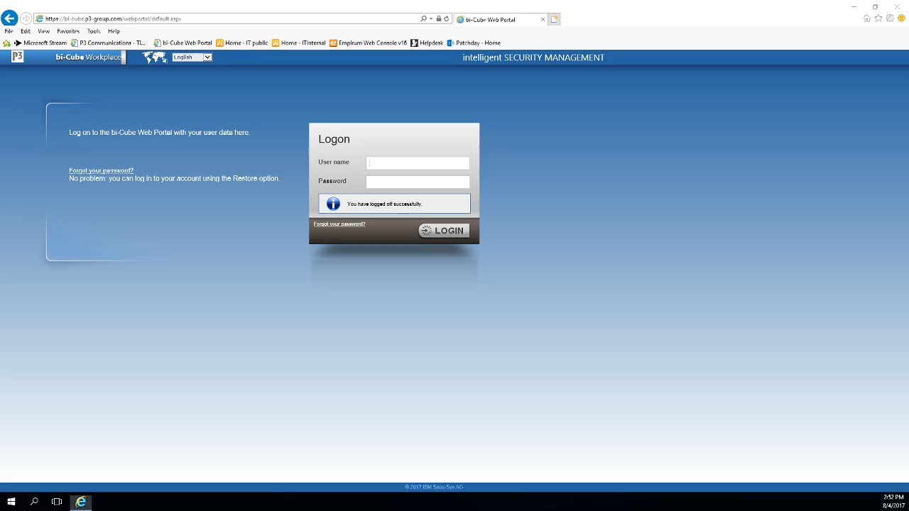
How the team leader manages the team space
How to add a user to the team:
Open the bi-Cube portal: https://bi-cube.p3-group.com
Enter your P3 credentials to log in.
Go to „Service center“, select „Team“ and then select „Team management“.
Select the team in the left part of the window.
You can now manage this team in the right part of the window.
Click on the members tab
Click on „Add team member“ on the bottom of the right part of the window.
Search and click on the arrow of the person(s) you want to add to the team.
Click on “Next”
Click the button “Select role(s)“. Open the list “P3 Group Teams” and select one of the four team roles for the selected person(s).
Press the button „Make a request“.
When the process is completed, both the team manager and the user who was assigned to a role will receive an email from bi-Cube.
The user has to log out/in of his PC for the rights to be applied to the local PC as well.
Click on the video to see a short video how-to:

Slide 5
How the team leader manages the team space (2)
How to delete a user:
Go to “Team Management” in bi-Cube
Select the Team in the left part of the window.
Click on the tab “Members”
Select a user in the middle column and click on the red cross behind the name
Answer the following question with OK
How to change the team role of a user:
Go to “Team Management” in bi-Cube
Click on the tab “Members”
Select the user in the middle column and click on the last icon “Display team roles of the user”
Click the red cross behind the assigned role in the right column
Answer the following question with OK
Wait 15 minutes so that the revoke is completed
Click the button “New team role” in the lower right corner
Click on the plus sign
Choose the new team role out of the four
Click the button “assign roles”
After 15 minutes the new rights are assigned

Slide 6
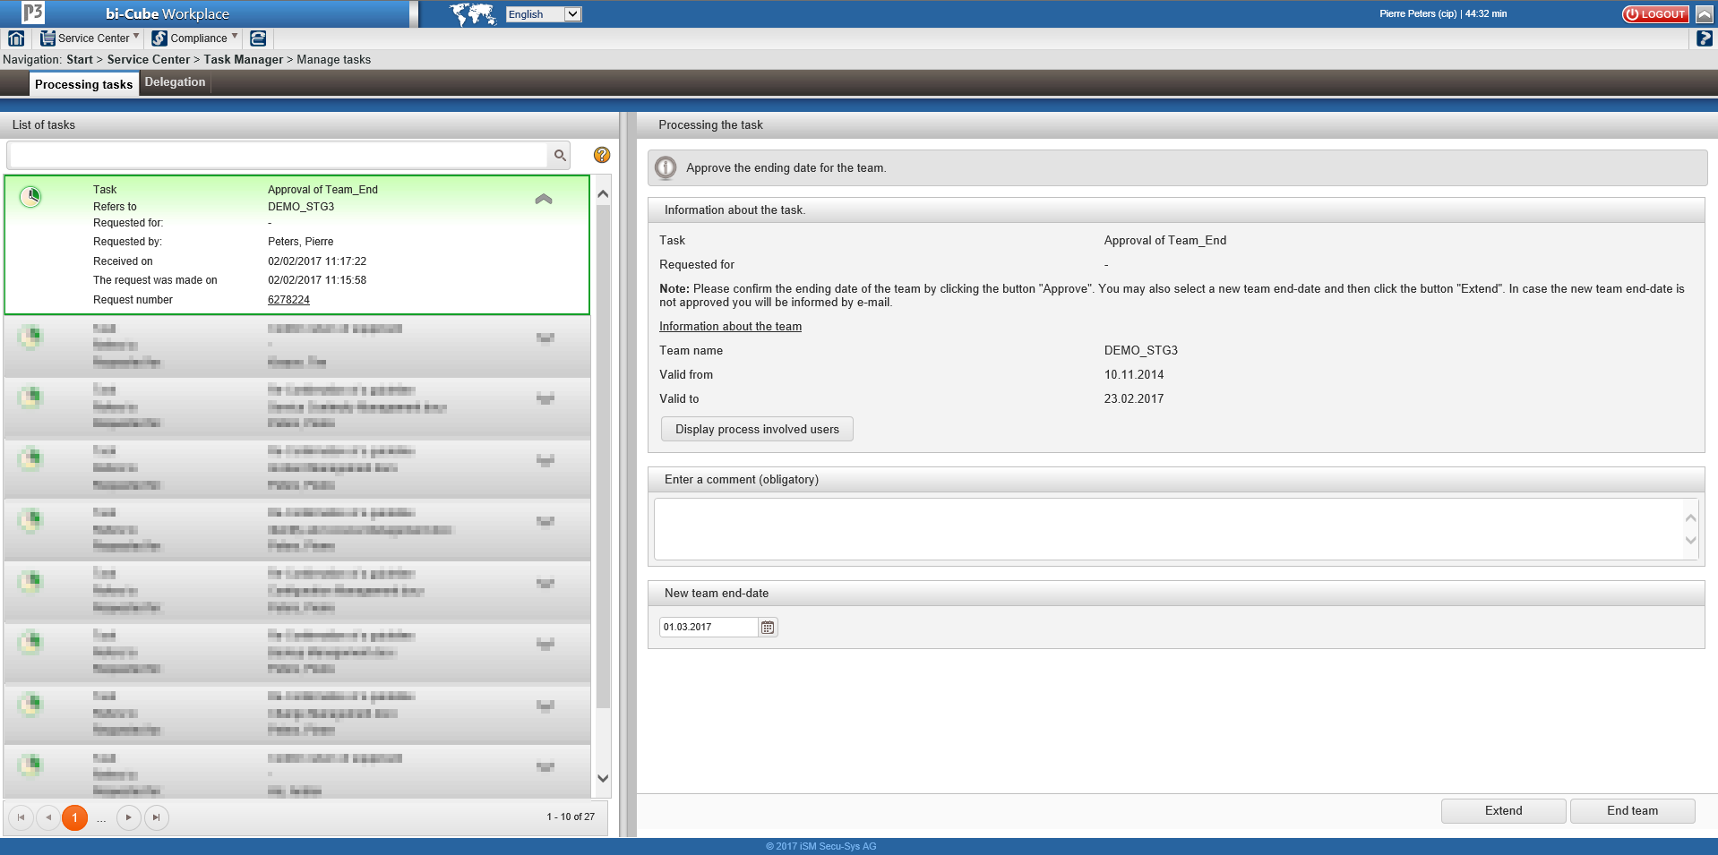
What to do when the end of the team is reached
After you have received an e-mail as team leader you find a task in bi-Cube:
Navigate to the “Service Center” dropdown menu
Choose “Task Manager” and “Manage tasks”
Choose the task on the left column
A new window in the right column appears:
Enter a new team end date, write a comment
and click the left button “Extend” at the
bottom of the right column to set the new
end date for the team
or
Write a comment and click the right button
“End team” on the bottom of the right
column to confirm the team end date.

