Slide 1



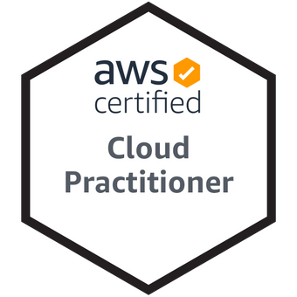
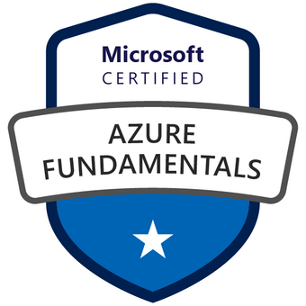
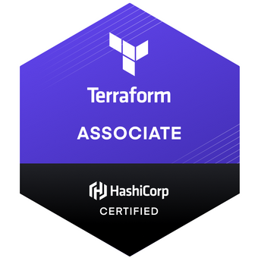

Basic Tutorial hands-on Linux
Marco A Hernández Marroquin
Application Development Senior Analyst
Email: marco.a.marroquin@accenture.com

Slide 2
Index
Introduction
  What is Linux
  What is Shell and what are the most popular
Basic commands
  Print working directory (pwd)
  List file and directories (ls)
  Make a directorie (mkdir)
  Create an empty file (touch)
  Change to a different directory (cd)
    Relative vs Absolute path
  Copy files(cp)
  Remove files (rm)
  Display the content of a file on the screen
    cat
    less
    head
    tail
  f
Xx

