Slide 1
R tidyverse tutorial
Mark Cherrie

Slide 2
Contents
Learning outcomes
Setup
Tidyverse
Read data
Processing data
Vizualising data

Slide 3
Learning Outcomes
Read, process and visualise data using tidyverse
Load tidyverse packages
Find the right function
Modify functions for our use
Run functions and understand output
Understand how to chain multiple functions together

Slide 4
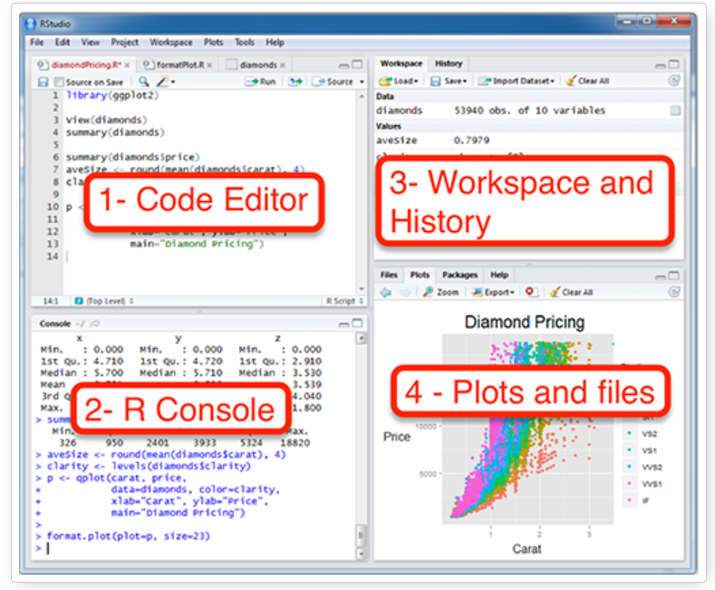
Setup
Use your username and password that I have sent you and log in to:
exposomapps.com
usethis::use_course(“https://github.com/markocherrie/Rtidyverse_tutorial/archive/master.zip”)

Slide 5
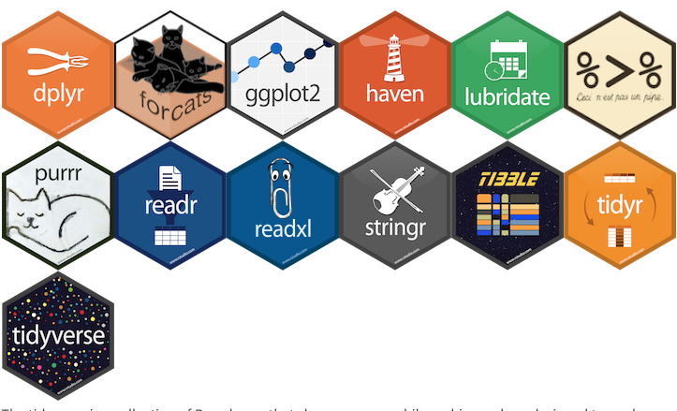
Tidyverse
The Tidyverse is a collection of R packages built around the basic concept that data in a table should have one observation per row, one variable per column, and only one value per cell (i.e. it is tidy)
The packages work well together
Some advantages over base, e.g. read_csv from readr
10 times faster than read.csv
Some useful formatting on the fly - they don’t convert character vectors to factors, use row names, or munge the column names
More reproducible – no system/environment variable issues

Slide 6

Reading data
library(readr)
read_csv()
help("read_csv")
All options in Usage
Look at the code below usage, notice that all except “file” have pre-defined default arguments… that means that you need to specify “file” and then tweak the defaults to get what you need
:: is used to access the exact function from that specific package
<- is the assignment operator, it creates a new object (check your workspace!)

Slide 7

Reading data

Slide 8
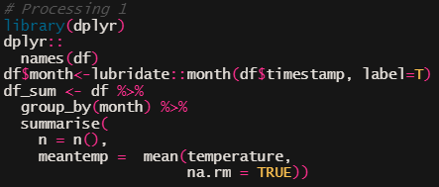
Processing data
‘group_by’ is a function that subsets the data into chunks
‘summarise’ is a function that creates a new data frame
‘names’ is a function that tells you the column names
‘month’ extracts the month from a date
‘mean’ is a function that computes the arithmetic mean

Slide 9
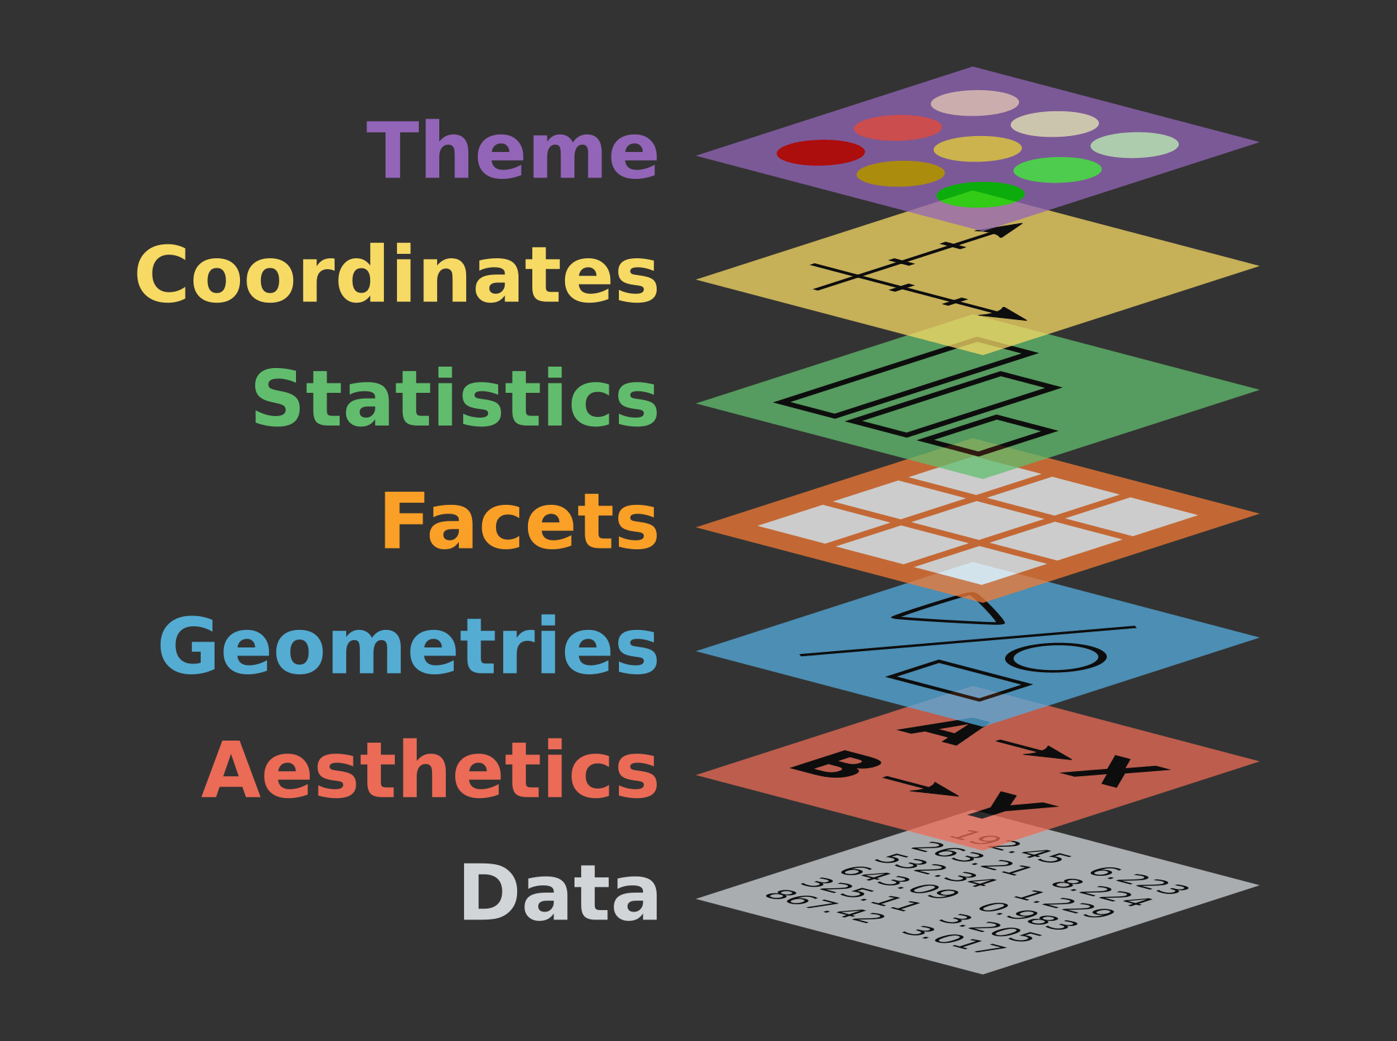
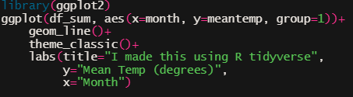
Visualising data
‘ggplot’ is the function to create plots
‘geom_line’ adds a line through the points
‘theme_classic’ and ‘labs’ changes how the plot looks

Slide 10
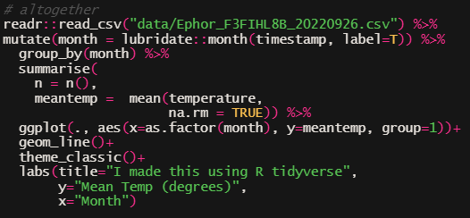
All together now
What has been added or taken away for it to be able to be run all together?

Slide 11
Questions?

