Slide 1
IMS 228 / Group 5
Hand Remote
A presentation remote you control
with your hand
Ana Avramov, Jacob Brztowski
Yongzhen Lu, Marko Deric
Notes:
We are Group 5. Our project is a presentation remote that uses a webcam to track hand gestures. Presenters can change slides and control a video without holding a clicker.
Source: supplied IMS 228 Mi-IP Design Document, Phase 2.

Slide 2
Why we built it
Changing slides interrupts
a presentation
Presenters have free hands, but often
stand away from their laptop.
Our webcam demo replaces
a handheld clicker.
02
Notes:
We narrowed the idea after feedback that it needed a clearer purpose. Presenters already have their hands free. The current version uses index and middle upright for a right swipe to the next slide, and only index upright for a left swipe to the previous slide. Both gestures use the same response parameters. Source: supplied Phase 2 Design Document for purpose and user revisions for current gestures.

Slide 3
Gesture controls
Index + middle, swipe right
Next slide
Only index, swipe left
Previous slide
Closed fist
Pause video
Full open palm, hold 0.6 seconds
Play video
Keep the finger pose to repeat. Both directions use the same sensitivity.
03
Notes:
Raise index and middle, then swipe right for the next slide. Raise only index, then swipe left for the previous slide. Keep the other fingers naturally lowered. Both gestures use the same distance threshold, smoothing and actual movement sample requirements. No pose-hold or minimum movement-duration timer applies. Keep the pose for consecutive pages and hold still to stop. Return strokes in the wrong direction do not navigate. On slide 4, a held fist pauses the video, and a full open palm held continuously for about 0.6 seconds plays it. Single-index and two-finger navigation never request playback. Source: user revisions to the gesture rules.

Slide 4
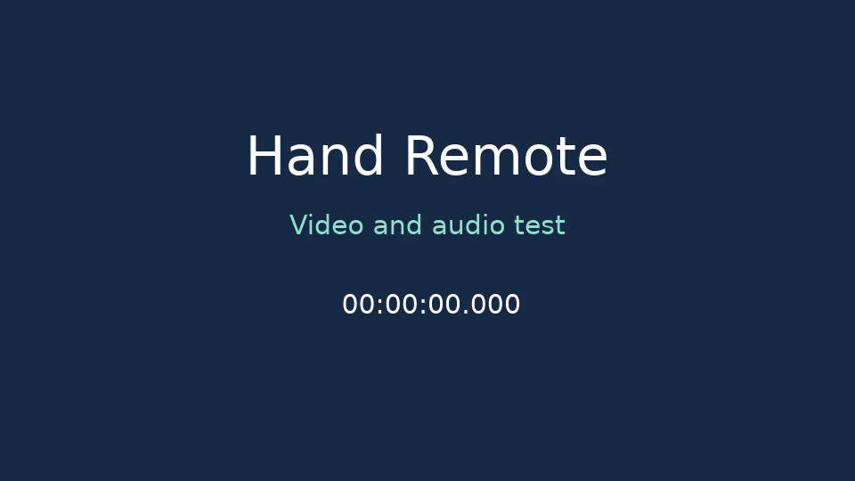
Video demo
Fist to pause. Open your whole palm and hold to play.
Fist
Pause video
Open palm
Hold to play
04
Notes:
Open the browser demo and start the camera. Go to slide 4 and click Play once if the browser requires it. A held fist pauses the video. Fully open all four main fingers continuously for about 0.6 seconds to resume. A single-index left swipe or two-finger right swipe navigates while keeping the video paused. Brief palm transitions, three raised fingers and missing hands cannot resume playback. Present fullscreen shows only the five-slide stage and retains camera gestures. This PPTX keeps the original 12-second tone and timer clip embedded for standard playback. Source: user revisions. Webcam gestures operate in the browser demo.

Slide 5
Next steps
Testing plan
Try gestures with different presenters
Check lighting and camera distance
Tune false triggers and arm effort
Prototype: ml5.js + p5.js, shared on GitHub
Controls work inside our own browser presentation
05
Notes:
Our next step is to test the prototype with different presenters. We need to check lighting, distance from the webcam, and accidental actions during normal talking. We will tune gesture thresholds based on those tests. These are planned checks, not completed user-study results. The demo controls its own slides, not PowerPoint or Google Slides.
Source: supplied Phase 2 Design Document, testing and platform sections.

