Slide 1
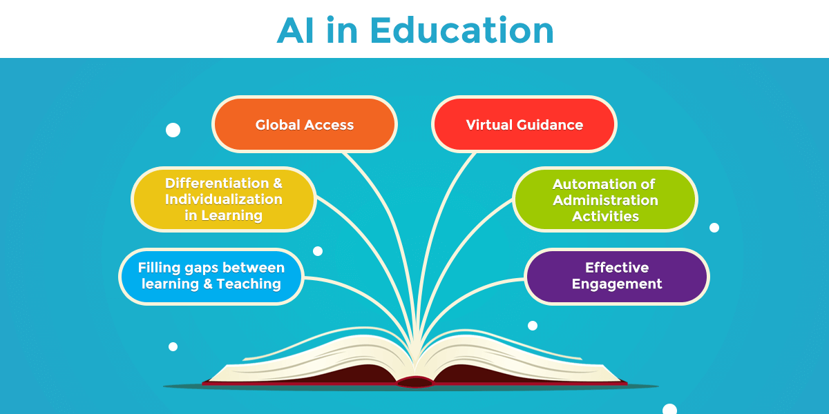
Impacts of AI in Education
Jordan Markoff
Professor Kaplun
CSIT100_04
24 November 2025

Slide 2
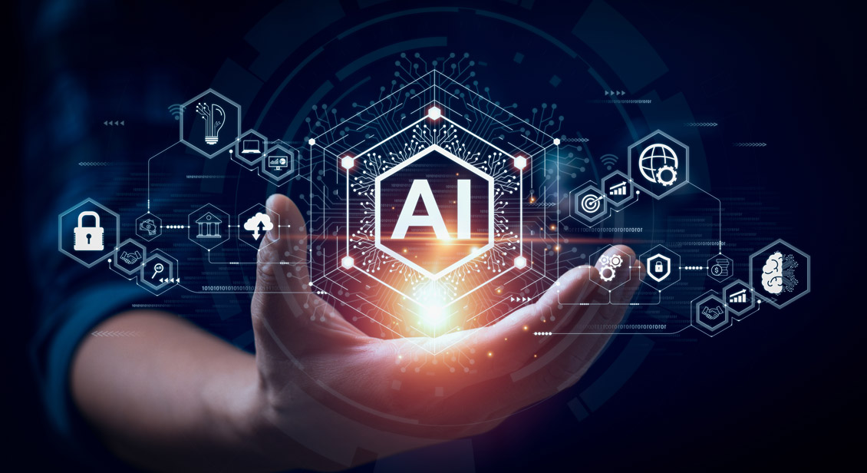
What is AI?
AI, also known as Artificial Intelligence, is classified as the technology that enables computers to simulate human intelligence, allowing them to perform complex tasks like learning, problem solving, decision making and perception.
It’s a field of computer science that develops systems capable of performing tasks that typically require human reasoning, such as understanding language, identifying patterns in data, and acting autonomously.

Slide 3
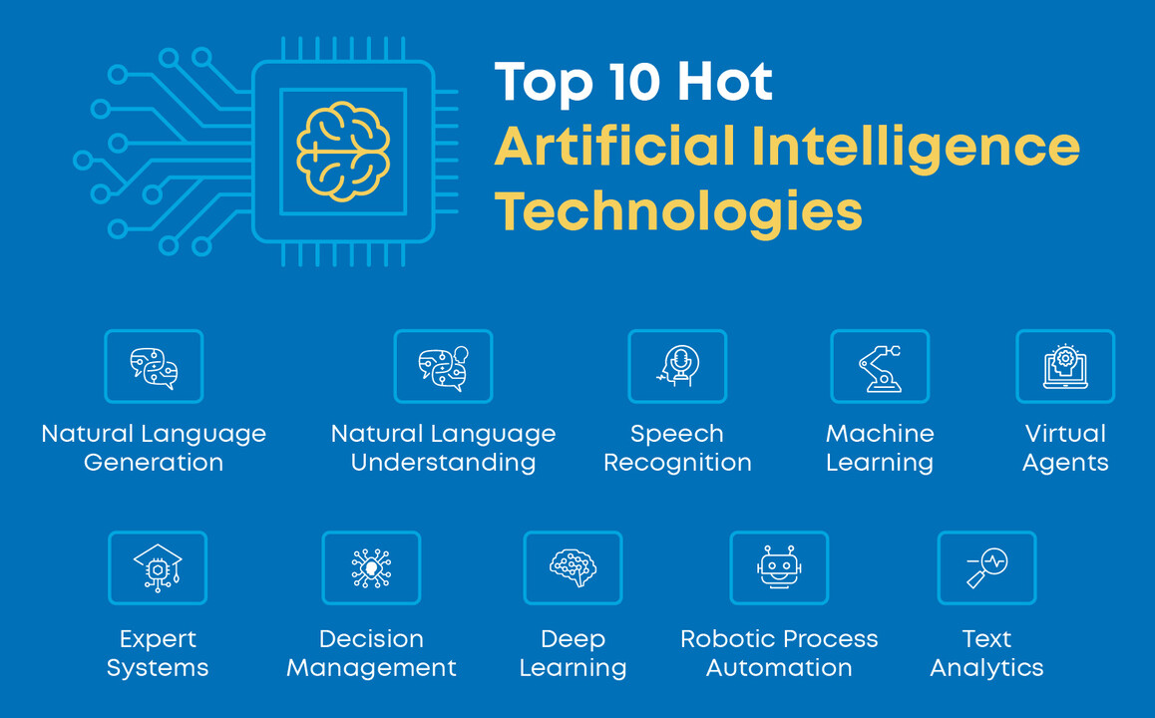
What are some current AI technologies?
Some current AI technologies include…
Natural Language Processing (NLP): Focuses on enabling computers to understand, interpret, and generate human language through speech recognition, text analytics/sentiment analysis, and machine translation
Machine Learning: A subset of AI that allows systems to learn from data and improve their performance over time without being explicitly programmed
Generative AI: AI models that can create new, original content, such as text, images, music, and code, based on the data they were trained on
Computer Vision: Allows AI to “see” and interpret visual information, enabling applications like facial recognition, image analysis, and self driving cars

Slide 4

Personalized learning & adaptive tools
AI tailors instruction based on each student’s strengths, weaknesses, and learning pace
Adaptive platforms adjust difficulty levels instantly to improve understanding
Students receive customized feedback and suggestions for improvement
Helps support diverse learners, including those who need remediation or enrichment
Increases engagement by offering content that matches individual interests and needs

Slide 5
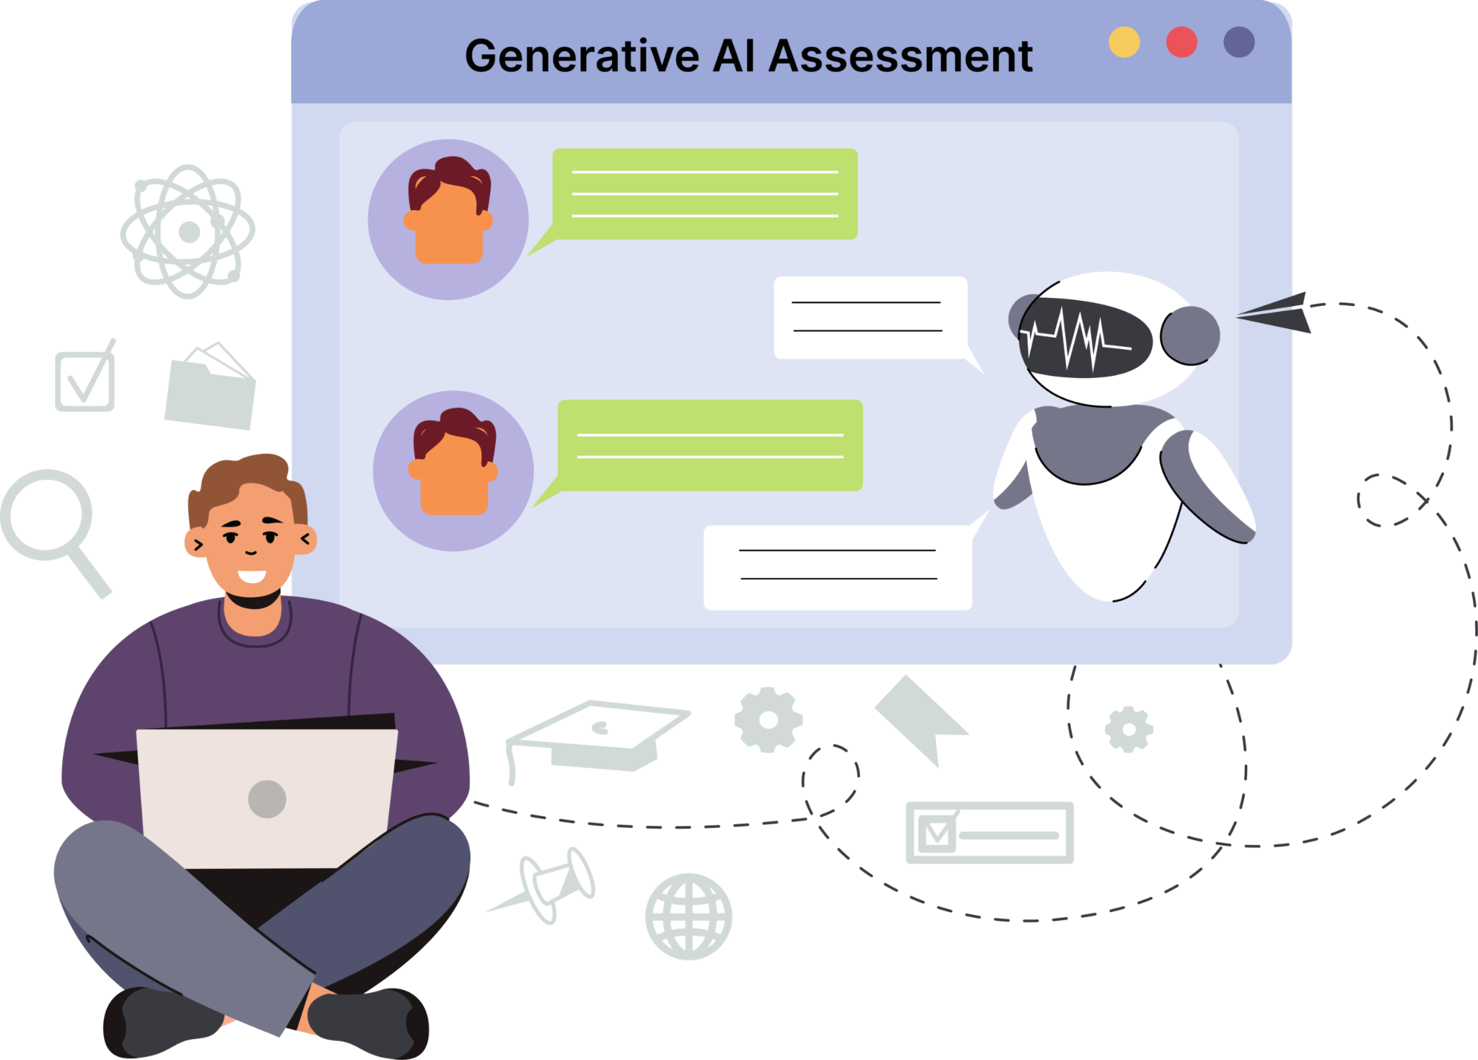
AI powered assessment & feedback
Automates grading for quizzes, assignments, and short responses to save teacher time
Provides immediate feedback so students can correct mistakes and learn faster
Identifies patterns in student errors to target specific areas for improvement
Uses analytics to track progress and predict where students may struggle next
Reduces bias in grading by applying consistent evaluation criteria
Allows teachers to focus more on instruction and personalized support

Slide 6
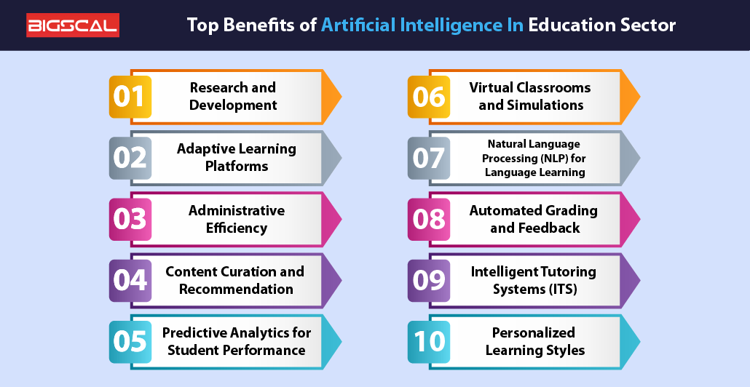
How does AI benefit education?
Personalized Learning: AI adapts lessons, pacing, and content to each student’s individual needs. Students receive immediate guidance to improve their work
Increased Accessibility: Tools like speech to text, translation, and reading support help diverse learners
Efficient grading/administrative tasks: AI reduces teacher workload, giving them more time for instruction
Enhanced student engagement: interactive platforms and adaptive activities keep students motivated and involved

Slide 7
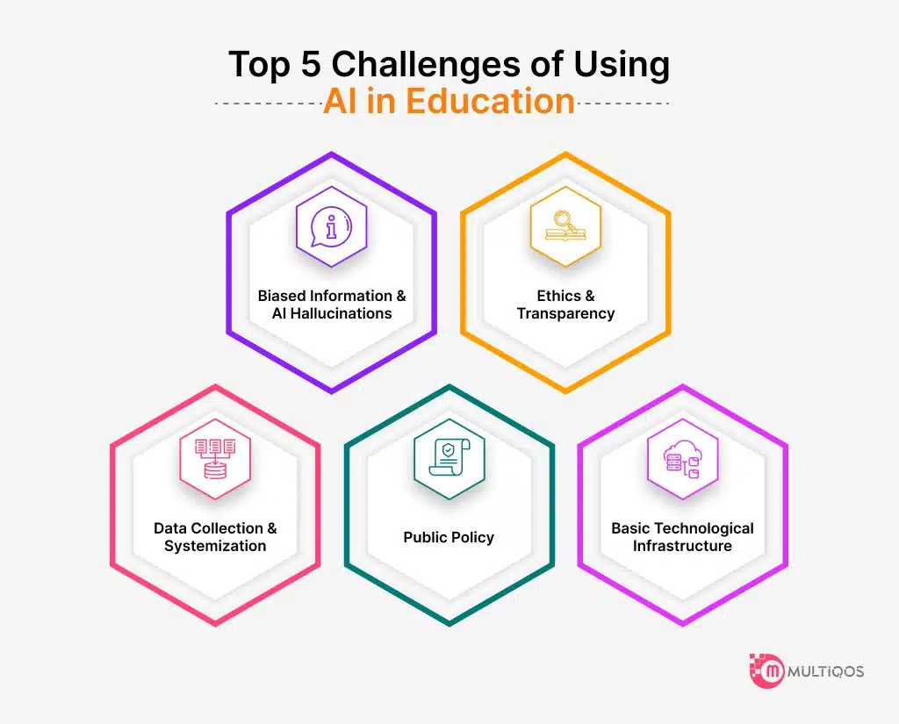
What are some challenges/risks of AI in education?
Privacy concerns: AI tools collect large amounts of student data, which can be misused or mishandled
Algorithm bias: AI systems may unintentionally reinforce stereotypes or treat groups of students unfairly
Equity issues: Schools with fewer resources may struggle to access reliable AI tools, widening existing differences
Overreliance on technology: students and teachers may became too dependent on AI, reducing critical thinking and creativity skills
Reduced human connection: Excessive use of AI could weaken teacher-student relationships

Slide 8
What are some impacts of AI on student & academic well being?
Pros:
Reduces academic stress by offering immediate feedback and extra support when students are confused or uncertain
Improves confidence as personalized tools help students learn at their own pace
Supports mental health through wellness check ins, chat based support tools, and early detection of academic struggles
Increases accessibility for students with disabilities like text to speech, speech to text, translation, and reading support
Cons:
Risk of reduced social connection when AI replaces too much human interaction with teachers and peers
Privacy and trust concerns from data collection related to emotions, performance, or behavior
Digital fatigue due to increased screen time and reliance on technology

Slide 9
What roles do teachers play in the evolution of AI?
Teachers decide when and how AI should be used to support learning
Teachers provide human judgment as they interpret AI generated data and correct errors and or biases
Teachers offer emotional support, encouragement, and relationship building that AI can't replace
As AI automates routine tasks, teachers shift towards mentoring, guiding, and supporting deeper learning

Slide 10
What are some ethical concerns with AI?: Privacy, bias, & equity
AI tools often collect large amounts of student data such as performance, behavior, and even emotions
Sensitive information can be exposed, shared without consent, or stored insecurely
AI systems can reflect biases in the data they were trained on, possibly resulting in unfair grading, inaccurate predictions, or unequal recommendations
Schools with fewer resources may not be able to afford high quality AI tools
Unequal access can deepen existing educational differences between richer and poorer districts
Students who lack technology at home may fall further behind

Slide 11
Real world examples & case studies with AI
Duolingo (Language Learning)
Uses AI to adapt lessons to each learner’s skill level
Tracks mistakes to personalize future exercises
Helps millions of students learn language at their own speed
Khan Academy (Khanmigo)
An AI tutoring assistant designed to guide students through math, writing, and science
Supports teachers by helping with lesson planning and giving feedback on student work
Used in classrooms to provide individualized help
Google Classroom & AI Features
Offers automated feedback suggestions, grammar support, and writing help
Helps teachers streamline grading and communication
Gives students accessible, AI powered feedback immediately

Slide 12
Future directions for AI in education
Virtual tutors will become more interactive, natural, and capable of supporting complex subjects 24/7
AI will help with teachers with lesson planning, grading, assessments, and classroom management tools
AI may detect early signs of stress, disengagement, or confusion to help schools intervene earlier
Expanded support for students with disabilities using improved speech, reading, and translation technologies

Slide 13
Key takeaways
AI is transforming education by personalizing learning, improving feedback and expanding access to support
Teachers remain essential, guiding ethical use, providing human connection, and ensuring AI supports rather than replaces learning
Benefits are significant, including reduced workload, increased engagement, and more individualized instruction
Challenges still exist, such as privacy risks, bias, equity concerns, and overdependence on technology

Slide 14
References
https://www.linkedin.com/pulse/top-10-artificial-intelligence-technologies/
https://www.ibm.com/think/topics/artificial-intelligence#:~:text=Artificial%20intelligence%20(AI)%20is%20technology%20that%20enables,can%20understand%20and%20respond%20to%20human%20language.
https://www.sciencedirect.com/science/article/pii/S2666920X25000694
https://www.tandfonline.com/doi/full/10.1080/02602938.2024.2415649
https://education.illinois.edu/about/news-events/news/article/2024/10/24/ai-in-schools--pros-and-cons
https://www.sciencedirect.com/science/article/pii/S2451958825001083
https://educationaltechnologyjournal.springeropen.com/articles/10.1186/s41239-024-00448-3
https://pmc.ncbi.nlm.nih.gov/articles/PMC8455229/
https://onlinedegrees.sandiego.edu/artificial-intelligence-education/
https://www.unesco.org/en/articles/ai-and-future-education-disruptions-dilemmas-and-directions
https://element451.com/blog/benefits-of-ai-in-education

