Slide 1

CREi@30

Slide 2
Did the Cuban Missile Crisis Cause the Great Depression
Author: Filip Novak (U-S-S-S-R)

Slide 3
CREi – UPF PhD Students Lunch

Slide 4
Continous Redunant Endless interventions
Max Pressione Noah Idea
CREi – UPF PhD Students Lunch

Slide 5
The Approach
A calibrated 3D model of the universe
Nominal rigidities and bubbly episodes in the voting booths
Amenities with collateral constraints, causing turbulence and stagnation
Divine–coincidence does not hold

Slide 6
The Approach
A calibrated 3D model of the universe
Nominal rigidities and bubbly episodes in the voting booths
Amenities with collateral constraints, causing turbulence and stagnation
Divine–coincidence does not hold
Data
Big Brother Dataset (1984 onwards)
CREi Memoires (1994 onwards)

Slide 7
The Approach
A calibrated 3D model of the universe
Nominal rigidities and bubbly episodes in the voting booths
Amenities with collateral constraints, causing turbulence and stagnation
Divine–coincidence does not hold
Data
Big Brother Dataset (1984 onwards)
CREi Memoires (1994 onwards)
Solving the model takes several years … writing the code took forever

Slide 8
Main Findings: CREi’s age increases over time!

Slide 9
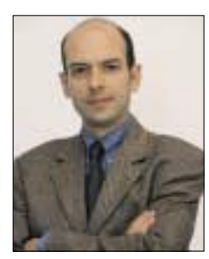
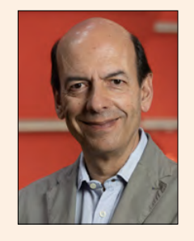
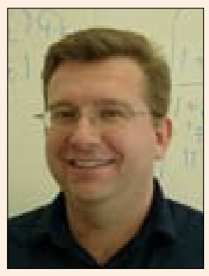
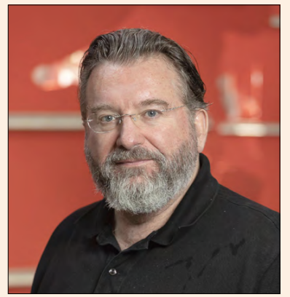
Robustness: Director-Level Data
1994
2024

