Slide 1

Spring
Building application
with srping BOOT FRAMEWORK

Slide 2
contents
Overview
SPrING FRAMEWORK
SPRING ECOSYSTEM
WHY DO WE USE SPRING
Understanding core (DI/AOP)
Applicaiton architecture
Application design smells
LOMBOK
Spring boot

Slide 3
Spring framework
Overview
Term “Spring” usually refers to Spring framework and it’s key modules
Dependency Injection
AOP
Nowadays it’s more than just a framework, it’s a platform
Spring boot
Spring HATEOAS
Spring data
Spring security
Spring cloud
Etc.(https://spring.io/projects)

Slide 4
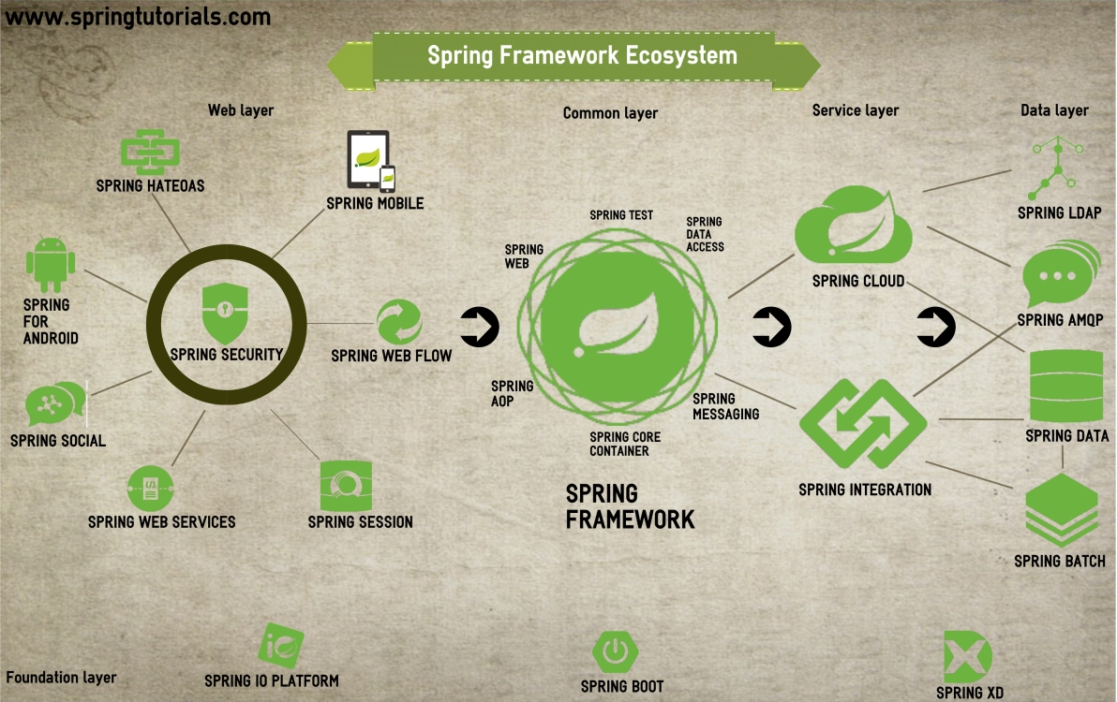
Spring framework
ecosystem

Slide 5
Spring framework – Why?
Why do we use spring?
Simplify JEE application development
IoC pattern: easy abstraction, wiring, …
AOP: transactions, caching, …
Easy testing
Multiple modules for main stream technologies
Big user community
Promote good application architecture/design (?)
Easy to meet SOLID principles (?)
Layering ( Horizontal slicing )
Modularization ( Vertical slicing )

Slide 6
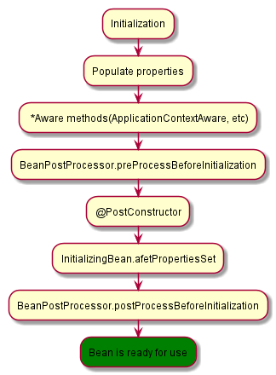
Spring framework – CORE
DI&AOP
IoC
Creation beans by using annotations
@Bean, @Component, @Repository, @Service, @Controller,…
Bean scopes:
Singleton
Prototype
Session
Request
Dependency injection: @Autowired, @Resource

Slide 7
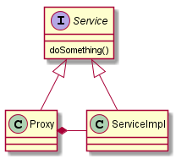
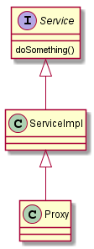
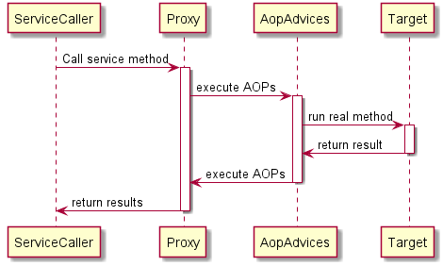
Spring framework – CORE
DI&AOP
Spring AOP is used to support
@Transactional, @Cache and custom aspect
It uses Dynamic Proxy(interface inheritance) and CGLib(class inheritance)

Slide 8
Spring application architecture
The layers – Horizontal slicing
Web Layer
(controllers, exception handlers, filters, etc)
DTOs
Service Layer
(Application and infrastructural services )
Domain model
(entities, VO)
Repository Layer

Slide 9
Spring application architecture
THE Modules - Vertical slicing
Module/feature - 1
Module/feature - 2
Module/feature - n
Web
Web
Web
Service
Service
Service
Repository
Repository
Repository

Slide 10
Spring application DESIGN SMELLS
Smell checklist
Circular wiring(dependency)
Two or more beans are directly or indirectly depend on each other . Try to analyze flow and to decouple them
Interface with too many methods
If method has to many method, it’s obvious that it does more than one things. Break it into two or more smaller interfaces (I)
Self wiring
Because of transactions we are calling the methods from the same service. Move it into new interface/service
Service bean is not singleton
Services and Repositories should be stateless, especially in RESTful and MS apps. In special cases stateful bean is allowed, but be sure that your case is special case
Abstraction absence
Service doesn’t have an interfaces, it means that DI is useless. Use interface abstraction for service and repository layer
Service input isn’t immutable
Service should return result , if doesn’t do it, refactore in that way. Sometimes is mutable arg is allowed, because of performanse

Slide 11
PROJECT LOMBOK
GetTING rid of boilerplate code
Project Lombok is a java library that easy plugs into editor and build tool, it eliminates boilerplate code.
public class Person { private Long id; private String name; private String email; private String phone; public Long getId() { return this.id; }
public void setId( Long id ) { this.id = id; } public String getName() { return this.name; } public void setName( String name ) { this.name = name; }
…
Omitted code more 110 lines
… public String toString() { return "Person(id=" + this.getId() + ", name=" + this.getName() + ")"; } }
@Data @Builder public class Person { private Long id; private String name; private String email; private String phone; }
//Example of usage somewhere in code Person person = Person.builder() .id( 1L ) .name( "Max Mustermann" ) .email( "em@ail.com" ) .phone( "555333" ) .build(); String name = person.getName(); person.setId( 2L );

Slide 12
PROJECT LOMBOK
GetTING rid of boilerplate code
Build dependency
<dependency> <groupId>org.projectlombok</groupId> <artifactId>lombok</artifactId> </dependency>
IDE plugin setup
IntelliJ
Ctrl+Alt+S
Plugins
Search: Lombok Plugin
Install and Restart
Netbeans doesn‘t require plugin installation
etc

Slide 13
PROJECT LOMBOK – COMMON annotations
GetTING rid of boilerplate code
Class annotations
@Data - data class: all getters, setters and Object methods
@Value – immutable data class: all getters and Object methods
@Builder – Fluen builder API.
@ToString – human readable toString(covered by @Data)
@EqualsAndHashCode – hash and equals with class fields, allow exluding and including fileds(covered by @Data)
@NoArgsConstructor,@RequiredArgsConstructor,@AllArgsConstructor – default constructor, final fields constructor and all arguments constuctor.
Field anntotaions
@Setter/@Getter – field setter and getter.
@Getter(lazy-true) – getter with lazy initialization of field
Full list of annotations:
Features
Experimental

Slide 14
SPRING BOOT STARTER
OVERVIEW
Spring boot is a Spring module is used for:
Build anything( RESTful, web, batch, integration, … )
Easy and fast build and run
A spring framework for the spring framework
Why do we use it?
Dependency that works.
Easy configuration: auto-configuration
Embedded servers ( tomcat, jetty, …)
Key components
Starter
Auto-configuration
Actuator
CLI

Slide 15
SPRING BOOT STARTER
OVERVIEW
Starter makes dependency management easier and provides a faster project bootstrapping
Usually every spring boot project starts with maven spring-boot-starter-parent, but it isn’t necessary. It provides us default:
Configuration( various props, i.e. java version )
Dependency Management - Version of dependencies
Default Plugin Configuration
It should contain dependency starters. A starter dependency is an “empty” project, with just one pom. There are more than 30 already predefined starters: list of starters

Slide 16
SPRING BOOT STARTER
OVERVIEW
It configures automatically your Spring application based on the dependencies that are added in project.
To enable autoconfiguration you should add one of following :
@EnableAutoConfiguration
@SpringBootApplication = @Configuration + @EnableAutoConfiguration + @ComponentScan
It tells to spring to spring to load configuration and scan all components from the same package as Application and all sub-packages.
If you need some components from other packages you can use scanBasePackageClasses, @YourOwnAnnotation with @Include etc

Slide 17
SPRING BOOT AUTOCONFIGURATION
OVERVIEW
How does it work?
When spring starts, it looks in class path for the file META-INF/spring.factories
Then load those classes, and thanks to @Conditional* spring-boot decides which configuration has to be enabled/loaded.
Class: @ConditionalOnClass, @ConditionalOnMissingClass
Bean: @ConditionalOnBean , @ConditionalOnMissingBean
Property: @ConditionalOnProperty
Resource: @ConditionalOnResource
WebApplication: @ConditionalOnWebApplication @ConditionalOnNotWebApplication
Expression: @ConditionalOnExpression
Try to write your own autoconfiguration( i.e. GreetingService )
Examples: MongoAutoConfiguraiton, HornetQ

Slide 18
SPRING BOOT actuator
OVERVIEW
Actuator is production-ready tools mainly used to expose different types of information about the running application – health, metrics, info, dump, env etc.
How to enable/configure actuator
Include dependency spring-boot-starter-actuator
security settings in application.properties management.security.enabled=false ( only for test )
More about actuator
There is no official GUI support ( swagger or boot admin )

Slide 19
SPRING BOOT TEST
TESTING WITH SPRING BOOT
It provides a numbers of utilities and annotations in order to help easy testing.
Enable by including spring-boot-starter-test dependency, that includes:
Junit
Spring Test - Utilities and integration test support
AssertJ - a fluent assertion library
Mockito - a mocking library.
JSONassert - an assertion library for JSON.
JsonPath - XPath for JSON
Important annotation:
@RunWith( SpringRunner.class )
@SpringBootTest
@MockBean ( != @Mock )
@SpyBean ( != @Spy )

