Slide 1
Spring boot
Build app from zero with spring boot

Slide 2
Before start
Goal
Get familiar with Spring philosophy
Demystify Spring Boot magic
Rest and Spring Data ( MongoDB, Redis )
Build application from the scratch
Pre-requirements
JDK8
Java IDE ( IntelliJ, Netbeans, Eclipse, …)
SourceTree/git
Docker

Slide 3
Spring
What is spring?
Term “Spring” usually refers to Spring framework and it’s key modules
Dependency Injection
AOP
Nowadays it’s more than just a framework, it’s a platform
Spring boot
Spring HATEOAS
Spring data
Spring security
Spring cloud
Etc.(https://spring.io/projects)

Slide 4
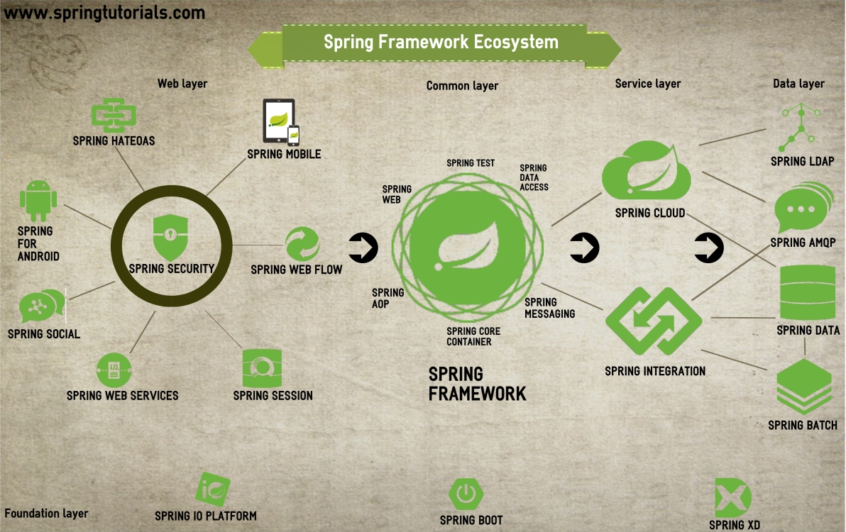

Slide 5
Spring
Why do we use spring?
Simplify JEE application development
IoC pattern: easy abstraction, wiring, …
AOP: transactions, caching, …
Easy testing
Multiple modules for main stream technologies
Big user community
Promote good application architecture/design (?)
Easy to meet SOLID principles (?)
Layering ( Horizontal slicing )
Modularization ( Vertical slicing )

Slide 6
Spring application architecture
Layers ( Horizontal slicing )
Web Layer
(controllers, exception handlers, filters, etc)
DTOs
Service Layer
(Application and infrastructural services )
Domain model
(entities, VO)
Repository Layer

Slide 7
Spring application architecture
Modules ( Vertical slicing )
Module/feature - 1
Module/feature - 2
Module/feature - n
Web
Web
Web
Service
Service
Service
Repository
Repository
Repository

Slide 8
Wrong design check list
Circular wiring(dependency)
Two or more beans are directly or indirectly depend on each other . Try to analyze flow and to decouple them
Interface with too many methods
If method has to many method, it’s obvious that it does more than one things. Break it into two or more smaller interfaces (I)
Self wiring
Because of transactions we are calling the methods from the same service. Move it into new interface/service
Service bean is not singleton
Services and Repositories should be stateless, especially in RESTful and MS apps. In special cases stateful bean is allowed, but be sure that your case is special case
Abstraction absence
Service doesn’t have an interfaces, it means that DI is useless. Use interface abstraction for service and repository layer
Service input isn’t immutable
Service should return result , if doesn’t do it, refactore in that way. Sometimes is mutable arg is allowed, because of performanse

Slide 9
Spring boot
What is spring boot?
Build anything( RESTful, web, batch, integration, … )
Easy and fast build and run
A spring framework for the spring framework
Why do we use it?
Dependency that works.
Easy configuration: auto-configuration
Embedded servers ( tomcat, jetty, …)
Key components
Starter
Auto-configuration
Actuator
CLI

Slide 10
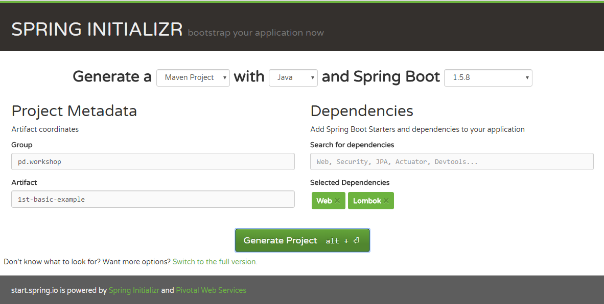
Let’s start
Good point to start: start.spring.io

Slide 11
Spring Boot Starter
Starter makes dependency management easier and provides a faster project bootstrapping.
Usually every spring boot project starts with maven spring-boot-starter-parent, but it isn’t necessary. It provides us default:
Configuration( various props, i.e. java version )
Dependency Management - Version of dependencies
Default Plugin Configuration
It should contain dependency starters. A starter dependency is an “empty” project, with just one pom. There are more than 30 already predefined starters: list of starters

Slide 12
Spring boot: Auto-configuration
It configures automatically your Spring application based on the dependencies that are added in project.
To enable autoconfiguration you should add one of following :
@EnableAutoConfiguration
@SpringBootApplication(= @Configuration + @EnableAutoConfiguration + @ComponentScan )
It tells to spring to spring to load configuration and scan all components from the same package as Application and all sub-packages.
If you need some components from other packages you can use:
scanBasePackageClasses = { WrongLocationResource.class, Application.class }
@YourOwnAnnotation with @Include

Slide 13
Auto configuration
How does it work ?
When spring starts, it looks in class path for the file META-INF/spring.factories
Then load those classes, and thanks to @Conditional* spring-boot decides which configuration has to be enabled/loaded.
Class: @ConditionalOnClass, @ConditionalOnMissingClass
Bean: @ConditionalOnBean , @ConditionalOnMissingBean
Property: @ConditionalOnProperty
Resource: @ConditionalOnResource
WebApplication: @ConditionalOnWebApplication @ConditionalOnNotWebApplication
Exrpression: @ConditionalOnExpression
Try to write your own autoconfiguration( i.e. GreetingService )
Examples: MongoAutoConfiguraiton, HornetQ

Slide 14
Spring boot: Actuator
Actuator is production-ready tools mainly used to expose different types of information about the running application – health, metrics, info, dump, env etc.
How to enable/configure actuator
Include dependency spring-boot-starter-actuator
security settings in application.properties
management.security.enabled=false ( only for test )
More about actuator
There is no official GUI support ( swagger or boot admin )

Slide 15
Spring boot Test
It provides a numbers of utilities and annotations in order to help easy testing.
Enable by including spring-boot-starter-test dependency, that includes:
JUnit
Spring Test - Utilities and integration test support
AssertJ - a fluent assertion library
Mockito - a mocking library.
Hamcrest - a library of matcher objects
JSONassert - an assertion library for JSON.
JsonPath - XPath for JSON
Importan annotation:
@RunWith( SpringRunner.class )
@SpringBootTest
@MockBean ( != @Mock )
@SpyBean ( != @Spy )

Slide 16
RESTful API design
Proper resource naming
Use nouns instead of verbs
Use plurals, but in case of relation singular noun is acceptable
Describe resource functionality with HTTP methods
GET - Used to retrieve a representation of a resource
POST - Used to create new resources and sub-resources
PUT - Used to update/replace existing resources
PATCH - Used to partical update existing resources (?)
DELETE - Used to delete existing resources
Use HTTP status codes ( diagram )
2xx - OK/successful
4xx - Client errors
5xx - Server errors
Use error payloads - convert exception to error payload.
Provide filtering, pagination and sorting
Use HATEOAS for better navigation.
Provide API versioning

Slide 17
RESTful API example
Resource | GET | POST | PUT | DELETE
/users | Return all (200) | Create new(201) | Bulk update(204) | Bulk delete(204,200)
/users/13 | Return a specific user(200) | 405 - method is not allowed | Update specific users(200,204) | Delete specific users(204,200)
/users/13/contacts | Return all (200) | Create new(201) | Bulk update(204) | Bulk delete(204,200)
/users/13/contacts/1 | Return subresource for give id(1) (200) | 405 - method is not allowed | Update specific contact(200,204) | Delete specific contact(204,200)
/users/13/blocked | Return user blocked flag(200) | Block user, set block flag(200, 201) | Block, unblock(200, 204) | Unblock user(200, 204)
 | Filtering, pagination and sorting
GET | /users?firstName=Max&page=1&size=23&sort=firstName,lastName,asc
GET | /users?firstName=Max&page=1&size=23&sort=firstName,asc&sort=lastName,desc
POST | /users/search - with some complex criteria in body request. i.e. { $or: [ { lastName: { $startWith: ‘M’ }}, { contacts: { $isEmpty: true}}] }

Slide 18
Testing RESTful API
Unit test REST controller:
@RunWith( SpringRunner.class )
@WebMvcTest - provide necessary configuration for mvc testing( doesn’t load components, services, they should be mocked -@MockBean )
@WebAppConfiguration - provide web app configuration needed for some component(i.e. Link builder)
Given configuration will provide MockMvc for @Autowire
Perform get, post, put, delete ( MockMvcRequestBuilders )
Unit test with non-mocked converters:
@SpringTest
@Autowired WebApplicationContext
MockMvcBuilders.webAppContextSetup( webApplicationContext ).build()
Additional utils for testing
ObjectMapper to serialization to JSON
Status, content, jsonPath matchers( MockMvcResultMatchers )

Slide 19
Rest controller
Create controller class
package: web/resource
@RestController
@RequestMapping( value = "/users", produces = APPLICATION_JSON )
Provide resource functionality by implementing class methods
@RequestMapping( method = GET ) - get all resources
@RequestMapping( method = GET, value = "/{id}") - get single
@PathVariable
@RequestMapping( method = POST )
@RequestBody
@RequestMapping( method = PUT, value = "/{id}")
@RequestBody
@RequestMapping( method = DELETE, value = "/{id}")
Provide sub-resource functionality in new controller class
Methods should return ResponseEntity
Use static constructors ok, notFound, etc.

Slide 20
Exception and HTTP status
There is a few approaches to map exception to HTTP status
The simplest way with annotating exception @ResponseStatus
Create controller advice @ControllerAdvice
Use @ControllerAdvice ( by package, annotation )
Method @ExceptionHandler( targetexception.class ) to handle given type
Create @ExceptionHandler method inside of controller.
Introduce ErrorDTO in order to provide better error payload
In performance critical API try to minimize exception usage.

Slide 21
Converters and DTOs
Provide DTO
It’s not real duplication
Will protect API from changes in domain
Help in case of versioning
Converter provide DTO <-> Entity conversion
Register conversion service bean in configuration
DefaultConversionService
It should be @Primary
Create at least one converter component ( extends Converter<S,R>)
For conversion list use TypeDescriptor

Slide 22
HATEOAS: API navigation
HATEOS is a principle that hypertext links should be used to create a better navigation through the API.
Enable it with including dependency in maven/gradle spring-boot-starter-hateoas
ResourceSupport - supports adding links to result, almost every DTOs should extend it.
Link builders:
EntityLinks - bean are available for autowiring, provide building links for dtos
ControllerLinkBuilder - provides static methods for building links according to controller and controllers method
linkTo( controllerClass ) - create link for controller class
methodOn( controllerClass ) - is used in combination with linkTo for fluent creating link on exact method

Slide 23
MongoDB
The most popular noSql database
Document oriented
Easy master-slave replication
Data sharding
Querying/server scripts in JavaScript
Map reducing
Can be used as file storage (grid file system 16MB+)
Why to use?
Good performance with big db ( Machine generated, soc. media )
GeoSpatial index( store data about location )
When your data structure changes often ( polls, soc. networks, content management, etc)

Slide 24
Spring data: MongoDB
Easy enable just by import dependency: spring-boot-starter-data-mongodb
Create interface that extends MongoRepository <T, ID>
insert, save, delete
find, find by example, sort, pagination
Query methods ( by method names )
findByAttribute, getByAttribute ( see: supported query keywords )
findByLocation (see: examples)
deleteBy, countBy
Querying with @Query
Sometimes it’s not easy to support complex query i.e. $where with calculation

Slide 25
Spring data: MongoDB
Implement Repository method:
Why?
Partial update( increment, push, etc..)
Complex querying with Criteria, Aggregation or QueryDSL
How?
With extension with custom interface ( name+Custom )
Create new interface and implement it.
Audit
@CreatedDate, @LastModifiedDate
@CreatedBy, @LastModifiedBy
@Version & optimistic locking
Transaction, there is no transaction support. But you can do some hacks with two steps commit.

Slide 26
Spring security
Spring Security is a authentication and access-control framework. It is the de-facto standard for securing Spring-based applications.
Security modules:
Core - contains core authentication, access-control and basic provisioning APIs.
Configuration - contains the security configurations.
Web - contains filters and related web-security infrastructure code. Anything with a servlet API dependency
Remoting, OAuth, LDAP and many others

Slide 27
Spring security for RESTful API
How to enable
Include dependency: `spring-boot-starter-security`
Default configuration is loaded.
Default user: user
Default password: it is generated during start, and printed in console.
Security is applied on all rest services
How to test secure rest
MockMvcBuilders.apply( springSecurity() ) – apply security in mvc mock.
@WithMockUser(username, role) – run test as a mock user
@WithAnonymousUser – run test as an anonymous user

Slide 28
Spring security for RESTful API
How to configure?
Configuration class that extends WebSecurityConfigurerAdapter
Override method configure( HttpSecurity http )
Protect wanted api, by url maching or http status
Configuration by annotation
@EnableGlobalMethodSecurity – on an configuration class
@Secure, @PreAuthorization, @PostFilter - on Controller or Service class
These two approaches can be combined

Slide 29
Spring security for RESTful API
Authentication provide
Setup by overriding method configure( AuthenticationManagerBuilder )
Spring offers a few providers:
AuthenticationManagerBuilder#inMemoryAuthentication()
AuthenticationManagerBuilder#ldapAuthentication()
AuthenticationManagerBuilder#jdbcAuthentication()
Create authentication provider by yourselve
Why, when? Support different kind of authentication ( file/db + JWT )
How? Implements interface AuthenticationProvider and register service bean
Assign bean AuthenticationManagerBuilder.authenticationProvider( authenticationProvider )

Slide 30
Spring-cache
Spring cache provides a declarative caching mechanism.
How to enable it?
Including dependency `spring-boot-starter-cache`
Put annotation @EnableCaching to configuration/application class
To apply and work with cache only following annotations are needed
@Cachable – put method result to the cache first time, every next time returns the result from cache(without executing method)
@CachePut – put result into cache, and execute method every time.
@CacheEvict – remove object from cache
@Caching – allow multiple cache operation
Where to apply cache? Caching strategy and security problems ?

Slide 31
Redis
Redis is one of the most popular in-memory key-data-structure database.
Use cases:
Cache
Messaging - publisher/subscriber
Distributed session/access token
Temporary data with TTL - i.e. reservation, user block, voting system one per day
Real-time access data - inventory, product prices.
Data structures:
String - store values as string, ops: SET,GET, SETNX, INCR, etc
List - list of strings, Ops: LPUSH, LPOP, LLEN, etc
Set - unordered collection of strings with no repetition. SADD, SUNION, SINTER, etc
SortedSet - ordered collection of strings with no repetition. ZADD, ZRANGEBYSCORE, etc
Hash - is map between key and string value. HSET, HGET, HINCRBY, etc
Limitations:
Values up to 512MB
Collections up to 2^32-1 ( more than 4 billion ) elements

Slide 32
Spring Netflix cloud
Should provide easy developing of microservice architecture
Netflix alternatives: Cloudfoundry, Consul
The main components:
Configuration server – provides centralized configuration for all microservices
Eureka – discovery server/client exposes services to each other.
Zuul - embedded and programable server.
Feign – microservice clients
Ribbon – interservice communication and load balansing

Slide 33
Save vs Insert

Slide 34
{ firstName : "Max",
lastName : "Mustermann",
links : [ { rel : "self", href : "http://localhost/users/13" },
{ rel : "contacts", href : "http://localhost/users/13/contacts" }
]
}

