Slide 1

SPRING hateoas
RESTful API with
Spring Boot and HATEOAS

Slide 2
contents
Overview
REStful API design
Testing restful api
Rest controller
Exception and http status
Converters and DTOs
HATEOAS

Slide 3
REStful API design
How to design clean restful api
Proper resource naming
Use nouns instead of verbs
Use plurals, but in case of relation singular noun is acceptable
Describe resource functionality with HTTP methods
GET - Used to retrieve a representation of a resource
POST - Used to create new resources and sub-resources
PUT - Used to update/replace existing resources
PATCH - Used to partial update existing resources (?)
DELETE - Used to delete existing resources
Use HTTP status codes ( diagram )
2xx - OK/successful
4xx - Client errors
5xx - Server errors
Use error payloads - convert exception to error payload.
Provide filtering, pagination and sorting
Use HATEOAS for better navigation.
Provide API versioning

Slide 4
REStful API design
EXample
Resource | GET | POST | PUT | DELETE
/users | Return all (200) | Create new(201) | Bulk update(204) | Bulk delete(204,200)
/users/13 | Return a specific user(200) | 405 - method is not allowed | Update specific users(200,204) | Delete specific users(204,200)
/users/13/contacts | Return all (200) | Create new(201) | Bulk update(204) | Bulk delete(204,200)
/users/13/contacts/1 | Return subresource for give id(1) (200) | 405 - method is not allowed | Update specific contact(200,204) | Delete specific contact(204,200)
/users/13/blocked | Return user blocked flag(200) | Block user, set block flag(200, 201) | Block, unblock(200, 204) | Unblock user(200, 204)

Slide 5
REStful API design
FILTERING example
 | Filtering, pagination and sorting
GET | /users?firstName=Max&page=1&size=23&sort=firstName,lastName,asc
GET | /users?firstName=Max&page=1&size=23&sort=firstName,asc&sort=lastName,desc
POST | /users/search - with some complex criteria in body request. i.e. { $or: [ { lastName: { $startWith: ‘M’ }}, { contacts: { $isEmpty: true}}] }

Slide 6
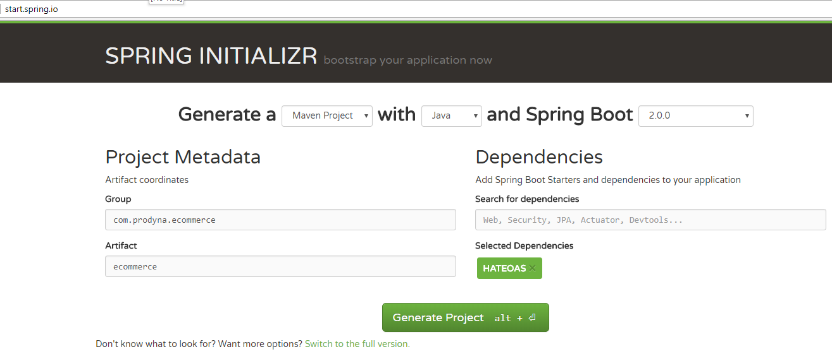
How to start
How to start
Create new project with start.spring.io
In existing project include dependency:
<dependency> <groupId>org.springframework.boot</groupId> <artifactId>spring-boot-starter-hateoas</artifactId> </dependency>

Slide 7
Testing restful api
How to test spring restful api
Test class should
@RunWith( SpringRunner.class )
@WebAppConfiguration - provide web app configuration needed for some component(i.e. Link builder).
@WebMvcTest or @SpringTest
@WebMvcTest – provides MockMvc bean, but not all beans from appliction context. Example.
@SrpingTest - provide all beans from application context, but you have initialize MockMvc. Example.

Slide 8
Testing restful api
How to test spring restful api
Writing test methods
MockMvc – fluent API for calling REST api without running server and result assertation.
MockMvcRequestBuilders – static factories: get, post, put, patch, delete for relevant http methods.
MockMvcResultMatchers – result matchers for status, content, jsonPath
JsonPathResultMatchers – assertation for json attibutes
mvc.perform( post( UserRest.createLink().toUri() ) .accept( MediaType.APPLICATION_JSON_UTF8 ) .contentType( MediaType.APPLICATION_JSON_UTF8 ) .content( mapper.writeValueAsString( userDTO ) ) ) .andExpect( status().isOk() ) .andExpect( jsonPath( "$.userId" ).value( userDTO.getUserId() ) ));

Slide 9
Rest controller
How to write rest controller
Create controller class
package: resource
@RestController
@RequestMapping( value = "/users", produces = APPLICATION_JSON )
Provide resource functionality by implementing class methods
@RequestMapping( method = GET )
method = GET, POST, PUT, PATCH, DELETE
Or @GetMapping, @PostMapping, etc..
Method arguments annotation:
@PathVariable – extract argument from path
@RequstBody – exteract argument from request body.
Provide sub-resource in new controller class
Method should return Response entity with appropriate HTTP status code.
Example: UserRest

Slide 10
Exception handlers
How to convert exceptions to http status
There is a few approaches to map exception to HTTP status
The simplest way with annotating exception @ResponseStatus
Create controller advice @ControllerAdvice
Use @ControllerAdvice ( by package, annotation )
Method @ExceptionHandler( targetexception.class ) to handle given type
Example: RestExceptionHandler
Create @ExceptionHandler method inside of controller.
Introduce ErrorDTO in order to provide better error payload
In performance critical API try to minimize exception usage.

Slide 11
HATEOAS
Build navigable rest api
HATEOS is a principle that hypertext links should be used to create a better navigation through the API.
{ firstName : "Max", lastName : "Mustermann", links : [ { rel : "self", href : "http://localhost/users/13" }, { rel : "contacts", href : "http://localhost/users/13/contacts" } ] }
Setup dependency:
<dependency> <groupId>org.springframework.boot</groupId> <artifactId>spring-boot-starter-hateoas</artifactId> </dependency>

Slide 12
HATEOAS
How to use
To provide links in DTO, DTO should extend ResourceSupport
HATEOS provides link builder for entity class. We create links using ControllerLinkBuilder static methods:
Create link for resource endpoint:
public static final ControllerLinkBuilder createLink() { return linkTo( UserRest.class ); }
Create link for single resource:
public static final ControllerLinkBuilder creatSingleLink( Long id ) { return linkTo( methodOn( UserRest.class ).getUser( id ) ); }
Also we can use EntityLinks, ResourceAssemblerSupport, for more details take a look docs

Slide 13
Dto converters
How to write dto/entity converters
Provide DTO
It’s not real duplication
DTO protects API from changes in domain and vice versa
Help in case of versioning
Converter provide DTO <-> Entity conversion
Register conversion service bean in configuration
DefaultConversionService
It should be @Primary
Configuration example
Create at least one converter component ( extends Converter<S,R>)
For conversion list use TypeDescriptor

Slide 14
API DOcumentation
REST API DOCS library
REST API should be well documented, nowadays we have many libraries help us to do it:
Swagger
Spring Rest Doc
Etc.
Setup swagger
Include dependency in pom.xml
groupId: io.springfox
artifactId: springfox-swagger2
artifactId: springfox-swagger-ui
Configure put annotation @EnableSwagger2 add Docket bean in a WebMmvConfigurer
@Bean
public Docket api() { return new Docket( DocumentationType.SWAGGER_2 )
.select().apis( RequestHandlerSelectors.any() )
.paths( PathSelectors.any() ) .build(); }

Slide 15
API DOcumentation
SWAGGER
After Swagger setup, it provides minimal documentation:
Available REST endpoints
Methods per rest points
Response/request models info
To providing more information about endpoints and models we use swagger annotation:
Documenting endpoint:
@Api – document resource
@ApiOperation, @ApiResponse – document methods
Documenting model
@ApiModel – document dto class
@ApiModelProperty – document property of dto
Access SwaggerUI: http://localhost:8080/swagger-ui.html

