Slide 1

WORKSHOP · EDGE DEVICES
Edge Computing
Tiny computers, big possibilities
Single-board computers, microcontrollers, and the things you can build with them.
Part 1: Presentation (10–15 min)
Part 2: Hands-on workshop (10–15 min)

Slide 2




THE BIG IDEA
What is edge computing?
Doing the processing near where the data is created (on small devices at the “edge” of the network) instead of sending everything to a distant cloud server. These little computers are the edge.
Low latency
Less bandwidth
Works offline
Privacy
No round-trip to a server, so responses are instant.
Only useful results get sent onward.
Keeps running with no internet.
Raw data can stay on the device.

Slide 3


WHY IT MATTERS
What can you build with it?
Digital arts
Software engineering
Interactive installations that react to people
Reactive lighting & LED strips
Sound art driven by sensors
Kinetic & responsive sculpture
IoT sensor networks
Distributed computing (Pi clusters)
Real-time control & robotics
Machine learning on the device
The common loop: sense something → decide → make something happen.

Slide 4

KNOW YOUR HARDWARE
Two kinds of device
Single-board computer
Microcontroller
Raspberry Pi
Arduino · Raspberry Pi Pico
Runs a full operating system (Linux)
Boots like a PC; USB, HDMI, networking
Multitasks on heavy jobs: vision, servers, ML
No OS, just one program on bare metal
Instant-on, precise timing, tiny power
Cheap; ideal for reading sensors & control
Heads up: the Pi Pico is itself a microcontroller, and the ESP32 is a microcontroller with built-in Wi-Fi.

Slide 5
READING THE HEADER
What the pins mean & do
GPIO = General Purpose Input / Output. Each pin is a connection you switch and read in software.
Power
Ground (GND)
Digital I/O
3.3V / 5V to power your parts
Completes the circuit at 0V
On / off: read a button, drive an LED
PWM
I2C / SPI / UART
Analog in (ADC)
Fakes analog: dim LEDs, motor & servo speed
A few wires to many sensors & screens
Read a varying voltage: dials, light
Two gotchas: mind voltage levels (3.3V vs 5V), and a plain Raspberry Pi has no analog input (only the Pico / Arduino do).

Slide 6
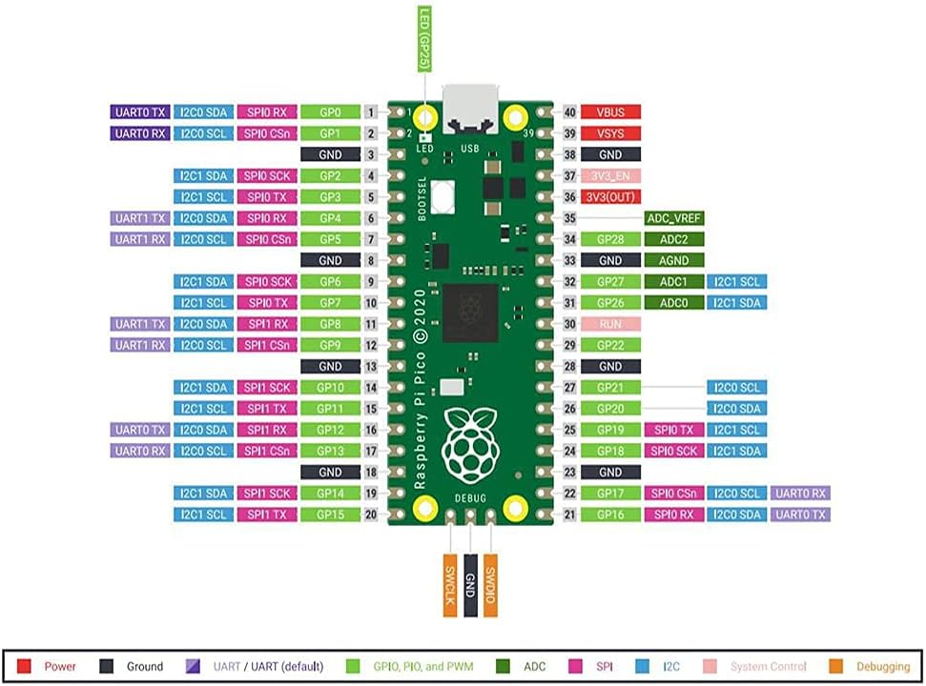
YOUR REFERENCE
Where the pins are
How to read it
A pinout maps every physical pin to its job. Use it to find the right pin for power, ground, a digital signal, PWM, I2C / SPI, or analog input before you wire anything up.
Use your board's own diagram: Raspberry Pi, Pico, and Arduino each lay their pins out differently.

Slide 7
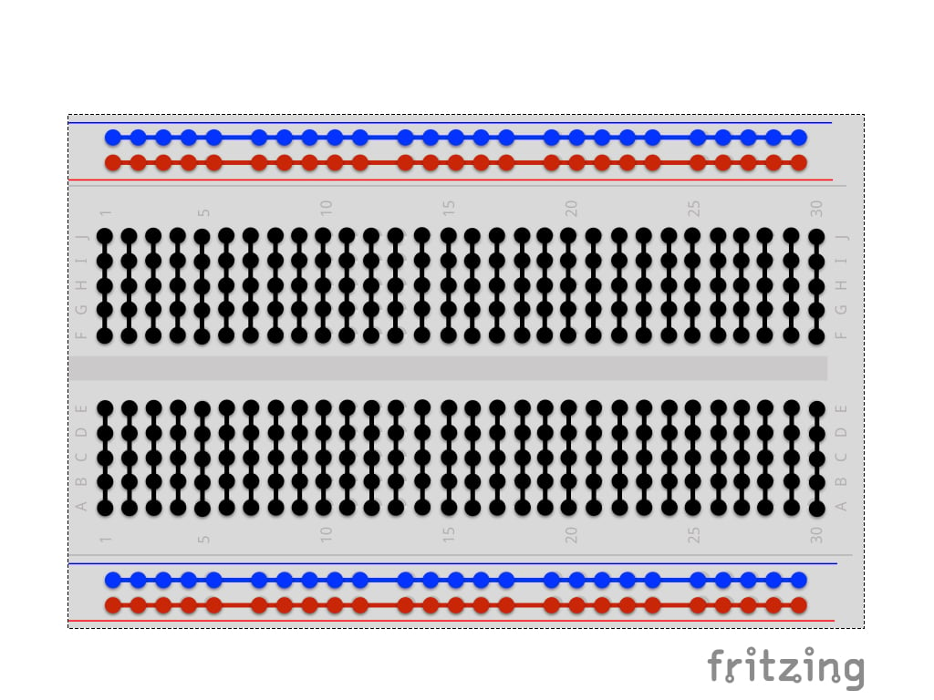
BUILD WITHOUT SOLDERING
The breadboard
Power rails. The long + (red) and − (blue) strips run the whole length, so every hole in a rail is connected.
Connected groups. Short groups of holes are linked together, split by the center channel down the middle.
Just push it in. Component legs and jumper wires push into the holes, so there's no soldering and it's easy to change.
A connected group of 5 is highlighted in teal.
This is exactly what you'll wire up in the workshop.

Slide 8



THE FUN PARTS
Sensors, outputs & add-ons
Inputs: sensors
Outputs: actuators
Light, motion (PIR), distance (ultrasonic)
Temperature & humidity, sound
Dials (potentiometers) and buttons
LEDs & addressable RGB strips
Buzzers, speakers, servo & DC motors
Relays and small OLED screens
HATs (Raspberry Pi) and shields (Arduino) plug straight onto the pins so you skip the wiring, e.g. the Sense HAT.

Slide 9
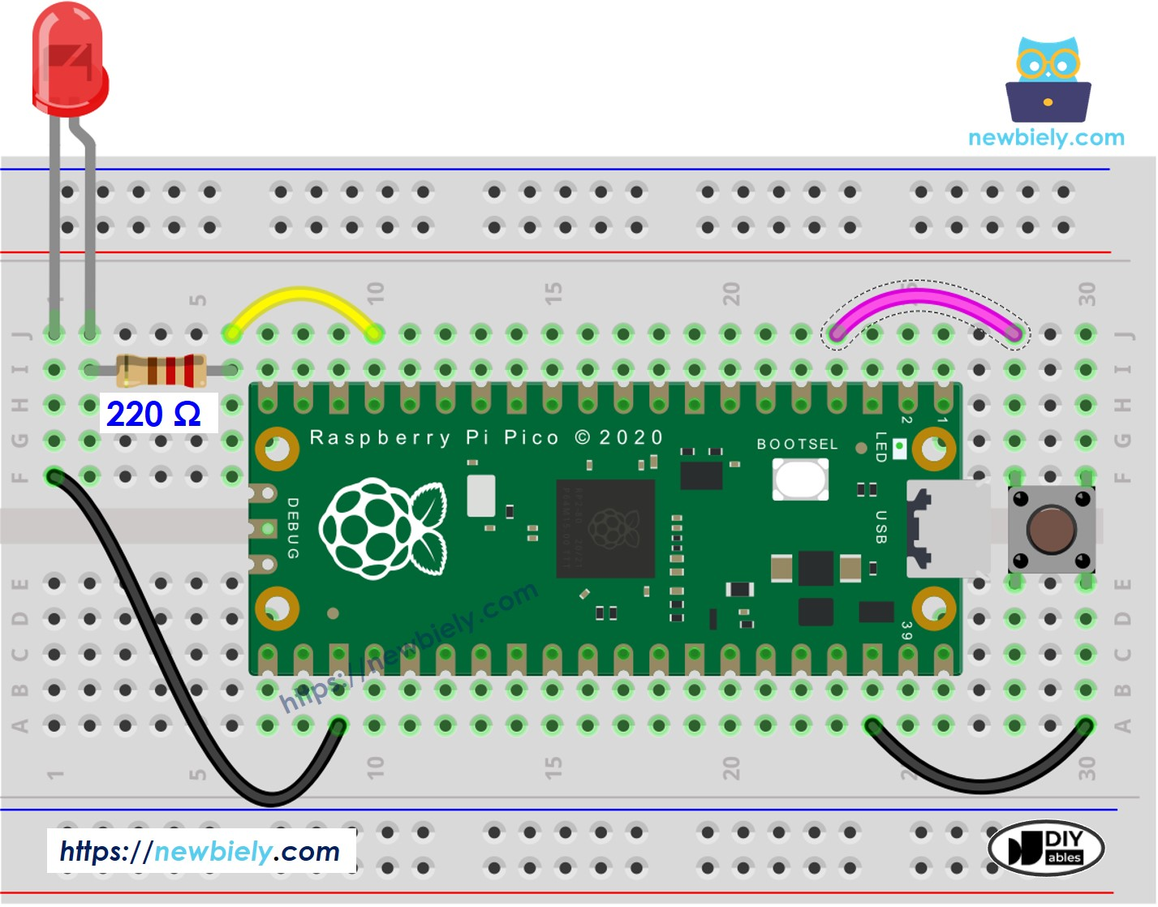
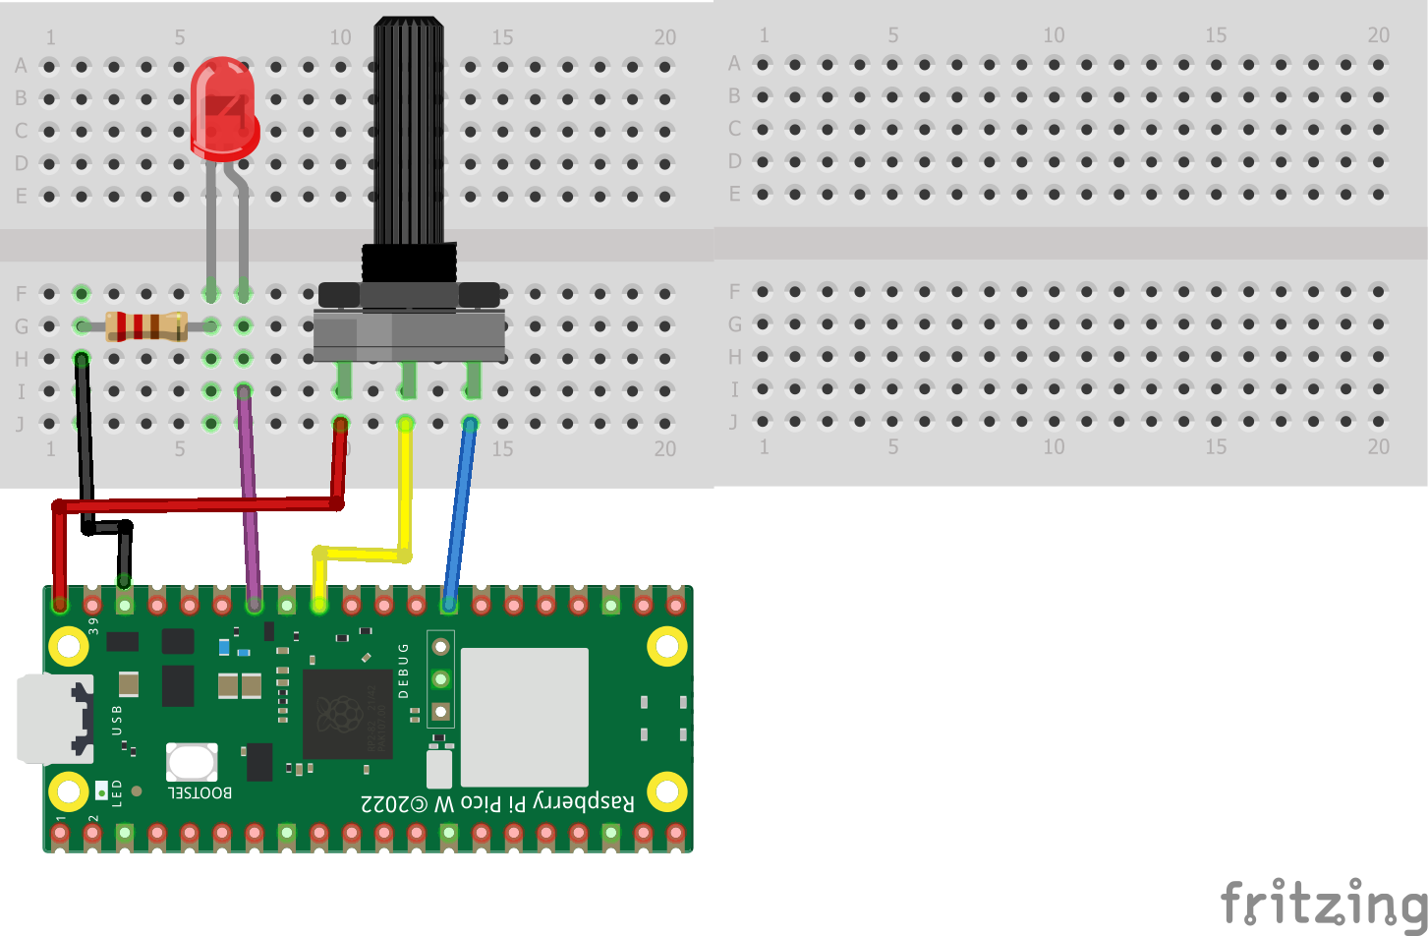
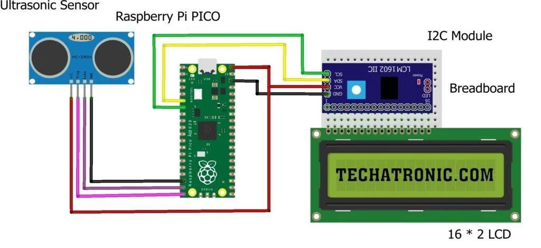

PUTTING IT TOGETHER
Three example circuits
Add your circuit picture
Add your circuit picture
Add your circuit picture
Button → LED
Dial → brightness
Sensor → micro → output
Press the button and the LED turns on: a digital input switching a digital output, the simplest sense-and-act circuit.
Turn the potentiometer to fade the LED up and down: an analog input mapped to a varying output.
A ultrasonic sensor tells a microcontroller how far away something is, and shows it on the screen. Sense, decide, act.

Slide 10



INSPIRATION
A few things people build
Reactive light installation
Arts
Sound sculpture
Arts
A motion sensor triggers patterns across an LED strip.
A distance sensor changes pitch as people approach.
Environmental monitor
IoT
Edge-ML camera
Engineering
Logs temperature & air quality to a screen or dashboard.
Detects objects or gestures live, with no internet needed.

Slide 11

HANDS-ON · NO CODE NEEDED
Your turn: build it in Tinkercad
1
2
3
4
Light an LED
Add a button
Add a dial
Explore
Power, resistor, LED on the breadboard
The LED lights only when pressed
A potentiometer to vary the brightness
Try an RGB LED, a buzzer, or more
Go to tinkercad.com → Circuits

