Slide 1
Encryption
//And why we shouldn’t let anyone take it away

Slide 2
What is encryption
Encryption is “to change (information) from one form to another especially to hide its meaning” (Merriam-Webster)

Slide 3
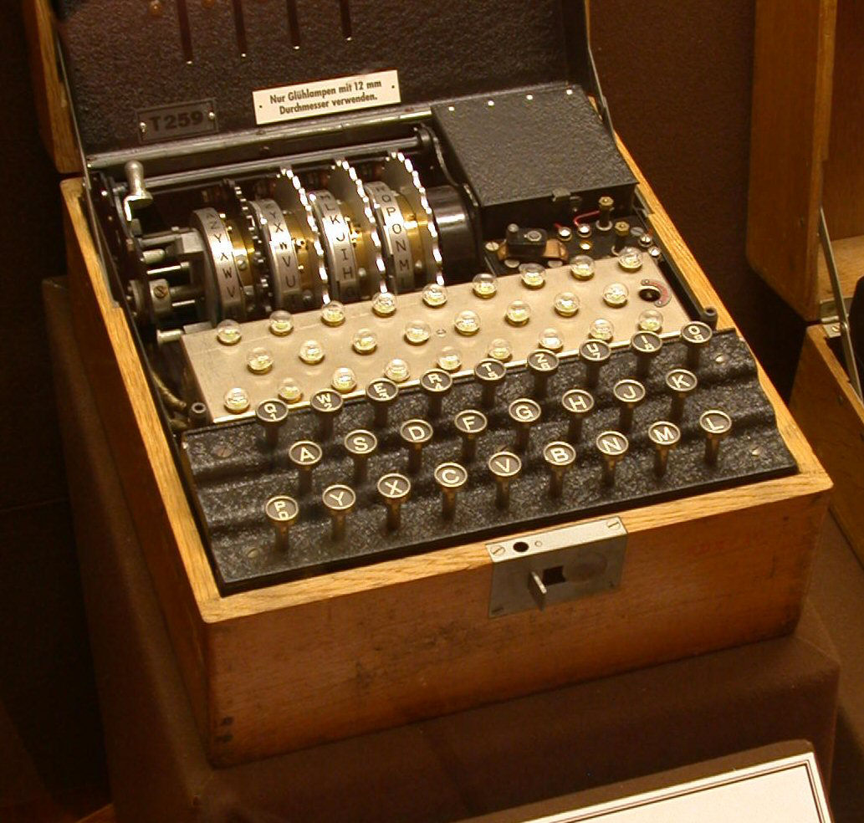
Origin
Before the for of encryption as we see it today, they were ciphers in messages that had a code book between 2 people used for decoding messages.
During World War 2 the German military used enigma machines to hide communications between German.
The United States in WW2 used Navajo Native language to mask location in the Pacific Theatre

Slide 4
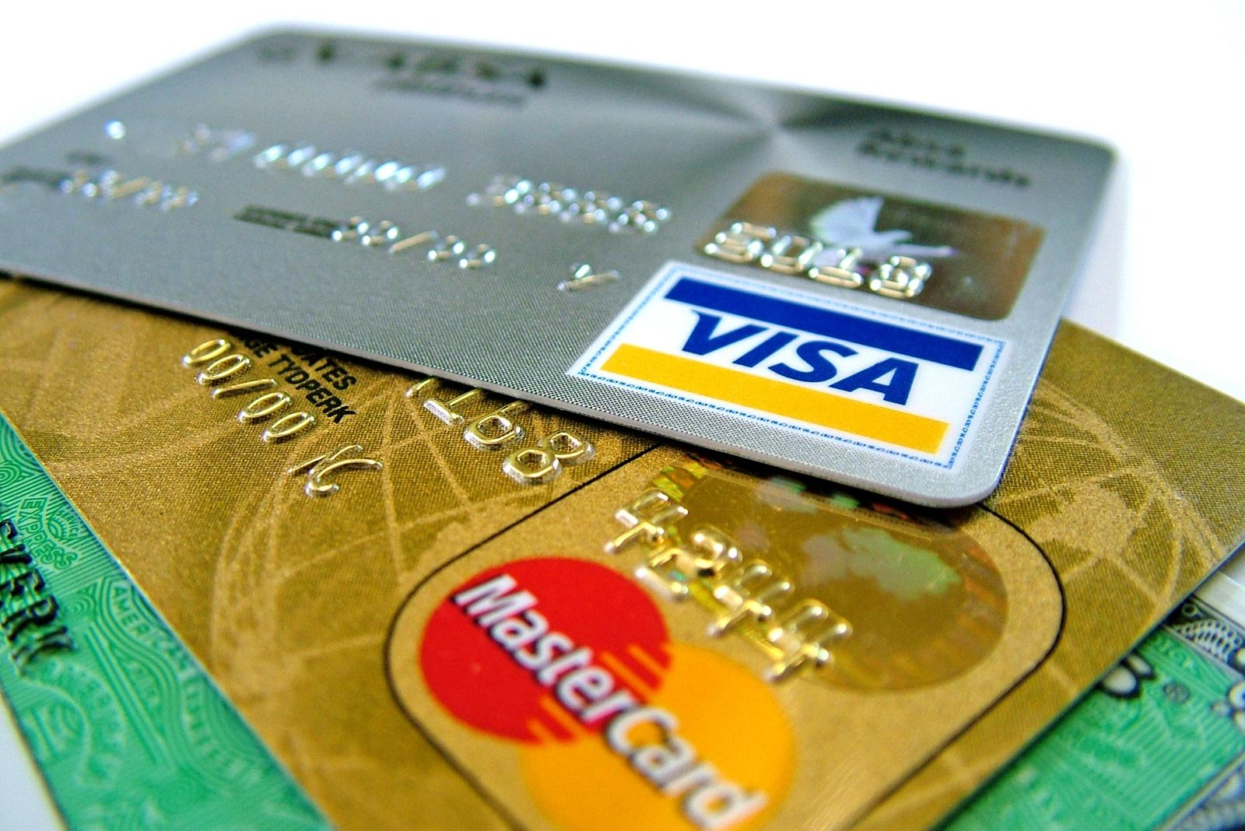

Uses
Securing the web
Credit Card transactions

Slide 5

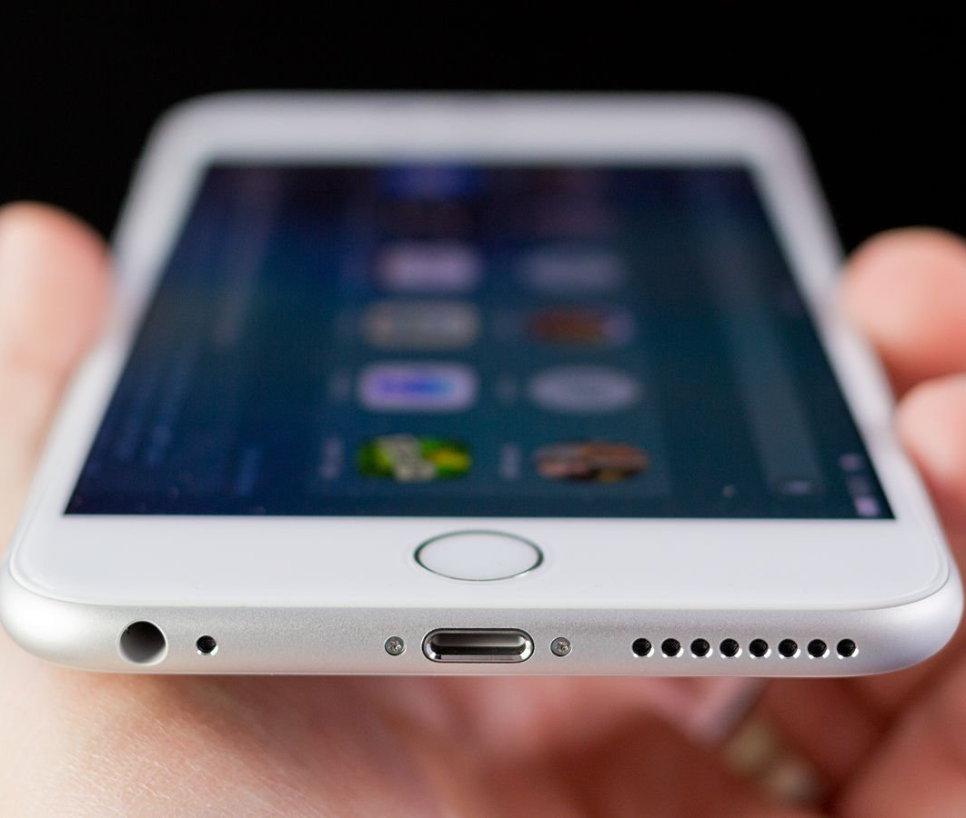
Uses
Messaging
Your Smartphone

Slide 6
Why we need it.
We need to encryption as our devices are becoming an essential part of our lives, thus we need a way to hide things from everyone else.

Slide 7
How are they taking it away
“Encryption ban proposal in the United Kingdom”
A proposal by the David Cameron PM of the Britain to Barack Obama to pressure American companies to work with intelligence companies to leave backdoor in their programs or risk a ban in UK
“Compliance with Court Orders Act of 2016”
“Outlaws end to end encryption” - Joseph Hall, chief technologist
Does this by requiring handover of data, and if given data is unintelligible(encrypted), they can demand the data be decrypted
“FBI–Apple encryption dispute”
Instead of breaking the encryption, the FBI wanted to set a precedence of breaking encryptions for them.
This however failed, thus acquired a tool from professional hackers instead.

