Slide 1

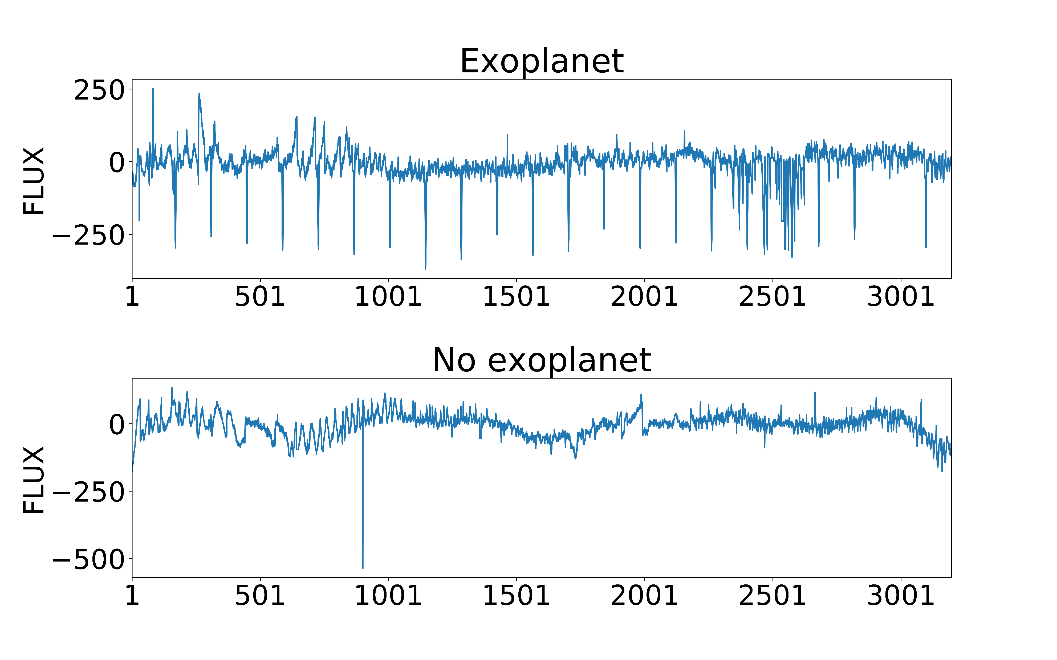
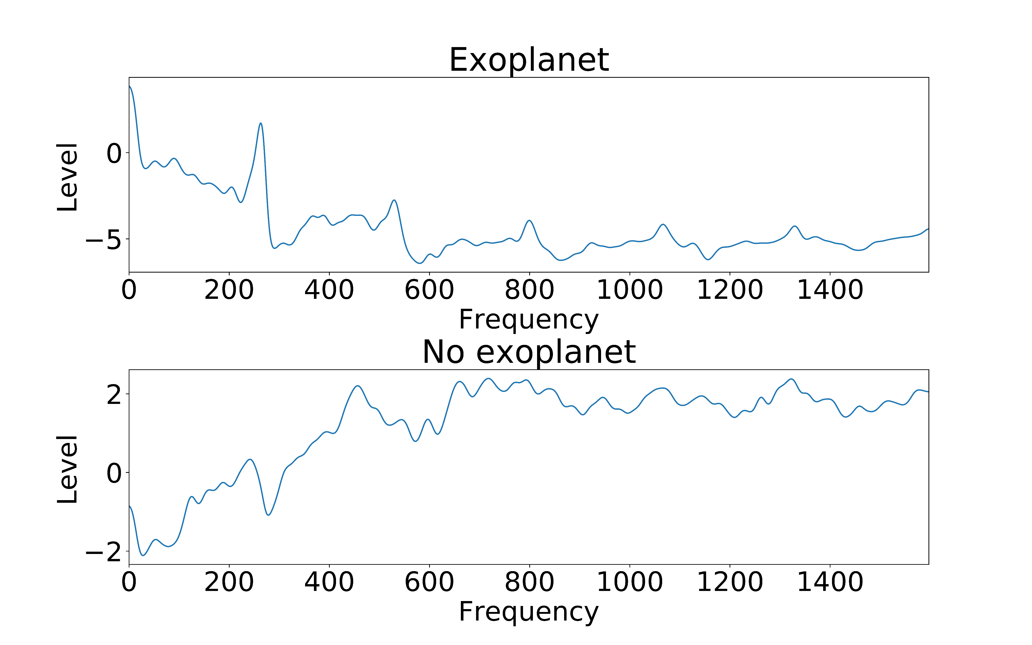
Exoplanet detection using the transit method
Authors: Marko Raidlo, Raido Everest
Introduction
An exoplanet is defined as a planet which orbits a star outside our own solar system. Exoplanets are a field of research for astronomers and astrophysicists to gather more data on different planetary systems and make better theories on system formation and evolution. Also of great interest is the possibility of extraterrestrial life existing. Studying exoplanets could help answer the age-old question: are we alone in the universe?
Building models
Conclusions
Data
Processing

