Slide 1

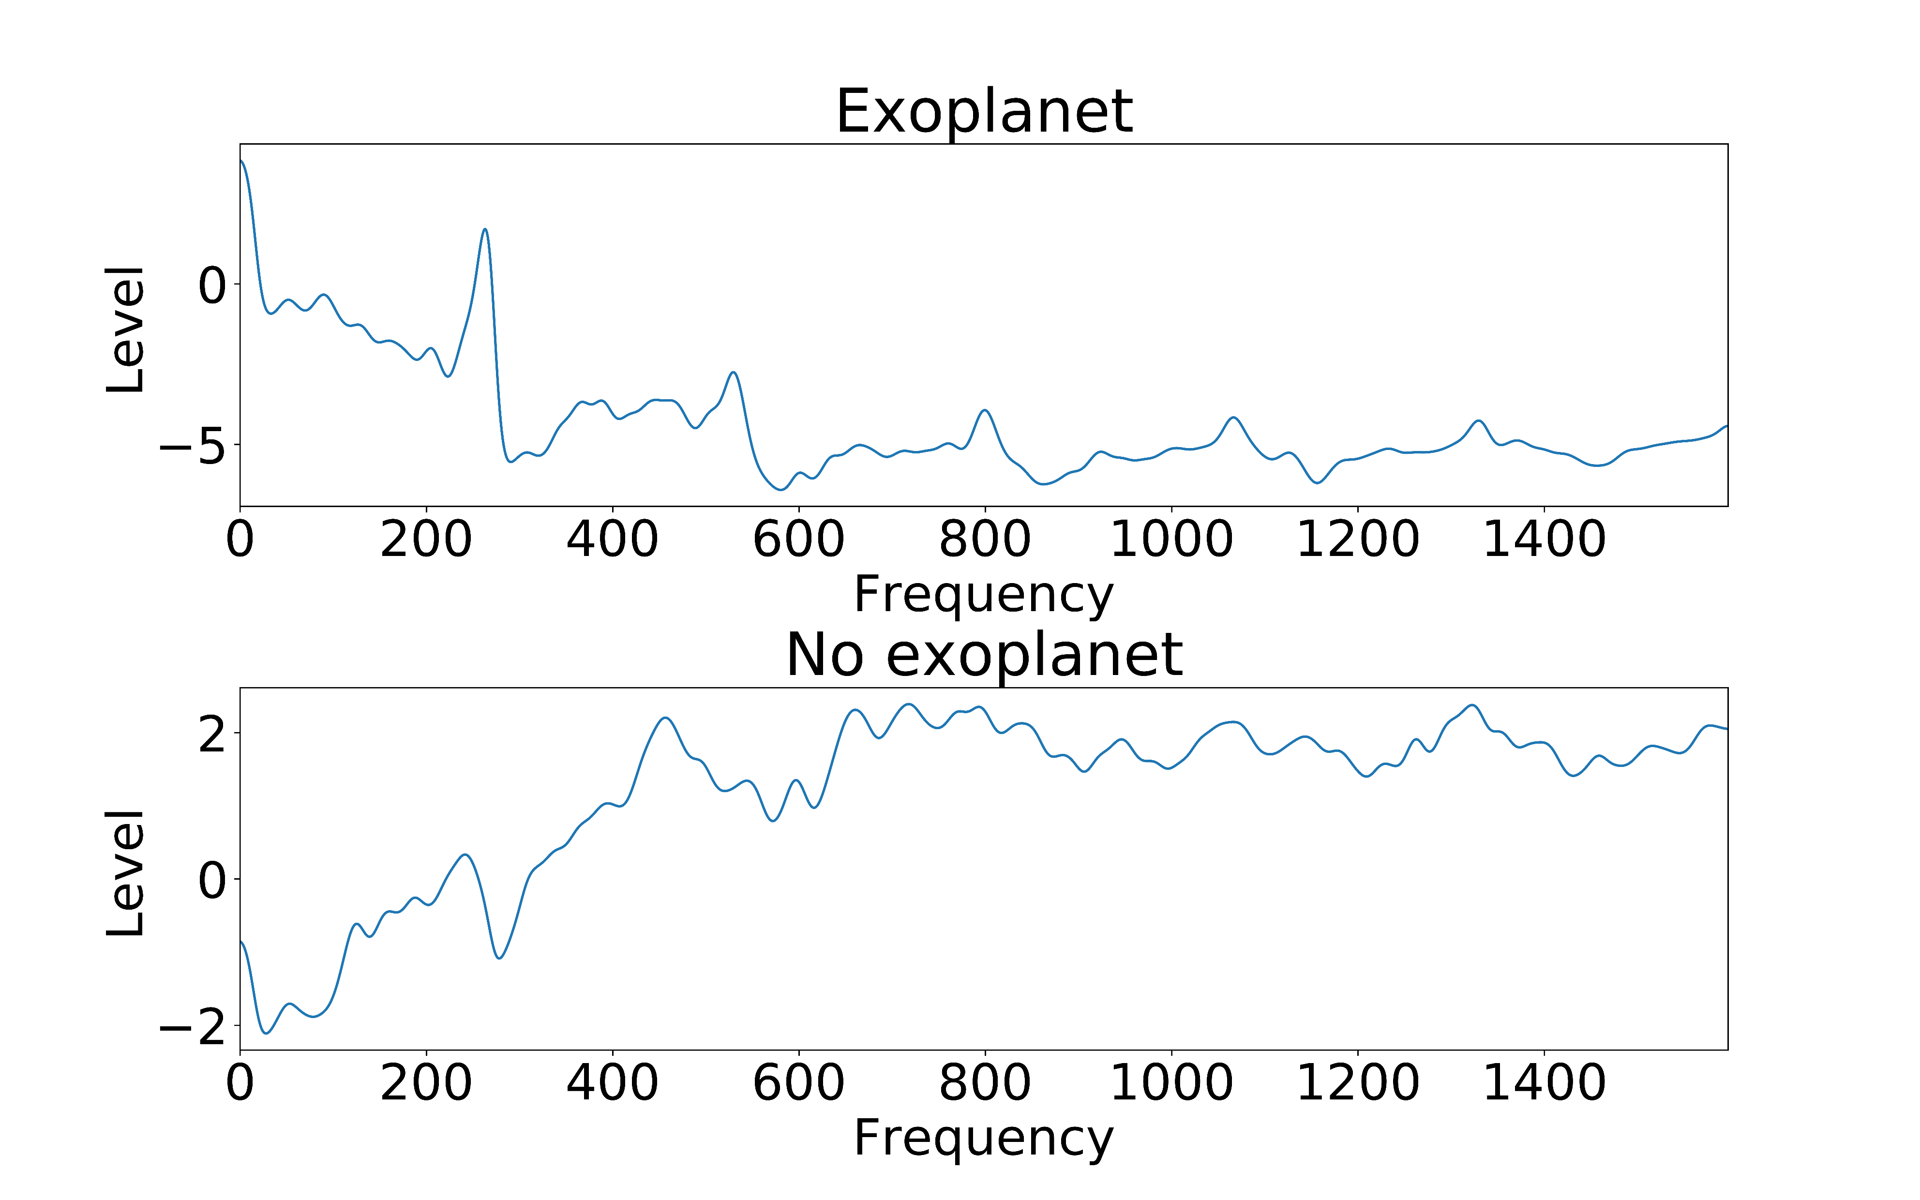
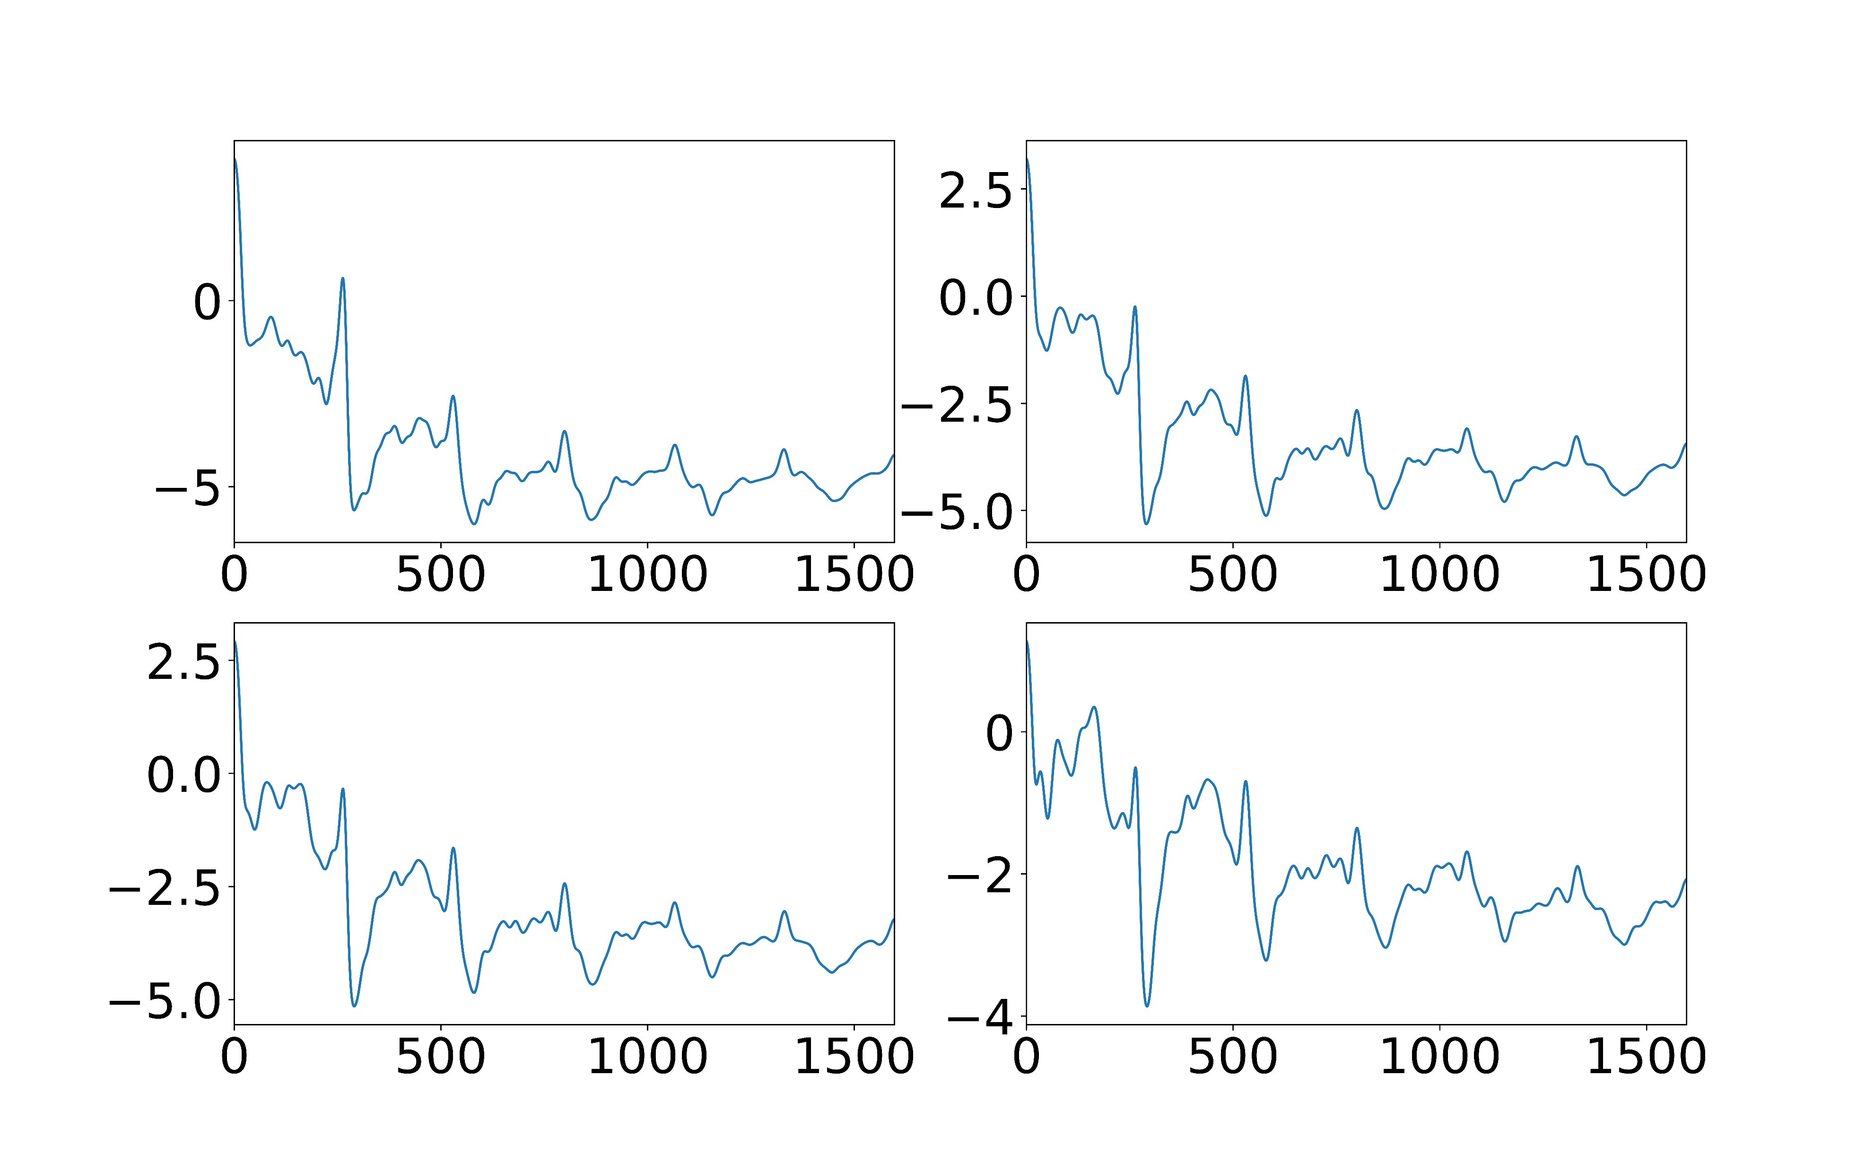
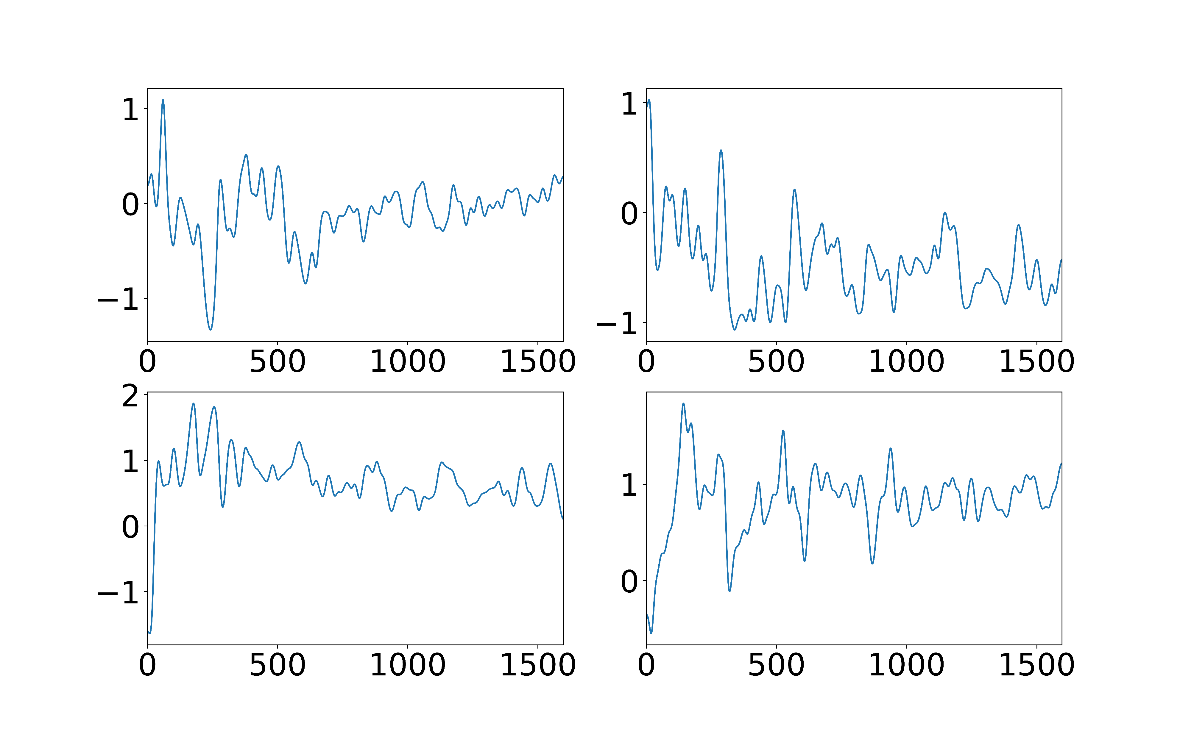
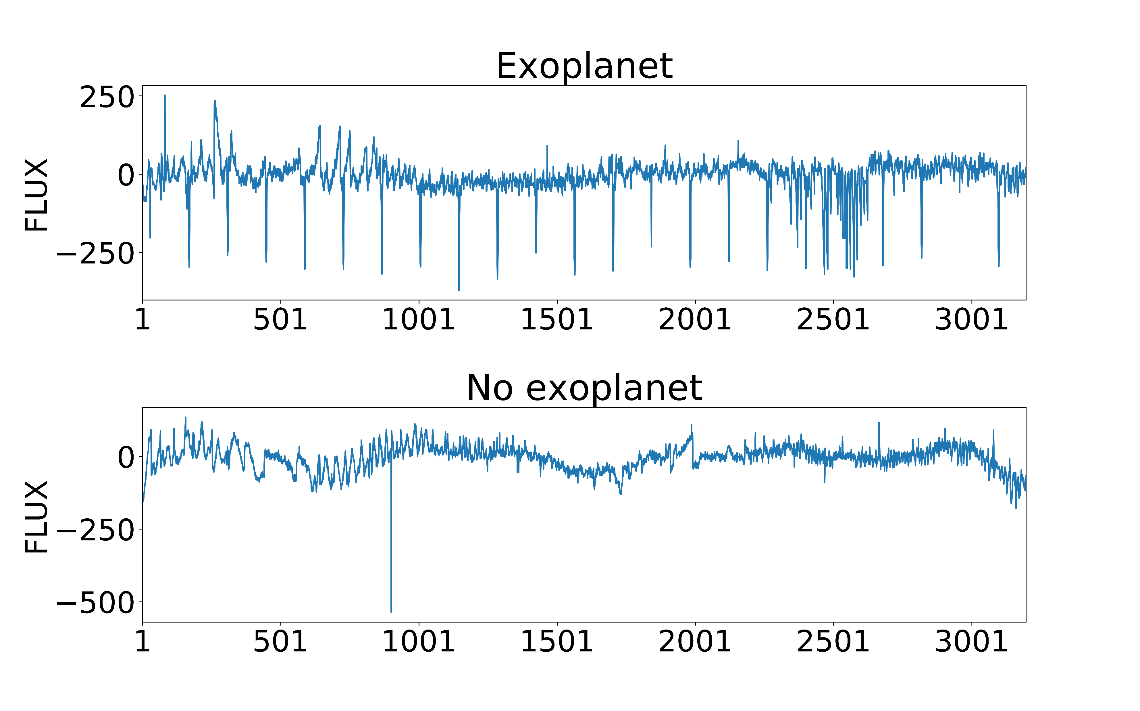

Exoplanet detection using the transit method
Authors: Marko Raidlo, Raido Everest
Introduction
An exoplanet is defined as a planet which orbits a star outside our own solar system. Exoplanets are a field of research for astronomers and astrophysicists to gather more data on different planetary systems and make better theories on system formation and evolution. The transit method (aka. Transit photometry) is the most widely used method of exoplanet detection. The light curve of a distant star is measured for periodic dips in brightness. Usually, these are caused by exoplanets transiting in front of the star.
Data
The light curve data comes from the Kepler space telescope, publicly available on NASA exoplanet archive. For this project, Kaggle dataset was used, which uses Kepler Campaign 3 data. Kaggle dataset has been made much more usable than raw data from NASA, as it has been made into a .csv file, while as NASA provides raw .fits files. The datasets include indicator of exoplanet existence and 3197 flux measurements. The training set contains 5087 observations with 37 confirmed planets and the test set contains 570 observations with 5 confirmed planets.
Caption: Post processing data
Caption: Examples of exoplanets (left) vs non exoplanets (right)
Building models
Following models were tested on the dataset:
Logistic Regression
Support Vector Machine
K-Nearest Neighbours
Decision tree
Random forest
Conclusions
Best results were provided by the random forest models. With a small amount of decision trees in the forest, the model managed to gain 1.0 recall and precision on tests. We find that this model is very efficient way to detect planets with short orbital periods, as they are detected several times during a measurement campaign. Planets with periods longer than measurement campaigns need more work as repeat detections on the light curve are needed for conformation of the exoplanets existence. Below are the confusion matrices for the random forest model.
Caption: Raw light curve data
Preprocessing
Fourier transform
Normalization
Gaussian filter
Standardization
 | Predicted False | Predicted True
Actual False | 5050 | 0
Actual True | 0 | 37
 | Predicted False | Predicted True
Actual False | 565 | 0
Actual True | 0 | 5
Confusion matrixes for training and testing datasets.

