Slide 1

Technology Trends and Analysis
Markos Gkikas
4/17/26

Slide 2



OUTLINE
Executive Summary
Introduction
Methodology
Results
Visualization – Charts
Dashboard
Discussion
Findings & Implications
Conclusion
Appendix

Slide 3

EXECUTIVE SUMMARY
Key Findings
JavaScript and SQL Lead Current Language Usage
Rising Interest in Rust and Go for the Future
PostgreSQL Dominates Database Preferences
AWS and Google Cloud Lead Platform Adoption
Demographic Concentration in the 25-34 Age Group

Slide 4

INTRODUCTION
Purpose of the Report
This report aims to analyze “Current and Future Technology Trends” among developers.
Target Audience
The primary audience includes technology recruiters, workforce planners, and educational institutions.
Value of Analysis for Strategic Planning
The analysis provides value by highlighting the gap between current skills and future interests.
Value of Demographic Insights
The report offers deep insights into the developer pipeline, showing that the largest segment of respondents is in the 25-34 age group and holds a Bachelor's degree.

Slide 5

METHODOLOGY
Data Source
The primary data source is an open-sourced subset of the Stack
Overflow Developer Survey (18845x114).
Data Collection
APIs and Web Scraping.
Data Wrangling
Duplicate removal
Handling missing data
Data standardization
Handling outliers to prevent skewed results
Data normalization using statistical methods
Multi-value splitting

Slide 6
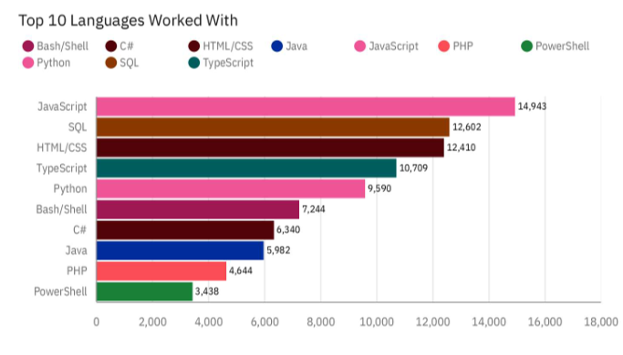
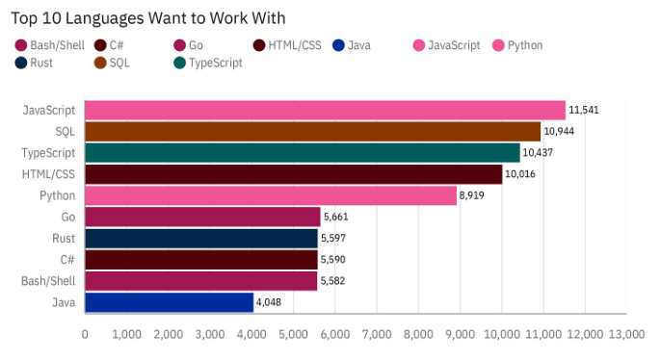
PROGRAMMING LANGUAGE TRENDS
Summarize key trends shown in the charts.
Current Year
Next Year
<Bar chart of top 10 programming languages for the current year goes here.>
< Bar chart of top 10 programming languages for the next year goes here.>

Slide 7
PROGRAMMING LANGUAGE TRENDS - FINDINGS & IMPLICATIONS
Findings
JavaScript and SQL dominance
New contenders (Go and Rust)
Java declining
Implications
Web tech is the core
Modernization shift
Talent competition

Slide 8
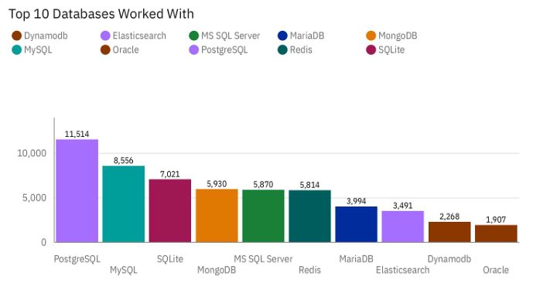
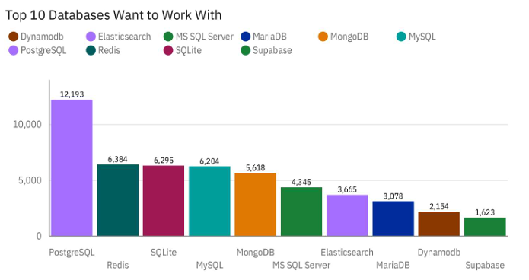
DATABASE TRENDS
Summarize key trends shown in the charts.
Current Year
Next Year
< Bar chart of top 10 databases for the current year goes here >
< Bar chart of top 10 databases for the next year goes here.>

Slide 9
DATABASE TRENDS - FINDINGS & IMPLICATIONS
Findings
PostgreSQL dominance
Redis surge
Oracle out, Supabase in
Implications
Open Scource Wins
Performance is priority
Developer experience matters

Slide 10
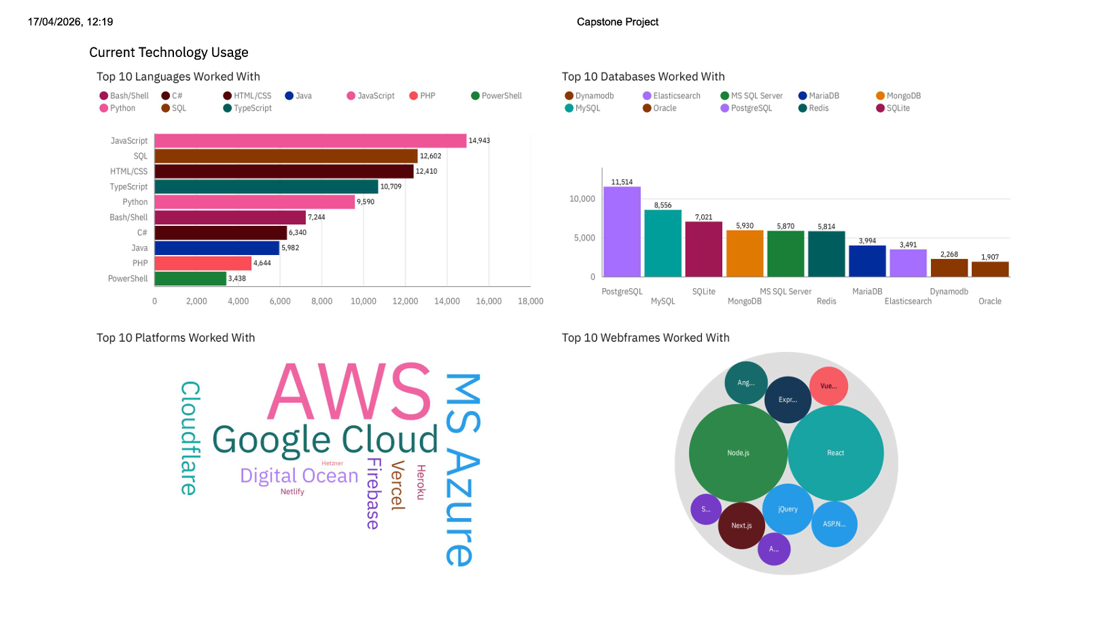
DASHBOARD TAB 1: Current Technology Usage
The JavaScript Ecosystem Dominates:
JavaScript is the #1 language, and its related frameworks represent the largest share of the web framework landscape. This confirms a highly unified stack for modern development.
PostgreSQL is the "Gold Standard":
In a fragmented database market, PostgreSQL holds a massive lead over competitors like MySQL and SQLite. It has nearly double the usage of secondary options like MongoDB or Redis.
Cloud is a Three-Horse Race:
The platform word cloud shows AWS, Google Cloud, and MS Azure as the overwhelming leaders. While niche players like Vercel and Digital Ocean are present, the "Big Three" remain the primary infrastructure choice for developers.
Screenshot of dashboard tab 1 goes here
Dashboard Insight
Summarize key insights shown

Slide 11
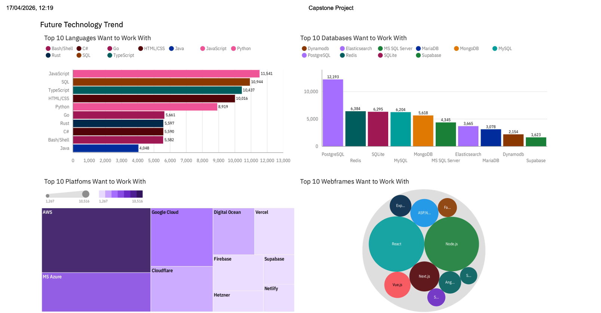
DASHBOARD TAB 2: Future Technology Trends
AWS remains the undisputed leader:
While developers show interest in a variety of platforms, AWS maintains the largest footprint in future interest, significantly outpacing Google Cloud and MS Azure in the treemap.
The Rise of High-Performance Tools:
Future interest is shifting toward speed and efficiency, evidenced by Go and Rust appearing in the top languages, and Redis climbing to the #2 most desired database.
Framework Consolidation:
Interest is heavily concentrated in a few "heavy hitters." React and Node.js continue to dominate the webframe bubble chart, indicating that the industry is doubling down on these ecosystems rather than fragmenting into new alternatives.
Screenshot of dashboard tab 2 goes here
Dashboard Insight
Summarize future trends.

Slide 12
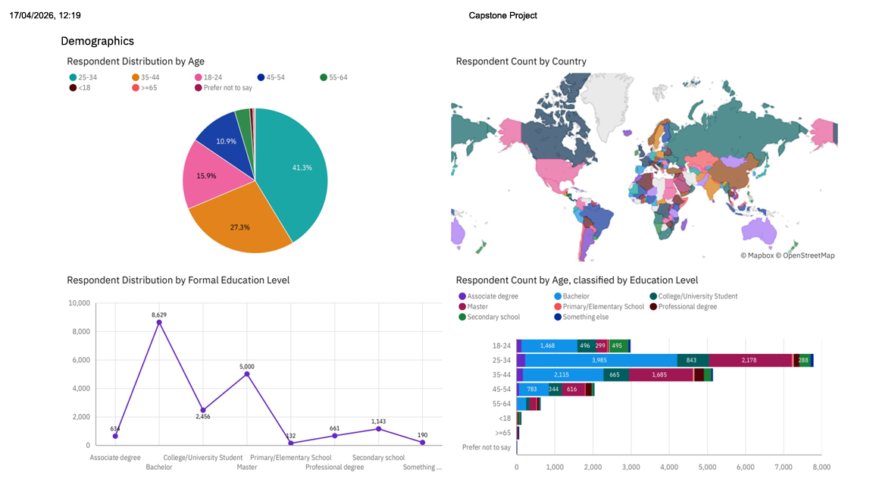
DASHBOARD TAB 3: Demographics
Dominant Age Bracket:
The tech workforce is overwhelmingly young to mid-career, with 41.3% of respondents in the 25-34 age group. This remains the primary demographic for the industry.
Education Benchmark:
A Bachelor’s degree (8,629) is the most common formal education level, followed by Master’s degrees. This indicates that while "self-taught" paths exist, formal higher education remains the standard entry point.
The "Experience Gap" in Education:
The bar chart shows that as developers age into the 25-34 and 35-44 brackets, the proportion of Master’s degrees increases significantly compared to the 18-24 group, suggesting a trend toward advanced specialization as careers progress.
Screenshot of dashboard tab 3 goes here
Dashboard Insight
Summarize demographic insights

Slide 13

DISCUSSION
1. The Market is Consolidating Around "Gold Standards"
While the tech landscape is vast, both current and future data show a massive concentration of talent around specific "winners." JavaScript (and its React/Node ecosystem), SQL (specifically PostgreSQL), and AWS form a dominant "super-stack." Developers aren't just using these; they actively want to stay within these ecosystems, suggesting they have become the industry's default infrastructure.
2. A Significant Shift Toward Performance & Type-Safety
There is a clear "modernization" trend occurring. The high future interest in Rust, Go, and TypeScript—paired with the rising desirability of Redis—indicates that developers are moving away from the "move fast and break things" era. Instead, they are prioritizing memory safety, strict typing, and high-concurrency performance for the next generation of applications.
3. The "Legacy Exit" for Enterprise Stalwarts
Traditional enterprise heavyweights like Java, PHP, and Oracle are facing a "desirability deficit." While they still have high current usage, they are being replaced in future trend charts by more modern alternatives (like Supabase and Go). This suggests that while these technologies remain critical for existing systems, new project starts and developer enthusiasm are moving elsewhere.
4. A Young, Highly-Educated, Global Workforce
The demographic data shows that the industry is fueled by a "prime-age" workforce (25-34) that values formal education (Bachelor's and Master's). This group is globally distributed but shares a very narrow set of tool preferences, creating a worldwide standardized "language" of development that allows for high mobility across different cloud platforms and frameworks.

Slide 14
OVERALL FINDINGS & IMPLICATIONS
Findings
Platform & Language Consolidation.
Performance Migration
Demographic Homogeneity
Implications
Skill Standardization.
Tech Debt Risks.
Targeted Talent Strategy.

Slide 15

CONCLUSION
JavaScript, PostgreSQL, and AWS remain the undisputed standards for current and future development.
Interest is shifting from legacy languages (Java/PHP) to high-performance, type-safe tools like Rust, Go, and TypeScript.
Growth is favoring modern, cloud-native platforms and tools (Supabase/Vercel) that prioritize developer experience.
The industry is driven by a young (25–34), highly educated global workforce with unified tooling preferences.

