Slide 2
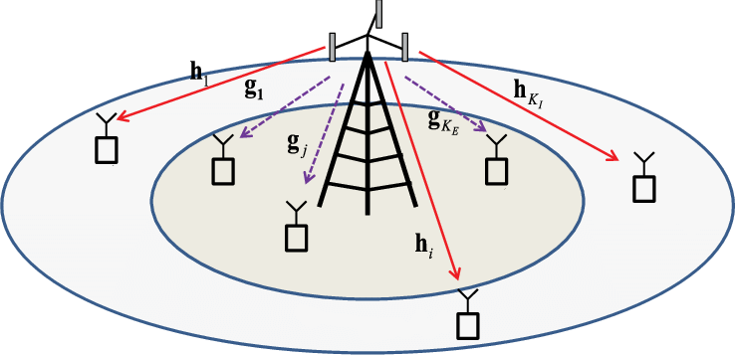
Motivation
Broadcast nature
  Susceptible to eavesdropping

Slide 3
Motivation
Encryption
  Key distribution in dynamic networks used in symmetric cryptosystems
  High computational complexity of asymmetric cryptosystems

Slide 4
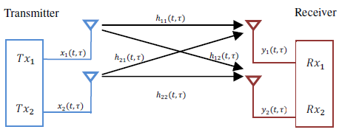
Model
Channel state constant for duration of frame
            y^{R} = Hx + n

Slide 5
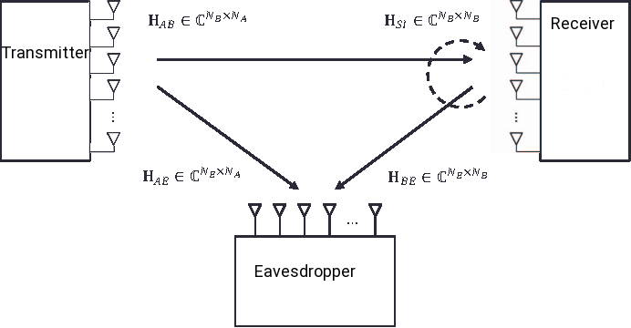
Model
  y^{R} = H^{st}x + n^{R} y^{E} = H^{AE}x + n^{E}

Slide 6
Physical Security
Information Theoretic Secrecy

Slide 7
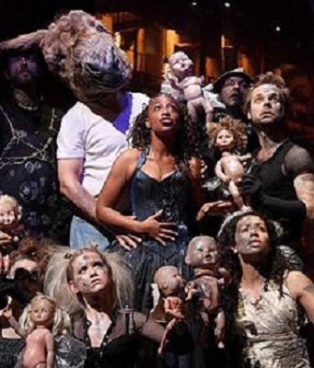
Title
Bullet 1
  Sub-bullet

