Slide 1
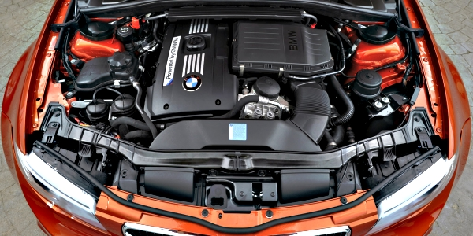

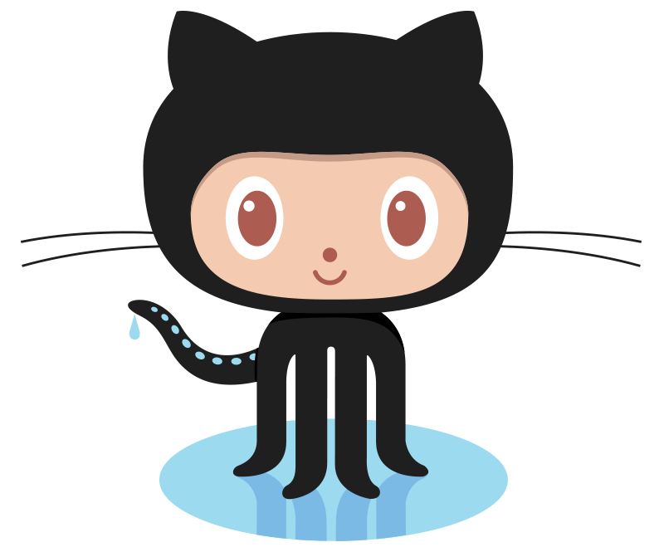

Angular Under the Hood
Marko Stanimirović
SAP Commissions Tech Meetup – 11/04/2020

Slide 2
Contents
Compilation
Zone.js
Change Detection
Zone-Less Applications

Slide 3
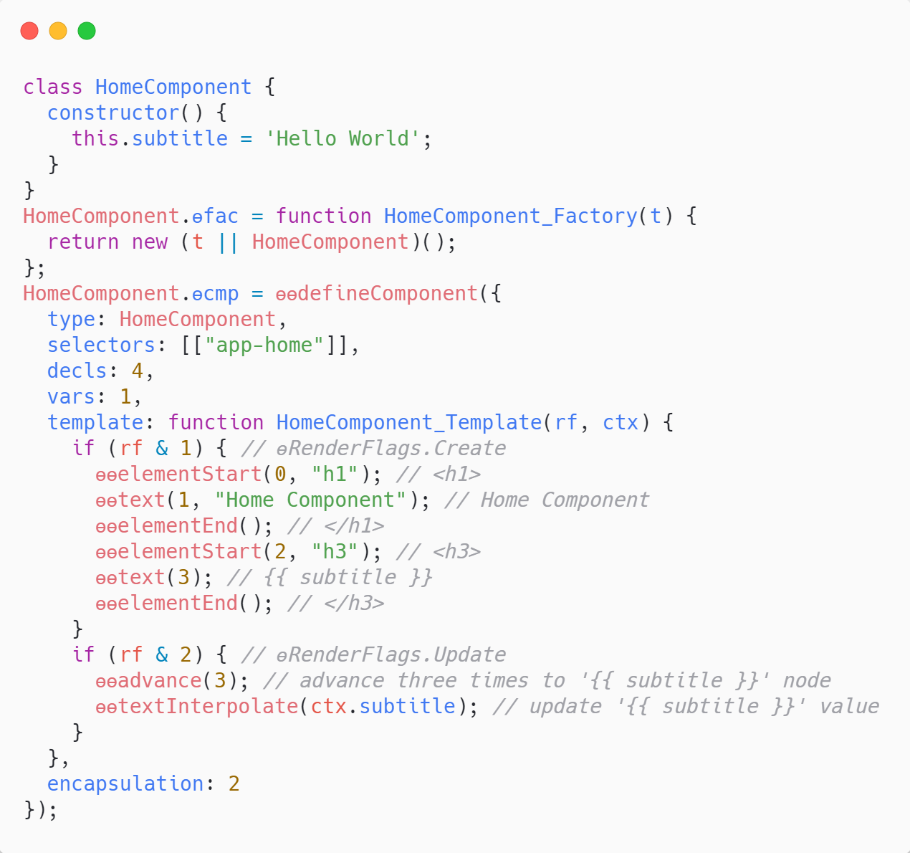
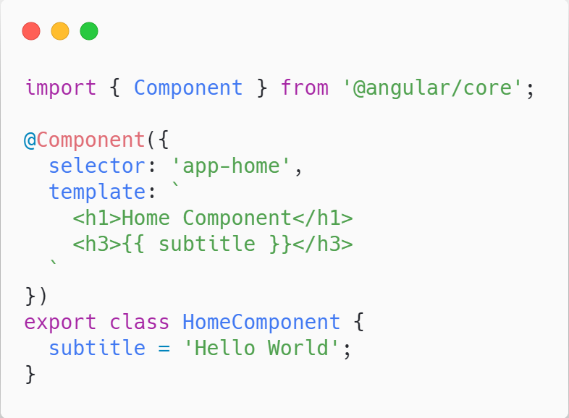
Compilation

Slide 4
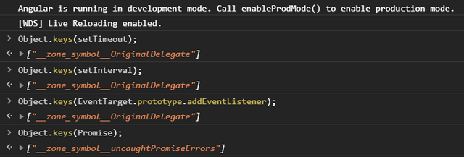
What is Zone.js?
Executed before the Angular application is bootstrapped
Tells Angular when to run the change detection mechanism
Monkey patches asynchronous browser APIs

Slide 5
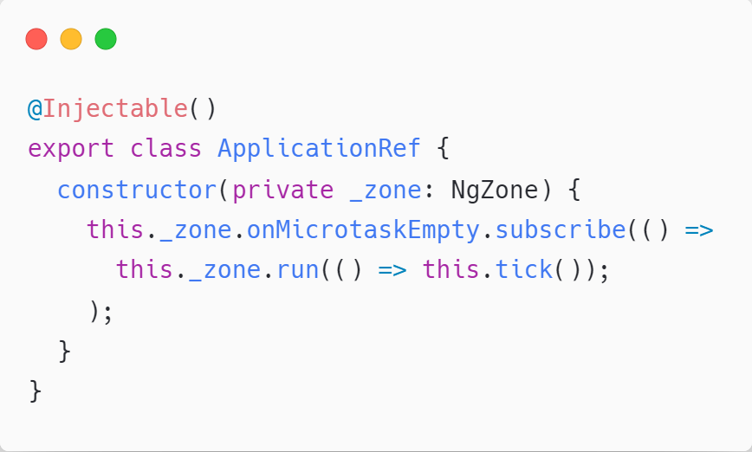
Change Detection
Application Ref
App Component
Child Component 2
Child Component 1
Child Component 1.1
Child Component 1.2

Slide 6
Zone.js Downsides
Not tree shakable (uncompressed size >100kB)
Slower application bootstrap speed
Unnecessary change detection triggering
Magic
Cannot monkey patch native async/await (ES2017)

Slide 7
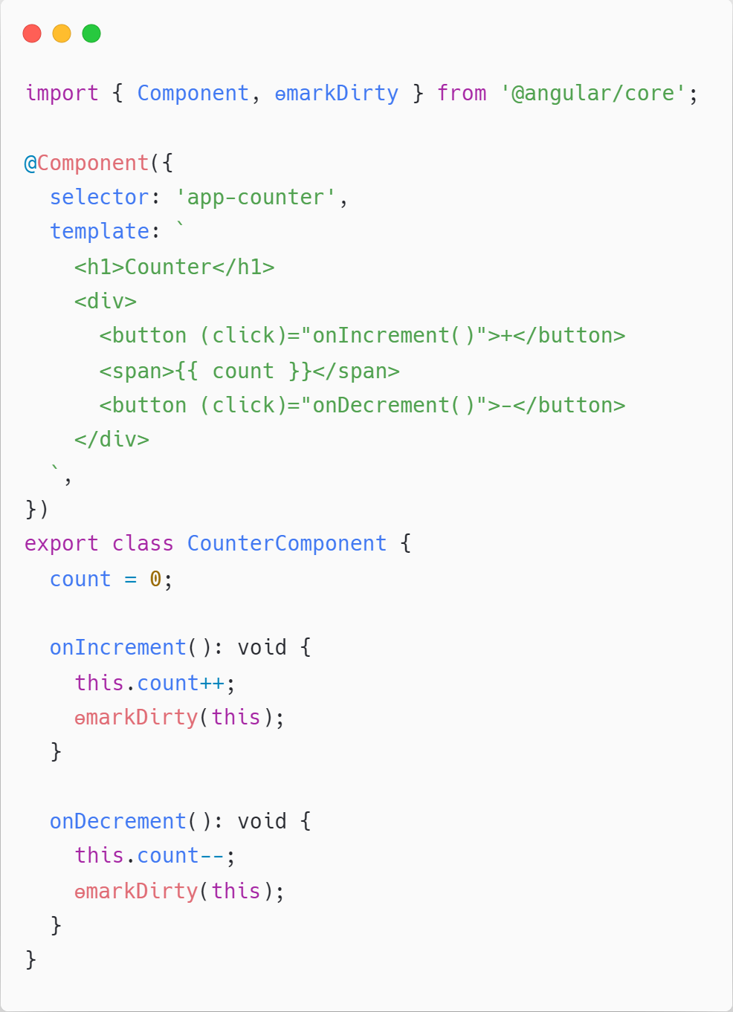
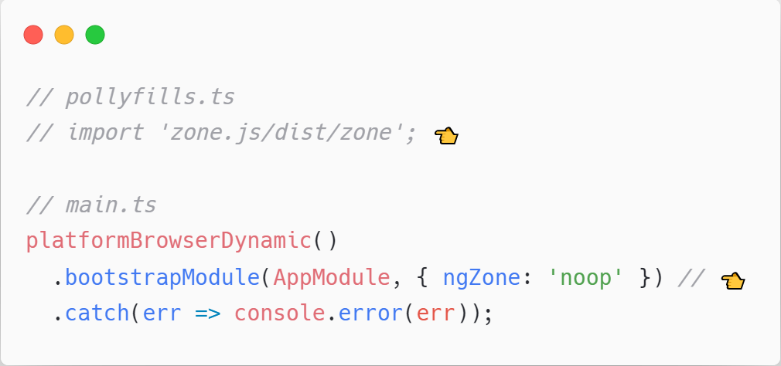
Zone-Less Applications
Trigger change detection only when necessary

Slide 8
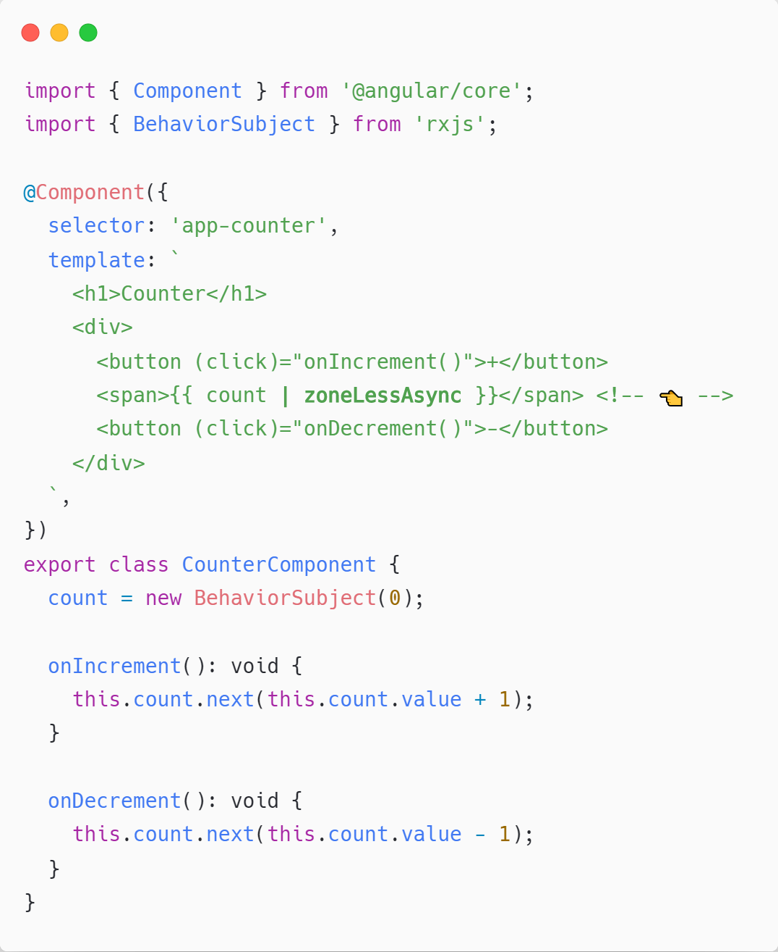

How to trigger change detection automatically?

Slide 9
Demo

Slide 10
Thanks!
Marko Stanimirović
SAP Commissions Tech Meetup – 11/04/2020

