Slide 1
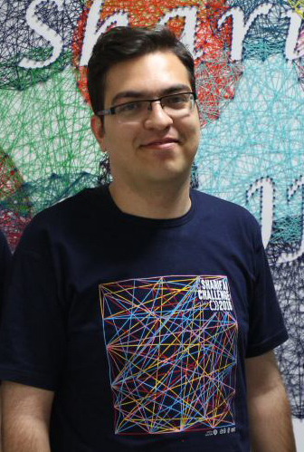
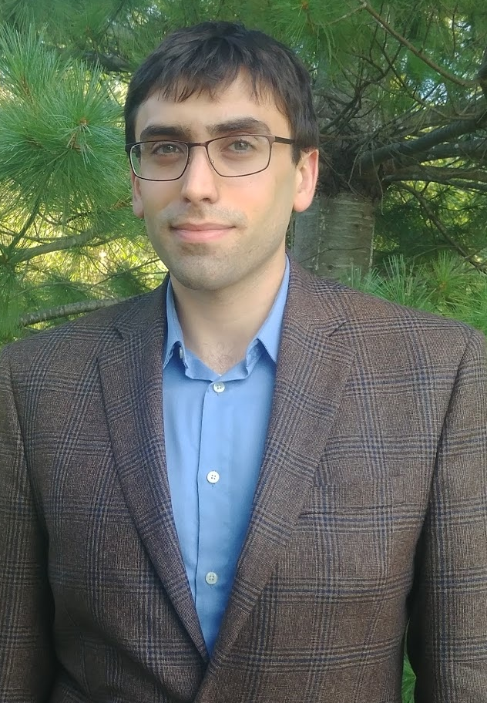



Variational Recurrent Topic Model
Mehdi Rezaee
Francis Ferraro
Notes:
My name is Mehdi Rezaee PHD student from UMBC, I’m working with frank ferraro and my research interest is varitional inference in NLP. I want to talk about Variational Recurrent Topic Model.
-- Cynthia: Replace tables instead of latex except for theorem.
-- break slides....

Slide 2
Natural Language Understanding
“She received a master’s degree in EE from Anytown University.”
Thematic word relations
Syntactic word relations
Notes:
In Natural Language Understanding and specially text generation, capturing both syntactic and thematic word relations is crucial, consider the sentence, we see there are words like in from and , they are responsible for the grammar of the sentence and words like master’s, EE and University that are covering long range dependencies and they are coming from education topic.
--Slide numbers
-- remove top lines
-- change arrows color but how all of these arre used in language ...
--Bigger on thematic and syntactic...
Add this also after the model....

Slide 3
Previous Work
RNN
Local Syntactic
Global Semantic
RNN
TopicRNN
LDA
LSTM
TGVAE
LSI
GRU
TDLM
pLSI
…
TCNLM
…
…
Notes:
By looking at available models in ML and NLP, we see that architectures like RNN, LSTM, GRU are capable of capturing short range dependencies and syntactic relations, also topic models like LDA, LSI , pLSI are well known models
that can capture long range dependencies between words. So by combining these two models we can conjoin the benefits of both words. There are lots of recent models trying to combine these two architectures.
-- much less detail for this one.
-- Talk to audiounce...
-- The key point of the slide is ...
-- Unbold those make it bigger...

Slide 4
Previous Work
RNN
Local Syntactic
Global Semantic
TopicRNN
RNN
LDA
TGVAE
LSTM
LSI
TDLM
GRU
TCNLM
pLSI
…
…
VRTM
Previously: marginalize out word-level topic assignments
Our work: learn to model them within a neural framework
Notes:
All these models are marginalizing out the word-level topic assignments.
Recent work has shown that topic models that have relatively consistent word-level topic assignments are preferred by end-users.​
-- Make VRTM bigger and bold. advertise yourself.
selling yourself and work communicate...
--- Title up...

Slide 5
Model Architecture
Notes:
We see the underlying structure and graphical model for VRTM.

Slide 6
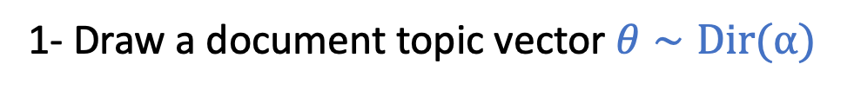
Model Architecture
1- Draw a document topic vector $θ∼\text{Dir}\text{(}α)$
Document
Topic
Vector
Notes:
Like a regular topic model, first we sample a document topic vector from the Dirichlet distribution.
Font size at least 18.
Diagram make it bigger.

Slide 7
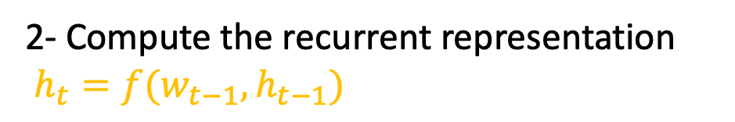
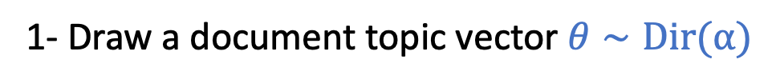
Model Architecture
Recurrent Representation
1- Draw a document topic vector $θ∼\text{Dir}\text{(}α)$
2- Compute the recurrent representation
$h_{t}=f(w_{t−1},h_{t−1})$
Document
Topic
Vector
Notes:
Then it computes the recurrent representation that includes the information about all the previous words.
---remove l_t color.

Slide 8
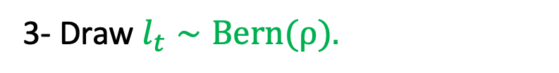
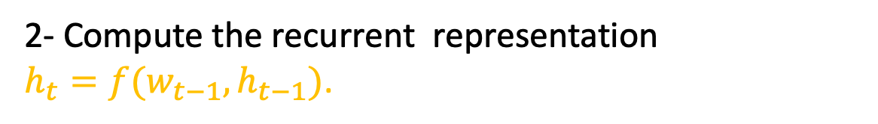
Model Architecture
Recurrent Representation
1- Draw a document topic vector $θ∼\text{Dir}\text{(}α).$
2- Compute the recurrent representation
$h_{t}=f(w_{t−1},h_{t−1})$.
Document
Topic
Vector
3- Draw $l_{t}∼\text{Bern}\text{(}ρ).$
Thematic word prediction
Notes:
Then given all the previous words, VRTM predicts that whether the next word is coming from a syntactic or semantic relation.

Slide 9
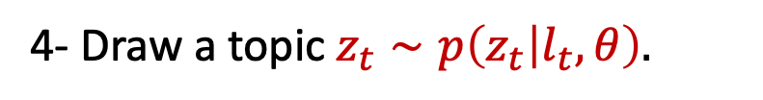
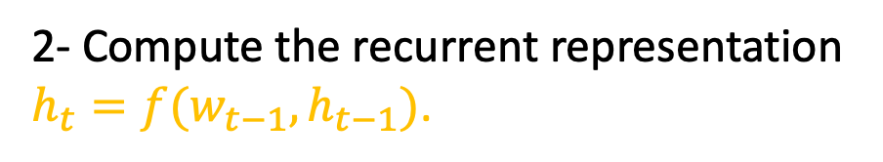

Model Architecture
Recurrent Representation
Topic Assignment
1- Draw a document topic vector $θ∼\text{Dir}\text{(}α).$
2- Compute the recurrent representation $h_{t}=f(w_{t−1},h_{t−1})$.
Document
Topic
Vector
3- Draw $l_{t}∼\text{Bern}\text{(}ρ).$
Thematic word prediction
4- Draw a topic $z_{t}∼p\left(z_{t} | l_{t},θ\right).$
Notes:
We draw a topic for that word.
-- use this colors on the description as well.
-- Title moving up all the slides.
--Last slide name and email information
text larger.

Slide 10
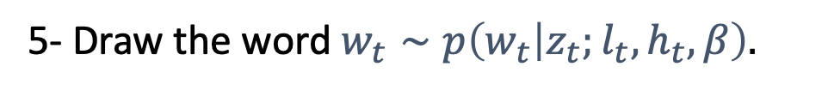
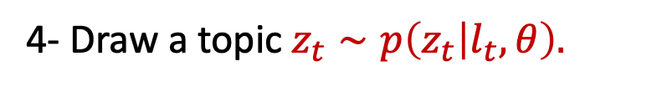
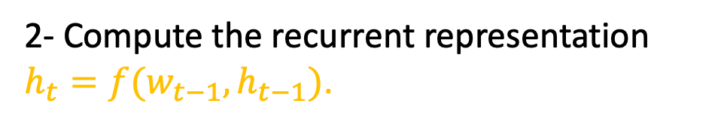
Model Architecture
Recurrent Representation
Topic Assignment
1- Draw a document topic vector $θ∼\text{Dir}\text{(}α).$
2- Compute the recurrent representation $h_{t}=f(w_{t−1},h_{t−1})$.
Word prediction
Document
Topic
Vector
3- Draw $l_{t}∼\text{Bern}\text{(}ρ).$
Thematic word prediction
4- Draw a topic $z_{t}∼p\left(z_{t} | l_{t},θ\right).$
5- Draw the word $w_{t}∼p\left(w_{t} | z_{t};l_{t},h_{t},β\right).$
Notes:
And finally the word is sampled from the relevant topic.

Slide 11
Model Architecture
Recurrent Representation
Topic Assignment
1- Draw a document topic vector $θ∼\text{Dir}\text{(}α).$
2- Compute the recurrent representation $h_{t}=f(w_{t−1},h_{t−1})$.
Word prediction
Document
Topic
Vector
3- Draw $l_{t}∼\text{Bern}\text{(}ρ).$
Thematic word prediction
4- Draw a topic $z_{t}∼p\left(z_{t} | l_{t},θ\right).$
5- Draw the word $w_{t}∼p\left(w_{t} | z_{t};l_{t},h_{t},β\right).$
$$p\left(w_{t}=v | z_{t}=k;h_{t},l_{t},β\right)∝\exp{(p_{v}^{T}h_{t}+\left(1−l_{t}\right)β_{k,v})}$$
Notes:
And finally the word is sampled from the relevant topic.

Slide 12
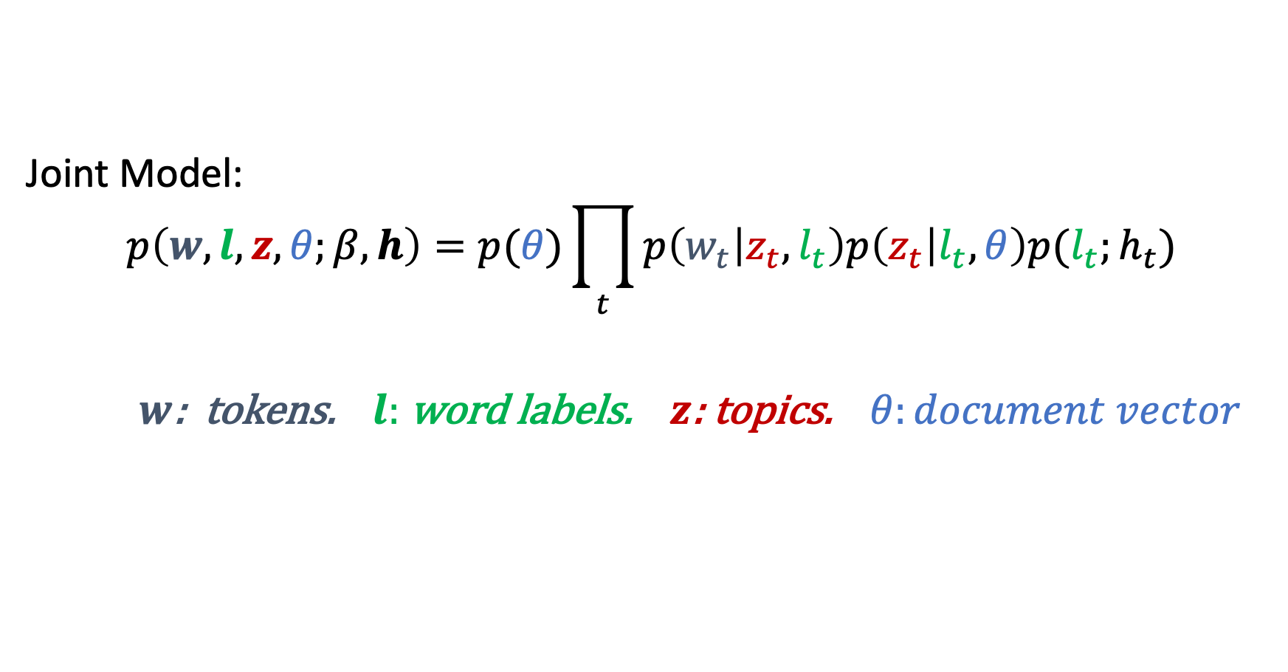
Model and Inference
Joint Model:
$$p\left(w,l,z,θ;β,h\right)=p(θ)\prod_{t}{p\left(w_{t} | z_{t},l_{t}\right)p\left(z_{t} | l_{t},θ\right)p(l_{t};h_{t})}$$
$w$: tokens. $l:$ word labels. $z$: topics. $θ:document vector$
Notes:
Based on what we explained, our joint model for words, labels and topics is completey decomposes
We can write our joint model as a product of probability factors.
-- label things here or color code ...
---what are w_t,z_t and l_t??!
--- prod t=1 to T or just t
--- color coding .....
under brace

Slide 13
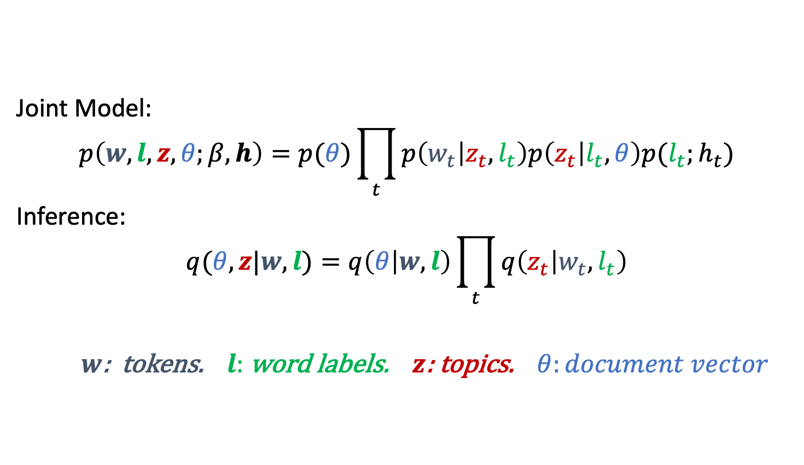
Model and Inference
Joint Model:
$$p\left(w,l,z,θ;β,h\right)=p(θ)\prod_{t}{p\left(w_{t} | z_{t},l_{t}\right)p\left(z_{t} | l_{t},θ\right)p(l_{t};h_{t})}$$
Inference:
$$q(θ,z|w,l)=q\left(θ | w,l\right)\prod_{t}{q\left(z_{t} | w_{t},l_{t}\right)}$$
$w$: tokens. $l:$ word labels. $z$: topics. $θ:document vector$
Notes:
Our inference is completey based on mean field assumption.
-- High level explanation.
--- Add ELBO as a text or formula...
Auxilary slide or say it here ...

Slide 14
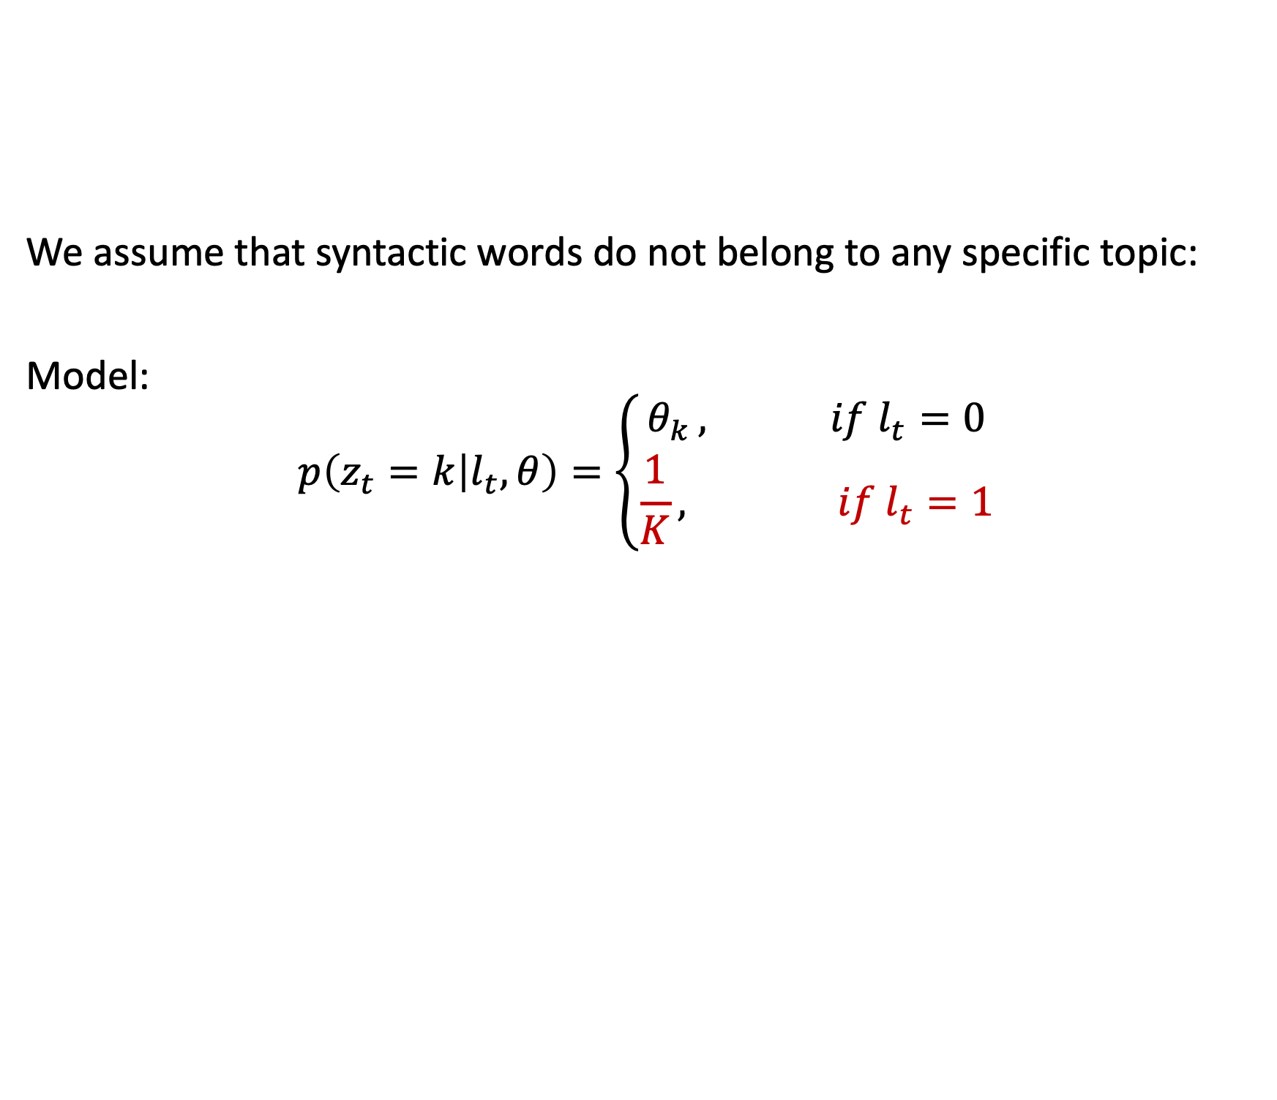
Stop-words topic assignment
We assume that syntactic words do not belong to any specific topic:
Model:
$$p\left(z_{t}=k | l_{t},θ\right)=\left\{\begin{aligned}θ_{k }, if l_{t}=0 \\ \frac{1}{K}, if l_{t}=1\end{aligned}\right.$$
Notes:
We present a simple yet efficient mechanism.For both the model and inference part if the word is coming from a short range dependency we use uniform distribution, other wise we learn the parameters for each of them.
--- English insteead of formula
-- Start from the model remove the inference Make it larger center it .... if l_t=0 choose a topic
-- Rename it to thematic word topic assignment redefine it to l_t slow reveal...

Slide 15
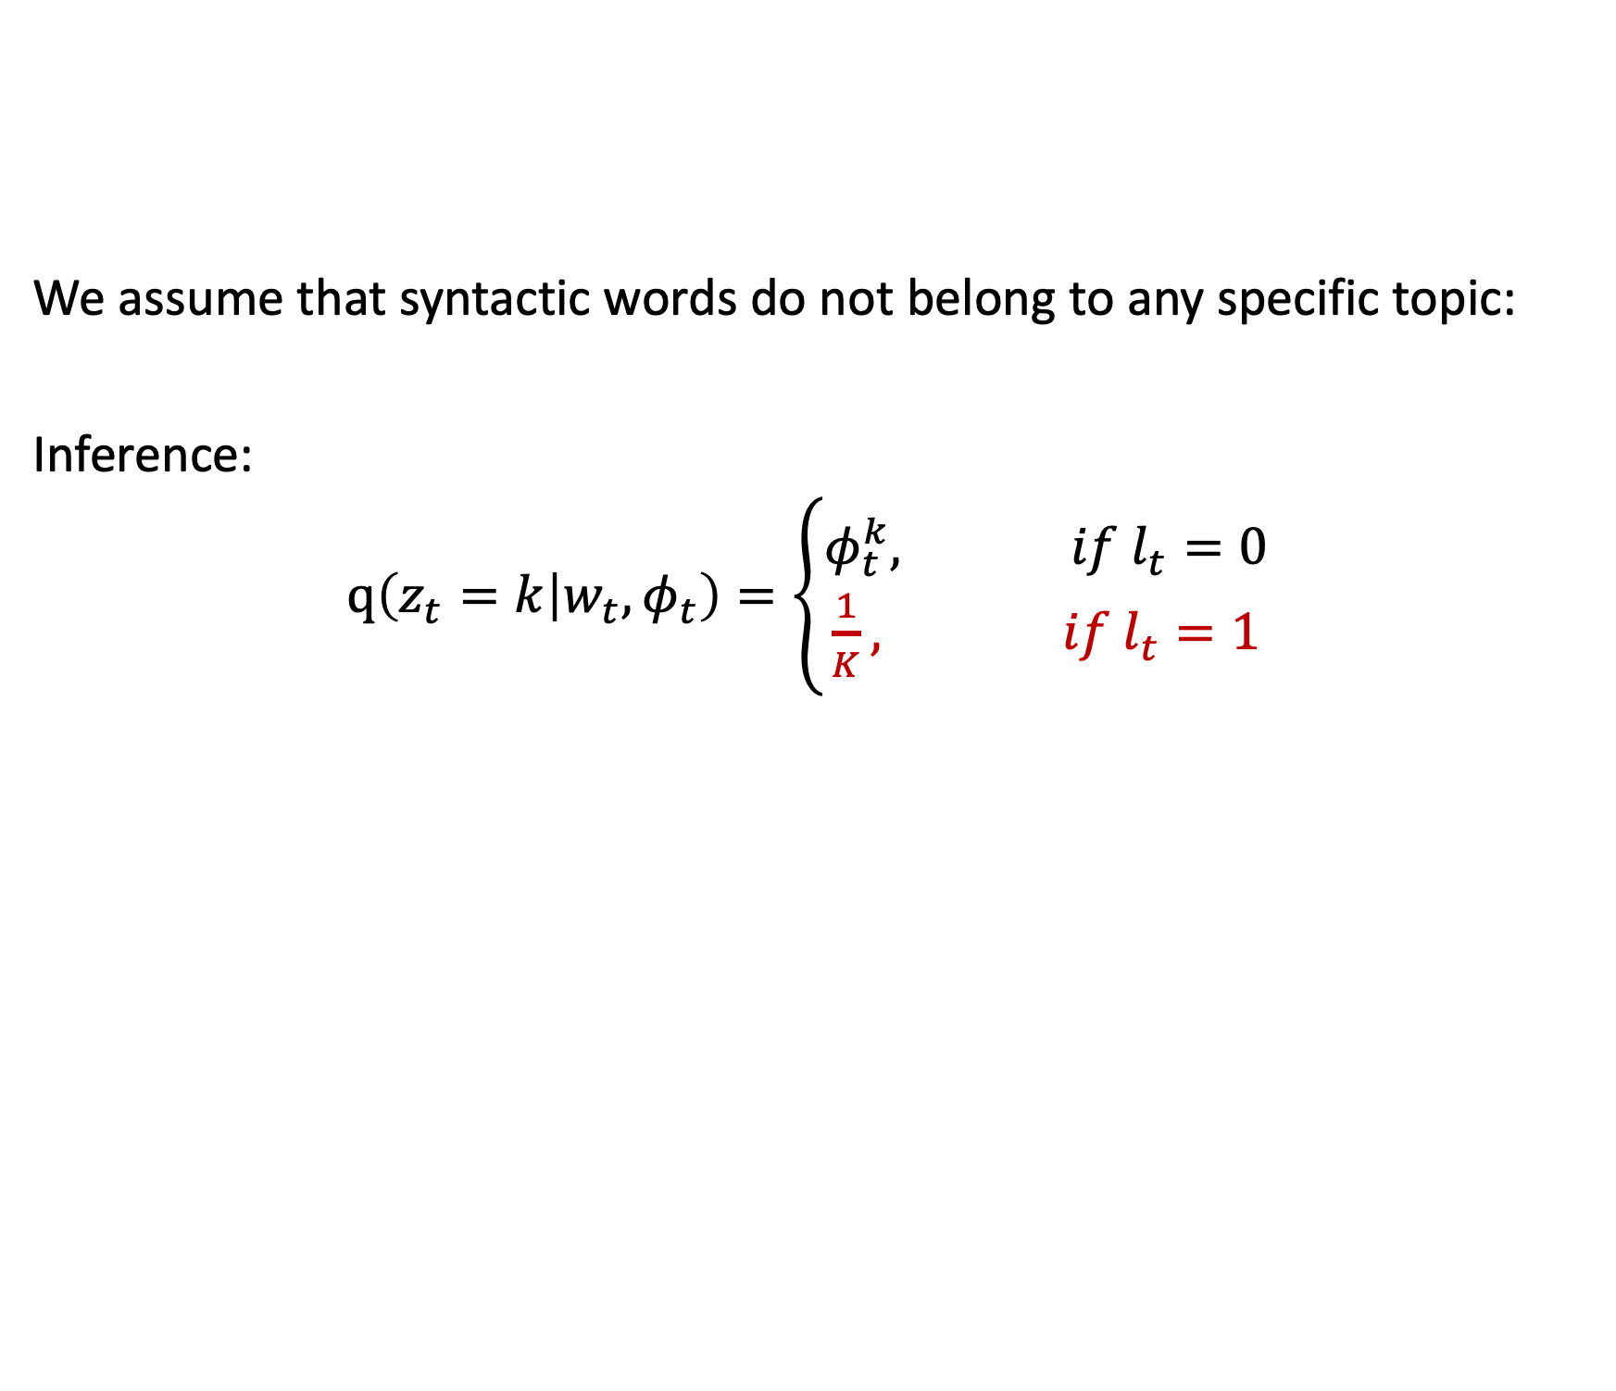
Stop-words topic assignment
We assume that syntactic words do not belong to any specific topic:
Inference:
$q\left(z_{t}=k | w_{t},φ_{t}\right)=\left\{\begin{aligned}φ_{t}^{k}, if l_{t}=0 \\ \frac{1}{K}, if l_{t}=1\end{aligned}\right.$
Notes:
We present a simple yet efficient mechanism.For both the model and inference part if the word is coming from a short range dependency we use uniform distribution, other wise we learn the parameters for each of them.
--- English insteead of formula
-- Start from the model remove the inference Make it larger center it .... if l_t=0 choose a topic
-- Rename it to thematic word topic assignment redefine it to l_t slow reveal...

Slide 16
Performance Guarantee

Slide 17
Performance Guarantee
VRTM outperforms an RNN cell.
Notes:
---outperforms ....
-- center the green box between the theorem and photo and horizontally.

Slide 18
Datasets
Dataset | Vocabulary | Training Docs
APNEWS | 7788 | 50 K
IMDB | 8734 | 75 K
BNC | 9769 | 15 K
Notes:
We see the information about different datasets we used,
APNEWS contains 54k newswire article
IMDB contains 100k movie reviews
BNC contains journals, books and newswires.
-- Text is small , not Tex, too much information. break it up
Just training information ...just number of documents not sents or tokens.... and vocab size...

Slide 19
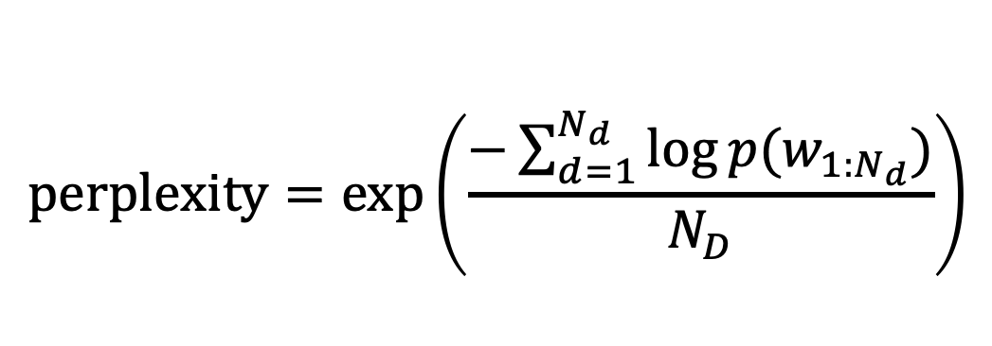
VRTM as a Language Model
how well a probability model predicts a sample
$$\text{perplexity}=\exp\left(\frac{−\sum_{d=1}^{N_{d}}{\log{p(w_{1:N_{d}})}}}{N_{D}}\right)$$
Notes:
As a language model we reported the perplexity of our model .
-- useful like this.
-- It should be larger...

Slide 20
Test Perplexity (50 Topics)
Methods | APNEWS | IMDB | BNC
Basic-LSTM | 62.79 | 70.38 | 100.07
LDA+ LSTM | 57.05 | 69.58 | 96.42
Topic-RNN | 56.77 | 68.74 | 94.66
TDLM | 53.00 | 63.67 | 91.42
TCNLM | 52.75 | 63.98 | 87.98
TGVAE | 48.73 | 57.11 | 87.86
VRTM (Ours) | 47.78 | 51.08 | 86.33
( Ours )
Lower is Better
Notes:
VRTM outperforms other baselines across all the benchmark datasets..
-- So latex color code thing. background the table.
highlight the whole line.
--- Indicate and say that lower is better....

Slide 21
Test Perplexity
Methods | APNEWS | IMDB | BNC
TGVAE (T=10) | 55.77 | 62.22 | 91.19
TGVAE (T=30) | 51.27 | 59.45 | 88.34
TGVAE (T=50) | 48.73 | 57.11 | 87.86
VRTM (T=10) | 54.31 | 59.82 | 92.89
VRTM (T=30) | 51.47 | 54.36 | 89.26
VRTM (T=50) | 47.78 | 51.08 | 86.33
Notes:
We can see that our results are consistent for different number of topics, where our perplexities are close to or lower than TGVAE.
-- Same comments. color highlight.
-- Transpose the table…

Slide 22
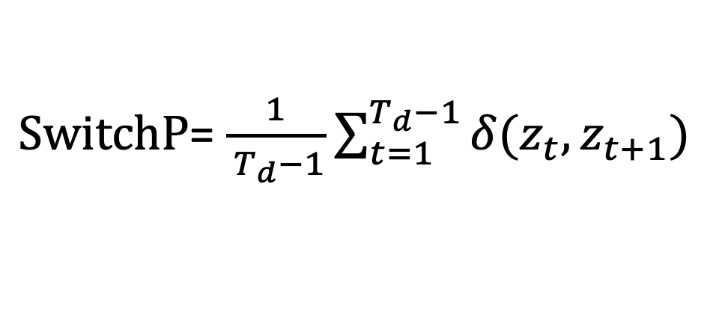
Topic Switch Percent (Lund et al., 2019)
Tokens near each other should switch infrequently, and thus be consistent in expressing a single idea.
$\text{SwitchP}$= $\frac{1}{{ T}_{d}−1}\sum_{t=1}^{T_{d}−1}{δ(z_{t},z_{t+1})}$
Notes:
Shows the consistency of word–level topic assignments. It’s out performing variational LDA.
-- Two slides
-- citation in the title
-- Use English instead of
-- give some insight....
-- Graph like bars.

Slide 23
Topic Switch Percent (Lund et al., 2019)
Topic | APNEWS |  | IMDB |  | BNC
 | LDA | VRTM | LDA | VRTM | LDA | VRTM
5 | 0.26 | 0.59 | 0.24 | 0.52 | 0.24 | 0.51
10 | 0.18 | 0.43 | 0.14 | 0.35 | 0.15 | 0.40
15 | 0.14 | 0.33 | 0.12 | 0.31 | 0.13 | 0.35
30 | 0.10 | 0.31 | 0.09 | 0.28 | 0.10 | 0.23
50 | 0.08 | 0.20 | 0.07 | 0.26 | 0.07 | 0.20
Notes:
Shows the consistency of word–level topic assignments. It’s out performing variational LDA.
-- Two slides
-- citation in the title
-- Use English instead of
-- give some insight....
-- Graph like bars.

Slide 24
Summary
We present a neural topic model that explicitly models each word’s assigned topic.
Integrate both topic modeling and sequential neural networks.
Relatively consistent word-level topic assignments.
The model offers promising word prediction and generated sentences.
Notes:
relatively should be captial...

Slide 25
VRTM as a Topic Model
Dataset | #1 | #2 | #3
APNEWS | dead | washington | fund
 | killed | american | million
 | hunting | california | bill
 | deaths | texas | finance
IMDB | films | horror | friends
 | directed | murder | series
 | story | strange | dvd
 | imdb | killing | channel
BNC | king | house | today
 | londen | st | ago
 | northern | street | life
 | conservative | town | years
Notes:
should be said that they are not completely random.
-- VRTM as a topic model good ones...

Slide 26
Generated Sentences
Dataset | Generated Sentence
APNEWS | a damaged car and body <UNK> were taken to the county medical center from dinner with one driver
 | another agency will investigate possible abuse of violations to the police facility .
 | not even if it represents everyone under control . we are getting working with other items .
IMDB | the film is very funny and entertaining . while just not cool and all ; the worst one can be expected
 | if you must view this movie , then i ’d watch it again again and enjoy it .this movie surprised me .
 | they definitely are living with characters and can be described as vast in their parts .
BNC | she drew into her eyes . she stared at me . molly thought of the young lady , there was lack of same feelings of herself.
 | these conditions are needed for understanding better performance and ability and entire response .
 | not a conservative leading male of his life under waste worth many a few months to conform with how it was available .
Notes:
--- We have some good sentences here....
--- Talk more about our work rather than others.

