Slide 1
Surface Mine Optimization
Marko Visnjic
GEOL 5700
Final Project

Slide 2
Objective
Maximize Profit
Base on cost and price functions wrt. Time window.

Slide 3
Simplified model
2-D
Rectangular
Constant cost/price
Correlated random lithology

Slide 4
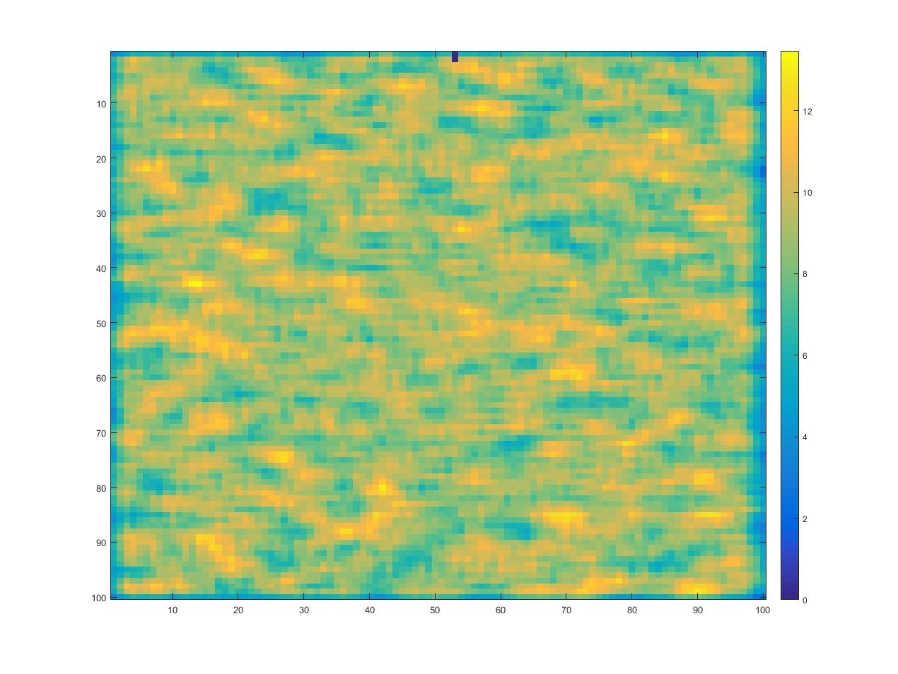
Start

Slide 5
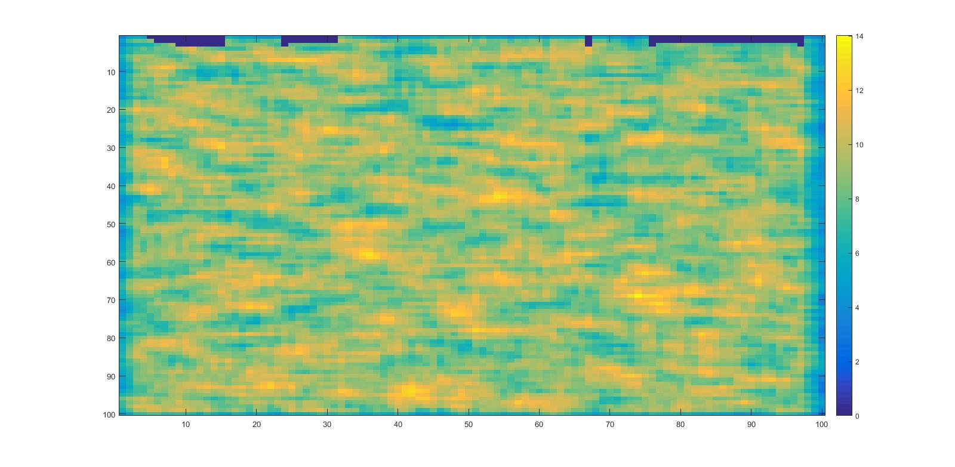
Continue

Slide 6
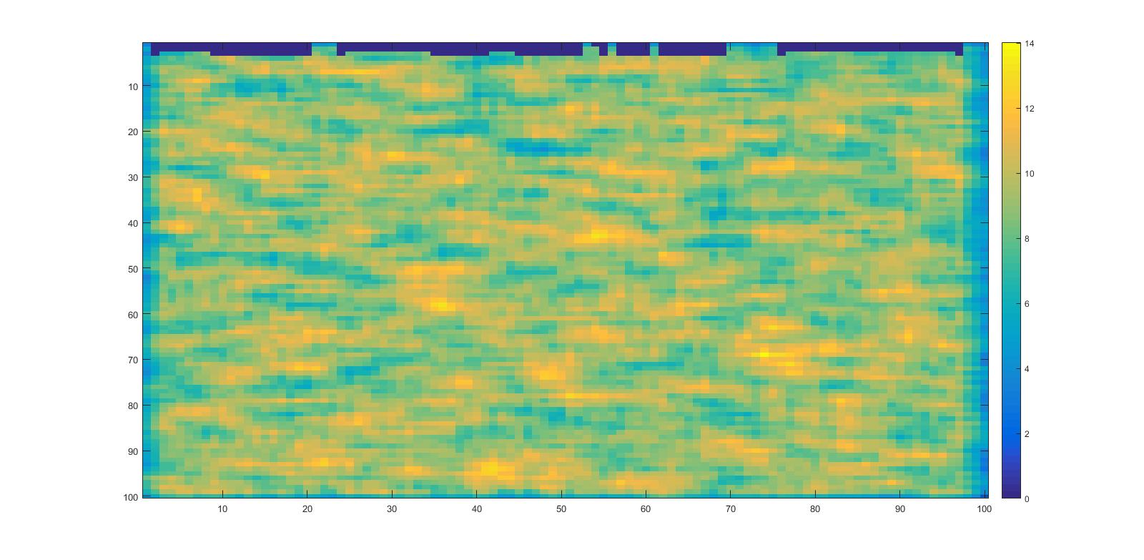
Continue

Slide 7
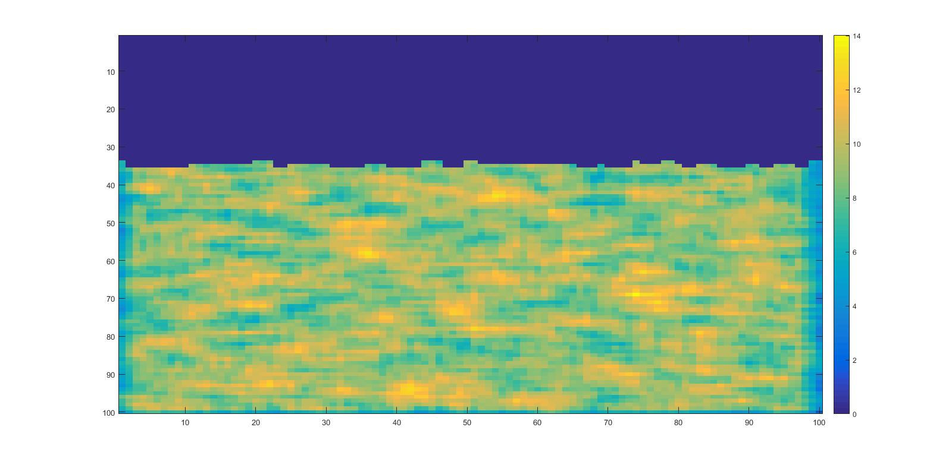
Continue

Slide 8
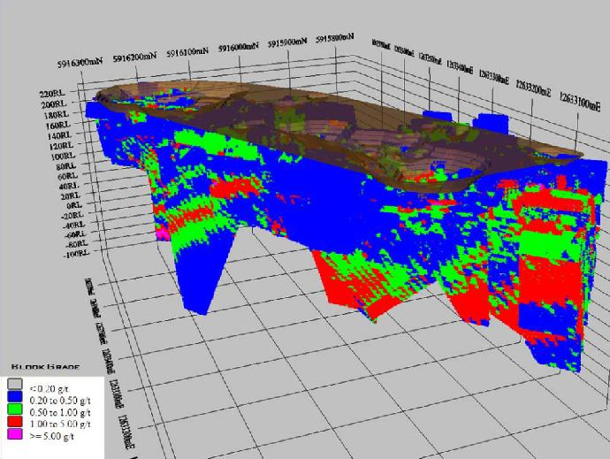
Real Block Model
Alhambra Resources Ltd.

Slide 9
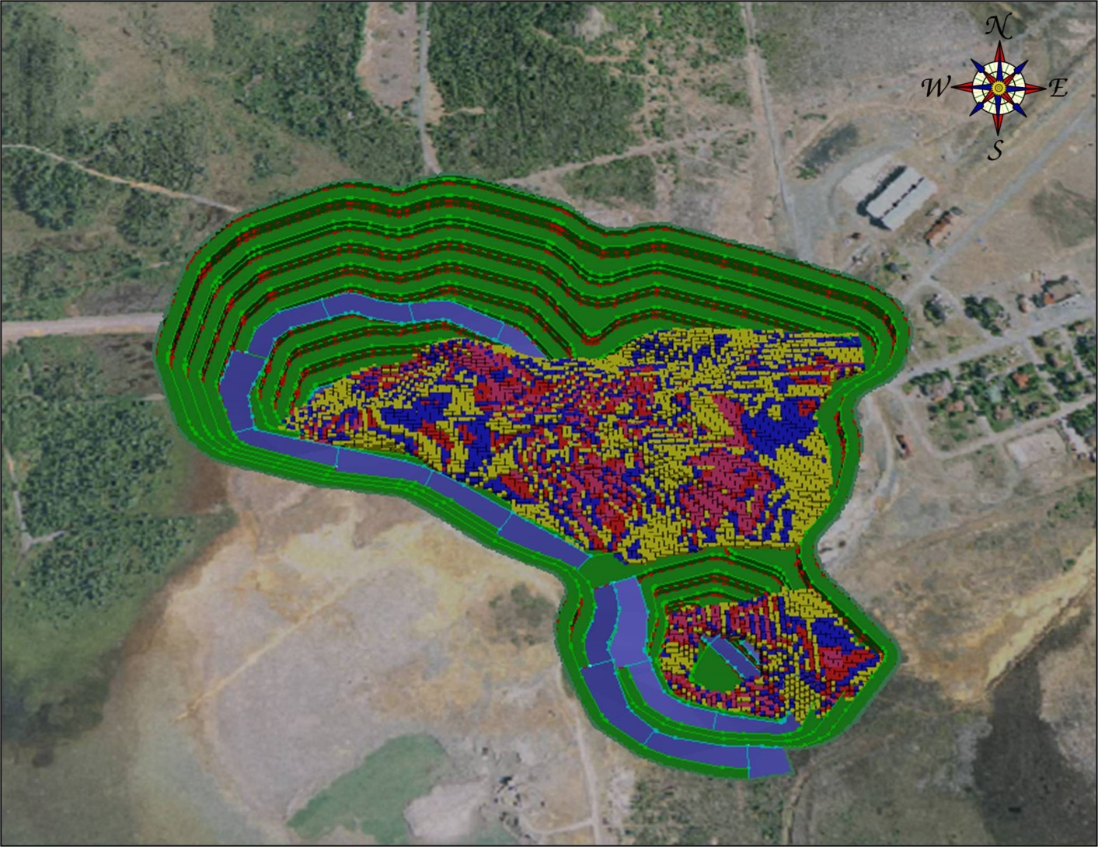
Real Block Model
Buchans Mineral Company.

