Slide 1
A decision tree for predicting the income individuals from U.S. Census data
Mark Patrick White
CSIT 599G Computational Data Mining
Hood College, Computer Science Department
Frederick, Maryland, USA
mpw6@hood.edu

Slide 2
A decision tree for predicting the income individuals from U.S. Census data
Project Overview
Introduction and Background
Approach and Implementation
Results
Future Work
Conclusions
Questions and Discussion
Mark Patrick White Hood College, Computer Science Department CSIT 599G Computational Data Mining

Slide 3
A decision tree for predicting the income individuals from U.S. Census data
Project Overview
The intent of this project is to use a standard data mining technique (classification with a decision tree algorithm) on a collection of U.S. Census data in order to predict the income range of future census entries.
The goal of the project is to make accurate predictions on whether a person makes either up to or more than $50,000 annually, based upon certain attributes associated with that person’s census information.
Mark Patrick White Hood College, Computer Science Department CSIT 599G Computational Data Mining

Slide 4
A decision tree for predicting the income individuals from U.S. Census data
Project Overview
U.S. Census Bureau Data (census.gov)
Decision Tree can be used to predict an individual’s income using a subset of U.S. Census data
Modified ID3 Decision Tree
More data improves results, but also can complicate results
Mark Patrick White Hood College, Computer Science Department CSIT 599G Computational Data Mining

Slide 5
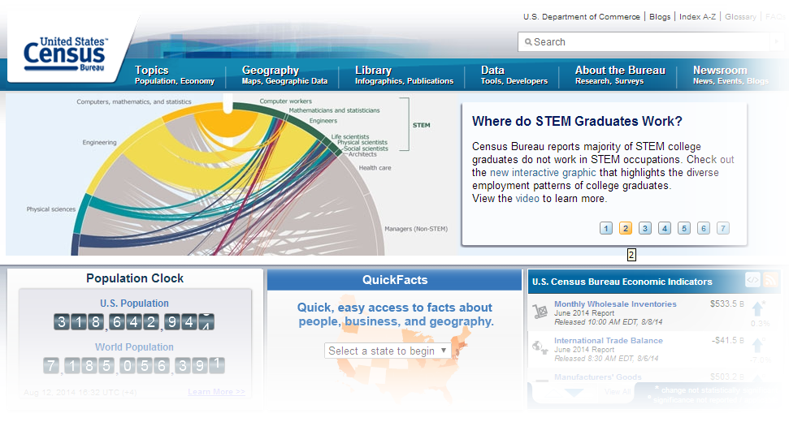
A decision tree for predicting the income individuals from U.S. Census data
Introduction and Background
U.S. Census Bureau
http://www.census.gov/
Mark Patrick White Hood College, Computer Science Department CSIT 599G Computational Data Mining

Slide 6
A decision tree for predicting the income individuals from U.S. Census data
Introduction and Background
Part of the U.S. Department of Commerce
Primary mission is the U.S. Census every ten years, which allocates the seats of the U.S. House of Representatives to the states based on their population.
In addition to the decennial census, the Census Bureau continually conducts dozens of other censuses and surveys, including the American Community Survey, the U.S. Economic Census, and the Current Population Survey.
Bureau censuses and surveys are used by the federal government help assign budgetary allocations to various agencies and jurisdictions.
Mark Patrick White Hood College, Computer Science Department CSIT 599G Computational Data Mining

Slide 7
A decision tree for predicting the income individuals from U.S. Census data
Approach and Methodology
Approach
Preprocess a sample of U.S. Census data, collected from the UCI Machine Learning Repository (https://archive.ics.uci.edu/ml/datasets/Census+Income)
Use ID3 Decision Tree Algorithm with training set to generate a decision tree
Process test set using driver application running the decision tree logic to show number of hits/misses for decision tree predictions
Mark Patrick White Hood College, Computer Science Department CSIT 599G Computational Data Mining

Slide 8
A decision tree for predicting the income individuals from U.S. Census data
Approach and Methodology
ID3 Algorithm Summary
Calculate the entropy of every attribute using the data set
Split the set into subsets using the attribute for which entropy is minimum (or, equivalently, information gain is maximum)
Make a decision tree node containing that attribute
Recurse on subsets using remaining attributes
Mark Patrick White Hood College, Computer Science Department CSIT 599G Computational Data Mining

Slide 9
A decision tree for predicting the income individuals from U.S. Census data
Approach and Methodology
UCI Dataset Attributes
age: continuous.
workclass: Private, Self-emp-not-inc, Self-emp-inc, Federal-gov, Local-gov, State-gov, Without-pay, Never-worked.
fnlwgt: continuous. (???)
education: 16 distinct education attribute classes.
education-num: continuous.
marital-status: 7 distinct marital status attribute classes.
occupation: 14 distinct occupation attribute classes.
relationship: Wife, Own-child, Husband, Not-in-family, Other-relative, Unmarried.
race: White, Asian-Pac-Islander, Amer-Indian-Eskimo, Other, Black.
sex: Female, Male.
capital-gain: continuous. (???)
capital-loss: continuous. (???)
hours-per-week: continuous.
native-country: 41 distinct native country attribute classes.
Mark Patrick White Hood College, Computer Science Department CSIT 599G Computational Data Mining

Slide 10
A decision tree for predicting the income individuals from U.S. Census data
Approach and Methodology
Test Execution Dataset Attributes
age_class: 5 distinct age attribute classes (U21, U30, U40, U55, 55PLUS).
workclass: 8 distinct workclass attribute classes.
education: 16 distinct education attribute classes.
marital_status: 7 distinct marital status attribute classes.
occupation: 14 distinct occupation attribute classes.
relationship: 6 distinct relationship attribute classes.
race: 5 distinct race attribute classes.
sex: Female, Male.
hours_class: 5 distinct hours-per-week attribute classes (UPTO20, UPTO40, UPTO60, UPTO80, 80PLUS).
native_country: 41 distinct native country attribute classes.
Target Test Attribute
income_class: <=50K, >50K
Mark Patrick White Hood College, Computer Science Department CSIT 599G Computational Data Mining

Slide 11
A decision tree for predicting the income individuals from U.S. Census data
Approach and Methodology
Test Execution Dataset Attributes
age_class: 5 distinct age attribute classes (U21, U30, U40, U55, 55PLUS).
workclass: 8 distinct workclass attribute classes.
education: 16 distinct education attribute classes.
marital_status: 7 distinct marital status attribute classes.
occupation: 14 distinct occupation attribute classes.
relationship: 6 distinct relationship attribute classes.
race: 5 distinct race attribute classes.
sex: Female, Male.
hours_class: 5 distinct hours-per-week attribute classes (UPTO20, UPTO40, UPTO60, UPTO80, 80PLUS).
native_country: 41 distinct native country attribute classes.
Target Test Attribute
income_class: <=50K, >50K
Mark Patrick White Hood College, Computer Science Department CSIT 599G Computational Data Mining

Slide 12
A decision tree for predicting the income individuals from U.S. Census data
Results
Trouble in Prediction Paradise
Resulting Decision Tree was over 118,000 lines of code
Java compiler can only handle up to 64K of code
Sequential scale back of learning data was required
Mark Patrick White Hood College, Computer Science Department CSIT 599G Computational Data Mining

Slide 13
A decision tree for predicting the income individuals from U.S. Census data
Results
Learning set of 3500 records with 10 attributes (118000+ lines of code)
Learning set of 500 records with 10 attributes (35000+ lines of code)
Learning set of 3500 records with 8 attributes (5000+ lines of code)
Learning set of 2000 records with 8 attributes (~4000 lines of code)
Learning set of 500 records with 8 attributes (~2000 lines of code)
Mark Patrick White Hood College, Computer Science Department CSIT 599G Computational Data Mining

Slide 14
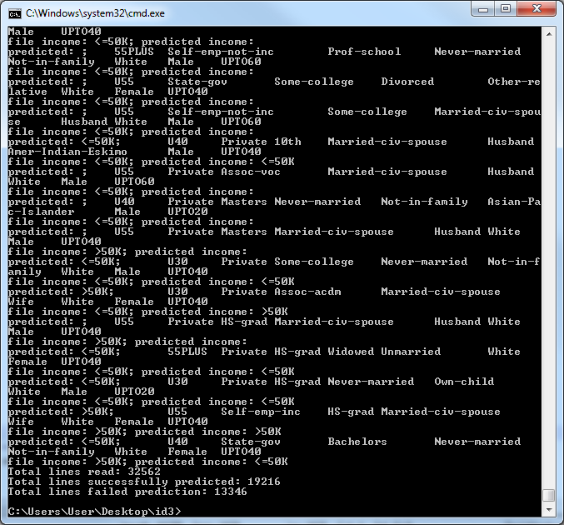
A decision tree for predicting the income individuals from U.S. Census data
Results
Learning set of 2000 records with 8 attributes (~4000 lines of code)
Total lines read: 32562
Total lines successfully predicted: 19216
Total lines failed prediction: 13346
Success (%): 59.0%
Mark Patrick White Hood College, Computer Science Department CSIT 599G Computational Data Mining

Slide 15
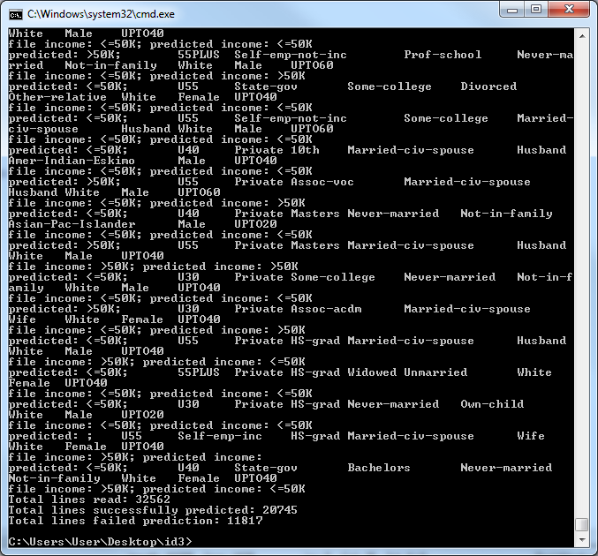
A decision tree for predicting the income individuals from U.S. Census data
Results
Learning set of 500 records with 8 attributes (~2000 lines of code)
Total lines read: 32562
Total lines successfully predicted: 20745
Total lines failed prediction: 11817
Success (%): 63.7%
Mark Patrick White Hood College, Computer Science Department CSIT 599G Computational Data Mining

Slide 16
A decision tree for predicting the income individuals from U.S. Census data
Results
Learning set of 2000 records with 8 attributes: 59.0%
Learning set of 500 records with 8 attributes: 63.7%
What’s going on here?
Mark Patrick White Hood College, Computer Science Department CSIT 599G Computational Data Mining

Slide 17
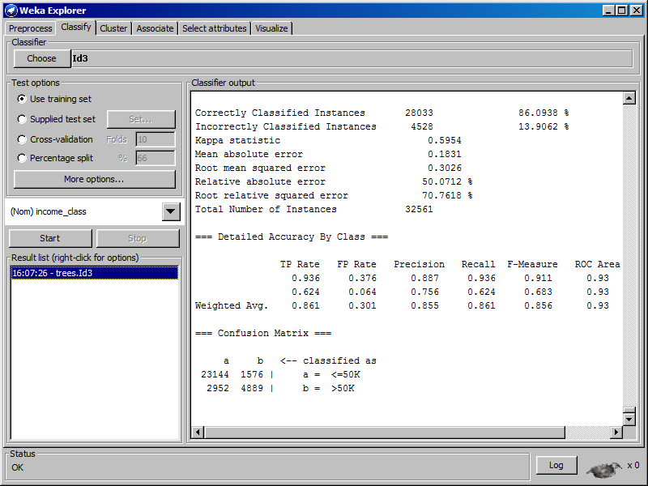
A decision tree for predicting the income individuals from U.S. Census data
Results
Weka (ID3 with learning set of all 32562 records)
Total lines read: 32562
Total lines successfully predicted: 28033
Total lines failed prediction: 4528
Success (%): 86.1%
Mark Patrick White Hood College, Computer Science Department CSIT 599G Computational Data Mining

Slide 18
A decision tree for predicting the income individuals from U.S. Census data
Future Work
Use larger subset of U.S. Census data
Include more attributes into the datasets
Use different classification algorithms
Streamline ID3 decision tree generation code
Mark Patrick White Hood College, Computer Science Department CSIT 599G Computational Data Mining

Slide 19
A decision tree for predicting the income individuals from U.S. Census data
Conclusions
Decision Tree prediction is heavily dependent upon the dataset (record variety, attributes).
Decision Tree prediction is heavily dependent upon the quality of the decision tree generation algorithm.
ID3 Decision Tree Classification is a fairly effective means of classifying/predicting data.
Mark Patrick White Hood College, Computer Science Department CSIT 599G Computational Data Mining

Slide 20
A decision tree for predicting the income individuals from U.S. Census data
References
Saini, R., P. Singh. “Classification using decision trees,” Internet: http://iasri.res.in/ebook/win_school_aa/notes/Decision_tree.pdf. [July 18, 2014].
Bache, K., Lichman, M., “Census Income Data Set”. Internet: https://archive.ics.uci.edu/ml/datasets/Census+Income. UCI Machine Learning Repository [http://archive.ics.uci.edu/ml]. Irvine, CA: University of California, School of Information and Computer Science. [July 18, 2014].
Wikipedia. “ID3 algorithm,” Internet: http://en.wikipedia.org/wiki/ID3_algorithm. [July 18, 2014].
Antonov, A., "Classification and association rules for census income data", Internet: http://mathematicaforprediction.wordpress.com/2014/03/30/classification-and-association-rules-for-census-income-data/. Mathematica for prediction algorithms: Using Mathematica implementations of machine learning algorithms [http://mathematicaforprediction.wordpress.com]. (March 30, 2014).
Mark Patrick White Hood College, Computer Science Department CSIT 599G Computational Data Mining

Slide 21
A decision tree for predicting the income individuals from U.S. Census data
Questions?
Mark Patrick White Hood College, Computer Science Department CSIT 599G Computational Data Mining

Slide 22
A decision tree for predicting the income individuals from U.S. Census data
Thank you!
Mark Patrick White
CSIT 599G Computational Data Mining
Hood College, Computer Science Department
Frederick, Maryland, USA
mpw6@hood.edu

