Slide 1
DSDP Status Update
2005 CDT Conference
Doug Gaff, Wind River Systems, PMC Lead
Martin Oberhuber, Wind River Systems, TM Project Lead
Darin Wright, IBM, Eclipse Platform

Slide 2
Outline
DSDP Overview
Device Debugging Project
  Mission & participation
  What we’ve done so far
  Overview of proposed changes in the Platform Debug interfaces
  Additional tasks on our roadmap
Target Management Project
  Mission & participation
  Upcoming release plans
  Proposal for remote C/C++ application launch configuration

Slide 3
DSDP: Device Software Development Platform
Goal: Develop framework and exemplary tools for device software development .
“Traditional” Software Dev. | Device Software Dev.
Local (changing!) | Remote
Hardware abstraction through OS | Custom hardware (DSP, Multi-core, FPGA, …)
Standards based | Many vendors – many connection schemes
 | Managed targets / access restrictions
 | Secure tunnels for deployed targets
Device Software Vendors want to plug-in solutions for their specific area of expertise → need a highly modular, pluggable framework for connectivity
Notes:
The DSDP space is very wide, with lots of vendors providing partial solutions in their area of expertise.
DSDP needs to be very modular, so that vendors can plug in THEIR implementations of connectivity, target descriptions, and target actions.
“Traditional” software development is also changing from local-only to adding remote hosts (thus DSDP-TM is relevant there as well):
- Multi-Platform development, I.e. build and debug on remote hosts from a single local installation
- Distributed / Remote Build
- Distributed Test environments for multiple platforms
- Web Applications deployed to remote servers
Managed targets – e.g. board labs; managed deployed targets (via DSM) with a database of deployed configurations (for updates, …)

Slide 4
DSDP Projects (www.eclipse.org/dsdp)
Device Debugging Project
  Interfaces: Drive extensions of the Platform and CDT debug interfaces to make them more applicable for embedded development
  Model: Explore changes in debug model to make the model more asynchronous for increased debugger performance
  Views: Explore extensions to Platform and CDT debug views to provide additional functionality for embedded development
Target Management Project
  creates data models and frameworks
  to configure and manage
    Targets, processors, cores, scan chains, processes, threads
    local, remote or deployed
  their connections,
    TCP, UDP, Serial, various agents, ICE boxes, …
  and their services.
    Download, run, debug, query information, reset, FLASH utility, …
    UI for configuring services, and UI-less delegate for execution
Mobile Java Tools Project
  UI Design, Application Creation, Code Generation, Localization, Packaging, Deployment, and Management of Mobile Java Applications.

Slide 5















Companies active in DSDP
Notes:
These are the companies that were at the last DSDP face-to-face meeting.
- Embedded OS vendors, semiconductor vendors, tools vendors
More companies have been at previous phone meetings:
- HP
- MontaVista
- Nokia

Slide 6
Device Debugging Project

Slide 7
Towards A Flexible Debug Platform (3.2)
State of the World in 3.1 and Earlier
  A debug model provides implementations of specific interfaces (IDebugTarget, etc), and fires debug events in order for the following features to work:
    View updating
    Action updating
    Source Lookup
  The Debug view is the single source of the ‘active debug context’ and must be open to drive a debugger.
  The variables view (as others) is hard wired to the selection in the Debug view, and only responds to IStackFrame selections.
  Actions (step, terminate, etc.), are hard wired to the selection in the Debug view, and respond to debug events.

Slide 8
Requests from the Community
DSDP and PTP projects found the debug platform does not meet their needs and expressed the need for these features:
  Flexible debug element hierarchy
  Pluggable view update policies
  Asynchronous interactions between UI and debug model
  Flexible view wiring (e.g. input to variables view)
  Ability to debug multiple sessions simultaneously
Meetings resulted in groups being formed to investigate solutions to each of these problems
  It turns out that all these features are interrelated
  i.e. A flexible hierarchy is only useful if there is a way to update it

Slide 9
The Proposed Solution
Old Way
  Hierarchy is based on IDebugTarget/IThread/IStackFrame…
  View update policy is based on events
  API is synchronous
  View wiring is based on stack frame selection
  Source lookup is based on stack frame selection
New Way
  Goal: Support arbitrary debug architectures and implementations of debuggers.
  A debugger implementation provides a layer of adapters to interact with the platform’s basic views and actions
    View Content: Content and label adapters for views
    View Update: Update policy adapters for views
    User Interaction: Capability adapters for actions, Source display adapters
  The debug platform provides adapters for implementations of the standard model
    Existing models continue to work; new models have a choice
  Additionally the platform provides services for debug context management
    Ways to retrieve and provide the active debug context that drives a debug session

Slide 10
(1) View Content: 3.1
_{getChildren()}
_{schedule}
_{Deferred Content}
_{Manager}
_{Viewer}
_{Content Provider}
_{Job}
_{add(child)}
_{place-holder}
_{getChildren()}
_{replace}
_{Workbench Adapter}
_{Standard Debug}
_{Model}
_{getThreads(), etc.}

Slide 11
View Content: 3.2
_{Viewer}
_{Content Adapter}
_{Model Specific API}
_{retrieveChildren()}
_{add(…)}
_{done()}
_{Model}
_{Request Monitor}
_{setChildren()}

Slide 12
(2) View Update: 3.1
_{Viewer}
_{Standard Debug}
_{Model}
_{Event Handler}
_{Model}
_{refresh()}
_{update()}
_{select()}
_{expand()}
_{Model}
_{events}

Slide 13
View Update: 3.2
_{Viewer}
_{Update Policy}
_{Element}
_{installs}
_{Model Specific API}
_{refresh()}
_{update()}
_{select()}
_{expand()}
_{Model}

Slide 14
User Interaction: 3.1
_{Actions}
_{(instanceof IStep, etc)}
_{Source}
_{Locator}
_{Debug}
_{View}
_{Selection}
_{Source Lookup}
_{events}
_{Model}
_{Presentation}
_{Standard Debug}
_{Model}

Slide 15
User Interaction: 3.2
_{Actions}
_{(getAdapter IStep, etc)}
_{Debug}
_{View}
_{Selection}
_{Provides context}
_{Debug Context}
_{Manager}
_{Source Lookup}
_{(getAdapter ISourceDisplay)}

Slide 16
Summary
The debug platform needs to replace all of its element specific and event specific code with a layer of adapters that other models contribute.
  This way the debug platform can interact with any implementation of a debugger based on these adapters
  Note that many of the adapters are not debug specific
    View content, label, update and selection policies are independent of debug (but we own the code)
  We plan to maintain capability adapters with existing interfaces such as IStep, ITerminate, etc., except that implementors no longer need to fire events in underlying implementations.
    It’s not clear that we need to replace these interfaces with equivalent ‘asynchronous request’ adapters

Slide 17
What does this infrastructure enable?
Flexible element hierarchies/content per element, per view
Customized labels per element, per view
Pluggable update policy per element, per view
Pluggable source lookup
Retargettable debug actions
Flexible view wiring
Debugging without the debug view
Debugging simultaneous sessions in different views

Slide 18
Implementation Plan
3.2 Milestone 3 (API draft) – November 4th, 2005
  Release first draft and implementation of new APIs
  Provide implementation of adapters for standard models
    Existing models continue to work using the new support
  Provide draft of migration documentation
    Actually, there should be no migration
    Documentation describes how to use the new support
3.2 Milestone 4 (API freeze) – December 16th, 2005
  Collect feedback from users of the new API
  Evolve and solidify the API as required to converge with API freeze
The current thinking is to make the API’s internal for the 3.2 release to allow users of the Debug model time to prototype and provide feedback.

Slide 19
CDT and Device Debugging
Goal: Reduce duplication where possible
Where do these Platform Debug changes fit into your roadmap?
Half of DD participates build commercial products on top of CDT, so an ideal solution is for CDT to adapt to these interfaces
  DD participates will provide use cases for the adaptable hierarchy
Some companies work directly on top of the Platform, so DD will also need to concentrate on these use cases.
References
  www.eclipse.org/dsdp/dd
  Darin’s full proposal: http://www.eclipse.org/downloads/download.php?file=/dsdp/dd/2005-10-12_Chicago_DD_FlexibleDebugPlatform.ppt
  (tentative) Dec 20 conference call to introduce the deployed changes to the community.

Slide 20
Next Steps for Device Debugging
Feedback on Platform Debug API changes and prototyping implementations
Embedded-specific views
  Examples: on-chip registers, hardware cache, flash programming
  Depends on needs of participating companies
Multiple-context debugging
  Debug and data views colorized and labeled for specific contexts being debugged simultaneously
  Clone and pin capabilities for making copies of views
  Context-specific breakpoints
  Colorized instruction pointers
  See: http://www.eclipse.org/downloads/download.php?file=/dsdp/dd/2005-10-12_Chicago_DD_MultipleDebugContexts.ppt and http://www.eclipse.org/downloads/download.php?file=/dsdp/dd/2005-10-12_Chicago_DD_EclipsePinnedDebugViews.ppt
Open Debug Server
  Proposal by TI to collaborate on an open framework for a Debug Engine focused on embedded development

Slide 21
Target Management Project

Slide 22
TM: Services
Typical services to be provided include
OS-Aware Services
  Remote File System (for File download)
    Plus mappings for cross-mounted file systems
  Remote Process Explorer (Query target info, Kernel Objects)
  Kernel Module Downloads
Services that do not necessarily need an OS
  Remote Console (Serial, TCP/IP, …)
  Reset / Reboot (Start and Stop Cores)
  RAM download of arbitrary images (e.g. via JTAG)
  FLASH utility
  Debugger Launcher
Need pluggable services to be contributed by vendors
Want to autodetect services as much as possible
Notes:
Services should be available as GUI plug-in (e.g. menu),
But also as a component or action to use as part of a Launch.
When a Service Type is defined with a common interface, vendors can exchange a service with a different one of same type.
This slide can be gone over very fast if you don’t want to explain services in much detail.

Slide 23
Step 1: IBM RSE
IBM Remote System Explorer (RSE)
A Framework and product for working on remote systems
Shipping to IBM partners since 4 years
Planned to go Open Source under DSDP-TM in January
The RSE provides
A standardized data model for remote systems (based on EMF)
A framework for dealing with remote systems and subsystems
Pluggable connection schemes
  Default “Datastore” communication works on most systems
Predefined views, reusable widgets and filters
http://www.developer.ibm.com/isv/rational/remote_system_explorer.html
Notes:
Might want to mention that RSE was originally developed for remote Edit and Compile on Mainframe computers.
Still shipping with the IBM iSeries systems.
But the framework is very useful for DSDP-TM.
“Datastore” uses a special Java-based agent on the remote computer. It basically runs on every remote system that has a JVM.
On devices, Java is often not available. But RSE Plug-ins already exist for many other connection schemes besides “Datastore”.
An FTP plugin, for example, exists today.

Slide 24
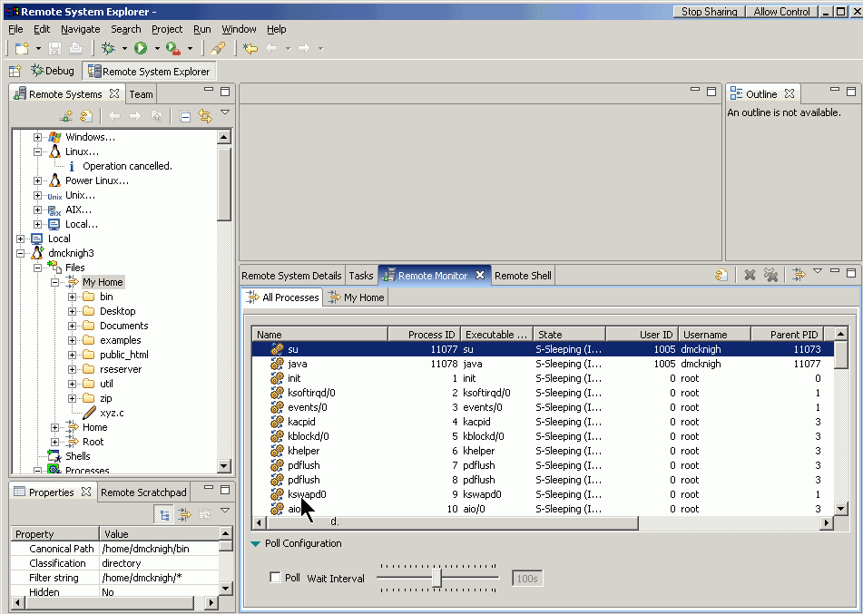
RSE Screenshot
Notes:
The left pane shows the Remote Systems view:
- Multiple system types are possible (more system types pluggable via extension point)
- The “Files” subsystem supports file system browsing, upload, download on a remote host
- Files can be edited as if they were local
- Customizable filters limit the view to show only relevant items (mimizes data transfer)
- Other subsystems exist for “Shells” and “Processes”
- The bottom pane shows the Remote Monitor showing process activity on a remote system

Slide 25
Step 2: Integrate with CDT
Most device software development is done in C
  Some big players have products based on CDT
  Integrating DSDP-TM with CDT provides a basis for many products
DSDP-TM / RSE Views and Services can be added as plug-ins to any Eclipse based product without further integration
Launches require integration → Advantages for CDT
  Connections can be team-shared and used in multiple Launches / Products
  “Remote Application” is cleaner than “Local Application → Remote settings”
  Contributed DSDP-TM services and actions can be used
    In a first version, only “Start debugger” will be enabled
  The new Launch remains optional (shown only if DSDP-TM is installed)
Notes:
Current products that are based on CDT and support remote Launching use the “Local C/C++ Application” Launch
and provide an additional GUI for debugger setup via CDI, to modify the debugger options such that a remote application
is created or attached.
We provide a clean, flexible connection configuration, connection selection and contributed services

Slide 26
Plug-in dependencies
Products
Vendor-specific debuggers, connection types, services, …
(Optional) CDT “Remote Application” Launch
DSDP-TM core
DSDP-TM plug-ins
CDT
Wizards
Views
Reusable Widgets
services
Services (Remote Files, Processes, Shells)
connection types
Data Models (EMF)
Eclipse Platform
Notes:
The CDT “Remote Application” Launch depends on DSDP-TM.
But this doesn’t necessarily mean that products based on CDT have to depend on DSDP-TM.
The optional “Remote Application” Launch will not be loaded if the DSDP-TM is not available.
DSDP provides views, team-shareable connections, and pluggable services.
The arrows mean “depends on”.

Slide 27
Where should the integration live?
“Remote C/C++ Application” Launch depends on DSDP and CDT
  DSDP-TM: Target-specific part (launch actions)
  CDT: Tool-specific part (select project, build, launch shortcut)
  Debuggers based on CDI also depend on CDT
We think the integration should be shipped with CDT, because DSDP-TM is considered base technology for many projects
  FDT, PTP, TPTP, … may also want to use DSDP-TM
  DSDP-TM cannot ship integrations for all of these
DSDP-TM will provide public interfaces for all functionality needed by the integration
Notes:
Launches have two parts:
- a “Tool-specific part” (Select a C/C++ Project; build-on-launch; Launch Shortcuts)
- a “Target-specific part” (Download, remote run, remote attach)
FDT … Fortran Development Tools
PTP … Parallel Tools Platform
TPTP … Test and Performance Tools Project

Slide 28
Some DSDP-TM Interfaces
The code shown below is just for example. Finalization of interfaces is pending RSE to be released.
interface ITargetUI {
ITargetSelectWidget makeTargetSelectWidget(Composite parentControl);
ITargetConnectionReference showTargetSelectDialog();
}
interface ITargetService {
ITargetConnection getConnectionData(ITargetConnectionReference ref);
void connect(ITargetConnection tc, IProgressMonitor progress);
ITargetAction getAvailableActions(ITargetConnection tc);
}
interface ITargetModelFactory {
ITargetConnectionReference makeTargetConnectionReference(String rep);
}
Notes:
The CDT Integration needs to
Show a widget for selecting (or potentially creating) a connection for the given Launch
Persist the target connection reference as a String in the Launch, and re-create it from its String representation
Get target connection data that is relevant for attaching the debugger properly (and potentially store additional data that is relevant for the debugger only, like a default Source Path Mapping for the given connection)

Slide 29
Future Directions of DSDP-TM
Connectors: Define a Framework for even more modular connection chains to the target than RSE provides today
  We plan to use the Eclipse Communication Framework (ECF)
  Add more protocol support (ssh, …)
  Framework for auto-detecting available services and protocols
Launch Actions and Launch Sequencer
  “Custom Remote Launch” to be composed of arbitrary actions (configure, download, reset, start, …) contributed via extension point
  Launches are like a “script” to run against one or more targets
Connection Groups for controlling multiple targets at the same time
Framework for Board Lab Management and Access Control
Notes:
Eclipse Communication Framework (ECF) planned to provide connection abstractions for DSDP-TM in the future.
ECF is currently a Technology project (depending on Eclipse Runtime and OSGi only).
Since it provides good, lightweight abstractions for communication, it might go into the Platform eventually.
The First version of DSDP-TM core will not (yet) depend on ECF.
Implementation of the Launch Sequencer might depend on how Scripting in general progresses in Eclipse

Slide 30
Project Plan / Timeline
Implementation - Milestone 1 (January)
RSE goes Open Source! – Release 1.0
Implementation - Milestone 2 (With Eclipse 3.2, End of June)
CDT Integration
Target Definition & Selection, “Remote Debug” Launch configuration
Implementation - Milestone 3
Standards based target connections (FTP, Telnet, ssh?)
“Download” and “Run” Launch actions based on above services
Implementation - Milestone 4
Open Connectors for HW Debuggers (Preconfigured Connection Types only)
Connection Model for HW Debugging (complex connector setup)
Flexible Launch Scripts
Future
Connector plumbing algorithm
Framework for autodetect
Adapters for Target access control (shared board labs)
Ssh tunneling connector
Notes:
People might notice that the M2 (first CDT integration) is NOT guaranteed to have FTP transport and download as part of the Launch.
Explain that for us it is important to get the basic infrastructure out as a release, so that vendors can start working with it / extend it.

Slide 31
Next steps
Exactly define DSDP-TM interfaces to be used by CDT
  This may require RSE to go Open Source before
Release RSE on time
Implement “Remote Launch”
Clarify build infrastructure to ship “Remote Launch” as part of CDT
  When can “Remote Launch” go into the CDT release train?
Get Involved!
  Next Phone Conference Nov.7
  Next Face-to-face meeting Feb.21-23, Toronto
  Meet at EclipseCon (Mar.20-23, Santa Clara)
  http://www.eclipse.org/dsdp/tm
Notes:
AI Doug: Please clarify CDT release train, to understand when and how we can contribute the “Remote Launch”

