Slide 1
WR Debugger Backend Interface Proposal
Martin Oberhuber, Wind River Systems

Slide 2
The Wind River Debugger
The Wind River debugger is
Multi-X external debug server
gdb/mi ASCII protocol via TCP/IP socket
Standard gdb/mi commands + WR extensions
There was a need to
Launch the debugger, or connect to an existing instance
Send gdb/mi commands and wait for response
  Allow gdb/mi parallel command execution (multiplexing)
  Simple gdb/mi response parsing
  Allow command canceling
Listen to gdb/mi asynchronous events.

Slide 3
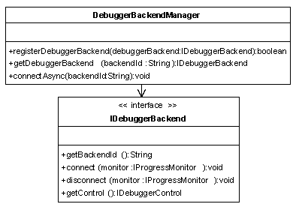
WR Debugger Backend Interface
The proposed interface fulfills these needs.
Not necessarily bound to gdb/mi
  Commands and responses can be any Object
Debuggers can be connected in any way (remote socket, local JNI)
connectAsync() performed as an Eclipse Job

Slide 4
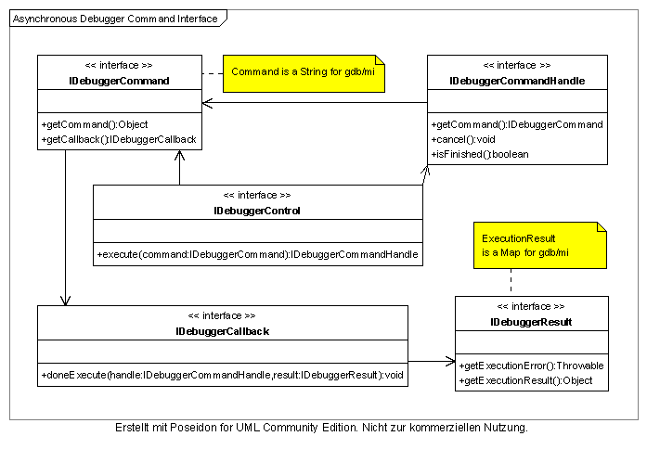
Asynchronous Debugger Command Interface

Slide 5
Future Vision / Next Steps
Planned: Debugger Command Lifecycle listener
  allows debugger command consistency checks
  allows collecting performance data
Planned: Debugger Backend Actions
  Extension point based backend action contribution
    Example: Actions for download module, unload module, fetch thread list etc.
  Benefit: Extensible backends, abstract actions
  Benefit: Clients (TM, Launch) do not need to know the backend specific command details, they only care for the action availability

