Slide 1
jQuery Mobile School – Video 2
Adding UI Elements

Slide 2
In this Video
We will learn about adding UI Elements
Buttons
List View
Search Box
Navigation

Slide 3
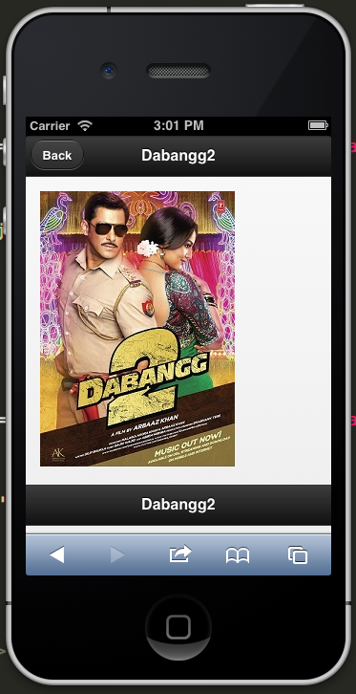
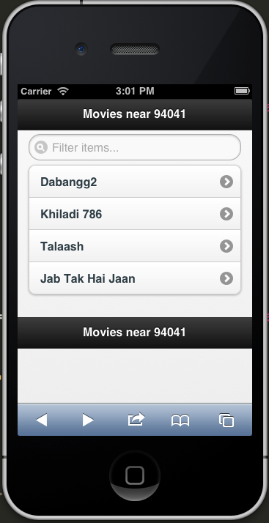
Final Output on Mobile Device

Slide 4
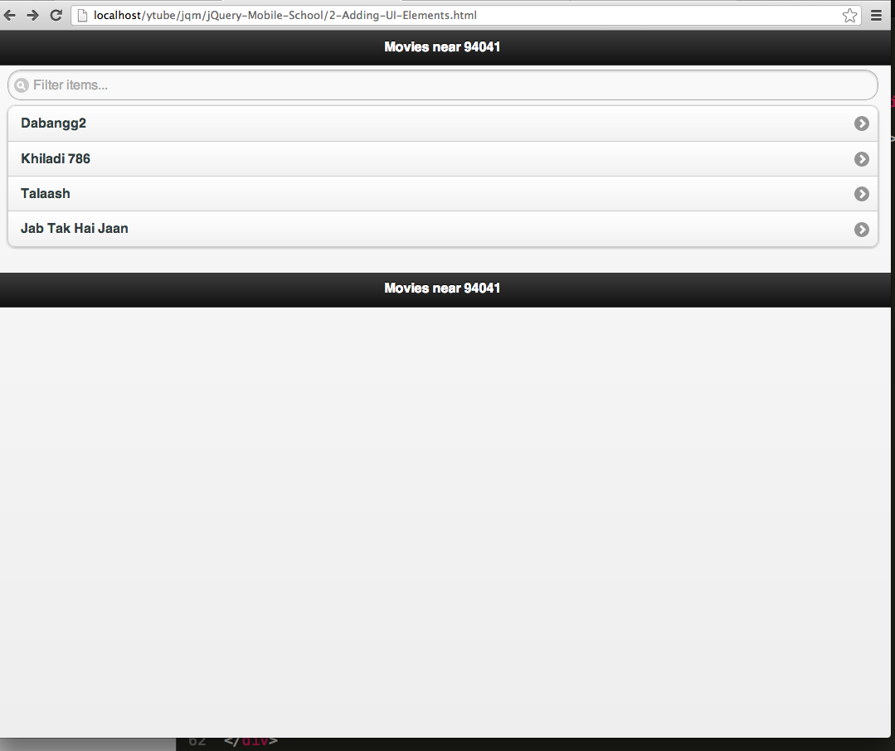
Same output on web browser ( chrome in this example )

Slide 5
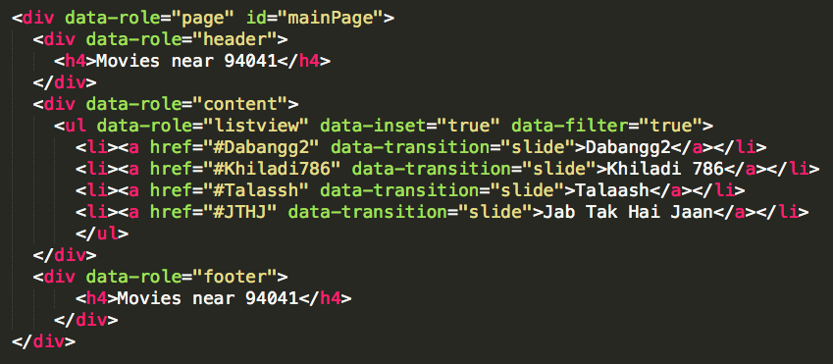
Code –Adding Main page

Slide 6
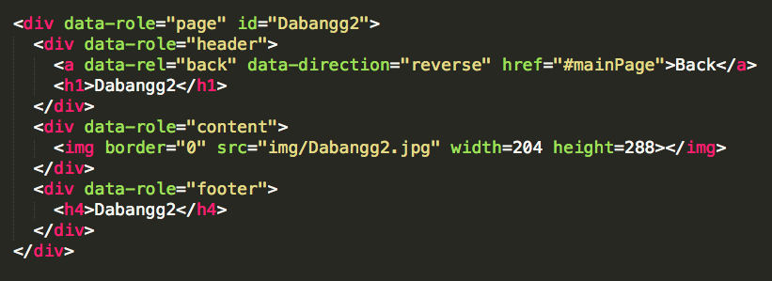
Code – Adding sub page

Slide 7
6 new data attributes ☺
Data-role =“list-view”
Data-inset=“true”
Data-filter=“true”
Data-transition=“slide”
Data-rel=“back”
Data-direction=“reverse”

Slide 8
Recap
6 new data* attributes for :
Adding UI Elements
Button
List view
Searching
Navigation

Slide 9
Up Next
Dialogs
Popups
Page Transitions
Themes
Thanks !

