Slide 1
jQuery Mobile School – Video 3
Themes & Navigation
JQM 1.2.0
jQuery 1.8.2
Date : 12/26/12

Slide 2
Things we will cover …
5 Inbuild JQM themes – a,b,c,d,e
Navigation in JQM web app :
To Sub page, New Page or an External Page
With Ajax vc Full Page reload
Using Back button, Global vs local back button
Dialog Box
Transitions
JQM 1.2.0
jQuery 1.8.2
Date : 12/26/12

Slide 3
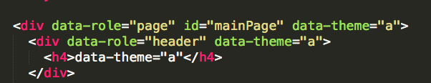
data-theme attribute
JQM 1.2.0
jQuery 1.8.2
Date : 12/26/12

Slide 4
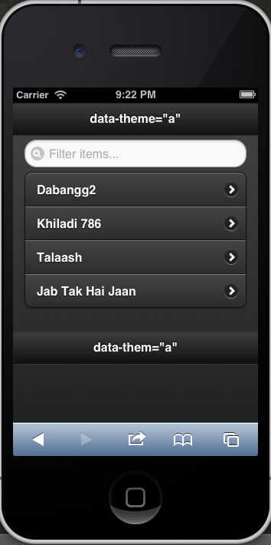
data-theme=“a”
JQM 1.2.0
jQuery 1.8.2
Date : 12/26/12

Slide 5
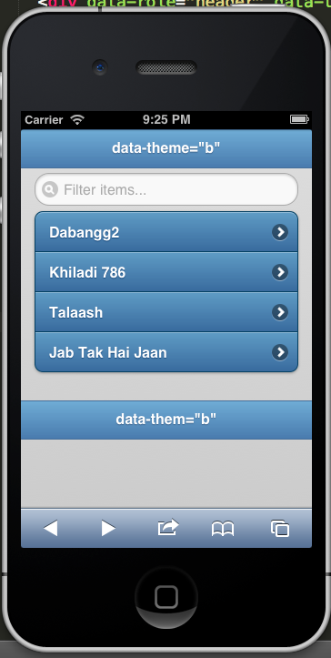
data-theme=“b”
JQM 1.2.0
jQuery 1.8.2
Date : 12/26/12

Slide 6
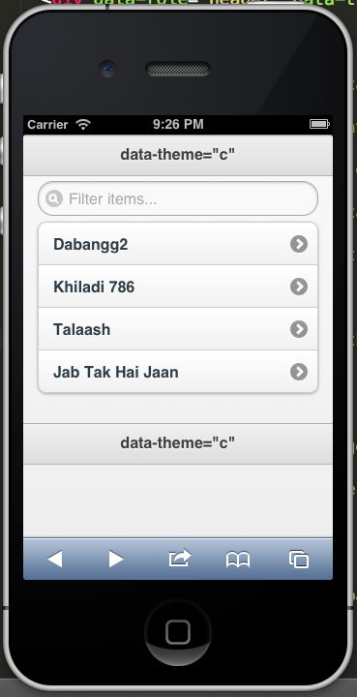
data-theme=“c”
JQM 1.2.0
jQuery 1.8.2
Date : 12/26/12

Slide 7
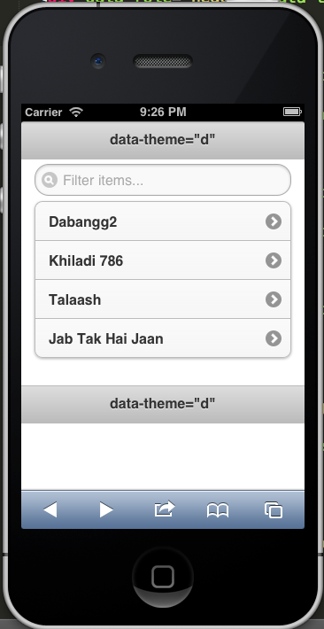
data-theme=“d”
JQM 1.2.0
jQuery 1.8.2
Date : 12/26/12

Slide 8
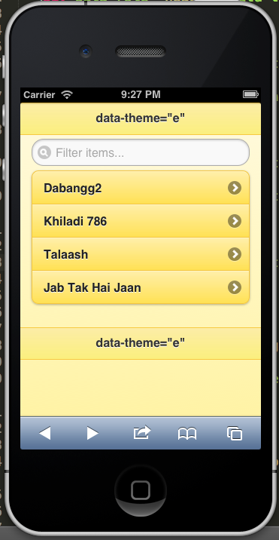
data-theme=“e”
JQM 1.2.0
jQuery 1.8.2
Date : 12/26/12

Slide 9
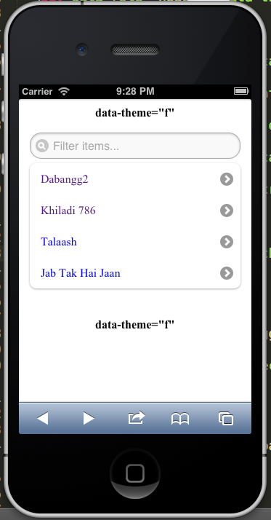
data-theme=“f” – Does not exits
JQM 1.2.0
jQuery 1.8.2
Date : 12/26/12

Slide 10
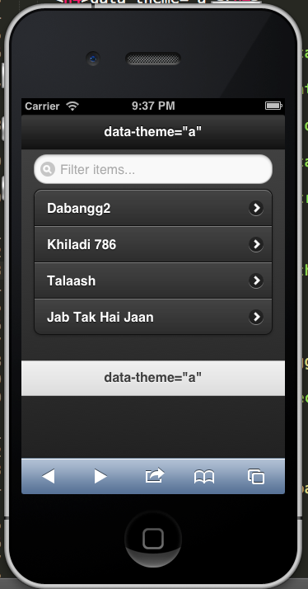
Mix and match themes
JQM 1.2.0
jQuery 1.8.2
Date : 12/26/12

Slide 11
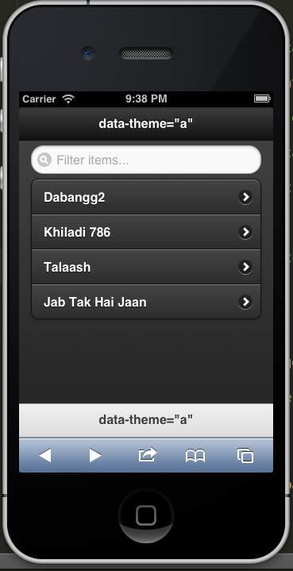
data-position attribute
data-position=“fixed”
JQM 1.2.0
jQuery 1.8.2
Date : 12/26/12

Slide 12
Navigation
Creating a nav bar
Navigating to Sub Page (ajax)
Navigating to External Page (ajax)
Navigating to External JQM Page ( non ajax - full page load)
Navigation to External non JQM Page (non ajax – full page load)
Creating global back button for all sub pages
Creating default transition for all sub pages
JQM 1.2.0
jQuery 1.8.2
Date : 12/26/12

Slide 13
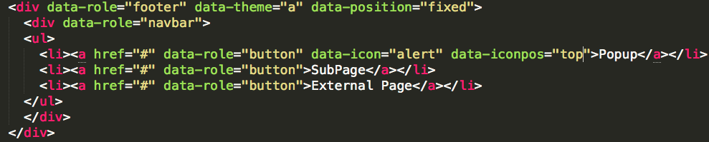
Positioning Icons in Nav Bar
Data-role=“navbar”
Data-icon=“alert”
Data-iconpos=“right”
JQM 1.2.0
jQuery 1.8.2
Date : 12/26/12

Slide 14
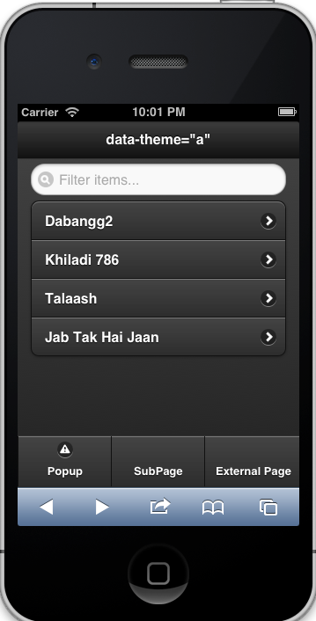
Result
JQM 1.2.0
jQuery 1.8.2
Date : 12/26/12

Slide 15
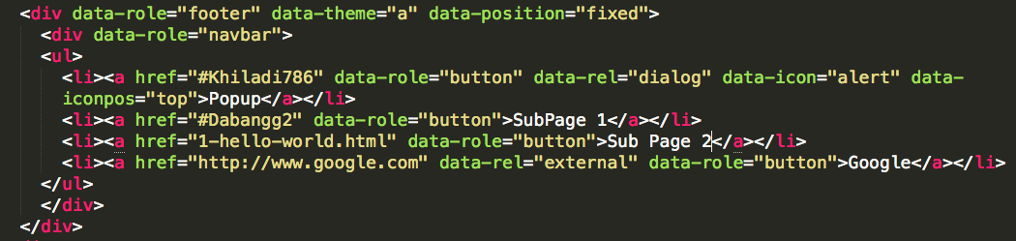
2. Types of Navigations
Sub page (ajax)
Sub page (Popup + ajax)
Sub page ( full load )
External page ( full load )
JQM 1.2.0
jQuery 1.8.2
Date : 12/26/12

Slide 16
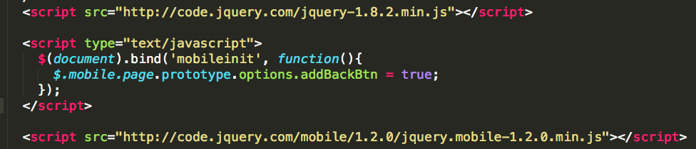
3. Global back button
MobileInit Event
JQM 1.2.0
jQuery 1.8.2
Date : 12/26/12

Slide 17
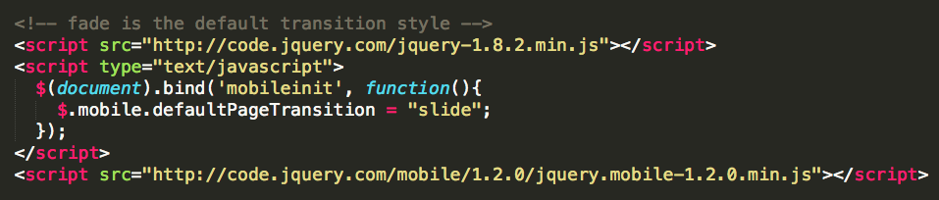
4. Global Transition behaviour
JQM 1.2.0
jQuery 1.8.2
Date : 12/26/12

Slide 18
Recap
5 Different inbuild themes, data-theme attribute
Navigation to sub page, external page, ajax, non ajax
Data-role=“navbar”, data-position=“fixed”, data-icon=“alert”, data-iconpos=“top”
Creating global behavious for back button and tranistion event by overwriting mobileinint event
JQM 1.2.0
jQuery 1.8.2
Date : 12/26/12

