Slide 1
jQuery Mobile School video 6
Movie App code Details

Slide 2
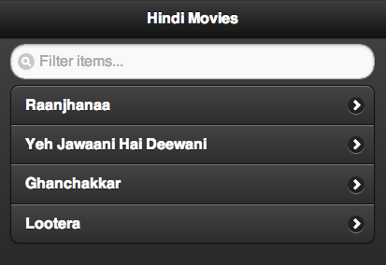
Code Path for Movie Listing page
index.html
Application.js
MovieListRouter.js
MovieListView.js
bit.ly/movies-app

Slide 3
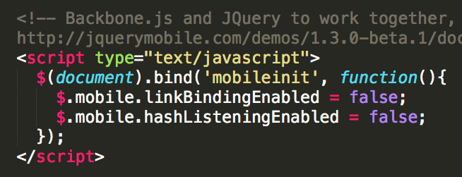
Disable LinkBinding & hashListening in your HTML page

Slide 4
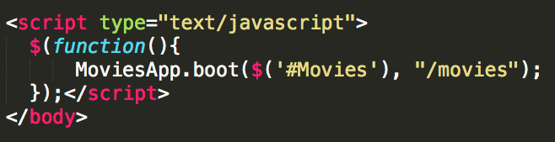
Index.html

Slide 5
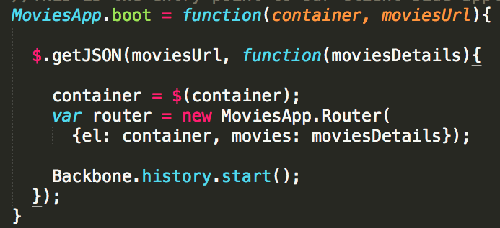
Application.js

Slide 6
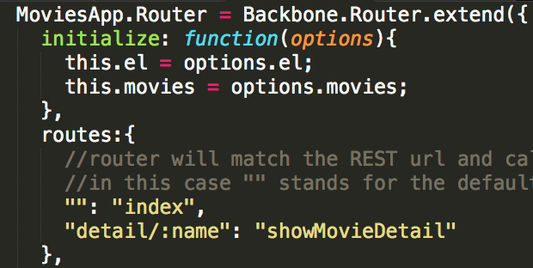
MovieListRouter.js (index)

Slide 7
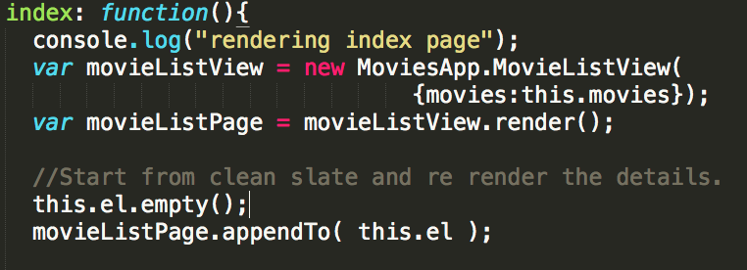
MovieListRouter.js (index action)

Slide 8
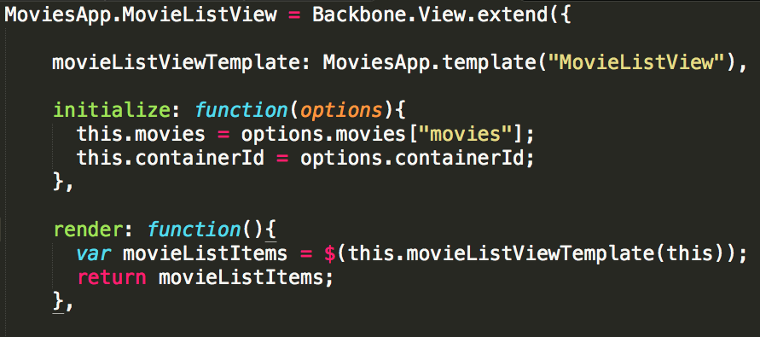
MovieListView.js (1)

Slide 9
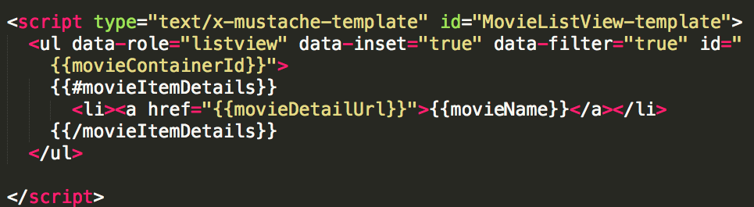
MovieListView.js(2)

Slide 10

Code Path for Movie Detail page
index.html
Application.js
MovieListRouter.js
MovieDetailView.js

Slide 11
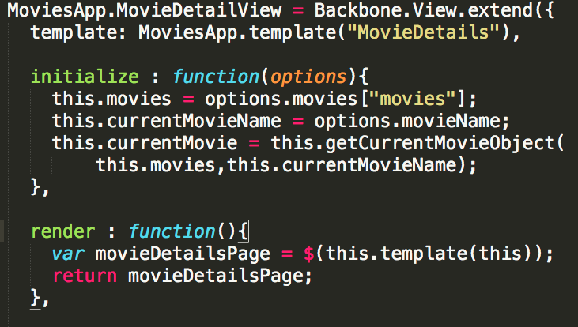
MovieDetailView.js (1)

Slide 12
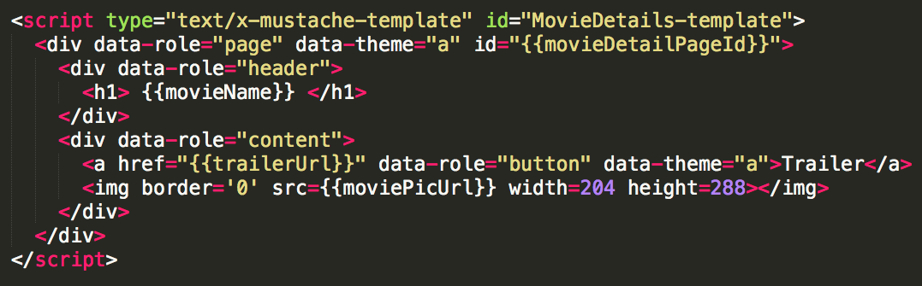
MovieDetailView.js (2)

Slide 13
BackBone + jQueryMobile Summary
HTML Page
Application Js file
Router Js file
View Js file
Views

Slide 14
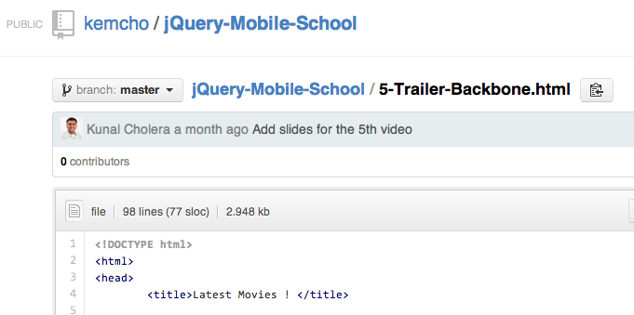
Code

Slide 15
Code is Live at ->
bit.ly/movies-app

Slide 16
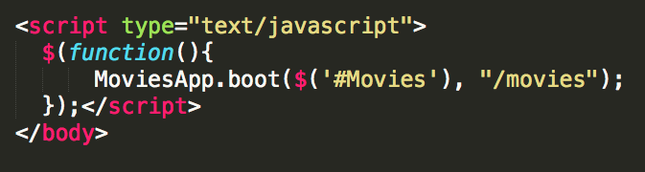
Up Next
Creating Dynamic Movie List json file from Internet.

