Slide 1
jQuery Mobile School video 7
Generating movies json file

Slide 2

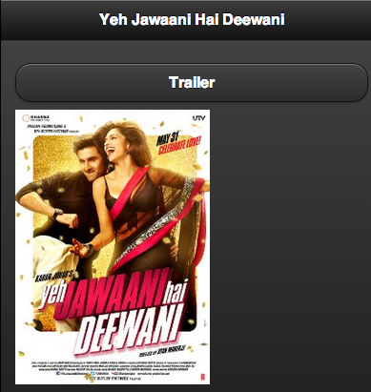
/movies json end point
movies.json
read
write
Internet
Imdb website
Play App
bit.ly/json-endpoint

Slide 3
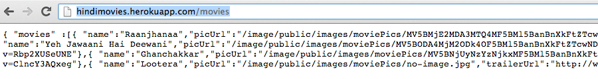
Step 1 - Define the route

Slide 4
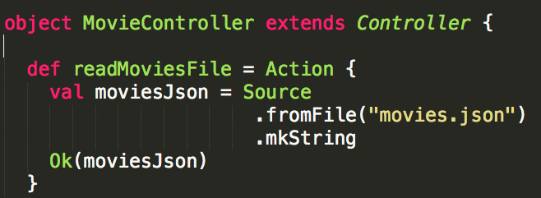
Step 2 – Implement the route end point

Slide 5
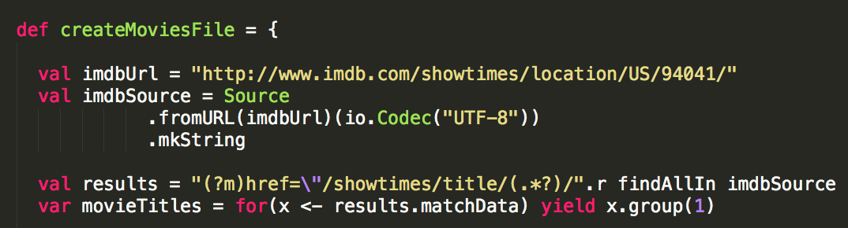
Step 3 – Generate the movies.json file by scraping imdb web site

Slide 6
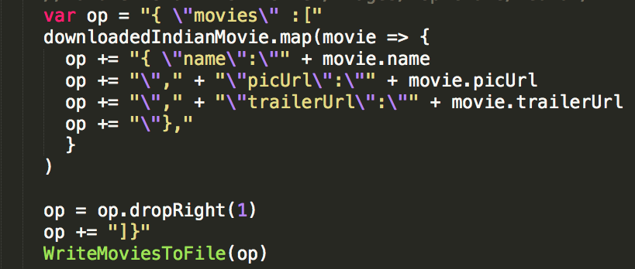
Write json file with data

Slide 7
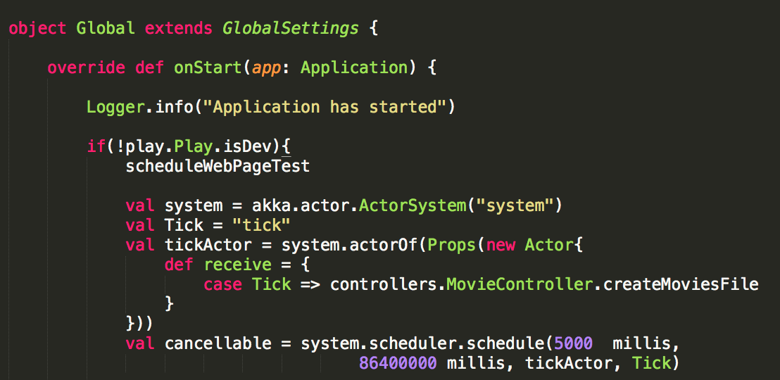
Step 4 – Schedule generation of movies.json file

Slide 8
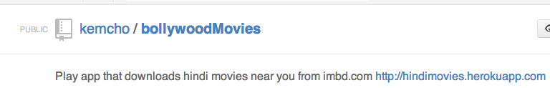
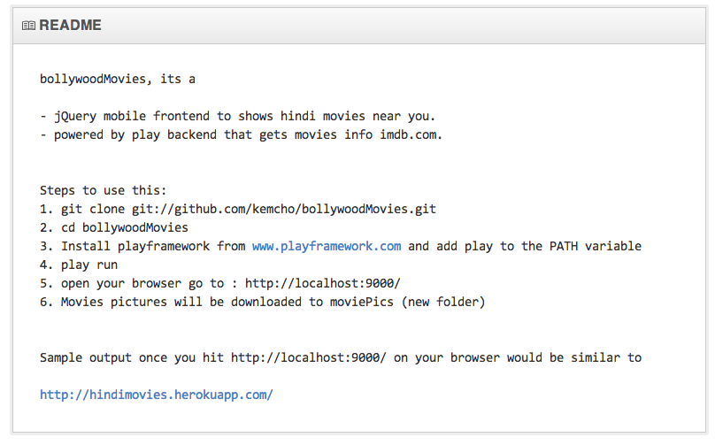
See it in action

Slide 9
Up Next
How to deploy your jQuery Mobile app on HEROKU.com

