Slide 1
EGX30 Historical Analysis
Exploratory Data Analysis, Technical Indicators & ARIMA Forecasting
Egyptian Exchange (EGX) · January 2014 – May 2026 · 3,000 Trading Days
Arab Academy for Science, Technology & Maritime Transport · Data Analysis Course · 2026
github.com/markraouf10/EGX30-Analysis

Slide 2
Agenda
01
Project Overview & Data
What we analyzed and where the data comes from
02
Exploratory Data Analysis
Price history, returns, volatility, drawdown, volume
03
Calendar & Ramadan Effects
Day-of-week patterns and Ramadan market behavior
04
Risk Metrics
Sharpe ratio, VaR, CVaR, and annual performance
05
Technical Indicators
Moving averages, RSI, MACD, Bollinger Bands
06
ARIMA Forecasting
Time-series modeling and predictability assessment
07
Dashboard & Conclusions
Power BI dashboard and key takeaways

Slide 3
Project Overview & Data
What We Analyzed
Dataset At a Glance
EGX30 index — top 30 companies on the Egyptian Exchange
12 years of daily OHLCV data (Open, High, Low, Close, Volume)
3,000 trading days from January 2014 to May 2026
Sunday–Thursday trading week (Egyptian work calendar)
4 major economic events analyzed: 2016 EGP float, COVID-19, 2022 & 2024 currency crises
3,000
Trading Days
12 yrs
Time Span
7
Columns (OHLCV + Returns)
0
Null Values (after cleaning)
9
Volume Gaps (forward-filled)

Slide 4
Key Metrics at a Glance
666.9%
17.16%
21.71%
Total Return (12 yrs)
Ann. Return
Ann. Volatility
-52.85%
+0.10
59.56%
Max Drawdown
Sharpe Ratio (RF=15.06%)
ARIMA Dir. Accuracy
Sharpe ratio uses Egyptian T-bill rate (RF = 15.06%) as risk-free benchmark

Slide 5
EGX30 Price History & Major Events
2016
EGP Float
COVID
Crash
2022
Devaluation
2024
Crisis
Index grew from ~6,800 to ~52,500 — a 666.9% total return over 12 years
2022 devaluation caused the worst sustained crash — max drawdown of -52.85%

Slide 6
Returns Analysis & Distribution
Return Statistics
Key Distribution Findings
Mean Daily Return
0.068%
NOT Normally Distributed
Jarque-Bera test p-value ≈ 0. Returns fail the normality test — standard financial models that assume normality underestimate risk.
Std Dev (daily)
1.369%
Fat Tails (Leptokurtic)
Best Day
+6.49%
Kurtosis of 5.82 means extreme daily moves (crashes and rallies) occur far more often than a normal distribution would predict.
Worst Day
-9.81%
Negative Skew
Skewness
-0.31 (left tail)
Left tail is slightly longer than right — extreme losses are marginally more likely than extreme gains of the same magnitude.
Kurtosis
5.82 (fat tails)
Log Returns Used Throughout
We model log returns (not price) because they are time-additive, stationary, and better-suited for statistical analysis.
Normality (JB)
Rejected p≈0

Slide 7
Volatility Clustering & Drawdown
30-Day Rolling Annualized Volatility
Drawdown from Peak
Volatility Clustering Confirmed
Max Drawdown: -52.85%
Calm periods cluster together; turbulent periods follow turbulent periods. COVID (2020) peaked at ~55% ann. vol, 2022 at ~45%.
If an investor bought at the 2022 peak, they lost over half their investment by July 5, 2022 — the worst peak-to-trough in 12 years.

Slide 8
Calendar Effects & Ramadan Analysis
Average Return by Day of Week
Ramadan Effect
Non-Ramadan Vol
21.4%
Ramadan Vol
24.3%
Ramadan Days
259 / 3,000
-0.095%
+0.019%
+0.129%
+0.083%
+0.231%
+0.080%
-0.054%
Sunday Effect: Sunday (first trading day) has the lowest average return (-0.095%) while Thursday has the highest (+0.231%). The Sunday vs Thursday difference is statistically significant (p=0.0001) — but Sunday alone is not significantly different from zero (p=0.135).

Slide 9
Risk Metrics & Annual Performance
+0.10
-2.01%
-4.12%
-3.27%
Sharpe Ratio (RF=15.06%)
VaR 95% (daily)
VaR 99% (daily)
CVaR 95% (daily)
Annual Returns by Year vs Risk-Free Rate (27%)

Slide 10
Technical Indicators & Feature Engineering
SMA / EMA
RSI (14)
7, 20, 50, 200-day windows. SMA gives equal weight; EMA reacts faster to recent prices. Used to identify trends and crossover signals.
Relative Strength Index: momentum oscillator 0 to 100. Above 70 = overbought; below 30 = oversold. Built from 14-day average gains vs average losses.
MACD
Bollinger Bands
Difference between 12-day and 26-day EMA. Signal line = 9-day EMA of MACD. Captures trend momentum and direction change. Histogram = MACD minus Signal.
Price envelope: 20-day SMA ± 2 standard deviations. BB_Width narrows before big moves; BB_Pct shows where price sits in the band (0 = low, 1 = high).
ATR (14)
33 Features Total
Average True Range: measures volatility using the full daily price range including overnight gaps. Higher ATR = more volatile market conditions.
All indicators + lag returns (1/2/3/5/10 days) + rolling volatility + volume ratio. Correlation heatmap confirms minimal redundancy across features.
📊 Charts for all indicators are available in the project notebook and GitHub repository · github.com/markraouf10/EGX30-Analysis

Slide 11
Autocorrelation & Market Efficiency
Returns ACF ≈ 0
Squared Returns ACF ≫ 0
Log returns show minimal autocorrelation at all lags — today's return gives almost no information about tomorrow's. This is the statistical definition of weak-form market efficiency.
Squared returns show strong autocorrelation — confirming volatility clustering. Large moves today predict large moves tomorrow (but not the direction).
Weak-Form Efficiency
ARCH/GARCH Effects
Past price data cannot be reliably used to earn above-market returns. The EGX30 has largely priced in historical information.
The strong ACF in squared returns is the signature of ARCH effects — variance is not constant, it clusters around events and crises.
These findings directly motivated the choice of ARIMA for forecasting — if returns had strong ACF, a more aggressive AR model would be warranted.

Slide 12
ARIMA(0,0,2) Forecasting Model
Model Specification
Test Set Results
Model:
ARIMA(0,0,2)
RMSE:
0.01118
Target:
Log Returns
MAE:
0.00830
p = 0:
No AR terms (insignificant)
Directional Accuracy:
59.56%
d = 0:
Already stationary (ADF confirmed)
Random Baseline:
50.00%
q = 2:
2 MA terms (both significant)
Ljung-Box p (lag 10):
0.638 ✓
Train period:
Jan 2014 – Nov 2024 (85%)
Ljung-Box p (lag 20):
0.246 ✓
Test period:
Nov 2024 – May 2026 (15%)
Residuals:
White noise ✓
59.56% directional accuracy means the model beats random chance (50%) by ~9.5pp — confirming modest but real short-term predictability, consistent with near weak-form efficiency.

Slide 13
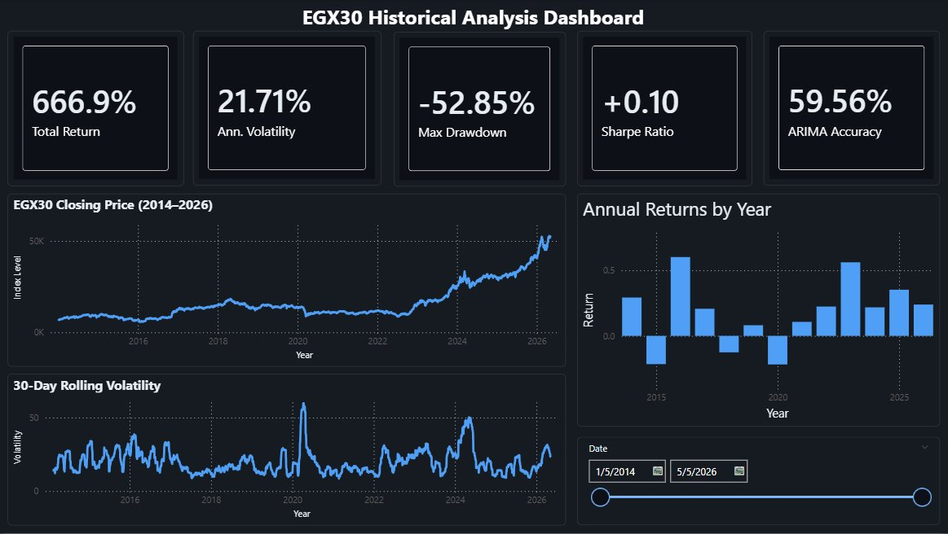

Interactive Power BI Dashboard
Interactive date slicer filters all visuals simultaneously · Built with Power BI Desktop · Data source: EGX30_cleaned.csv

Slide 14
Key Conclusions
Strong nominal return, near-zero risk-adjusted performance
EGX30 delivered 666.9% total return (17.16% annualized) but a Sharpe of +0.10 with RF=15.06% means Egyptian index barely compensated investors for the volatility and drawdown risk taken.
Near weak-form efficient market
Returns show minimal autocorrelation. ARIMA achieves only 59.56% directional accuracy. Past prices contain little exploitable information — consistent with weak-form efficiency.
Volatility concentrates around crises
Volatility clustering is statistically confirmed via ACF of squared returns. Max drawdown of -52.85% shows how severe and sustained crisis impacts can be.
Calendar anomalies are real but small
Sunday underperforms Thursday significantly (p=0.0001). Ramadan periods show negative average returns (-0.054%) and higher volatility (24.3% vs 21.4%). Real but not easily exploitable.
Ramadan effect is an original finding
The Ramadan market anomaly is rarely covered in international literature. This project contributes a documented, quantified analysis of a MENA-specific market phenomenon.

Slide 15
Thank You
Questions & Discussion
GitHub Repository:
github.com/markraouf10/EGX30-Analysis
Dataset:
EGX_30_Historical_Data.csv (Investing.com)
Tools Used:
Python · Pandas · Statsmodels · Power BI · Git
Institution:
AAST · Data Analysis Course · 2026

