Slide 1
Neocortex Early User Program Scientific Goals
Paola A. Buitrago Principal Investigator, Neocortex

Slide 2
Instructions for Neocortex EUP Scientific Goals Slides
Please use slides 2-3 of this slide deck to provide PSC’s Neocortex team with details regarding the ongoing research that your research team is doing as part of the Neocortex Early User Program (EUP).
Slide 2-3: Scientific Research Goals Required
Include a title for your work, your team and institution, a figure or photo, and outline of your tasks during the EUP.
Problem Statement and expected results.
Dataset you are using (size, file type, number of files).
Model you are using.
Challenges so far.
Slide 4: Additional Figures/Information Optional
Use this slide to include additional figures or pictures that you wish to share.
Slide 5: Information Release Required
The information you provide on these slides will only be shared confidentially with the National Science Foundation and with the review panel for the purpose of passing acceptance testing. Please indicate whether the Neocortex team has your permission to additionally share any of the information provided within these slides to promote the availability of Neocortex to a wider audience.
Return Completed Slides by May 5, 2021

Slide 3
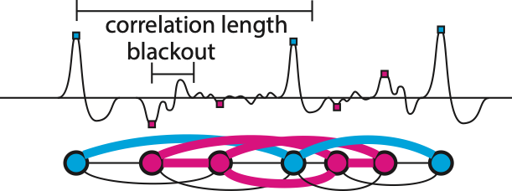
Required Slide: Determination of Optimal Graph Size for the Network Parameter Outlier Algorithm
PI: Mark Bower
Recently, we have developed the Network Parameter Outlier (NPO) algorithm, that uses graphical clustering mehods to cluster biological event data (e.g., action potentials, sharp-wave ripples) in O(n) time, improving on current methods that require O(n log n) time. Biologically-relevant events are detected and stored as a graph with connections weighted by corresponding correlation coefficients. A graphical clustering technique (Louvain) partitions the graph into clusters. This process is repeated in a moving-window fashion with new vertices being added and old vertices being dropped. Because graph size remains constant, processing time is bounded, but optimal parameters are unknown due to memory limitations of conventional CPUs.
Yale University
Neocortex EUP Goals
run NPO with a grid of parameters
data: intracranial rodent recordings
metric is correct % clustering
Challenge: the NPO algorithm has been wrapped in a Docker container to run on Cerebras and communicates with a MySQL database running in another container, running in Docker. This communication stream has not been established, however, in Singularity as required by Cerebras.
Network Parameter Outlier (NPO) algorithm. All local peaks (the largest amplitude during the surrounding “blackout” time) are detected in a sequential (time-voltage) data stream. Each peak is represented as a node in a graph and the correlation coefficient to time-local peaks (as defined by the “correlation length” parameter) provides a weight to connect nodes. Similar-shaped peaks can then be identified by graphical clustering algorithms (the Louvain algorithm). Because the “correlation length” restricts the size of each graph, computational time is bounded and the algorithm runs in O(n) time.
SDF
CS-1

Slide 4

Delete the text below that does not apply to you.
No, PSC does not have my permission to use the information included in these slides on PSC’s website, social media channels, and other public communications channels to more broadly promote the availability of the Neocortex platform.

