Slide 1
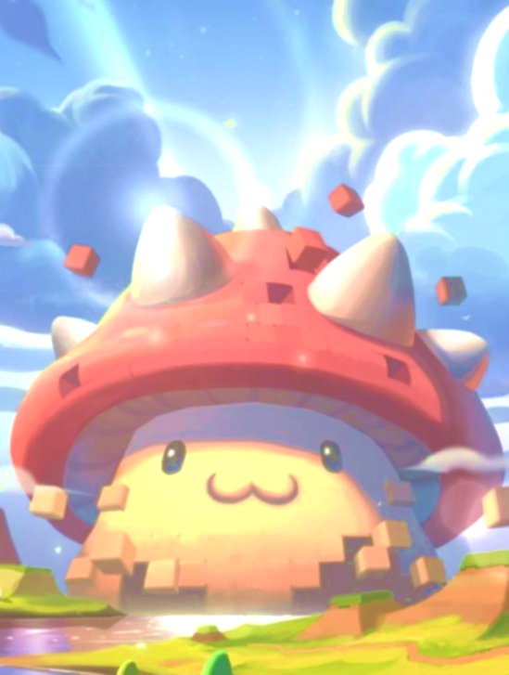
Dodge The Rocks!
Mark Decello
Marlin Abdelmalak
Jorge Gonzalez-Vazquez

Slide 2
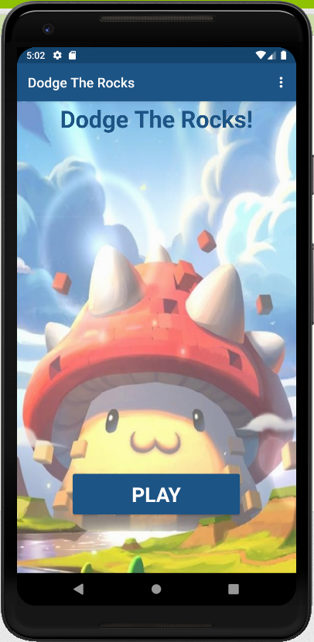
The main menu screen
The Main Menu screen was created as a way to let the player select either to play the game or exit the game by pressing the home/back button or gesture

Slide 3
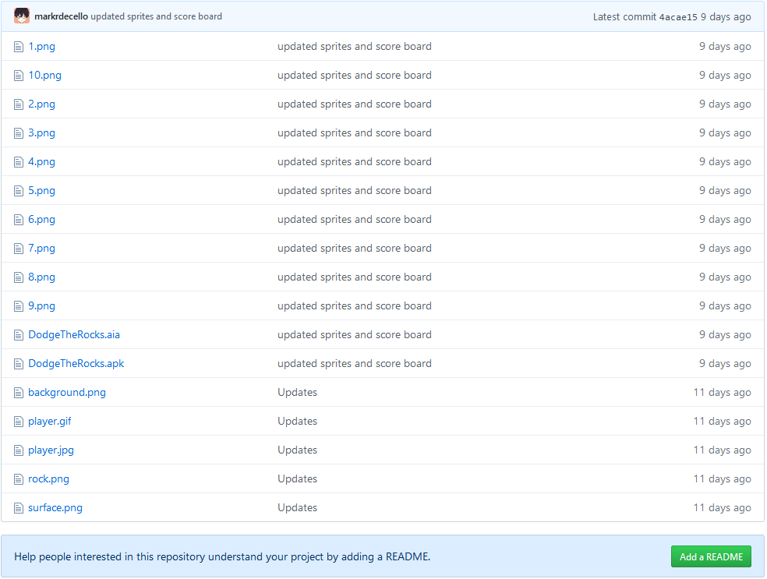
Github/Discord
We created a Github repository to have access to all the work. We will all share our contributions through Github, if needed, and push all the changes made to the game. Other ways we shared the work is also creating a discord chat and uploading the aia file and tampering with it with our own changes for the game.

Slide 4
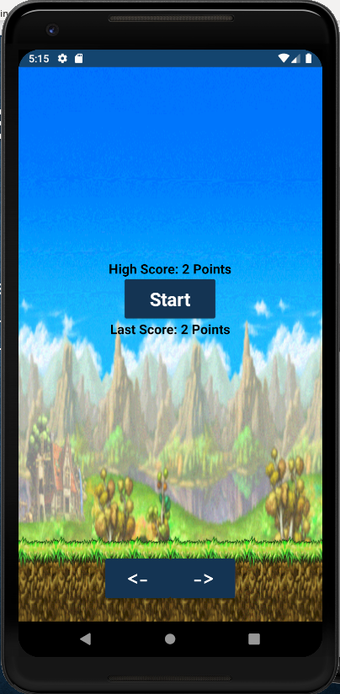
Using TinyDB
To keep the user’s score saved into their device, we had to use a database. We used TinyDB as a way to save the player’s high score and last score.

Slide 5
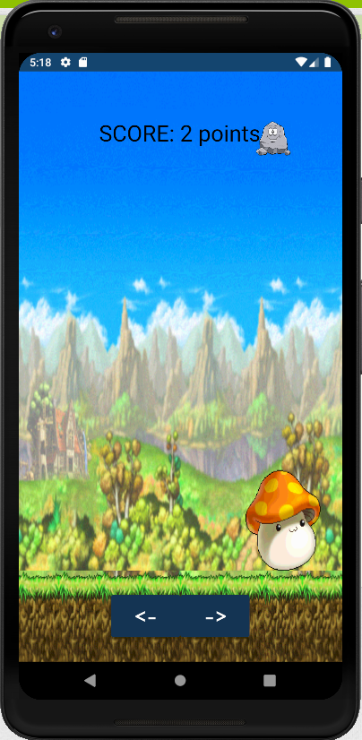
Controls and User Interaction
To make the sprite move left or right, we added to buttons, one to move right and the other to move left. There is also another option to move the character sprite, which is to drag it from left to right in order to evade the rocks. Colliding with the rock will result to a game over and loading back to the score screen. The rock will spawn in different locations and change its speed at random times for each time it collides with the ground.

Slide 6
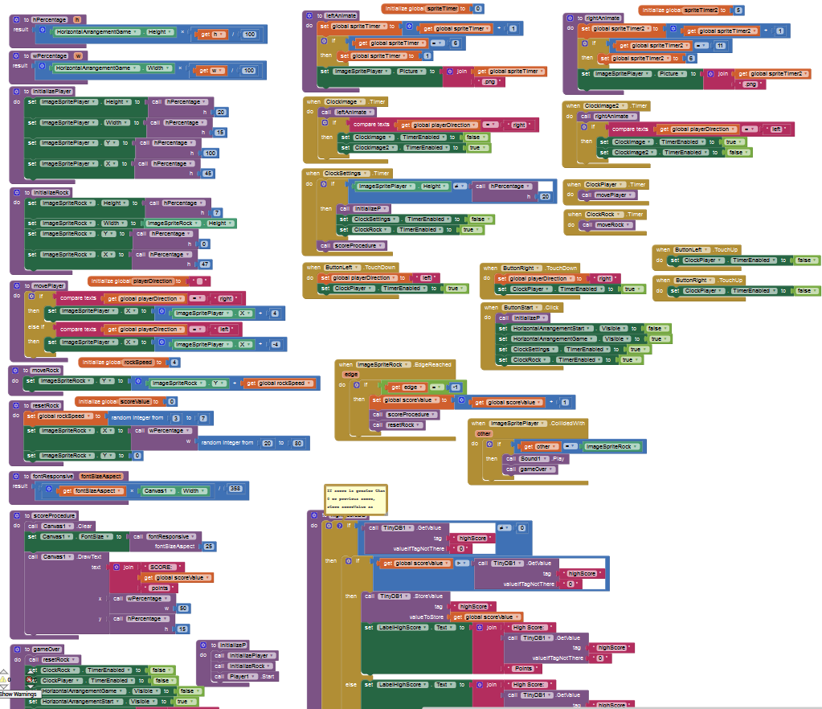
Blocks
For the blocks section of the MIT App Inventor, we focused on using procedures to shorten the blocks we needed. So when a function/method is needed, it will just call the procedure required to finish the task an action needs.

