Slide 1
Computational Biology
Under supervision:
Dr. Ibrahim el semman

Slide 2
Load mzml file and fasta file
from matplotlib import pyplot as plt from pyopenms import * import matplotlib.patches as mpatches exp = MSExperiment() # Load mzML file and store it in MSExperiment MzMLFile().load("20190723_ZTT_TMT6plex_PC_3_C_M_f13.mzML", exp) protein_ids = [] peptide_ids = [] SimpleSearchEngineAlgorithm().search("20190723_ZTT_TMT6plex_PC_3_C_M_f13.mzML", "sequence.fasta", protein_ids, peptide_ids)

Slide 3
Print identification data
for peptide_id in peptide_ids: # Peptide identification values print(35 * "=") print("Peptide ID m/z:", peptide_id.getMZ()) print("Peptide ID rt:", peptide_id.getRT()) print("Peptide scan index:", peptide_id.getMetaValue("scan_index")) print("Peptide ID score type:", peptide_id.getScoreType()) # PeptideHits for hit in peptide_id.getHits(): print(" - Peptide hit sequence:", hit.getSequence()) mz = hit.getSequence().getMonoWeight(Residue.ResidueType.Full, hit.getCharge()) / hit.getCharge() print(" - Peptide hit monoisotopic m/z:", mz) score = mz / peptide_id.getMZ() print("comparsion score = ", score)

Slide 4
Create theoretical spectrum
a = str(hit.getSequence()) tsg = TheoreticalSpectrumGenerator() spec1 = MSSpectrum() peptide = AASequence.fromString(a) p = Param() p.setValue("add_b_ion", "true") p.setValue("add_metainfo", "true") tsg.setParameters(p) tsg.getSpectrum(spec1, peptide, 1, 2) print("Spectrum 1 of", peptide, "has", spec1.size(), "peaks.") tsg1 = TheoreticalSpectrumGenerator() theo_spectrum = MSSpectrum() p = tsg1.getParameters() p.setValue("add_y_ions", "true") p.setValue("add_b_ions", "true") p.setValue("add_metainfo", "true") tsg1.setParameters(p) peptide = AASequence.fromString(a) tsg1.getSpectrum(theo_spectrum, peptide, 1, 2) experiment_spectrum = exp.getSpectrum(peptide_id.getMetaValue("scan_index"))

Slide 5
Print aligned peaks between two spectrum
alignment = [] spa = SpectrumAlignment() p = spa.getParameters() # use 0.5 Da tolerance (Note: for high-resolution data we could also use ppm by setting the is_relative_tolerance value to true) p.setValue("tolerance", 0.5) p.setValue("is_relative_tolerance", "false") spa.setParameters(p) # align both spectra spa.getSpectrumAlignment(alignment, theo_spectrum, experiment_spectrum) print("Number of matched peaks: " + str(len(alignment))) print("ion\ttheo. m/z\tobserved m/z") for theo_idx, obs_idx in alignment: ion_name = theo_spectrum.getStringDataArrays()[0][theo_idx].decode() ion_charge = theo_spectrum.getIntegerDataArrays()[0][theo_idx] print(ion_name + "\t" + str(ion_charge) + "\t" + str(theo_spectrum[theo_idx].getMZ()) + "\t" + str(experiment_spectrum[obs_idx].getMZ()))

Slide 6
Draw experiment spectrum
theo_mz, theo_int, obs_mz, obs_int = [], [], [], [] for theo_idx, obs_idx in alignment: theo_mz.append(theo_spectrum[theo_idx].getMZ()) theo_int.append(theo_spectrum[theo_idx].getIntensity()) obs_mz.append(experiment_spectrum[obs_idx].getMZ()) obs_int.append(experiment_spectrum[obs_idx].getIntensity()) plt.subplot(2, 1, 1) # set range for mz as minimum and maximum aligned mz for mz, intensity in zip(*experiment_spectrum.get_peaks()): if mz >= min(obs_mz) and mz <= max(obs_mz): plt.plot([obs_mz, obs_mz], [0, intensity], color='red') plt.plot([mz, mz], [0, intensity], color='black') b = str(peptide_id.getMetaValue("scan_index")) plt.title(a + " " + b)

Slide 7
Draw theoretical spectrum
plt.subplot(2, 1, 2) color_bar = ['red', 'blue'] count = 0 for mz, i in zip(*theo_spectrum.get_peaks()): if mz >= min(theo_mz) and mz <= max(theo_mz): if 'y' in theo_spectrum.getStringDataArrays()[0][count].decode(): plt.plot([mz, mz], [0, i], snap=False, color=color_bar[0]) count = count + 1 else: plt.plot([mz, mz], [0, i], snap=False, color=color_bar[1]) count = count + 1 red_patch = mpatches.Patch(color='red', label='y ions') blue_patch = mpatches.Patch(color='blue', label='b ions') plt.legend(handles=[red_patch, blue_patch], loc='lower right') plt.ylim(bottom=0) plt.show()

Slide 8
Output
Number of matched peptide and spectrums
Number of matched peaks
In each plot has the hit sequence and the index of matched spectrum
The full output is provided in Output.docx
How many peaks that theoretical spectrum has

Slide 9
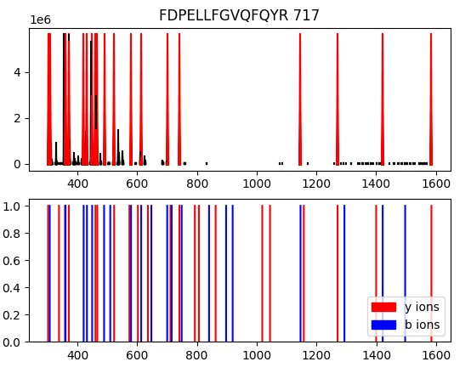
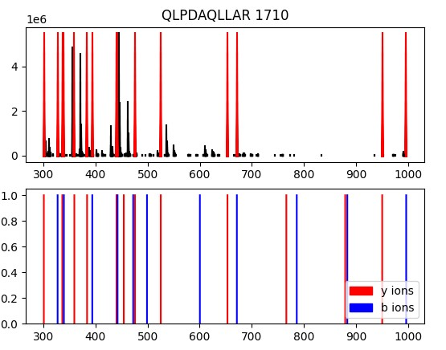
Mzml #1 Mark Refat
Number of matched peaks: 20
Number of matched peaks: 15

Slide 10
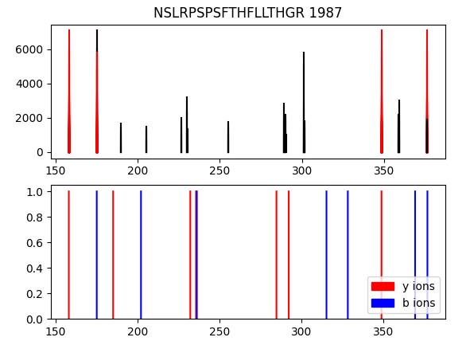
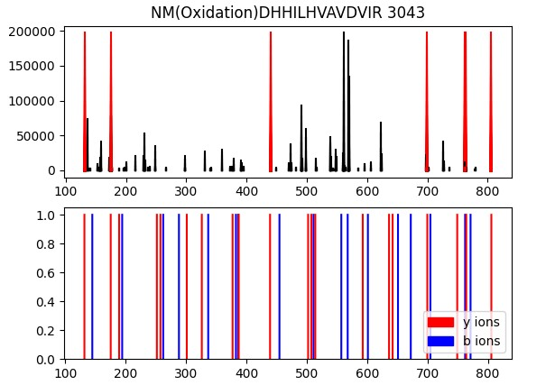
Mzml #1 Mark Refat
Number of matched peaks: 4
Number of matched peaks: 7

Slide 11
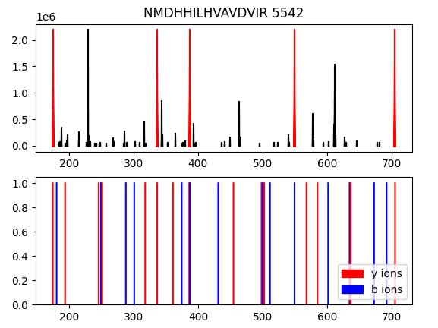
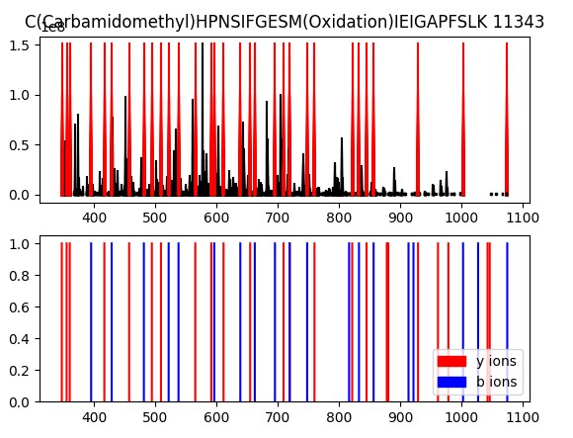
Mzml #1 Mark Refat
Number of matched peaks: 5
Number of matched peaks: 32

Slide 12
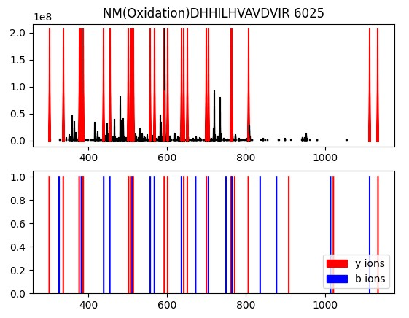
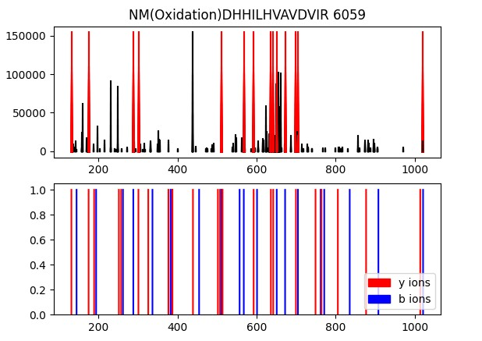
Mzml #1 Mark Refat
Number of matched peaks: 26
Number of matched peaks: 14

Slide 13
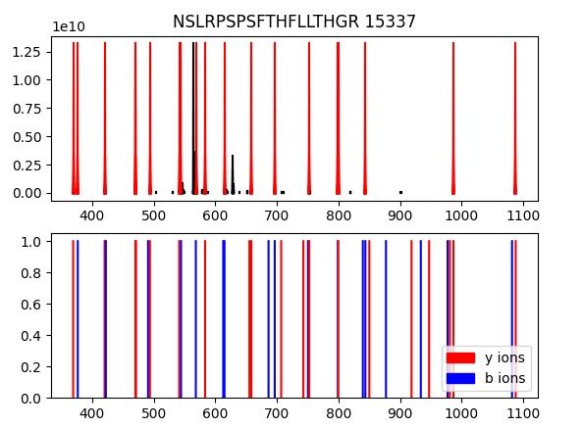
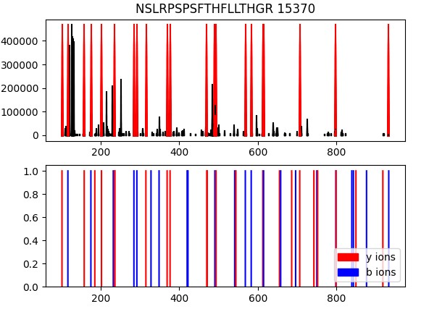
Mzml #1 Mark Refat
Number of matched peaks: 19
Number of matched peaks: 21

Slide 14
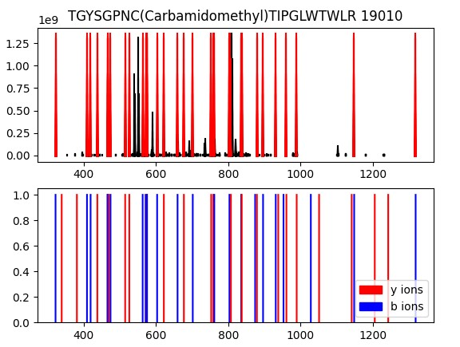
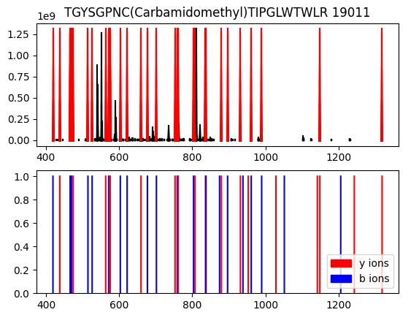
Mzml #1 Mark Refat
Number of matched peaks: 32
Number of matched peaks: 31

Slide 15
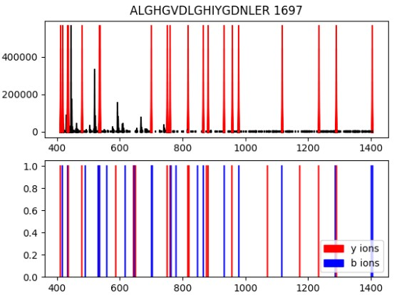
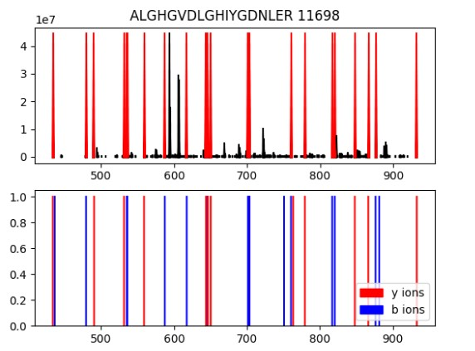
Mzml #2 Mark Refat
Number of matched peaks: 20
Number of matched peaks: 24

Slide 16
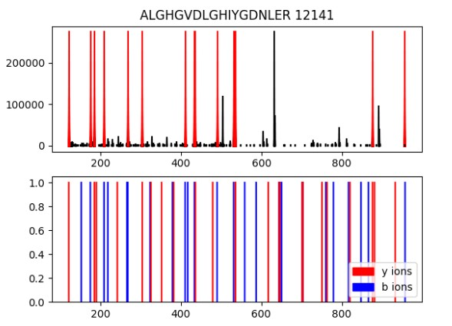
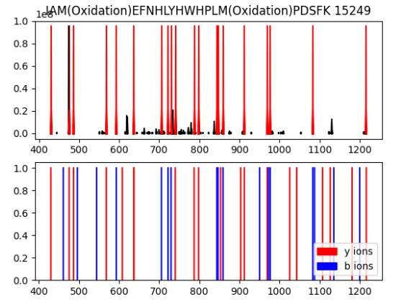
Mzml #2 Mark Refat
Number of matched peaks: 14
Number of matched peaks: 20

Slide 17
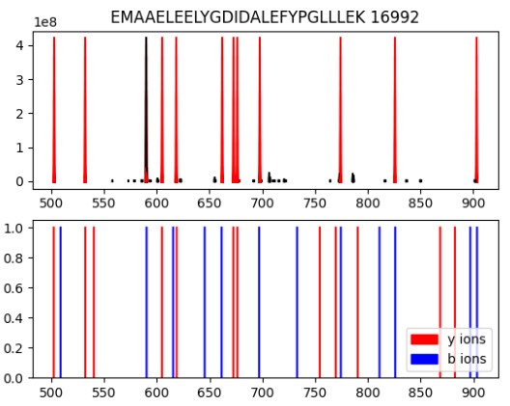
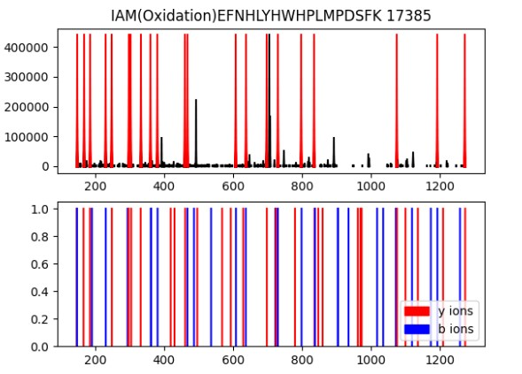
Mzml #2 Mark Refat
Number of matched peaks: 12
Number of matched peaks: 21

Slide 18
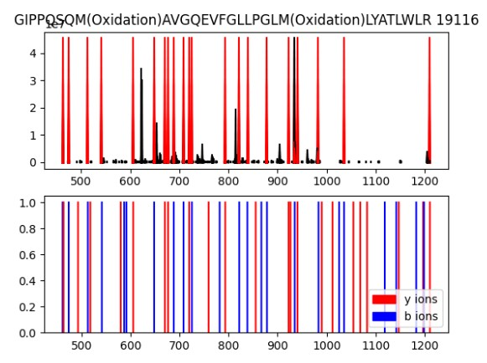
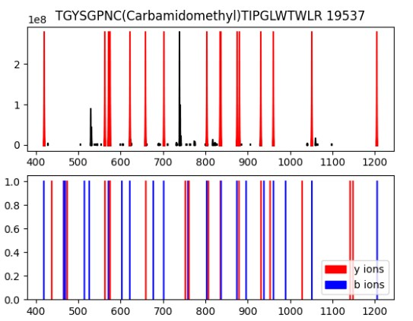
Mzml #2 Mark Refat
Number of matched peaks: 22
Number of matched peaks: 17

Slide 19
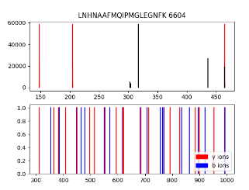
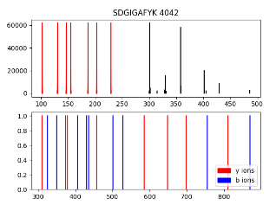
Mzml #1 Kerolos Ramses
Number of matched peaks: 3
Number of matched peaks: 5

Slide 20
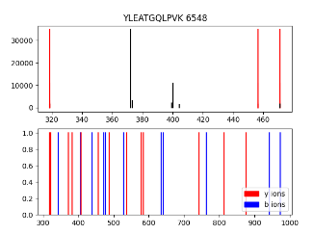
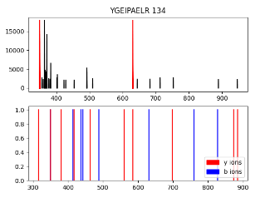
Mzml #1 Kerolos Ramses
Number of matched peaks: 3
Number of matched peaks: 2

Slide 21
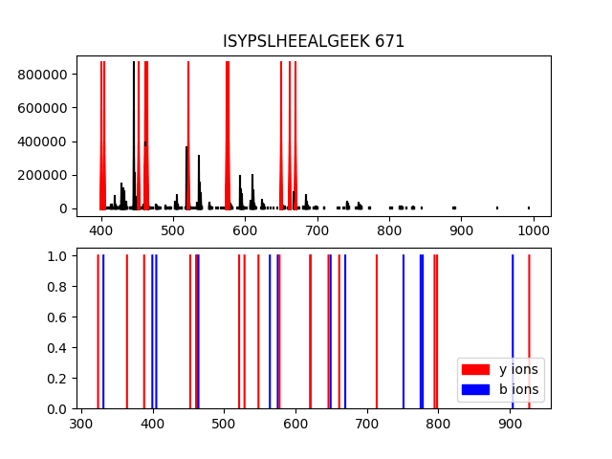
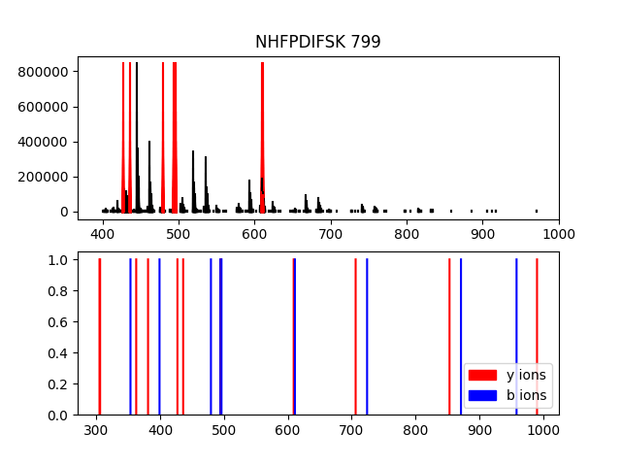
Mzml #1 Beshoy Atef
Number of matched peaks: 12
Number of matched peaks: 8

Slide 22
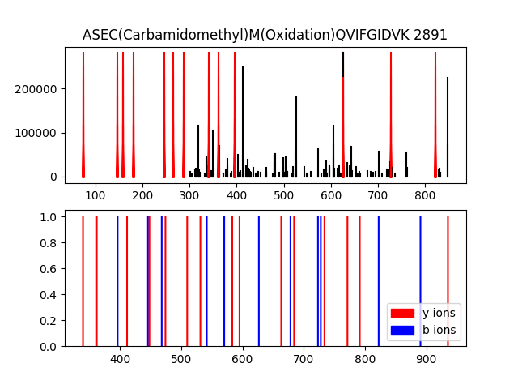
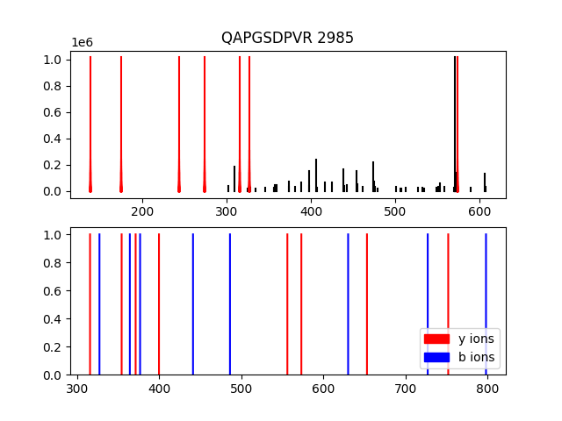
Mzml #1 Beshoy Atef
Number of matched peaks: 13
Number of matched peaks: 7

Slide 23
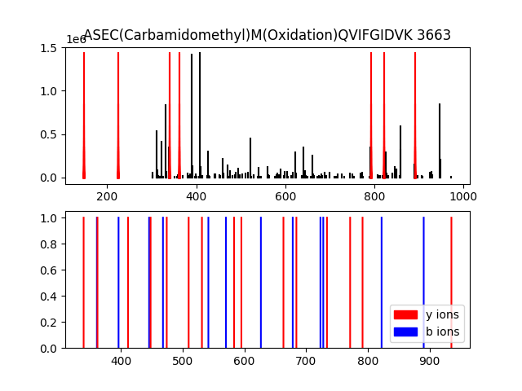
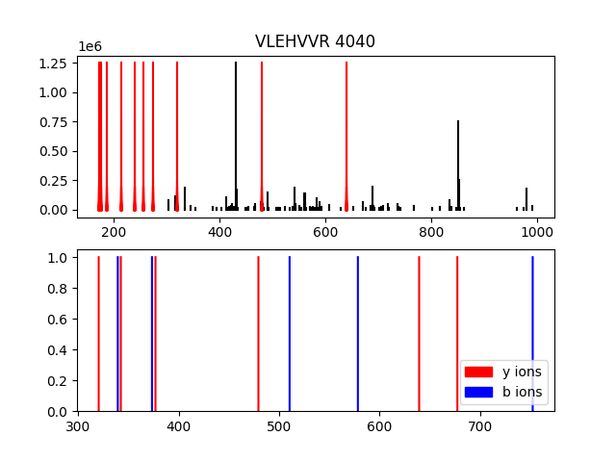
Mzml #1 Beshoy Atef
Number of matched peaks: 7
Number of matched peaks: 10

Slide 24
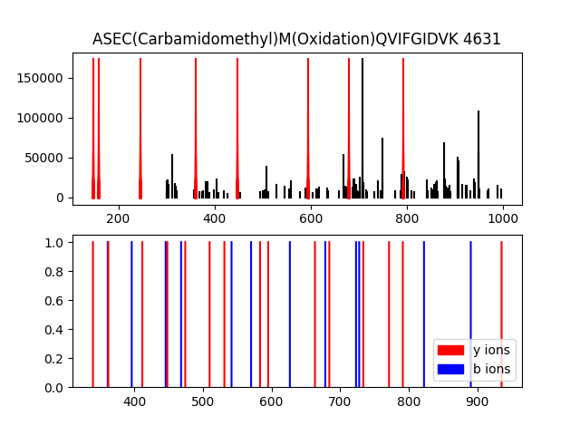
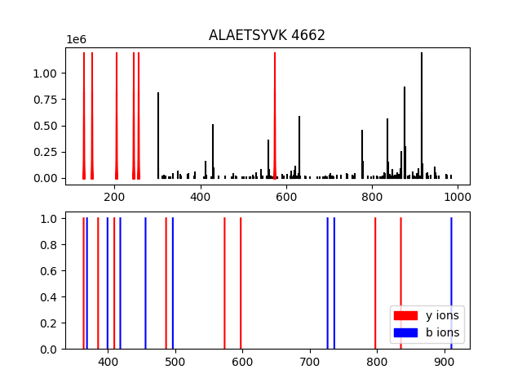
Mzml #1 Beshoy Atef
Number of matched peaks: 8
Number of matched peaks: 6

Slide 25
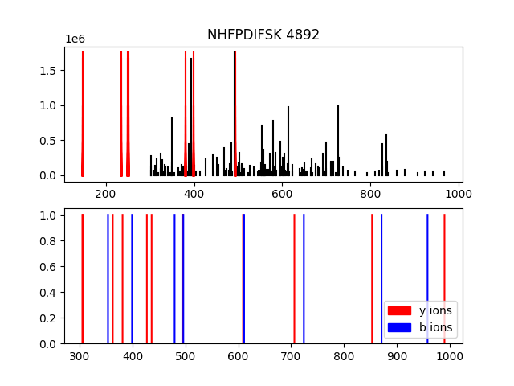
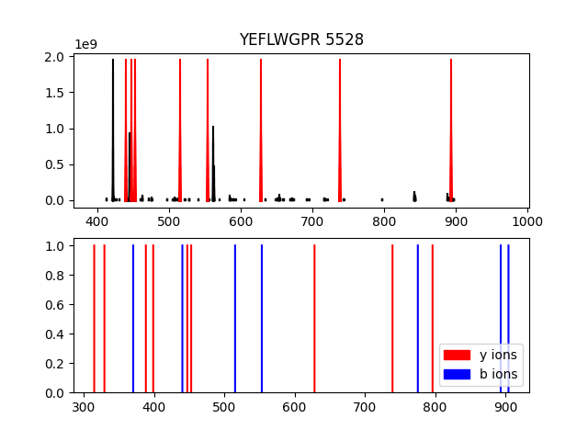
Mzml #1 Beshoy Atef
Number of matched peaks: 7
Number of matched peaks: 8

Slide 26
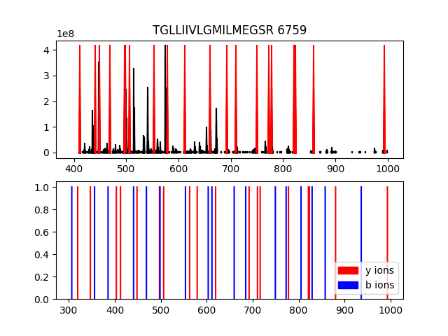
Mzml #1 Beshoy Atef
Number of matched peaks: 20

Slide 27
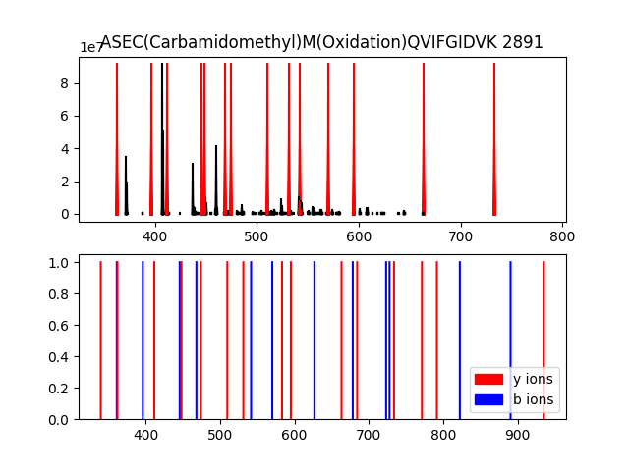
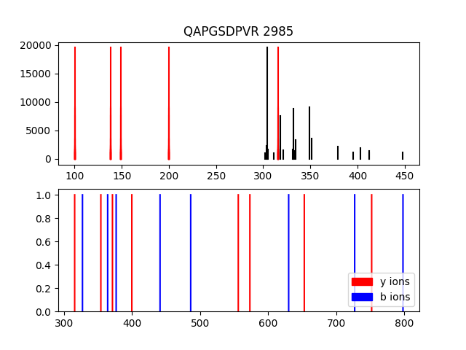
Mzml #2 Beshoy Atef
Number of matched peaks: 14
Number of matched peaks: 5

Slide 28
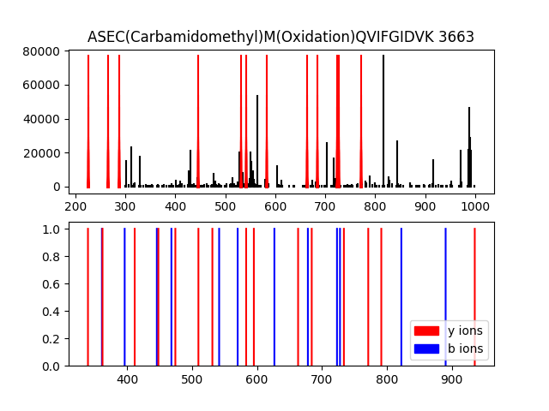
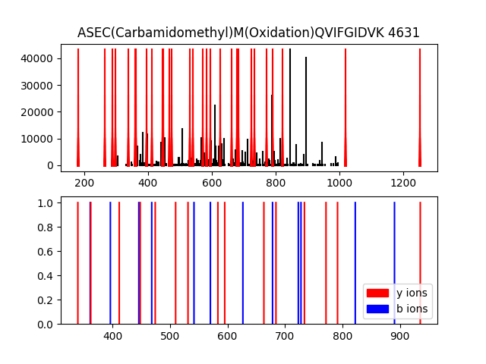
Mzml #2 Beshoy Atef
Number of matched peaks: 12
Number of matched peaks: 29

Slide 29
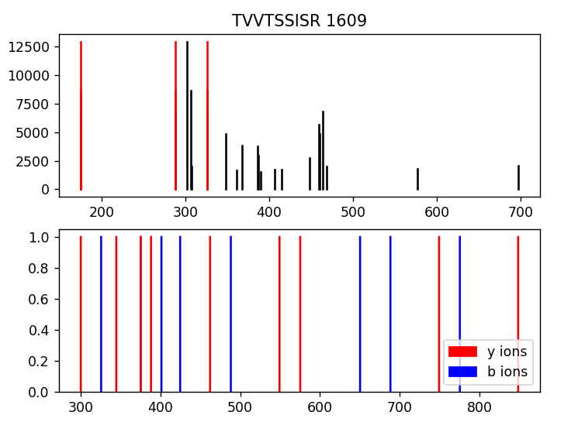
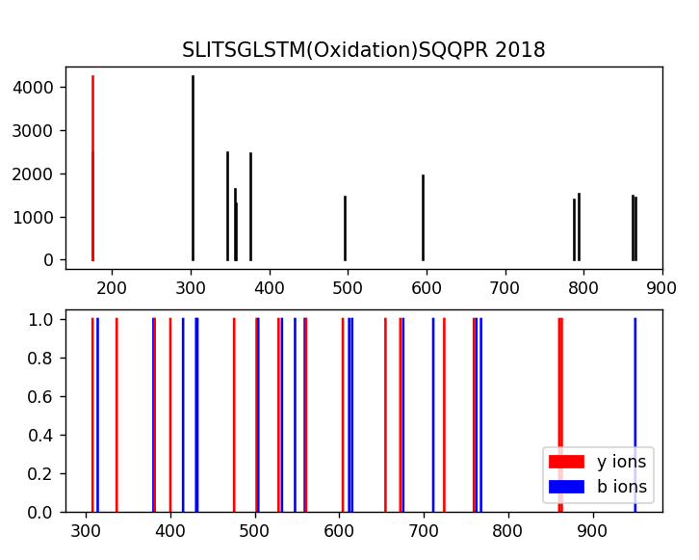
Mzml #1 Mario Ehab
Number of matched peaks: 3
Number of matched peaks: 1

Slide 30
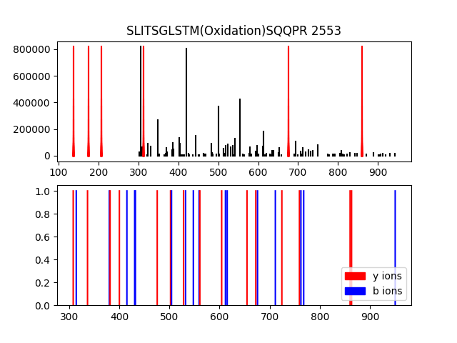
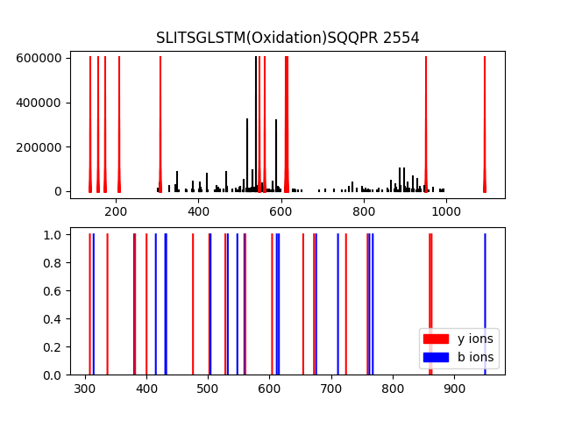
Mzml #1 Mario Ehab
Number of matched peaks:6
Number of matched peaks:11

Slide 31
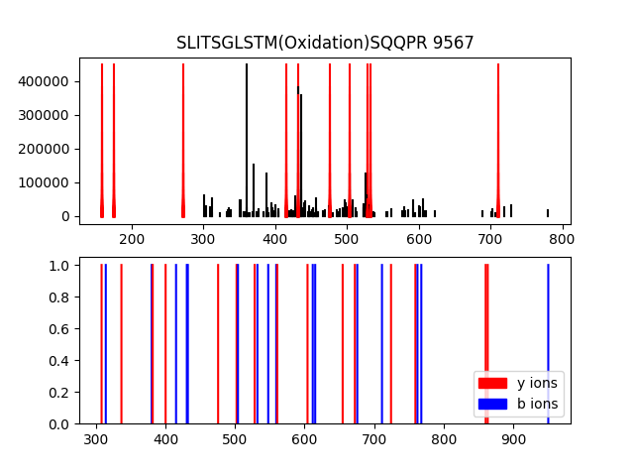
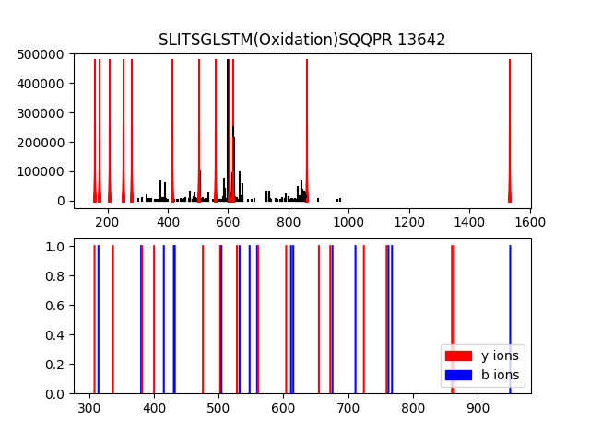
Mzml #1 Mario Ehab
Number of matched peaks:10
Number of matched peaks:12

Slide 32
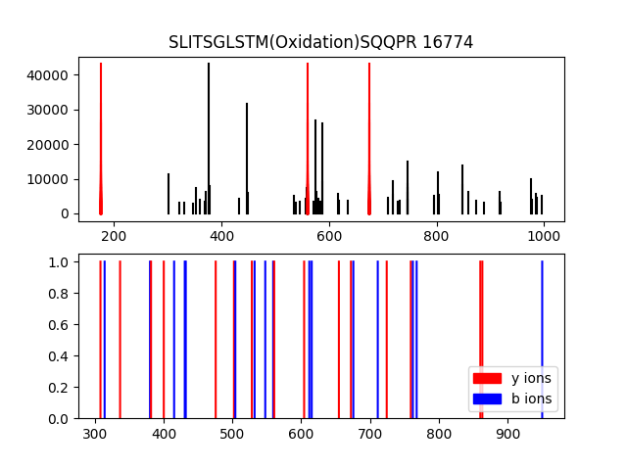
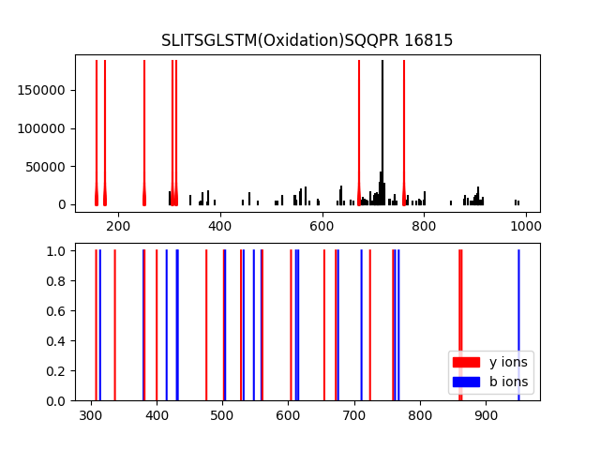
Mzml #1 Mario Ehab
Number of matched peaks:3
Number of matched peaks:7

Slide 33
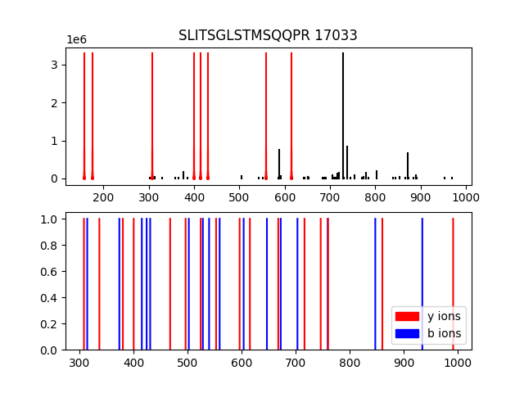
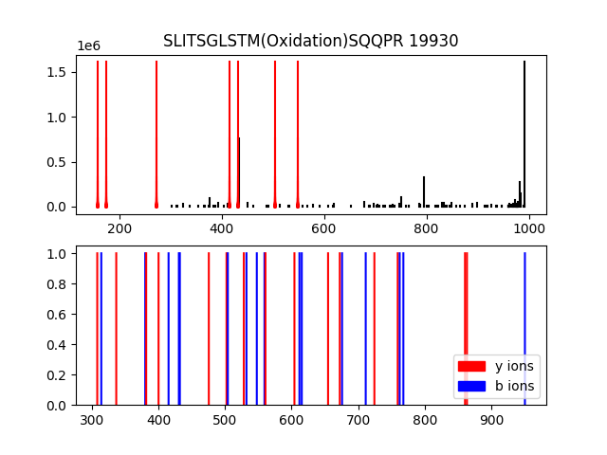
Mzml #1 Mario Ehab
Number of matched peaks:8
Number of matched peaks:7

Slide 34
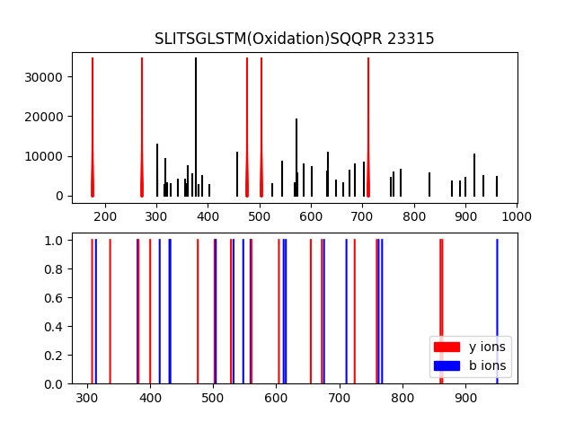
Mzml #1 Mario Ehab
Number of matched peaks:5

Slide 35


Mzml #2 Mario Ehab
Number of matched peaks: 14
Number of matched peaks: 20

Slide 36

Mzml #2 Mario Ehab
Number of matched peaks: 28

Slide 37


Mzml #1 Kerolos Onsy

Slide 38


Mzml #1 Kerolos Onsy

Slide 39


Mzml #1 Kerolos Onsy

Slide 40


Mzml #2 Kerolos Onsy

Slide 41


Mzml #2 Kerolos Onsy

Slide 42
Mzml #2 Kerolos Onsy

Slide 43


Mzml #1 Felopater Nashat

Slide 44


Mzml #1 Felopater Nashat

Slide 45


Mzml #1 Felopater Nashat

Slide 46


Mzml #2 Felopater Nashat

Slide 47


Mzml #2 Felopater Nashat

Slide 48


Mzml #2 Felopater Nashat

Slide 49


Mzml #2 Felopater Nashat

Slide 50


Mzml #1 John Osama

Slide 51

Mzml #1 John Osama

Slide 52

Mzml #1 John Osama

Slide 53


Mzml #2 John Osama

Slide 54


Mzml #2 John Osama

Slide 55


Mzml #2 John Osama

Slide 56

Mzml #2 John Osama

