Slide 1
Computational Biology (Bonus)
(SILAC)
SILAC: It’s an abbreviation of Stable Isotope Labeling by amino acids in cell culture
The purpose or goal of silac to detect the difference between quantity of proteins in samples using non-radioactive isotopic
And this step comes after Mass Spectrometry (MS) process, So it depends on MS

Slide 2
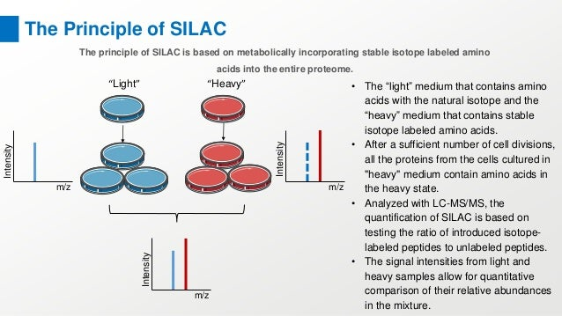
Computational Biology

Slide 3
Computational Biology
Mass spectrometry (MS)-based quantitative proteomics has matured into a methodology able to detect and quantitate essentially all proteins of model microorganisms, allowing for unprecedented depth in systematic protein analyses. The most accurate quantitation approaches currently require lysine auxotrophic strains, which precludes analysis of most existing mutants, strain collections, or commercially important strains (e.g. those used for brewing or for the biotechnological production of metabolites).

Slide 4
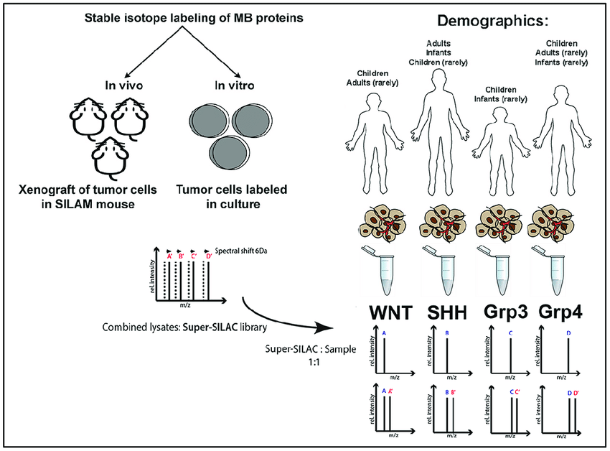
Computational Biology

Slide 5
Computational Biology
Stable isotope labeling by amino acids in cell culture (SILAC) is a powerful method to study the relative proteomic change under differential treatments, which relies on the mass spectrometry and the metabolic incorporation of amino acids with substituted stable isotopic nuclei. In SILAC, a given 'light' or 'heavy' form of the amino acid is incorporated into two samples. Two cell populations are grown in culture media that are identical except that one of them contains a 'light' and the other contains a 'heavy' form of a particular amino acid (e.g. 12C and 13C labeled L-lysine, respectively). As the two isotopically labeled amino acids are essentially chemically identical, their incorporation does not interfere with normal cell growth, while leading to proteins/peptides that are distinguishable by mass and thus are ideal for mass spectrometric analysis. SILAC approaches are well suited for monitoring changes in post-translational modifications.

Slide 6
Computational Biology
Overview of SILAC-based Proteomics Analysis
At Creative Proteomics, we can provide a complete SILAC service, including cell culture, treatment of cells, and proteomics analysis. Based on SLIAC and mass spectrometry, we can analyze the relative proteomic change under differential treatments. In addition, compare with other technologies, we can provide protein-protein interaction and post-translational modification analysis. The ability to multiplex two or three samples per analysis allows for increased throughput and cost savings in quantitative proteomics experiments along with improved relative quantitation.

Slide 7
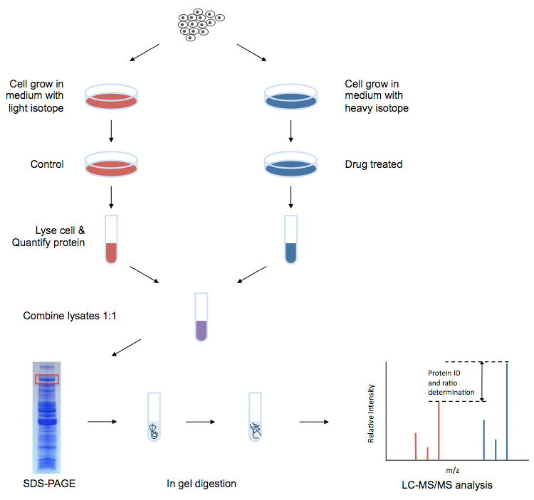
Computational Biology

